Slide 1
Lecture 18: Minimum Spanning Trees
Shang-Hua Teng

Slide 2
Weighted Undirected Graphs
Positive weight on edges for distance
2100
BOS
200
v
4
ORD
1500
JFK
v
2
v
6
SFO
1100
1400
DFW
900
LAX
v
3
v
1
MIA
v
5

Slide 3
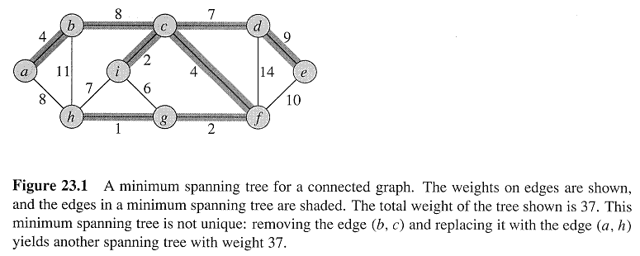
Weighted Spanning Trees
Weighted Undirected Graph G = (V,E,w): each edge (v, u) ∈E has a weight w(u, v) specifying the cost (distance) to connect u and v.
Spanning tree T ⊆ E connects all of the vertices of G
Total weight of T

Slide 5
Applications
ATT Phone service
Internet Backbone Layout

Slide 6
Growing a MST
Generic algorithm
Grow MST one edge at a time
Manage a set of edges A, maintaining the following loop invariant:
Prior to each iteration, A is a subset of some MST
At each iteration, we determine an edge (u, v) that can be added to A without violate this invariant
A ∪ {(u, v)} is also a subset of a MST
(u, v) is called a safe edge for A

Slide 7
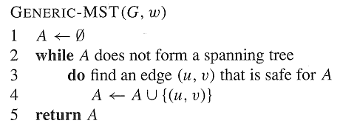
GENERIC-MST
Loop in lines 2-4 is executed |V| - 1 times
Any MST tree contains |V| - 1 edges
The execution time depends on how to find a safe edge

Slide 9
How to Find A Safe Edge? A Structure Theorem
Let A be a subset of E that is included in some MST, let (S, V-S) be any cut of G that respects A
Let (u, v) be a light edge crossing (S, V-S).
Then edge (u, v) is safe for A
Cut (S, V-S): a partition of V
Crossing edge: one endpoint in S and the other in V-S
A cut respects a set of A of edges if no edges in A crosses the cut
A light edge crossing a partition if its weight is the minimum of any edge crossing the cut

Slide 11
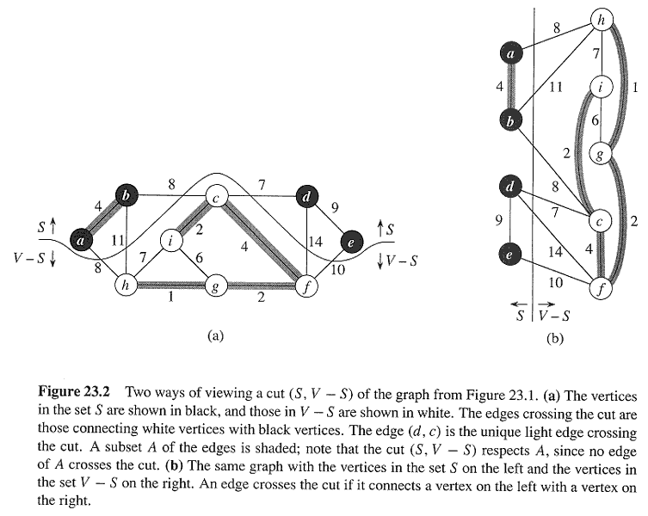
An Example of Cuts and light Edges

Slide 12
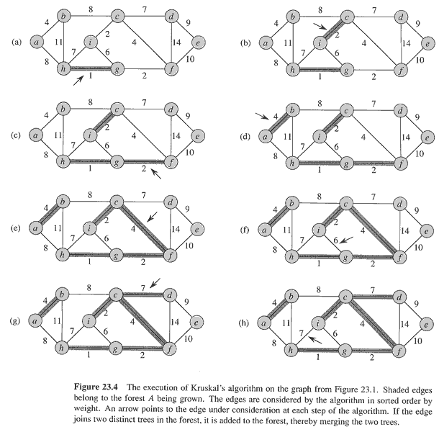
More Example
A={(a,b}, (c, i}, (h, g}, {g, h}}
S={a, b, c, i, e}; V-S = {h, g, f, d}: there are many kinds of cuts respect A
(c, f) is the light edges crossing S and V-S and will be a safe edge

Slide 13
Proof of The Theorem
Let T be a MST that includes A, and assume T does not contain the light edge (u, v), since if it does, we have nothing more to prove
Construct another MST T’ that includes A ∪ {(u, v)} from T
Add (u,v) to T induce a cycle, and let (x,y) be the edge crossing (S,V-S), then w(u,v) <= w(x,y)
T’ = T – (x, y) ∪ (u, v)
T’ is also a MST since W(T’) = W(T) – w(x, y) + w(u, v) ≤ W(T)
(u, v) is actually a safe edge for A
Since A ⊆ T and (x, y) ∉ A → A ⊆ T’
therefore A ∪ {(u, v)} ⊆ T’

Slide 14
Property of MST
MSTs satisfy the optimal substructure property: an optimal tree is composed of optimal subtrees
Let T be an MST of G with an edge (u,v) in the middle
Removing (u,v) partitions T into two trees T1 and T2
Claim: T1 is an MST of G1 = (V1,E1), and T2 is an MST of G2 = (V2,E2) (Do V1 and V2 share vertices? Why?)
Proof: w(T) = w(u,v) + w(T1) + w(T2) (There can’t be a better tree than T1 or T2, or T would be suboptimal)

Slide 15
Greedy Works

Slide 16
GENERIC-MST
Loop in lines 2-4 is executed |V| - 1 times
Any MST tree contains |V| - 1 edges
The execution time depends on how to find a safe edge

Slide 17
Properties of GENERIC-MST
As the algorithm proceeds, the set A is always acyclic
GA=(V, A) is a forest, and each of the connected component of GA is a tree
Any safe edge (u, v) for A connects distinct component of GA, since A ∪ {(u, v)} must be acyclic
Corollary: Let A be a subset of E that is included in some MST, and let C = (VC, EC) be a connected components (tree) in the forest GA=(V, A). If (u, v) is a light edge connecting C to some other components in GA, then (u, v) is safe for A

Slide 18
Kruskal
1. A ← ∅
2. for each vertex v ∈ V[G]
3. do Make-Set(v)
4. sort edges of E into non-decreasing order by weight w
5. ∀ edge (u,v) ∈ E, taken in nondecreasing order by weight
6. do if Find-Set(u) ≠ Find-Set(v)
7. then A ← A ∪ {(u,v)}
8. Union(u,v)
9. return A

Slide 19
Kruskal
We select edges based on weight.
In line 6, if u and v are in the same set, we can’t add (u,v) to the graph because this would create a cycle.
Line 8 merges Su and Sv since both u and v are now in the same tree..

Slide 27
Complexity of Kruskal
4. sort edges of E into non-decreasing order by weight w
How would this be done?
We could use mergesort, with |E| lg |E| run time.
6. do if Find-Set(u) ≠ Find-Set(v)
The run time is O(E lg E)

Slide 28
The Algorithms of Kruskal and Prim
Kruskal’s Algorithm
A is a forest
The safe edge added to A is always a least-weight edge in the graph that connects two distinct components
Prim’s Algorithm
A forms a single tree
The safe edge added to A is always a least-weight edge connecting the tree to a vertex not in the tree

Slide 29
Prim’s Algorithm
The edges in the set A always forms a single tree
The tree starts from an arbitrary root vertex r and grows until the tree spans all the vertices in V
At each step, a light edge is added to the tree A that connects A to an isolated vertex of GA=(V, A)
Greedy since the tree is augmented at each step with an edge that contributes the minimum amount possible to the tree’s weight

Slide 30
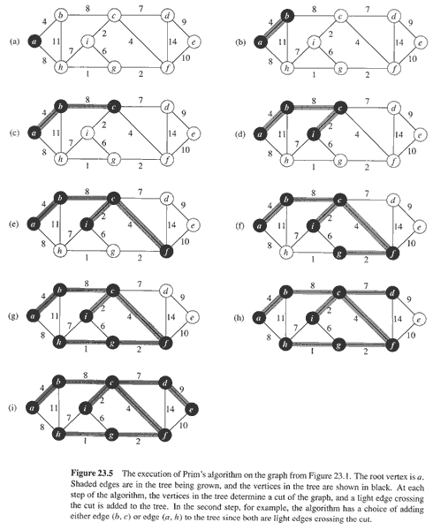

Slide 31
Prim’s Algorithm
MST-Prim(G, w, r)
Q = V[G];
for each u ∈ Q
key[u] = ∞;
key[r] = 0;
p[r] = NULL;
while (Q not empty)
u = ExtractMin(Q);
for each v ∈ Adj[u]
if (v ∈ Q and w(u,v) < key[v])
p[v] = u;
key[v] = w(u,v);

Slide 32
Prim’s Algorithm (Cont.)
How to efficiently select the safe edge to be added to the tree?
Use a min-priority queue Q that stores all vertices not in the tree
Based on key[v], the minimum weight of any edge connecting v to a vertex in the tree
Key[v] = ∞ if no such edge
π[v] = parent of v in the tree
A = {(v, π[v]): v∈V-{r}-Q} ➔ finally Q = empty

Slide 34
Prim’s Algorithm
MST-Prim(G, w, r)
Q = V[G];
for each u ∈ Q
key[u] = ∞;
key[r] = 0;
p[r] = NULL;
while (Q not empty)
u = ExtractMin(Q);
for each v ∈ Adj[u]
if (v ∈ Q and w(u,v) < key[v])
p[v] = u;
key[v] = w(u,v);
What will be the running time? Depends on queue binary heap: O(E lg V) Fibonacci heap: O(V lg V + E)

Slide 35
Prim’s Algorithm
At each step in the algorithm, a light edge is added to the tree, so we end up with a tree of minimum weight.
Prim’s is a greedy algorithm, which is a type of algorithm that makes a decision based on what the current best choice is, without regard for future.

