Slide 1
<number>
Chapter 3
3.1 Algorithms
3.2 The Growth of Functions
3.3 Complexity of Algorithms
3.4 The Integers and Division
3.5 Primes and Greatest Common Divisors
3.6 Integers and Algorithms
3.7 Applications of Number Theory
3.8 Matrices

Slide 2
<number>
Chapter 3
3.2 The Growth of Functions
Big-O Notation
Some Important Big-O Results
The Growth of Combinations of Functions
Big-Omega and Big-Theta Nation

Slide 3
<number>
The Growth of Functions
We quantify the concept that g grows at least as fast as f.
What really matters in comparing the complexity of algorithms?
We only care about the behavior for large problems.
Even bad algorithms can be used to solve small problems.
Ignore implementation details such as loop counter incrementation, etc. we can straight-line any loop.

Slide 4
<number>
Big-O Notation
Definition 1: let f and g functions from the set of integers or the set of real numbers to the set of real number. We say that f(x) is O(g(x)) if there are constants C and k such that |f(x)| ≤ C |g(x)| whenever x > k.
This is read as “ f(x) is big-oh of g(x) ”.
The constants C and k in the definition of big-O notation are called witnesses to the relationship f(x) is O(g(x)).
Note:
Choose k
Choose C ; it may depend on your choice of k
Once you choose k and C, you must prove the truth of the implication (often by induction).
Example 1: show that f(x)= x2+ 2x + 1 is O(x2)

Slide 5
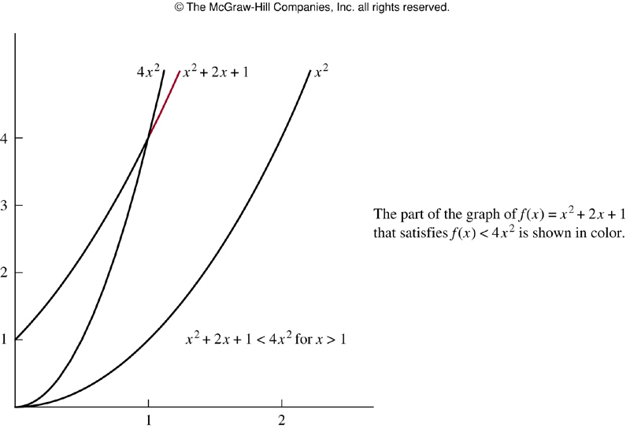
<number>
Big-O Notation
FIGURE 1 The Function x2 + 2x + 1 is O(x2).

Slide 6
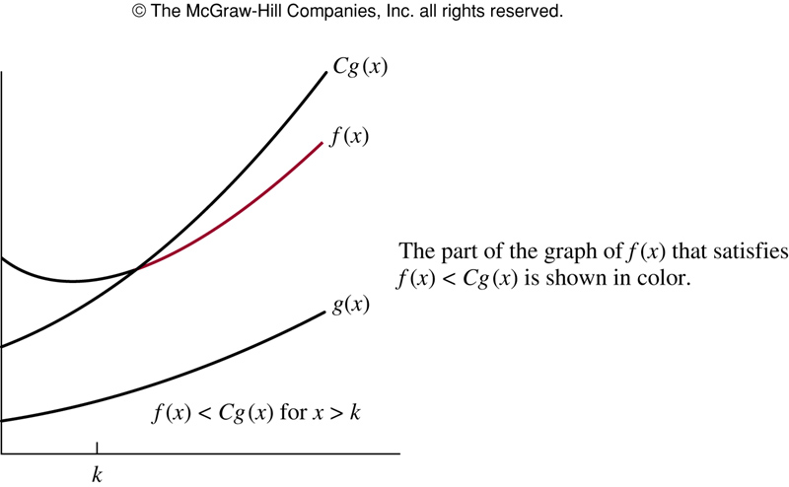
<number>
Big-O Notation
FIGURE 2 The Function f(x) is O(g(x)).

Slide 7
<number>
Big-O Notation
Example 2: show that 7x2 is O( x3 ).
Example 4: Is it also true that x3 is O(7x2)?
Example 3: show that n2 is not O(n).

Slide 8
<number>
Little-O Notation
An alternative for those with a calculus background:
Definition: if then f is o(g),
called little-o of g.

Slide 9
<number>
Theorem: if f is o(g) then f is O(g).
Proof: by definition of limit as n goes to infinity, f(n)/g(n) gets arbitrarily small.
That is for any ε >0 , there must be n integer N such
that when n > N, | f(n)/g(n) | < ε.
Hence, choose C = ε and k= N . Q.E.D.
It is usually easier to prove f is o(g)
Using the theory of limits
Using L’Hospital’s rule
Using the properties of logarithms
etc

Slide 10
<number>
Example : 3n + 5 is O(n2).
Proof: it’s easy to show using the theory of limits.
Hence, 3n+5 is o(n2) and so it is O(n2).
Q.E.D.

Slide 11
<number>
Some Important Big-O Results
Theorem 1: let
where a0, a1, . . .,an-1 , an are real numbers
then f(x) is O(xn) .
Example 5: how can big-O notation be used to estimate the sum of the first n positive integers?

Slide 12
<number>
Some Important Big-O Results
Example 6: give big-O estimates for the factorial function and the logarithm of the factorial function, where the factorial function f(n) =n! is defined by
n! = 1* 2 * 3 * . . .*n
Whenever n is a positive integer, and 0!=1.

Slide 13
<number>
Some Important Big-O Results
Example 7: In Section 4.1 ,we will show that n <2n whenever n is a positive integer.
Show that this inequality implies that n is O(2n) , and use this inequality to show that log n is O(n).

Slide 14
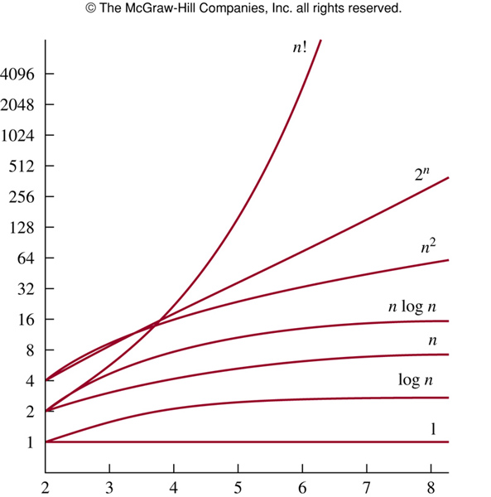
<number>
The Growth of Combinations of Functions
1
logn
n
n log n
n2
2n
n!
FIGURE 3 A Display of the Growth of Functions Commonly Used in Big-O Estimates.

Slide 15
<number>
Important Complexity Classes
Where j > 2 and c> 1.
Example :Find the complexity class of the function
Solution: this means to simplify the expression.
Throw out stuff which you know doesn’t grow as fast.
We are using the property that if f is O(g) then f + g is O(g).

Slide 16
<number>
Important Complexity Classes
if a flop takes a nanosecond, how big can a problem be solved (the value of n ) in
a minute?
a day?
a year?
For the complexity class O(n n! nn)

Slide 17
<number>
Important Complexity Classes
a minute= 60*109= 6*1010 flops
a day= 24*60*60= 8.65*1013 flops
a year= 365*24*60*60*109= 3.1536*1016 flops
We want to find the maximal integer so that
n*n!*nn < 6*1010
n*n!*nn < 8.65*1013
n*n!*nn < 3.1536*1016
Notes:
<number>

Slide 18
<number>
Important Complexity Classes
Maple Program:
for k from 1 to 10 do (k,k*factorial(k)*kk)end do;
1, 1
2, 16
3, 486
4, 24576
5, 187500
6, 201553920
7, 29054597040
8, 5411658792960
9, 1265284323434880
10, 362880000000000000
So, n=7,8,9 for a minute, a day, and a year.

Slide 19
<number>
The Growth of Combinations of Functions
Theorem 2: suppose that f1(x) is O(g1(x)) and f2(x) is O(g2(x)). Then (f1 + f2)(x) is O(max( |g1(x)| , |g2(x)| )).
Corollary 1: suppose that f1(x) and f2(x) are both O(g(x)). Then (f1 + f2)(x) is O(g(x)).

Slide 20
<number>
Theorem: If f1 is O(g1) and f2 is O(g2) then
f1 f2 is O(g1g2)
f1+f2 is O(max {g1 ,g2})

Slide 21
<number>
The Growth of Combinations of Functions
Theorem 3 :suppose that f1(x) is O(g1(x)) and f2(x) is O(g2(x)).
Then (f1f2)(x) is O(g1(x) g2(x)).
Example 8: give a big-O estimate for
f(n)=3n log(n!) + (n2 +3) log n
where n is a positive integer.
Example 9: give a big-O estimate for
f(x)=(x+1)log(x2+1) + 3x2

Slide 22
<number>
Properties of Big-O
f is O(g) iff
If f is O(g) and g is O(f) then
The set O(g) is closed under addition:
if f is O(g) and h is O(g) then f+h is O(g)
The set O(g) is closed under multiplication by a scalar a (real number):if f is O(g) then af is O(g)
That is ,O(g) is a vector space. (The proof is in the book.)
Also, as you would expect,
If f is O(g) and g is O(h), then f is O(h) .
In particular

Slide 23
<number>
Note : we often want to compare algorithms in the same complexity class
Example:
Suppose
Algorithm 1 has complexity n2 – n +1
Algorithm 2 has complexity n2/2 + 3n + 2
Then both are O(n2) but Algorithm 2 has a smaller leading coefficient and will be faster for large problems.
Hence we write
Algorithm 1 has complexity n2 +O(n)
Algorithm 2 has complexity n2/2 + O(n)

Slide 24
<number>
Big-Omega and Big-Theta Nation
Definition 2: Let f and g be functions from the set of integers or the set of real numbers to the set of real numbers.
We say that f(x) is Ω(g(x)) if there are positive constants C and k such that |f(x)|≥ C|g(x)|
Whenever x > k. ( this is read as “f(x) is big-Omega of g(x)” .)
Example 10 :The function f(x) =8x3+ 5x2 +7 is Ω(g(x)) , where g(x) is the function g(x) =x3.
This is easy to see because f(x) =8x3+ 5x2 +7 ≥ x3 for all positive real numbers x. this is equivalent to saying that
g(x) = x3 is O(8x3+ 5x2 +7 ) ,which can be established directly by turning the inequality around.

Slide 25
<number>
Definition 3: Let f and g be functions from the set of integers or the set of real numbers to the set of real numbers.
We say that f(x) is Θ(g(x)) if f(x) is O(g(x)) and f(x) is Ω(g(x)).
When f(x) is Θ(g(x)) , we say that” f is big-Theta of g(x)” and we also say that f(x) is of order g(x).
Example 11: we showed (in example 5) that the sum of the first n positive integers is O(n2). Is this sum of order n2?
Example 12: show that 3x2 + 8x(logx) is Θ(x2).

Slide 26
<number>
Theorem 4: let
, where a0, a1, . . .,an-1 , an are real numbers with an≠0 . Then f(x) is of order xn .
Example 13: the ploynomials
3x8+10x7+221x2+1444
x19-18x4-10112
-x99+40001x98+100003x
are of orders x8, x19 and x99 ,respectively.

