Slide 1
Current understanding of tokamak plasma eruption control and the consequences for ITER
Joe Allen, JOA509

Slide 2
Talk Outline
Background understanding of type-I Edge Localised Modes (ELMs)
Problems ELMs cause & ITER’s requirements
Methods for ELM control on ITER
Resonant magnetic perturbations (RMPs)
Pellet injection
Vertical kicks
Alternatives

Slide 3
1. Background understanding of ELMs
Generic to tokamaks in H-mode

Slide 4
1. Background understanding of ELMs
Generic to tokamaks in H-mode
Edge pedestal gradient is inherently unstable

Slide 5
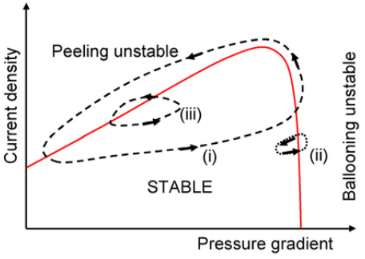
1. Background understanding of ELMs
Type-I ELM cycles
Generic to tokamaks in H-mode
Edge pedestal gradient is inherently unstable
Thought to be caused by Peeling-Ballooning mode instabilities
ELM causes crash, cycle repeats
H. Wilson Plas. Phys. 48 2006

Slide 6
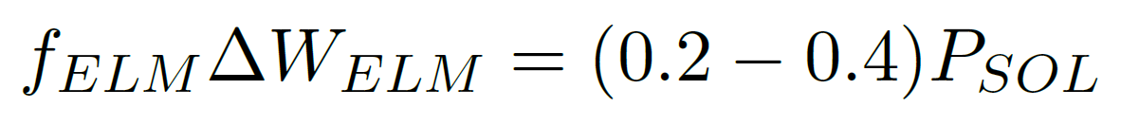
1. Background understanding of ELMs
A. Leonard Journal of Nuclear Materials 266 1999
Several tokamaks have corroborated this scaling for ELM frequency, f_{ELM}
∆W_{ELM} is the ELM energy
Notes:
Quick slide!

Slide 7
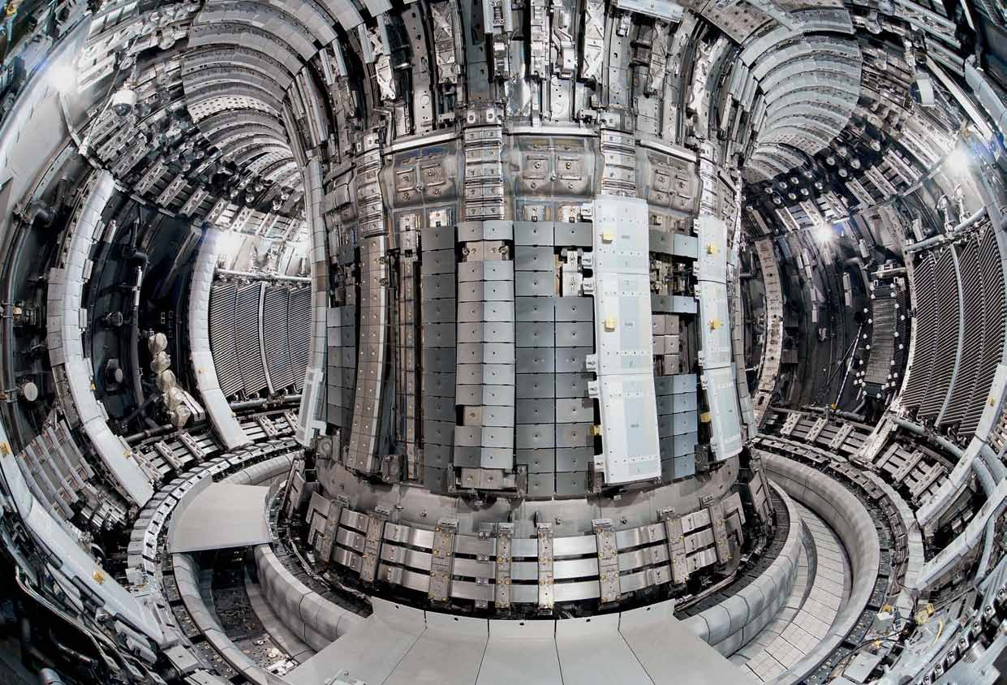
2. Problems ELMs cause

Slide 8
2. Problems ELMs cause
Loss of confinement

Slide 9
2. Problems ELMs cause
Loss of confinement
High heat flux expelled from the plasma
Can cause critical damage to PFCs

Slide 10
2. Problems ELMs cause
Loss of confinement
High heat flux expelled from the plasma
Can cause critical damage to PFCs
May destabilise core plasma modes

Slide 11

2. Problems ELMs cause
Loss of confinement
High heat flux expelled from the plasma
Can cause critical damage to PFCs
May destabilise core plasma modes
However they reduce plasma impurity levels

Slide 12
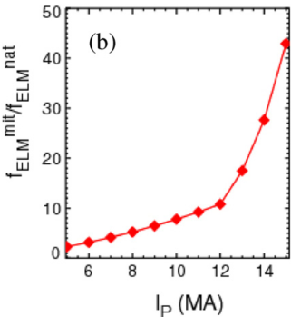
2. ITER’s requirements
Natural ELMs on ITER could release up to 20 MJ
The first wall can tolerate < 1 MJ eruptions
Target operation: 15 MA
AT LEAST need a sustained >40 times f_{ELM} increase
A. Kirk Phys. Rev. Lett. 108.25 2013

Slide 13
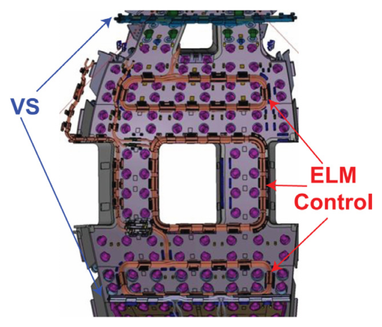
3. Methods for ELM control on ITER
Vertical stability coils already included
27 RMP coils added to design
Pellet injectors also added
P. Lang Nuclear Fusion 53.4 2013
Notes:
Quick slide!

Slide 14
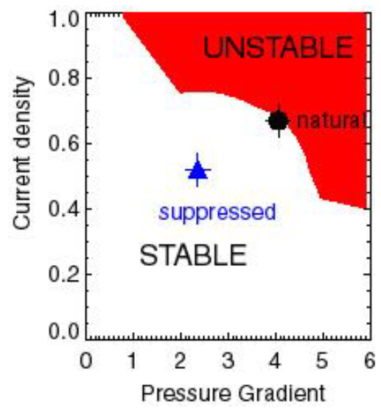
3. i) RMPs (Resonant Magnetic Perturbations)
Suppress ELMs by keeping below PB stability limit
A Kirk Frontiers Lectures 2016
Notes:
Complete suppression is ideal
Small perturbations disrupt toroidal symmetry
Divertor heat loads become non uniform → perturbations must be varied around tokamak or mode number changed to even out this divertor degradation
Not always achievable → Parameters for RMP success need to be calculated in ITER’s early operation

Slide 15
3. i) RMPs (Resonant Magnetic Perturbations)
Suppress ELMs by keeping below PB stability limit
Small perturbations ≈ 10⁻⁴ T
A Kirk Frontiers Lectures 2016
Notes:
Complete suppression is ideal
Small perturbations disrupt toroidal symmetry
Divertor heat loads become non uniform → perturbations must be varied around tokamak or mode number changed to even out this divertor degradation
Not always achievable → Parameters for RMP success need to be calculated in ITER’s early operation

Slide 16
3. i) RMPs (Resonant Magnetic Perturbations)
Suppress ELMs by keeping below PB stability limit
Small perturbations ≈ 10⁻⁴ T
Perturbations must be toroidally cycled to keep divertor damage uniform
A Kirk Frontiers Lectures 2016
Notes:
Complete suppression is ideal
Small perturbations disrupt toroidal symmetry
Divertor heat loads become non uniform → perturbations must be varied around tokamak or mode number changed to even out this divertor degradation
Not always achievable → Parameters for RMP success need to be calculated in ITER’s early operation

Slide 17
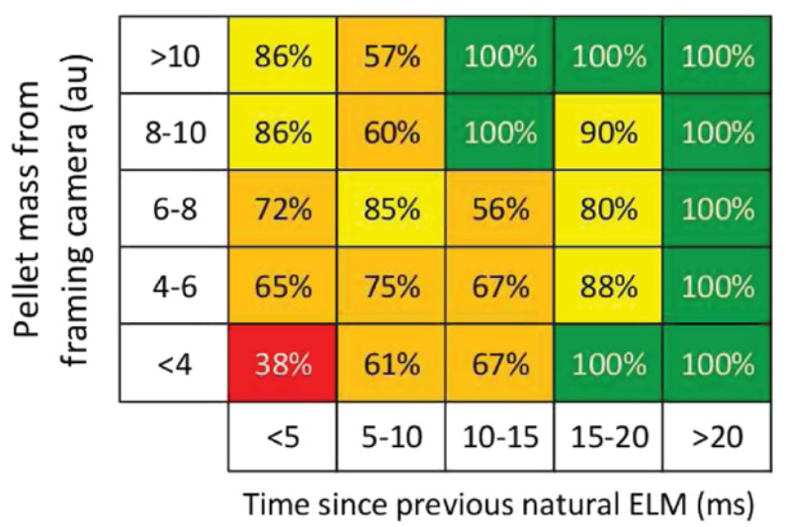
3. ii) Pellet Injection (PI)
Mitigation by increasing f_{ELM} → less damage to PFCs
Mechanism not fully understood
Heavily dependent on time since
last ELM
I. Chapman Plas. Phys. Cont. Fus. 58 1 2016
Notes:
Non-resonant effect so can be used at all times throughout at discharge
Thought to be caused by ablation of pellet in pedestal region → increasing local pressure above ballooning stability limit and provoking an ELM
Can cause over-fuelling of the plasma which reduces fusion performance

Slide 18
3. ii) Pellet Injection (PI)
Mitigation by increasing f_{ELM} → less damage to PFCs
Mechanism not fully understood
Heavily dependent on time since
last ELM
iii) Vertical Kicks (VKs)
Control by pacing the frequency of ELMs
Vertical stability coils
Plasma moves ≈ 2% of minor radius
I. Chapman Plas. Phys. Cont. Fus. 58 1 2016
Notes:
Non-resonant effect so can be used at all times throughout at discharge
Thought to be caused by ablation of pellet in pedestal region → increasing local pressure above ballooning stability limit and provoking an ELM
Can cause over-fuelling of the plasma which reduces fusion performance

Slide 19




1st: Complete, sustained RMP suppression
2nd: Partial RMP suppression + VK/PI mitigation
3rd: Sustained VK/PI mitigation with f_{ELM} above threshold
Notes:
Likely will need some small ELMs to control core impurity levels → unless alternatives can be found to increase internal transport

Slide 20
4. Alternatives
QH-mode or I-mode
High fusion performance without ELMs!
(but with enhanced transport!)
Sounds worth investigating
Notes:
Sounds worth investigating, if not for ITER then at least for the next generation of tokamaks
Control techniques discussed don’t work in every scenario → need something more robust
A new, more stable operating regime would be ideal for a fusion power plant

Slide 21
Thank you for listening!

