Slide 1
Current understanding of tokamak plasma eruption control and the consequences for ITER
Joe Allen, JOA509

Slide 2
Talk Outline
Background understanding of Edge Localised Modes (ELMs)
Problems ELMs cause
Methods for ELM control
Resonant magnetic perturbations (RMPs)
Pellet injection
Vertical kicks
ELM control on ITER

Slide 3
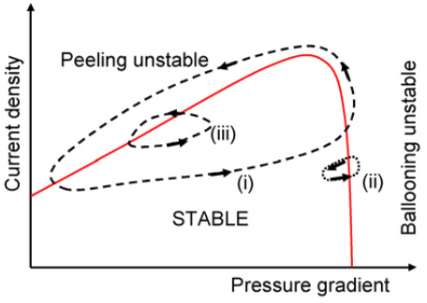
1. Background understanding of ELMs
Generic to tokamaks in H-mode
Edge pedestal gradient is inherently unstable
Several different types
Focussing on type I ELMs here
Thought to be caused by Peeling-Ballooning mode instabilities
H. Wilson Plas. Phys. 48 2006

Slide 4
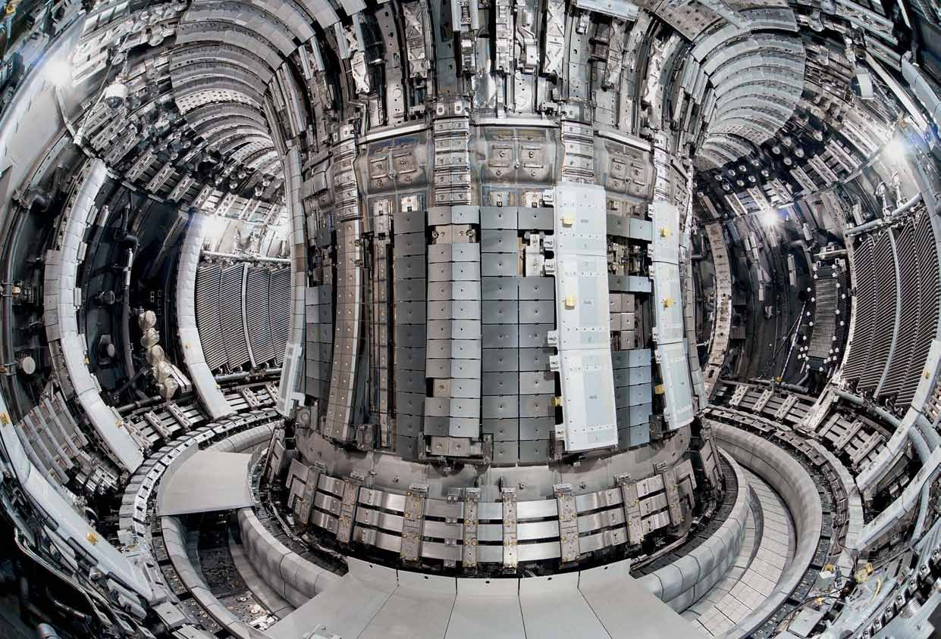
2. Problems ELMs cause
Loss of confinement
High heat flux expelled from the plasma
Can cause critical damage to PFCs
May destabilise core plasma modes

Slide 5
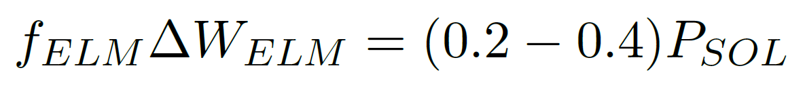
3. Methods for ELM control
Several tokamaks have corroborated this scaling for ELM frequency, f_{ELM}
∆W_{ELM} is the ELM energy
A. Leonard Journal of Nuclear Materials 266 1999

