Slide 1
Current understanding of tokamak plasma eruption control and the consequences for ITER
Joe Allen, JOA509

Slide 2
Talk Outline
Background understanding of ELMs
Problems ELMs cause
Methods for ELM control
Resonant magnetic perturbations (RMPs)
Pellet injection
Vertical kicks
ELM control on ITER

Slide 3
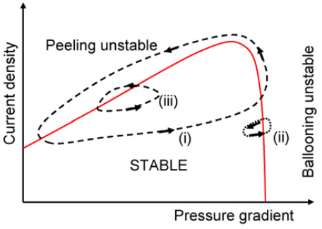
1. Background understanding of ELMs
Generic to tokamaks in H-mode
Several different types
Focussing on type I ELMs in this talk
H. Wilson Plas. Phys. Fusi. 48 2006

