Slide 1
Current understanding of tokamak plasma eruption control and the consequences for ITER
Joe Allen, JOA509

Slide 2
Talk Outline
Background understanding of type-I Edge Localised Modes (ELMs)
Problems ELMs cause & ITER’s requirements
Methods for ELM control
Resonant magnetic perturbations (RMPs)
Pellet injection
Vertical kicks
ELM control on ITER

Slide 3
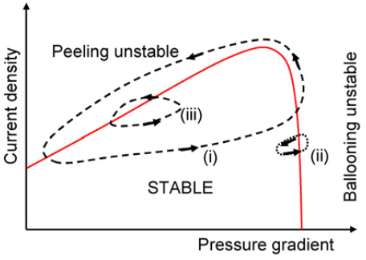
1. Background understanding of ELMs
Type-I ELM cycles
Generic to tokamaks in H-mode
Edge pedestal gradient is inherently unstable
Thought to be caused by Peeling-Ballooning mode instabilities
ELM causes crash, cycle repeats
H. Wilson Plas. Phys. 48 2006

Slide 4
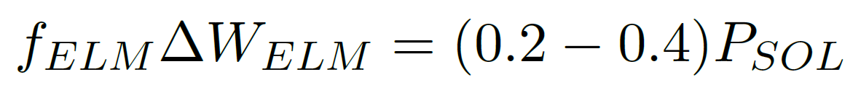
1. Background understanding of ELMs
A. Leonard Journal of Nuclear Materials 266 1999
Several tokamaks have corroborated this scaling for ELM frequency, f_{ELM}
∆W_{ELM} is the ELM energy

Slide 5
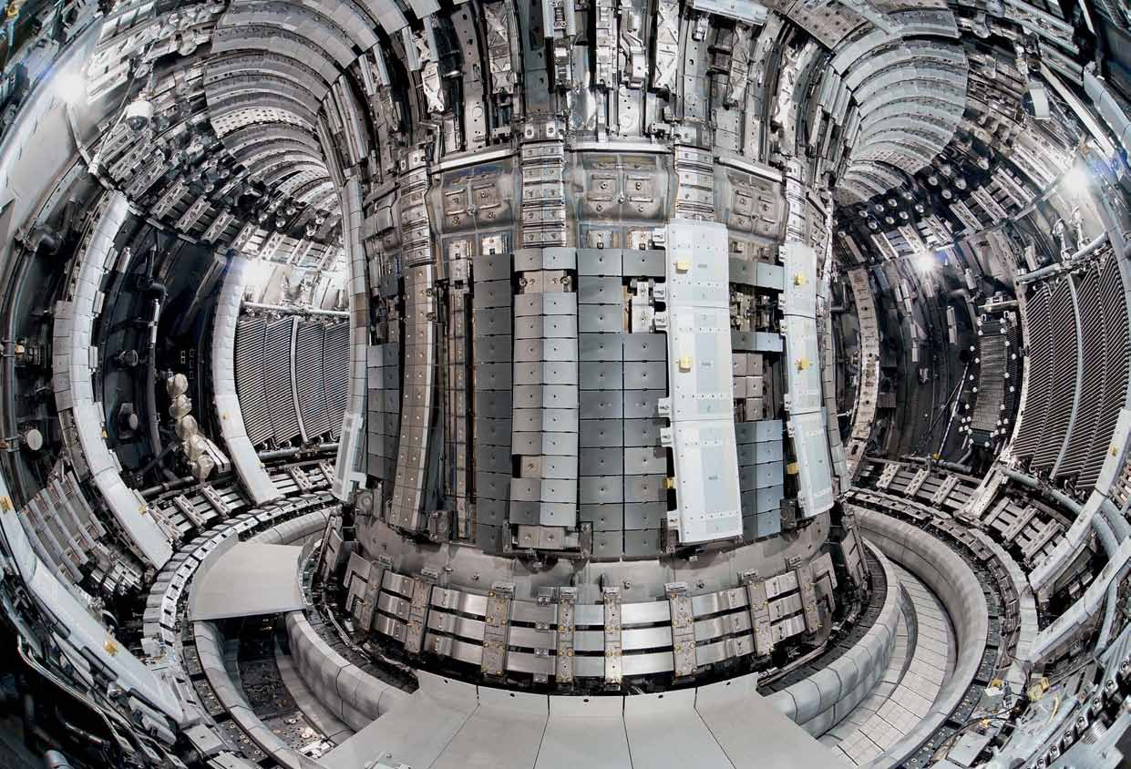

2. Problems ELMs cause
Loss of confinement
High heat flux expelled from the plasma
Can cause critical damage to PFCs
May destabilise core plasma modes
However they reduce plasma impurity levels

Slide 6
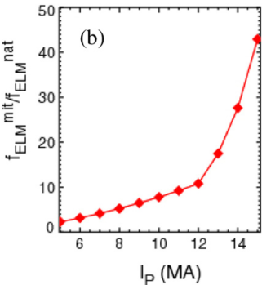
2. ITER’s requirements
Minimum ELM frequency increase to maintain acceptable impurity levels and sufficient PFC lifetime, depending on plasma current.
Target operation: 15 MA
AT LEAST need a sustained >40 times f_{ELM} increase
A. Kirk Phys. Rev. Lett. 108.25 2013

Slide 7
3. Methods for ELM control
RMP – suppress ELMs by keeping below PB stability limit
PI & VK – mitigation by increasing f_ELM → less damage to PFCs
ITER coil layout pic

Slide 9
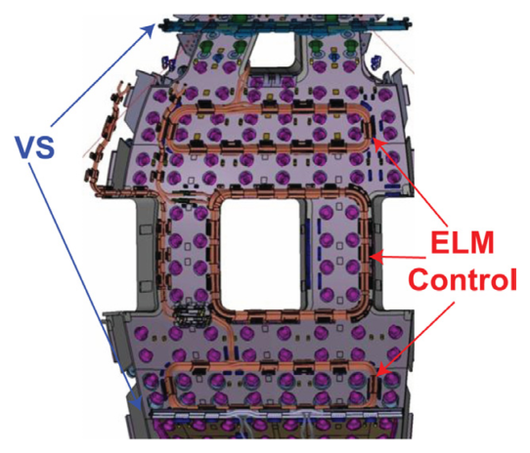
4. ELM control on ITER
Vertical stability coils already included
27 RMP coils added to design
Pellet injectors also added
P. Lang Nuclear Fusion 53.4 2013

Slide 10




1st: Complete, sustained RMP suppression
2nd: Partial RMP suppression + VK/PI mitigation
3rd: Sustained VK/PI mitigation with f_{ELM} above threshold

Slide 11
4. ELM control on ITER

