Slide 1
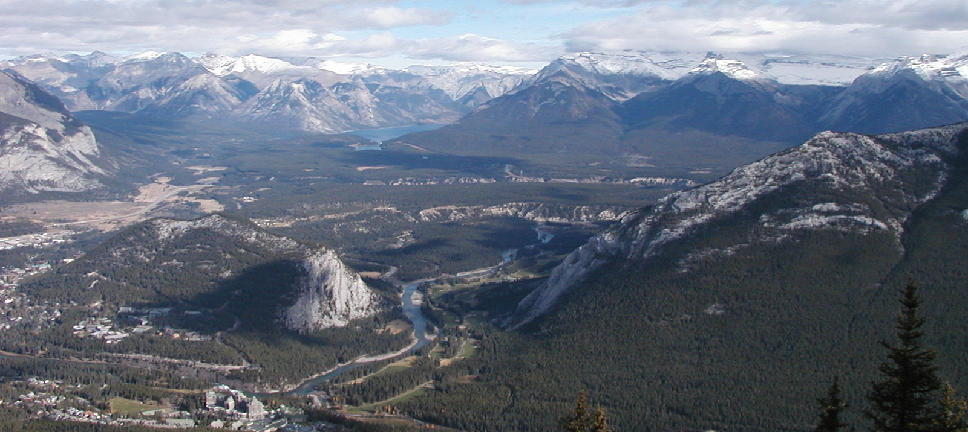

Fifth International Workshop on Artificial Intelligence for Requirements Engineering (AIRE'18)
with special focus topic CrowdRE
AIRE Overview
This workshop explores synergies between artificial intelligence (AI) and Requirements Engineering (RE) so that complex RE problems, such as quality defects, can be addressed through AI techniques. CrowdRE stimulates, collects, and analyzes crowd-generated data with AI techniques to derive requirements. AIRE aims to strengthen the links in the community, including industry and academia. We welcome submissions in the intersection between RE and AI. The topics of interest include but are not limited to:
RE quality models and their automation
Natural language processing and comprehension
Machine learning techniques including supervised, unsupervised, and machine-human interactions
Reasoning about uncertainties and ambiguities
Reasoning techniques
Knowledge acquisition and representation
Agent-based solutions
Problem-solving and decision-making support mechanisms
Optimization techniques
Automated approaches for prioritization
We especially invite approaches that address specific challenges of the focal topic of CrowdRE, including:
Crowd-based monitoring and usage mining approaches
Application scenarios of CrowdRE using AI technology
Automatic approaches to motivate, steer, and boost creativity towards requirements elicitation and validation
Platforms and tools supporting CrowdRE through mining
AI and human computation
Organizers
Eduard C. Groen, Fraunhofer IESE, Germany
Rachel Harrison, Oxford Brookes University, U.K.
Pradeep K. Murukannaiah, Rochester Inst. of Tech., U.S.A.
Andreas Vogelsang, TU Berlin, Germany
Program Committee
Nirav Ajmeri, North Carolina State University, USA
Raian Ali, Bournemouth University, UK
Fatma Başak Aydemir, Utrecht University, NL
Nelly Bencomo, Aston University, UK
Daniel Berry, University of Waterloo, Canada
Jaspreet Bhatia, Carnegie Mellon University, USA
Jane Cleland-Huang, University of Notre Dame, USA
Fabiano Dalpiaz, Utrecht University, Netherlands
Neil A. Ernst, Software Engineering Institute, USA
Henning Femmer, Technical University Munich, Germany
Alessio Ferrari, ISTI Pisa, IT
Vincenzo Gervasi, University of Pisa, Italy
Jin Guo, University of Notre Dame, USA
Emitza Guzman, University of Zurich, Switzerland
Mahmood Hosseini, Bournemouth University, UK
Frank Houdek, Daimler AG, Germany
Marjo Kauppinen, Aalto University, Finland
Soo Ling Lim, University College London, UK
Daniel Mendez Fernandez, TU Munich, Germany
Itzel Morales Ramirez, Infotec, Mexico
Cristina Palomares, UPC, Spain
Anna Perini, Fondazione Bruno Kessler, Italy
Lorijn van Rooijen, University of Paderborn, Germany
Kurt Schneider, Leibniz Universitat Hannover, Germany
Contribution Types
The workshop solicits two contribution types:
Research papers (max. 7 pages). These papers should describe ongoing research, in terms of automating RE tasks supporting RE tasks by AI techniques, improvements of existing approaches, as well as empirical studies and experience reports (e.g., of applied work in industry).
Position papers (max 3 pages). These papers serve to foster discussion on hot, relevant topics in the field, as well as problem statements explaining problems in industrial settings.
In both cases, papers will be peer-reviewed and accepted papers will appear in the IEEE digital library.
Key Dates
Abstract Submission | Tuesday, June 5, 2018 AoE
Paper Submission | Tuesday, June 12, 2018 AoE
Paper Notification | Friday, July 6, 2018
Camera Ready Due | Tuesday, July 17, 2018 AoE
Workshop | August 21, 2018
Contact
Web: aire18.aset.tu-berlin.de
Mail: aire18@easychair.org
Photo credit: Wikimedia Commons / D‘Arcy Norman, cc-by-2.0
AIRE'18 is co-located with the 26th IEEE International Requirements Engineering Conference (RE 2018) in Banff, Canada.

