Slide 1

Welcome to AIRE‘18
Organizers:
Eddy Groen, Rachel Harrison, Pradeep Murukannaiah, Andreas Vogelsang

Slide 2
AIRE: purpose
The purpose of this workshop is to explore synergies between Artificial Intelligence and Requirements Engineering in order to identify complex RE problems that could benefit from the application of AI techniques
Focal Topic: CrowdRE
The use of AI techniques for stimulating, collecting, and analyzing crowd-generated data to derive requirements, a process commonly known as CrowdRE. Crowd-generated data provides great potential and challenges for AI techniques and automation. Research in the fields of AIRE and CrowdRE is highly compatible.

Slide 3
AIRE: history
AIRE’14 at RE’14 in Karlskrona, Sweden
AIRE’15 at RE’15 in Ottawa, Canada
AIRE’16 at RE’16 in Beijing, China
AIRE’17 at RE’17 in Lisbon, Portugal
AIRE’18 at RE’18 in Banff, Canada

Slide 4
AIRE’18 program committee
Nirav Ajmeri, North Carolina State University, USA
Raian Ali, Bournemouth University, UK
Fatma Başak Aydemir, Utrecht University, NL
Nelly Bencomo, Aston University, UK
Daniel Berry, University of Waterloo, Canada
Jaspreet Bhatia, Carnegie Mellon University, USA
Jane Cleland-Huang, University of Notre Dame, USA
Fabiano Dalpiaz, Utrecht University, Netherlands
Neil A. Ernst, Software Engineering Institute, USA
Henning Femmer, Technical University Munich, Germany
Alessio Ferrari, ISTI Pisa, IT
Vincenzo Gervasi, University of Pisa, Italy
Jin Guo, University of Notre Dame, USA
Emitza Guzman, University of Zurich, Switzerland
Mahmood Hosseini, Bournemouth University, UK
Frank Houdek, Daimler AG, Germany
Marjo Kauppinen, Aalto University, Finland
Soo Ling Lim, University College London, UK
Daniel Mendez Fernandez, Technical University Munich, Germany
Itzel Morales Ramirez, Infotec, Mexico
Cristina Palomares, UPC, Spain
Anna Perini, Fondazione Bruno Kessler, Italy
Lorijn van Rooijen, University of Paderborn, Germany
Kurt Schneider, Leibniz Universitat Hannover, Germany

Slide 5
AIRE‘18 review process
20 abstract submissions
15 papers submitted (13 full papers, 2 short papers)
Each paper has been reviewed by 3 PC members
8 papers were accepted (53% acceptance rate)
 | AIRE‘14 | AIRE’15 | AIRE‘16 | AIRE’17 | AIRE‘18
Submissions | 17 | 6 | 15 | 7 | 15
Accepted Papers | 9 | 6 | 8 | 7 | 8
Acceptance Rate | 53% | 100% | 53% | 100% | 53%
Attendees | 24 | 15 | 25 | 29 | 37

Slide 6

AIRE’18 word cloud (from abstracts)

Slide 7
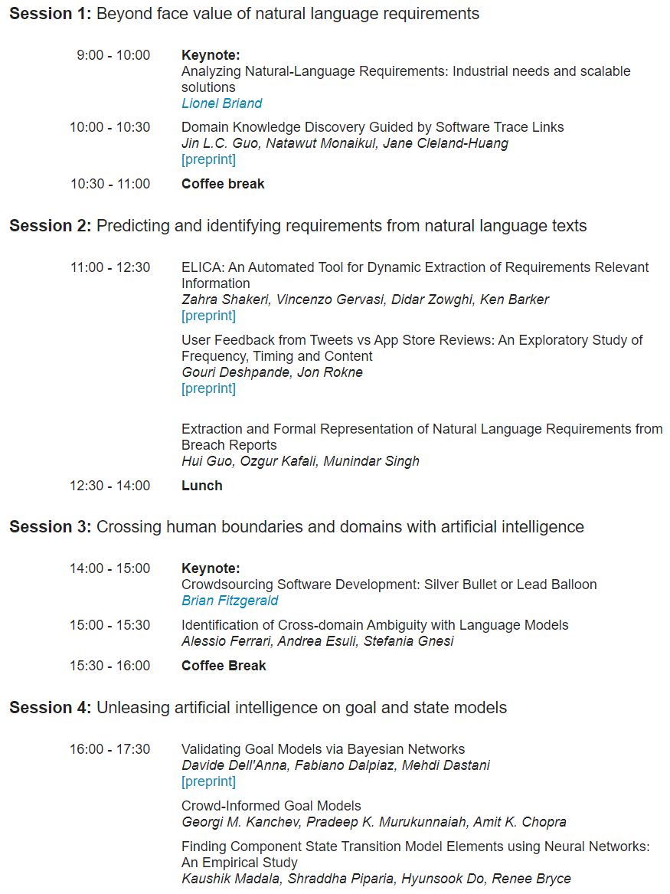
AIRE’18 program

Slide 8
AIRE’18 program

Slide 9
AIRE and Beyond
NLP4RE workshop @ REFSQ
Special issue on AIRE in the Automated Software Engineering Journal (Deadline: October 20)
SI related to the synergies that exist between Artificial Intelligence and Requirements Engineering
Springer Journal with 5-year IF of 2.795

Slide 10
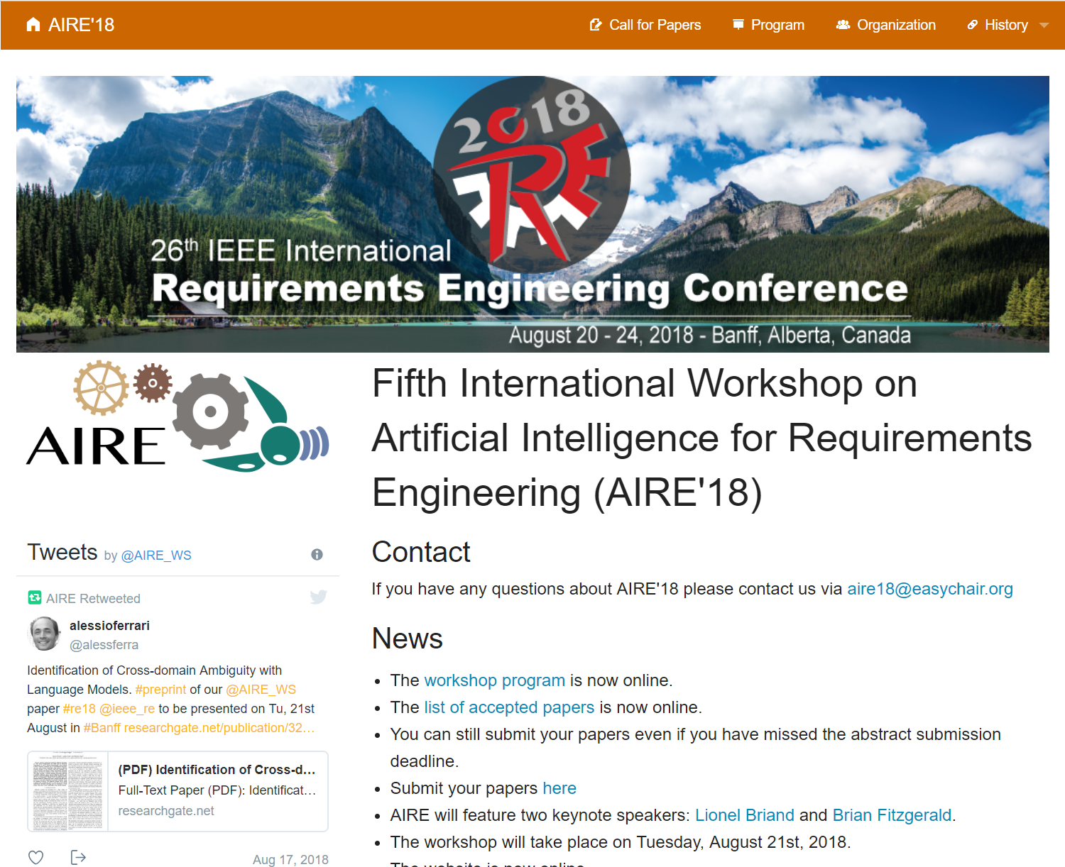
Enjoy AIRE http://aire18.aset.tu-berlin.de/

