Slide 1
Identifying and Understanding Stakeholders using Process Mining
Case Study on Discovering Business Processes that Involve Organizational Entities
NTT Software Innovation Center
Shinobu Saito

Slide 2
Agenda
Introduction
Approach
Tool
Case Study
Conclusion

Slide 3
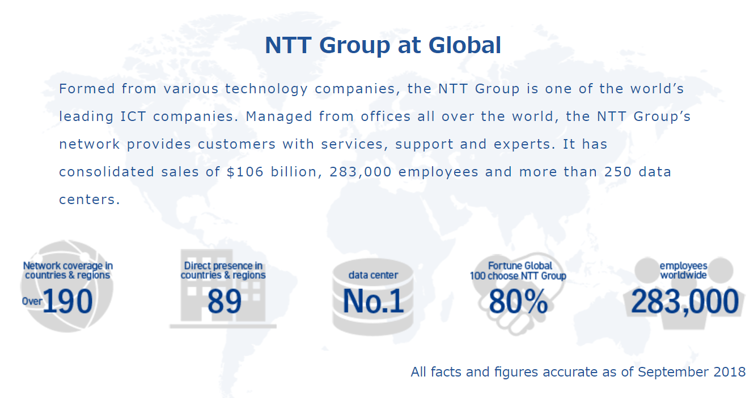
Who is NTT?

Slide 4
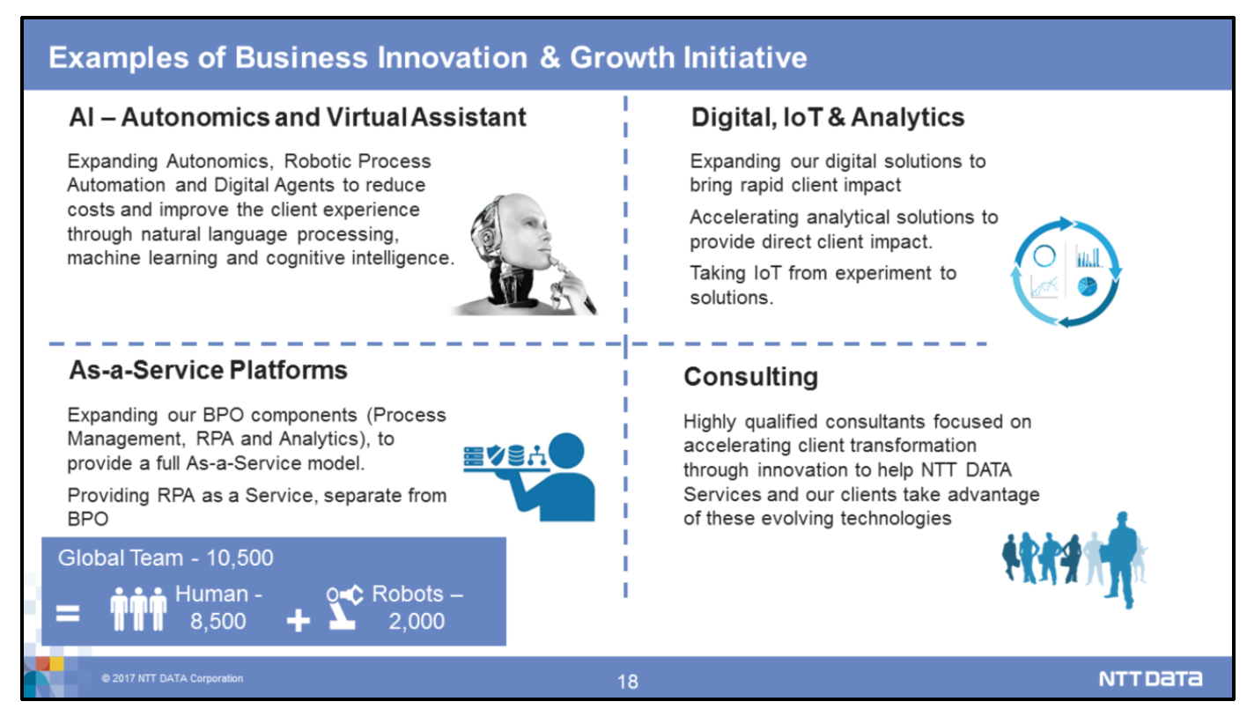
Focusing Areas of NTT’s IT Offering
Consultants play a key role in requirements engineering.

Slide 5
Background
One decisive factor influencing success of requirements engineering is to identify and understand the right stakeholders correctly and completely.
Requirements engineers need to know which organizational entity, as a stakeholder, has an influence on the requirements of the system.

Slide 6


Lack of Business Process Document
Business process models are very helpful to identify organizational entities related to the system.
However, business processes are often undocumented.
Requirements
Engineering
Dev.
Design
Implementation/Test
Ops.
Existing
System
No Documents
Documents degraded
Few (or No) Experts
？
？
Consultant
(BA / RE)

Slide 7
Process Mining
Process mining is a research field for identifying business processes from the event logs generated by a system.
Process Mining Manifesto
http://dx.doi.org/10.1007/978-3-642-28108-2_19

Slide 8

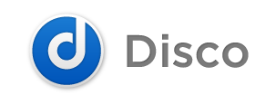
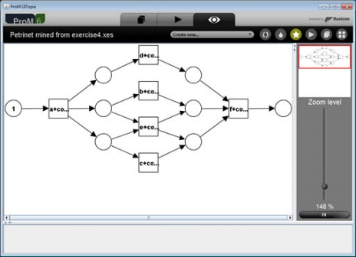
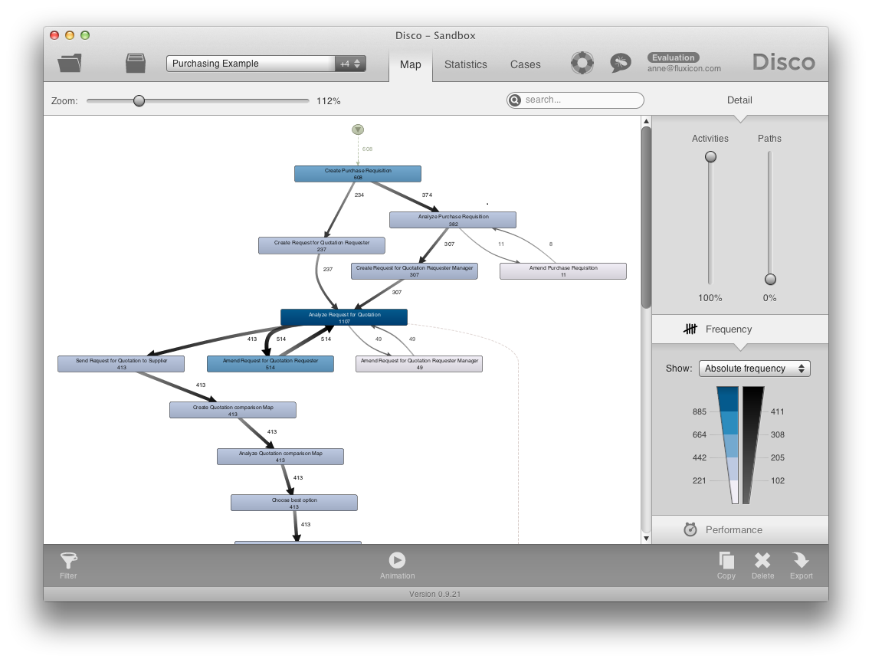
Business Processes by Process Mining
Existing process mining approaches focus on sequential flows. The models lack information on organizational entities.
http://www.promtools.org/doku.php
http://fluxicon.com/

Slide 9
Agenda
Introduction
Approach
Tool
Case Study
Conclusion

Slide 10
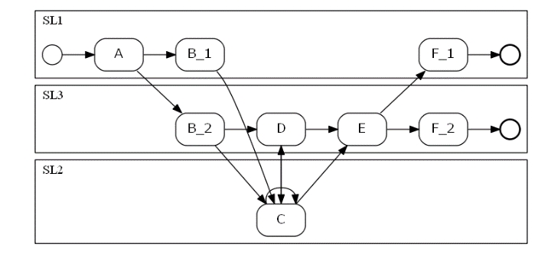

Approach: Discovering business processes that involve organizational entities from an event logs and user information
Requirements
Engineering
Dev.
Ops.
Design
Implementation
Existing
System
Business Process Discovery
Business
Process
Design Recovery
Event log
Source Code
Biz. & Sys.
Restructuring
Design doc.
User
Info
Reverse Engineering and Design Recovery: A Taxonomy (Elliot Chikofsky, James Cross II, IEEE Computer Society, 1900)

Slide 11
Basic Concept of Discovery Method(1/2) -Generating Business Processes that Involve Organizational Entities-
Event log
Case | Activity | Time stamp | User ID
W₁ | A | TS₁ | 001
W₁ | B | TS₂ | 001
W₁ | C | TS₃ | 002
W₁ | D | TS₄ | 002
Business Process
R₁
A
B
R₂
C
D
User
Info
User ID | Organization
001 | R₁
002 | R₂
003 | R₃
Activity A and B are executed in Swimlane R₁.
Activity C and D are executed in Swimlane R₂.

Slide 12
Basic Concept of Discovery Method(2/2) -Generating Business Processes that Involve Organizational Entities-
Event log
Case | Activity | Time stamp | User ID
W₁ | A | TS₁ | 001
W₁ | B | TS₂ | 001
W₁ | C | TS₃ | 002
W₁ | D | TS₄ | 002
W₂ | A | TS₁ | 001
W₂ | C | TS₂ | 003
W₂ | D | TS₃ | 002
R₁
A
B
R₂
C_1
R₃
D
C_2
User
Info
User ID | Organization
001 | R₁
002 | R₂
003 | R₃
Activity C is divided into two activities (C_1 and C_2)

Slide 13
Agenda
Introduction
Approach
Tool
Case Study
Conclusion

Slide 14
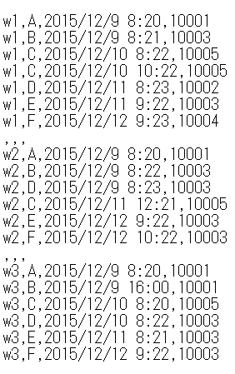
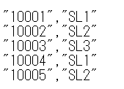
Software Implementation (BP retriever)
Event log
“BP retriever” automates the discovery steps.
Business Process
BP retriever
User
Info

Slide 15
Agenda
Introduction
Approach
Tool
Case Study
Conclusion

Slide 16


Target System in Case Study
An industry workflow system for procuring office supplies and equipment.
Departments
Shared Service
Center
Workflow System
Approval process??
DB
16

Slide 17

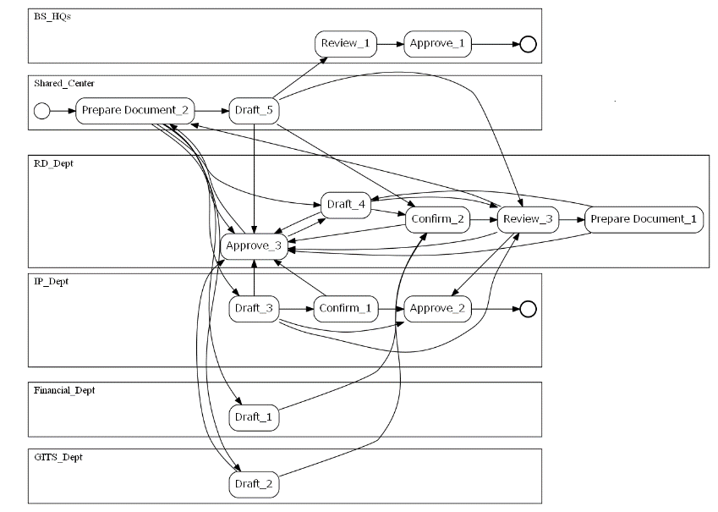
Business Process Discovery
We used our tool to discover this department’s approval process based on two years system’s data.
Workflow System
Generated Business Process
DB
BP retriever
1,960
records
User Info
269
records
17

Slide 18
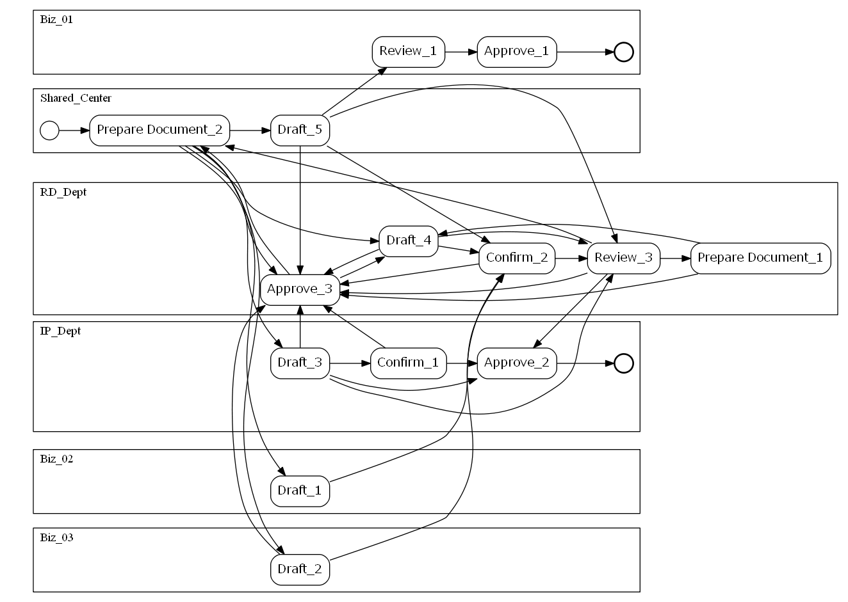
Generated Business Process

Slide 19
Stakeholder - Activity Matrix
All the activities are affected by more than one department.
Activity Department | Prepare Document | Draft | Confirm | Review | Approve
RD_Dept | X | X | X | X | X
Shared_Center | X | X
IP_Dept |  | X | X |  | X
Biz_01 |  |  |  | X | X
Biz_02 |  | X
Biz_03 |  | X

Slide 20
Agenda
Introduction
Approach
Tool
Case Study
Conclusion

Slide 21
Summary and Future Issue
Summary
We introduced our industrial case study for identifying and understanding stakeholders.
Our tool generated the business process model that involves organizational entities (i.e., swim-lanes) by analyzing the database of the system.
The model can helped requirements engineers to capture correct and complete stakeholders.
Future Issue
We plan to verify the generated process models from the case study.
We will evaluate whether the stakeholder identification by our approach is effective for the consulting business.

