Slide 1

Have large-language models (LLMs) made previous AI tools obsolete?
AIRE’24 Joint Activity
by Chetan Arora, Fatma Başak Aydemir, and Julian Frattini
aire-ws/aire24-activity
Public

Slide 2






Goal
Pre-LLM era
LLM era
Conscious, specific design
Out-of-the-box usability
Manual data curation and training
Requiring a few examples
Decent results, but rarely
any adoption
Better/worse performance?
→ Have large-language models made previous AI tools obsolete?

Slide 3







Method Overview
Select a study that presents an AI-powered tool performing an RE task (e.g., from the AIRE or NLP4RE workshops)
Select data from the evaluation of that tool
Human output (ground truth)
/
Input Data
Tool output
/
LLM output
Engineer a prompt for the LLM of your choice that performs the same task
Reflect on the strengths and weaknesses of the LLM
Finally, we discuss the results

Slide 4
Preconditions
Minimum preconditions:
Access to an LLM/GenAI (e.g., ChatGPT) of your choice
Optional preconditions:
Account at GitHub for accessing the material
Working local git setup to store your solution

Slide 5
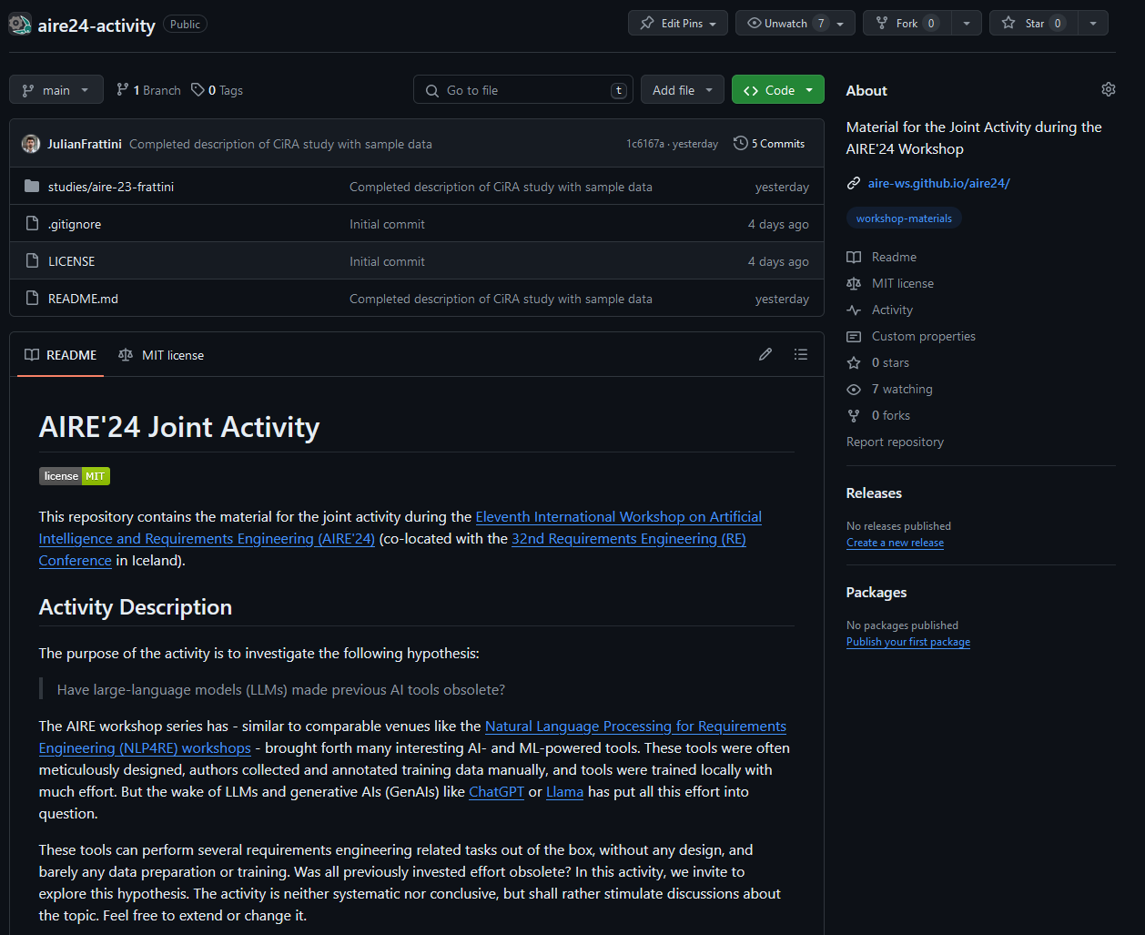
Material available on GitHub
aire-ws/aire24-activity
Public
5

Slide 6
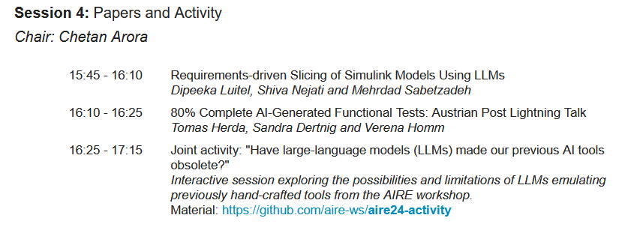
Material available on GitHub
Find the link to the material on the workshop website: https://aire-ws.github.io/aire24/program.html

Slide 7
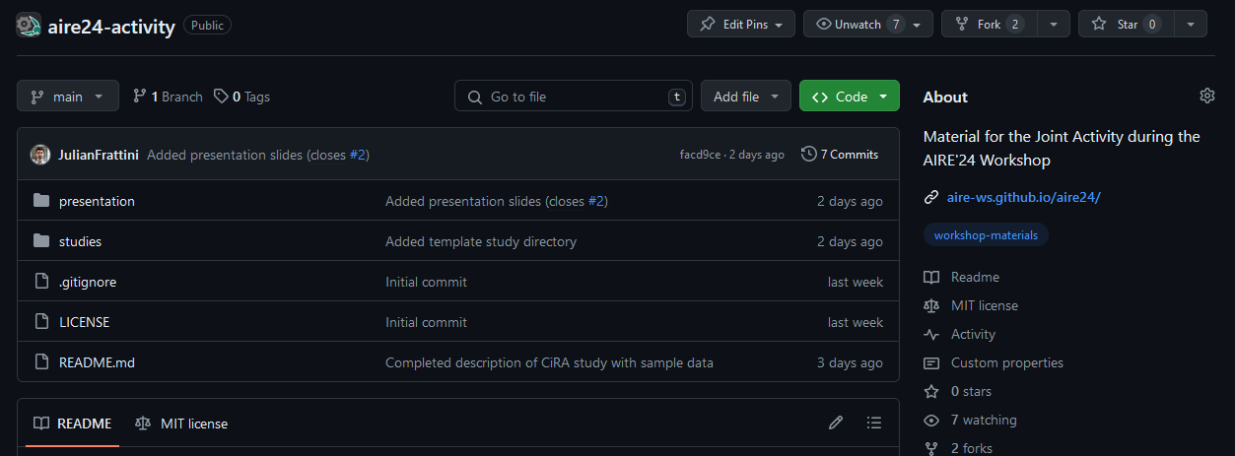
Process
Fork the repository https://github.com/aire-ws/aire24-activity

Slide 8
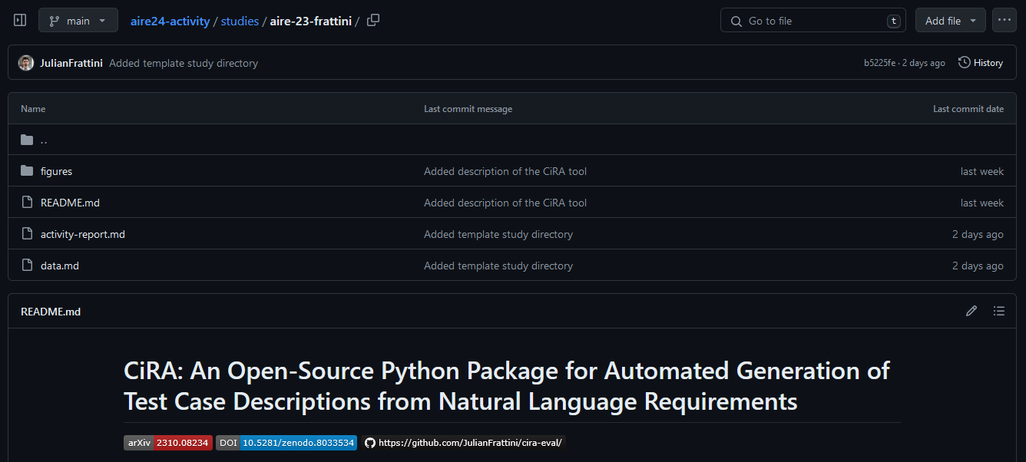
Process
Select a study presenting a tool

Slide 9
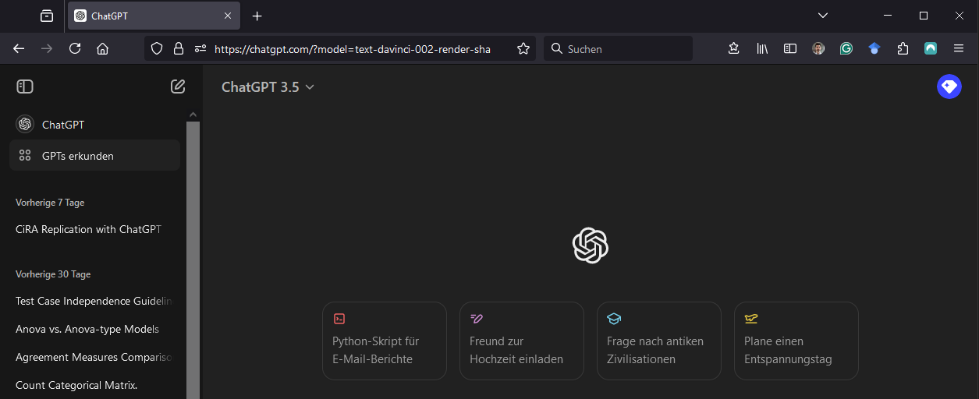
Process
Select an LLM …

Slide 10
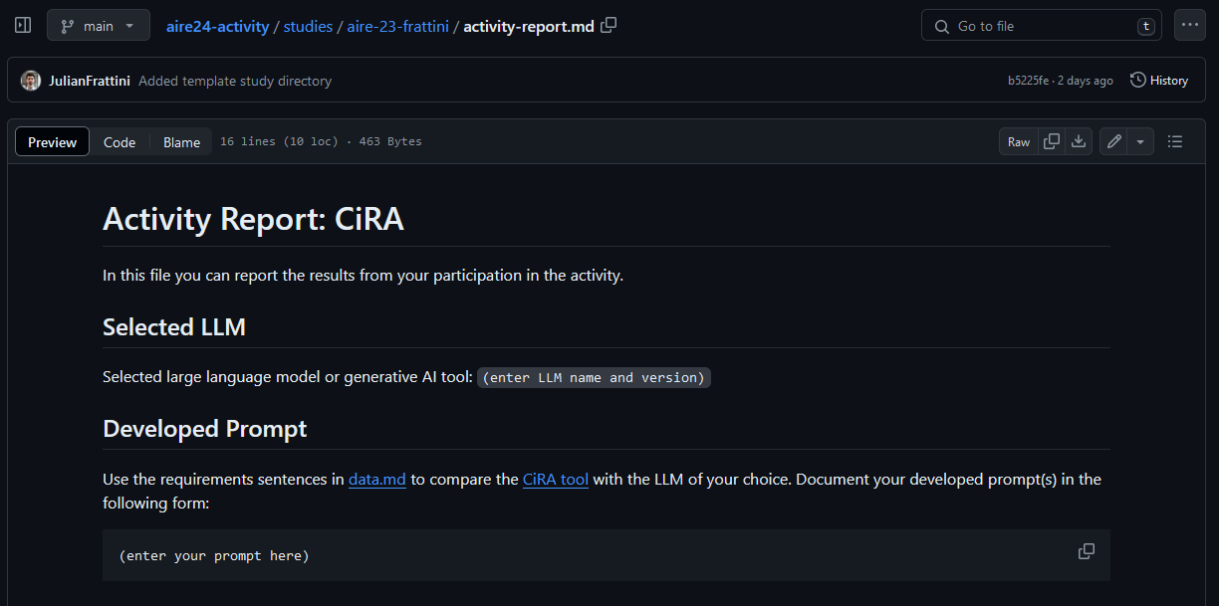
Process
Select an LLM and enter the name and version to the activity-report.md

Slide 11
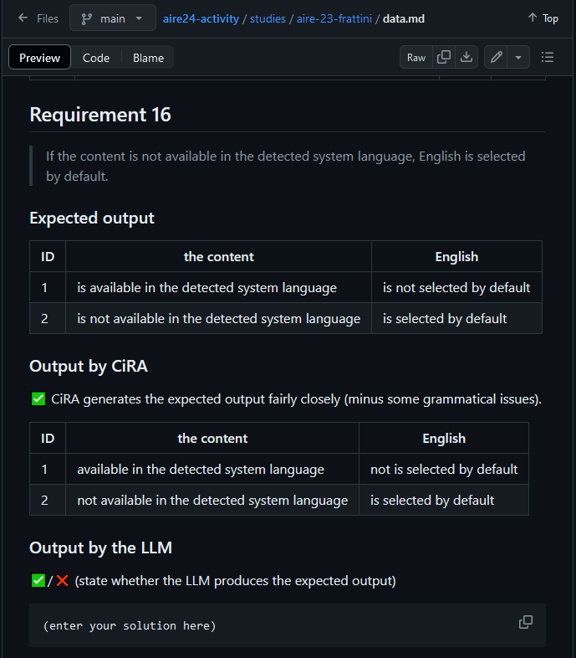

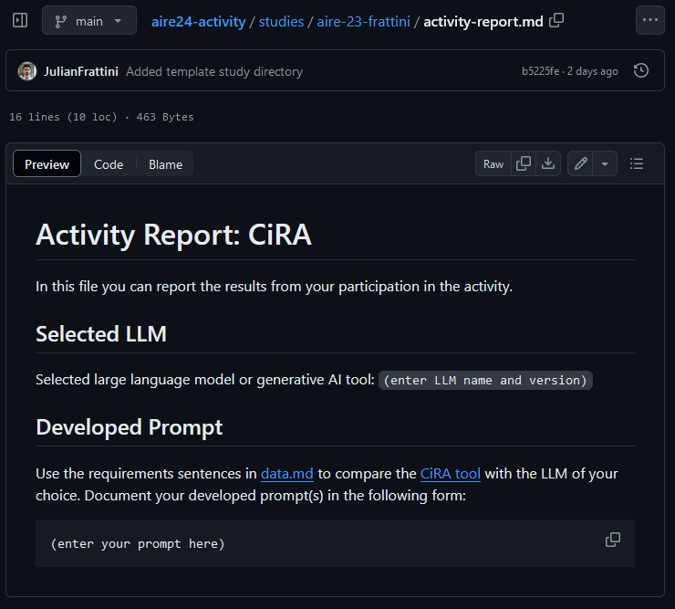

Process
Develop a prompt that performs the tool’s task with the input data in the data.md file
Prompt

Slide 12
Process
Reflect on the LLM’s performance
How close is the LLM’s output to the ground truth?
How close is the LLM’s output to the tool’s output?
/
/

Slide 13
Process
Fork the repository https://github.com/aire-ws/aire24-activity
Select a study presenting a tool
When selecting an unfamiliar, prepared tool from the repository (under studies/): read the summary of its use case in the respective README.md file.
When selecting an own tool: copy the template/ directory under studies/ and name it after your study
Select an LLM and enter the name and version to the activity-report.md
Develop a prompt that performs the tool’s task with the input data in the data.md file and report your prompt in the activity-report.md
Reflect on the LLM’s performance

Slide 14
Execute
Perform the task by following the steps (1) select a study, (2) select data, (3) engineer a prompt, and (4) reflect.
The public material on GitHub also contains the activity description in more detail.
aire-ws/aire24-activity
Public
14

Slide 15
Discussion
Have large-language models made previous AI tools obsolete?
What were the strengths of the LLM?
What were the weaknesses of the LLM?

Slide 16
Wrap-Up
Push your changes back into your forked repository
… and share any feedback that you have.

Slide 17
Thank you for your participation
We welcome constructive feedback
aire-ws/aire24-activity
Public

