Slide 1

CASE STUDY II
Classification on Wi-fi Dataset
Aires Miguens
Ms. Data Science

Slide 2

Objective
How much data is enough data ?
Using Machine Learning algorithm to determine users’ location (building and floor number ) by analyzing WLAN signal strengths.

Slide 3

Methods and tools
Classification algorithm selections
SK-Learn, numpy, matplotlib libraries.
Pandas for cleaning and storing the data.
Data analysis

Slide 4

What is the right Estimator ?

Slide 5

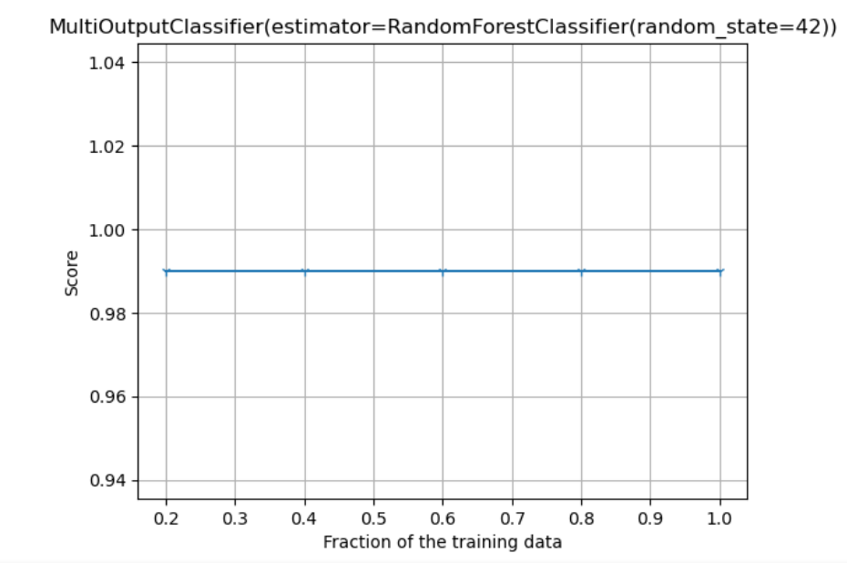
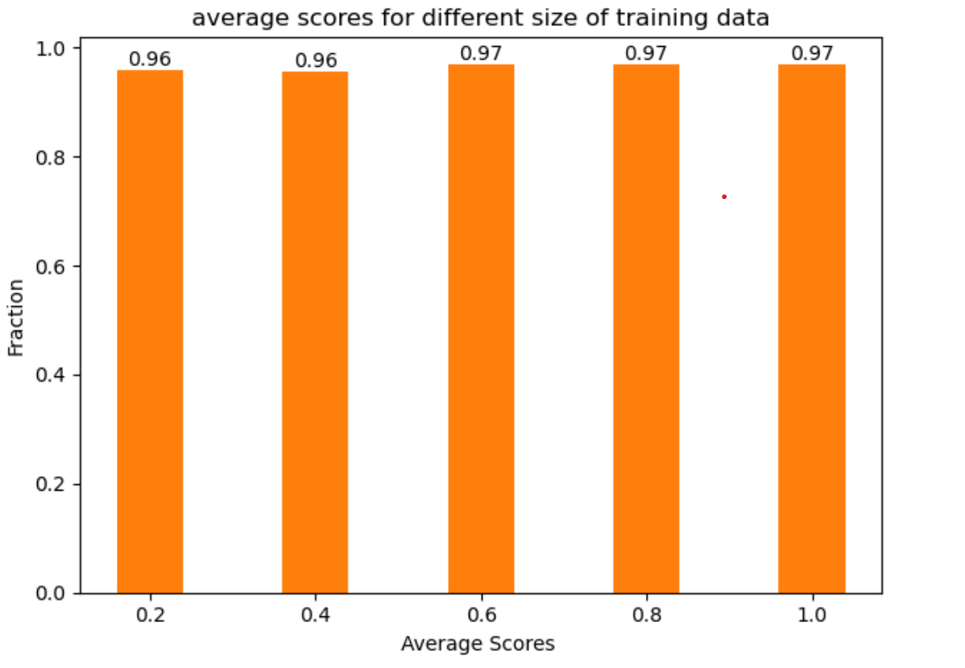
Adding more data vs performance

Slide 6
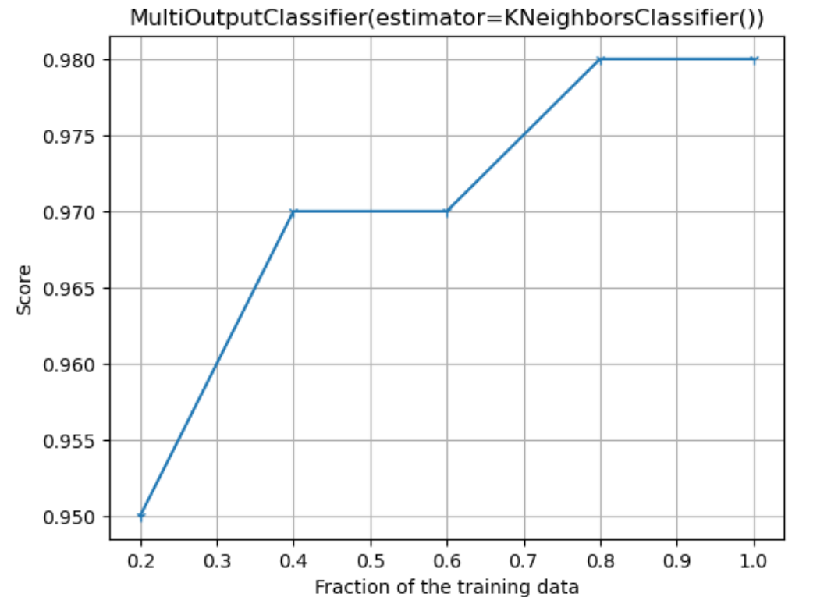
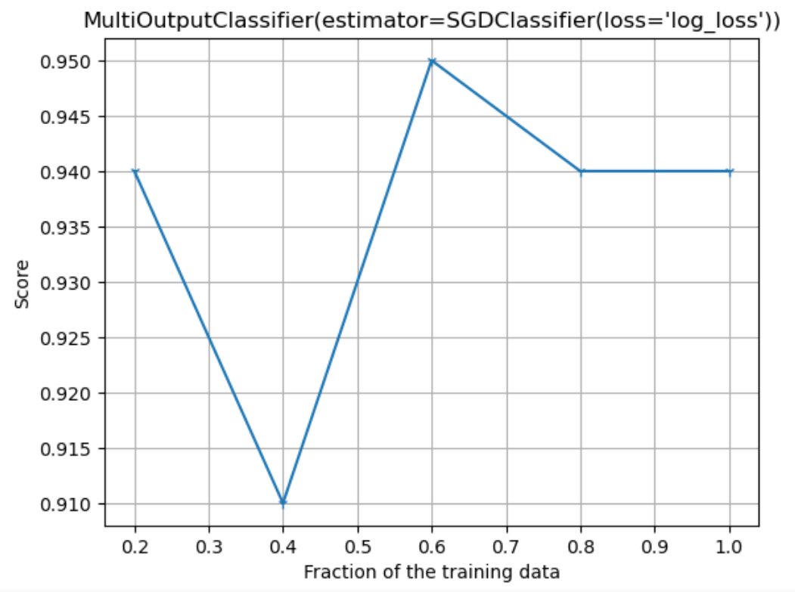
Adding more data vs performance

Slide 7
Challenges
Equalizing the testing size to the validation size
Selecting the appropriate Estimator
Working on the features of the dataset

Slide 8
Conclusions
More training data does not always imply better score;
It may depend on multiple factors like
The type of estimator
The type of data (if it is adding noise or not and how the models fits the data)
It is always good practice to use more than one estimator in order to make a more informed decision.

Slide 9

Thank you
Aires miguens
303-725-8668
amiguns@wpi.edu

