Slide 1
Classification of Salary: Objective
Predict income bracket of American citizen given certain metrics
Occupation
Gender
Age
Education
Marital status
Year survey was taken
Help understand how career and life choices may impact income

Slide 2
Classification of Salary: Methodology
General Social Survey (GSS) dataset from 1972—2018
Interested in full-time employees
Missing values: use combination of KNN imputation and row deletion
Discretization of salaries via k-means clustering
Low income: $227—$30,600
Middle income: $30,600—$117,000
High income: $117,000—$480,000
Use “occupational prestige” quantity as determined by sociologists
Classification via k-nearest neighbor k = 10, 29000 samples
Dummy coding for categorical data (0 = absence, 1 = presence)

Slide 3
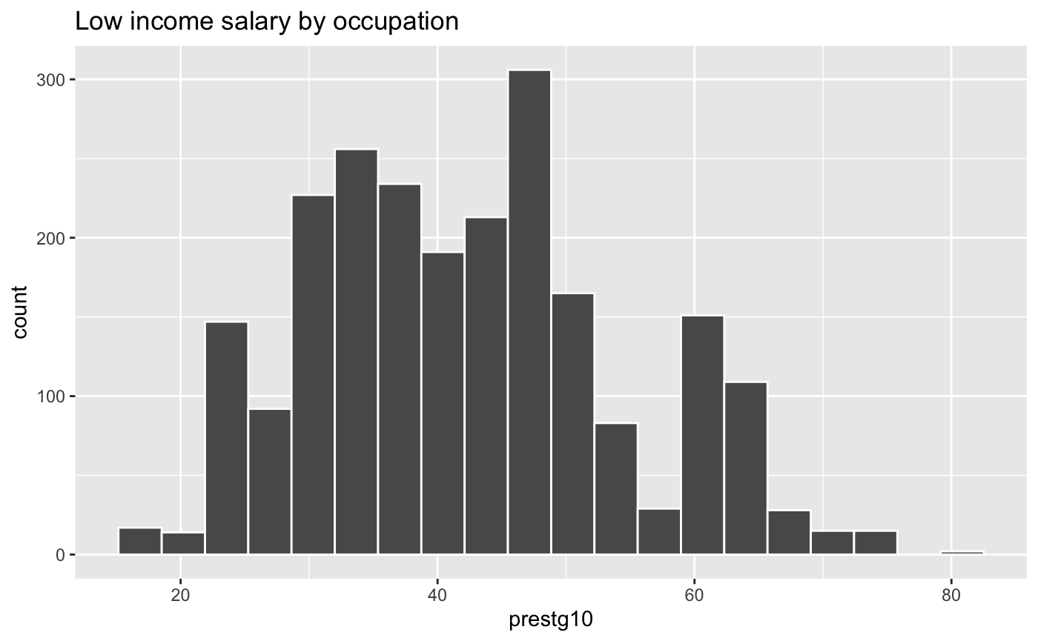
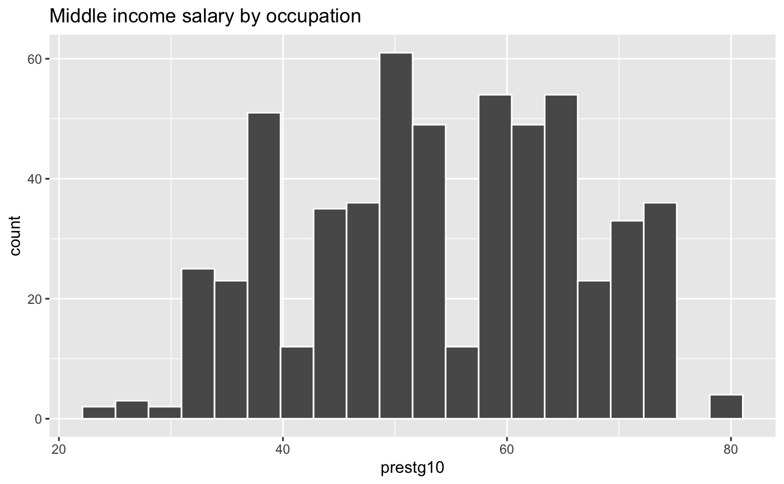
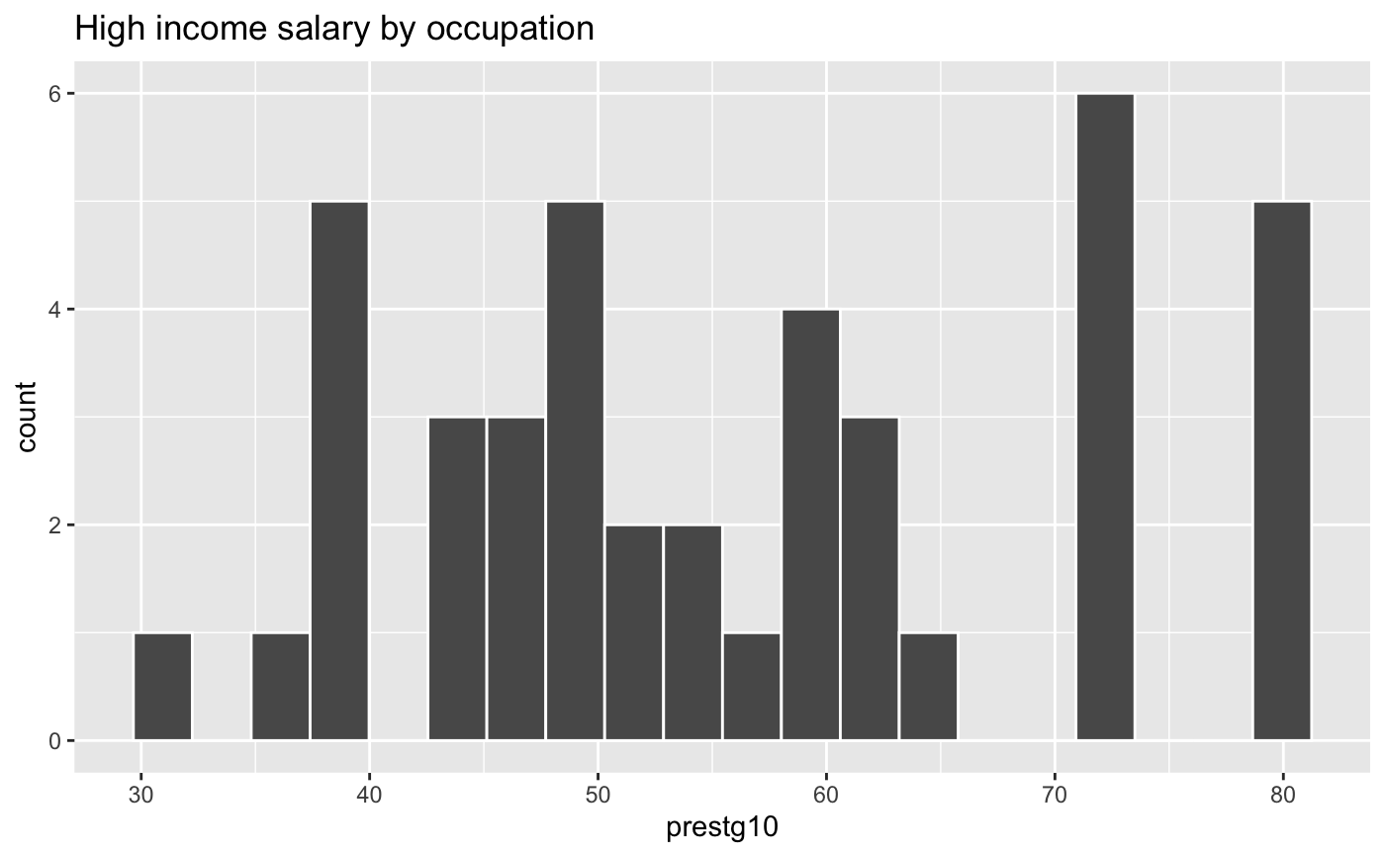
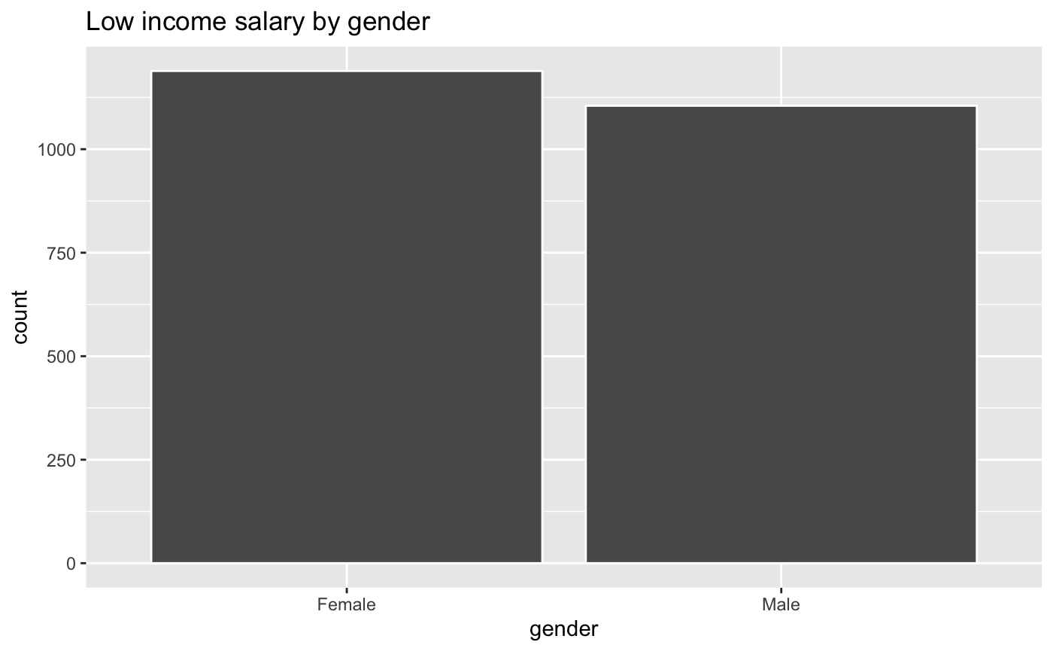
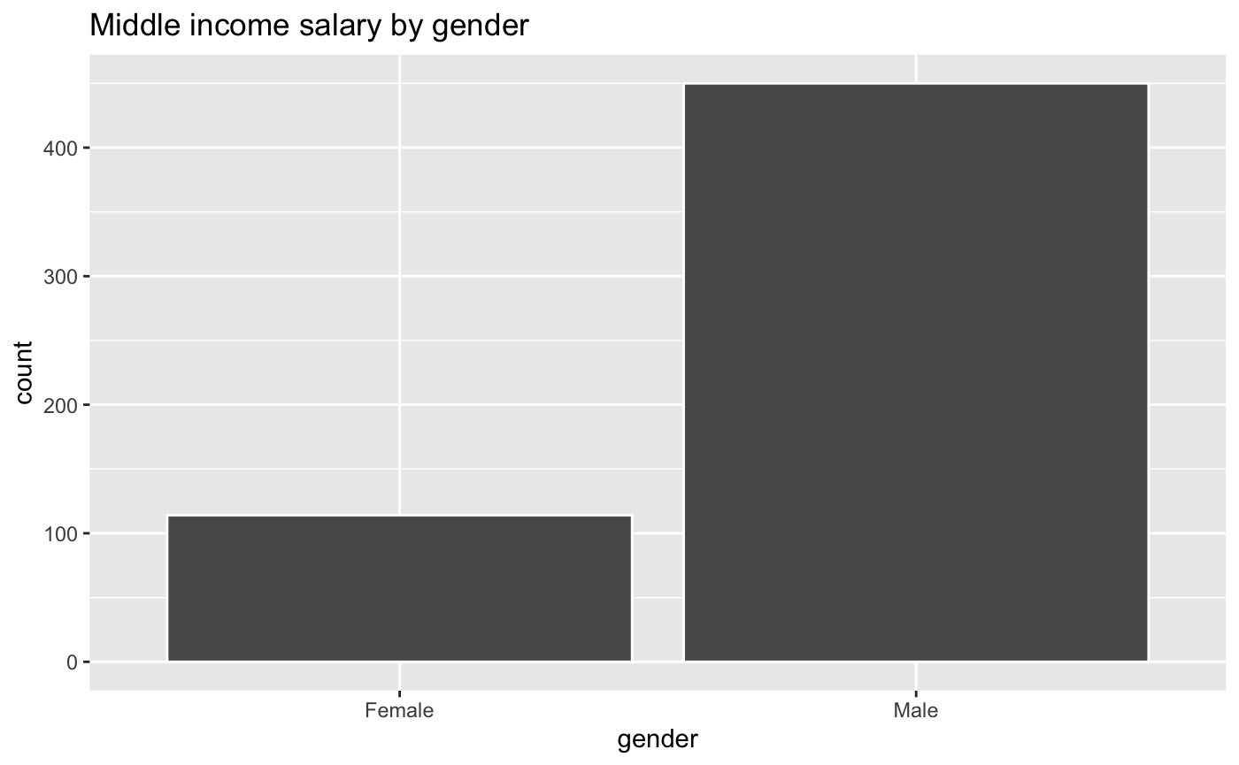
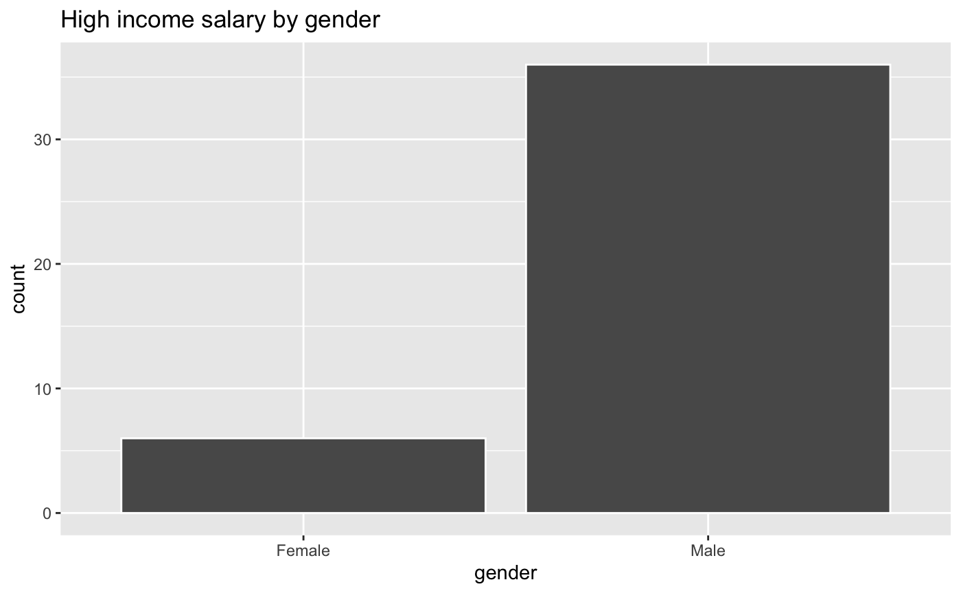
Classification of Salary: Results
~ 90% accuracy for k > 9 (confusion matrix); train = 26100; test = 2900
Notes:
low-gender.png
high-gender.png
mid-gender.png

Slide 4
Classification of Salary: Conclusion
Occupation positively influences salary prediction (prestige pays more)
Gender strongly influences salary prediction (males are paid more)
Other metrics (graphs not included):
Age: Positive correlation (older -> higher income)
Education: Positive correlation (higher education -> higher income)
Marital status: Higher income correlates to more stable marriage
Survey year: Higher salaries appear starting from late 1990s—present
Possible future work:
Address class imbalance (more people have lower incomes)
Study how the combination of different metrics could influence prediction
Apply model to new data
References:
https://quantdev.ssri.psu.edu/sites/qdev/files/kNN_tutorial.html

