Slide 1
Data stream mining
Presented by Eric Nguyen

Slide 2
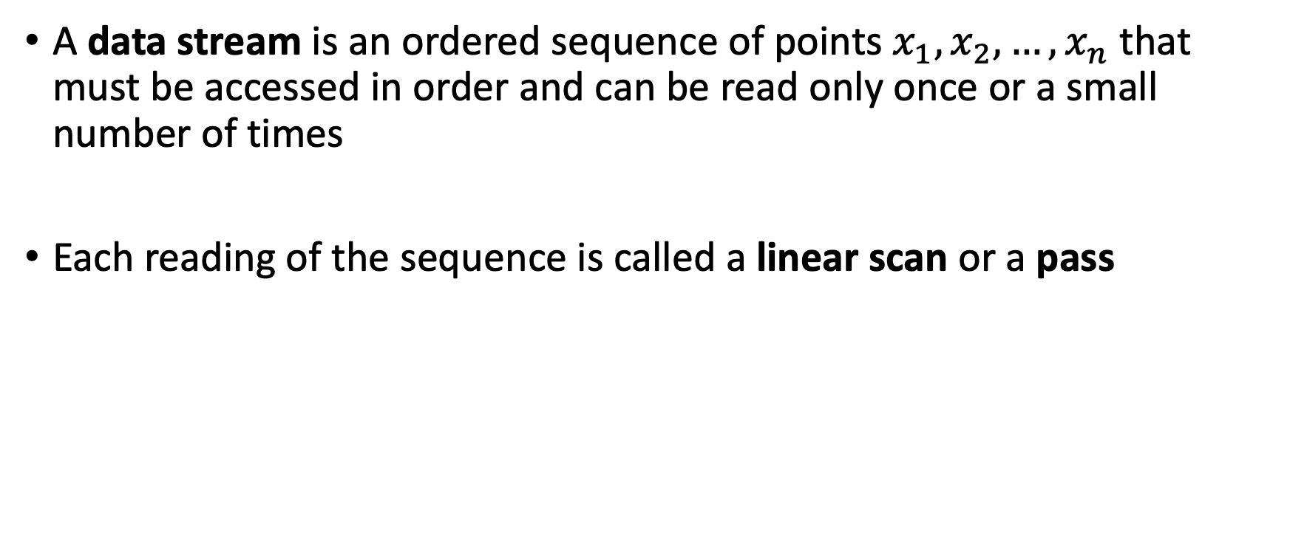
What are data streams?
A data stream is an ordered sequence of points $x_{1},x_{2},…,x_{n}$ that must be accessed in order and can be read only once or a small number of times
Each reading of the sequence is called a linear scan or a pass

Slide 3
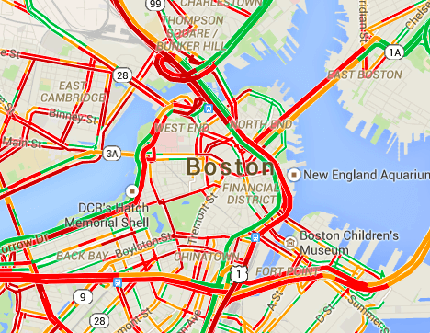
Applications of data streams
Sensor data and IoT
Telecommunication data
Social media
Marketing and e-commerce
Health care
Epidemics and disasters
Computer security
Electricity demand
Sensor data is used to predict traffic

Slide 4
What is data stream mining?
We want to build models to make predictions based on data streams
Two problems:
Data streams are large and fast
We need to extract information in real time
We need:
To accept approximate solutions
To have our model adapt to changes in the data
We want to maximize accuracy and minimize time and memory use

Slide 5
Types of algorithms in data stream mining
Supervised
Classification (e.g., label incoming mail as spam/not spam)
Regression (e.g., predict future value of stock in stock market)
Unsupervised
Clustering (e.g., obtain user profiles from website)
Frequent pattern mining (e.g., customers who buy cheese buy wine)
We are interested in applying these algorithms on “streams” (online) as opposed to “batches” (offline)

Slide 6
Data stream mining: Classification
In general, a data stream mining classifier is always ready to either
Receive unlabeled example and make prediction based on current model
Receive label for previous example and use it to train the model
Example (Customer behavior):
Predict whether a web customer will want to buy a particular product.
When the customer session ends, the classifier receives label of whether customer made a purchase.

Slide 7
Data stream mining: Classification (cont.)
Classifier evaluation by cross-validation is impractical (too much data)
Two main approaches to evaluate data stream classifiers:
Holdout
Measure performance on a single holdout partition
Only gives good estimate if holdout set is like current data (hard to guarantee)
Interleaved test-then-train or prequential
Each example is used to test and incrementally update the model
No holdout set is used, making use of all data

Slide 8
Data stream mining: Regression
Like classification but the label is a real value, not discrete
Predict the label under some measure (e.g., mean squared distance)
Example (Stock market):
Predict the value of a stock in the stock market tomorrow.

Slide 9
Data stream mining: Clustering
Useful when we have unlabeled data and want to find groups according to similarities
Streaming methods for clustering usually have two levels
Online (one pass): a set of microclusters is computed and updated from the stream
Offline (multiple pass): perform classical batch clustering such as k-means on microclusters
Example (Social networks):
Finding communities in social networks.

Slide 10
Data stream mining: Frequent pattern mining
Determines a pattern is frequent if there are a fraction of instances above a certain threshold
Frequent pattern mining on streams often use batch miners as a base and are often approximate rather than exact
Example (Supermarket purchases):
In a stream of supermarket purchases, we find that the item
{cheese, wine} is frequent since it occurs in at least 10% of purchases

Slide 11
Data stream axioms
Algorithms on data streams must work under data stream axioms
Only one pass; each stream item is observed only once
Fast enough to keep up with data stream
Sublinear memory usage with respect to length of the stream
The algorithm must provide answers at any time
Streams evolve over time

Slide 12
The sketch/summary data structure
The sketch (or summary) is a data structure with accompanying data stream mining algorithms used to store sufficient information to answer one or more predefined queries about the stream
Data stream mining algorithms often produce many sketches, so it is necessary for sketches to have low memory usage

Slide 13
Concept drift
Concept drift refers to the change in the distributions of data streams
Example (Email spam classification):
Spammers may try to trick email spam classifiers into thinking that their spam emails are not spam.
Example (Customer behavior prediction):
Customer behavior may change as prices and products change.

Slide 14
Concept drift definition
Sudden change occurs when the distribution remains unchanged for a long time and then changes significantly in a shift
Gradual or incremental change occurs when the distribution accumulates small changes over time which become significant later
Changes may be global or partial depending on whether they affect the entire item space or just part of it
Recurrent concepts occur when distributions that appeared in the past tend to reappear later

Slide 15
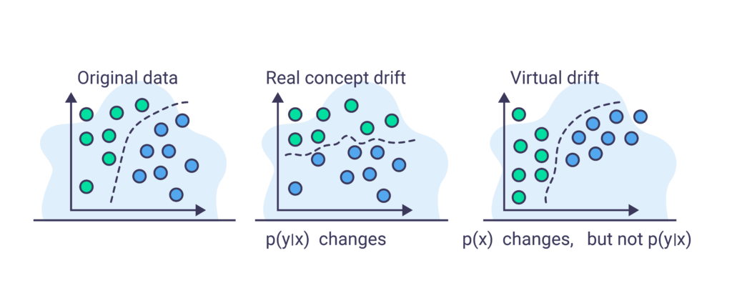
Concept drift definition (cont.)
In prediction scenarios, we predict some outcome Y of an item given the input features X observed in the item
Real change occurs when P(Y | X) changes
Virtual change occurs when P(X) changes, but P(Y | X) is unchanged

Slide 16
Implications of concept drift
We need to distinguish concept drift from outliers/noise
Data stream mining algorithms must meet the following requirements
Detect change in the stream as soon as possible
Be robust to noise and outliers
Operate in less than instance arrival time and sublinear memory

Slide 17
Estimators
An estimator algorithm estimates one or more several statistics on input data, which may change over time
Two kinds of estimators
Those that store a sample of the data stream
Memoryless estimators
Example (Linear estimator):
The linear estimator is the simplest estimator algorithm which simply returns the average of the data items stored in memory

Slide 18
Change detection
We can evaluate change detection methods with the following criteria
Mean time between false alarms
Mean time to detection
Missed detection rate
Average run length
Example (CUSUM test):
The cumulative sum (CUSUM) test is designed to raise an alarm when the mean of the input data significantly deviates from its previous value

Slide 19
Bibliography
A. Bifet, R. Gavalda, G. Holmes, and B. Pfahringer, Machine learning for data streams: With practical examples in MOA. London, England: MIT Press, 2018.
S. Guha, A. Meyerson, N. Mishra, R. Motwani, and L. O’Callaghan. Clustering Data Streams: Theory and Practice. IEEE Transactions on Knowledge and Data Engineering, 15(3):515–528, May/June 2003.

Slide 20
Homework Question
What is concept drift in data streams?
Email: tuk94307@temple.edu

