Slide 1
Werner Heisenberg
Presented by Eric Nguyen

Slide 2
Overview
Who was Werner Heisenberg?
Education
Quantum mechanics
Uncertainty principle
Nuclear fission
Matrix mechanics

Slide 3
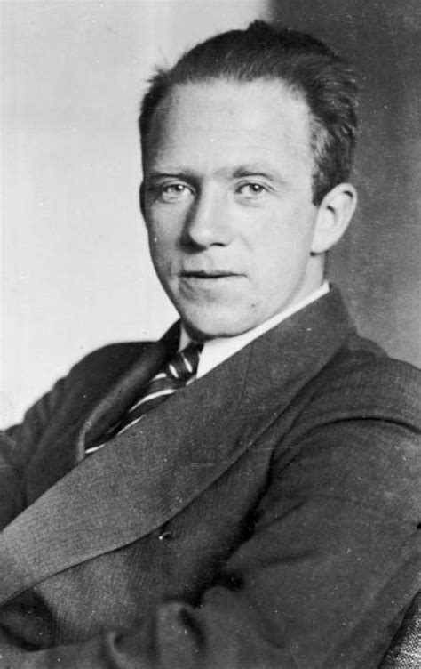
Who was Werner Heisenberg?
Born 1901 in Würzburg, Germany
German theoretical physicist
Pioneer of quantum mechanics
Nobel Prize in physics (31 years old)
Died in 1976
Notes:
Werner Heisenberg was a German theoretical physicist and one of the principal founders of modern quantum physics. He is best known for his publication of the uncertainty principle, which I will go into more detail later. He received the Nobel Prize in physics in 1932 at the age of 31, being the second youngest to receive the award in his field, for his work on the spectra of atoms and molecules. He built a foundation for problems concerning rotations of atoms and successfully predicting that hydrogen molecules would appear in two forms.

Slide 4
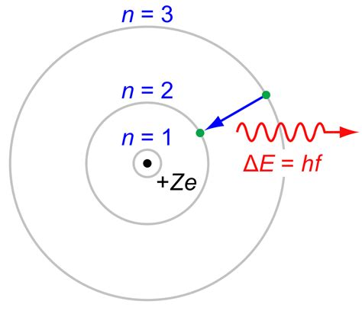
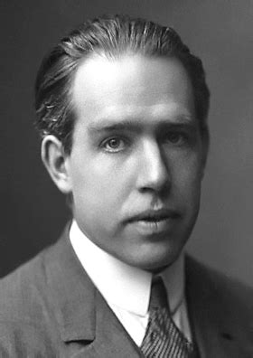
Education
Studied under Niels Bohr at Universitets Institut for Teoretisk Fysik in Copenhagen

Slide 5
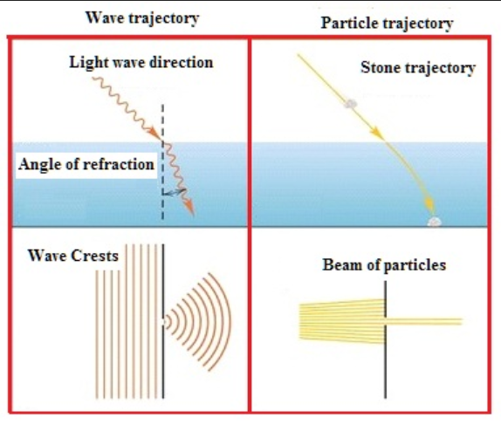
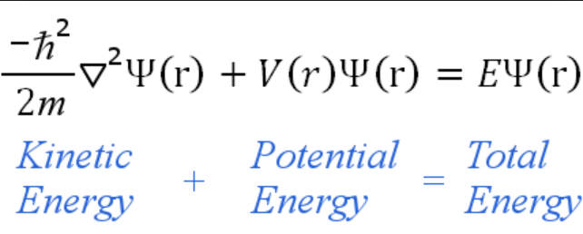
Quantum Mechanics
Schrödinger equation
Not classical mechanics
Wave-particle duality

Slide 6
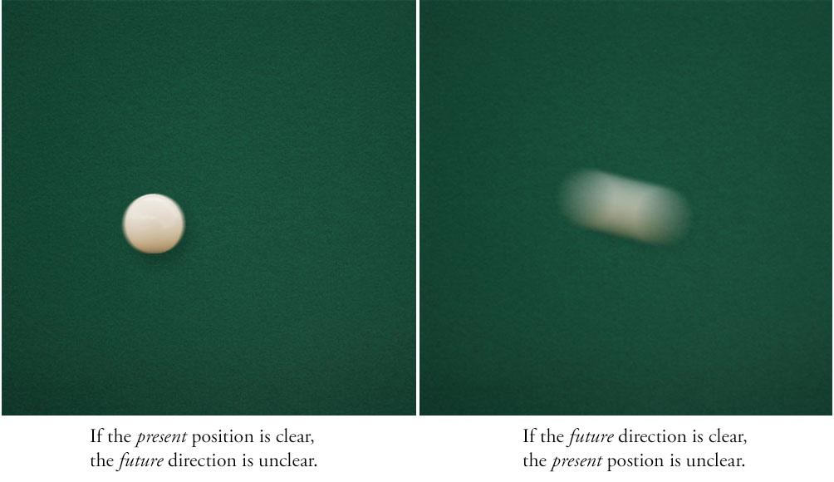
Uncertainty Principle
You cannot be certain of both the exact position and speed of a particle

Slide 7
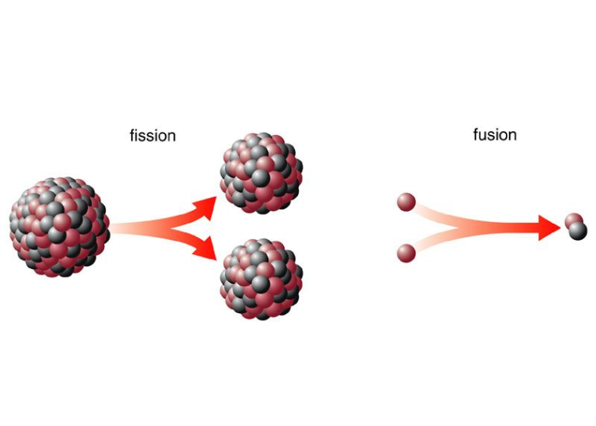
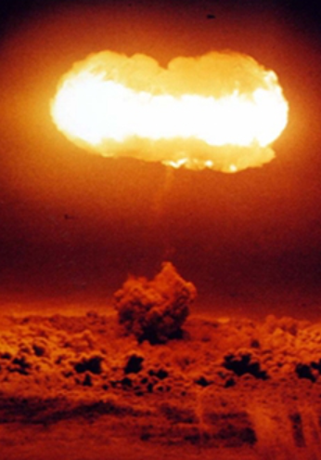
Nuclear Fission

Slide 8
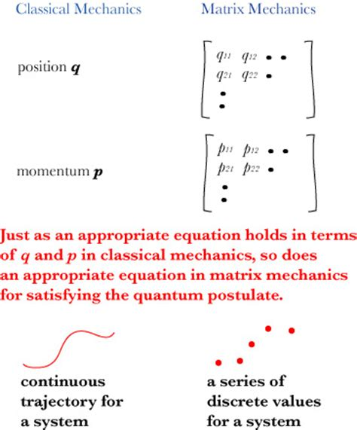
Matrix Mechanics
Alternative to Schrödinger equation

Slide 9

Quiz
Who was Werner Heisenberg?
German pioneer of quantum mechanics
What is the Heisenberg uncertainty principle?
You cannot be certain of both the exact position and speed of a particle
What is wave-particle duality?
Any particle can also behave as a wave
How is quantum mechanics different from classical mechanics?
Quantum mechanics is linear, but classical mechanics is continuous

Slide 10
Resources
http://simons.hec.utah.edu/NewUndergradBook/Chapter1.pdf
https://www.livescience.com/33816-quantum-mechanics-explanation.html
https://sciencestruck.com/basics-of-quantum-mechanics-for-dummies
http://skipper.physics.sunysb.edu/phy313/Heisenberg-jk1-september9.pdf
http://naturalthinker.net/trl/texts/Heisenberg,Werner/Heisenberg,%20Werner%20-%20Physics%20and%20philosophy.pdf
http://www.garfield.library.upenn.edu/essays/v14p186y1991.pdf
https://physics.illinois.edu/people/baym/copenhagen.pdf

