Slide 1

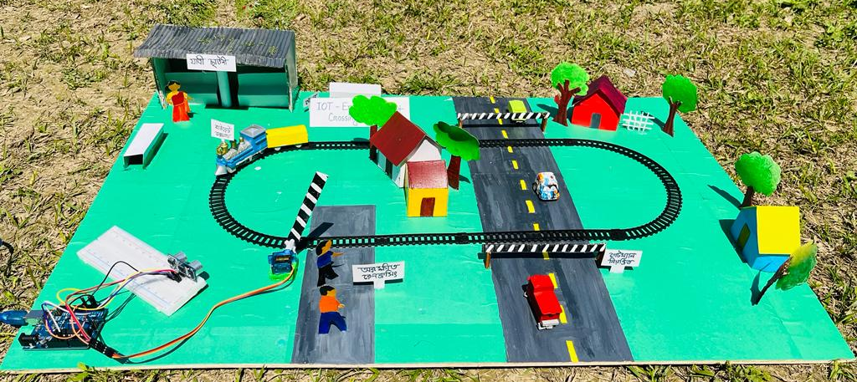
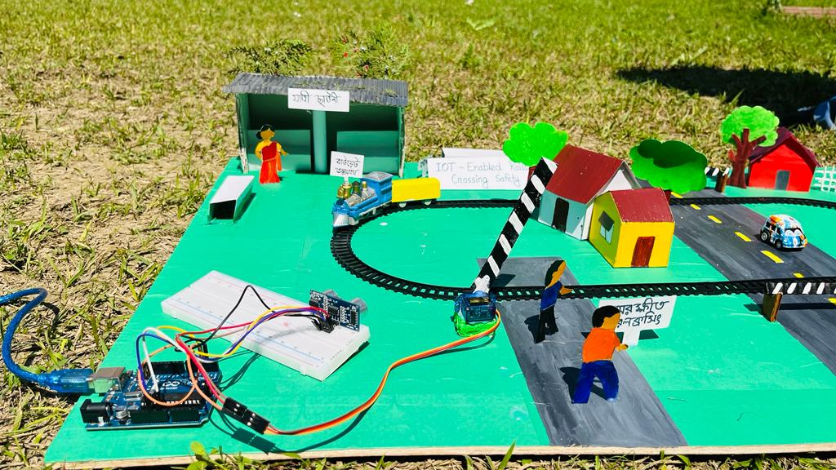
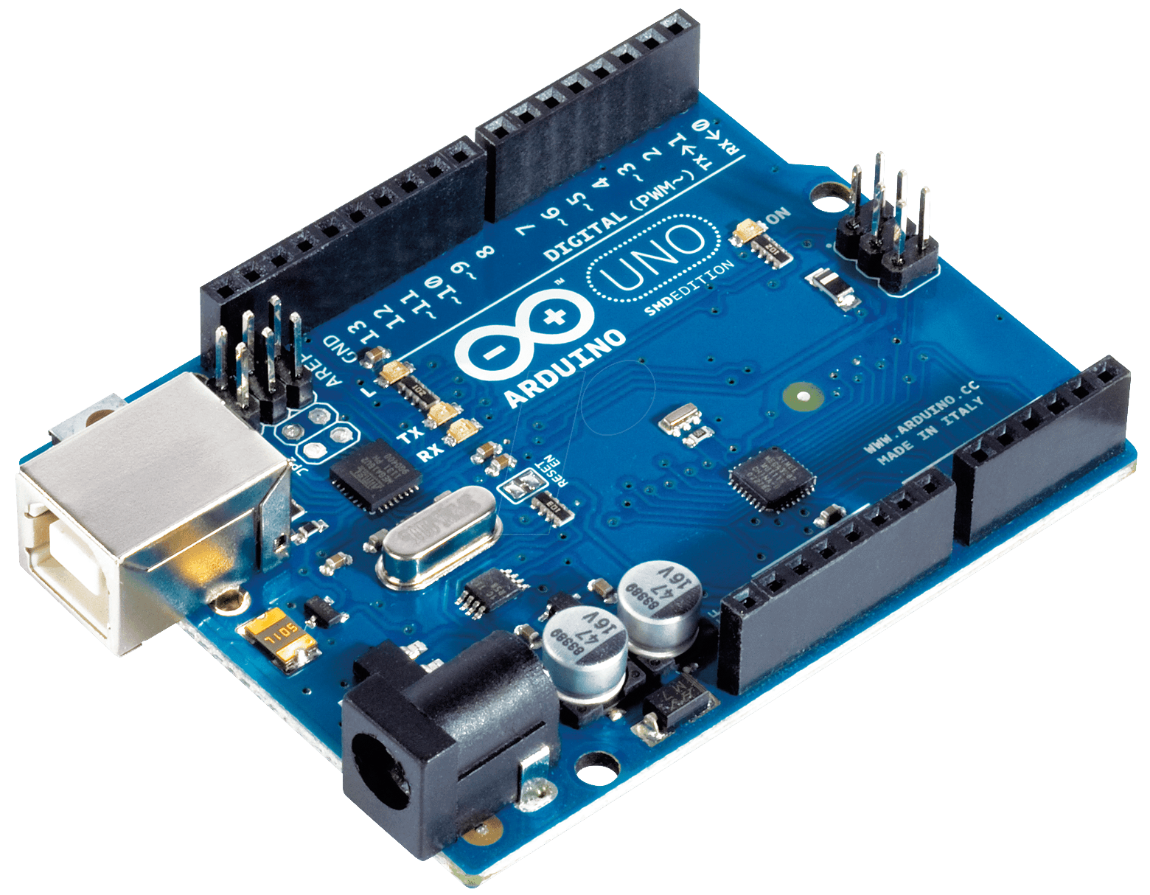
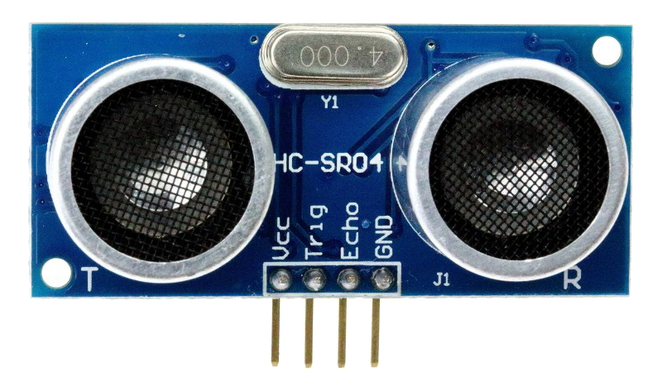
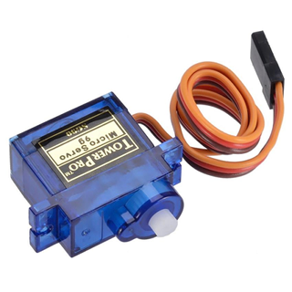
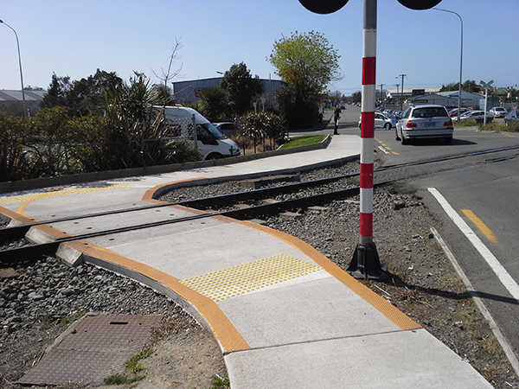

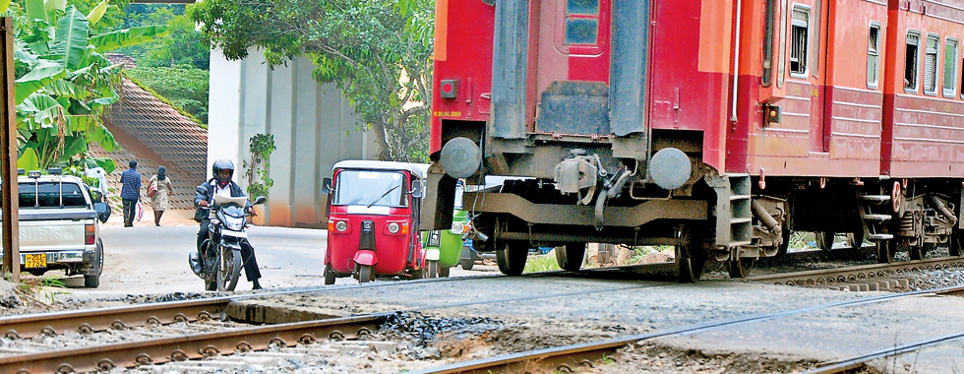
IOT Enabled Railway Crossing Safety
Presented by: Airin, Zannat, Sania, Taki, Lubna (ICE-9th)
Project Supervisor: Md. Nazmul Hussain
To solve these problems, the IOT Enabled Railway Crossing Safety System is a digital medium for avoid this unexpected amount of accident.
Feature: This system will automatically controls the crossing bar (When train arrives near the crossing the bar falls down to prevent vehicles or human and when the train leaves the bar rises).
187 people died at insecured railway crossing in 2014-2021
Eve Teasing
Cyber Bulling
Child marriage
Railway Crossing Safety system
Arduino uno
Ultrasonic sensor
Servo motor
Microcontroller Technology
Application areas (unprotected railway crossing)

