Slide 1
Progress Update 8/11/2026

Slide 2
Last week's plans
Profile the per-exit inference cost of a single model on both the training device and the target edge device. Then, estimate the translation gap between the two device profiles for hw.
Smaller subtasks:
  Train and Run the models on a100 (Done )
  Run the models on JetsonOrin (Done but the LLama Model)
Drive link : intip.in/DriveEarlyExit
Hassan Khoury ©

Slide 3
What has been done
Run the models on A100 for benchmarking and using Lens Probing
For Training i implement 3 methods
  Lora Cascading (SEGD)
  Lora Pairwise Training (our method)
  Benchmarking on Jetson and A100
  Translation Table
The Result of this experiment is on
http://intip.in/DriveEarlyExit under Artifact folder
The hardware used in this experiment is an NVIDIA GeForce A100
Hassan Khoury ©

Slide 4




Result of Training of the model using 4 generalizable methods
Protocol:
SeGD LoRaExit (Liu, 2024):
  We put a fresh head on each layer , we freeze the weights
  Train deepest exit first on labels quality loss, then walk downward each shallow exit learns from the exit immediately above it
  For each stages it the loss is the KL-divergence of logits + quality loss on labels
Pairwise LoRaExit:
  The sameway for SeGD but we use The deepest layer as a teacher and add feature hint loss.
Hassan Khoury ©

Slide 5
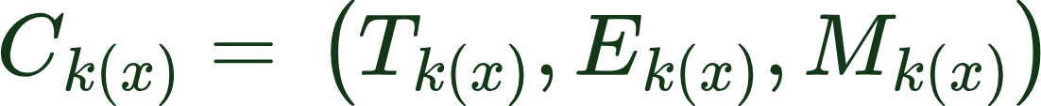
Result of Inference Hardware and quality profile of Early Exit BERT
Protocol:
we apply all of the early exit after the transformer every blocks (11)
We use the simplest method that is using Lens only early exit (No training only Applying exit head on the exit by copying the trained FC to the early exit head)
We measure Hardware Energy Profile, Energy and Memory profile
The model we ran are (LlaMa 3.2 1B, Bert-Large, Yolo v9-Gelan M, Google ViT )
All results are reported as the mean of all of the samples across different tasks
Hassan Khoury ©

Slide 6
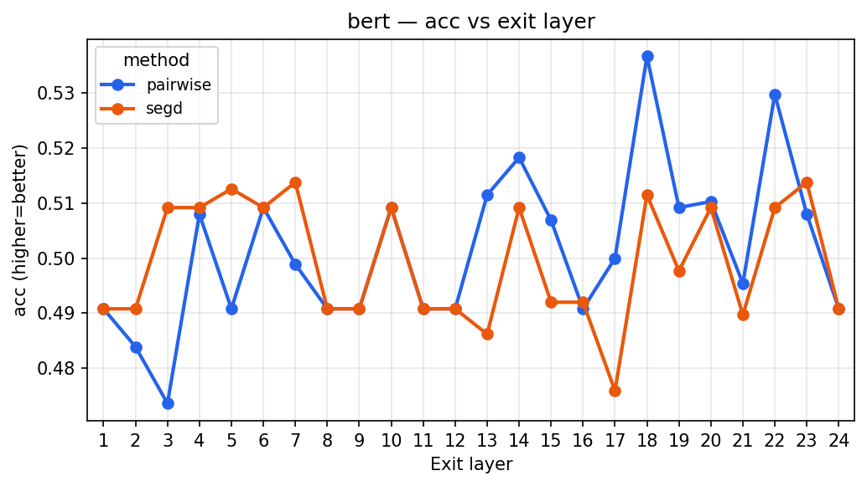
A100 Result of Lens probing- BERT Averaged over 7 data (Quality ACC)
Hassan Khoury ©

Slide 7
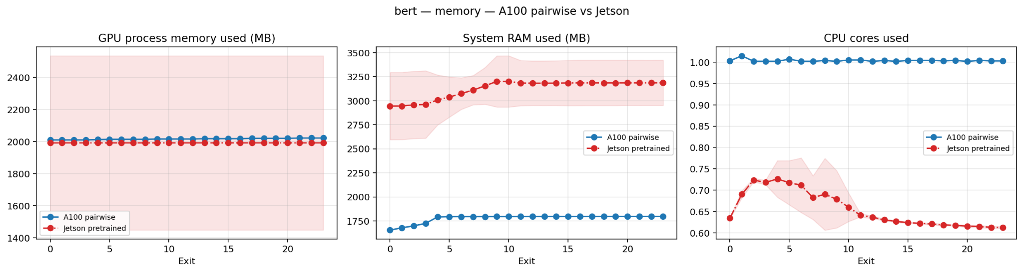
A100 Result BERT Averaged over 7 data (Hardware profile) vs Jetson
Hassan Khoury ©

Slide 8
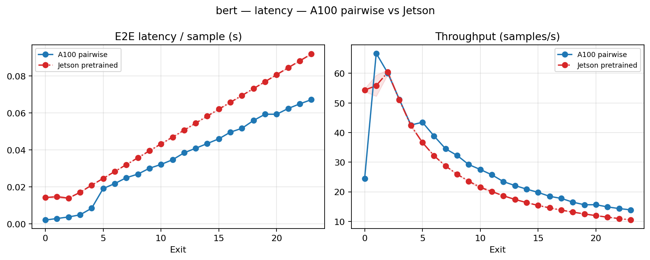
A100 Result BERT Averaged over 7 data (Latency)
Hassan Khoury ©

Slide 9
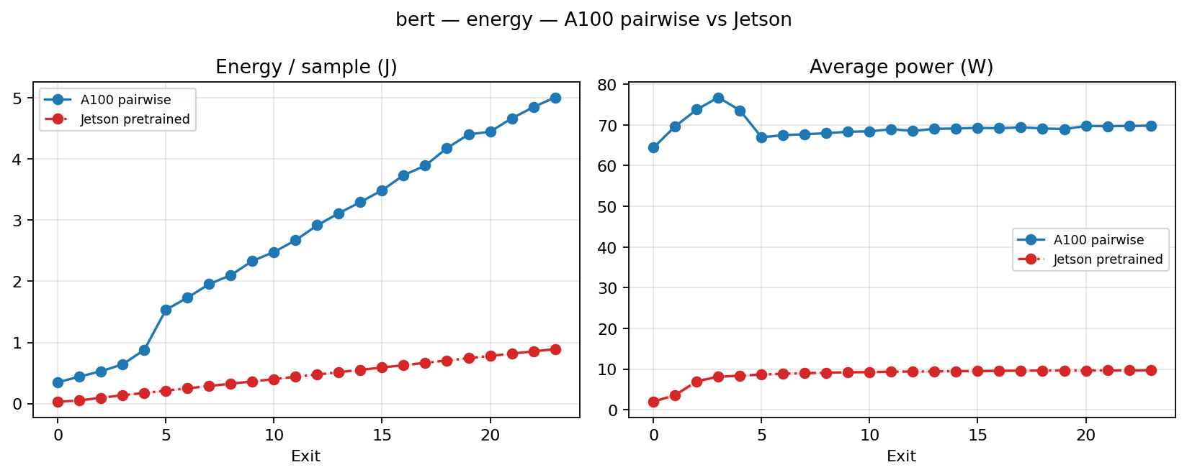
A100 Result BERT Averaged over 7 data (Energy Cost)
Hassan Khoury ©

Slide 10
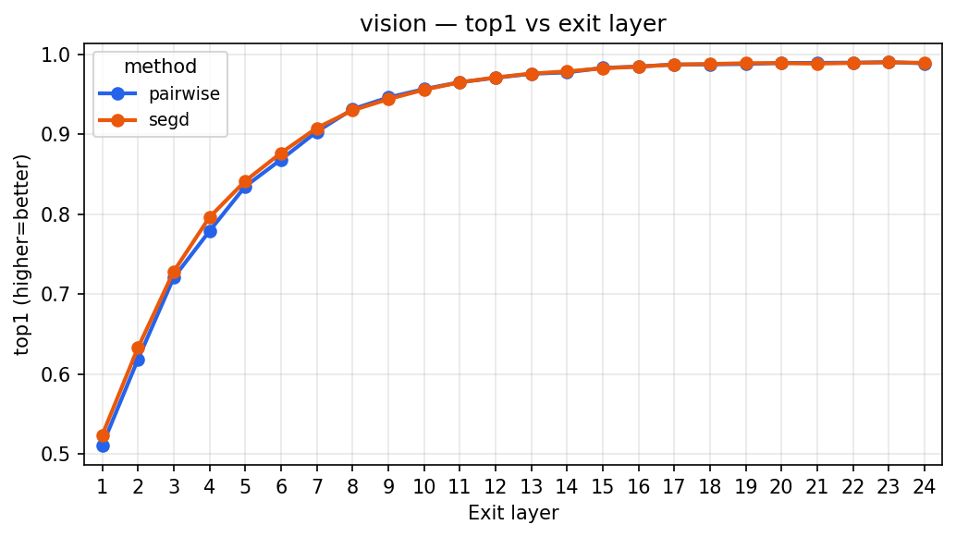
A100 Result ViT Averaged over 7 data (Quality)
Hassan Khoury ©

Slide 11
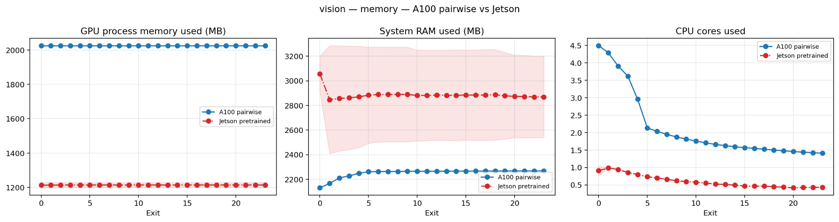
A100 Result ViT Averaged over 7 data (Hardware profile)
Hassan Khoury ©

Slide 12
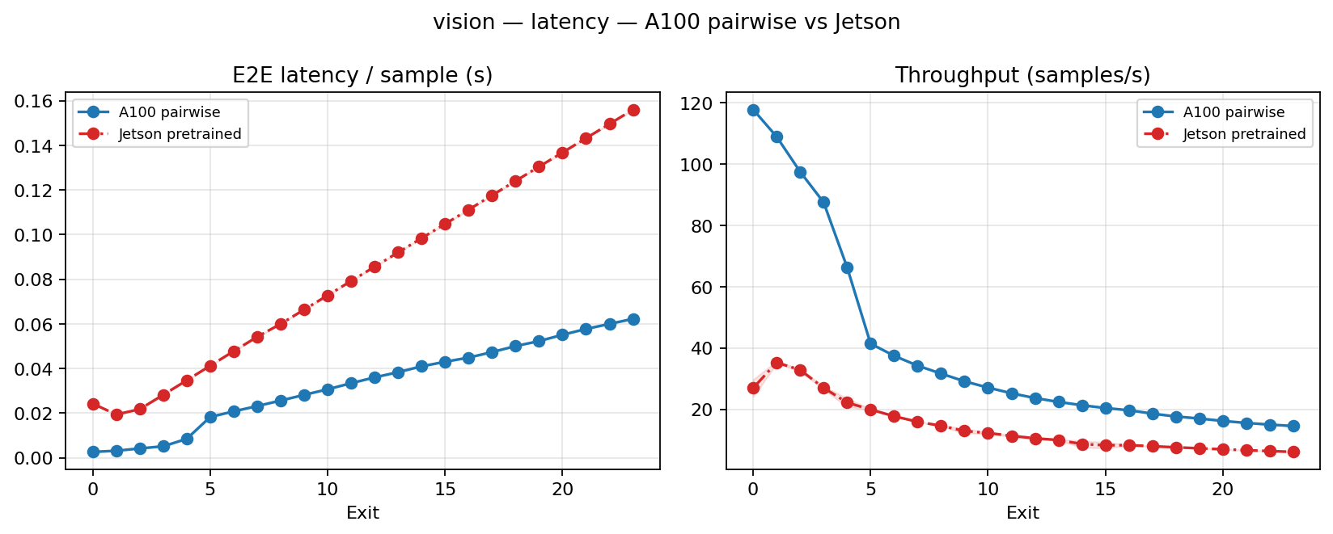
A100 Result ViT Averaged over 7 data (Latency)
Hassan Khoury ©

Slide 13
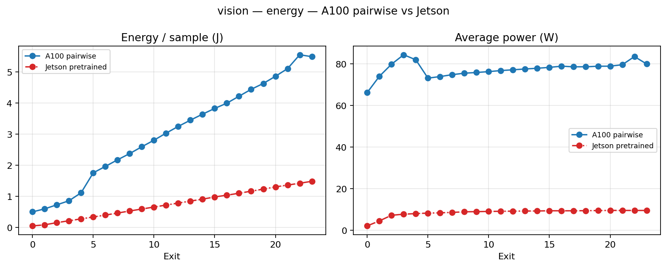
A100 ResultViT Averaged over 7 data (Energy Cost)
Hassan Khoury ©

Slide 14
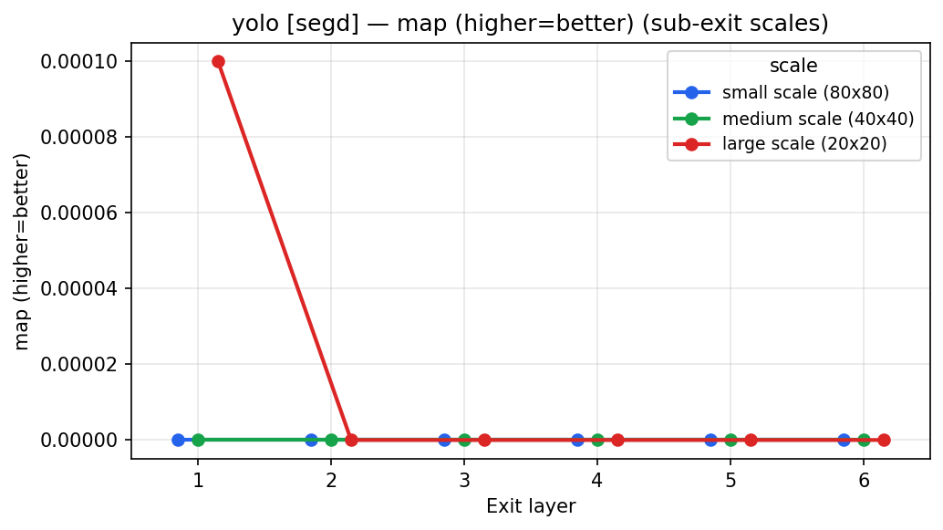
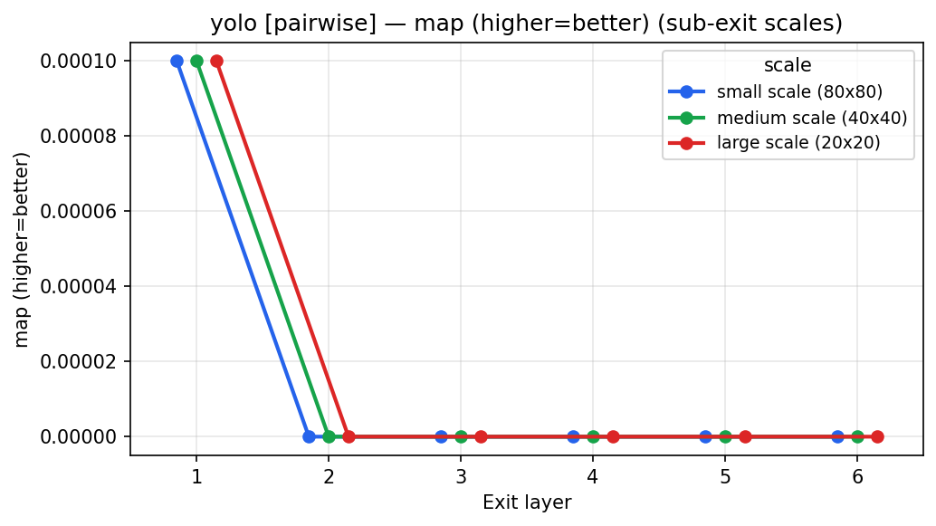
A100 Result of Lens probing- YoloV9 Gelan Averaged over 1 data (Quality)
Hassan Khoury ©

Slide 15
A100 Result YoloV9 Gelan Averaged over 1 data (Hardware profile)
Hassan Khoury ©

Slide 16
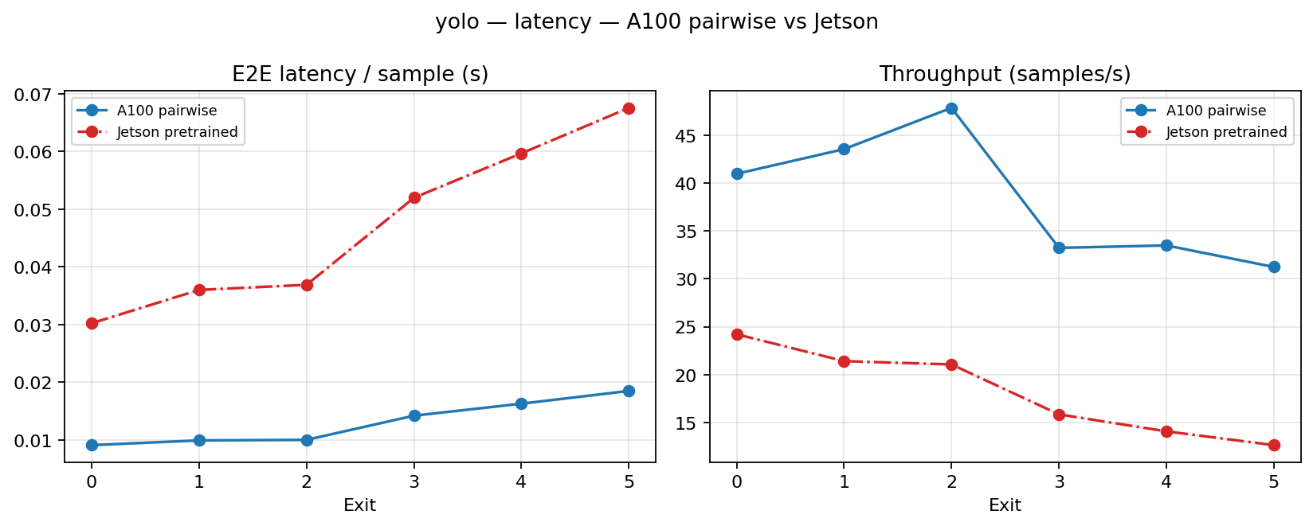
A100 Result YoloV9 Gelan Averaged over 1 data (Latency)
Hassan Khoury ©

Slide 17
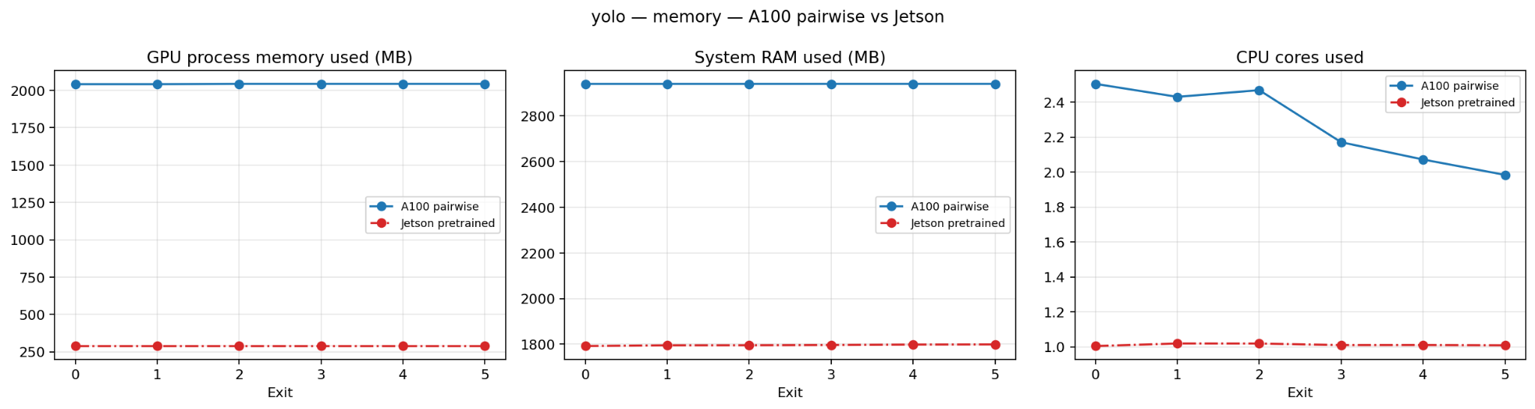
A100 Result of Lens probing- YoloV9 Gelan Averaged over 1 data (Energy Cost)
Hassan Khoury ©

Slide 18
Conclusion
Jetson Profile have a lower usage on hardware computation but follows overall thalmo0st similar trends
Our method have better quality in deper layer but not in shallower layer
Hassan Khoury ©

Slide 19
Obstacle
Hassan Khoury ©

Slide 20
What will be done next week
Continue training for the 3 methods
  Joint Training
  Lora Cascade Adaptation
  Lora Pairwise training
Also continue running Hardware Benchmarking on Jetson orin
Re run Yolo because of the bugs
Try to start to apply Quantization to the early exitted model that have been trained.
Create a hardware translation table on memory, energy, latency
Hassan Khoury ©
Notes:
Terus sampaikan di meeting kalau Kita aim untuk submit ke Asplos, deadline Augustus.

Slide 21
Bibliography
Zhang, L., Song, J., Gao, A., Chen, J., Bao, C. and Ma, K., 2019. Be your own teacher: Improve the performance of convolutional neural networks via self distillation. In Proceedings of the IEEE/CVF international conference on computer vision (pp. 3713-3722).
Liu, J., Tang, P., Hou, X., Li, C. and Heng, P.A., 2024, November. LoRAExit: empowering dynamic modulation of llms in resource-limited settings using low-rank adapters. In Findings of the Association for Computational Linguistics: EMNLP 2024 (pp. 9211-9225).
Hassan Khoury ©
Notes:
Terus sampaikan di meeting kalau Kita aim untuk submit ke Asplos, deadline Augustus.

