Slide 1
Progress Update 8/11/2026

Slide 2
Last week's plans
Profile the per-exit inference cost of a single model on both the training device and the target edge device. Then, estimate the translation gap between the two device profiles for hw.
Smaller subtasks:
  Train and Run the models on a100 (Done )
  Run the models on JetsonOrin (Done, all 4 models incl. Llama)
Drive link : intip.in/DriveEarlyExit
Hassan Khoury ©

Slide 3
What has been done
Run the models on A100 for benchmarking and using Lens Probing
For Training i implement 3 methods
  Lora Cascading (SEGD)
  Lora Pairwise Training (our method)
  Benchmarking on Jetson and A100
  Translation Table
The Result of this experiment is on
http://intip.in/DriveEarlyExit under Artifact folder
The hardware used in this experiment is an NVIDIA GeForce A100
Hassan Khoury ©

Slide 4




Result of Training of the model using 4 generalizable methods
Protocol:
SeGD LoRaExit (Liu, 2024):
  We put a fresh head on each layer , we freeze the weights
  Train deepest exit first on labels quality loss, then walk downward each shallow exit learns from the exit immediately above it
  For each stages it the loss is the KL-divergence of logits + quality loss on labels
Pairwise LoRaExit:
  The sameway for SeGD but we use The deepest layer as a teacher and add feature hint loss.
Hassan Khoury ©

Slide 5
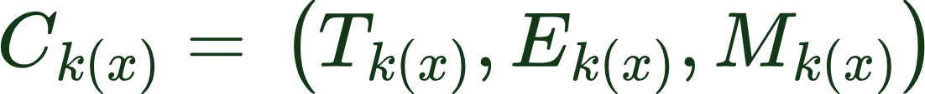
Result of Inference Hardware and quality profile of Early Exit BERT
Protocol:
we apply all of the early exit after the transformer every blocks (11)
We use the simplest method that is using Lens only early exit (No training only Applying exit head on the exit by copying the trained FC to the early exit head)
We measure Hardware Energy Profile, Energy and Memory profile
The model we ran are (LlaMa 3.2 1B, Bert-Large, Yolo v9-Gelan M, Google ViT )
All results are reported as the mean of all of the samples across different tasks
Hassan Khoury ©

Slide 6
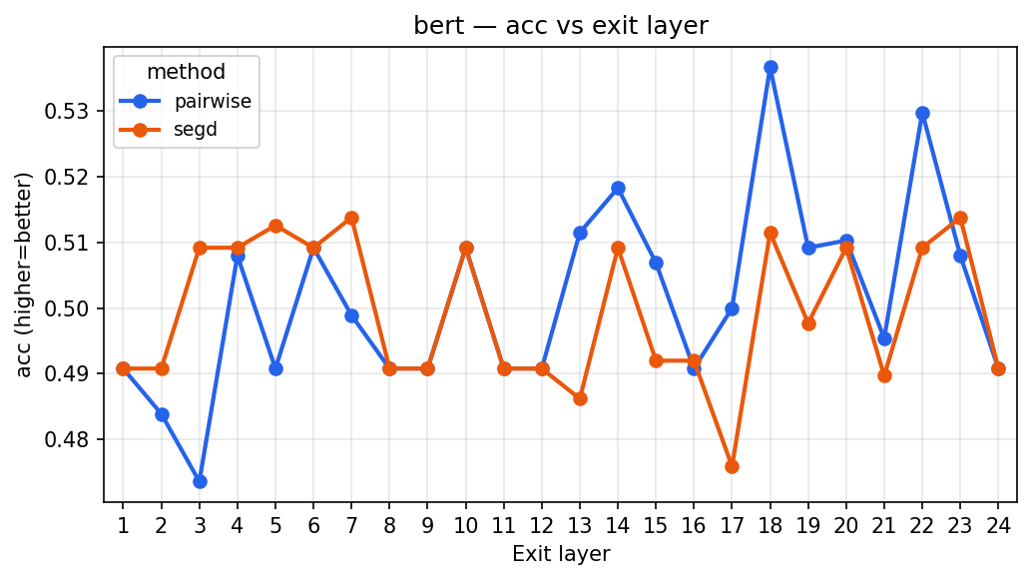
A100 Result of Lens probing- BERT Averaged over 7 data (Quality ACC)
Hassan Khoury ©

Slide 7
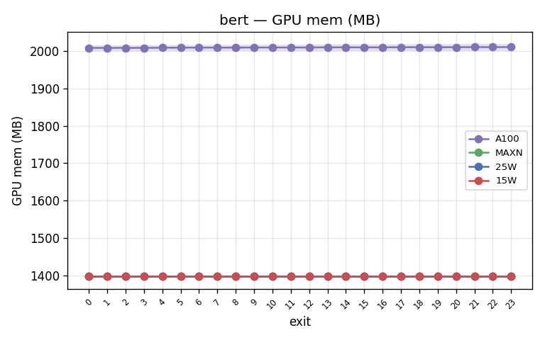
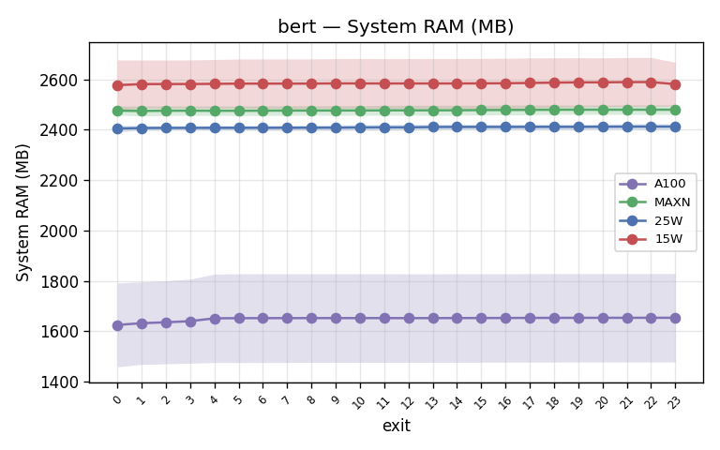
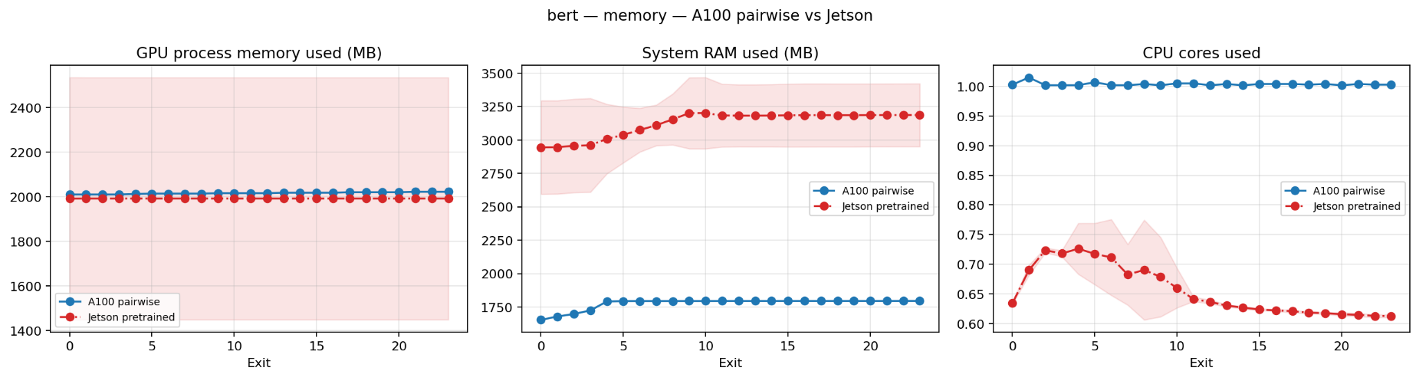
BERT - Memory: GPU mem + System RAM (A100 vs Jetson MAXN/25W/15W)
Hassan Khoury ©

Slide 8
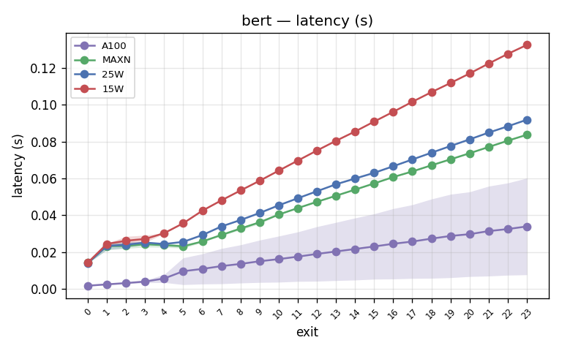
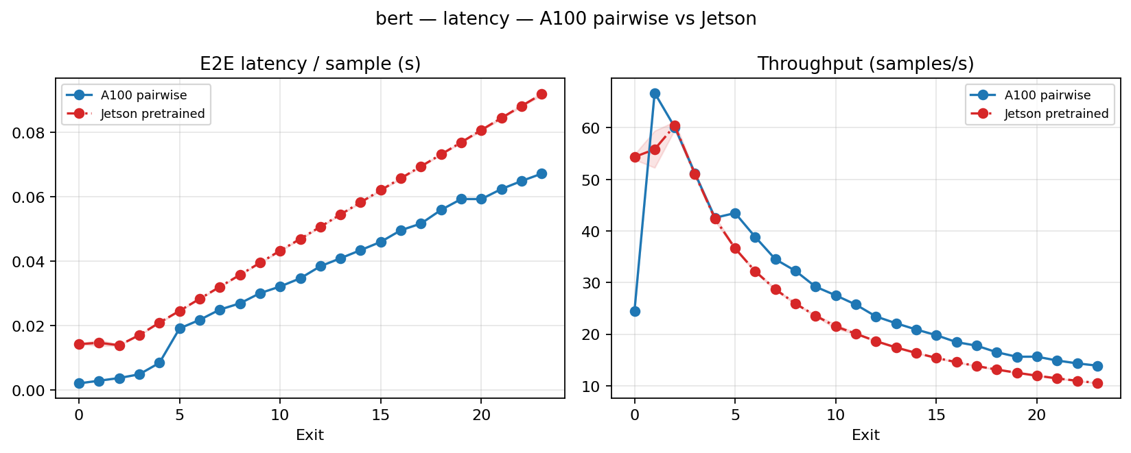
BERT - Latency (A100 vs Jetson MAXN / 25W / 15W)
Hassan Khoury ©

Slide 9
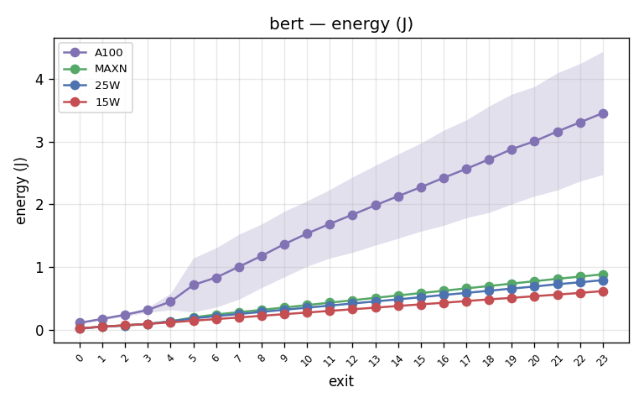
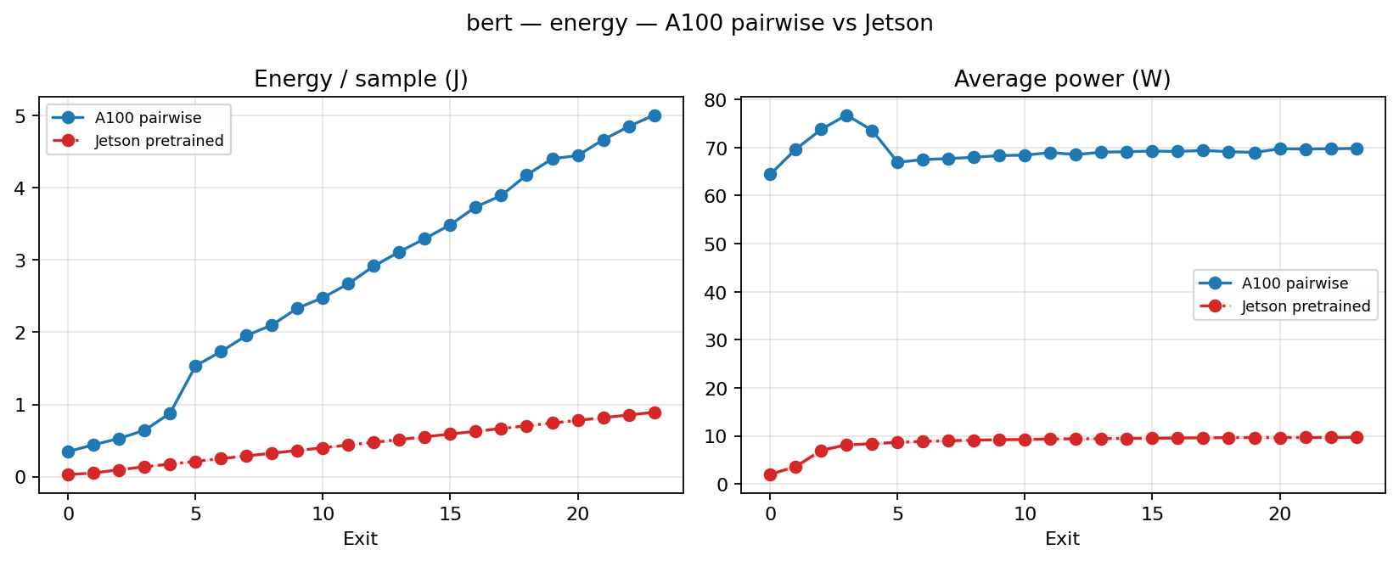
BERT - Energy (A100 vs Jetson MAXN / 25W / 15W)
Hassan Khoury ©

Slide 10
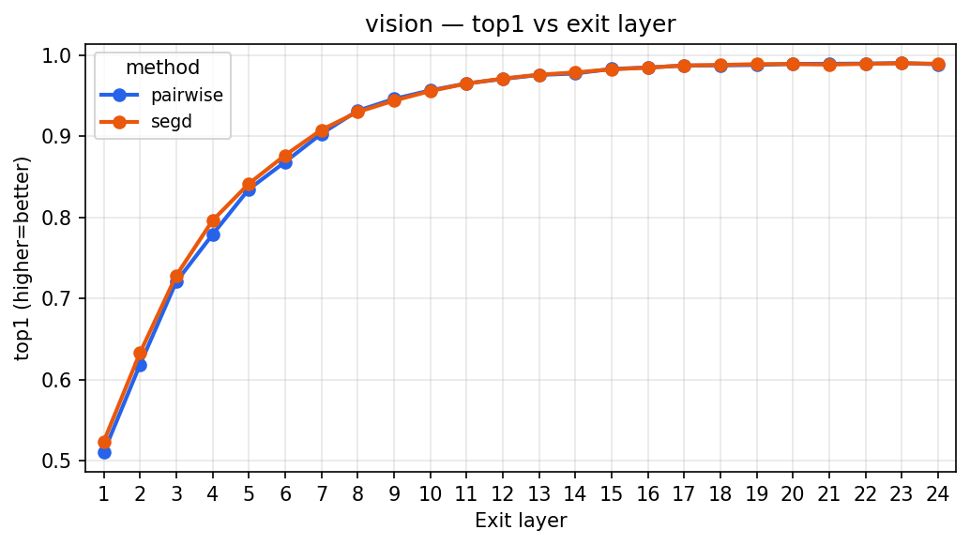
A100 Result ViT Averaged over 7 data (Quality)
Hassan Khoury ©

Slide 11
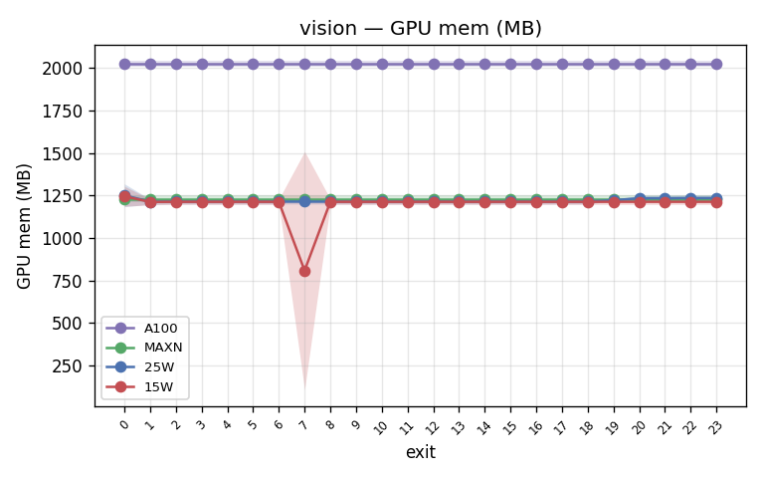
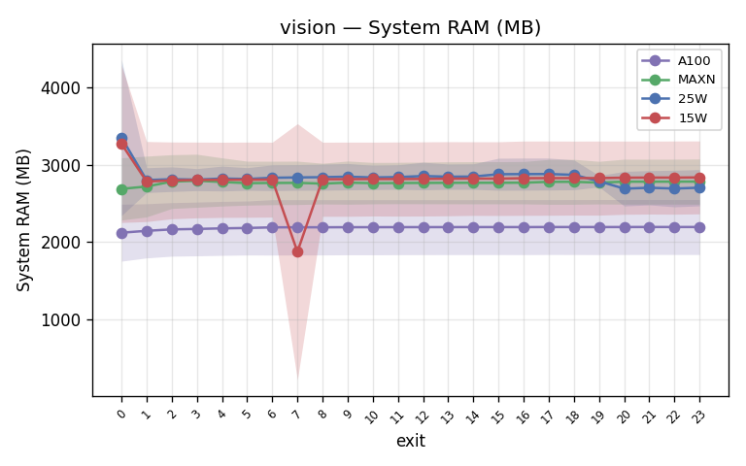
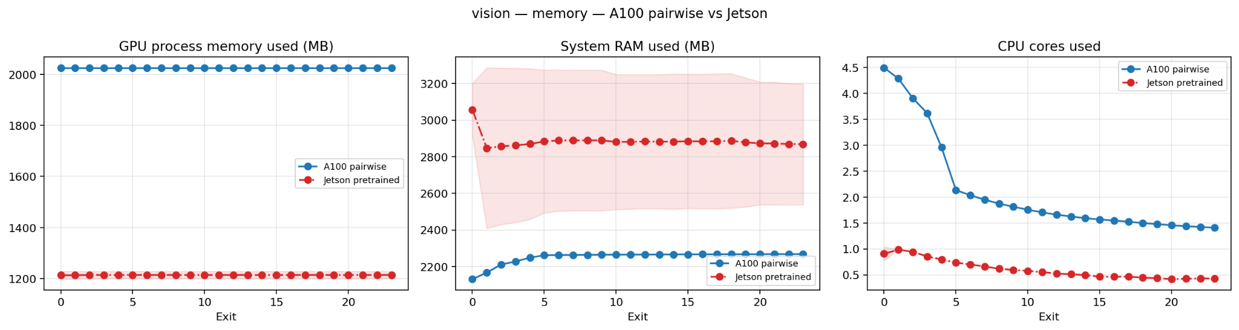
ViT - Memory: GPU mem + System RAM (A100 vs Jetson MAXN/25W/15W)
Hassan Khoury ©

Slide 12
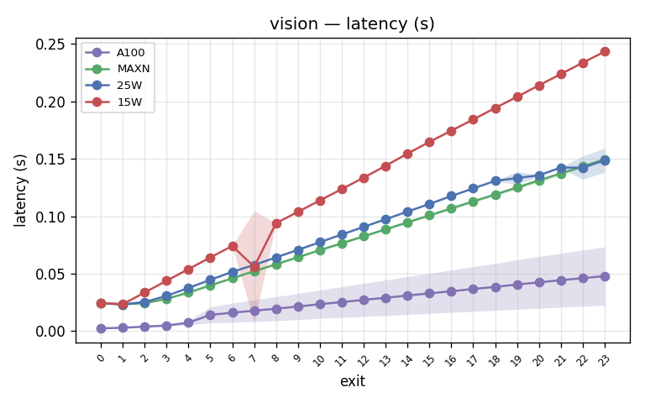
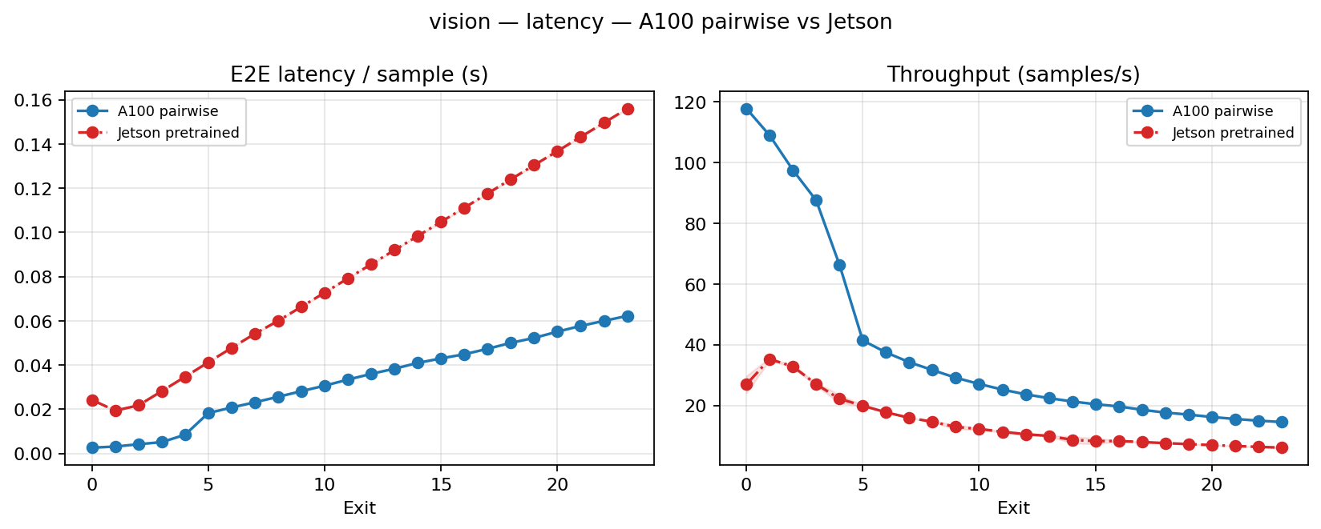
ViT - Latency (A100 vs Jetson MAXN / 25W / 15W)
Hassan Khoury ©

Slide 13
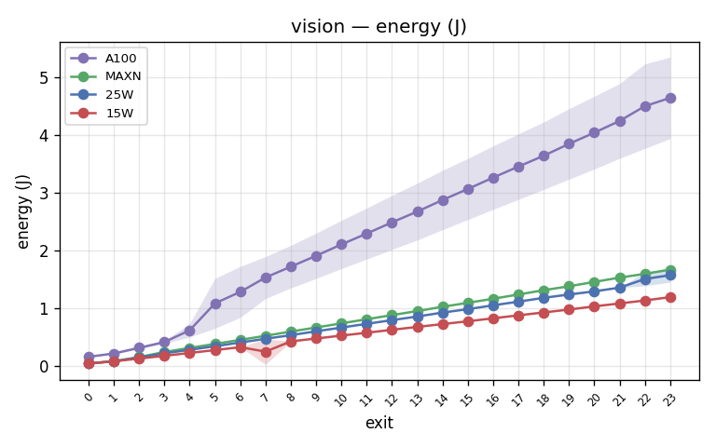
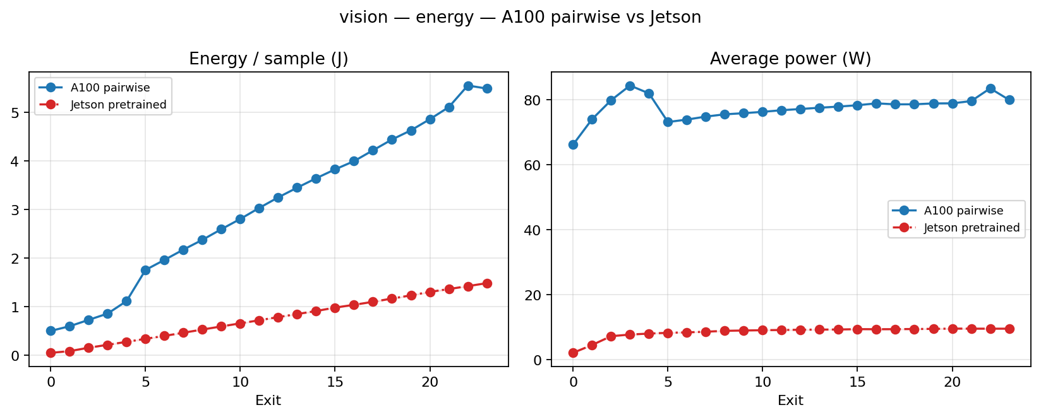
ViT - Energy (A100 vs Jetson MAXN / 25W / 15W)
Hassan Khoury ©

Slide 14
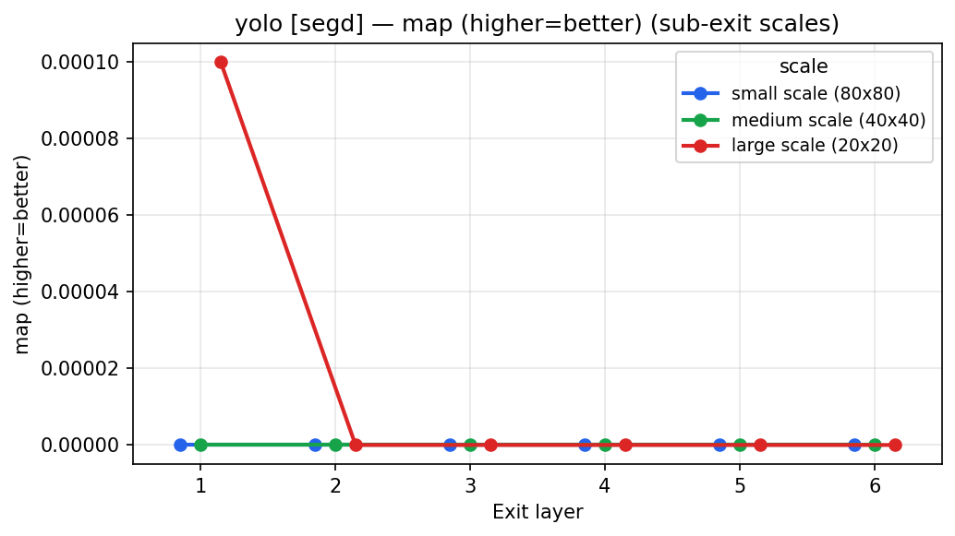
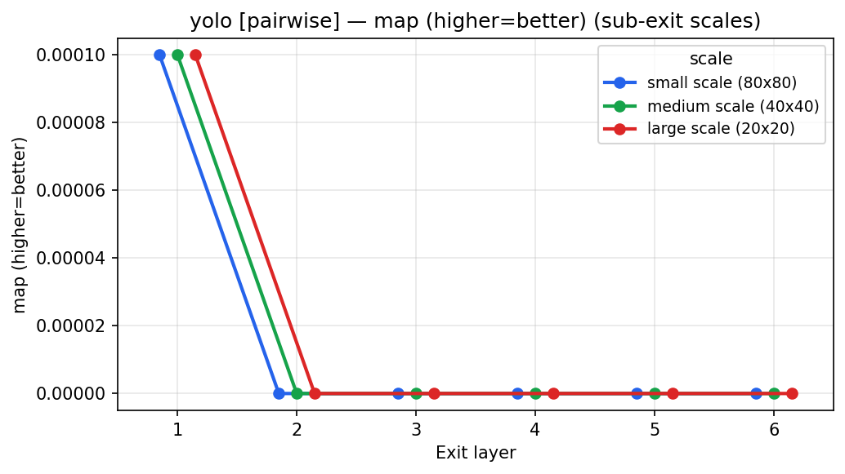
A100 Result of Lens probing- YoloV9 Gelan Averaged over 1 data (Quality)
Hassan Khoury ©

Slide 15
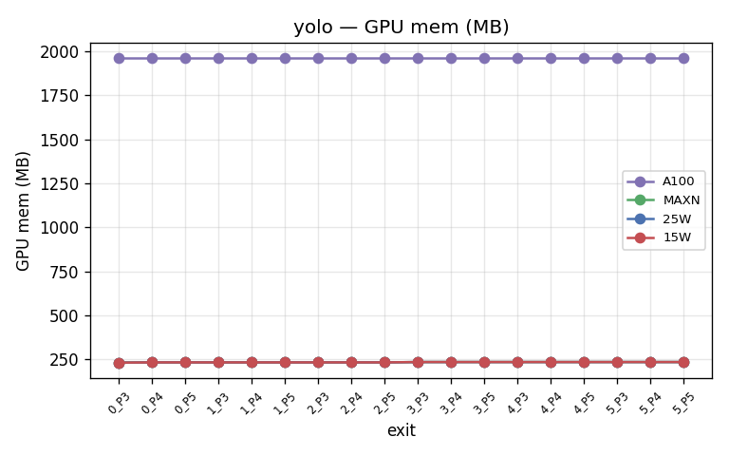
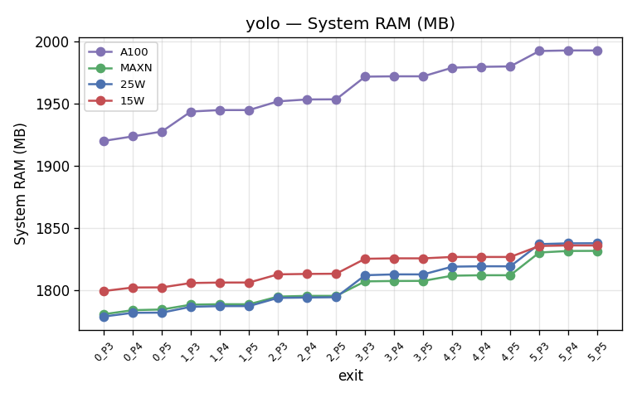
YOLOv9 - Memory: GPU mem + System RAM (A100 vs Jetson MAXN/25W/15W)
Hassan Khoury ©

Slide 16
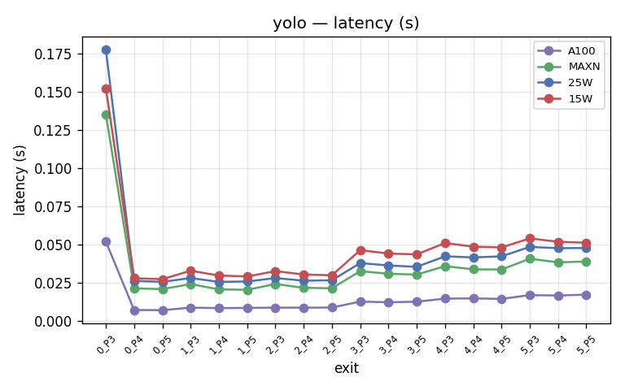
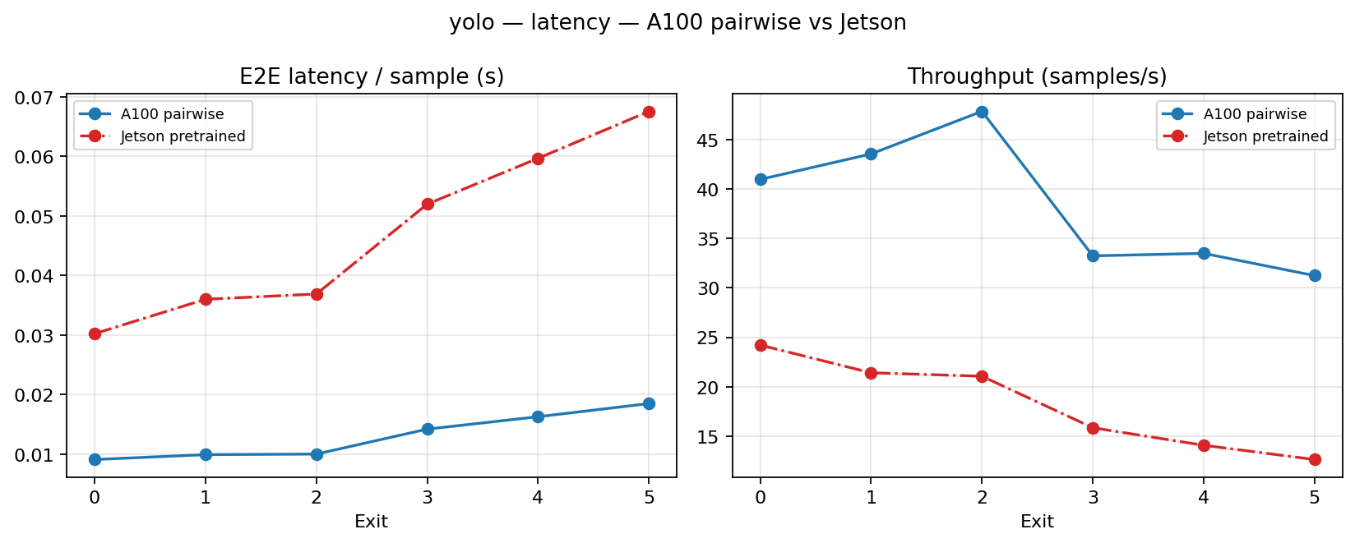
YOLOv9 - Latency (A100 vs Jetson MAXN / 25W / 15W)
Hassan Khoury ©

Slide 17
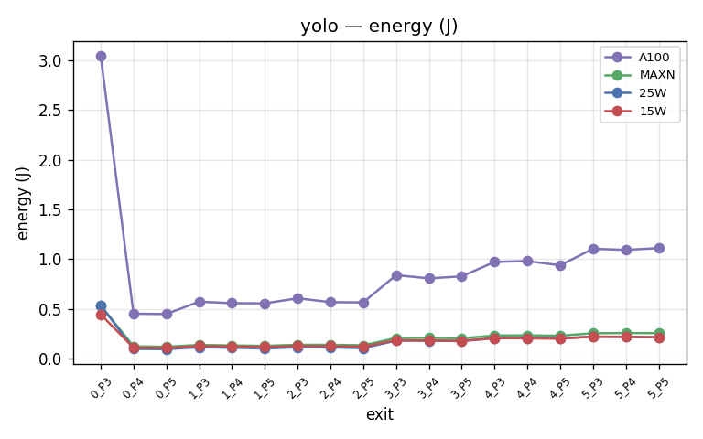
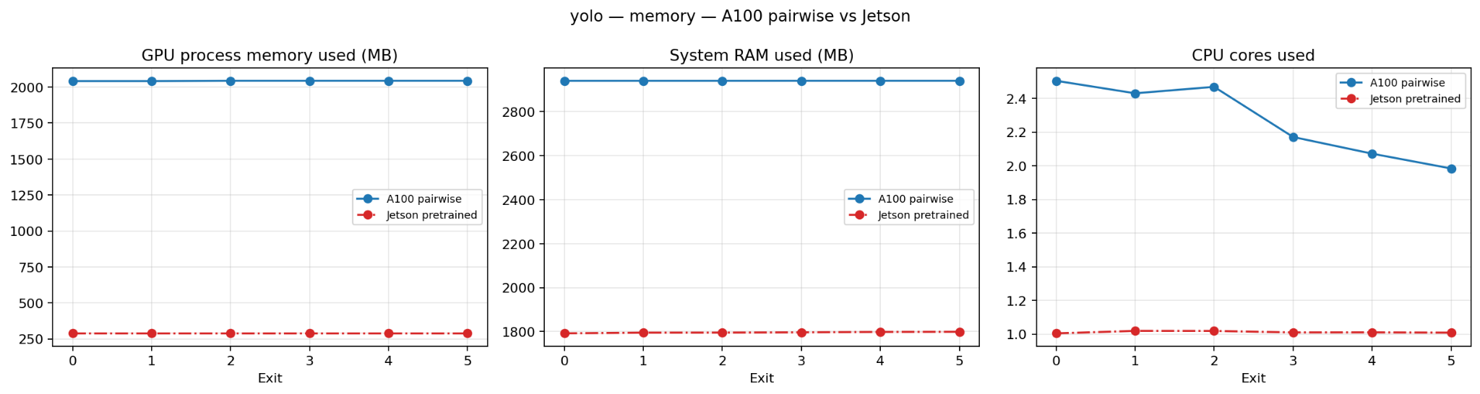
YOLOv9 - Energy (A100 vs Jetson MAXN / 25W / 15W)
Hassan Khoury ©

Slide 18
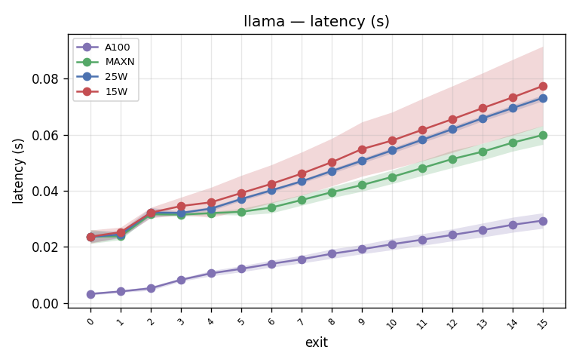
Llama-3.2-1B - Latency (A100 vs Jetson MAXN / 25W / 15W)

Slide 19
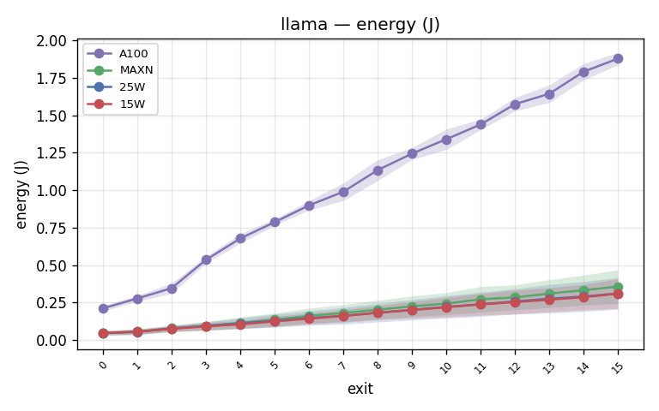
Llama-3.2-1B - Energy (A100 vs Jetson MAXN / 25W / 15W)

Slide 20
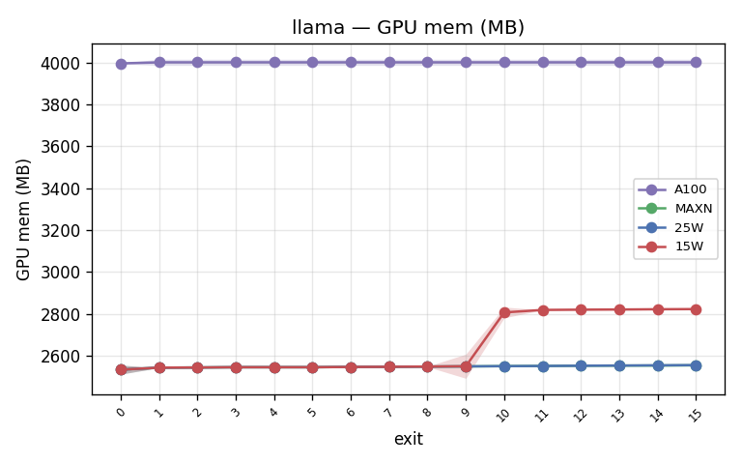
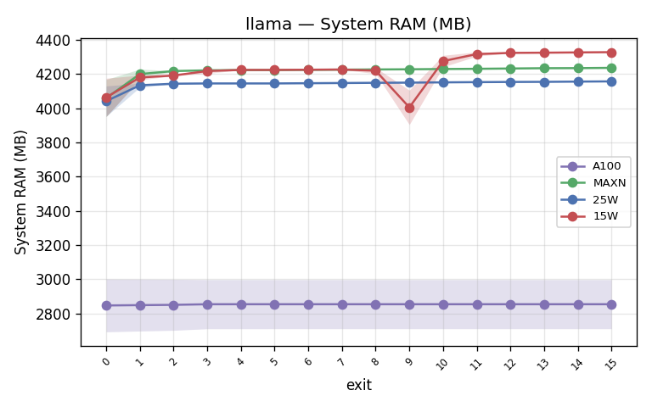
Llama-3.2-1B - Memory: GPU mem + System RAM (A100 vs Jetson MAXN/25W/15W)

Slide 21
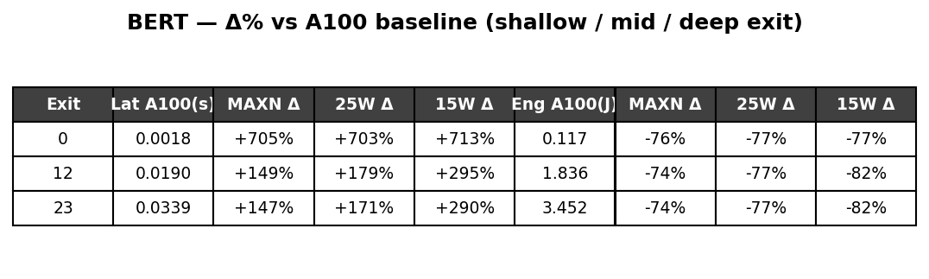
Cross-device summary - BERT (Δ% vs A100 baseline)

Slide 22
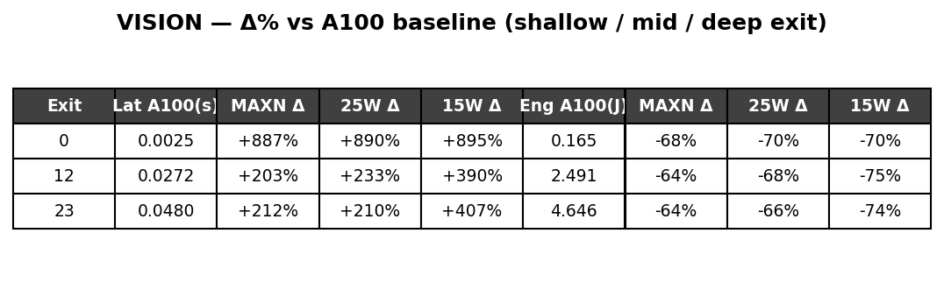
Cross-device summary - ViT (Δ% vs A100 baseline)

Slide 23
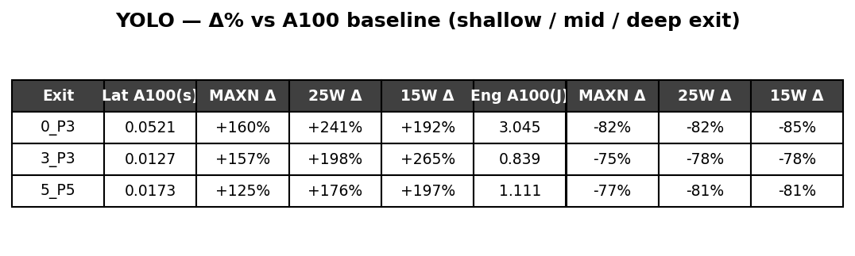
Cross-device summary - YOLOv9 (Δ% vs A100 baseline)

Slide 24
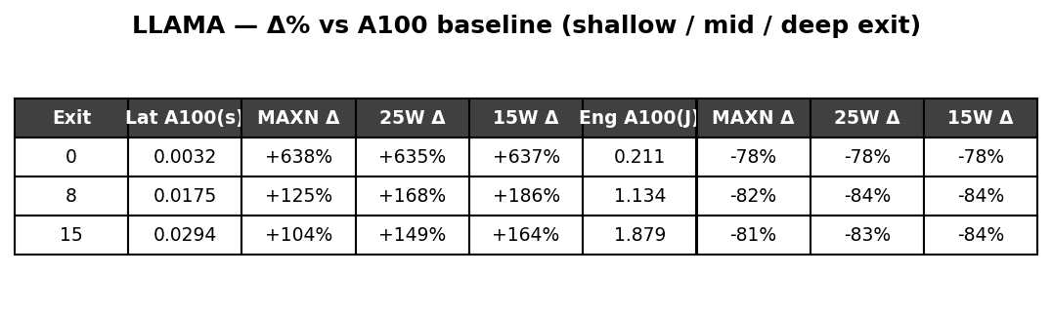
Cross-device summary - Llama-3.2-1B (Δ% vs A100 baseline)

Slide 25
Conclusion
Profiled per-exit inference cost of 4 early-exit models (BERT, ViT, YOLOv9, Llama-3.2-1B) across 4 operating points: A100 and Jetson Orin Nano at MAXN, 25W and 15W.
Jetson draws far less power and energy than the A100 (energy per sample 74 to 82 percent lower) but runs slower.
The latency gap is largest at shallow exits (about 8x) and narrows with depth (about 2.5x at the deepest exit).
Cross-task variance grows with depth on the A100 and stays tight on the Jetson.
GPU allocated memory is constant across power modes; system RAM is higher on the Jetson due to unified memory.
Power mode (MAXN / 25W / 15W) mainly shifts power and peak throughput; the 15W cap roughly halves attainable power.
Hassan Khoury ©

Slide 26
Obstacle
Hassan Khoury ©

Slide 27
What will be done next week
Continue training for the 3 methods
  Joint Training
  Lora Cascade Adaptation
  Lora Pairwise training
Also continue running Hardware Benchmarking on Jetson orin
Re run Yolo because of the bugs
Try to start to apply Quantization to the early exitted model that have been trained.
Create a hardware translation table on memory, energy, latency
Hassan Khoury ©
Notes:
Terus sampaikan di meeting kalau Kita aim untuk submit ke Asplos, deadline Augustus.

Slide 28
Bibliography
Zhang, L., Song, J., Gao, A., Chen, J., Bao, C. and Ma, K., 2019. Be your own teacher: Improve the performance of convolutional neural networks via self distillation. In Proceedings of the IEEE/CVF international conference on computer vision (pp. 3713-3722).
Liu, J., Tang, P., Hou, X., Li, C. and Heng, P.A., 2024, November. LoRAExit: empowering dynamic modulation of llms in resource-limited settings using low-rank adapters. In Findings of the Association for Computational Linguistics: EMNLP 2024 (pp. 9211-9225).
Hassan Khoury ©
Notes:
Terus sampaikan di meeting kalau Kita aim untuk submit ke Asplos, deadline Augustus.

