Slide 1
Progress Update 8/11/2026

Slide 2
Last week's plans
Profile the per-exit inference cost of a single model on both the training device and the target edge device. Then, estimate the translation gap between the two device profiles for hw.
Smaller subtasks:
  Train and Run the models on a100 (Done )
  Run the models on JetsonOrin (Done, all 4 models incl. Llama)
Drive link : intip.in/DriveEarlyExit
Hassan Khoury ©

Slide 3
What has been done
Run the models on A100 for benchmarking and using Lens Probing
For Training i implement 3 methods
  Lora Cascading (SEGD)
  Lora Pairwise Training (our method)
  Benchmarking on Jetson and A100
  Translation Table
The Result of this experiment is on
http://intip.in/DriveEarlyExit under Artifact folder
The hardware used in this experiment is an NVIDIA GeForce A100
Hassan Khoury ©

Slide 4




Result of Training of the model using 4 generalizable methods
Protocol:
SeGD LoRaExit (Liu, 2024):
  We put a fresh head on each layer , we freeze the weights
  Train deepest exit first on labels quality loss, then walk downward each shallow exit learns from the exit immediately above it
  For each stages it the loss is the KL-divergence of logits + quality loss on labels
Pairwise LoRaExit:
  The sameway for SeGD but we use The deepest layer as a teacher and add feature hint loss.
Hassan Khoury ©

Slide 5
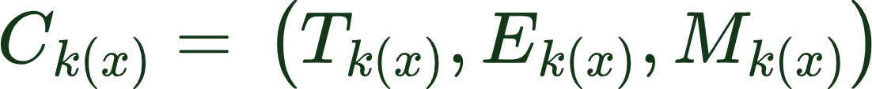
Result of Inference Hardware and quality profile of Early Exit BERT
Protocol:
we apply all of the early exit after the transformer every blocks (11)
We use the simplest method that is using Lens only early exit (No training only Applying exit head on the exit by copying the trained FC to the early exit head)
We measure Hardware Energy Profile, Energy and Memory profile
The model we ran are (LlaMa 3.2 1B, Bert-Large, Yolo v9-Gelan M, Google ViT )
All results are reported as the mean of all of the samples across different tasks
Hassan Khoury ©

Slide 6
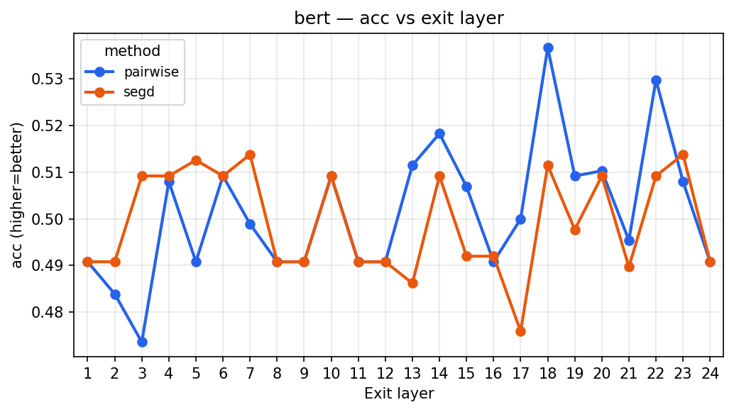
A100 Result of Lens probing- BERT Averaged over 7 data (Quality ACC)
Hassan Khoury ©

Slide 7
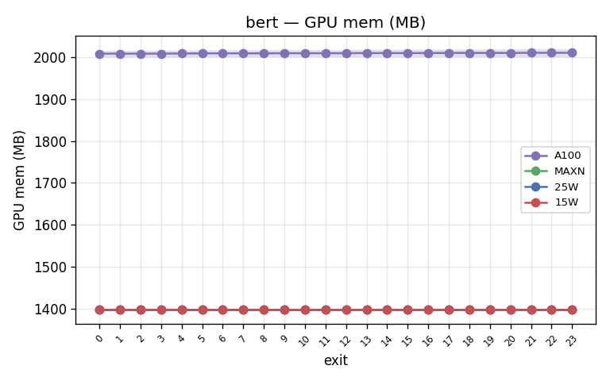
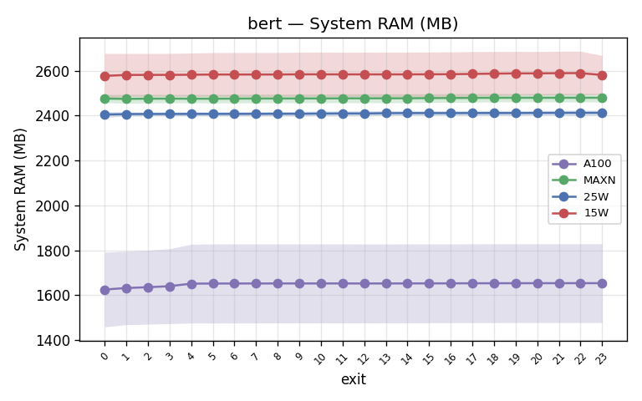
BERT - Memory: GPU mem + System RAM (A100 vs Jetson MAXN/25W/15W)
Hassan Khoury ©

Slide 8
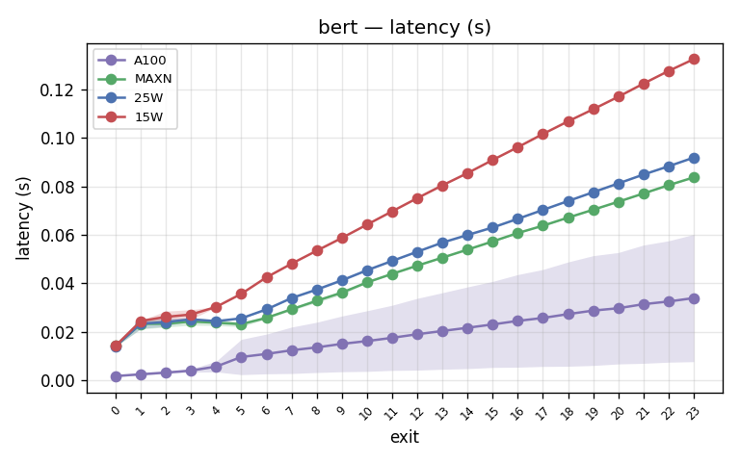
BERT - Latency (A100 vs Jetson MAXN / 25W / 15W)
Hassan Khoury ©

Slide 9
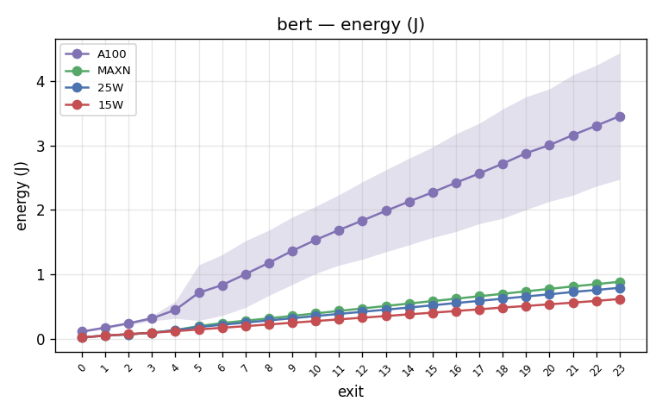
BERT - Energy (A100 vs Jetson MAXN / 25W / 15W)
Hassan Khoury ©

Slide 10
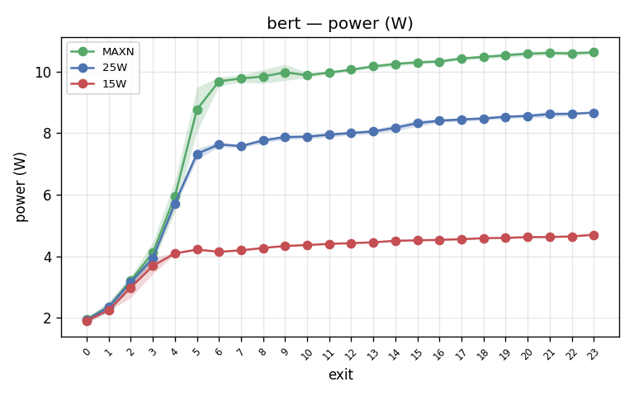
BERT - Power consumption (Jetson MAXN / 25W / 15W)

Slide 11
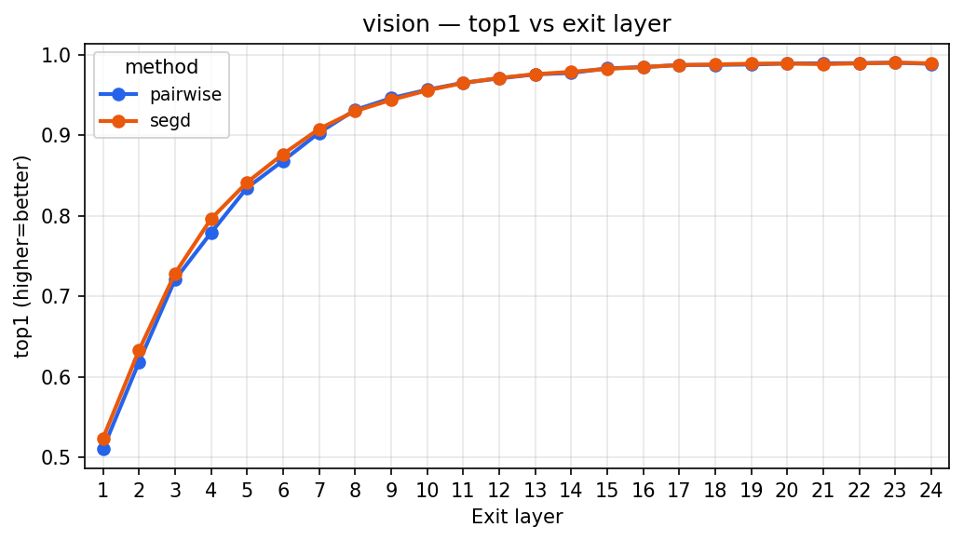
A100 Result ViT Averaged over 7 data (Quality)
Hassan Khoury ©

Slide 12
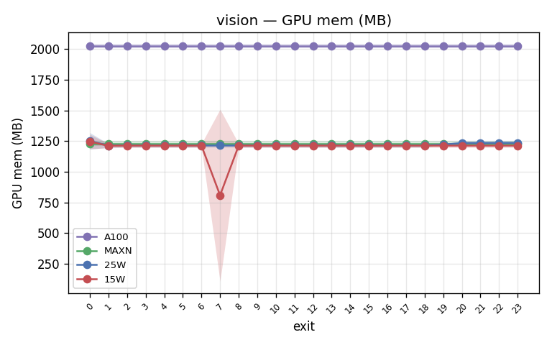
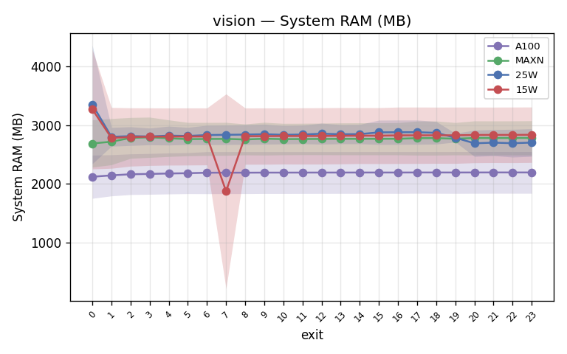
ViT - Memory: GPU mem + System RAM (A100 vs Jetson MAXN/25W/15W)
Hassan Khoury ©

Slide 13
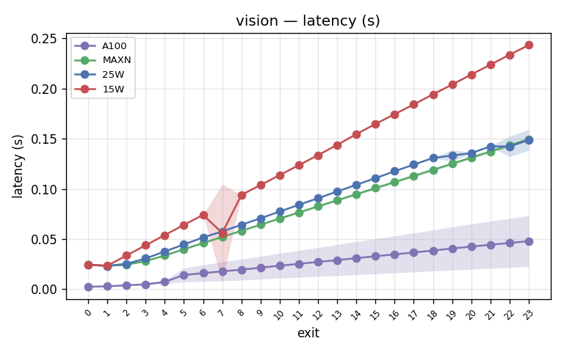
ViT - Latency (A100 vs Jetson MAXN / 25W / 15W)
Hassan Khoury ©

Slide 14
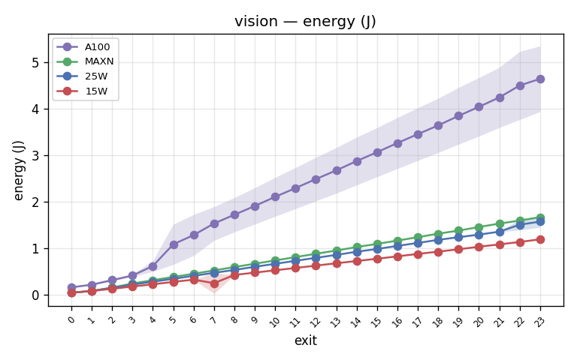
ViT - Energy (A100 vs Jetson MAXN / 25W / 15W)
Hassan Khoury ©

Slide 15
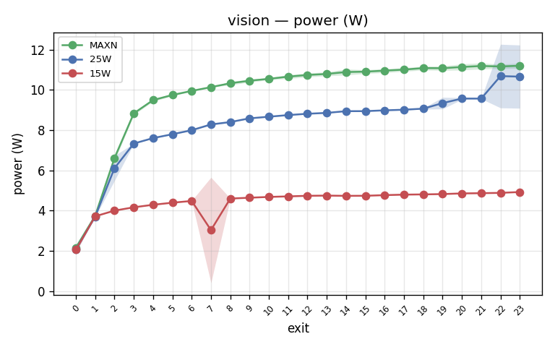
ViT - Power consumption (Jetson MAXN / 25W / 15W)

Slide 16
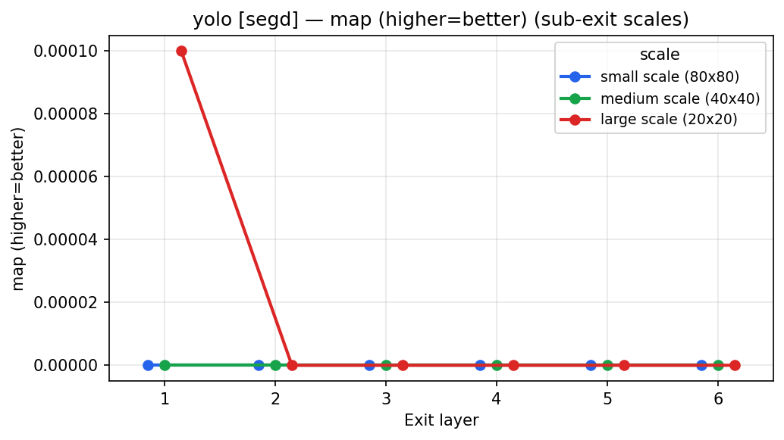
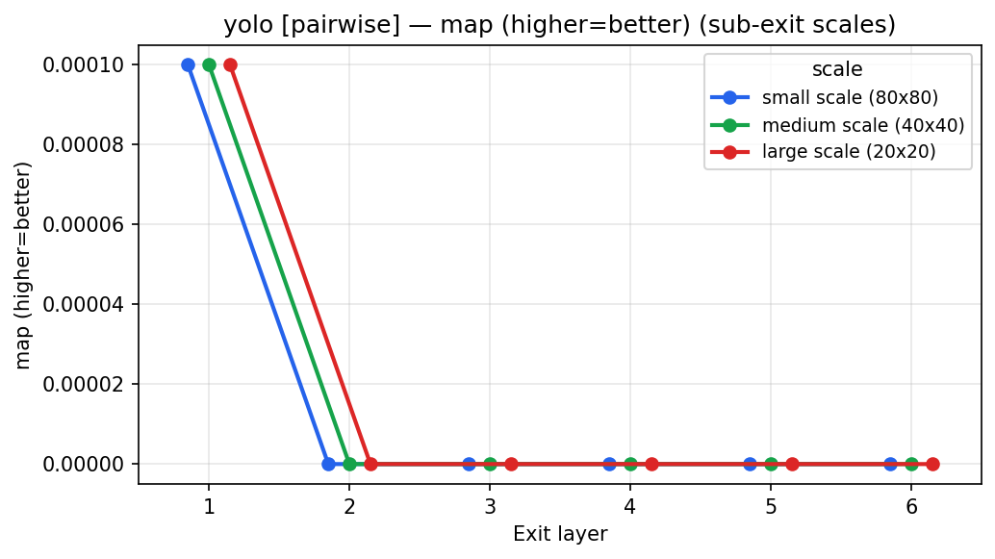
A100 Result of Lens probing- YoloV9 Gelan Averaged over 1 data (Quality)
Hassan Khoury ©

Slide 17
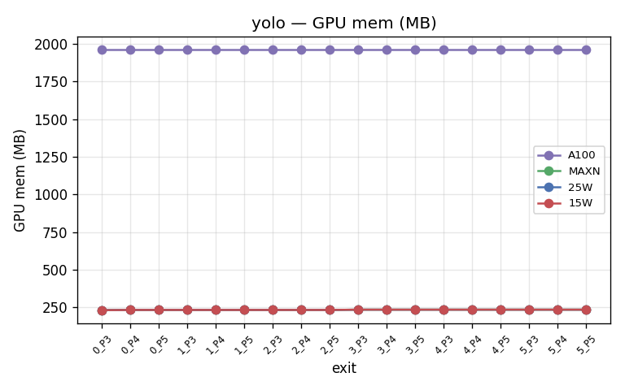
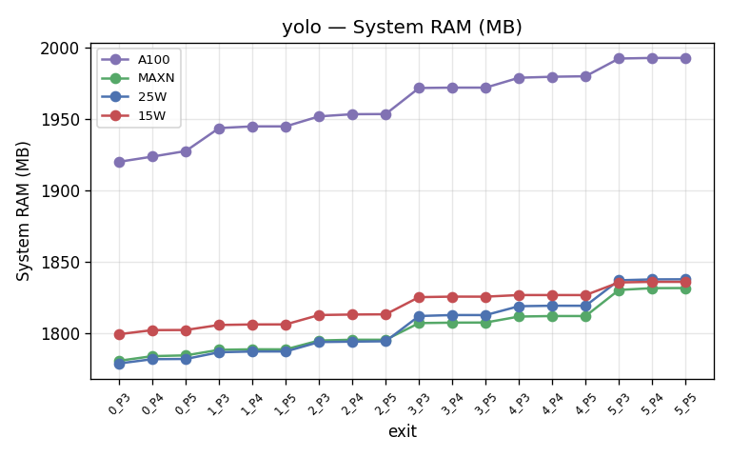
YOLOv9 - Memory: GPU mem + System RAM (A100 vs Jetson MAXN/25W/15W)
Hassan Khoury ©

Slide 18
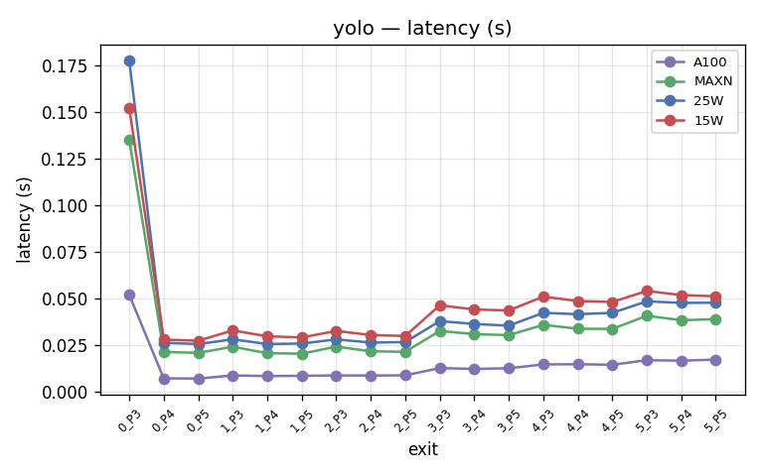
YOLOv9 - Latency (A100 vs Jetson MAXN / 25W / 15W)
Hassan Khoury ©

Slide 19
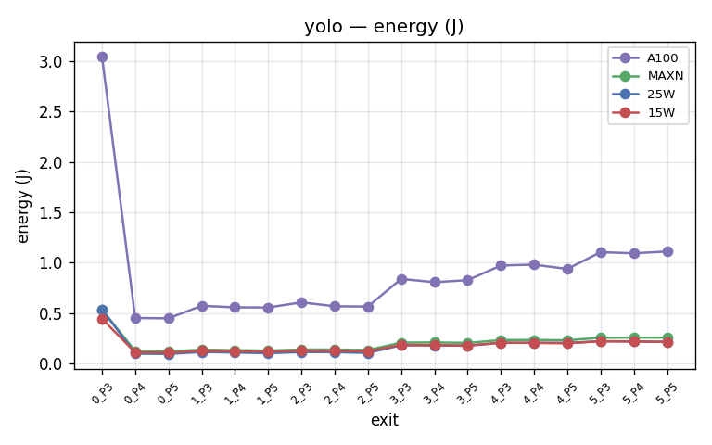
YOLOv9 - Energy (A100 vs Jetson MAXN / 25W / 15W)
Hassan Khoury ©

Slide 20
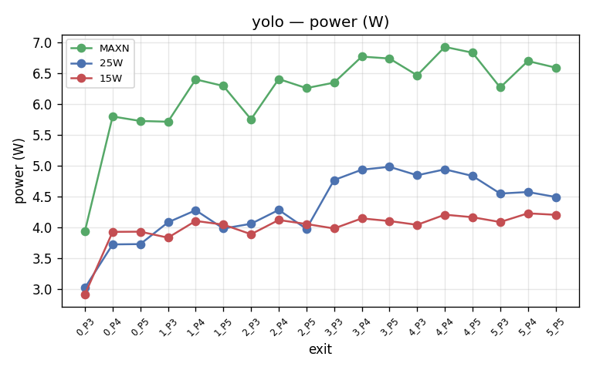
YOLOv9 - Power consumption (Jetson MAXN / 25W / 15W)

Slide 21
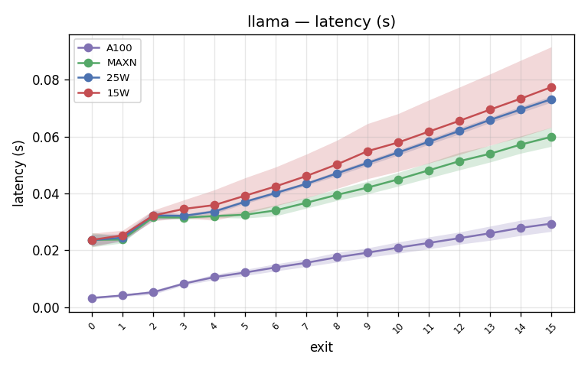
Llama-3.2-1B - Latency (A100 vs Jetson MAXN / 25W / 15W)

Slide 22
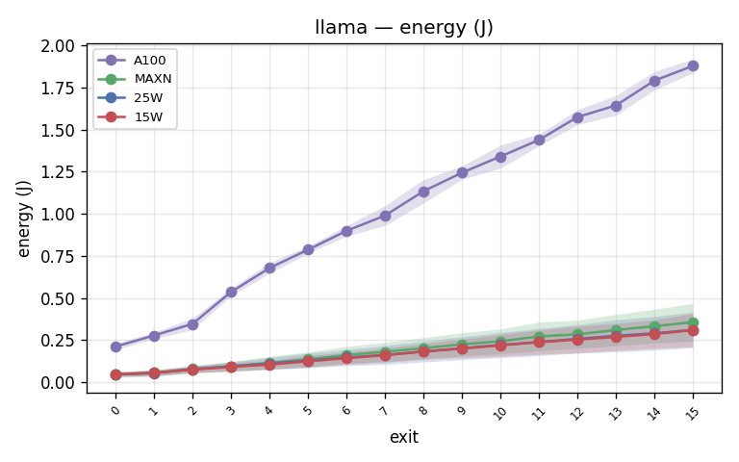
Llama-3.2-1B - Energy (A100 vs Jetson MAXN / 25W / 15W)

Slide 23
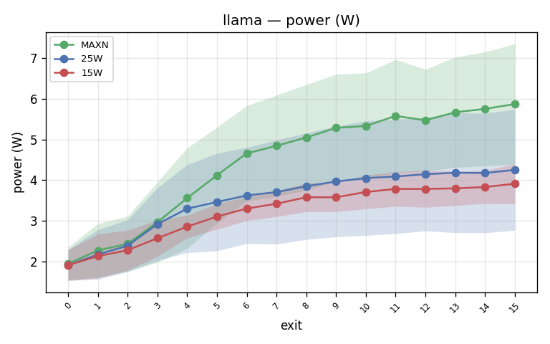
Llama-3.2-1B - Power consumption (Jetson MAXN / 25W / 15W)

Slide 24
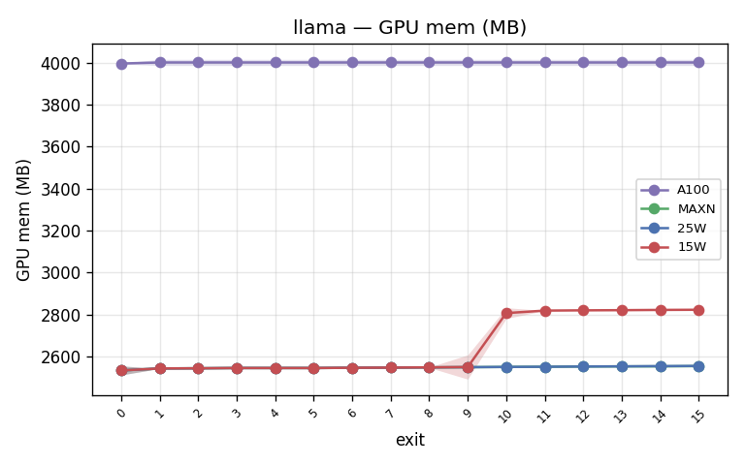
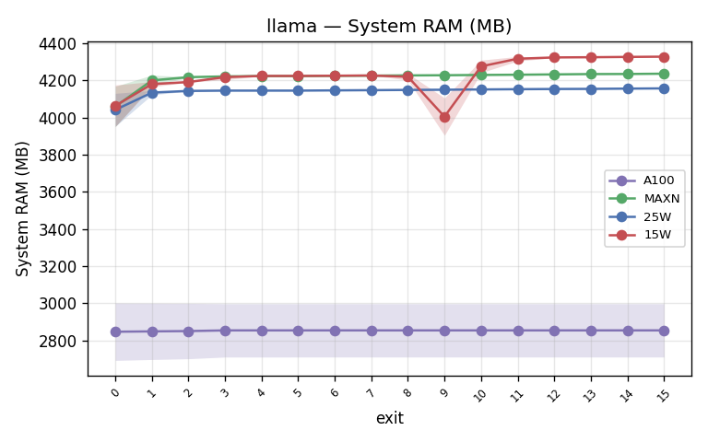
Llama-3.2-1B - Memory: GPU mem + System RAM (A100 vs Jetson MAXN/25W/15W)

Slide 25
Known Knobs & Objective
Known knob: which early exit to take, chosen per model.
Cost variables: memory, energy, latency.
Output: select from acceptable (minimum) up to maximum quality, traded against memory, energy and latency.
Purpose: optimal multi-tenant scheduling of multiple early-exit models on one device.

Slide 26
Current State
Have: early-exit models; NAS to pick the per-model exits.
Problem: multi-tenancy. Cost is driven by the models already running.
Profiling: a model best exit depends on the other models sharing the device, so exits can be co-optimized.
Hassan Khoury ©

Slide 27
Obstacle
Hassan Khoury ©

Slide 28
What will be done next week
Run multiple early-exit models concurrently (multi-tenant).
Collect per-exit metrics under contention: power consumption, energy, latency, memory.
Use the profiles to schedule exits across tenants under the shared cost budget.
Hassan Khoury ©
Notes:
Terus sampaikan di meeting kalau Kita aim untuk submit ke Asplos, deadline Augustus.

Slide 29
Bibliography
Zhang, L., Song, J., Gao, A., Chen, J., Bao, C. and Ma, K., 2019. Be your own teacher: Improve the performance of convolutional neural networks via self distillation. In Proceedings of the IEEE/CVF international conference on computer vision (pp. 3713-3722).
Liu, J., Tang, P., Hou, X., Li, C. and Heng, P.A., 2024, November. LoRAExit: empowering dynamic modulation of llms in resource-limited settings using low-rank adapters. In Findings of the Association for Computational Linguistics: EMNLP 2024 (pp. 9211-9225).
Hassan Khoury ©
Notes:
Terus sampaikan di meeting kalau Kita aim untuk submit ke Asplos, deadline Augustus.

