Slide 1

Copilot Sharing
Ji li

Slide 2
Agenda
0. ChatGPT vs Copilot
1. Simple Demo
2. Generated from Documents
3. Refactor
4. Unit Test
5. Copilot Chat
6. Copilot Labs
7. Best Practice

Slide 3
0. ChatGPT vs Copilot
0.1 What is ChatGPT/Copilot
GPT: Generative Pre-trained Transformer
ChatGPT:
Based on GPT-3(or GPT-4), developed by OpenAI
$ 20/month
Copilot:
Based on CodeX(Actually GPT-3), developed by GitHub & OpenAI
$ 10/month($ 19/month for Business)
Windows Copilot: AI assistant for M365 Applications(GPT-4)

Slide 4

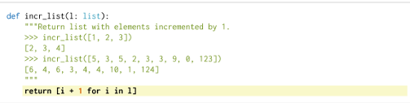
0. ChatGPT vs Copilot
0.2 What is ChatGPT/Copilot
Evaluation:
Evaluation Set:
HumanEval
Dataset: 159 GB Python files, filtered > 1000 lines, automated files > 100 lines(avg.)
Train: GPT-3 pre-train -> CodeX -> CodeX-S/CodeX-D
https://arxiv.org/pdf/2107.03374.pdf

Slide 5
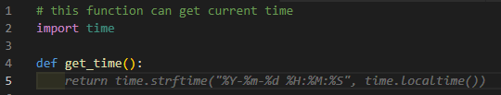

1. Simple Demo
1.1 Get Current Time

Slide 6
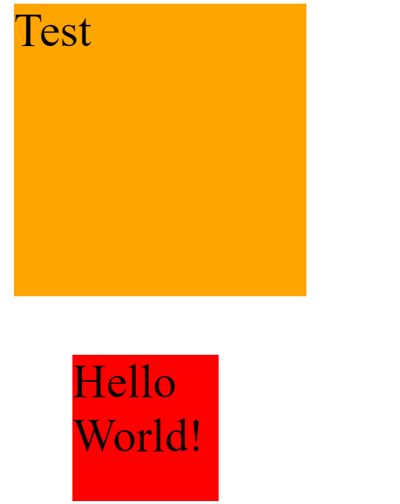
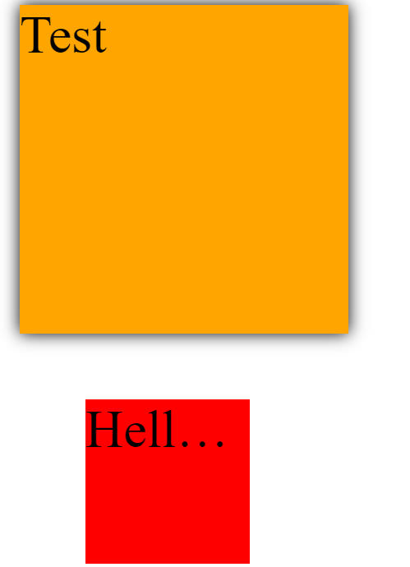
1. Simple Demo
1.2 Add CSS Style

Slide 7
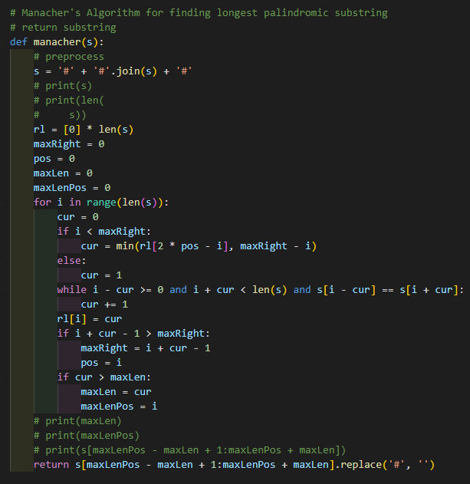
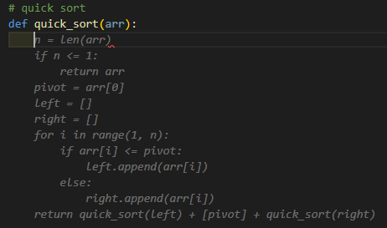
1. Simple Demo
1.3 Generate Algorithm solution

Slide 8
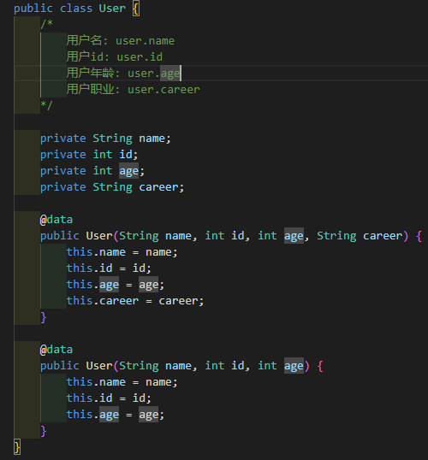
2. Generated from Documents

Slide 9
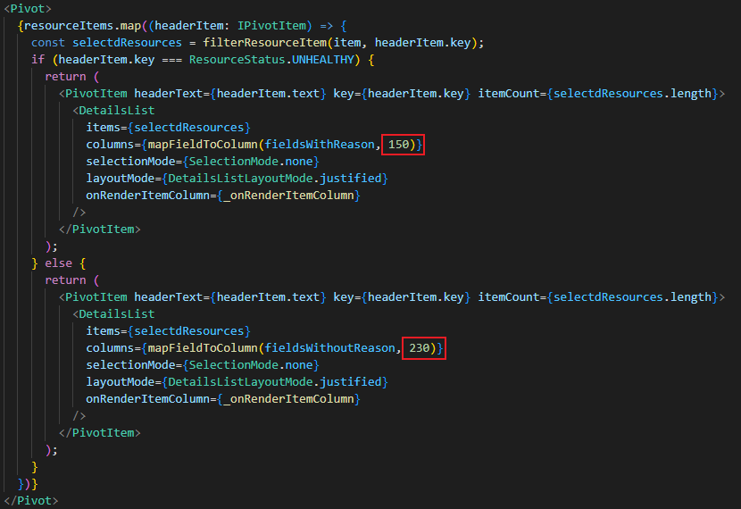
3. Refactor

Slide 10
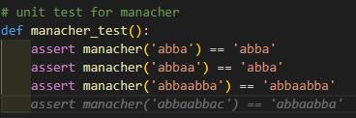
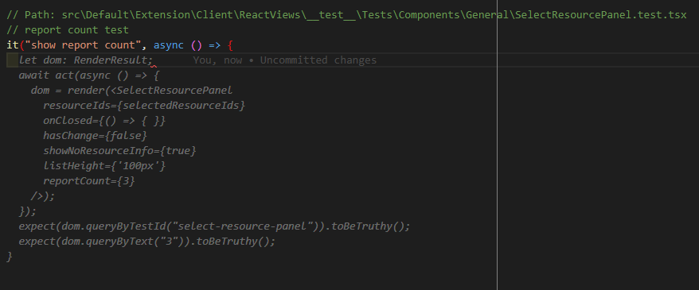
4. Unit Test

Slide 11
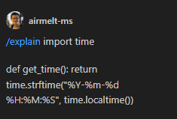
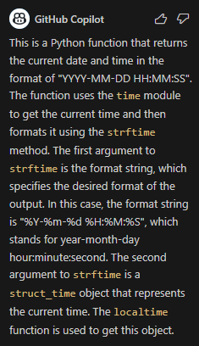
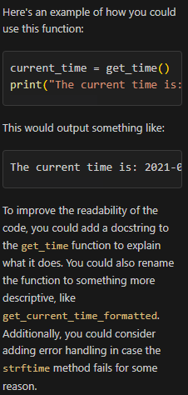
5. Copilot Chat
5.1 Shake Function
5.2 Explain Code
5.3 Test Code
5.4 Simplify Code

Slide 12
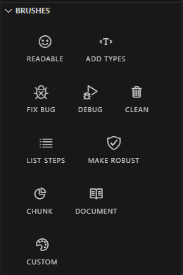
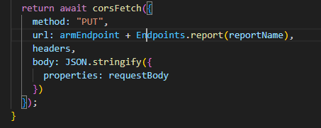
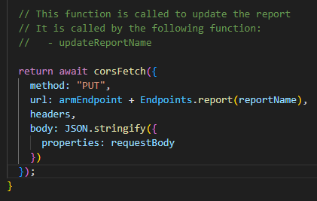
6. Copilot Labs
6.1 Add Types
6.2 Fix Bugs
6.3 Make Robust

Slide 13
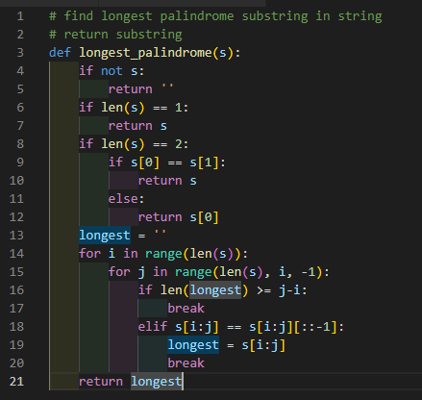
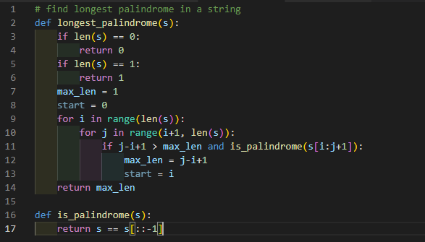
7. Best Practice
7.1 Prompt Engineering

Slide 14


7. Best Practice
7.2 Team Coding Style

Slide 15
Thanks for your listening!

