Slide 1

Copilot Sharing
Ji li

Slide 2
Agenda
1. Simple Demo
2. Generated from Documents
3. Refactor
4. Unit Test
5. Copilot Chat
6. Copilot Labs

Slide 3
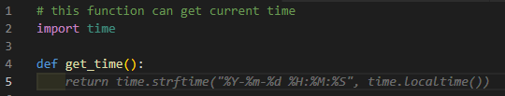
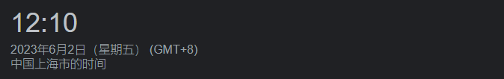
1. Simple Demo
1.1 Get Current Time

Slide 4
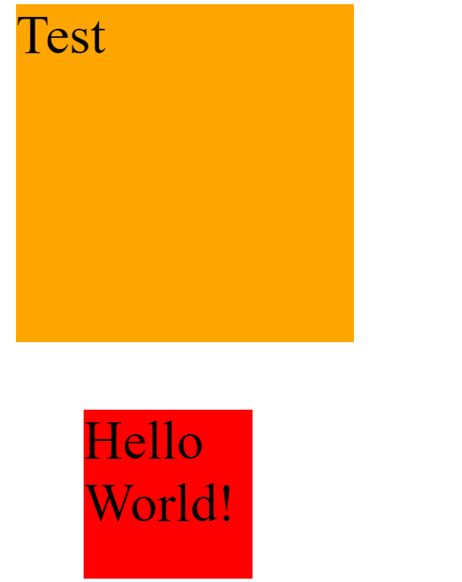
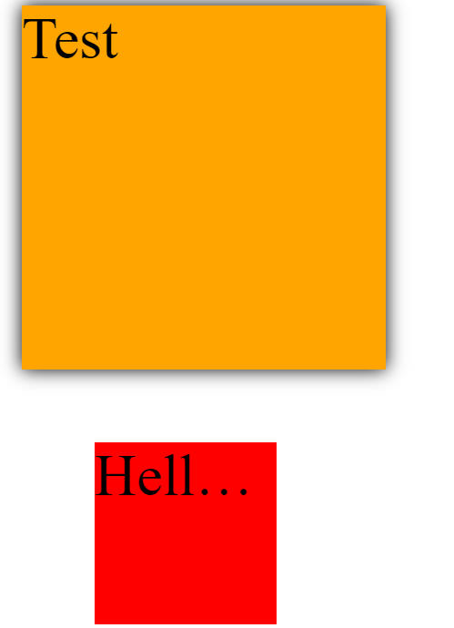
1. Simple Demo
1.2 Add CSS Style

Slide 5
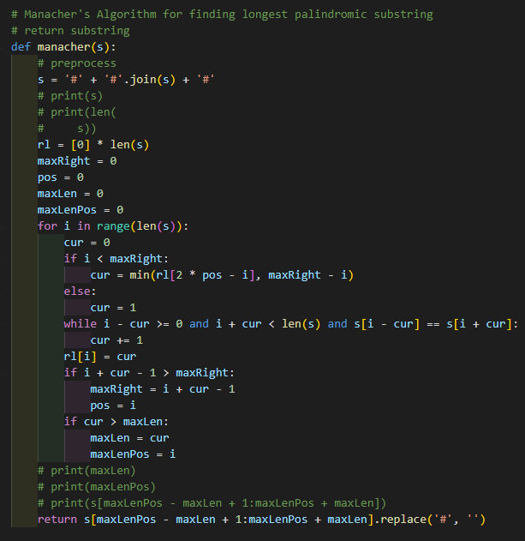
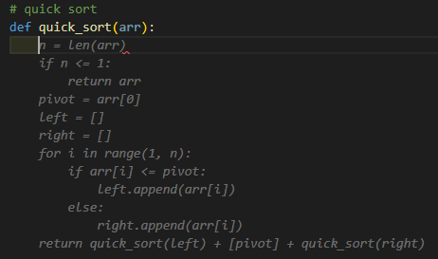
1. Simple Demo
1.3 Generate Algorithm solution

Slide 6
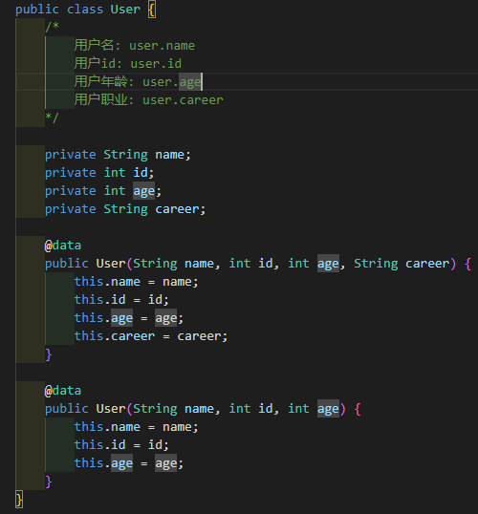
2. Generated from Documents

Slide 7
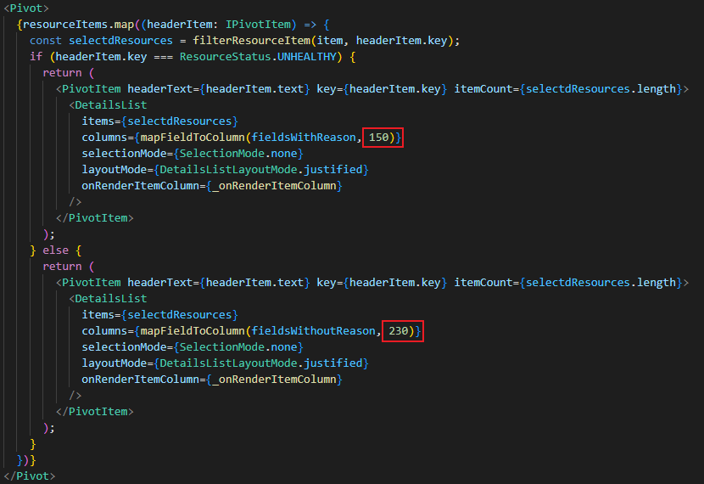
3. Refactor

Slide 8
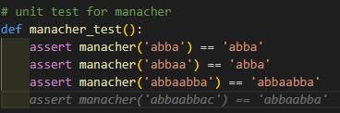
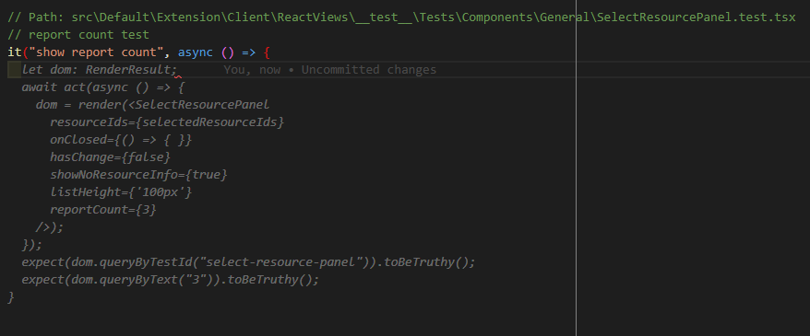
4. Unit Test

Slide 9
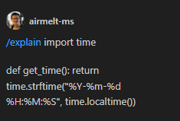
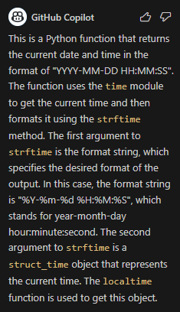
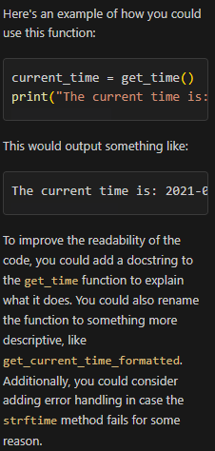
5. Copilot Chat
5.1 Shake Function
5.2 Explain Code
5.3 Test Code
5.4 Simplify Code

Slide 10
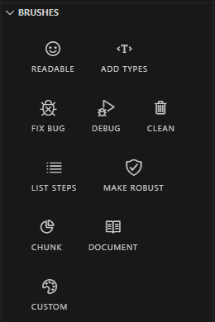
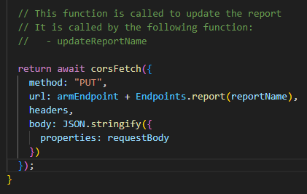
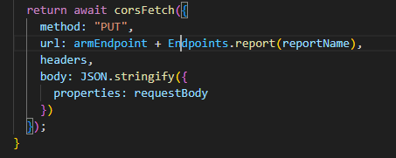
6. Copilot Labs

Slide 11
Thanks for your listening!

