Slide 1
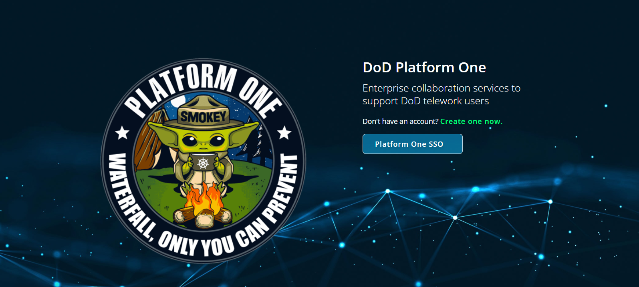
PLATFORM ONE (P1) MATTERMOST (MM) TRAINING
UNCLASSIFIED//FOR OFFICIAL USE ONLY

Slide 2
Mattermost General Overview Key areas you should know
What is Mattermost?
Profile Setup
Mattermost Organizational Structure
Impact Levels Explained
Admin Roles & Permissions
Notifications
Formatting Posts
Direct Messaging
JITSI – Video Conferencing
Best Use Suggestions & Ideas
UNCLASSIFIED//FOR OFFICIAL USE ONLY

Slide 3
WHAT IS MATTERMOST? (MM)
It’s a secure collaboration tool very similar to SLACK, a commercial standard for workplace collaboration. The difference is that DoD MM allows FOUO/PII/CUI/HIPAA in Private Teams or Private Channels and direct messages in Public Teams.
Hosted and developed by USAF Platform One (P1) an official DoD DevSecOps Enterprise Services team for the DoD.
UNCLASSIFIED//FOR OFFICIAL USE ONLY

Slide 4





WHY USE MATTERMOST? (MM)
Some of the major benefits include:
Impact Level 4 (IL4) Approved
Direct 1:1 and group messaging
Public Channels / Private Channels
Reduced email clutter
Searching across messages and channels
File attachments/sharing
JITSI Video Conferencing integrated
Pinned Posts
Future Feature Plugins
UNCLASSIFIED//FOR OFFICIAL USE ONLY

Slide 5
Mattermost Links
MATTERMOST SERVER LINK:
https://chat.il4.dso.mil/
NOTE: In order to automatically join your organization’s TEAM CHAT; Users need to use the Team Invite Link provided by your organization’s Team Admins
UNCLASSIFIED//FOR OFFICIAL USE ONLY

Slide 6
Mattermost Profile Setup The first few things you should do in MM
Ensure your Account Info is entered in your SSO profile.
Main Account on DoD SSO Server: https://login.dso.mil
Change Account Info
Change Password
Set up MFA
Join Primary Wing/Unit Channels that apply to you:
Recommended: Applicable Public Channels, Your Unit Public Channel, etc.
Comment in your Unit Public Channel to request access to Private Channels
Favorite Channels
Fill out your Position/Upload Profile Picture:
Click the menu button next to your name at the top left
Go to Account Settings > General Settings
Edit Position
Fill it with your Unit Information / Position (Ex. 349 LRS / MM Admin)
Edit Profile Picture > Upload Appropriate Photo/Image
UNCLASSIFIED//FOR OFFICIAL USE ONLY

Slide 7
Mattermost Profile Setup The first few things you should do in MM
Adjust Notifications Settings:
Notifications can be modified generally in Account Settings.
Click Menu Button > Account Settings > Notifications
Edit any of the possible notification settings such as Desktop, Email, Mobile Push, Words that Trigger, Reply notifications.
Note: Notifications can further be specified in specific channels by:
Clicking on the Drop Down Arrow on the right of the Channel Name at the top middle
Click Notification preferences > Edit any of the notification options
Automatic Direct Message Replies can also be enabled for automatic response to Direct Messages
Disable System Notifications:
System Notifications can be turned off to remove messages about user’s joining and leaving a channel in Account Settings.
Click Menu Button > Account Settings > Advanced
Edit “Enable Join/Leave Messages” > Turn it off
UNCLASSIFIED//FOR OFFICIAL USE ONLY

Slide 8
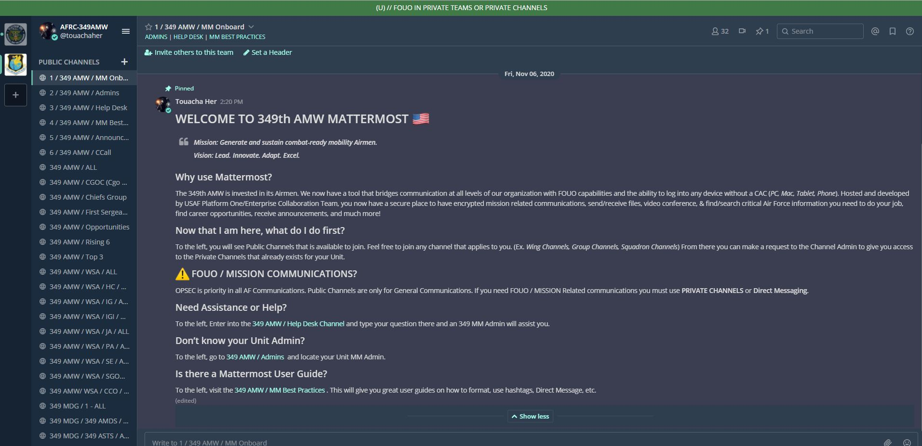
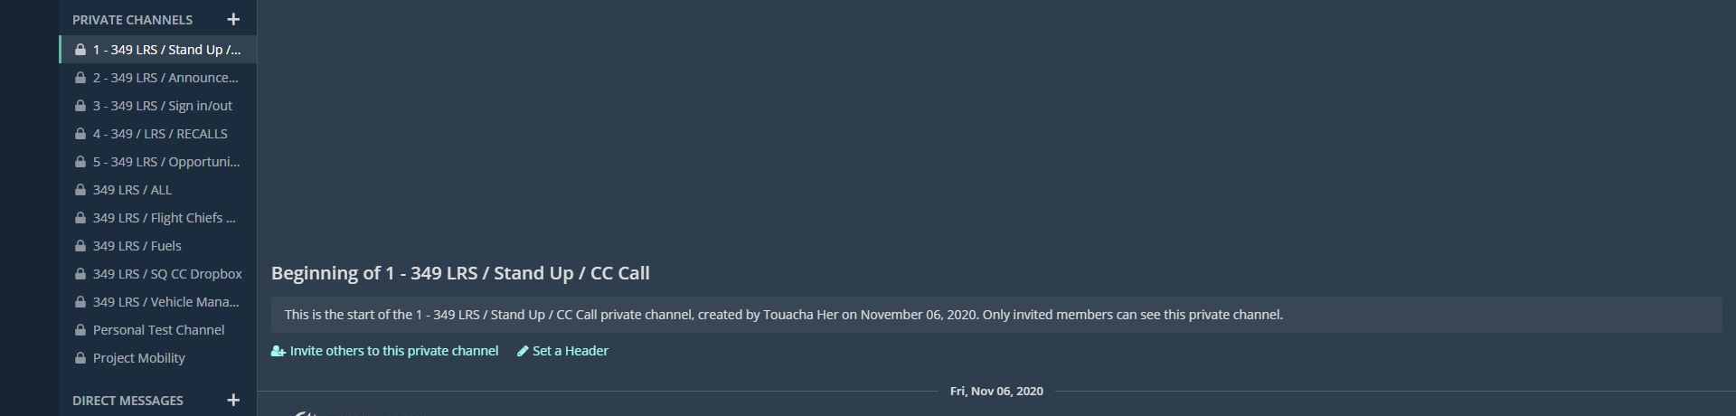
UNDERSTANDING MM ORG STRUCTURE
1
Be sure to select your Team Logo
1
2
2
New Users automatically join the Town Square
Public Channel
3
Public Channels are organized in Alphabetical Order, users can join any channel that applies
3
4
4
Private Channels marked with a LOCK can only be joined by invite
5
Direct Messages
are at the bottom
5
UNCLASSIFIED//FOR OFFICIAL USE ONLY

Slide 9


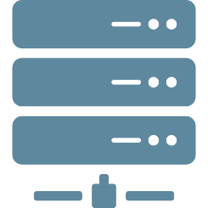



UNDERSTANDING MM ORG STRUCTURE
Mattermost is setup in this structure:
Private Channels; Direct Messages.
Servers >
Public Channels >
Teams >
Direct Messages
Public Channel
Private Channel
DoD Server
All MM Users
Team = Wing / Organization
The DoD is on the same "server", meaning you can contact anyone else with an account.
Teams are created for Wings (equivalent to a Workspace in slack)
Each Team can have many public and private channels (thousands).
Direct messages (DMs) can be sent to an individual or multiple people (up to 8 including yourself).
Impact Level 4 (IL4) approved
UNCLASSIFIED//FOR OFFICIAL USE ONLY

Slide 10
IMPACT LEVELS EXPLAINED IL2, IL4, IL5, IL6
What are Impact Levels?
Standards for categorizing information and information systems provided by DISA who developed the DoD Cloud Computing Security Requirements Guide (SRG). The SRG defines the baseline security requirements for cloud service providers (CSPs) that host DoD information, systems, and applications, and for DoD's use of cloud services. It replaces the DoD Cloud Security Model, and maps to the DoD Risk Management Framework and NIST 800-37/53.
IL2 is public information
IL4 is PII, PHI, CUI (controlled unclassified information), & HIPAA
IL5 is national security information and class
ex. Source code for a weapons system or anything touching national security
IL6 is secret data.
UNCLASSIFIED//FOR OFFICIAL USE ONLY

Slide 11







IMPACT LEVELS EXPLAINED IL2, IL4, IL5, IL6
Mattermost is approved for IL2, IL4, IL5. The instance of MM you are on is Impact Level 4 (IL4)
DoD MM allows FOUO/PII/CUI/HIPAA in Private Teams or Private Channels and direct messages in Public Teams.
Public Teams (FOUO only Private Channels, & DMs)
Private Teams (FOUO in Public Channels, Private Channels, & DMs)
Public Channel
Private Channel/Direct Messages
(FOUO Authorized)
Public Team
DoD Server
Public Channel
(FOUO Authorized)
Private Team
(FOUO Authorized)
Private Channel/Direct Messages
(FOUO Authorized)
UNCLASSIFIED//FOR OFFICIAL USE ONLY

Slide 12
Mattermost Admin Rights & Permissions
Admin Hierarchy:
System Admin – DoD P1 (Server Level)
Team Admin – Wing (Team Level)
Channel Admin – Unit
(Channel Level)
Member – User
(General User)
UNCLASSIFIED//FOR OFFICIAL USE ONLY

Slide 13
Mattermost Admin Rights & Permissions
SYSTEM ADMIN:
Role: Platform 1 / DevSecOps Admin
Purpose: Liaison between Team Admin to all of Air Force P1 Help Desk; This role is only assigned to P1 Personnel managing Mattermost at the Enterprise Level. They have all the Full Admin Rights and Permissions.
System Admin – DoD P1 (Server Level)
UNCLASSIFIED//FOR OFFICIAL USE ONLY

Slide 14
Mattermost Admin Rights & Permissions
TEAM ADMIN:
Role: Wing Admin Purpose: Liaison between Group/Squadron Admins to P1 Help Desk
Manage/Moderate the Channel assigned. Assist with Team Onboarding, Subject Matter Expert (SME) on MM, Create/Manage/Archive all Public Channels, funnel issues between team and P1 Help Desk, Train Unit Level Admins (Brief/Hands On-Training)
Team Admin – Wing (Team Level)
Ability to invite user to Team Chat
Add and remove channel members in the specified channels
Create/Archive Public Channels
Request Help Desk Ticket for Public Channel set to “Read Only”
Ability to post in “Read Only” Channels
Ability to Give or Remove “Team Admin Rights” to another member
Delete another user’s post
Rename Channels
UNCLASSIFIED//FOR OFFICIAL USE ONLY

Slide 15
Mattermost Admin Rights & Permissions
CHANNEL ADMIN:
Role: Group/Squadron/Section Admins Purpose: Liaison between User & Unit Admin
Further help onboard with Team Onboarding at the lowest level, Subject Matter Expert (SME) on MM, Create/Manage/Archive all Private Channels, funnel issues between Users to Squadron Admin. Identify/train local private channel admins, manage/moderate Private Channel Content, manage table of available private channels and appropriate admin to reach out for access
Channel Admin – Unit
(Channel Level)
Add and remove channel members in the specified channels
Ability to post in “Read Only” Channels
Ability to Give or Remove “Channel Admin Rights” to another member
Delete another user’s post
Rename Channels
UNCLASSIFIED//FOR OFFICIAL USE ONLY

Slide 16
Mattermost Admin Rights & Permissions
MEMBER:
Role: Member Purpose: General User
Join Public Channels applicable, follow rules of engagement. Further help onboard with Team Onboarding at the lowest level
Join/Leave any Public Channel
Post/Edit your own post in 2-way Public Channels/Private Channels
Invite Other Users to Channel you are in (Public or Private)
Launch Jitsi Video Conference
Set Notification Preferences
Automatic Direct Message Replies
Member – User
(General User)
UNCLASSIFIED//FOR OFFICIAL USE ONLY

Slide 17
Mattermost Notifications Settings
There are user account level notification settings and channel notification settings
User Account Level Notification Settings
Modify user account settings by clicking the main menu (hamburger) next to your username
Click "Account Settings“ > Click "Notifications"
From here you can set notifications (of each type except e-mail, which is not enabled now) to notify you for: All activity, Mentions (when @ yourusername is used in a post) and Direct Messages, Never
These settings are your general settings. If you are a member of a channel, you can also silence notifications for specific channels and customize which words will trigger a mention.
Channel Notification Settings
MUTE CHANNEL: This means your channel list will not indicate there are unread messages in the channel by changing the channel title to bold (or moving it to the top of your channel list if that is the option you have selected). You will only be notified if you are @ username mentioned
NOTIFICATION PREFERENCES: From here you can: Mute channel, Ignore @ channel @ all @ here (broadcast messages)
Edit "Send desktop notifications" settings
Edit "Send mobile push notifications" settings
UNCLASSIFIED//FOR OFFICIAL USE ONLY

Slide 18
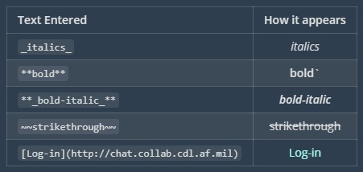
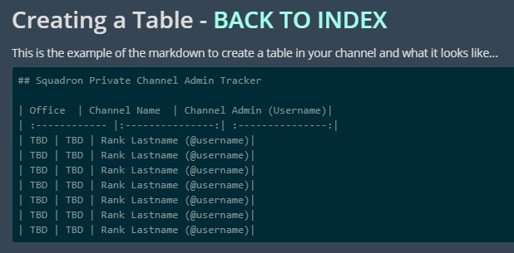
Mattermost Formatting Text, Tables, Posts, Emojis
Currently, in order to format your post, you need to use a set of inline “code” called Markdown (a lightweight markup language)
No need to memorize;
Formating can be copied in Microsoft Word
Tables can be copied and pasted from Excel
UNCLASSIFIED//FOR OFFICIAL USE ONLY

Slide 19
Mattermost Direct Messaging Using DMs
Users can Direct Message anyone on the DoD server (even users not in their Wing/Team)
As a default: Direct message conversations automatically close after 7 days of no new communication unless changed in Sidebar Settings set to never
You + Up to 7 people can be added to DM conversations
You will need to know the usernames of the people you want to add
Click the + next to "Direct Messages" in the channel list
Add all the users you want to include in the conversation and click "go"
A new window will open for the conversation
When you move away from the conversation, the new conversation will be under "Direct Messages" in your channel list
UNCLASSIFIED//FOR OFFICIAL USE ONLY

Slide 20
Mattermost JITSI Video Conferencing
JITSI is a open source video chat plugin that is similar to ZOOM, but is a fully encrypted, approved for IL4, 100% open source video conferencing solution that you can use all day, every day, for free — with no account needed. It is integrated with Mattermost at the top right corner with the “Video Camera Icon”.
Features include:
Share your desktop, presentations, and more
Trade messages and emojis while you video conference, with integrated chat.
Currently
NOTES TO REMEMBER:
In order to use JITSI on a mobile device, you must install the app.
JITSI Video Conferencing only works on commercial networks (Currently working on getting JITSI Video Conference to work on AF Networks)
Supports up to estimated 75-80 people, future updates will expand that to 200.
UNCLASSIFIED//FOR OFFICIAL USE ONLY

Slide 21
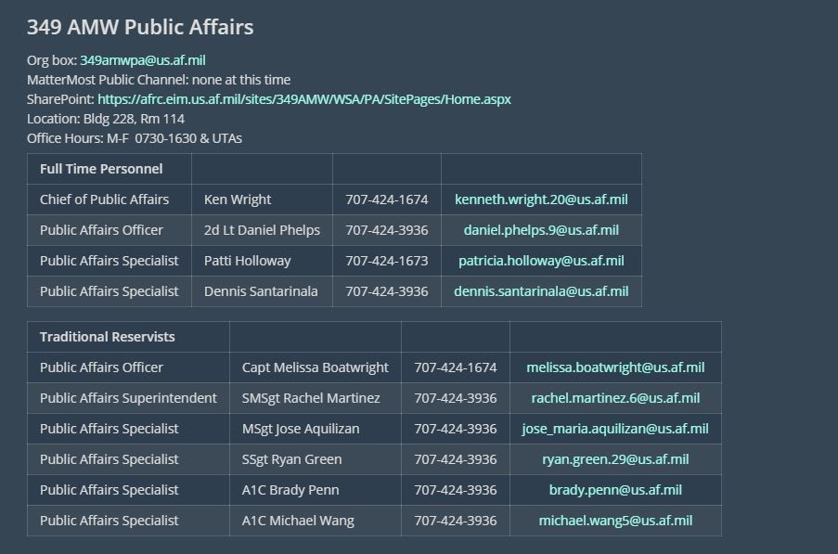
BEST USE SUGGESTION/IDEAS
PINNED POST with key information regarding POCs for certain areas
Helps people quickly reference and locate information they need to reach the right people
UNCLASSIFIED//FOR OFFICIAL USE ONLY

Slide 22
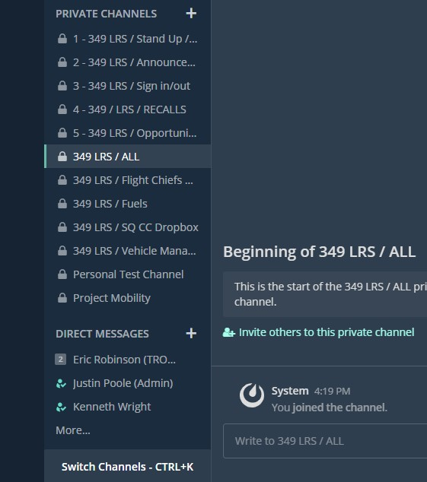
BEST USE SUGGESTION/IDEAS
PRIVATE CHANNELS that replaces some if not all forms of email or direct communication
Ex. Announcements can contain UTA Bulletins
Create personal drop boxes
UNCLASSIFIED//FOR OFFICIAL USE ONLY

Slide 23
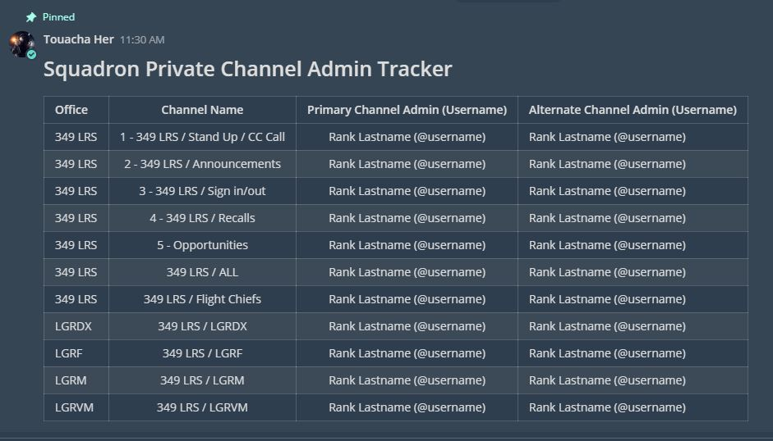
BEST USE SUGGESTION/IDEAS
Keep track of your Private Channel Admins
This will help users locate their Local Unit MM Admin quickly for help
UNCLASSIFIED//FOR OFFICIAL USE ONLY

Slide 24
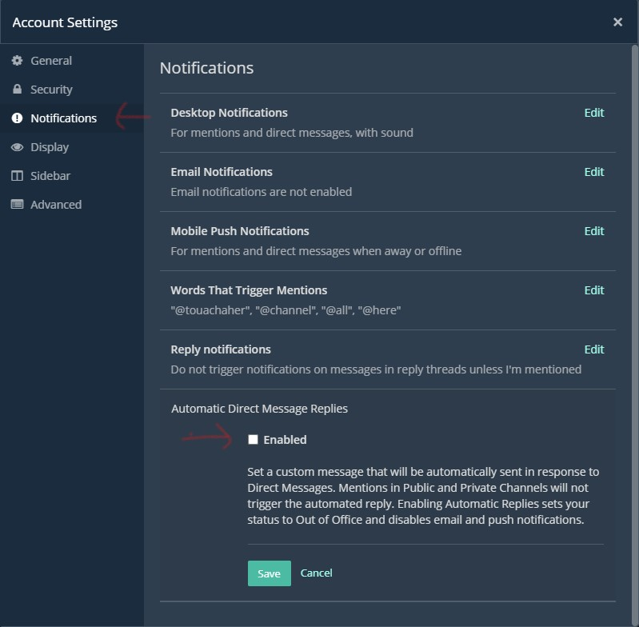
BEST USE SUGGESTION/IDEAS
OUT OF OFFICE REPLIES If you are unable to respond you can send messages automatically.
UNCLASSIFIED//FOR OFFICIAL USE ONLY

Slide 25
What we need from you
REGISTER Help onboard others
UNCLASSIFIED//FOR OFFICIAL USE ONLY

Slide 26

THANK YOU FOR BEING A PART OF THE DoD PLATFORM ONE TEAM
UNCLASSIFIED//FOR OFFICIAL USE ONLY

