Slide 1
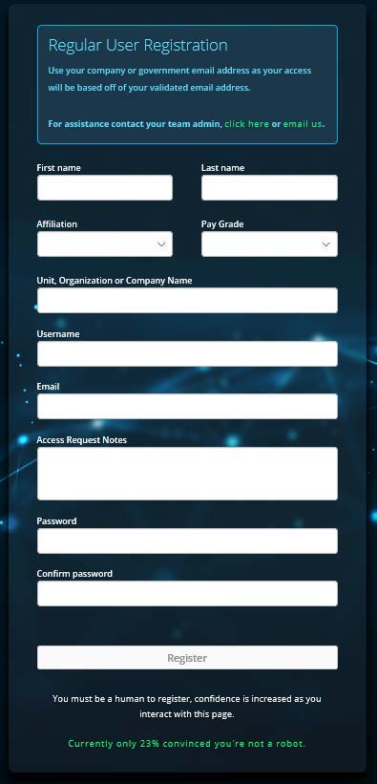
Mattermost INITIAL USER REGISTRATION
Get started on a Desktop
You’ll need a Computer, Internet Access, a CAC Card/Reader, and any .mil email account
Open Chrome, Edge, or Firefox (not Internet Explorer)
ENTER REGISTRATION LINK: →https://login.dso.mil/register
Fill out your profile with your Info. NOTE: Ensure you use the front part of the .mil Email as your username
Ex. John.Doe.23@us.af.mil
Username: John.Doe.23
Access Request Notes: (Leave Blank)
Password: 12 characters (minimum 2 special characters, 1 uppercase, 1 number)
(Optional: Leave password blank for CAC Only Access)
NOTE: At the bottom, a security feature in green makes you move the mouse around before you can click register.
Click Register.
UNCLASSIFIED

Slide 2
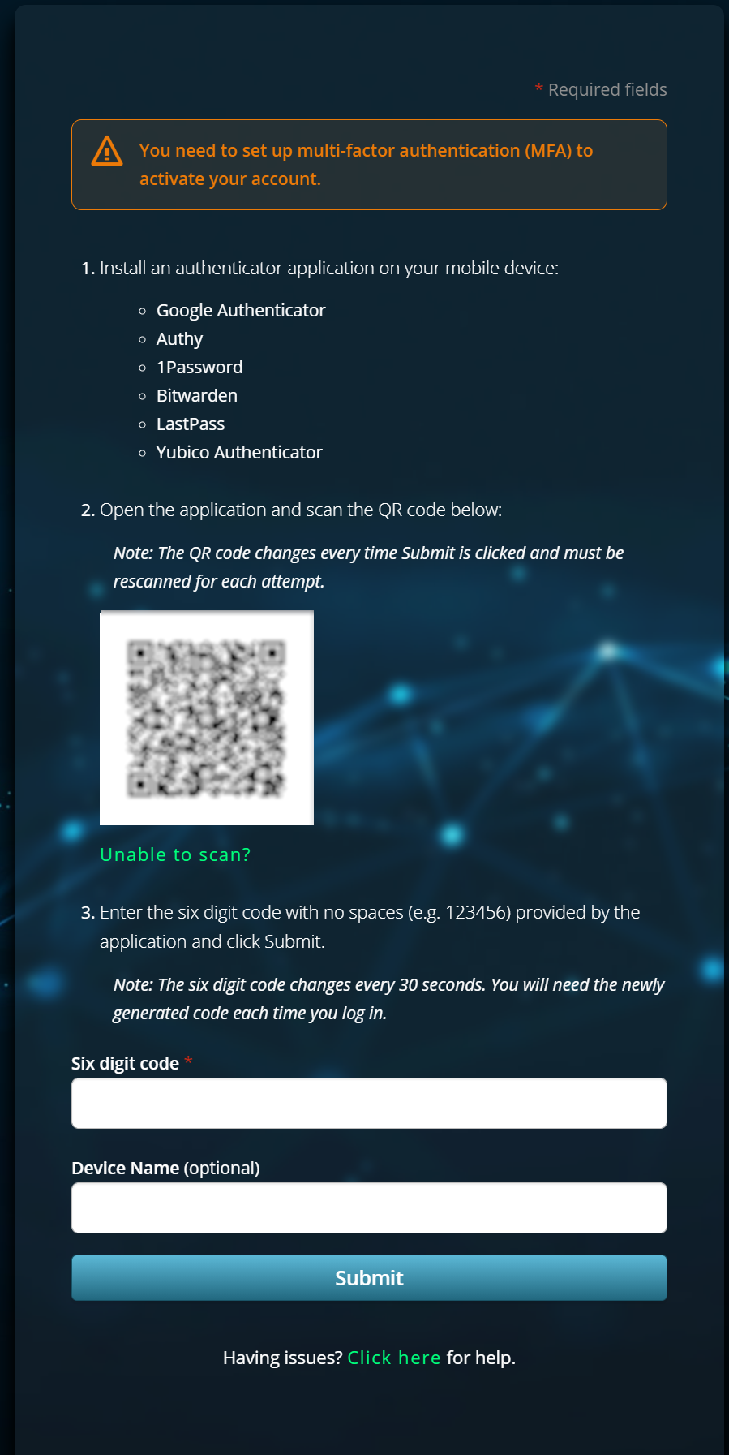
Mattermost INITIAL USER REGISTRATION
(Optional: Skip steps 5-9 if using CAC Only Access)
Setting up Multi-Factor Authentication (MFA)
The next screen will ask you to install an authenticator on your mobile device
Recommended install: Google Authenticator →SCAN QR CODE TO DOWNLOAD ON MOBILE PHONE
IOS ANDRIOD
Open the MFA app click “Get Started” at the bottom of screen followed by “Scan QR Code”
UNCLASSIFIED

Slide 3
Mattermost INITIAL USER REGISTRATION
Using the camera view from the MFA App, Scan the QR Code on the MFA Setup Page with your mobile device.
Scanning the QR code will create a six digit code in the MFA app.
Type in the Six Digit Code with no spaces (e.g. 123456) from the app into the “Six Digit Code” field on the MFA Setup Page.
This six digit code changes every 30 seconds.
The Device Name field is optional and can be anything you desire.
**NOTE: DO NOT DELETE THE MFA APP on your mobile device as you will need the Six Digit Code each time you log in without a CAC
UNCLASSIFIED

Slide 4
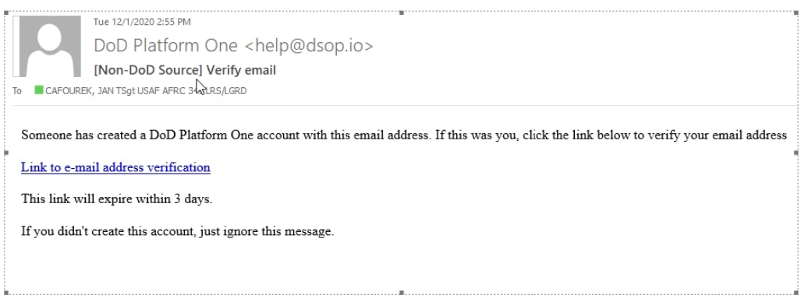
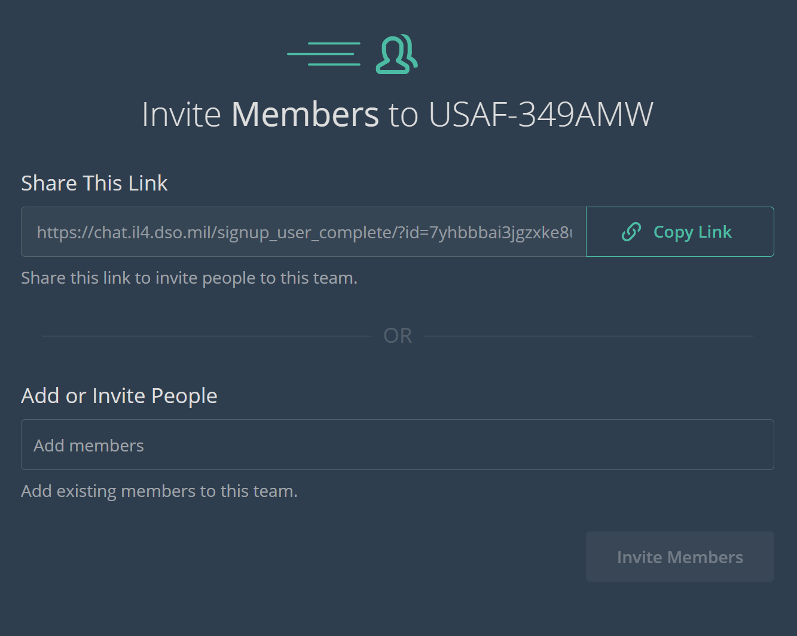
Mattermost INITIAL USER REGISTRATION
Email Verification. Check your .mil inbox.
The email will be from “DoD Platform One”
It may take up to 10-15 minutes to receive the email
The email link expires after 3 days
After confirming email, Verify your profile information
Go to: login.dso.mil
Fill out any missing information in the Account Tab
Note: You can change password or set up MFA again in this website.
To join Your Team; use one of the options
Option 1: Copy & Paste Team Invite Link
(Team Invite Link is provided by your Team Admin, reach out to your local MM Team)
--Next proceed to step 13
Option 2: Copy & Paste Link
https://chat.il4.dso.mil/welcome/pl/aqwxa7baztdnpq1smzbxwa9tec
--Next in the "write" box at the bottom type command: /requestaccess team (Insert Team Name)
--A Team Admin will get the request and approve your access to the team.
(If links comes up invalid, contact your Local Mattermost POC for assistance)
Team Invite Link
EXAMPLE:
UNCLASSIFIED

Slide 5
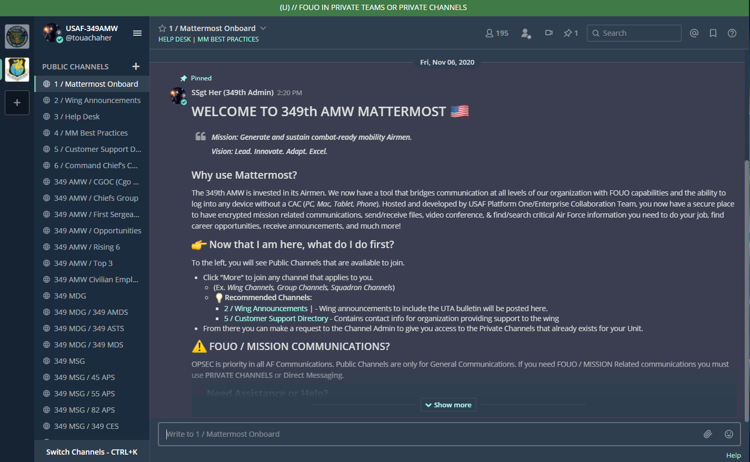
Mattermost INITIAL USER REGISTRATION
You already created an account, so select “Click here to sign in”
Click Platform One SSO button, you should see your (TEAM NAME) Team.
If you don’t see your team, attempt option 2 in step 12.
(If you do not see your organization contact your local Mattermost Admin)
UNCLASSIFIED

