Slide 1
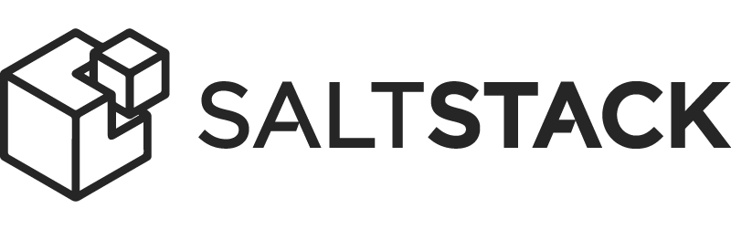





Salt is open source software for modern IT automation.
Cloud Automation
Configuration Management
Agent or Agentless
Remote Execution

Slide 2
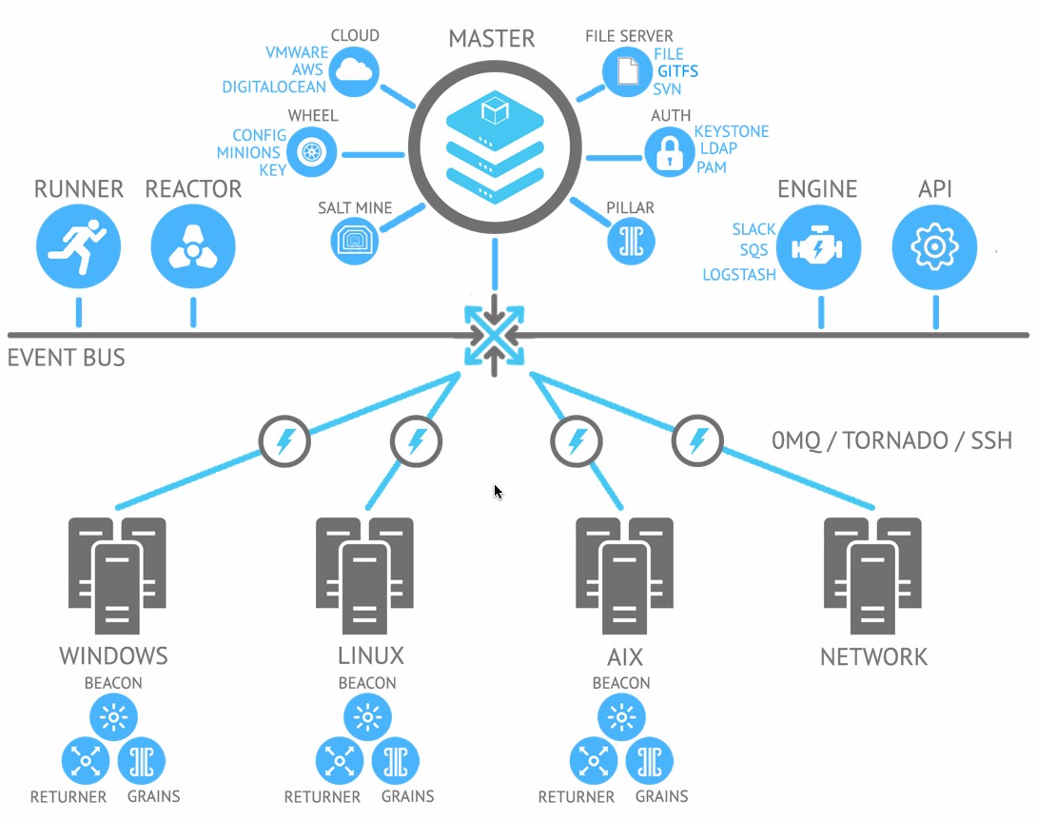
Server-agent architecture: server: salt master, agents: salt minions
Minions receive commands simultaneously from the master to execute locally and report back.
Communication over a high-performance data pipe using: ZeroMQ or raw TCP (Tornado), or SSH
Security using PKI for authentication and AES encryption for payloads.
State (SLS) files described using YAML
Salt uses Python plugins.

Slide 3

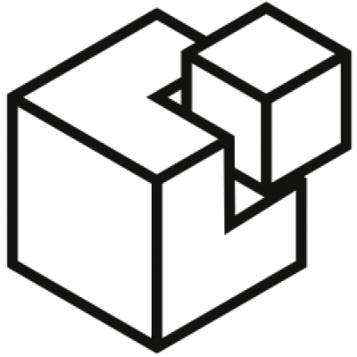
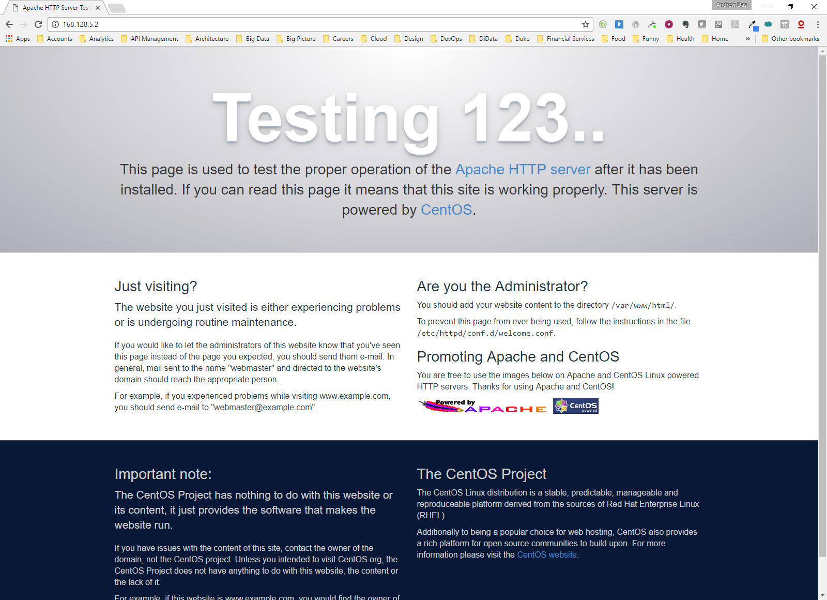






Salt deploys 3 nodes in DiData Cloud with Apache HTTP server
3
2
4
1
MASTER
CLOUD
https://github.com/airmetal/salt-dimensiondata

Slide 4
TERMINOLOGY
grains - static information about minions
pillar - secure user-defined variables stored on master and assigned to minions (equivalent to data bags in Chef or Hiera in Puppet)
mine - area on the master where result from minion executed commands can be stored, like IP address of a backend webserver used then to configure a load balancer
runners - modules executed on master
returners - inject minion data to another system
reactor - trigger actions in response to an event. It is a simple interface to watching Salt's event bus for event tags that match a given pattern and then running one or more commands in response.
beacons - little piece of code on the minion that are listening for thing, like server failure or file changes to inform the master. With reactor can be used to do self healing
salt cloud - bootstrap cloud nodes
salt ssh - run cmds on systems without minions
COMMANDS:
salt-master - daemon used to control the Salt minions
salt-minion - daemon which receives commands from a Salt master.
salt-key - management of Salt server public keys used for authentication.
salt - main CLI to execute commands across minions in parallel and query them too.
salt-ssh - allows to control minion using SSH for transport
salt-run - execute a salt runner
salt-call - runs module.function locally on a minion, use –local if you don’t want to contact your master
salt-cloud - VM provisionning in the cloud
salt-api - daemons which offer an API to interact with Salt
salt-cp - copy a file to a set of systems
salt-syndic - daemon running on a minion that passes through commands from a higher master
salt-proxy - Receives commands from a master and relay these commands to devices that are unable to run a full minion.
spm - frontend command for managing salt packages.

