Slide 1

Bachelor Thesis Project(BTP)
Spring Semester - 2023
Surisetti Sai Komal
1903136
Songa Yaniv Nishanth
1903135

Slide 2
VEHICLE PARKING MANAGEMENT SYSTEM
INDEX
Abstract
Introduction
Software Used
Previous System
Added Features
Modules
Use Case Diagram
ER Diagram
Conclusion
References

Slide 3
ABSTRACT
Vehicle Parking Management System maintains a good record of vehicles check-in and check-out time. It enables time management and control of vehicles by using parking number. The system tracks the entry and exit of vehicles, maintain a listing of vehicle within the parking lot, and determine the parking and it will also determine the cost of parking of vehicle.

Slide 4
INTRODUCTION
There is always a need of a system that will provide a way to effectively control records & track vehicle parking traffic. The purpose of developing vehicle parking management system is to automate the traditional way of booking a parking spot. Another purpose for developing this application is to generate the receipt automatically.
Vehicle Parking Management system(DriveIN) is a web-based system that will manage the records of the incoming and outgoing vehicles in a parking lot. It is easy for Admin to retrieve the data if the vehicle has been visited, through the parking number. Users can book their desired slot and view it any time they need, also through the parking number.

Slide 5
SOFTWARE USED
Frontend Tools
HTML
CSS
Javascript
Bootstrap - Framework
Backend Tools
Django
SQLite - Database
Others
VS Code - Text Editor
Any browser for viewing the webpage

Slide 6
PREVIOUS SYSTEM
The previous system contained and managed entry and exit of vehicles. But it only had admin access and no user authentication. There was no Parking Map and no way to book a slot. We mentioned in the future scope that new features would be added to make the system more useful and accessible to users too.
ADDED FEATURES
We have added the following features to the better and updated system:
User access.
Parking Map and slot booking.
URL to view booked slot anytime.

Slide 7
MODULES
There are different modules that are visible depending on admin or user.
Admin Modules:
Dashboard
Add Vehicle
Manage Incoming Vehicle
Manage Outgoing Vehicle
Search
User Modules:
Add Vehicle
In Status
Out Status

Slide 8
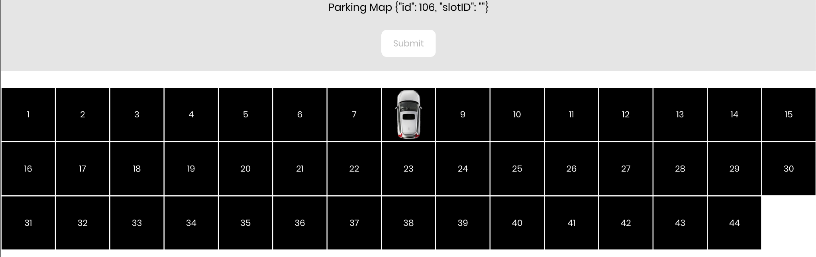
PARKING MAP

Slide 9

SLOT BOOKED MAP (URL)

Slide 10
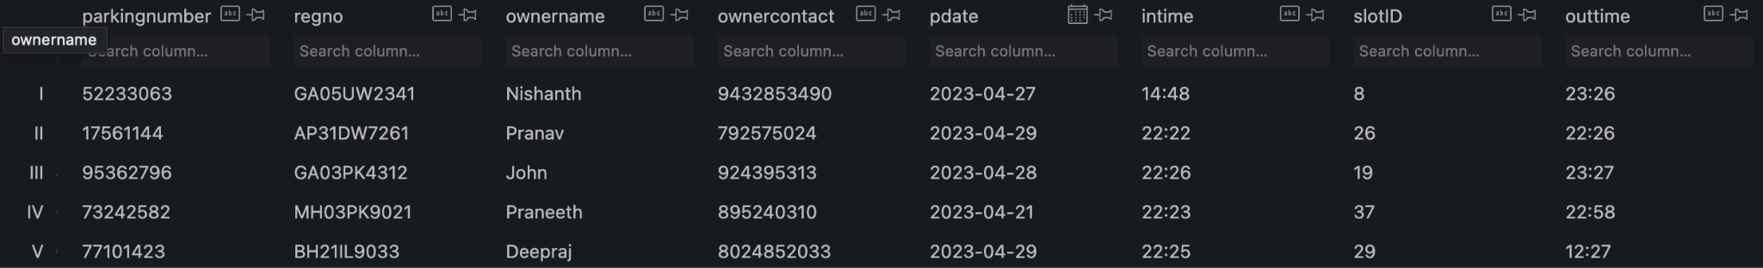
DATABASE STORAGE
This is how the data is stored in the database. The parking number is unique for all. The user enters the registration number, name, contact number, date and in-time. The slot ID is the slot number which the user has selected in the parking map. The admin enters the outgoing time of the vehicle.

Slide 11
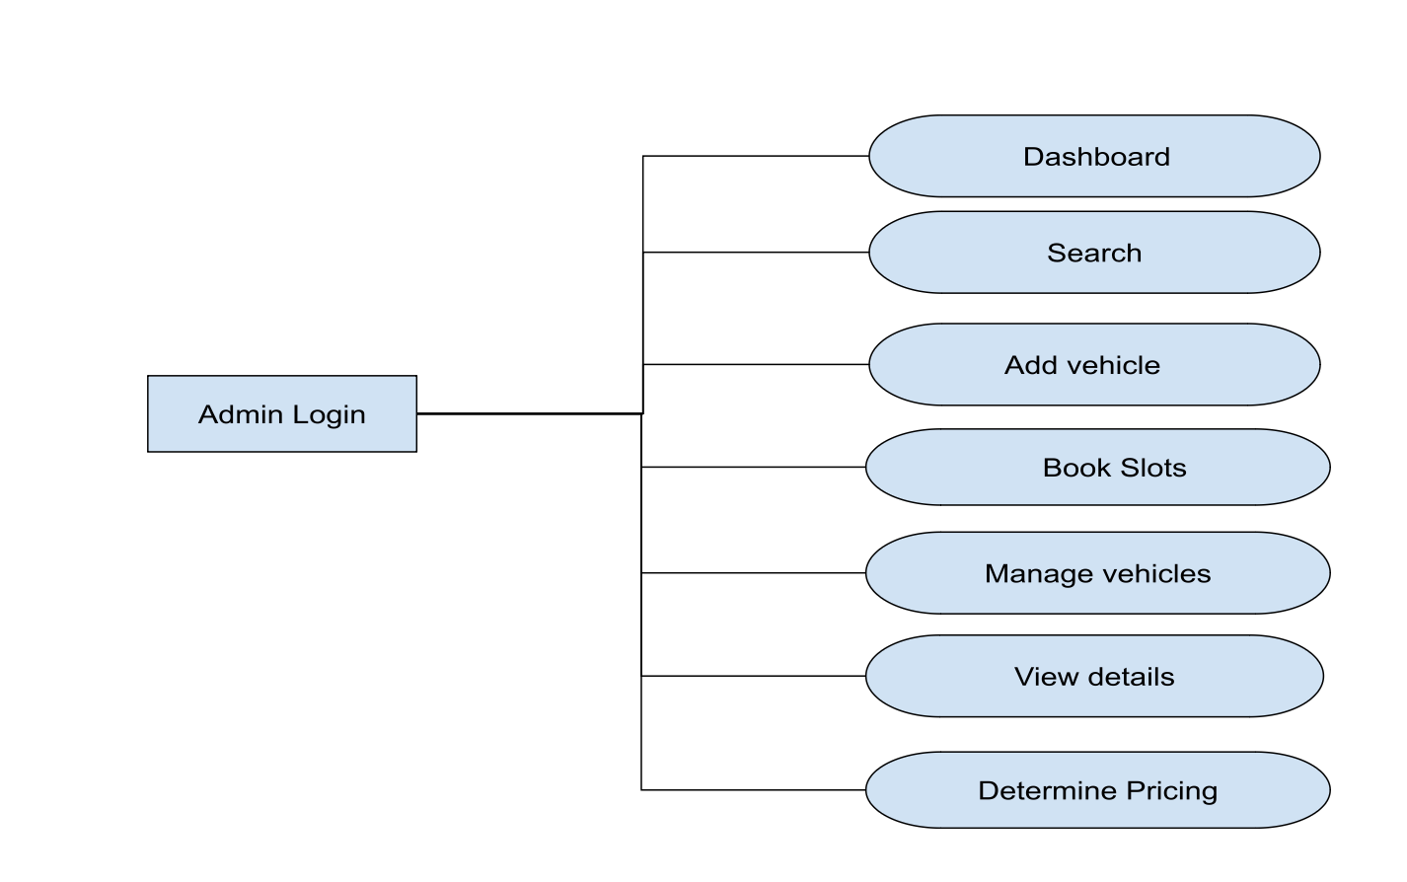
USE CASE DIAGRAM - ADMIN

Slide 12
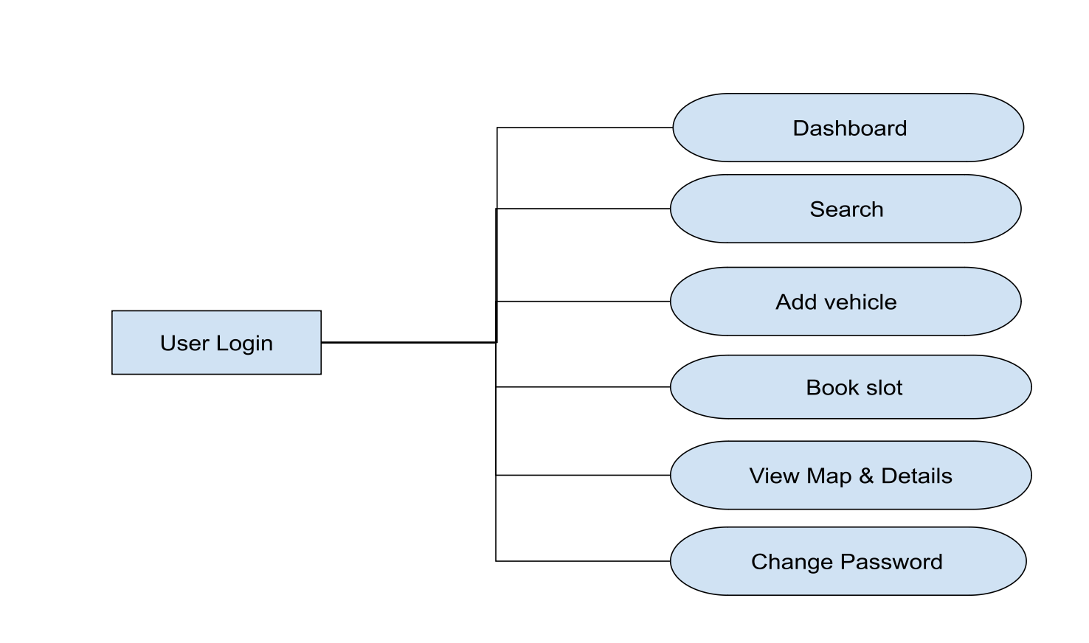
USE CASE DIAGRAM - USER

Slide 13
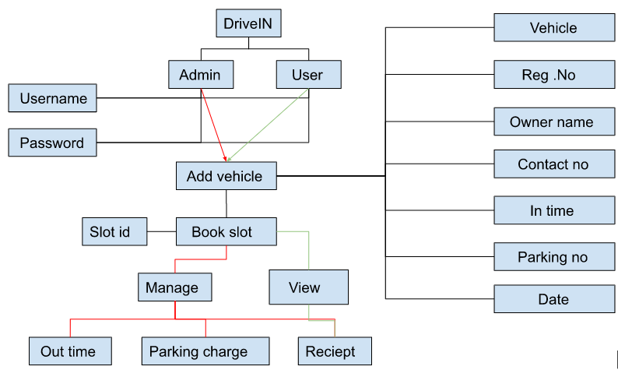
ER DIAGRAM

Slide 14
CONCLUSION
The Vehicle Parking Management System is a reliable and efficient solution for managing company visitor parking. With its user-friendly interface and backend technologies such as Python Django and Sqlite database, the system streamlines the parking process, making it easier for visitors to register their vehicles and for the company to manage parking slots. Overall, the system improves the efficiency and accuracy of company visitor parking management.

Slide 15
REFERENCES
https://www.w3schools.com
https://stackoverflow.com
https://www.geeksforgeeks.org/django-tutorial/
https://www.javatpoint.com/django-tutorial/
https://www.sqlitetutorial.net

Slide 16
THANK YOU

