Slide 1

R Package AQEval
AQEval
R package for change-point evaluation of air quality time-series data
And de-seasonalisation, de-weathering, background subtraction
(Developed in collaboration with Defra and IPSOS Mori)
Methods
How AQEval works: Break-points, Break-segments and Signal Isolation
Other Information
Code Examples: Package Installation and Standard Usage
Beta Testing
We are looking for third-party feedback on the package prior to release
(The insights that only come from fresh eyes and novel applications)
We appreciate that we are asking to your time and your input
But our objectives are to use this process to refine AQEval
And, at the same time, get you early access…
R Package AQEval [GENERAL DOCUMENT] Extra Slide

Slide 2
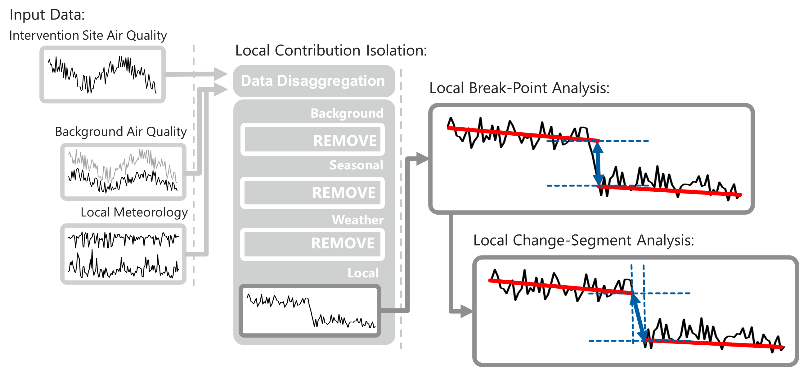
AQEval: Overview
Improved non-seasonal event detection by local contribution isolation, and break-point and change-segment analysis of the local contribution
Methods for third party, so
Accessible (high coverage) data sources
Robust, evidence-driven and documented methods, and open software (R package)
BUT also a need to refine methods, so some new elements, e.g. background correction, change-segment analysis…
R Package AQEval [GENERAL DOCUMENT] Extra Slide

Slide 3
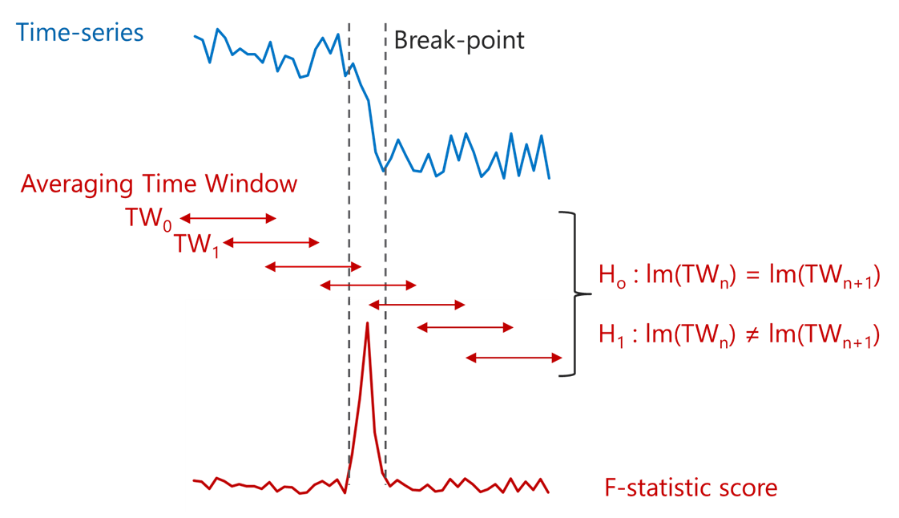
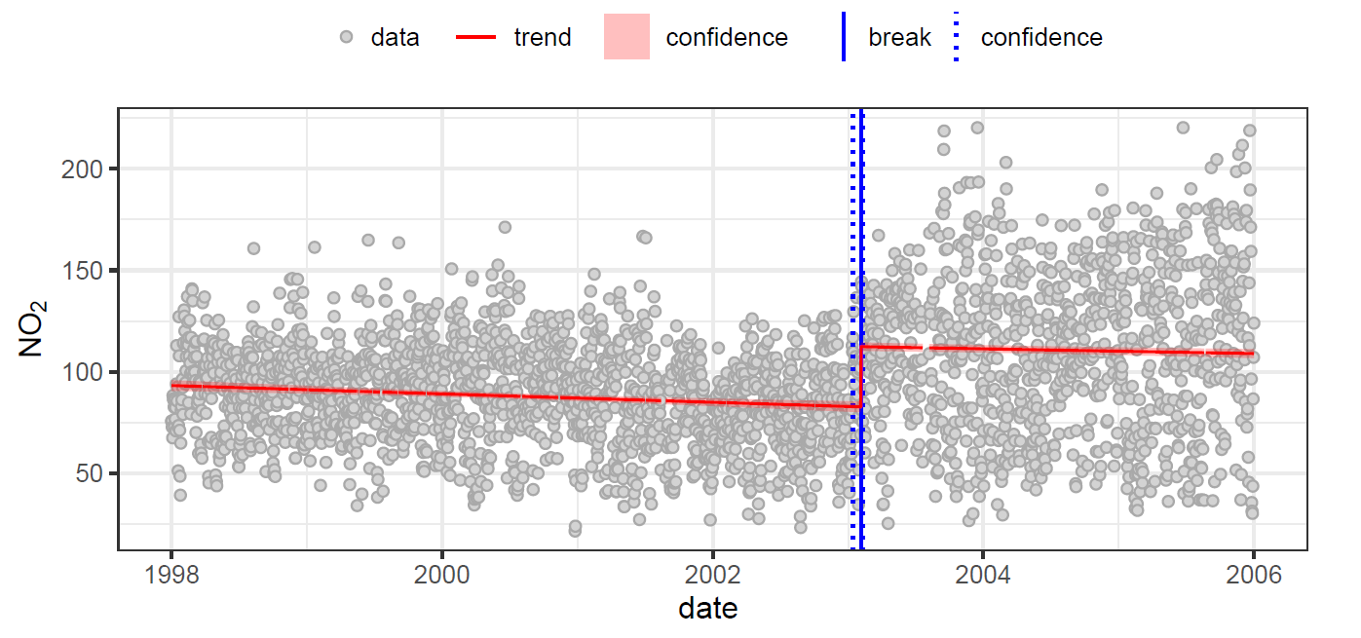
Break-point Detection
Break-point analysis and other similar change detection methods seek to find statistically significant step-changes in the properties of a time-series
Methods apply a rolling window strategy
Assume first window is change-free
Compare that and next window
(here by f-statistic by linear models)
And so on through time-series…
Assigning point (or points) of change and associated confidence intervals
[REF: Zeileis et al, 2002, J. Stat. Software, 7(2)]
Application of break-point methods to London Marylebone 1998-2005 NO₂ time-series
Late OCT 2003 Break-point
82.66->112.4; 29.69 µg.m⁻³ (36%)
R Package AQEval [GENERAL DOCUMENT] Extra Slide

Slide 4
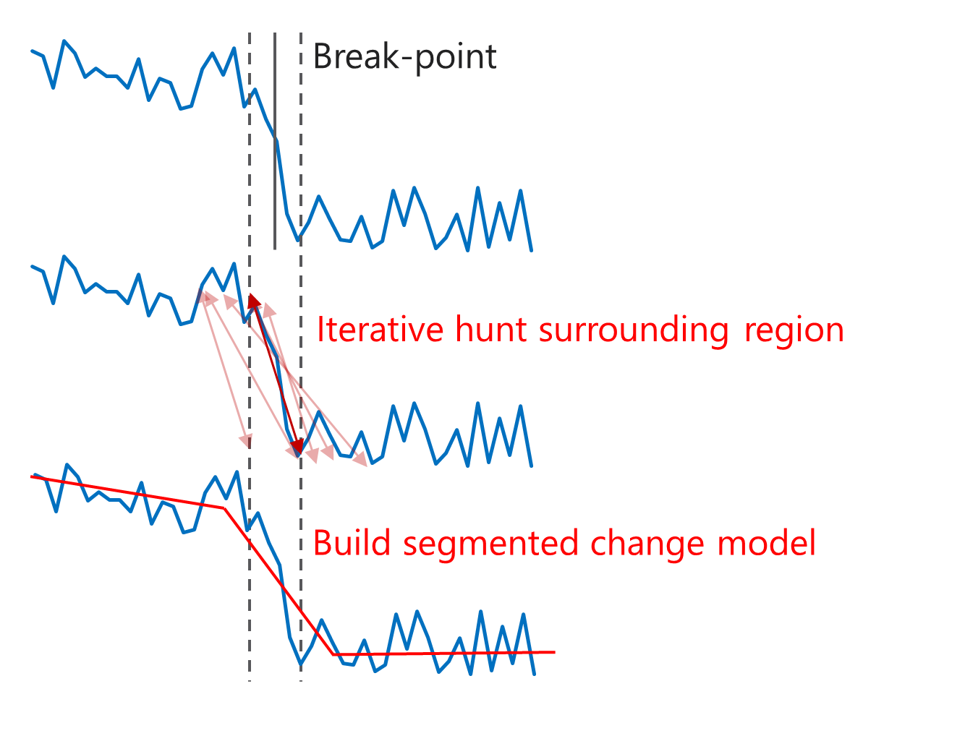
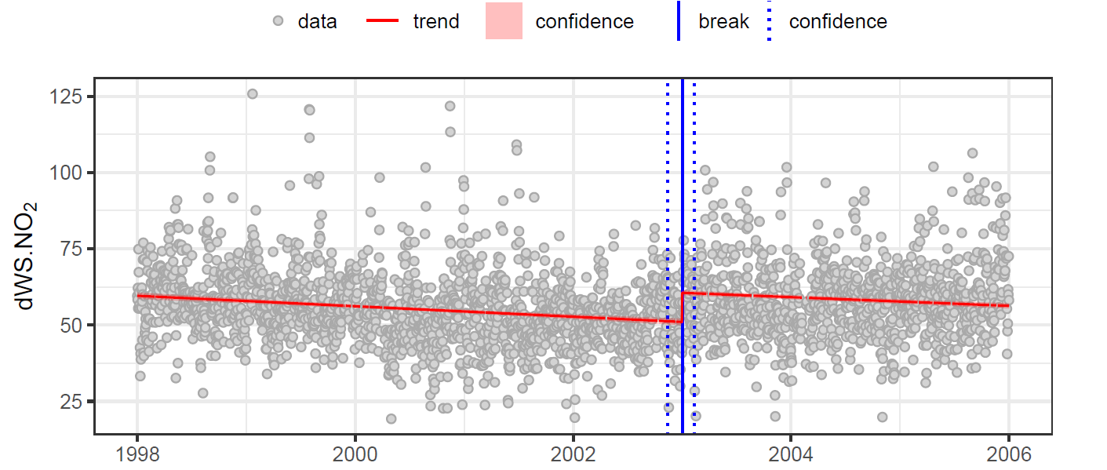
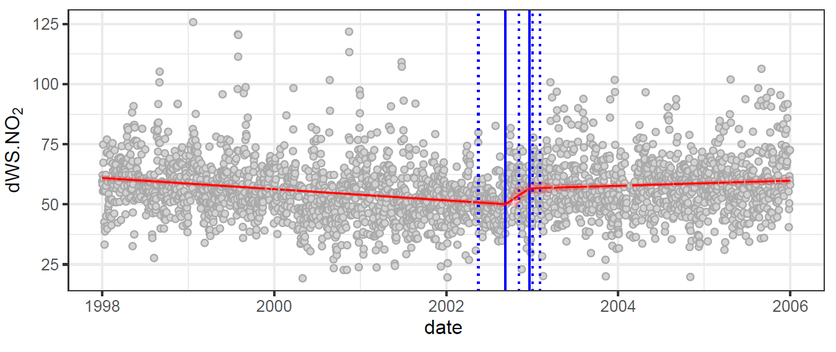
Break-segment Fitting and Quantification
However, break-points are instantaneous changes and no real-world intervention is ever likely to deliver such an abrupt change…
So, we use the break regions as a starting point to test for more gradual change, and build a more realistic model
[REF: Muggeo, M.R., 2008. R News, 8/1, 20-25]
R Package AQEval [GENERAL DOCUMENT] Extra Slide

Slide 5
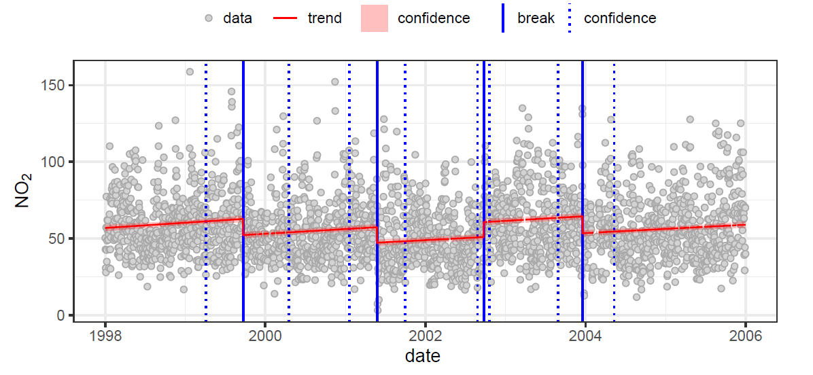
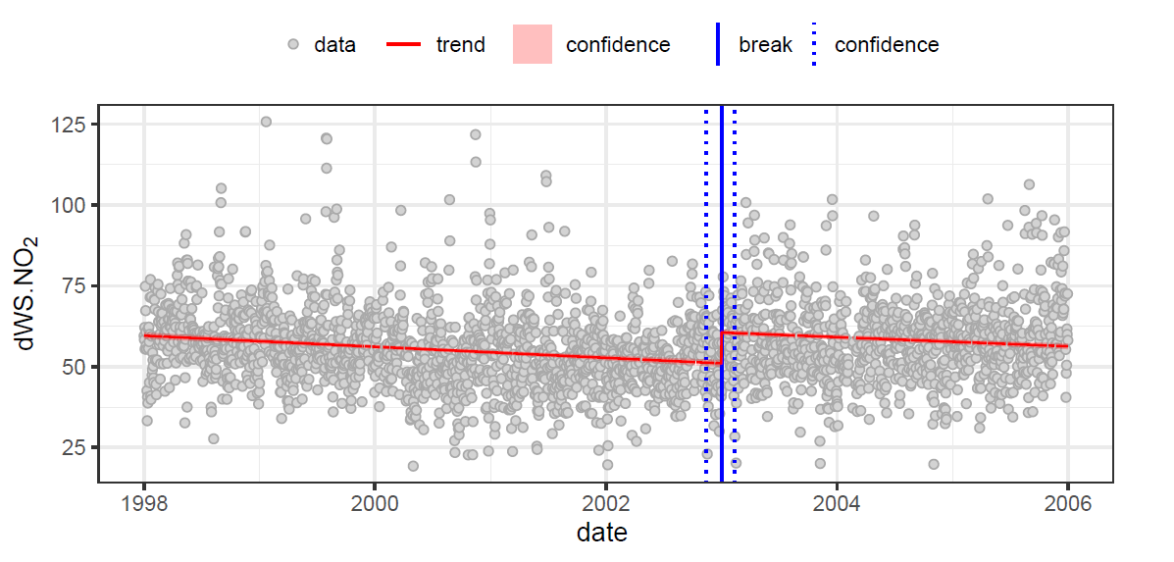
(Data Pre-processing) Signal Isolation
Multiple inputs often contribute to an air quality time-series (e.g. other sources, meteorology, etc) and any of these can produce change events…
Direct use with ambient data is often hindered by variance from other site contributions, e.g. weather, temperature, seasonal cycles, etc.
So, we also include functions for various signal isolations:
deseasonalisation
deweathering,
background subtraction
R Package AQEval [GENERAL DOCUMENT] Extra Slide

Slide 6
AQEval Pre-release R Package Installation
Installation
For A bundled version of AQEval (AQEval_0.1.3.tar.gz or later)
Copy file to a known directory, run R (or RStudio) and install using the following:
In R (or RStudio):
(if you do not have devtools package, install that first, then...)
Once released, the intention is to make AQEval freely available under General Public License via on-line archives (CRAN and GitHub).
In the meantime, the pre-release version is shared as an ‘tar ball’ bundle for testing and evaluation as part of software development, and for informal review and feedback
devtools::install_local(file.choose())
#and select the AQEval file
When you want to use AQEval, load it like any other specialist packages:
require(AQEval)
(Help documentation like other R packages)
R Package AQEval [GENERAL DOCUMENT] Extra Slide

Slide 7
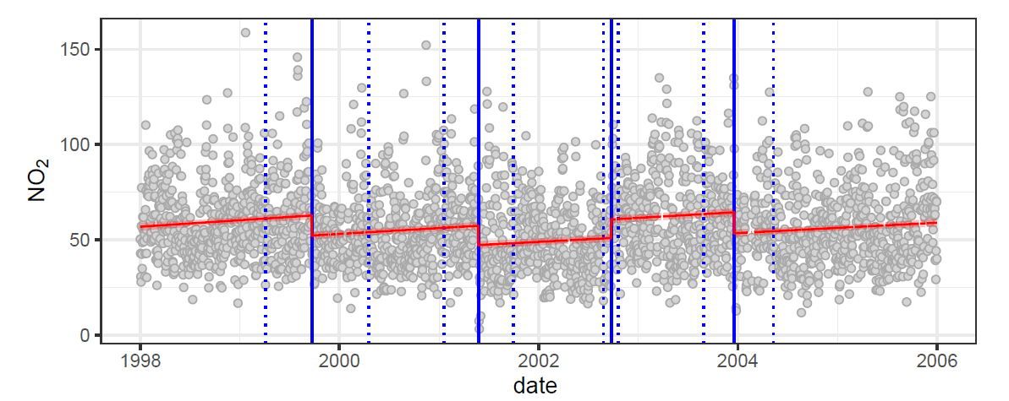
Basic AQEval Usage (1)
AQEval functions are coded in a similar style to openair (Carslaw & Ropkins, 2012), so the two can be easily used in combination
Example using 1998-2005 data from the London Ealing EA2 AURN site. Get data EA2 from the online KCL archive and convert to daily time-series, using openair:
require(openair)
ea.1998.2005 <- importKCL("ea2", year=1998:2005, met=TRUE)
ea.1998.2005.day <- timeAverage(ea.1998.2005, avg.time="day")
Apply AQEval function quantBreakPoints in form:
quantBreakPoints(ea.1998.2005.day, "no2", h=0.1)
The inputs are your data set, the time-series to be analysed and the break time-window to apply
R Package AQEval [GENERAL DOCUMENT] Extra Slide

Slide 8
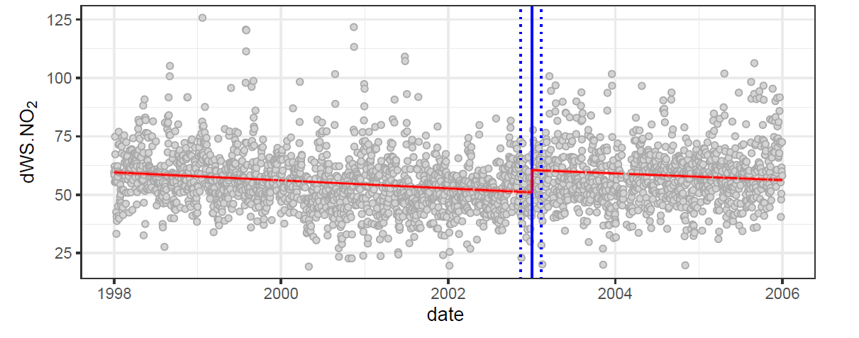
Basic AQEval Usage (2)
Deseasonaling and deweathering data before break-point testing
Using same data set and AQEval function isolateContribution:
ea.1998.2005$dWS.no2 <- isolateContribution(ea.1998.2005, "no2")
(By default, this builds and subtracts a model of wind speed/direction, hour-of-day and day-of-year, so applying it at 1-hour resolution, then handling the deweathered/deseasonalised, dWS, data as NO₂ was before)
ea.1998.2005.day <- timeAverage(ea.1998.2005, avg.time="day")
quantBreakPoints(ea.1998.2005.day, "dWS.no2", h=0.1)
Note: This requires openair-friendly date (time stamp in date column, wind speed and direction as wd and ws)
R Package AQEval [GENERAL DOCUMENT] Extra Slide

Slide 9
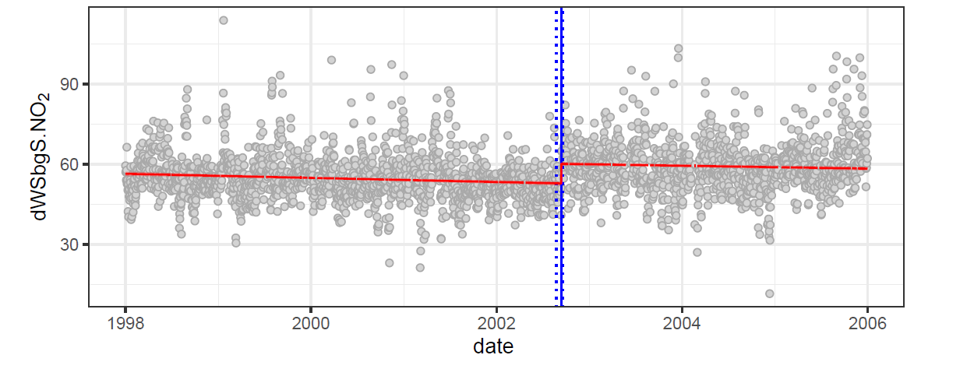
Basic AQEval Usage (3)
Expanding the local isolation model
Subtracting a local background, here London Kensington & Chelsea KC1, getting that from AURN (rather than KCL archive) and merging using dplyr before AQEval analysis:
require(dplyr)
kc.1998.2005 <- importAURN("kc1", year=1998:2005, meta=TRUE)
temp <- select(kc.1998.2005, date, no2) %>% rename(bg.no2=no2)
ea.1998.2005 <- left_join(ea.1998.2005, temp)
ea.1998.2005$dWSbgS.no2 <- isolateContribution(ea.1998.2005,
"no2", background="bg.no2")
ea.1998.2005.day <- timeAverage(ea.1998.2005, avg.time="day")
quantBreakPoints(ea.1998.2005.day, "dWSbgS.no2", h=0.1)
R Package AQEval [GENERAL DOCUMENT] Extra Slide

Slide 10
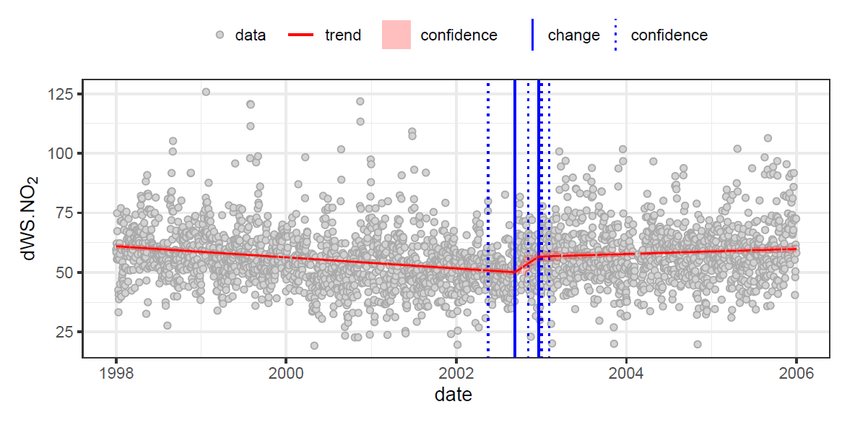
Basic AQEval Usage (4)
And a break-segment instead of a break-point..?
Use qauntBreakSegments instead of quantBreakPoints:
quantBreakSegments(ea.1998.2005.day, "dWSbgS.no2", h=0.1)
(If you have the time, there is a lot more in the package, but hopefully that is enough to get you started…)
R Package AQEval [GENERAL DOCUMENT] Extra Slide

