Slide 1




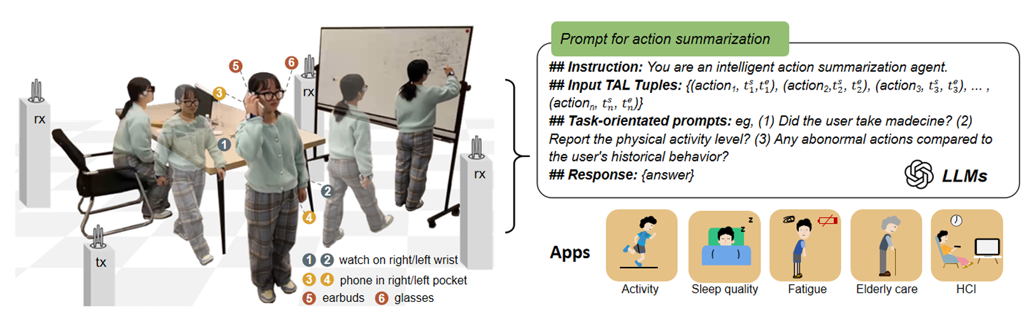
XRF V2: A Dataset for Action Summarization with Wi-Fi Signals, and IMUs in Phones, Watches, Earbuds, and Glasses
Bo Lan*, Pei Li*, Jiaxi Yin, Yunpeng Song, Ge Wang, Han Ding, Jinson Han, Fei Wang
*Equal contribution. Fei Wang initiated and led the project. feynmanw@xjtu.edu.cn.
: ) scan to access
- 30 indoor daily activities
- 853 sequences (16h 16m 8s)
- 16 volunteers
- Paired Wi-Fi, 6 IMUs, RGB+D+IR
- Action localization, Action forecasting, Pose estimation, …
Notes:
Good Day, everyone.
This is the AIOT Group from Xi’an Jiaotong University.
We are happy to introduce the XRF-V2 dataset paper, published in the ubicomp 2025.
Bo Lan*, Pei Li*, and Jiaxi Yin are graduate student with Xi’an Jiaotong University. Yunpeng Song, Ge Wang, and Han Ding are faculties with the Xi’an Jiaotong University. Jinsong Han is a professor with the Zhejiang University. Fei Wang initiated and led the project.

Slide 2

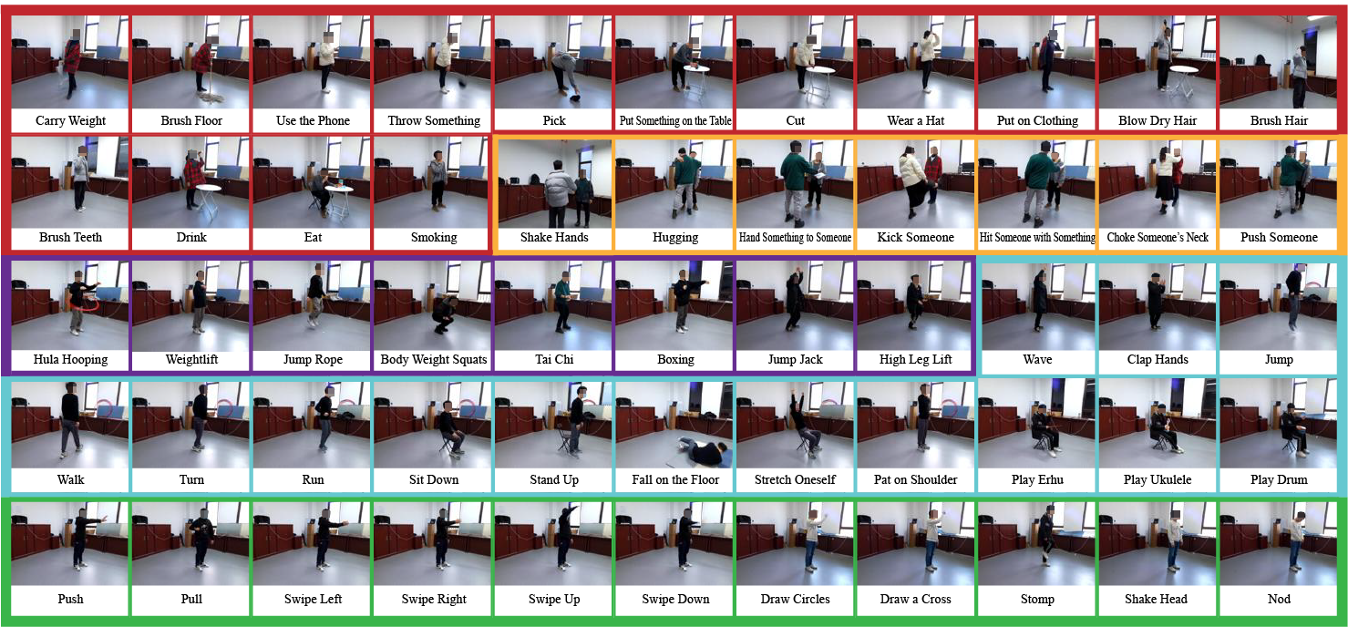

XRF55: A Radio Frequency Dataset for Human Indoor Action Analysis
Fei Wang, Yizhe Lv, Mengdie Zhu, Han Ding, Jinsong Han
: ) scan to access
- 55 action classes
- 42K samples
- Paired Wi-Fi, mm-wave radar, 23 RFID tags, rgb+d+IR videos
Cited by: IoTCoder (MobiCom 2024), ConSense (AAAI 2025), X-Fi (ICLR 2025)
Notes:
Last year, we introduced XRF55, a multi-modal radio frequency sensing dataset for 55-class classification.
Over the past year, it has garnered considerable attention and has been utilized for experimental evaluation in multiple papers from top-tier conferences, such as Mobicom，AAAI，and ICLR.
However, each sample in that dataset represents a 5-second action clip.
This year, we are taking a step further by proposing XRF V2, which is a continuous action dataset.

Slide 3
Human Indoor Action Understanding (HIAU): Enabling Intelligent Environment
What is HIAU? Human Indoor Action Understanding (HIAU) is a broad concept focused on enabling intelligent environments through the understanding of human actions.
Key applications:
Health monitoring
Smart home automation
Human-computer interaction
A traditional studied aspect of HIAU: HAR (Human Action Recognition)
HAR aims to identify discrete human actions by leveraging data from diverse modal sensors, such as smartwatches, smartphones, earbuds, smart glasses, and Wi-Fi signals
What’s Next in HIAU?
What other tasks are crucial for building smarter environments?
(Walking->Sit down->Eat something)
Notes:
We know Human Indoor Action Understanding aims to make our environments intelligent by understanding human actions.
The most established task is Human Action.
However, HAR's focus on isolated actions limits its ability to interpret the continuous, flowing nature of daily life.
What’s Next in Human Indoor Action Understanding for building smarter environments?

Slide 4
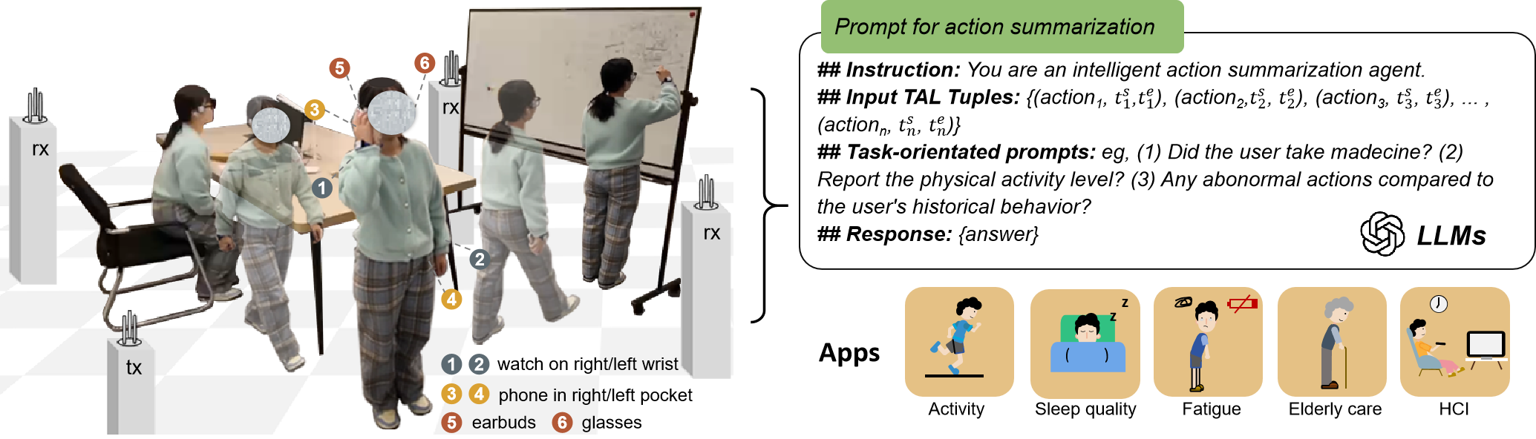
A New HIAU Task: Action Summarization
Applications:
Health Monitoring: fitness goals, irregular movement, …
Elderly Care: Detect critical events, missed medication, …
Smart Home Automation: Adaptive responses based on actions, …
Personal Assistants: Summarize daily routines to assist with task planning, …
Action Summarization: Understanding Continuous Actions
Recognizing continuous indoor actions, and capturing their start and end times.
Leveraging large language models (LLMs) to generate insights, detect anomalies (e.g., falls, missed medication), and summarize behavior patterns.
Key Technology: Temporal Action Localization (TAL): Accurately identifying the start and end times of actions to form the basis for action summarization.
Notes:
We think it could be the Action Summarization task.
As shown in the figure, for a person's continuous activities, Action Summarization can detect the start and end time of each action.
Based on these detection results, we can then integrate large language models to generate insights, detect anomalies (e.g., falls, missed medication), and summarize behavior patterns.

Slide 5
Existing Datasets Present Limitations for Action Summarization
Video-Based TAL Datasets
Task-specific : YouCook2 , Breakfast Dataset, 50Salads, lacks diversity, not generalizable to other types of everyday indoor activities
Focused on outdoor/sport: FineAction, THUMOS14, ActivityNet, not representative of daily indoor scenarios.
Privacy concerns: HACS Segment, ActivityNet, reliance on cameras limits indoor monitoring applications.
Indoor-Focused Datasets – Limitations
Ego-ADL : Lacks key motion-sensing data, missing hands/head movement; privacy concerns due to audio reliance.
WiFiTAD : Small dataset, poor generalizability only three participants, seven actions, a single scene).
Notes:
To advance indoor action summarization, a dedicated dataset is essential, but existing options present several limitations.
Most datasets are video-based, designed for specific tasks like cooking or outdoor activities.
While some indoor-focused datasets exist, they have notable constraints.
For example, Ego-ADL lacks critical hand and head motion data and relies on audio, which poses privacy risks.
WiFiTAD, with only three participants, seven actions, and a single scene.

Slide 6
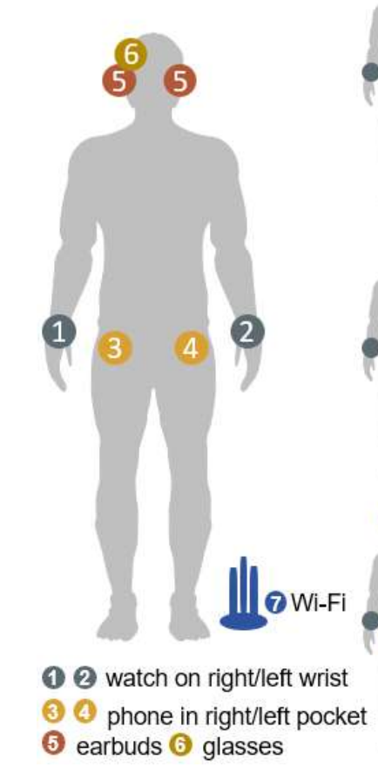
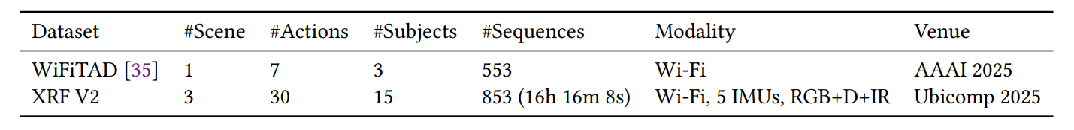
XRF V2: A Novel Dataset for Indoor Action Summarization
Multimodal Data: Wi-Fi signals, IMU sensors (smartphones, smartwatches, headphones, smart glasses), synchronized video.
Diverse Environments: Dining room, study room, bedroom.
Data Statistics:
16 participants, 30 unique indoor actions
16 hours 16 minutes of recordings
853 annotated action sequences
Covers daily activities (e.g., sleeping, cutting fruit, taking medicine).
Compared to WiFiTAD: More comprehensive benchmark for action summarization.
Notes:
XRF V2 leverages multi-modal data, combining Wi-Fi signals and IMU data from five wearable devices (smartphones, smartwatches, earbuds, smart glasses) with video recordings.
Data was collected across three indoor settings—dining room, study room, and bedroom.
The dataset includes 16 participants performing 30 diverse indoor actions, from sleeping to food preparation, yielding over 16 hours of data and 853 annotated sequences.
Compared to WiFiTAD, XRF V2 excels in scale, diversity, and modalities.

Slide 7
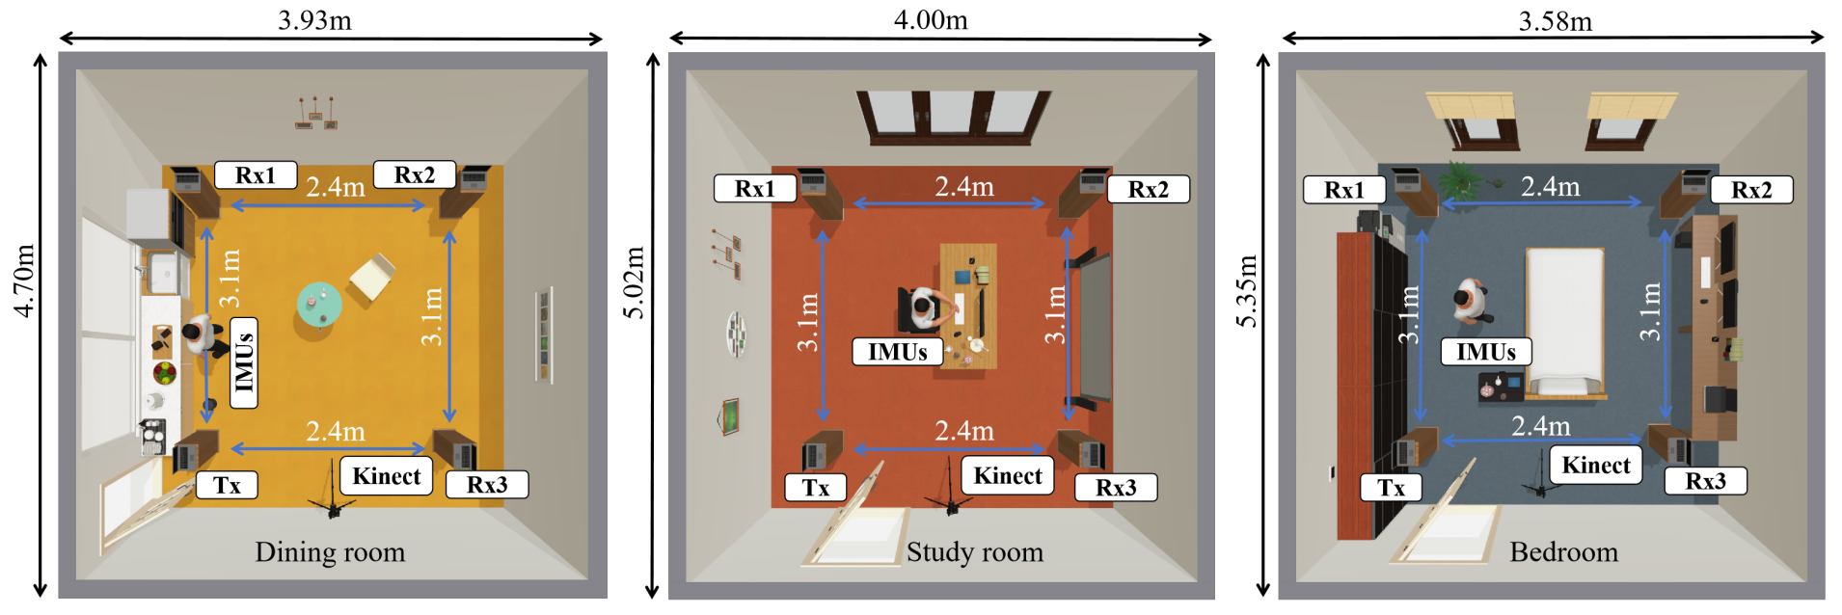
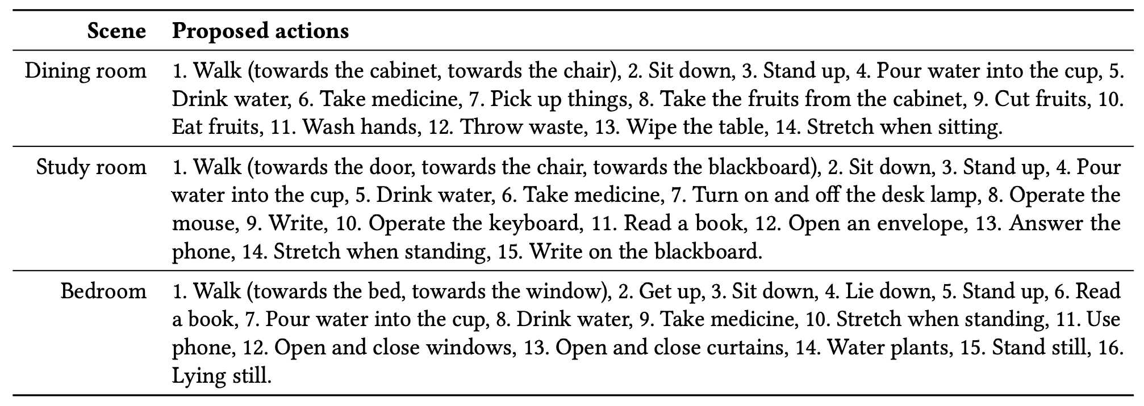
Diverse Indoor Scenarios & Actions
Three Typical Household Scenarios:
Dining Room → Eating-related actions
Study Room → Work & study activities
Bedroom → Sleeping & relaxation actions
Health-related: Taking medicine, drinking water, washing hands, stretching, …
Device interaction: Opening curtains, turning on lights, …
Others: Write, Answer the phone, …
Notes:
In the dining room, actions like eating or cutting fruit, reflect dietary habits, supporting health monitoring.
In the study room, study activities such as typing or reading, reveal work and study patterns, enabling smart assistants for time management.
In the bedroom, actions like taking medicine and sleeping, track health-related behaviors, aiding real-time health interventions.

Slide 8
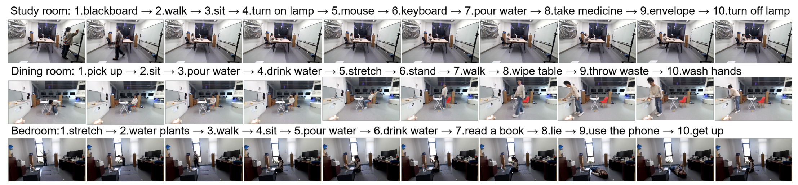
Continuous Action Sequences Example
Notes:
In this slide, we present three representative sequences from XRF V2, one for each indoor scenario.
Each sequence typically includes 7–12 actions, with individual actions lasting 5–20 seconds.
These are not random combinations of actions, but rather coherent sequences with contextual and semantic continuity.

Slide 9
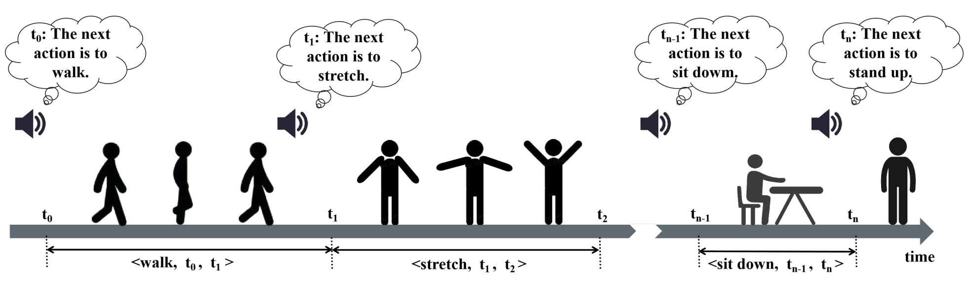
How Was the XRF V2 Dataset Collected and Annotated?
16 volunteers aged 22-34, with heights between 1.57-1.82 meters and weights from 43-90 kg.
Recruit Volunteers
Collect each volunteer’s personal habitual action sequences based on their daily routines in different indoor environments.
Action Habit Sequences
Adjust action durations to ensure sequences are realistic, typically ranging from 5-20 seconds, to ensure efficiency in data collection.
Adjust Action Duration
Automatically Annotate Data
Notes:
We recruited 16 volunteers to perform actions.
For annotation, we used an automated method: We pre-set the sequence of actions to be performed and randomly set the start and end times for each one.
An automated voice prompt would then announce the next action for the user. Upon hearing the voice, the user would perform the announced action.
The pre-set action sequence, along with its start and end times, was then used as the annotation for the sequence.

Slide 10
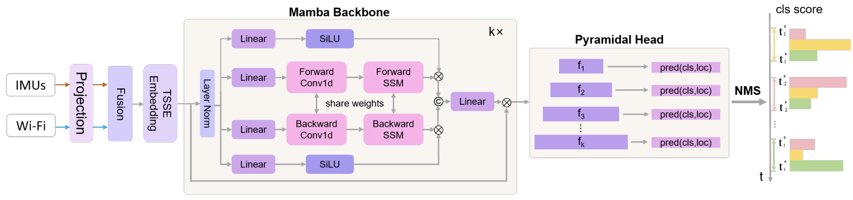
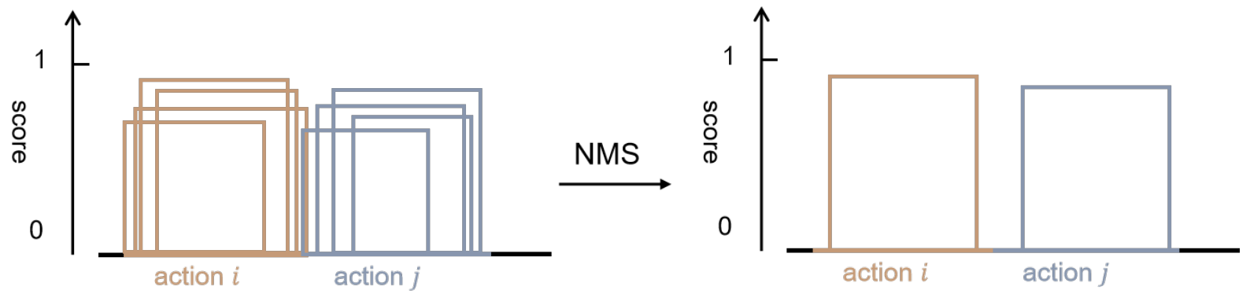
XRFMamba: Advancing Temporal Action Localization for Action Summarization
XRFMamba: is designed to accurately perform Temporal Action Localization (TAL)
Leveraging Mamba Architecture: Based on the State Space Model (SSM) and Mamba blocks, XRFMamba excels at capturing long-term dependencies in temporal sequences
TAL Process in XRFMamba: XRFMamba identifies actions within specific time spans by determining start and end times. It handles multiple localization predictions using Non-Maximum Suppression (NMS), ensuring only the best result is retained for each action.
Notes:
To achieve precise action summarization, we introduce XRFMamba, a Temporal Action Localization (TAL) method built on the Mamba architecture.
The Mamba architecture excels at modeling long-term dependencies in temporal data，and memory efficient.
Novelly, XRFMamba detects temporal actions in sequences as detect spatial objects in an image, which both output bounding box of the interests. Thus, we adopt the YOLO framework for our task.
Like YOLO, XRFMamba generates multiple temporal proposals, refined by Non-Maximum Suppression to remove redundant segments.
We use the intersection over union (IoU) between the predicted action time and the ground truth time, referred to as tIoU to evaluate the performance of Temporal Action Localization.

Slide 11
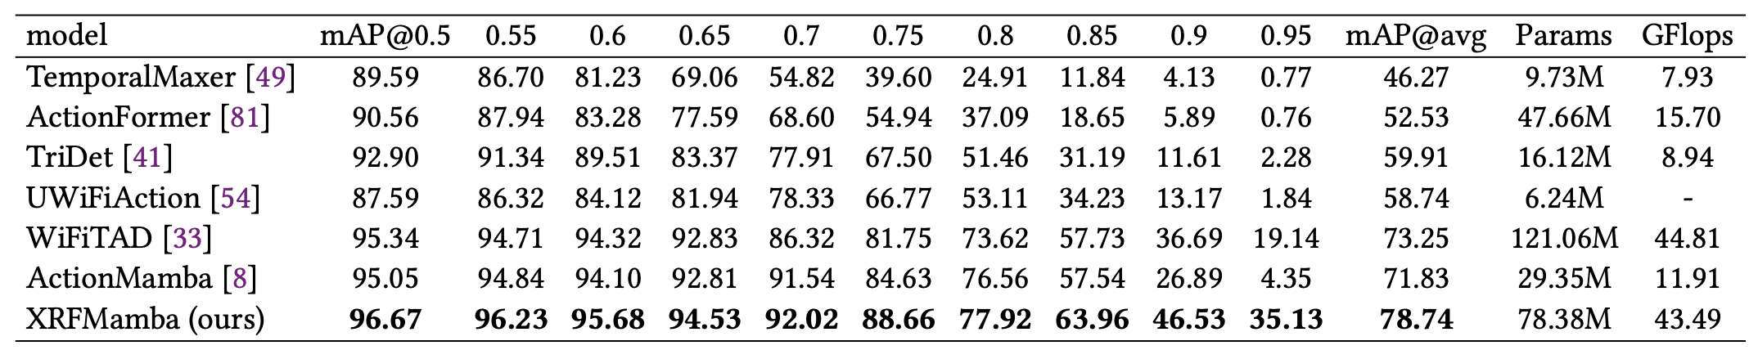
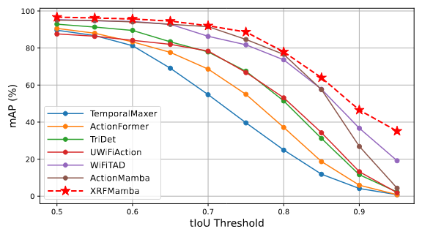
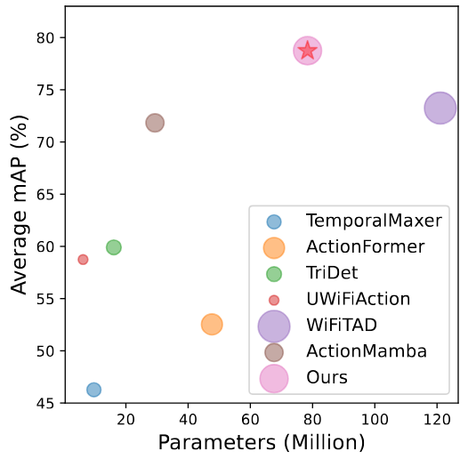
XRFMamba: Superior Performance in Action Localization
Comparison with Leading Models: XRFMamba outperforms several advanced methods such as ActionFormer, TriDet, ActionMamba, TemporalMaxer, UWiFiAction, and WiFiTAD.
Improved Performance:
XRFMamba achieves a 5.49-point improvement in mAP compared to WiFiTAD.
It uses 35% fewer parameters than existing models, making it more efficient.
Notes:
As shown in the table and figures, XRFMamba outperforms existing methods, e.g., achieves a 5.49 mAP improvement over WiFiTAD, with 35% fewer parameters, demonstrating superior accuracy and efficiency.

Slide 12
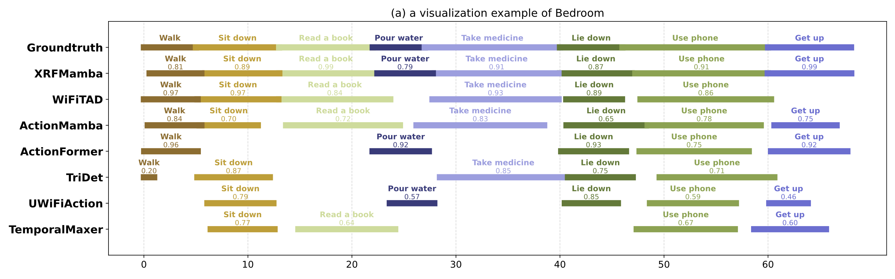
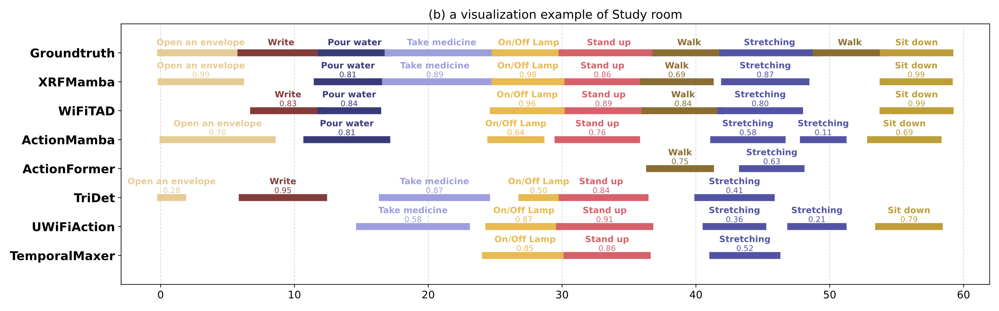
XRFMamba: Superior Performance in Action Localization
Notes:
The visualization results clearly confirm that XRFMamba delivers more accurate temporal boundaries than other strong baselines.

Slide 13
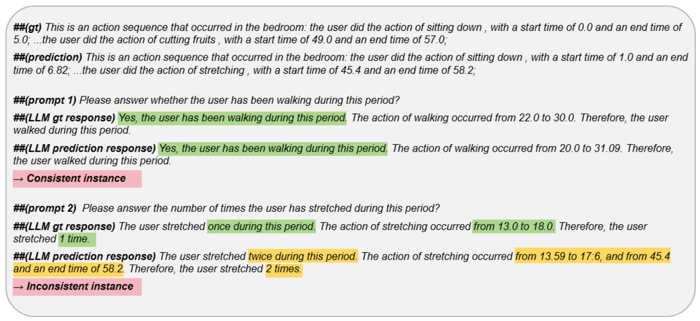
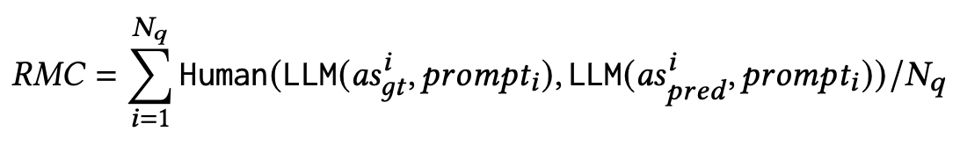
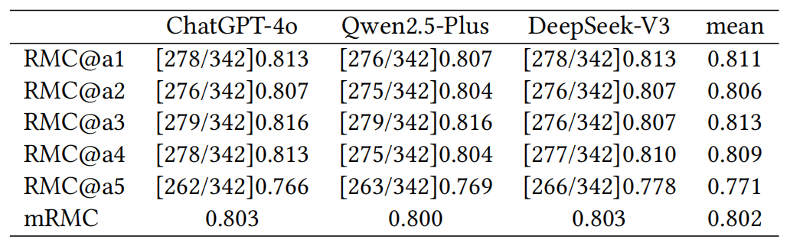
Summarization Results: Evaluating XRFMamba with LLMs
Action sequences are provided to large language models (LLMs) like ChatGPT4, Qwen2.5-Plus, and DeepSeek-V3. These models generate summaries based on predicted actions and their start/end times.
Response Meaning Consistency (RMC): A new evaluation metric, Response Meaning Consistency (RMC), measures the alignment between predicted action summaries and ground truth.
XRFMamba achieves high RMC
Notes:
To assess XRFMamba’s performance in action summarization, we fed its predicted action sequences to large language models (ChatGPT-4, Qwen2.5-Plus, DeepSeek-V3) to generate summaries.
We introduced a new metric, Response Meaning Consistency (RMC), to evaluate summary quality by measuring alignment with human-annotated ground truth for actions and their timing.
For example, if a prompt asks, “Did the user walk during this period?” and both ground truth and LLM response answer “yes,” it’s a consistent instance.
XRFMamba consistently earned high RMC scores across all LLMs, supporting the downstream LLM reasoning applications.
We have provided more details and all 27 Q&A prompts for action summarization in our paper’s appendix.

Slide 14
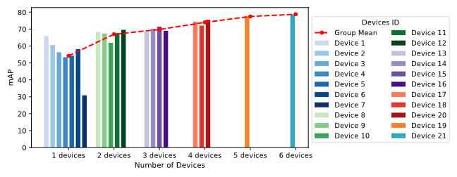
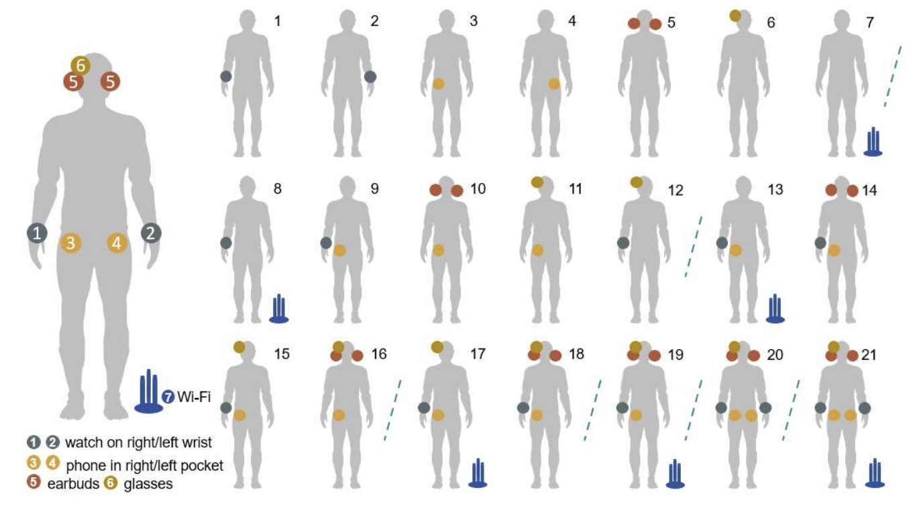
Device Combination Flexibility in XRF V2 Dataset
Multiple Device Types Supported: The XRF V2 dataset includes Wi-Fi signals and IMU data from five types of devices: phones, smartwatches, earbuds, and glasses.
Examples of common combinations:
Case1: A right-hand-worn smartwatch (mAP: 65.81)
Case 9: Phone + Smartwatch (mAP: 67.38)
Case 14: Phone + Smartwatch + Earbud (mAP: 70.23)
Case 17: Phone + Smartwatch + Glasses + Wi-Fi (74.35)
This flexibility allows for optimized performance and versatile usage in different real-world applications.
Notes:
So we tested various device combinations, and results show robust performance even with fewer devices.
This proves XRF V2 supports both multi-device setups and flexible user-selected device combinations.

Slide 15
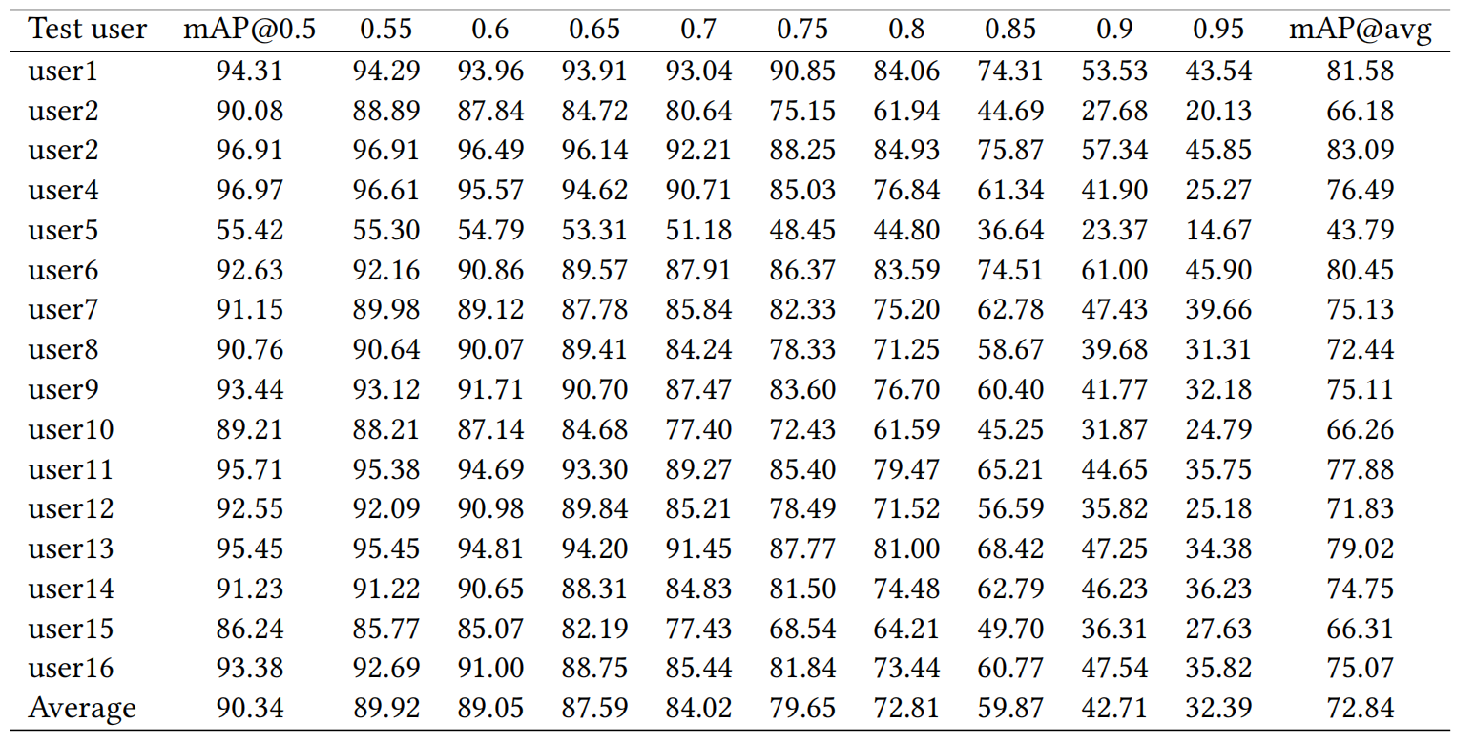
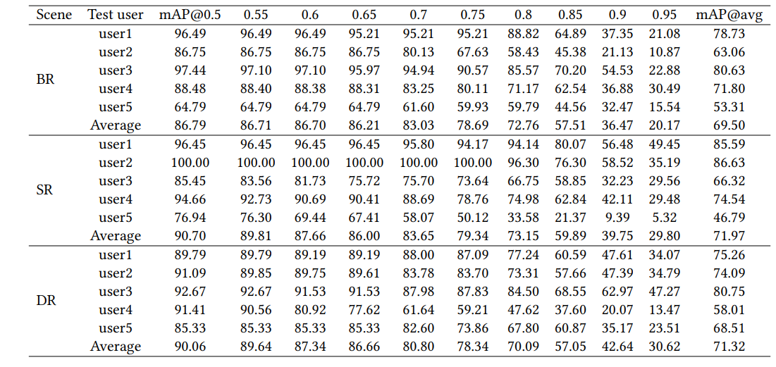
Good Zero-shot Generalizability
Zero-shot evaluation on new users:
mAP for new users: 0.72 mAP
Zero-shot evaluation in a unseen apartment:
mAP for new users: 0.70 mAP
Leave-one-person-out results.
5-volunteer test in a new apartment
Notes:
We conducted leave-one-person-out experiments.
Additionally, we recruited volunteers to perform a real-world zero-shot evaluation in an unseen apartment.
These two results demonstrate that our XFMamba has strong generalization capabilities.

Slide 16
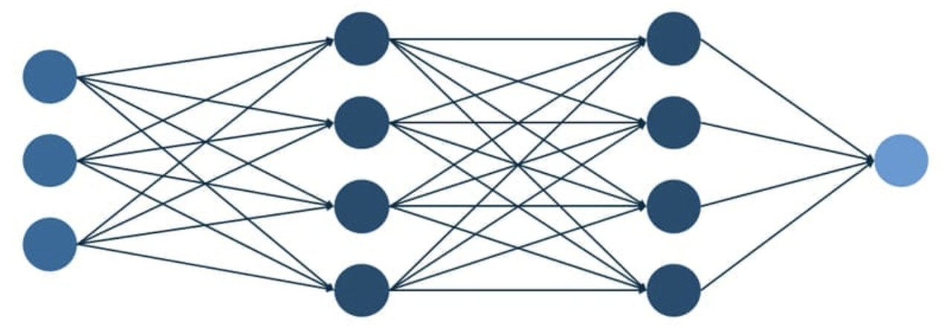
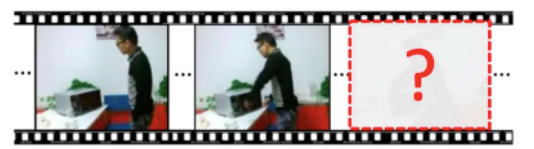
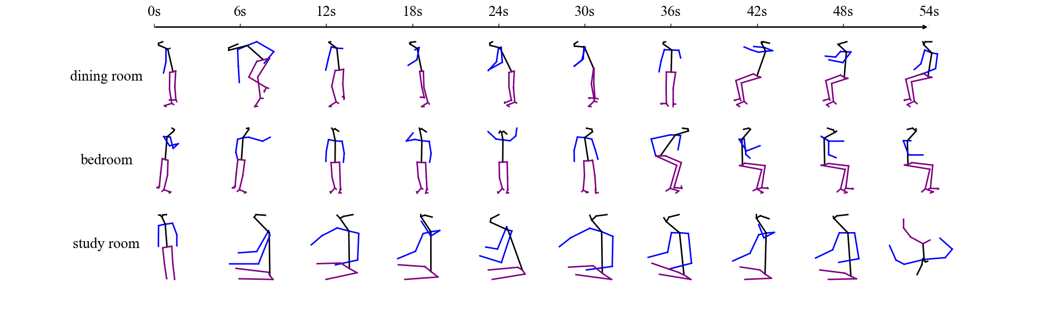
XRF V2: Unlocking New Research Opportunities
1. Advanced Action Summarization Models
2. Weakly Supervised & Unsupervised TAL
Develop more precise and efficient action summarization algorithms
Investigate methods to infer temporal action boundaries with limited or no labeled data.
Improve TAL efficiency for real-time applications in smart environments.
3. Future End-to-End Summarization
4. Next Action Prediction & Proactive AI
Explore end-to-end LLM methods for direct action summarization.
Investigate tokenization and alignment techniques for Wi-Fi and IMU time-series data.
Build predictive models that anticipate user actions for seamless smart home automation.
5. Continuous 2D Pose Estimation, Tracking, and Prediction
XRF V2 dataset provides continuous 2D pose data, enabling pose estimation, tracking, and prediction.
It captures dynamic and varied human behaviors, making it more representative of real-world scenarios than prior datasets.
Notes:
We envision XRF V2 dataset could open up new research opportunities across multiple fields.
For example, XRF V2 serves as a key benchmark for action summarization across daily devices.
It also supports weakly-supervised action localization, learning from category labels alone without precise timestamps.
Future work can also explore end-to-end methods. This may involves using LLMs to directly understand and summarize raw Wi-Fi and IMU signals.
Besides, XRF V2 dataset provides continuous 2D pose data, enabling pose estimation, tracking, and prediction.

Slide 17
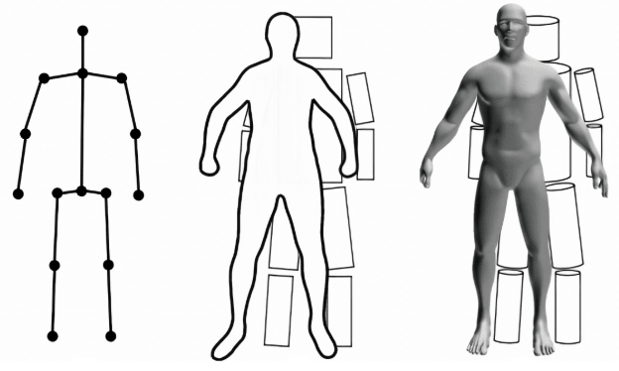
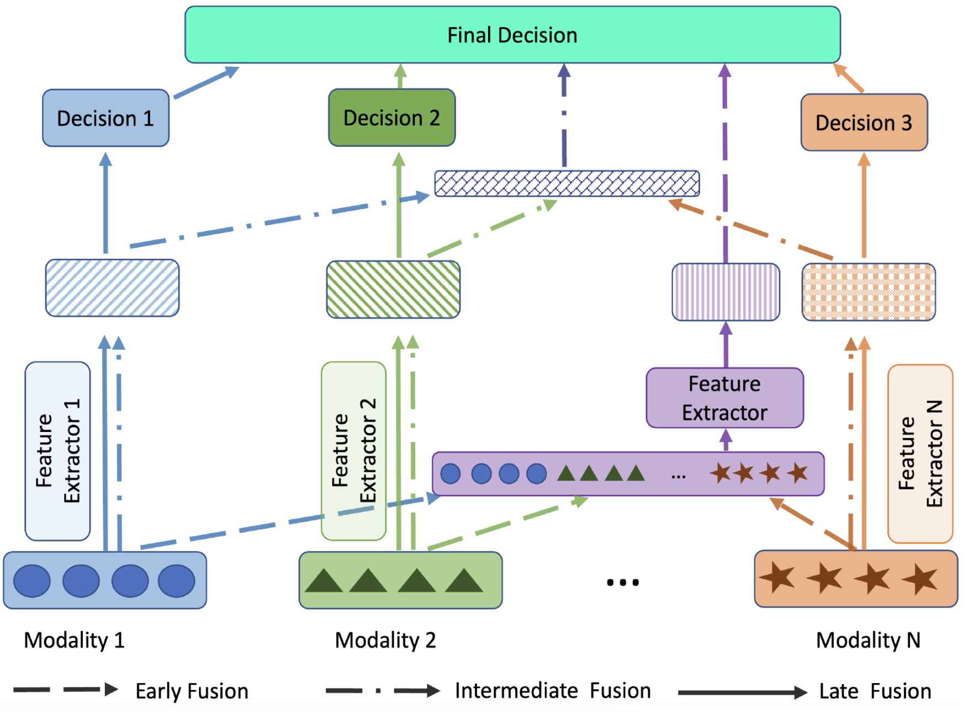
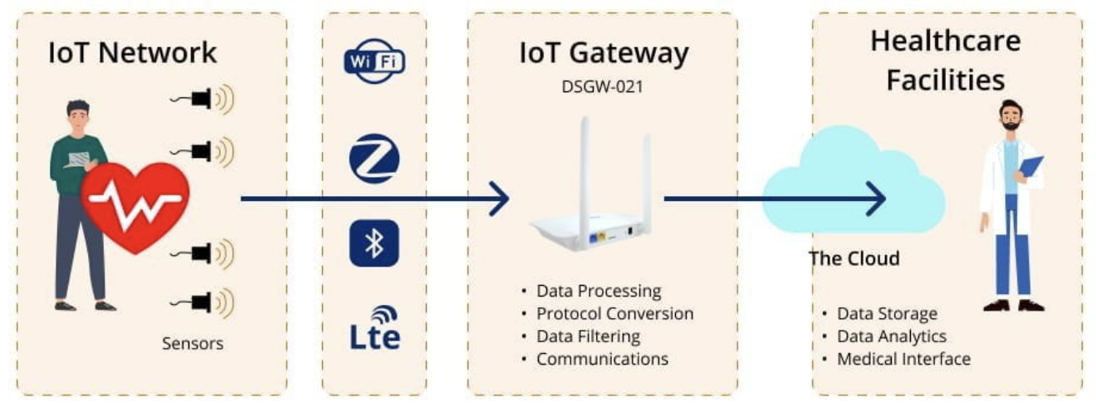
XRF V2: Unlocking New Research Opportunities
6. 3D Human Motion Extensions
7. Realistic Data Generation
we plan to gradually extend the dataset with 3D human pose, mesh, and densepose data to enable finer-grained human sensing research.
Serves as a benchmark for advancing realistic IMU and Wi-Fi data generation.
Reduces reliance on costly data collection and improves domain generalization.
8. Sensor Fusion & Multimodal Learning
9. Real-World Applications & Deployment
Enhance Wi-Fi and IMU fusion models for robust action recognition.
Develop cross-modal foundational models using processed video features.
Develop real-time ambient sensing for elderly care, health monitoring, and home automation.
Notes:
We also plan to extend the dataset to include 3D human pose, 3D human mesh, and densepose data.
XRF V2 can also serve as a high-quality resources for developing and evaluating synthetic IMU and Wi-Fi data generation techniques.
It also supports multimodal learning, bridging IMU, Wi-Fi, and video.

Slide 18

Thank you! Q&A!
We welcome discussion and collaboration!
Fei Wang (王飞)
Associate Professor, Xi’an Jiaotong University, China
feynmanw@xjtu.edu.cn
: ) scan to access
- 30 indoor daily activities
- 853 sequences (16h 16m 8s)
- 16 volunteers
- Paired Wi-Fi, 6 IMUs, RGB+D+IR
- Action localization, Action forecasting, Pose estimation, …
To access XRF V2, https://github.com/aiotgroup/XRFV2
Notes:
Please scan this QR-code to add Dr. Fei Wang on WeChat for discussion and communication.
We look forward to feedbacks and collaboration!
Thank you for your attention!

