Slide 1
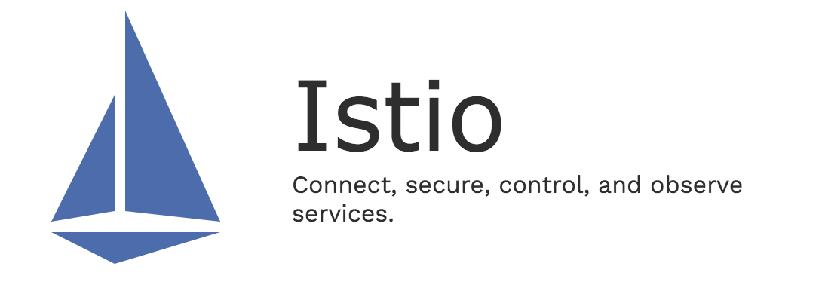
安全

Slide 2
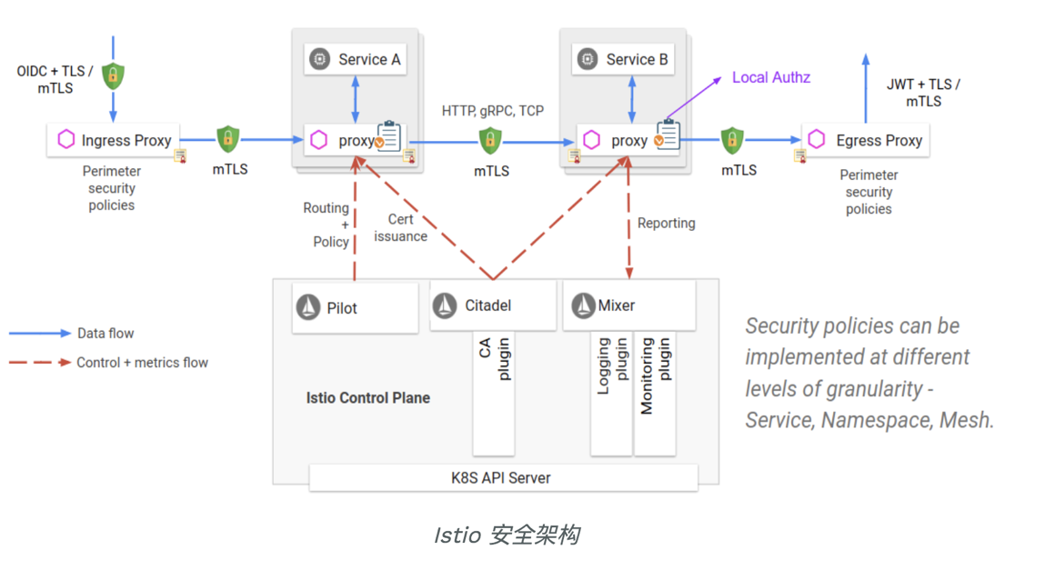
Notes:
citadel

Slide 3
概念
Policy/meshPolicy：认证策略
rbacConfig：RBAC授权配置
serviceRole&serviceRoleBinding：服务角色&服务角色绑定

Slide 4
认证
kubectl create ns foo
kubectl apply -f <(istioctl kube-inject -f samples/httpbin/httpbin.yaml) -n foo
kubectl apply -f <(istioctl kube-inject -f samples/sleep/sleep.yaml) -n foo
kubectl create ns bar
kubectl apply -f <(istioctl kube-inject -f samples/httpbin/httpbin.yaml) -n bar
kubectl apply -f <(istioctl kube-inject -f samples/sleep/sleep.yaml) -n bar
kubectl create ns legacy
kubectl apply -f samples/httpbin/httpbin.yaml -n legacy
kubectl apply -f samples/sleep/sleep.yaml -n legacy

Slide 5
认证
//都ok
for from in "foo" "bar" "legacy"; do for to in "foo" "bar" "legacy"; do kubectl exec $(kubectl get pod -l app=sleep -n ${from} -o jsonpath={.items..metadata.name}) -c sleep -n ${from} -- curl "http://httpbin.${to}:8000/ip" -s -o /dev/null -w "sleep.${from} to httpbin.${to}: %{http_code}\n"; done; done
//没有policy
kubectl get policy --all-namespaces
kubectl get meshpolicy
//host中没有foo、bar、lagacy下的service
kubectl get destinationrules --all-namespaces -o yaml | grep "host:"

Slide 6
认证-全局TLS
kubectl apply -f mp-default.yaml
//fail
for from in "foo" "bar"; do for to in "foo" "bar"; do kubectl exec $(kubectl get pod -l app=sleep -n ${from} -o jsonpath={.items..metadata.name}) -c sleep -n ${from} -- curl "http://httpbin.${to}:8000/ip" -s -o /dev/null -w "sleep.${from} to httpbin.${to}: %{http_code}\n"; done; done
kubectl apply -f dr-default.yaml
for from in "foo" "bar"; do for to in "foo" "bar"; do kubectl exec $(kubectl get pod -l app=sleep -n ${from} -o jsonpath={.items..metadata.name}) -c sleep -n ${from} -- curl "http://httpbin.${to}:8000/ip" -s -o /dev/null -w "sleep.${from} to httpbin.${to}: %{http_code}\n"; done; done
//fail
for from in "legacy"; do for to in "foo" "bar"; do kubectl exec $(kubectl get pod -l app=sleep -n ${from} -o jsonpath={.items..metadata.name}) -c sleep -n ${from} -- curl "http://httpbin.${to}:8000/ip" -s -o /dev/null -w "sleep.${from} to httpbin.${to}: %{http_code}\n"; done; done
//fail
for from in "foo" "bar"; do for to in "legacy"; do kubectl exec $(kubectl get pod -l app=sleep -n ${from} -o jsonpath={.items..metadata.name}) -c sleep -n ${from} -- curl "http://httpbin.${to}:8000/ip" -s -o /dev/null -w "sleep.${from} to httpbin.${to}: %{http_code}\n"; done; done

Slide 7
认证-全局TLS
kubectl apply -f dr-httpbin-legacy.yaml
for from in "foo" "bar"; do for to in "legacy"; do kubectl exec $(kubectl get pod -l app=sleep -n ${from} -o jsonpath={.items..metadata.name}) -c sleep -n ${from} -- curl "http://httpbin.${to}:8000/ip" -s -o /dev/null -w "sleep.${from} to httpbin.${to}: %{http_code}\n"; done; done
TOKEN=$(kubectl describe secret $(kubectl get secrets | grep default-token | cut -f1 -d ' ' | head -1) | grep -E '^token' | cut -f2 -d':' | tr -d '\t')
//fail
kubectl exec $(kubectl get pod -l app=sleep -n foo -o jsonpath={.items..metadata.name}) -c sleep -n foo -- curl https://kubernetes.default/api --header "Authorization: Bearer $TOKEN" --insecure -s -o /dev/null -w "%{http_code}\n"
kubectl apply -f dr-api-server.yaml
//403
kubectl exec $(kubectl get pod -l app=sleep -n foo -o jsonpath={.items..metadata.name}) -c sleep -n foo -- curl https://kubernetes.default/api --header "Authorization: Bearer $TOKEN" --insecure -s -o /dev/null -w "%{http_code}\n"

Slide 8
认证-全局TLS
kubectl delete meshpolicy default
kubectl delete destinationrules httpbin-legacy -n legacy
kubectl delete destinationrules api-server -n istio-system
kubectl delete destinationrules default -n istio-system

Slide 9
认证-NS TLS
kubectl apply -f dr-default.yaml
kubectl apply -f dr-default-ns.yaml
//sleep.legacy to httpbin.foo fail
for from in "foo" "bar" "legacy"; do for to in "foo" "bar" "legacy"; do kubectl exec $(kubectl get pod -l app=sleep -n ${from} -o jsonpath={.items..metadata.name}) -c sleep -n ${from} -- curl "http://httpbin.${to}:8000/ip" -s -o /dev/null -w "sleep.${from} to httpbin.${to}: %{http_code}\n"; done; done

Slide 10
认证-Service TLS
kubectl apply -n bar -f p-httpbin.yaml
kubectl apply -n bar -f dr-httpbin.yaml
//sleep.legacy to httpbin.foo & sleep.legacy to httpbin.bar fail
for from in "foo" "bar" "legacy"; do for to in "foo" "bar" "legacy"; do kubectl exec $(kubectl get pod -l app=sleep -n ${from} -o jsonpath={.items..metadata.name}) -c sleep -n ${from} -- curl "http://httpbin.${to}:8000/ip" -s -o /dev/null -w "sleep.${from} to httpbin.${to}: %{http_code}\n"; done; done

Slide 11
认证-Service TLS
kubectl apply -n bar -f p-httpbin-port.yaml
kubectl apply -n bar -f dr-httpbin-port.yaml
//sleep.legacy to httpbin.foo fail
for from in "foo" "bar" "legacy"; do for to in "foo" "bar" "legacy"; do kubectl exec $(kubectl get pod -l app=sleep -n ${from} -o jsonpath={.items..metadata.name}) -c sleep -n ${from} -- curl "http://httpbin.${to}:8000/ip" -s -o /dev/null -w "sleep.${from} to httpbin.${to}: %{http_code}\n"; done; done

Slide 12
认证-Service TLS
kubectl apply -n foo -f p-overwrite-example.yaml
kubectl apply -n foo -f dr-overwrite-example.yaml
for from in "foo" "bar" "legacy"; do for to in "foo" "bar" "legacy"; do kubectl exec $(kubectl get pod -l app=sleep -n ${from} -o jsonpath={.items..metadata.name}) -c sleep -n ${from} -- curl "http://httpbin.${to}:8000/ip" -s -o /dev/null -w "sleep.${from} to httpbin.${to}: %{http_code}\n"; done; done

Slide 13
认证-Service TLS
kubectl delete policy default overwrite-example -n foo
kubectl delete policy httpbin -n bar
kubectl delete destinationrules default overwrite-example -n foo
kubectl delete destinationrules httpbin -n bar

Slide 14
认证-终端用户JWT
kubectl apply -f gw-httpbin-gateway.yaml
kubectl apply -f vs-httpbin.yaml
export INGRESS_HOST=$(kubectl get po -l istio=ingressgateway -n istio-system -o jsonpath='{.items[0].status.hostIP}')
export INGRESS_PORT=$(kubectl -n istio-system get service istio-ingressgateway -o jsonpath='{.spec.ports[?(@.name=="http2")].nodePort}')
//200
curl $INGRESS_HOST:$INGRESS_PORT/headers -s -o /dev/null -w "%{http_code}\n"

Slide 15
认证-终端用户JWT
kubectl apply -n foo -f p-jwt-example.yaml
//401
curl $INGRESS_HOST:$INGRESS_PORT/headers -s -o /dev/null -w "%{http_code}\n"
TOKEN=$(curl https://raw.githubusercontent.com/istio/istio/release-1.2/security/tools/jwt/samples/demo.jwt -s)
//200
curl --header "Authorization: Bearer $TOKEN" $INGRESS_HOST:$INGRESS_PORT/headers -s -o /dev/null -w "%{http_code}\n"

Slide 16
认证-终端用户JWT
kubectl apply -n foo -f p-jwt-example-path.yaml
//401
curl $INGRESS_HOST:$INGRESS_PORT/headers -s -o /dev/null -w "%{http_code}\n"
//200
curl $INGRESS_HOST:$INGRESS_PORT/user-agent -s -o /dev/null -w "%{http_code}\n"
kubectl apply -n foo -f p-jwt-example-path-2.yaml
//200
curl $INGRESS_HOST:$INGRESS_PORT/headers -s -o /dev/null -w "%{http_code}\n"
//401
curl $INGRESS_HOST:$INGRESS_PORT/ip -s -o /dev/null -w "%{http_code}\n"
//200
curl --header "Authorization: Bearer $TOKEN" $INGRESS_HOST:$INGRESS_PORT/ip -s -o /dev/null -w "%{http_code}\n"

Slide 17
认证-终端用户JWT
kubectl apply -n foo -f p-jwt-example-tls.yaml
kubectl apply -f dr-httpbin-tls.yaml
//200 ingress-gateway->httpbin.foo
curl --header "Authorization: Bearer $TOKEN" $INGRESS_HOST:$INGRESS_PORT/headers -s -o /dev/null -w "%{http_code}\n"
//200 slepp.foo->httpbin.foo
kubectl exec $(kubectl get pod -l app=sleep -n foo -o jsonpath={.items..metadata.name}) -c sleep -n foo -- curl http://httpbin.foo:8000/ip -s -o /dev/null -w "%{http_code}\n" --header "Authorization: Bearer $TOKEN"
//fail sleep.legacy->httpbin.foo
kubectl exec $(kubectl get pod -l app=sleep -n legacy -o jsonpath={.items..metadata.name}) -c sleep -n legacy -- curl http://httpbin.foo:8000/ip -s -o /dev/null -w "%{http_code}\n" --header "Authorization: Bearer $TOKEN"

Slide 18
认证-终端用户JWT
kubectl -n foo delete policy jwt-example
kubectl -n foo delete destinationrule httpbin
kubectl delete ns foo bar legacy

Slide 19
授权-http
http://52.82.45.173:31380/productpage
kubectl apply -f samples/bookinfo/platform/kube/rbac/rbac-config-ON.yaml
//RBAC: access denied
http://52.82.45.173:31380/productpage
//all work?
kubectl apply -f samples/bookinfo/platform/kube/rbac/namespace-policy.yaml
http://52.82.45.173:31380/productpage
kubectl delete -f samples/bookinfo/platform/kube/rbac/namespace-policy.yaml

Slide 20
授权-http
kubectl apply -f samples/bookinfo/platform/kube/rbac/productpage-policy.yaml
//product work
http://52.82.45.173:31380/productpage
kubectl apply -f samples/bookinfo/platform/kube/rbac/details-reviews-policy.yaml
//review & detail work?
http://52.82.45.173:31380/productpage
kubectl apply -f samples/bookinfo/platform/kube/rbac/ratings-policy.yaml
//rating work?
http://52.82.45.173:31380/productpage

Slide 21
授权-http
kubectl delete -f samples/bookinfo/platform/kube/rbac/ratings-policy.yaml
kubectl delete -f samples/bookinfo/platform/kube/rbac/details-reviews-policy.yaml
kubectl delete -f samples/bookinfo/platform/kube/rbac/productpage-policy.yaml
kubectl delete -f samples/bookinfo/platform/kube/rbac/rbac-config-ON.yaml

Slide 22
授权-tcp
kubectl apply -f samples/bookinfo/platform/kube/bookinfo-ratings-v2.yaml
kubectl apply -f samples/bookinfo/networking/virtual-service-ratings-db.yaml
kubectl apply -f samples/bookinfo/platform/kube/bookinfo-db.yaml
kubectl apply -f samples/bookinfo/platform/kube/rbac/rbac-config-on-mongodb.yaml
//rating service unavailable
http://52.82.45.173:31380/productpage
kubectl apply -f samples/bookinfo/platform/kube/rbac/mongodb-policy.yaml
//rating work?
http://52.82.45.173:31380/productpage
kubectl delete -f samples/bookinfo/platform/kube/rbac/mongodb-policy.yaml
kubectl delete -f samples/bookinfo/platform/kube/rbac/rbac-config-on-mongodb.yaml

Slide 23
授权-终端用户JWT
export NS=rbac-groups-test-ns
kubectl delete namespace $NS
kubectl create ns $NS
kubectl apply -f <(istioctl kube-inject -f samples/httpbin/httpbin.yaml) -n $NS
kubectl apply -f <(istioctl kube-inject -f samples/sleep/sleep.yaml) -n $NS
//200
kubectl exec $(kubectl get pod -l app=sleep -n $NS -o jsonpath={.items..metadata.name}) -c sleep -n $NS -- curl http://httpbin.$NS:8000/ip -s -o /dev/null -w "%{http_code}\n"
Notes:
基于group或scope header授权

Slide 24
授权-终端用户JWT
kubectl apply -n $NS -f p-require-mtls-jwt.yaml
kubectl apply -n $NS -f dr-use-mtls-on-sleep.yaml
//200
TOKEN=$(curl https://raw.githubusercontent.com/istio/istio/release-1.2/security/tools/jwt/samples/groups-scope.jwt -s)
kubectl exec $(kubectl get pod -l app=sleep -n $NS -o jsonpath={.items..metadata.name}) -c sleep -n $NS -- curl http://httpbin.$NS:8000/ip -s -o /dev/null -w "%{http_code}\n" --header "Authorization: Bearer $TOKEN"
//401
kubectl exec $(kubectl get pod -l app=sleep -n $NS -o jsonpath={.items..metadata.name}) -c sleep -n $NS -- curl http://httpbin.$NS:8000/ip -s -o /dev/null -w "%{http_code}\n"

Slide 25
授权-终端用户JWT
kubectl apply -n $NS -f rbac-default.yaml
//403
kubectl exec $(kubectl get pod -l app=sleep -n $NS -o jsonpath={.items..metadata.name}) -c sleep -n $NS -- curl http://httpbin.$NS:8000/ip -s -o /dev/null -w "%{http_code}\n" --header "Authorization: Bearer $TOKEN"
kubectl apply -n $NS -f sr-httpbin-viewer.yaml
kubectl apply -n $NS -f srb-httpbin-viewer.yaml
//200
kubectl exec $(kubectl get pod -l app=sleep -n $NS -o jsonpath={.items..metadata.name}) -c sleep -n $NS -- curl http://httpbin.$NS:8000/ip -s -o /dev/null -w "%{http_code}\n" --header "Authorization: Bearer $TOKEN”
kubectl delete namespace $NS

