Slide 1

Docker Compose

Slide 2
Agenda
Swarm
Service
Stack

Slide 3
Swarm
docker swarm init
docker swarm join
docker node ls
docker swarm leave --force

Slide 4
Service
docker stack deploy -c docker-compose.yml getstartedlab
docker service ls
docker service ps getstartedlab_web
docker container ls |grep getstarted
docker network ls
curl -4 http://localhost:4000
//change replicas value in docker-compose.yml
docker stack deploy -c docker-compose.yml getstartedlab
docker service ps getstartedlab_web
docker stack rm getstartedlab

Slide 5
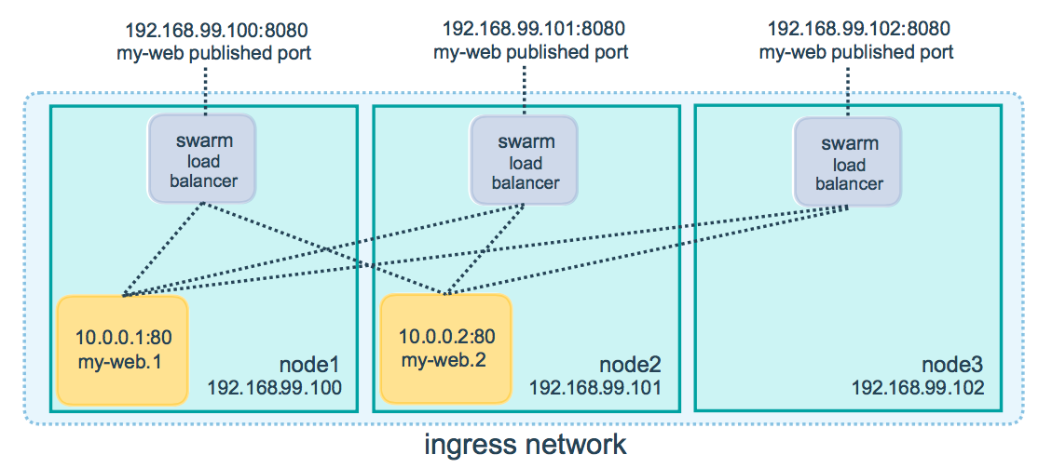
Swarm

Slide 6
Stack
docker stack deploy -c docker-compose.yml getstartedlab
docker stack ps getstartedlab
curl -4 http://localhost:4000
http://52.82.31.169:38080/
mkdir data
docker stack deploy -c docker-compose.yml getstartedlab
docker stack ps getstartedlab
curl -4 http://localhost:4000
ls data
docker stack rm getstartedlab

