Slide 1
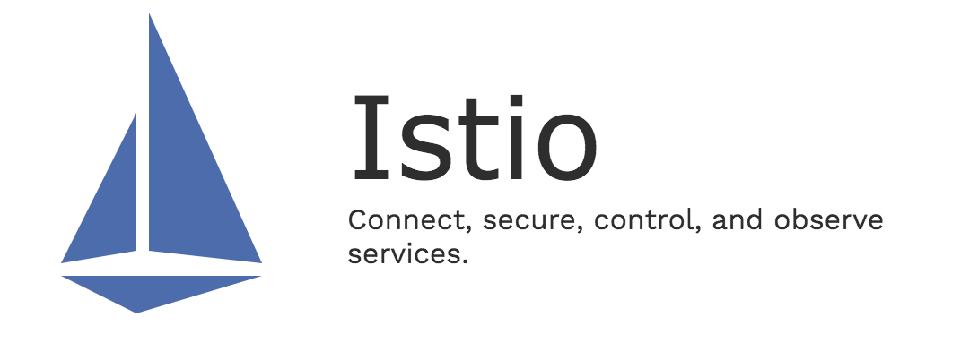
流量治理

Slide 2
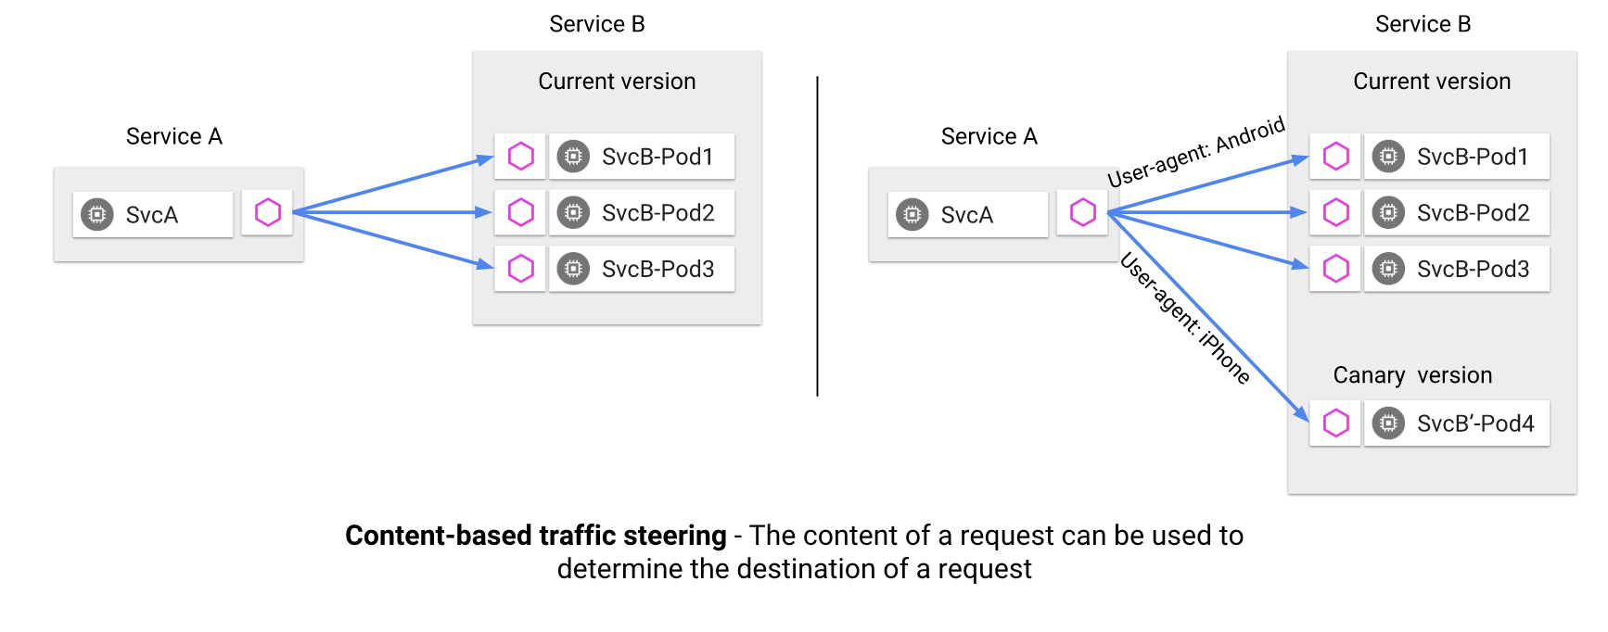
概念

Slide 3
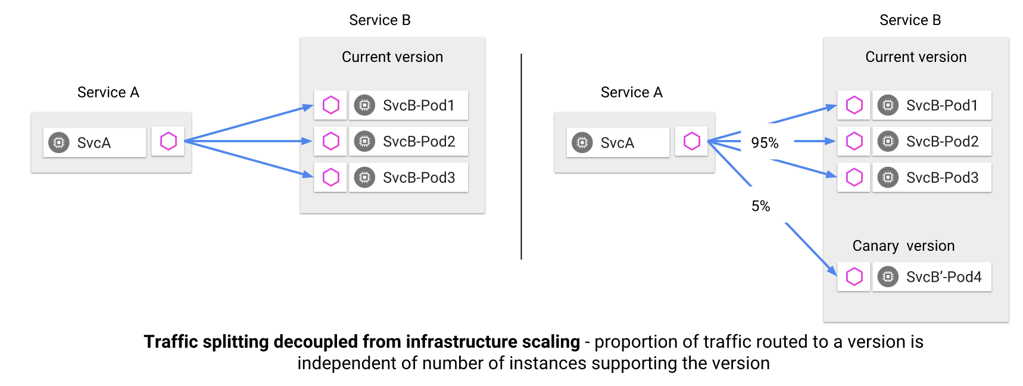
概念

Slide 4
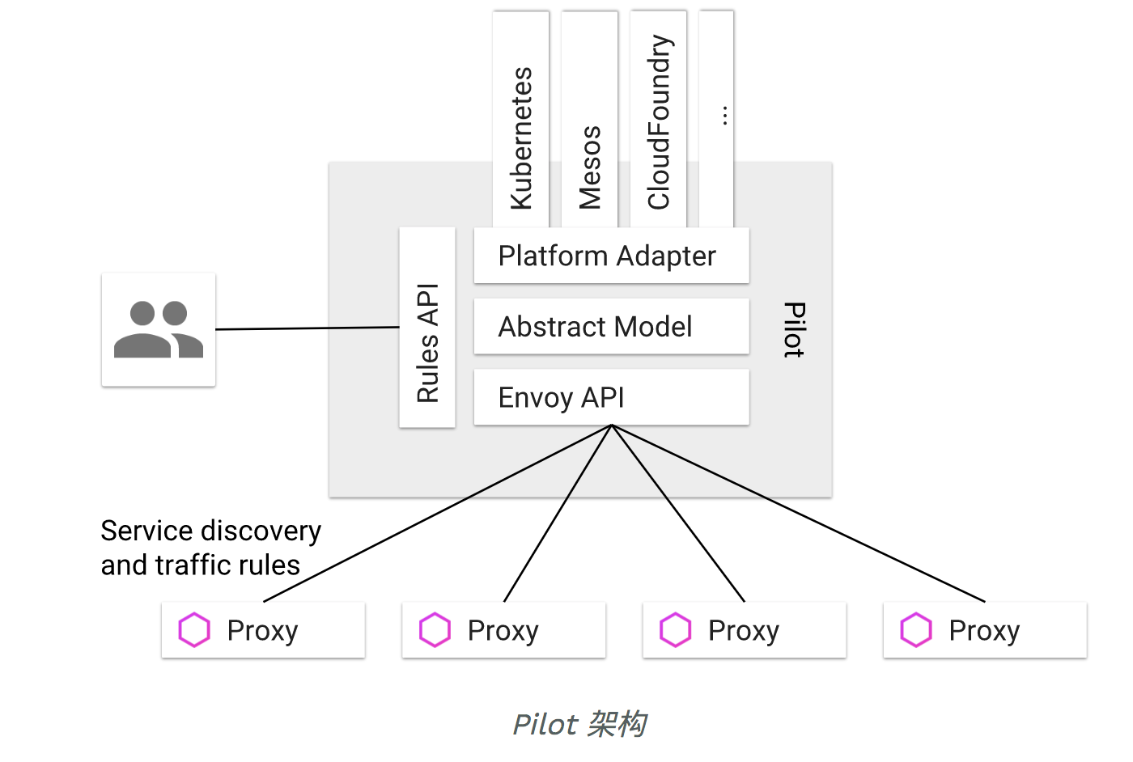
Notes:
pilot和envoy

Slide 5
概念
VirtualService：配置到目标服务的路由规则及超时重试、错误注入等
DestinationRule：为VirtualService配置策略集，比如subset（服务的各版本）的定义及它们的负载均衡策略，断路策略。也可以定义服务的负载均衡和断路策略，此时不需要定义virtualService路由规则，也会生效。
ServiceEntry：出口流量管理，可以配合virtualService设置路由超时等
Gateway：入口流量管理，可以配合virtaulService设置路由规则等

Slide 6
请求路由
kubectl apply -f samples/bookinfo/networking/virtual-service-all-v1.yaml
kubectl get virtualservices -o yaml
反复刷新 http://10.233.172.8:31380/productpage
kubectl apply -f samples/bookinfo/networking/virtual-service-reviews-test-v2.yaml
用jason登录http://10.233.172.8:31380/productpage
Notes:
abtest

Slide 7
故障注入
kubectl apply -f samples/bookinfo/networking/virtual-service-ratings-test-delay.yaml
kubectl apply -f samples/bookinfo/networking/virtual-service-ratings-test-abort.yaml
Notes:
7s-->2.8s

Slide 8
流量切换-TCP
kubectl apply -f samples/tcp-echo/tcp-echo-services.yaml
kubectl apply -f samples/tcp-echo/tcp-echo-all-v1.yaml
export INGRESS_PORT=$(kubectl -n istio-system get service istio-ingressgateway -o jsonpath='{.spec.ports[?(@.name=="tcp")].port}')
echo $INGRESS_PORT
(date; sleep 1)|nc 10.233.172.8 31400
kubectl apply -f samples/tcp-echo/tcp-echo-20-v2.yaml
for i in {1..10}; do (date; sleep 1)|nc 10.233.172.8 31400; done
Notes:
灰度发布

Slide 9
超时
kubectl apply -f vs-reviews.yaml
kubectl apply -f vs-ratings.yaml
kubectl apply -f vs-reviews-timeout.yaml

Slide 10
控制流入流量
kubectl apply -f samples/httpbin/httpbin.yaml
kubectl apply -f gw-httpbin.yaml
kubectl apply -f vs-httpbin.yaml
curl -I -HHost:httpbin.example.com http://10.233.172.8:31380/status/200
curl -I -HHost:httpbin.example.com http://10.233.172.8:31380/headers
kubectl apply -f gw+vs-httpbin.yaml
http://10.233.172.8:31380/headers

Slide 11
控制流入流量-https
export INGRESS_HOST=$(kubectl get po -l istio=ingressgateway -n istio-system -o jsonpath='{.items[0].status.hostIP}')
export SECURE_INGRESS_PORT=$(kubectl -n istio-system get service istio-ingressgateway -o jsonpath='{.spec.ports[?(@.name=="https")].nodePort}')
echo $INGRESS_HOST
echo $SECURE_INGRESS_PORT
git clone https://github.com/nicholasjackson/mtls-go-example
pushd mtls-go-example/
./generate.sh httpbin.example.com password
mkdir ../httpbin.example.com && mv 1_root 2_intermediate 3_application 4_client ../httpbin.example.com
popd

Slide 12
控制流入流量-https
helm template install/kubernetes/helm/istio/ --name istio --namespace istio-system -x charts/gateways/templates/deployment.yaml --set gateways.istio-egressgateway.enabled=false --set gateways.istio-ingressgateway.sds.enabled=true > $HOME/istio-ingressgateway.yaml
kubectl apply -f $HOME/istio-ingressgateway.yaml
kubectl apply -f dp+svc-httpbin.yaml
kubectl create -n istio-system secret generic httpbin-credential --from-file=key=httpbin.example.com/3_application/private/httpbin.example.com.key.pem --from-file=cert=httpbin.example.com/3_application/certs/httpbin.example.com.cert.pem
kubectl apply -f gw-httpbin-sec.yaml
kubectl apply -f vs-httpbin-sec.yaml
curl -v -HHost:httpbin.example.com --resolve httpbin.example.com:$SECURE_INGRESS_PORT:$INGRESS_HOST --cacert httpbin.example.com/2_intermediate/certs/ca-chain.cert.pem https://httpbin.example.com:$SECURE_INGRESS_PORT/status/418

Slide 13
控制流入流量-https
kubectl -n istio-system delete secret httpbin-credential
cd mtls-go-example
./generate.sh httpbin.example.com password
mkdir ../httpbin.new.example.com && mv 1_root 2_intermediate 3_application 4_client ../httpbin.new.example.com
cd ..
kubectl create -n istio-system secret generic httpbin-credential --from-file=key=httpbin.new.example.com/3_application/private/httpbin.example.com.key.pem --from-file=cert=httpbin.new.example.com/3_application/certs/httpbin.example.com.cert.pem
curl -v -HHost:httpbin.example.com --resolve httpbin.example.com:$SECURE_INGRESS_PORT:$INGRESS_HOST --cacert httpbin.new.example.com/2_intermediate/certs/ca-chain.cert.pem https://httpbin.example.com:$SECURE_INGRESS_PORT/status/418
curl -v -HHost:httpbin.example.com --resolve httpbin.example.com:$SECURE_INGRESS_PORT:$INGRESS_HOST --cacert httpbin.example.com/2_intermediate/certs/ca-chain.cert.pem https://httpbin.example.com:$SECURE_INGRESS_PORT/status/418
Notes:
第二个curl fail

Slide 14
控制流入流量-https
kubectl -n istio-system delete secret httpbin-credential
kubectl create -n istio-system secret generic httpbin-credential --from-file=key=httpbin.example.com/3_application/private/httpbin.example.com.key.pem --from-file=cert=httpbin.example.com/3_application/certs/httpbin.example.com.cert.pem --from-file=cacert=httpbin.example.com/2_intermediate/certs/ca-chain.cert.pem
kubectl apply -f gw-httpbin-sec-mut.yaml
curl -v -HHost:httpbin.example.com --resolve httpbin.example.com:$SECURE_INGRESS_PORT:$INGRESS_HOST --cacert httpbin.example.com/2_intermediate/certs/ca-chain.cert.pem https://httpbin.example.com:$SECURE_INGRESS_PORT/status/418
curl -v -HHost:httpbin.example.com --resolve httpbin.example.com:$SECURE_INGRESS_PORT:$INGRESS_HOST --cacert httpbin.example.com/2_intermediate/certs/ca-chain.cert.pem --cert httpbin.example.com/4_client/certs/httpbin.example.com.cert.pem --key httpbin.example.com/4_client/private/httpbin.example.com.key.pem https://httpbin.example.com:$SECURE_INGRESS_PORT/status/418
Notes:
第一个curl fail

Slide 15
控制流出流量
kubectl apply -f samples/sleep/sleep.yaml
export SOURCE_POD=$(kubectl get pod -l app=sleep -o jsonpath={.items..metadata.name})
kubectl get configmap istio -n istio-system -o yaml | grep -o "mode: ALLOW_ANY"
kubectl exec -it $SOURCE_POD -c sleep -- curl -I https://www.google.com | grep "HTTP/"; kubectl exec -it $SOURCE_POD -c sleep -- curl -I https://edition.cnn.com | grep "HTTP/"
kubectl get configmap istio -n istio-system -o yaml | sed 's/mode: ALLOW_ANY/mode: REGISTRY_ONLY/g' | kubectl replace -n istio-system -f -
kubectl exec -it $SOURCE_POD -c sleep -- curl -I https://www.google.com | grep "HTTP/"; kubectl exec -it $SOURCE_POD -c sleep -- curl -I https://edition.cnn.com | grep "HTTP/"

Slide 16
控制流出流量
kubectl apply -f se-httpbin.yaml
kubectl exec -it $SOURCE_POD -c sleep -- curl http://httpbin.org/headers
kubectl logs $SOURCE_POD -c istio-proxy | tail
kubectl -n istio-system logs -l istio-mixer-type=telemetry -c mixer | grep 'httpbin.org'
kubectl apply -f se-baidu.yaml
kubectl exec -it $SOURCE_POD -c sleep -- curl -I https://www.baidu.com | grep "HTTP/"
kubectl logs $SOURCE_POD -c istio-proxy | tail
kubectl -n istio-system logs -l istio-mixer-type=telemetry -c mixer | grep 'www.baidu.com'

Slide 17
控制流出流量
kubectl exec -it $SOURCE_POD -c sleep sh
time curl -o /dev/null -s -w "%{http_code}\n" http://httpbin.org/delay/5
exit
kubectl apply -f vs-httpbin-ext.yaml
kubectl exec -it $SOURCE_POD -c sleep sh
time curl -o /dev/null -s -w "%{http_code}\n" http://httpbin.org/delay/5
exit

Slide 18
熔断
kubectl apply -f dr-httpbin.yaml
kubectl apply -f samples/httpbin/sample-client/fortio-deploy.yaml
FORTIO_POD=$(kubectl get pod | grep fortio | awk '{ print $1 }')
kubectl exec -it $FORTIO_POD -c fortio /usr/bin/fortio -- load -curl http://httpbin:8000/get
kubectl exec -it $FORTIO_POD -c fortio /usr/bin/fortio -- load -c 2 -qps 0 -n 20 -loglevel Warning http://httpbin:8000/get
kubectl exec -it $FORTIO_POD -c fortio /usr/bin/fortio -- load -c 3 -qps 0 -n 30 -loglevel Warning http://httpbin:8000/get
kubectl exec -it $FORTIO_POD -c istio-proxy -- sh -c 'curl localhost:15000/stats' | grep httpbin | grep pending
Notes:
kubectl delete destinationrule httpbin
kubectl delete deploy httpbin fortio-deploy
kubectl delete svc httpbin

Slide 19
镜像
kubectl apply -f dp-httpbin-v1.yaml
kubectl apply -f dp-httpbin-v2.yaml
kubectl apply -f svc-httpbin.yaml
kubectl apply -f vs+dr-httpbin.yaml
export SLEEP_POD=$(kubectl get pod -l app=sleep -o jsonpath={.items..metadata.name})
kubectl exec -it $SLEEP_POD -c sleep -- sh -c 'curl http://httpbin:8000/headers' | python -m json.tool

Slide 20
镜像
export V1_POD=$(kubectl get pod -l app=httpbin,version=v1 -o jsonpath={.items..metadata.name})
kubectl logs -f $V1_POD -c httpbin
export V2_POD=$(kubectl get pod -l app=httpbin,version=v2 -o jsonpath={.items..metadata.name})
kubectl logs -f $V2_POD -c httpbin
kubectl apply -f vs-httpbin-mirror.yaml
kubectl exec -it $SLEEP_POD -c sleep -- sh -c 'curl http://httpbin:8000/headers' | python -m json.tool
kubectl logs -f $V1_POD -c httpbin
kubectl logs -f $V2_POD -c httpbin

