Slide 1

策略和遥测

Slide 2
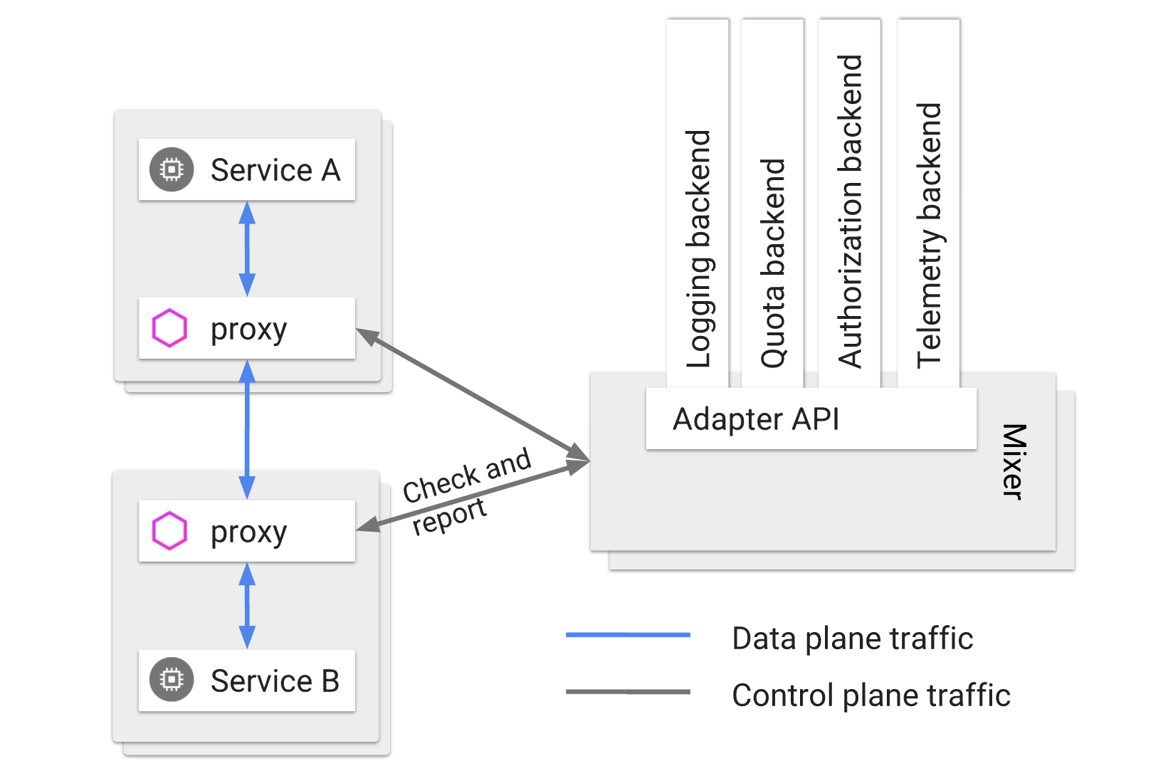
Notes:
mixer

Slide 3
概念
handler：适配器，封装mixer和外部infra后端交互，例如listchecker、prometheus、memquota等
instance：实例，将请求中的属性映射成适配器的输入，模板有listentry、metric、quota等
rule：实例调用适配器的条件

Slide 4
限流
kubectl -n istio-system get cm istio -o jsonpath="{@.data.mesh}" | grep disablePolicyChecks
kubectl apply -f samples/bookinfo/networking/virtual-service-all-v1.yaml
kubectl apply -f samples/bookinfo/policy/mixer-rule-productpage-ratelimit.yaml
kubectl -n istio-system get instance requestcountquota -o yaml
kubectl -n istio-system get rule quota -o yaml
kubectl -n istio-system get QuotaSpec request-count -o yaml
kubectl -n istio-system get QuotaSpecBinding request-count -o yaml
反复刷新http://10.233.172.8:31380/productpage

Slide 5
限流
kubectl -n istio-system edit rules quota
match: match(request.headers["cookie"], "session=*") == false
用jason登录，反复刷新http://10.233.172.8:31380/productpage
kubectl delete -f samples/bookinfo/policy/mixer-rule-productpage-ratelimit.yaml

Slide 6
访问控制
kubectl apply -f samples/bookinfo/networking/virtual-service-reviews-jason-v2-v3.yaml
kubectl apply -f samples/bookinfo/policy/mixer-rule-deny-label.yaml
反复刷新http://10.233.172.8:31380/productpage
用jason登录，反复刷新http://10.233.172.8:31380/productpage
kubectl delete -f samples/bookinfo/policy/mixer-rule-deny-label.yaml

Slide 7
访问控制
kubectl apply -f whitelist-handler.yaml
kubectl apply -f appversion-instance.yaml
kubectl apply -f checkversion-rule.yaml
反复刷新http://10.233.172.8:31380/productpage
用jason登录，反复刷新http://10.233.172.8:31380/productpage
kubectl delete -f checkversion-rule.yaml
kubectl delete -f appversion-instance.yaml
kubectl delete -f whitelist-handler.yaml
Notes:
用listchecker同样可以限制某些IP的访问

Slide 8
指标
kubectl apply -f samples/bookinfo/telemetry/metrics.yaml
http://10.233.172.8:31380/productpage
kubectl edit svc prometheus -n istio-system
NodePort
kubectl get svc prometheus -n istio-system
http://localhost:9090/graph?g0.range_input=1h&g0.expr=istio_double_request_count&g0.tab=1
kubectl delete -f samples/bookinfo/telemetry/metrics.yaml

Slide 9
指标
kubectl apply -f samples/bookinfo/telemetry/tcp-metrics.yaml
kubectl apply -f samples/bookinfo/platform/kube/bookinfo-ratings-v2.yaml
kubectl apply -f samples/bookinfo/platform/kube/bookinfo-db.yaml
kubectl apply -f samples/bookinfo/networking/virtual-service-ratings-db.yaml
http://10.233.172.8:31380/productpage
http://localhost:9090/graph?g0.range_input=1h&g0.expr=istio_mongo_received_bytes&g0.tab=1
kubectl delete -f samples/bookinfo/telemetry/tcp-metrics.yaml

Slide 10
指标-prometheus
http://localhost:9090/graph
istio_requests_total
istio_requests_total{destination_service="productpage.default.svc.cluster.local"}
istio_requests_total{destination_service="reviews.default.svc.cluster.local", destination_version="v3"}
rate(istio_requests_total{destination_service=~"productpage.*", response_code="200"}[5m])

Slide 11
指标-grafana
kubectl edit svc grafana -n istio-system
kubectl get svc grafana -n istio-system
http://localhost:3000/dashboard/db/istio-mesh-dashboard
http://localhost:3000/dashboard/db/istio-service-dashboard
http://localhost:3000/dashboard/db/istio-workload-dashboard

Slide 12
日志
kubectl apply -f samples/bookinfo/telemetry/log-entry.yaml
http://10.233.172.8:31380/productpage
kubectl logs --tail=100 -n istio-system -l istio-mixer-type=telemetry -c mixer | grep "newlog" | grep -v '"destination":"telemetry"' | grep -v '"destination":"pilot"' | grep -v '"destination":"policy"' | grep -v '"destination":"unknown"’
kubectl delete -f samples/bookinfo/telemetry/log-entry.yaml

Slide 13
日志
kubectl apply -f samples/sleep/sleep.yaml
kubectl apply -f samples/httpbin/httpbin.yaml
kubectl exec -it $(kubectl get pod -l app=sleep -o jsonpath={.items..metadata.name}) -c sleep -- curl -v httpbin:8000/status/418
kubectl logs -l app=sleep -c istio-proxy
kubectl logs -l app=httpbin -c istio-proxy
kubectl delete -f samples/sleep/sleep.yaml
kubectl delete -f samples/httpbin/httpbin.yaml
Notes:
Envoy log

Slide 14
日志-EFK
kubectl apply -f logging-stack.yaml
kubectl apply -f samples/bookinfo/telemetry/fluentd-istio.yaml
http://10.233.172.8:31380/productpage
kubectl edit svc kibana -n logging
NodePort
kubectl get svc kibana -n logging
使用*建立index
kubectl delete -f samples/bookinfo/telemetry/fluentd-istio.yaml
Notes:
所有node上运行
docker pull fashionnew/fluentd-elasticsearch:v2.0.1
docker tag fashionnew/fluentd-elasticsearch:v2.0.1 gcr.io/google-containers/fluentd-elasticsearch:v2.0.1

Slide 15
分布式追踪
kubectl edit svc jaeger-query -n istio-system
NodePort
kubectl get svc jaeger-query -n istio-system
http://10.233.172.8:31380/productpage
http://52.83.60.75:31779/jaeger/search
Notes:
默认100%采样

Slide 16
kaili
kubectl edit svc jaeger-query -n istio-system
NodePort
kubectl get svc jaeger-query -n istio-system
http://52.83.60.75:31567/kiali/console
Notes:
集成了grafana和jaeger

