Slide 1
KDD CUP 2018
Presenter:
M10607410 Yong Zhong
M10507434 Yi-Hao Cheng
Apr 25 , 2018
The Electronic Design Automation Laboratory
Department of Electrical Engineering
National Taiwan University of Science and Technology
Taipei 106, Taiwan
1

Slide 2
Data Description
Beijing:
35 stations with each locations and air quality data and meteorological data on hourly basis
Air quality data: PM2.5, PM10, NO2, CO, O3, SO2
Meteorological data: temperature, pressure, humidity, wind_direction, wind_speed, weather
London:
24 stations with each locations and air quality data and meteorological data on hourly basis (only 13 need to be predicted)
Air quality data: PM2.5, PM10, NO2
Meteorological data: temperature, pressure, humidity, wind_direction, wind_speed
2
Notes:
meteorological 氣象的

Slide 3
Platform & Tools & Feature
Platform: Linux with Nvidia GTX 1080 ti
Tools: Keras
Feature:
Beijing: latitude, longitude, PM2.5, PM10, NO2, O3, SO2, time
London: latitude, longitude, PM2.5, PM10, NO2, time
3

Slide 4
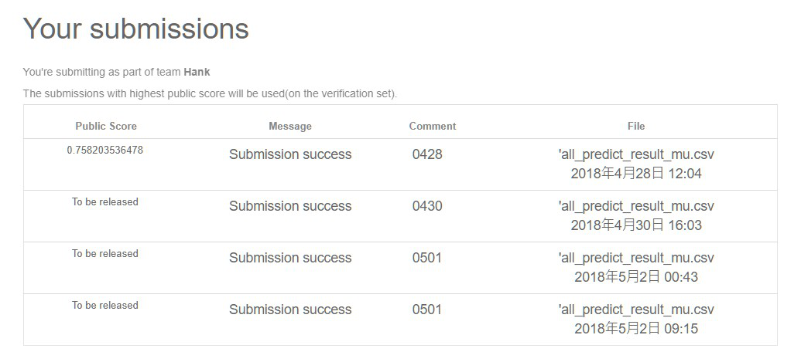
Result
Public score: 0.76 (once)
4

Slide 5
Result Analysis
Problem
Feature extraction
Normalization
Appropriate ratio of training data and testing data
Appropriate the parameters for the model
Methodology
More research of air quality related background and try more combinations of feature extraction
Feature Scaling to make the impact of parameters more uniform
More attempts on the ratio
More attempts on the parameters
5

