Slide 1
EE610
M10607501 陳俊瑋
M10607502 黃莉雯

Slide 2
Outline
Problem
Environment
Methods
Result
Analysis
Conclusion
Work

Slide 3
Problem

Slide 4
Problem
Air Quality：samples
Stations：locations
Grid：features
features
train
prediction
answer

Slide 5
Environment

Slide 6
environment
Main program： Tensorflow with Python
Data：SQLite 3

Slide 7
methods

Slide 8
Methods - training
Sample in AQs
Station ID in samples
Location of stations
GRID at locations
Features in GRIDs

Slide 9
methods - samples
Answer：PM2.5, PM10, O3, NO2, CO, SO2
Missing data：discard
Mean & Standard Deviation：1000 samples at random
Choose：the values less than one standard deviation away from the mean account
Station ID：get location of stations
Sample in AQs
Station ID in samples
Location of stations
GRID at locations
Features in GRIDs

Slide 10

Methods - locations
Standardization：$\overset{⃑}{L}\left(\overset{⃑}{l}\right)=round\left(\overset{⃑}{l}, 1\right)$
City（Beijing & London）：longitude、latitude
Sample in AQs
Station ID in samples
Location of stations
GRID at locations
Features in GRIDs

Slide 11

Methods - GRIDs
Grid name number：$g=10×\left(21\overset{⃑}{Δ_{lng}}+\overset{⃑}{Δ_{lat}}\right)$
Relative locations to the center of its city：$\overset{⃑}{Δ}=\overset{⃑}{L}−\overset{⃑}{C}$
Center of cities：$\overset{⃑}{C_{beijing}}=\left(115, 39\right)$，$\overset{⃑}{C_{london}}=\left(−2, 50.5\right)$
Sample in AQs
Station ID in samples
Location of stations
GRID at locations
Features in GRIDs

Slide 12
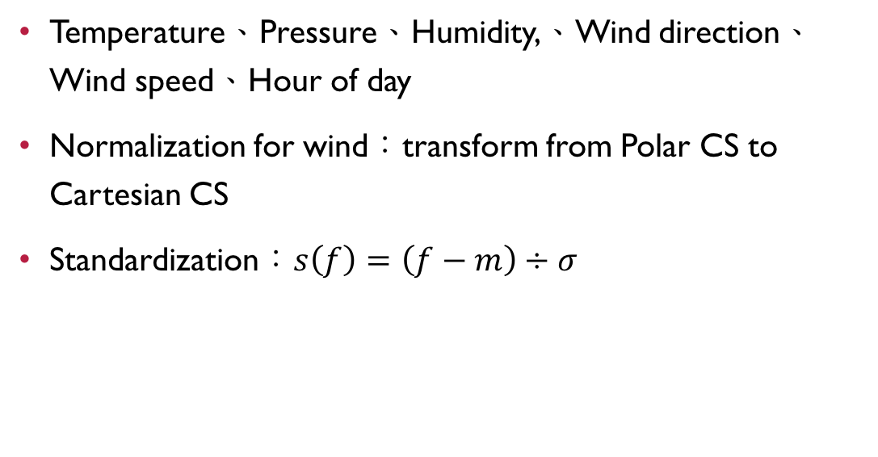
Methods - features
Temperature、Pressure、Humidity,、Wind direction、Wind speed、Hour of day
Normalization for wind：transform from Polar CS to Cartesian CS
Standardization：$s\left(f\right)=\left(f−m\right)÷σ$
Sample in AQs
Station ID in samples
Location of stations
GRID at locations
Features in GRIDs

Slide 13

Methods - model
Neural Network with Tensorflow
Inputs$\left[6\right]$ → Hidden Layers$\left[1024\right]\left[4096\right]\left[1024\right]$ → Outputs$\left[6\right]$
i1
o1
i2
h2
o2
h1
h3
i3
o3
i4
o4
i5
o5
i6
o6

Slide 14
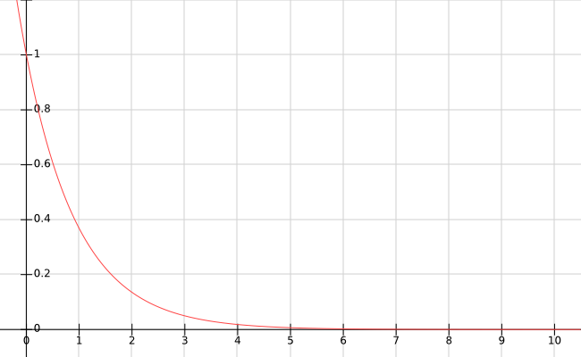

Methods - accuracy
Accuracy：$a_{i}=e^{−\left|p−b\right|÷σ^{′}}$
Overall accuracy：$\overline{a}=\frac{1}{n}\sum_{i}{a_{i}}$
Accuracy
error

Slide 15
result

Slide 16
Result
Submit：2018-4-30
Entries：once
Ranking：229/356
Score：0.93

Slide 17
analysis

Slide 18
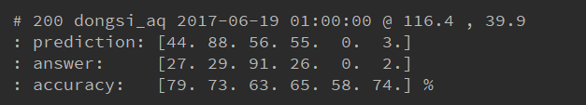
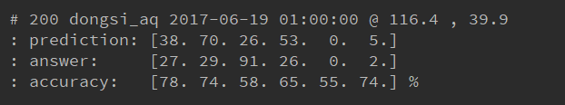
analysis
Optimizer
Neuron count
Unnecessary outputs
Features count

Slide 19
conclusion

Slide 20
conclusion
Keep unnecessary outputs in training model
Try other algorithm such like Gradient Boosting
Optimize database for time complexity
Extend features on location
Train another model for severe AQ conditions

Slide 21
work

Slide 22
work
陳俊瑋：Training Model、Data Analysis
黃莉雯：Data Processing、Problem Analysis

