Slide 1
SeatGate IT Audit
Instructor Guide
Using a Sandboxed Ticketing Website to Teach
Digital Trust and IT Audit
Classroom preparation, demonstration, and debrief
Notes:
Instructor-facing guide. Distribute the Student Case Instructions and assigned worksheet to students. Retain the Teaching Notes and Instructor Solutions for instructor use. Sources: case.tex; teaching-notes.tex; instructor-solutions.tex.

Slide 2
Instructor Preparation
Maintained website
https://ais-2026-anonymous.github.io/ticketing-system/
Admin account: admin
Default password: adminpass2
50 student accounts: student1 through student50
Each initial password is the same as its username
Check the configured ticket limit and inventory.
Distribute the instructions and one worksheet version.
2
Notes:
Source: teaching-notes.tex, Instruction Manual and Using the Maintained Website. Check the website before class. Assign student credentials. Use the administrator panel to prepare the trial and main releases. The optional customized deployment instructions are in the Teaching Notes and setup video.

Slide 3
Two Student Templates
Standard Version 1 | Alternative Version 2
COBIT 2019 framework questions | Website transaction discovery
Website discovery and process narrative | Short process narrative
Automation observations | Automation observations
Six-policy evaluation | Internal-control review
Internal-control review with COBIT mapping | Class debrief questions
Use the same system and evidence with different amounts of written documentation.
3
Notes:
Sources: student-case-instructions.tex; worksheet-version-1.docx; worksheet-version-2.docx. Both implementations use a trial event, one main ticket drop, an instructor-led automation demonstration, backend evidence review, and debrief. Neither requires a separate audit memo unless assigned.

Slide 4
The SeatGate Audit Engagement
Students act as junior IT auditors at Rogers & Rogers LLP.
SeatGate distributes limited tickets for university events.
Management suspects automated scripts after tickets sell out almost immediately.
The engagement evaluates whether stated policies are enforced and supported by audit evidence.
4
Notes:
Source: case.tex, SeatGate. Students take the role of a junior IT auditor at Rogers & Rogers LLP. The university events office distributes tickets for campus events. Management suspects automated scripts because tickets sell out almost immediately. The instructor acts as system administrator and supplies evidence requested by students.

Slide 5
SeatGate's Six Stated Policies
Policy | Stated Requirement
1 | Each student user may purchase no more than one ticket per event.
2 | Only valid users are able to complete purchases.
3 | Ticket inventory should update immediately after each sale.
4 | Automated or suspicious purchasing behavior should be logged, and an exception report should be generated.
5 | Every ticket purchased should have a timestamp in the admin view.
6 | Every ticket has a unique serial number.
5
Notes:
Source: case.tex, events office stated policies. Present these policies before the activity. Students compare the expected control with system behavior and administrative evidence. Do not reveal the suggested policy results until the debrief.

Slide 6
Classroom Activity Flow
Phase | Activity | Suggested Time
1 | Introduce the audit setting and stated policies | 15-20 minutes
2 | Trial event and website transaction discovery | 5-10 minutes
3 | One main ticket-drop event | 10-20 minutes
4 | Controlled automation demonstration | 10-20 minutes
5 | Backend evidence review | 10-20 minutes
6 | Policy evaluation and internal-control review | 10-15 minutes
7 | Class debrief | 10-15 minutes
6
Notes:
Source: case.tex, Implementation Guidance table; teaching-notes.tex, Exercise Notes. Suggested phase ranges total 70-120 minutes and can be adapted to the class. The automation demonstration normally follows the main ticket drop. The optional coding extension may be introduced during the trial. Keep all testing within the SeatGate sandbox.

Slide 7
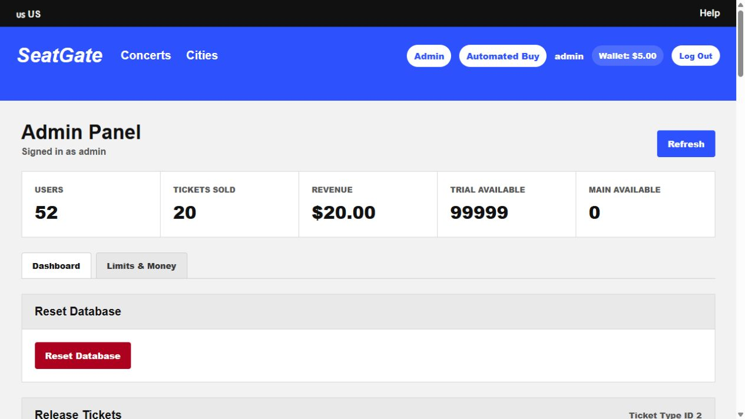
Administrator Panel and Audit Evidence
Compare user holdings, tickets sold, revenue, and remaining inventory.
7
Notes:
Sources: teaching-notes.tex, Opening and Checking the Website; screenshot of https://ais-2026-anonymous.github.io/ticketing-system/admin captured October 16, 2026. Before class, prepare the trial and main inventory. After the demonstration, compare ticket holdings, sales totals, revenue, and remaining inventory. Retain the classroom data until students finish reviewing the evidence.

Slide 8
Controlled Five-Ticket Purchase
Step | Instructor Action
1 | Sign in using the admin account.
2 | Open Automated Buy Demonstration and select a ticket class.
3 | Set quantity to five and click Buy Tickets.
4 | Return to the admin panel and confirm holdings and inventory changes.
Use a student account to test the stated purchase policy.
The admin account is exempt from the student limit.
8
Notes:
Source: teaching-notes.tex, Instructor Demonstration. Sign in as admin, select the ticket class, set quantity to five, and click Buy Tickets during the classroom demonstration. Review the pseudocode and confirm the result in the administrator panel. Use a student account to test the student purchase limit because admin purchases are exempt.

Slide 9
Backend Evidence Review
Evidence | Audit Question
User population and approved participant list | Does every account correspond to an authorized user?
Ticket holdings and inventory | Do recorded sales agree with changes in inventory?
Purchase requests and transaction logs | Was the transaction recorded and properly authorized?
Exception reports and monitoring records | Was suspicious purchasing identified and reviewed?
Timestamps and individual ticket identifiers | Can each ticket purchase be traced?
9
Notes:
Sources: case.tex, Automation Demonstration and Backend Evidence; teaching-notes.tex, Classroom User Roles and Embedded Audit Evidence. Ask students to request and inspect the records supporting each conclusion. The fakebuyer account is an embedded control issue. Retain its significance for the instructor-led evidence review or debrief.

Slide 10
Debrief: Expected Policy Evaluation
Policy | Expected Result | Key Finding
1 | Check configuration | Compare the configured per-type limit with one ticket per event.
2 | Not fully working | The fakebuyer account can purchase tickets.
3 | Working | Successful purchases reduce remaining inventory.
4 | Evaluate reporting | Review rate-limit logs, exception reports, and management follow-up.
5 | Not fully working | The admin holdings view does not show each purchase timestamp.
6 | Not working | Individual tickets lack unique serial numbers.
10
Notes:
Source: instructor-solutions.tex, Policy Evaluation. These are the expected results for the supplied sandbox, not guaranteed outcomes of every classroom run. Verify the current system and the evidence used by students. Accept a different conclusion when supported by the observed evidence.

Slide 11
Debrief: COBIT 2019 References
COBIT 2019 Practice | Relevant Control Issue
DSS06.02 Control the Processing of Information | Backend transaction validation and purchase limits
DSS06.04 Manage Errors and Exceptions | Exception reports for abnormal purchase activity
DSS05.04 Manage User Identity and Logical Access | Approval and periodic review of user accounts
DSS06.05 Ensure Traceability and Accountability for Information Events | Records that trace transactions to the user and purchase
11
Notes:
Source: instructor-solutions.tex, Suggested Answer Key: Internal-Control Review. These examples follow the references used in the case. Students should explain why their chosen objective or practice is relevant. COSO and NIST are optional supporting frameworks, not additional required worksheet mappings.

Slide 12
Debrief: Recommended Controls
Control Area | Example Recommendation
Purchase limits | Configure backend checks to match the stated policy for each user and event.
User access | Approve accounts and periodically review the user population.
Suspicious activity | Use rate limits, exception reports, and management review.
Traceability | Retain purchase timestamps and unique identifiers for individual tickets.
12
Notes:
Source: instructor-solutions.tex, Internal-Control Review and Policy Evaluation. Students may recommend other controls when they connect the recommendation to the observed weakness and explain the risk. Rate limits and challenges supplement server-side validation. Retain enough transaction detail for review and investigation.

Slide 13
Grading and Class Debrief
The main grading emphasis is the quality of audit reasoning and supporting evidence.
Ask which weakness matters most and what evidence supports the finding.
Ask whether a recorded transaction satisfied the underlying control objective.
Use the separate Instructor Solutions for both worksheet versions.
13
Notes:
Sources: teaching-notes.tex, Grading Guidance and Classroom Debrief. The suggested weights for Version 1 are participation 0-10%, framework questions 10%, transaction discovery 20-30%, policy evaluation 20-30%, and internal-control review 30%. Select weights that total 100%. Adapt the components to Version 2. Students should support conclusions with screenshots, requests and responses, ticket holdings, inventory changes, or logs.

Slide 14
Instructor Resources
Classroom Briefing Video
https://youtu.be/YJUvlqT4zYw
Observing Network Flow Video
https://youtu.be/u1Z670PWvwY
Optional GitHub Pages and Render setup
https://youtu.be/EGJwitU4Nos
Repository and supporting materials
https://github.com/ais-2026-anonymous/ticketing-system
14
Notes:
Source: teaching-notes.tex, Instructional Videos and Case Materials. Setup video: https://youtu.be/EGJwitU4Nos . Classroom briefing: https://youtu.be/YJUvlqT4zYw . Observing network flow: https://youtu.be/u1Z670PWvwY . Repository: https://github.com/ais-2026-anonymous/ticketing-system . The materials/instructor directory contains the Teaching Notes, Instructor Solutions, and this deck. The student instructions and worksheets are in materials.

