Slide 1



Jaguar?
an IR system should return a mixture of documents that provide a complete picture of all interpretations

Slide 2
Novelty and Diversity in Information Retrieval Evaluation
Charles L.A. Clarke, Maheedhar Kolla, Gordon V. Cormack, Olga Vechtomova, Azin Ashkan, Stefan Büttcher, and Ian MacKinnon.
In Proceedings of the 31st annual international ACM SIGIR conference on Research and development in information retrieval (SIGIR '08). 2008.
Aisana Bolatbek

Slide 3
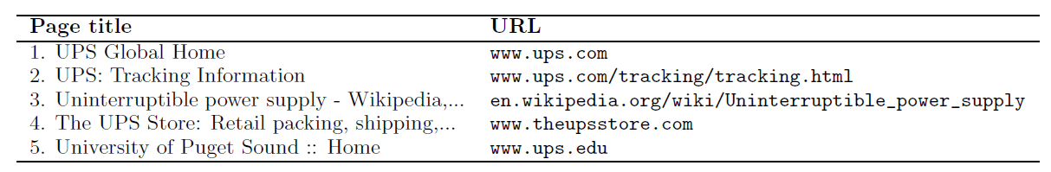
Web Search Example
five of the top ten results for the Web query “UPS”, as returned by a leading commercial search engine in late 2007.

Slide 4
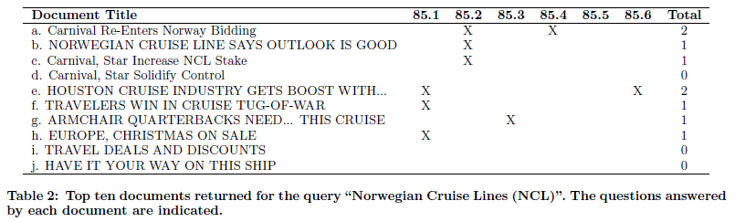
Question Answering Example
85: Norwegian Cruise Lines (NCL)
85.1: Name the ships of the NCL.
85.2: What cruise line attempted to take over NCL in 1999?
85.3: What is the name of the NCL’s own private island?
85.4: How does NCL rank in size with other cruise lines?
85.5: Why did the Grand Cayman turn away a NCL ship?
85.6: Name so-called theme cruises promoted by NCL.
based on a topic taken from the TREC 2005 question answering task

Slide 5




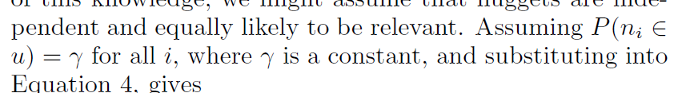
EVALUATION FRAMEWORK
, q - a query, u - the information need, d – document, R – random variable, representing relevance

Slide 6
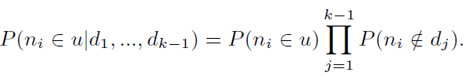


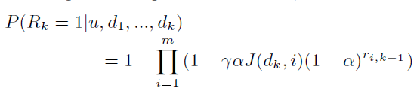

EVALUATION FRAMEWORK
Given the first $\text{k}\text{−1}$documents in a ranked list ($d_{\text{1}}$,..., $d_{\text{k}\text{−1}}$)
- number of documents ranked up to position k-1 that have been judged to contain nugget ${\text{n}}_{\text{i}}$

Slide 7
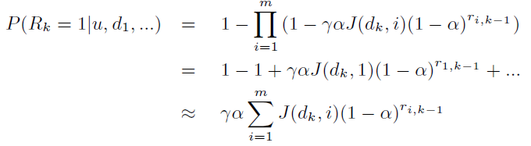




CUMULATIVE GAIN MEASURES

Slide 8








QA Example
$$α=\frac{1}{2}$$

Slide 9
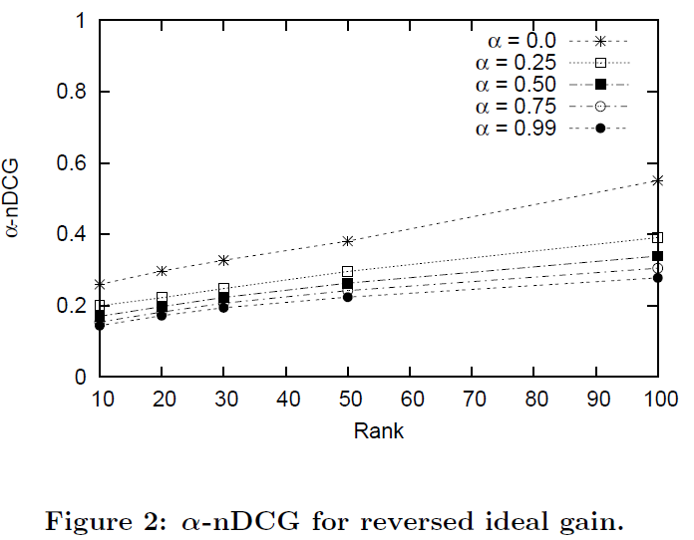
Experiments. Reverse ideal gain

Slide 10
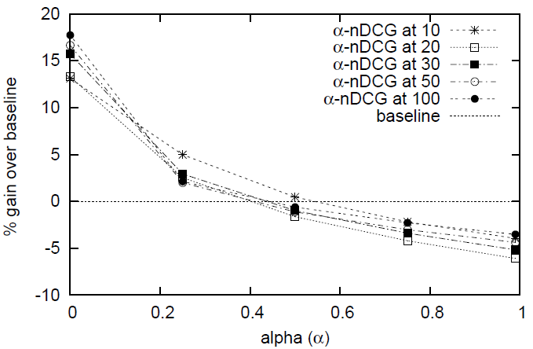
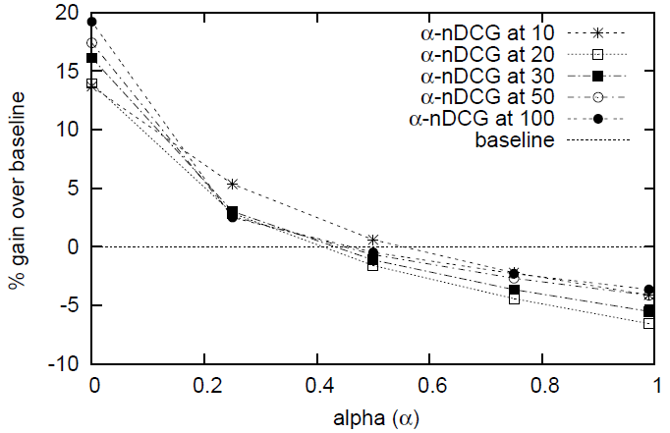
Experiments. Pseudo relevance feedback
The method is to do normal retrieval to find an initial set of most relevant documents, to then assume that the top "k" ranked documents are relevant, and finally to do relevance feedback as before under this assumption.

Slide 11
Criticism
Assumption of independence between nuggets may be invalid
Document considered to be relevant if it contains a previously unreported information
Document might contain only partial information, or be followed by other document, that accompanies it
What is best parameter?

