Slide 1
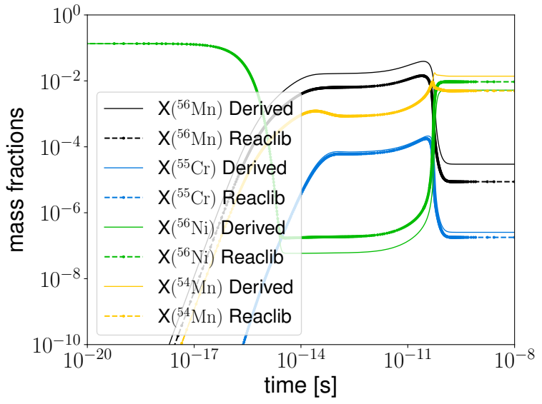
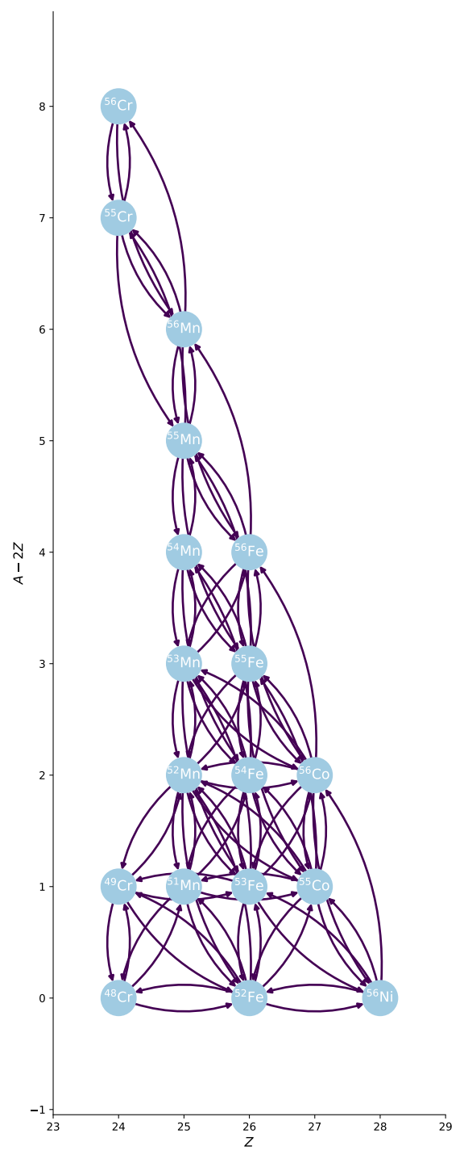
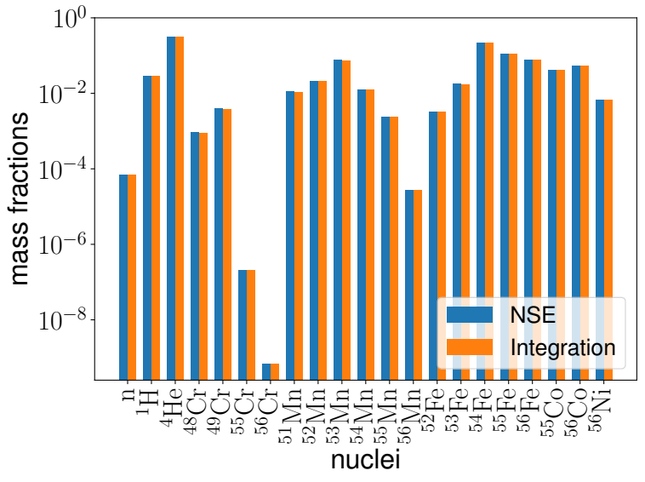
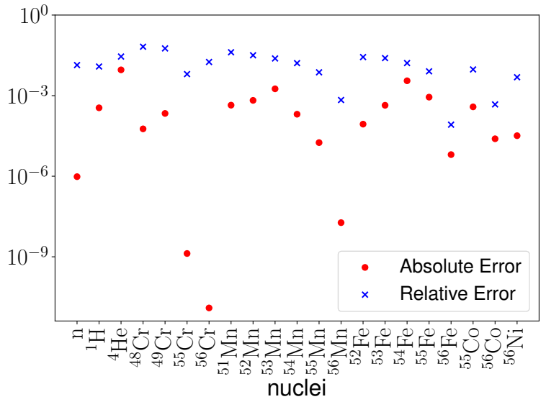
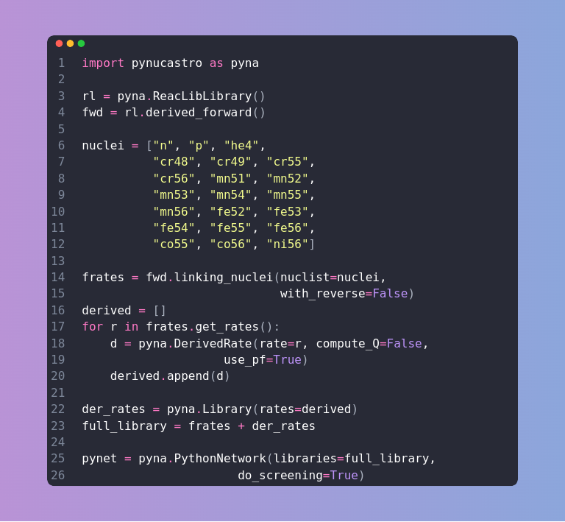



pynucastro 2.0: New Features and Implementation of a Python Library for Nuclear Astrophysics
Alexander Smith Clark¹, pynucastro Development Team.
1 Department of Physics and Astronomy,Stony Brook University, Stony Brook, NY, 11790, USA.
Introduction
The comparison between REACLIB inverse rates and the inverse rates effects obtained by pynucastro is depicted as follows:
Writing a Network
NSE Composition
pynucastro is an open-source python library with the main goal of providing visualization of rates and nuclei properties, given a particular set of rates or the nuclei involved in the reaction network of interest, and/or its composition.
In addition, pynucastro provides an interface of the first-order stiff differential system of equations, generated by the selected reaction network, to C++ and python. The C++ interface also provides GPU offloading techniques, making it suitable for Hydro+Reactive source calculations.
In this new version of pynucastro, we have implemented high temperature burning support for environments, including the nuclear partition function in baryonic inverse rates calculations, the nuclear statistical equilibrium (NSE) composition determination, and implementations for classical electron screening.
As an example of pynucastro, we can write the following network:
pynucastro provides a method to compute the mass fraction composition of a network once the nuclear statistical equilibrium is reached:
The difference between computing the mass fraction NSE composition + screening and by integrating the network, can be seen as follows:
The current network is composed by successive alpha-capture reactions, weak-reactions and neutron captures near the iron group
We can generate this network, with the snippet below:
Inverse Rates
Coulomb Screening
In pynucastro we use the REACLIB database from which all the important rates are selected. In pynucastro, for each baryonic forward reaction (exothermic), we compute its inverse rate (endothermic) by the use of detailed balance:
where and are the number of reactants and products respectively, are the nuclear partition functions of the nuclei and the remaining quantities are just temperature independent.
Under the assumption of linear mixing rule (Dewitt et.al 1973), the classical enhancement factor of the reaction rate,
is given by
where is the free-energy excess per particle of the one component plasma (OCP) made of a negative charge background and ions of atomic number .
Currently, pynucastro have support for two screening routines for (Potekhin et.al 1998, Chugunov et.al. 2007, 2009). However, there are plans to include more routines, including quantum effects (Kushnir 2019, Chugunov 2021).
References
Download Us
https://github.com/pynucastro/pynucastro
https://iopscience.iop.org/article/10.3847/1538-4357/acbaff
https://github.com/aisclark91/poster/blob/main/pynucastro_astronum.pdf
New contributions are welcome!

