Slide 1
Generative Adversarial Networks and Cycle-GANs
Presenter: Lecheng Zheng
Parts of slides are from Ian Goodfellow, Jun-Dan Zhu’s tutorials.

Slide 2
Outline
Generative Adversarial Networks (GANs)
Cycle-Consistent GANs

Slide 3
GANs Outline
Introduction to GANs
Training problem of GANs
Solutions to the training issues

Slide 4
GANs
Generative
Learn a generative model
Adversarial
Trained in an adversarial setting
Networks
Use deep neural networks

Slide 5
Why Generative models?
We’ve only seen discriminative models so far
Given an image X, predict a label Y
Estimates P(Y|X)
Discriminative models have several key limitations
Can’t model P(X), i.e. the probability of seeing a certain image
Thus, can’t sample from P(X), i.e. can’t generate new images
Generative models cope with all above
Can model p(X)
Can generate new images

Slide 6
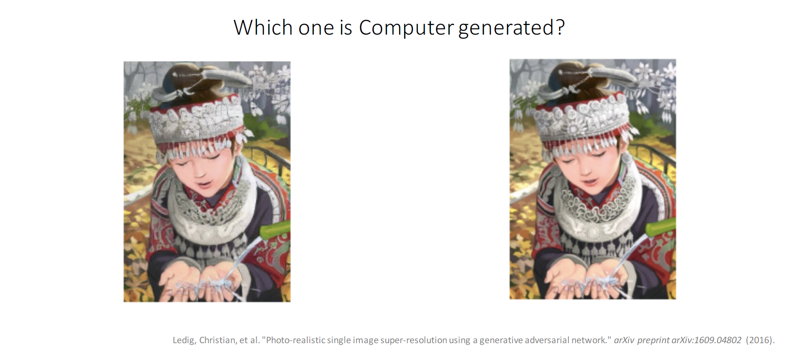
Magic of GANs

Slide 7
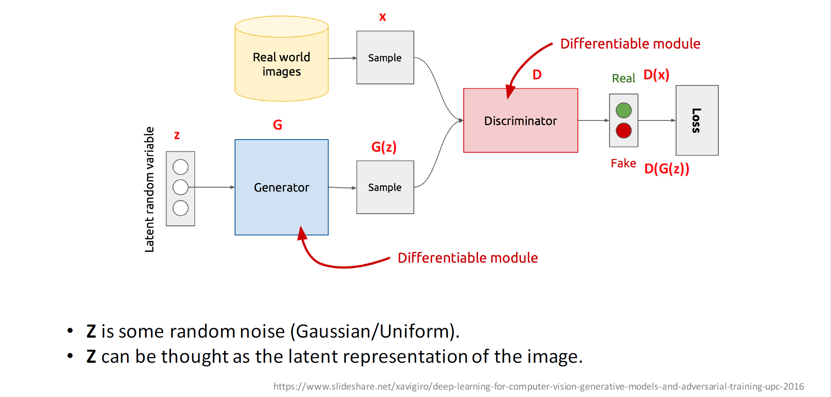
GAN’s Architecture

Slide 8
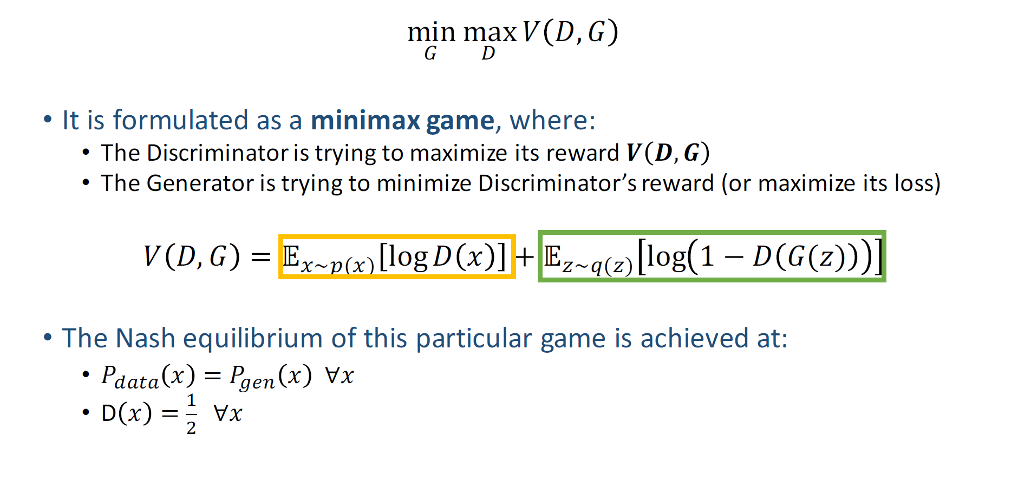
GAN’s Formulation

Slide 9
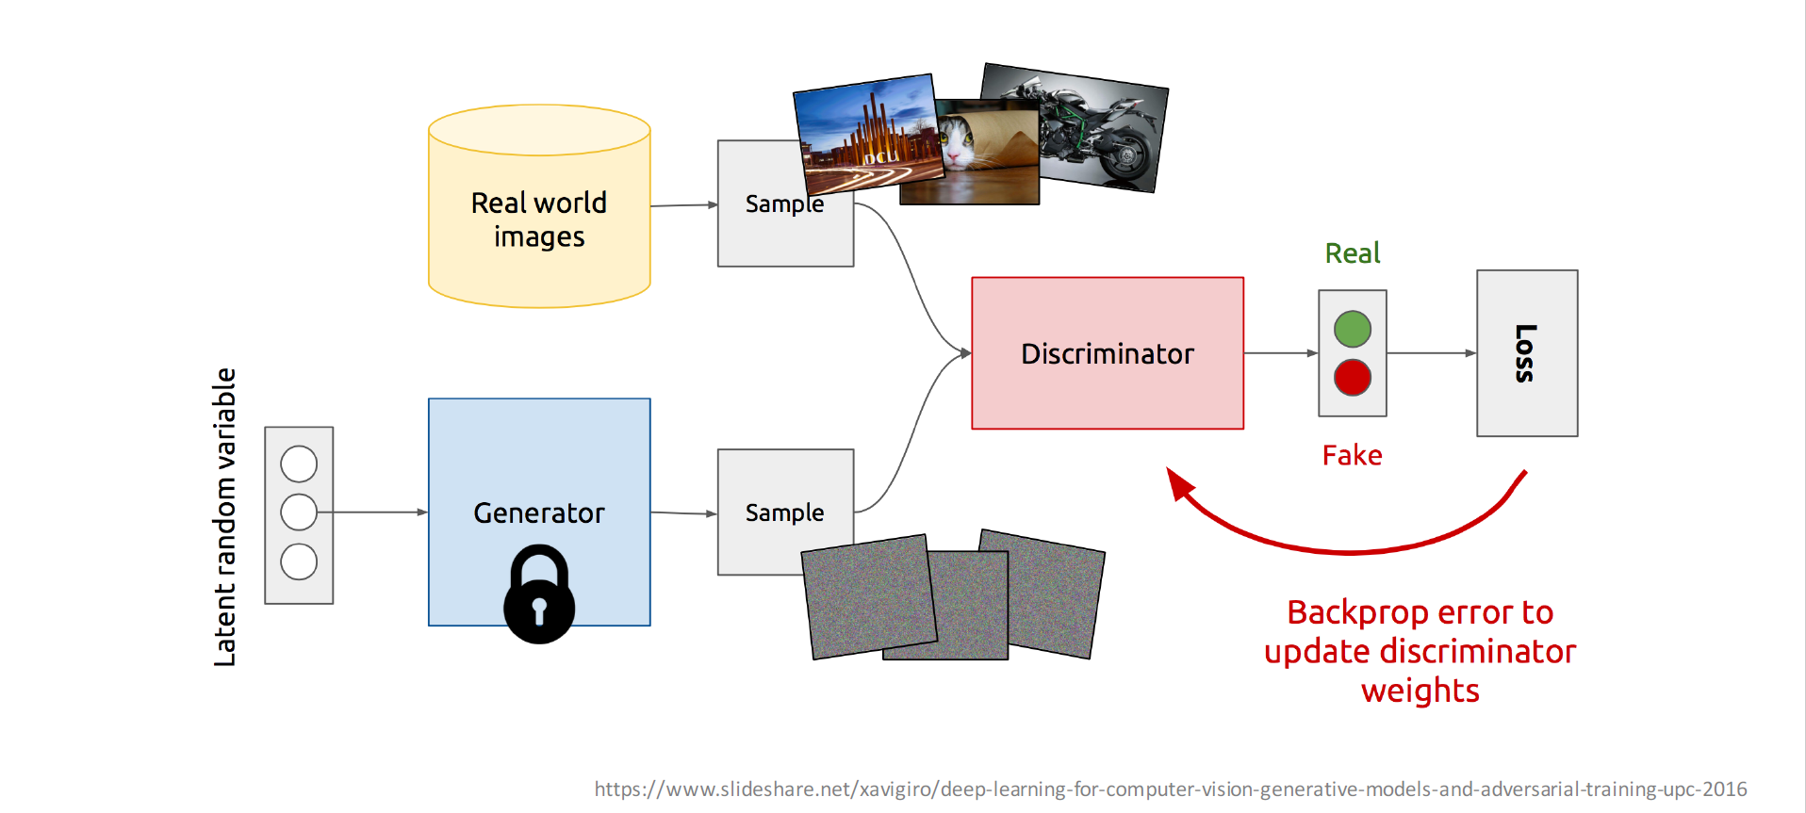
Training Discriminator

Slide 10
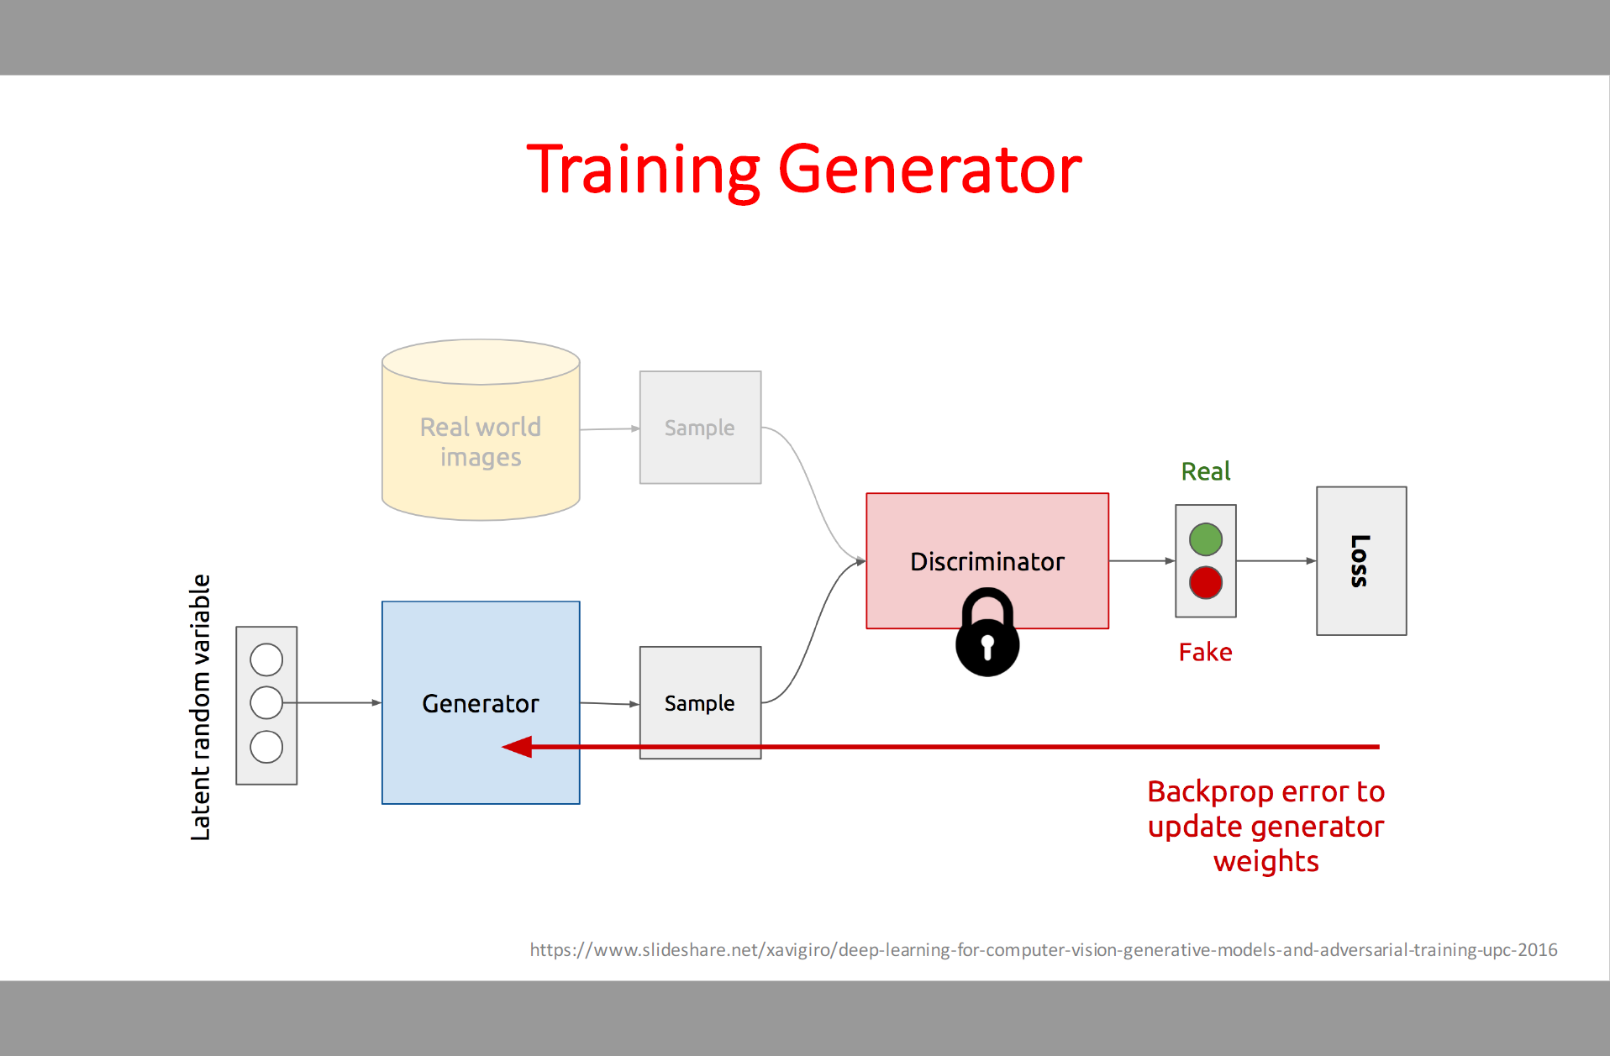
Training Generator

Slide 11
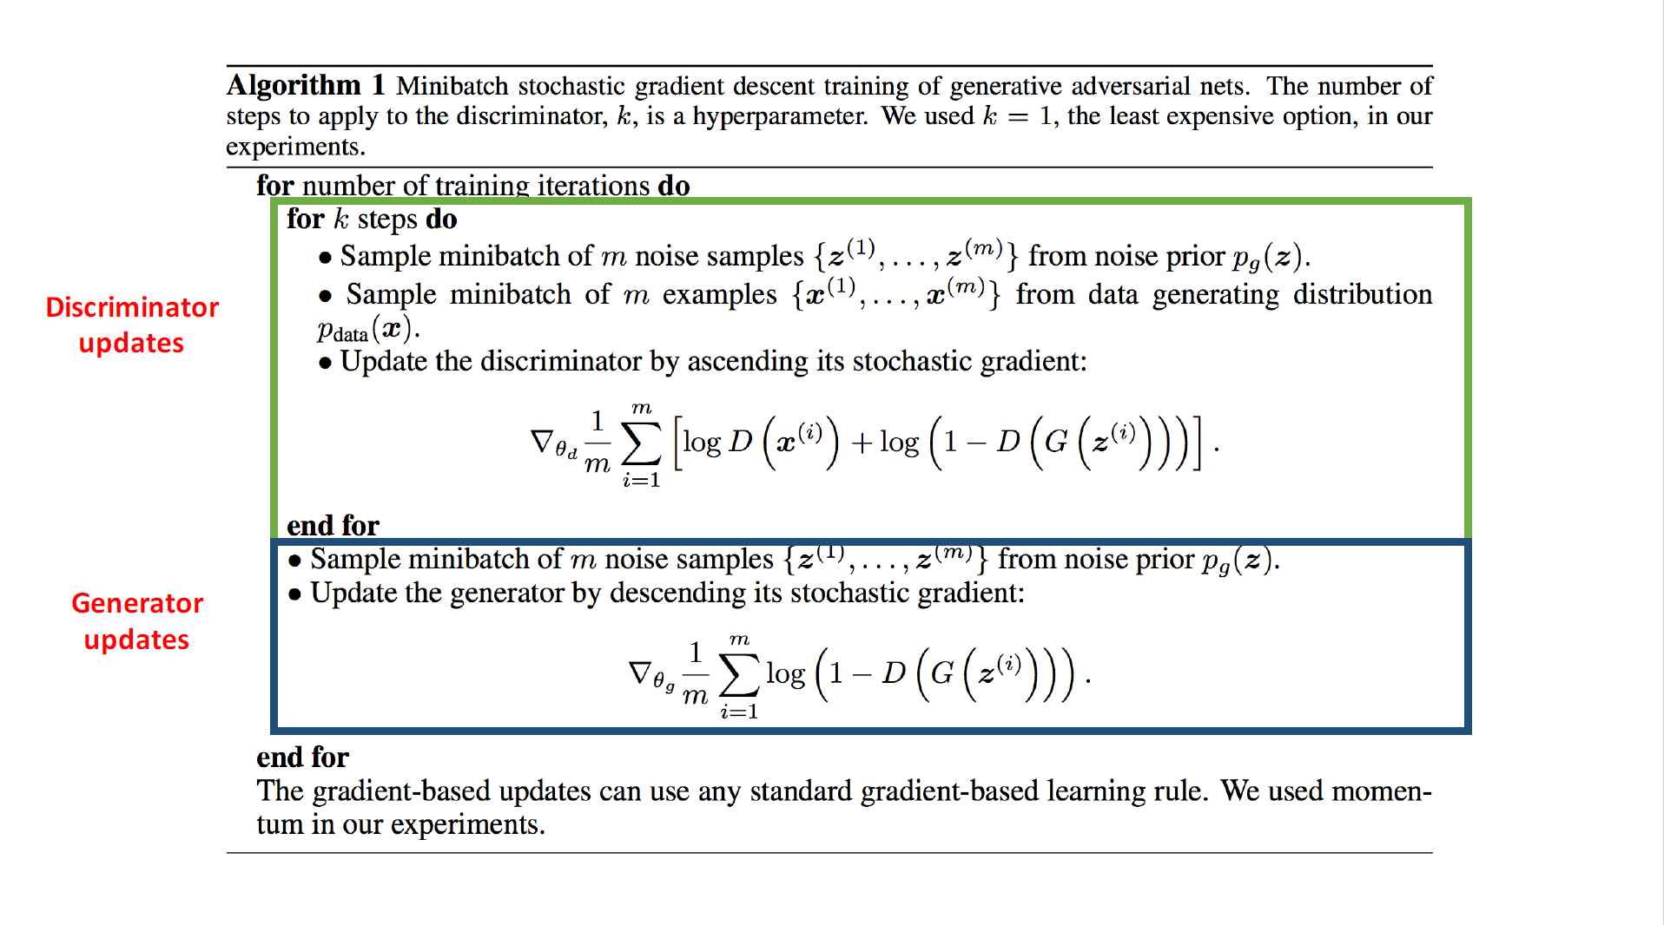

Slide 12
GANs Outline
Introduction to GANs
Training problem of GANs
Non-Convergence
Mode-Collapse
Solutions to the training issues

Slide 13
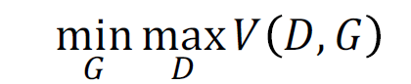
Non-Convergence
Most deep learning models involve a single player
The player tries to maximize its reward or minimize its loss.
Use SGD to find the optimal parameters and it has convergence guarantees (under certain conditions).
GANs involve two players
Discriminator is trying to maximize its reward.
Generator is trying to minimize Discriminator’s reward.
SGD was not designed to find the Nash equilibrium of a game.
Problem: We might not converge to the Nash equilibrium at all.

Slide 14
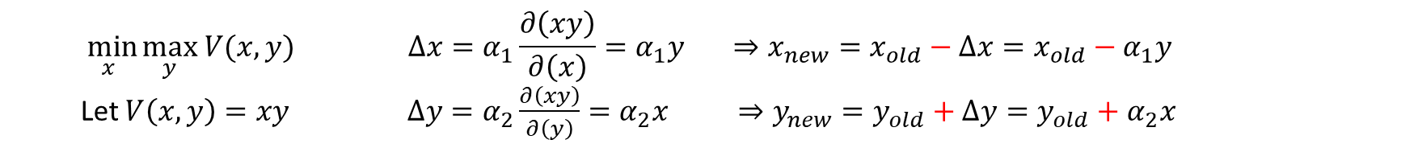

Non-Convergence
Example:
$\min_{x}{\max_{y} V(x,{y) }}$
$V\left(x,y\right)=xy$
$$\min_{x}{\max_{y} V(x,{y) } }∆x=α_{1}\frac{∂\left(xy\right)}{∂\left(x\right)}=α_{1}y ⇒{x_{new}=x}_{old}−∆x=x_{old}−α_{1}y$$
Let $V\left(x,y\right)=xy$ $∆y=α_{2}\frac{∂\left(xy\right)}{∂\left(y\right)}=α_{2}x ⇒{y_{new}=y}_{old}+∆y=y_{old}+α_{2}x$

Slide 15
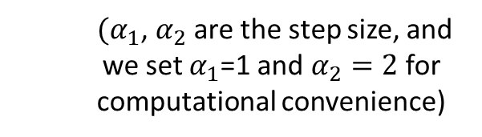
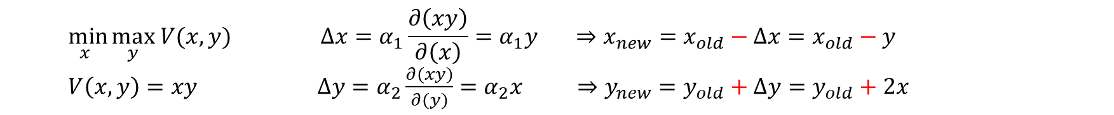
Non-Convergence
$$\min_{x}{\max_{y} V(x,{y) } }∆x=α_{1}\frac{∂\left(xy\right)}{∂\left(x\right)}=α_{1}y ⇒{x_{new}=x}_{old}−∆x=x_{old}−y$$
$V\left(x,y\right)=xy$ $∆y=α_{2}\frac{∂\left(xy\right)}{∂\left(y\right)}=α_{2}x ⇒{y_{new}=y}_{old}+∆y=y_{old}+2x$
$(α_{1}$, $α_{2}$ are the step size, and we set $α_{1}$=1 and $α_{2}=2$ for computational convenience)
Iteration | X | Y | V | Goal
0 | X = 2 | Y = 5 | 10 | Random initialization
1 | X=2-5=-3 | Y = 5 | -15 | G want to minimize x
2 | X = -3 | Y=5+(-3)*2=-1 | 3 | D want to maximize y
3 | X=-3-(-1)=-2 | Y = -1 | 2 | G want to minimize x
4 | X = -2 | Y=-1+(-2)*2=-5 | 10 | D want to maximize y
5 | X=-2-(-5)=3 | Y = -5 | -15 | G want to minimize x
6 | X = 3 | Y=-5+2*3=1 | 3 | D want to maximize y
7 | X = 3 – 1 = 2 | Y = 1 | 2 | G want to minimize x
8 | X = 2 | Y = 1 + 2*2 =5 | 10 | D want to maximize y

Slide 16
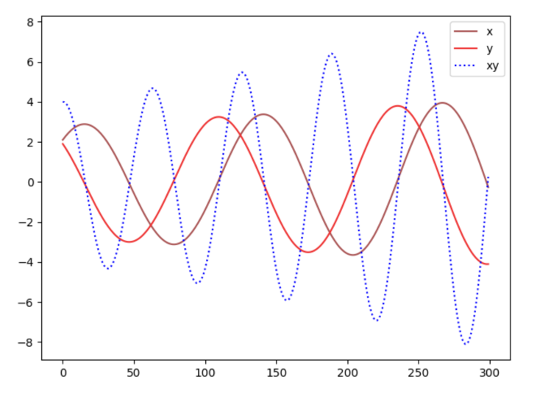
Non-Convergence
The Nash equilibrium happens when x=y=0.
This is the only state where the action of your opponent does not matter.
It is the only state that any opponents’ actions will not change the game outcome.

Slide 17
GANs Outline
Introduction to GANs
Training problem of GANs
Non-Convergence
Mode-Collapse
Solution to training issues

Slide 18
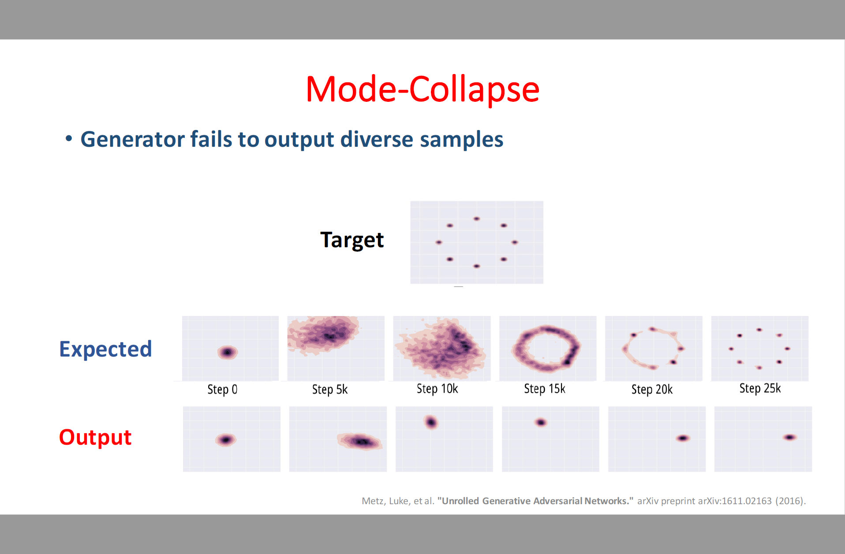
Mode-Collapse
Generator fails to output diverse samples
Due to imbalanced data

Slide 19
GANs Outline
Introduction to GANs
Training problem of GANs
Solutions to the training issues

Slide 20
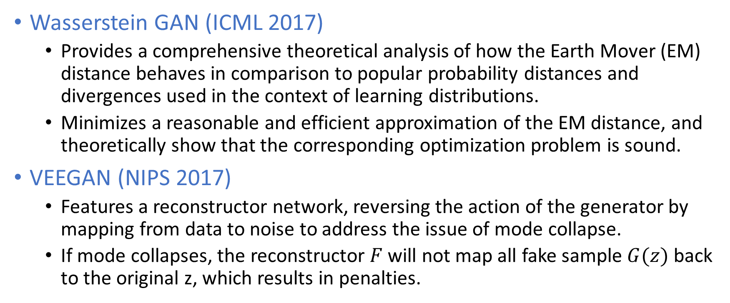
Solutions to address these training issues
Wasserstein GAN (ICML 2017)
Provides a comprehensive theoretical analysis of how the Earth Mover (EM) distance behaves in comparison to popular probability distances and divergences used in the context of learning distributions.
Minimizes a reasonable and efficient approximation of the EM distance, and theoretically show that the corresponding optimization problem is sound.
VEEGAN (NIPS 2017)
Features a reconstructor network, reversing the action of the generator by mapping from data to noise to address the issue of mode collapse.
If mode collapses, the reconstructor $F$ will not map all fake sample $G(z)$ back to the original z, which results in penalties.

Slide 21
Outline
Generative Adversarial Networks (GANs)
Cycle-Consistent GANs

Slide 22
Cycle-Consistent GANs Outlines
Framework
Examples and Applications
Failure Case

Slide 23
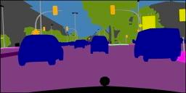
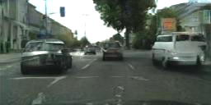
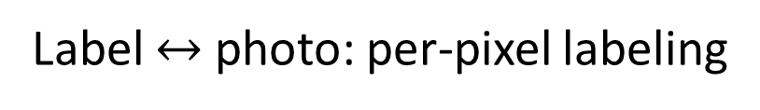
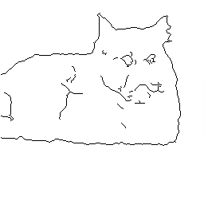
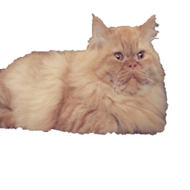
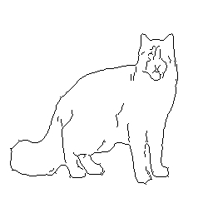
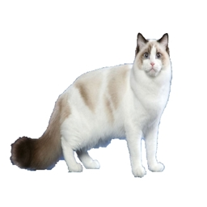
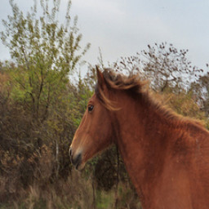

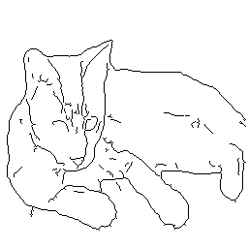
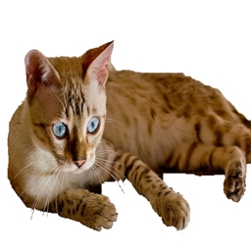
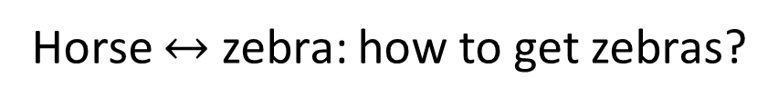
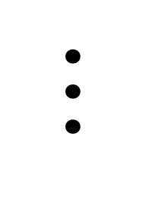
Paired
Label $↔$ photo: per-pixel labeling
Horse $↔$ zebra: how to get zebras?
- Expensive to collect pairs.
- Impossible in many scenarios.
$$⋯$$

Slide 24
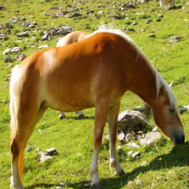
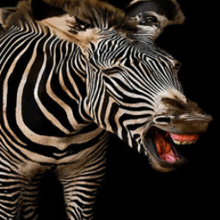
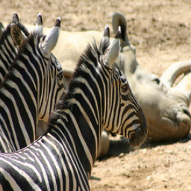
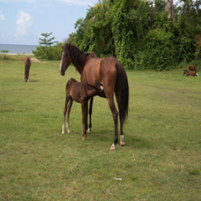
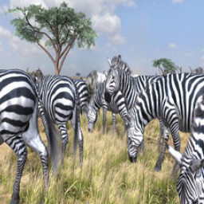
Paired
Unpaired
…
…
$$⋯$$

Slide 25
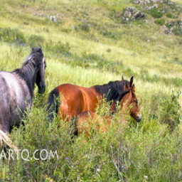
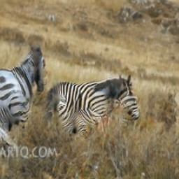


$$x$$
$$G(x)$$
$$G$$
$$D$$
Real!
Generator
Discriminator

Slide 26
$$x$$
$$G(x)$$
$$G$$
$$D$$
Real too!
Generator
Discriminator
GANs do not force output to correspond to input

Slide 27








Cycle-Consistent Adversarial Networks
$$x$$
$$G(x)$$
$$F(G\left(x\right))$$
$$D_{Y}(G\left(x\right))$$
Reconstruction
error
$${\left\|F\left(G\left(x\right)\right)−x\right\|}_{1}$$
[Zhu*, Park*, Isola, and Efros, ICCV 2017]

Slide 28
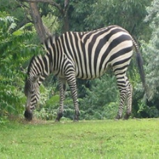
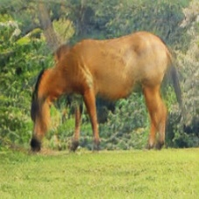





Cycle Consistency Loss
$$x$$
$$G(x)$$
$$F(G\left(x\right))$$
$$y$$
$$F(y)$$
$$G(F\left(x\right))$$
$$D_{Y}(G\left(x\right))$$
$$D_{G}(F\left(x\right))$$
Reconstruction
error
Reconstruction
error
$${\left\|F\left(G\left(x\right)\right)−x\right\|}_{1}$$
$${\left\|G\left(F\left(y\right)\right)−y\right\|}_{1}$$
See similar formulations [Yi et al. 2017], [Kim et al. 2017]
[Zhu*, Park*, Isola, and Efros, ICCV 2017]

Slide 29
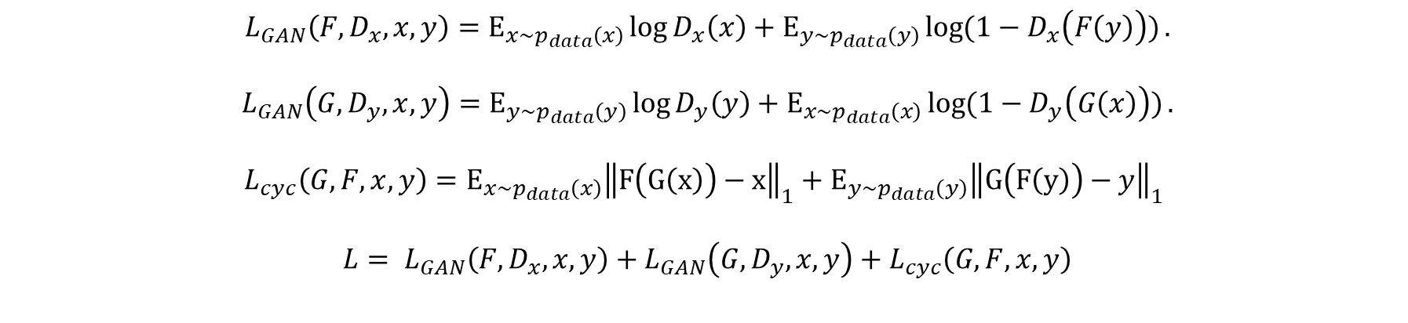
Cycle Consistency Loss
$L_{GAN}\left(F, D_{x},x,y\right)=Ε_{x\sim p_{data}\left(x\right)}\log{D_{x}\left(x\right)}+Ε_{y\sim p_{data}\left(y\right)}\log{(1−D_{x}\left(F\left(y\right)\right))}$
$L_{GAN}\left(G, D_{y},x,y\right)=Ε_{y\sim p_{data}\left(y\right)}\log{D_{y}\left(y\right)}+Ε_{x\sim p_{data}\left(x\right)}\log{(1−D_{y}\left(G\left(x\right)\right))}$
$$L_{cyc}\left(G, F,x,y\right)=Ε_{x\sim p_{data}\left(x\right)}{\left\|F\left(G\left(x\right)\right)−x\right\|}_{1}+Ε_{y\sim p_{data}\left(y\right)}{\left\|G\left(F\left(y\right)\right)−y\right\|}_{1}$$
${L= L}_{GAN}\left(F, D_{x},x,y\right)+L_{GAN}\left(G, D_{y},x,y\right)+L_{cyc}\left(G, F,x,y\right)$

Slide 30
Cycle-Consistent GANs Outlines
Framework
Examples and Applications
Failure Case

Slide 31
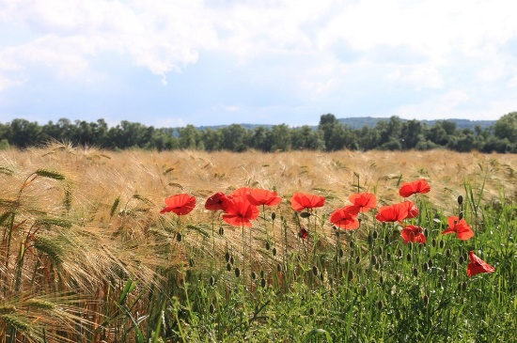
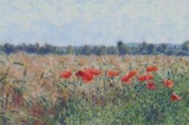
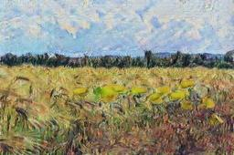
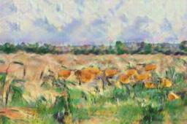
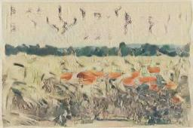
Collection Style Transfer
Monet
Van Gogh
Photograph
@ Alexei Efros
Cezanne
Ukiyo-e
Notes:
Transfer Images to painting

Slide 32
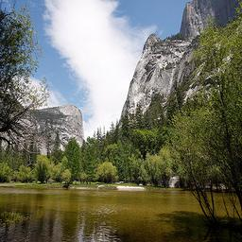
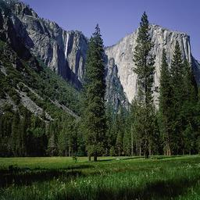
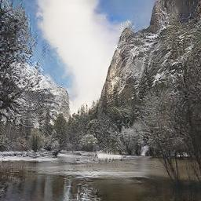
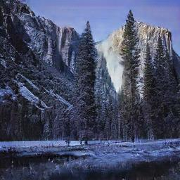
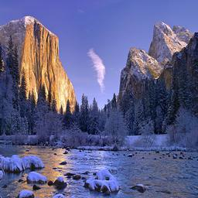
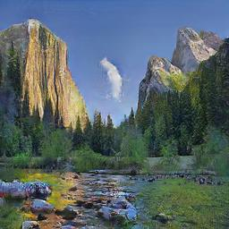
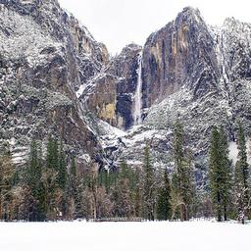
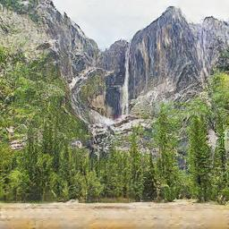

Slide 33
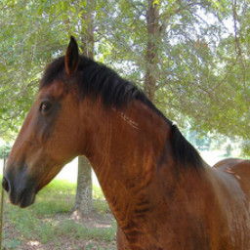




Slide 34





Slide 35


Photo Enhancement
WESPE: Weakly Supervised Photo Enhancer for Digital Cameras. arXiv 1709.01118
AndreD Ignatov, NikolaD KobDshev, Kenneth VanhoeD, Radu Timofte, Luc Van Gool

Slide 36
Cycle-Consistent GANs Outlines
Framework
Examples and Applications
Failure Case

Slide 39


Slide 40
Summary
Difference between GAN and Cycle-GAN
GAN involves only one generator and one discriminator, while Cycle-GAN involves two generators and two discriminators.
GAN generates samples from random noise, while Cycle-GAN transfers real images from one domain to another domain.

Slide 41



