Slide 1
Effectiveness of GANs
Aiyu Cui

Slide 2
Outline
Two papers:
Generalization and equilibrium in generative adversarial nets (GANs) (ICML’17)
​Do GANs Actually Learn the Distribution? (ICLR’18)
Take-outs in theory:
Are GAN capable enough to capture/recover the targeted distribution?
Is Equilibrium guaranteed during training?
How do we measure it and how do we quantify it?
Does Encoder-Decoder GANs guarantee anything more than regular GANs?
Take-Outs in practices:
MIX-GAN: a protocol to train better GAN
Birthday Paradox Test: a measure of support size of a trained distribution

Slide 3
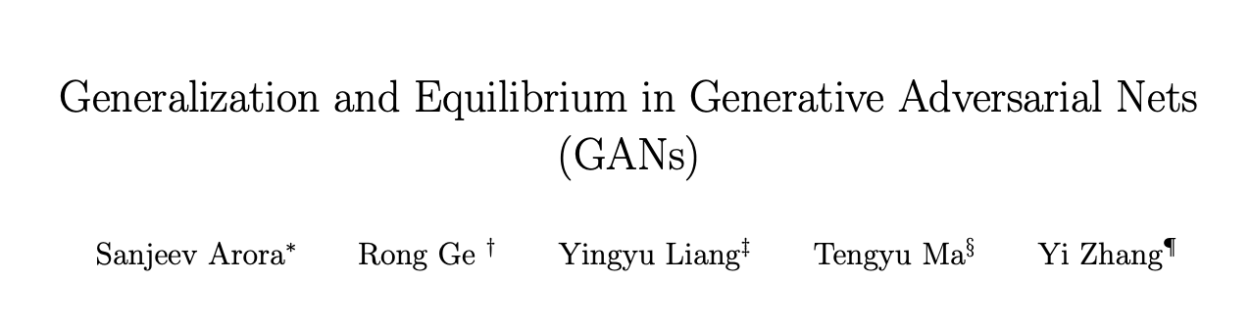

Slide 4
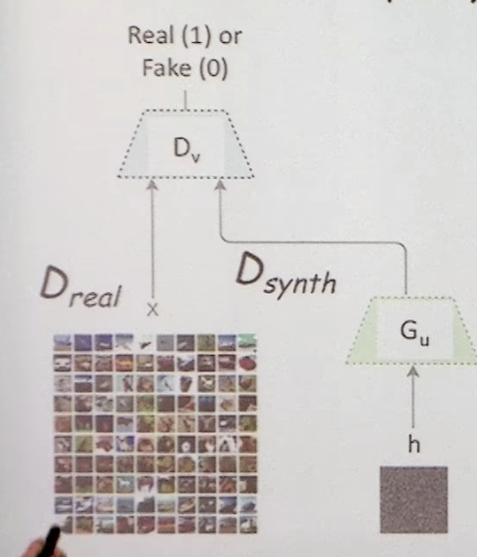

GANs
What are GANs?
a minimax game formed by Discriminator and Generator
What are GANs trying to do?
To model

Slide 5
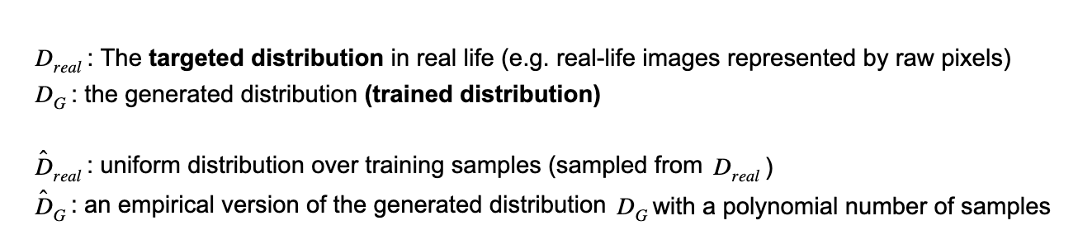

Terms/Notations

Slide 6


Theory vs. Practice
D capability: = # of parameters
d: # of training sample
In theory [ ],
Generator wins => , if:
Discriminator capability is large enough ( ~exp(d) )
Number of samples is large enough
In practice:
Sadly, neither of the above assumptions holds
But still

Slide 7
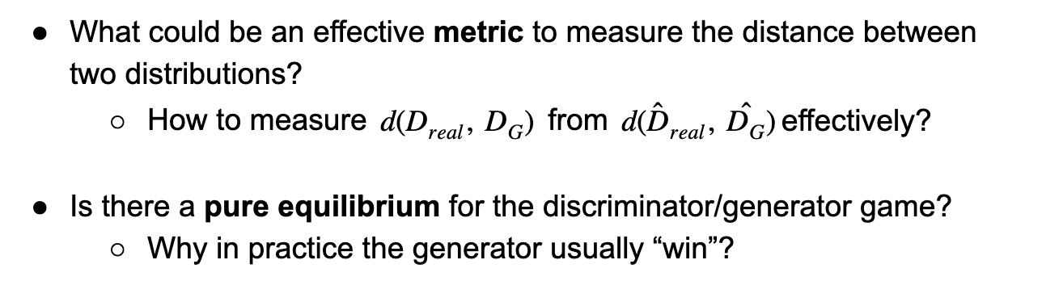
Questions,

Slide 8
Outline for paper 1
Generalization of GAN and new measurement on distance of two distributions
Pure equilibrium of GAN game exists
An empirical method to train better GAN in terms of ability to generalize
MIX+GAN

Slide 9

Generalization in GAN
Defined as:
If the above condition holds, we call it generalize.
JS Divergence and Wasserstein don’t Generalize
Proof by counterexample.
What we have access to - empirical
What we want to minimize - true

Slide 10

GAN Training - Objective functions (1)
General GAN training:
𝜙 is the measuring function
Concave, Bounded, lipschitz, monotone
Best strategy ½, and value 2𝜙(½)

Slide 11



GAN Training - Objective functions (2)
Original objective function GAN training:
Optimal solution exists, but computationally infeasible
Object to minimizing Jensen-Shannon(JS) Divergence.

Slide 12


GAN Training - Objective functions (3)
Wasserstein distance GAN training:
Object to minimizing Wasserstein distance

Slide 13
JS Divergence and Wasserstein Don’t Generalize
Counter Case:
So:

Slide 14
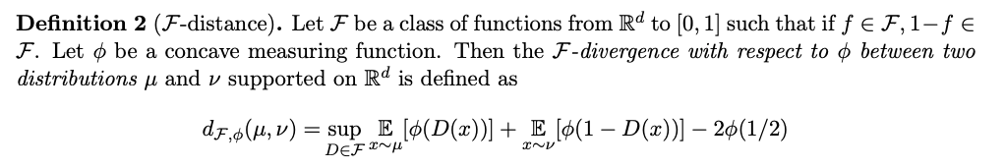

Neural Net distance - F Distance

Slide 15
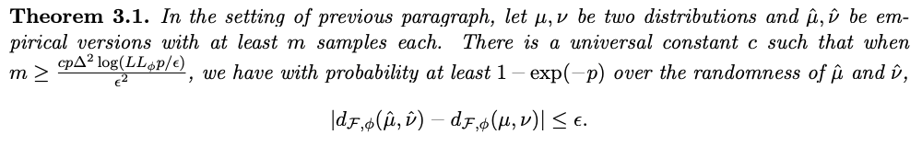

Neural Network Divergence
Neural Network Divergence has better generalization properties:
If is small, we know is also small.

Slide 16
Expressive Power and Equilibrium
In practice, why the generator usually “wins” so that the discriminator is unable to do much better random guessing at the end?
Equilibrium
Is it just lucky to get able to model the distribution D_real by a fairly compact neural net?

Slide 17
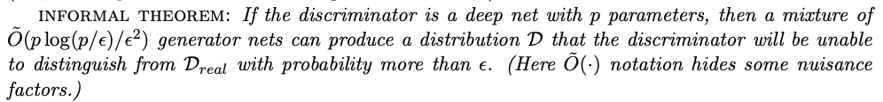


Expressive Power and Equilibrium Cont.
Generator can still win the GAN game even if not achieve
Generator can still win the GAN game even if Generator is not powerful enough to recover the real distribution
Depends on whether Discriminator can distinguish D from

Slide 18

Equilibrium using a Mixture of Generator
A finite mixture of generators can “win” against all discriminators.
A finite mixture of generators can achieve “approximate equilibrium” in the GAN game with the generate win.
If deep nets of size p are capable of generating any point mass, then the GAN game for generator neural network of size has an approximate equilibrium in which the generator wins.

Slide 19
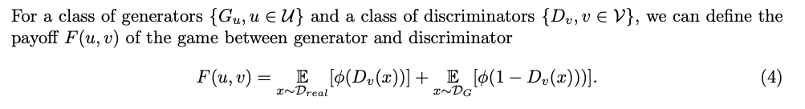
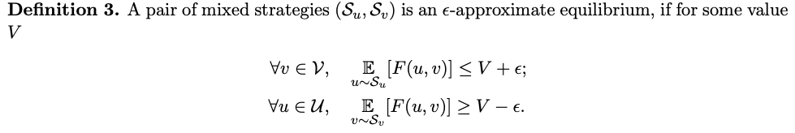
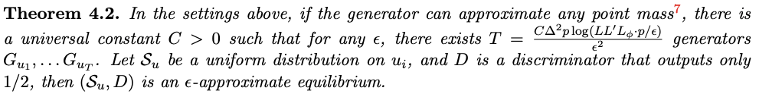
𝜖-approximate equilibrium

Slide 20
MIX+GAN
From the math, it shows that
Using a mixture of generators and discriminators guarantees existence of approximate equilibrium.
Using a mixture may lead to more stable training
MIX+GAN (usually with T components mixed, T < 5 in usual to fit GPU)

Slide 21
MIX+GAN cont.
What to train:
Train a mixture of T generators and T discriminators:
Share Same architectures
But have their own parameters.
A selector to select whose output to take from the T generators/distrinimators
Advantage:
Can be applied with existing methods like DCGAN, WGAN etc.

Slide 22
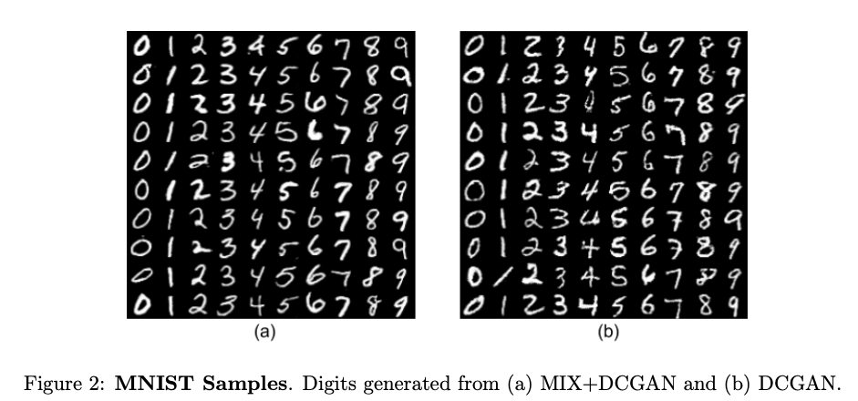
MIX+GAN: Experiments

Slide 23
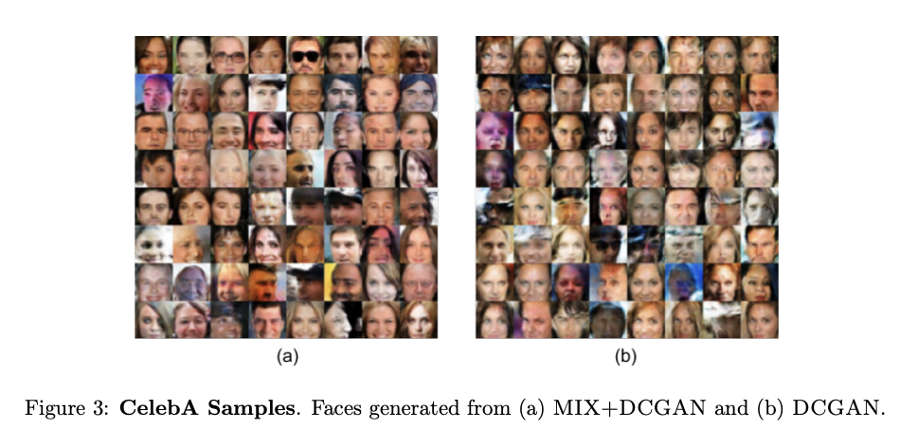
MIX+GAN: Experiments

Slide 24
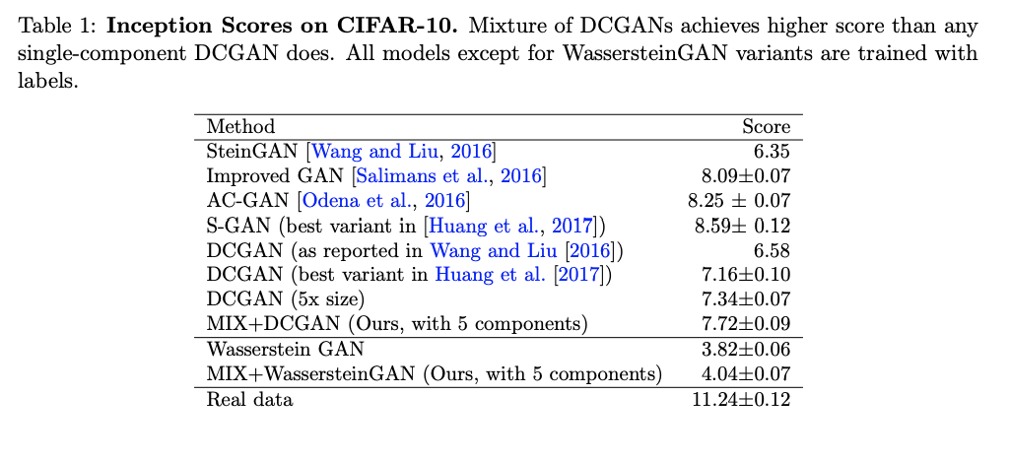

Slide 25
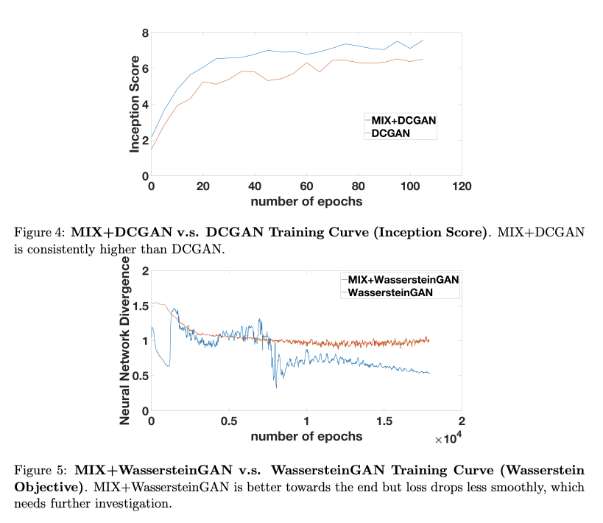

Slide 26
Take-out
Neural Net Distance - A loose distance which ensures the generalization
Equilibrium
MIX-GAN

Slide 27
Whoops, one more paper to go.

Slide 28
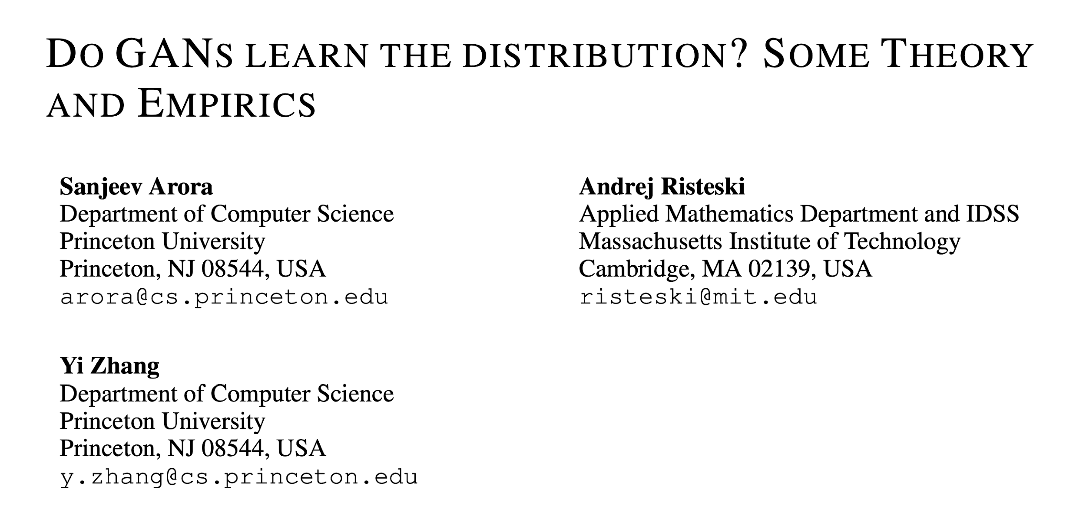

Slide 29
Outline
When discriminator has bounded size, does the optimal solution of GANs imply the real distribution is learnt?
- The training examples are unable to prevent Mode Collapse
If not, how much is learnt?
A novel test - Birthday Paradox
Encoder-Decoder GANs
Better performance on model collapse?

Slide 30
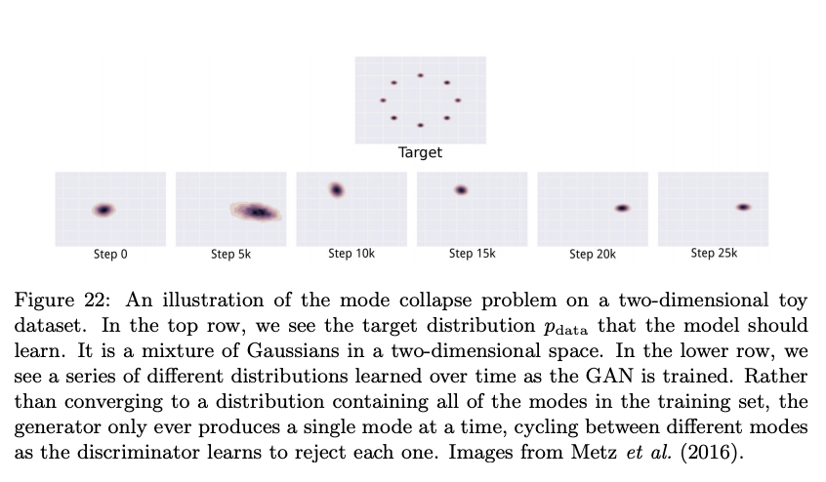
Mode Collapse
Mode Collapse: A problem that occurs when the generator learns to map several different input z values to the same output point.
https://arxiv.org/pdf/1701.00160.pdf

Slide 31
Birthday Paradox
Suppose there are k people in the room. How large must k be before we have a high likelihood of having two people with the same birthday?

Slide 32
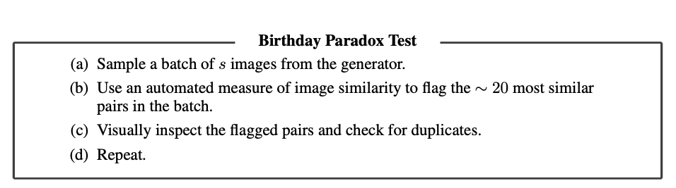
Birthday Paradox Test for GAN support size.
Support size: If the test reveals that batches of sizes s, then suspect that the distribution has support size about s^2. (the higher, the better)

Slide 33
Experiments of Birthday Paradox
With probability > 50% on CelebA
 | > 50% batch size | Support size
DCGAN | ~800 | 640k
MIX_DCGAN | ~800 | 640k
ALI (BiGAN) | ~1200 | 1m

Slide 34
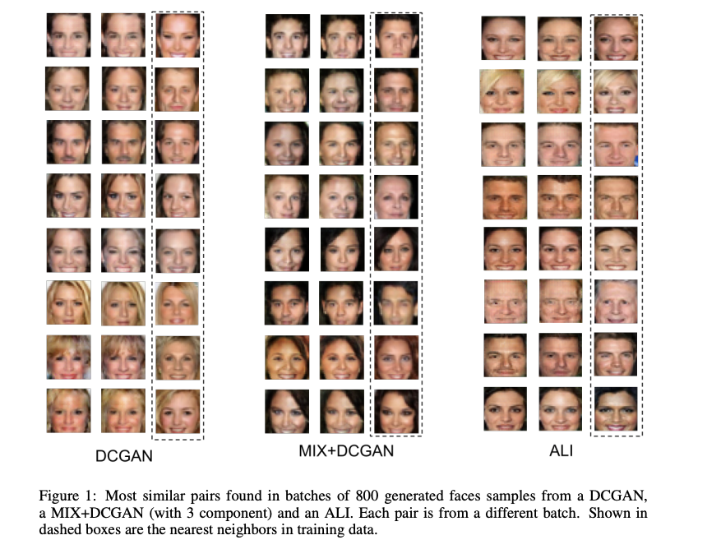

Slide 35
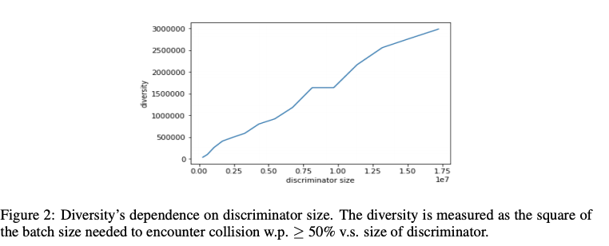
Celeb-A Cont. Diversity vs. Discriminator size
Paper 1 suggests that there is a near-equilibrium which a distribution of such a small support (linear) could suffice to fool the best discriminator.

Slide 36
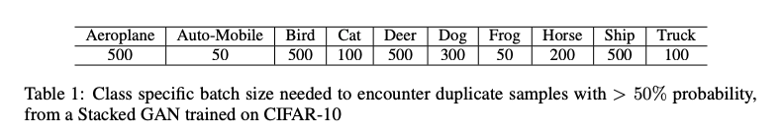
CIFAR-10 Result

Slide 37
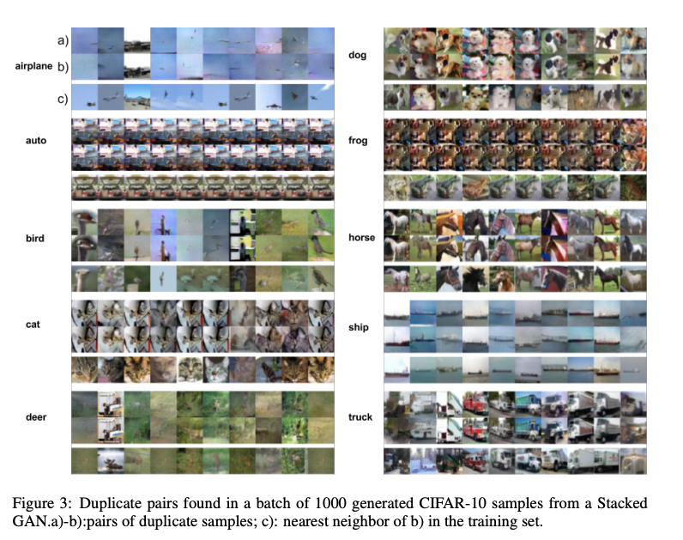

Slide 38
Limitation of Encoder-Decoder GAN
Previous Statements: Encoder-decoder GAN
learns more meaningful feature
Also solve the mode-collapse issue.
Here this work shows: Encoder-decoder GANs
Cannot guarantee learning of the full directribution
Because they cannot prevent serious mode collapse
They cannot prevent learning meaningless codes for data (contrary to intuition)

Slide 39
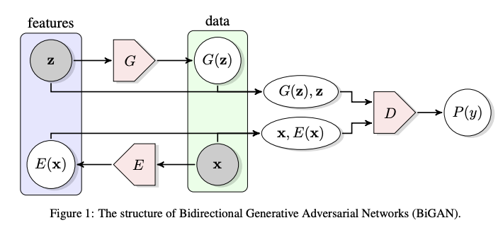

BiGAN

Slide 40
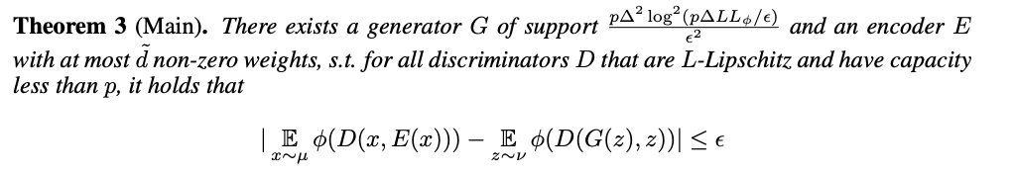
Limitation of BiGAN
The encoder E has very small complexity
Can simply extracts noise from the input x
Generator G is a small-support distribution
So presumably far from the true data distribution

Slide 41
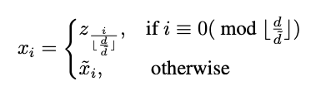

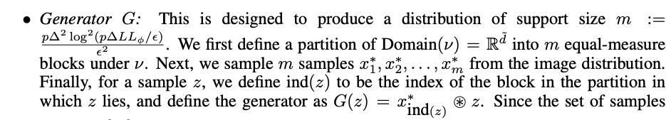
Proof of Thm. 3
Let’s say the input image x is add uniform noise as
Then we can construct
encoder as noisy extractor
and generator as
To satisfy:

Slide 42
Take-out
Birthday Paradox Test
Encoder-decoder GANs cannot guarantee neither meaningful feature learning nor no mode collapse

