Slide 1
Adversarial Attacks on Graph Embedding
Presented by Jun Wu

Slide 2
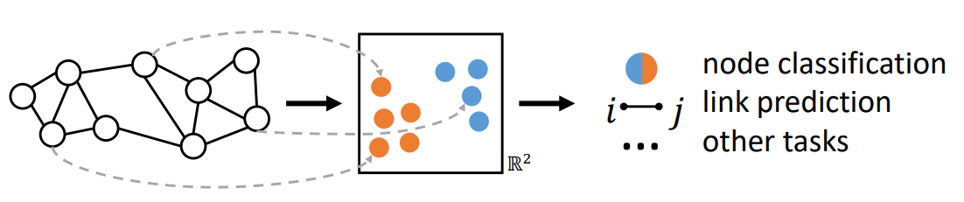

Background: Node Embedding
Objective: Every node $v$ is mapped to a low-dimensional vector $z_{v}∈ℝ^{d}$ such that the graph structure is captured
Similar nodes are close to each other in the embedding space.
Notes:
Similar nodes are close to each other in the embedding space
It could be used to many downstream graph mining tasks: node classification, node clustering, link prediction, etc.

Slide 3
Background: Node Embedding
 | Random Walk Based | Graph Convolution Based
Input | Plain network without node features | Attributed network with node features
Output | Node embeddings (unsupervised) | Node embedding Predictive node class-label (semi-supervised)
Assumption | Nearby nodes share the similar embeddings | Nearby nodes share the similar embeddings
Key idea | Maximize the likelihood of positive node-context pairs sampled by (biased) random walk | Recursively aggregate node messages along edges of the graph
Attacks | Aleksandar Bojchevski, and Stephan Günnemann. "Adversarial attacks on node embeddings via graph poisoning." In ICML 2019. | Daniel Zügner, and Stephan Günnemann. "Adversarial attacks on graph neural networks via meta learning." ICLR 2019.

Slide 4
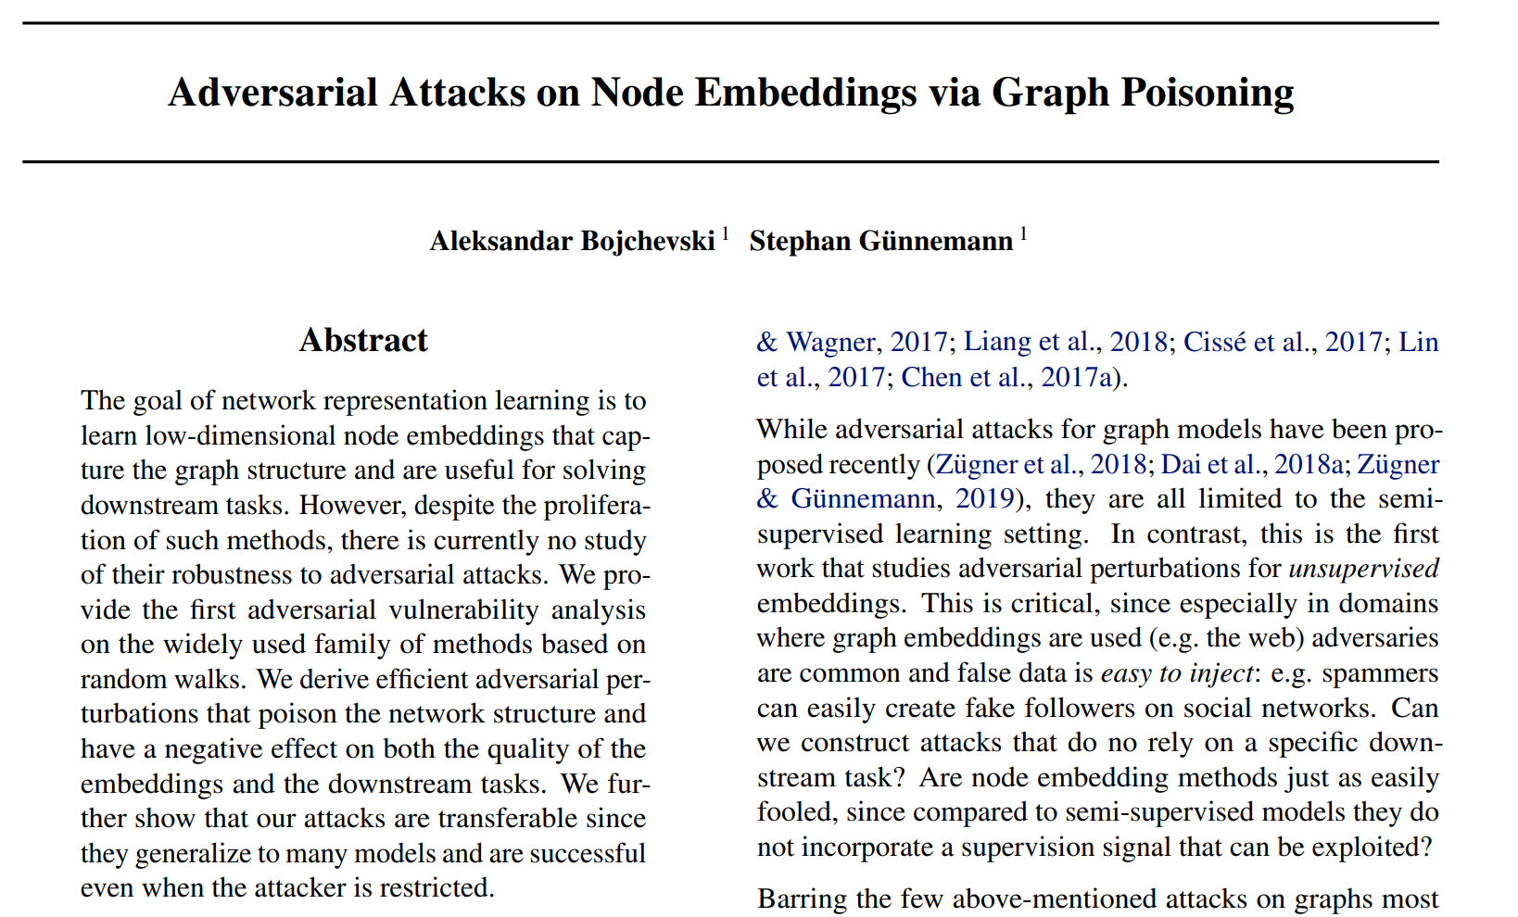
Random Walk Based Embedding

Slide 5
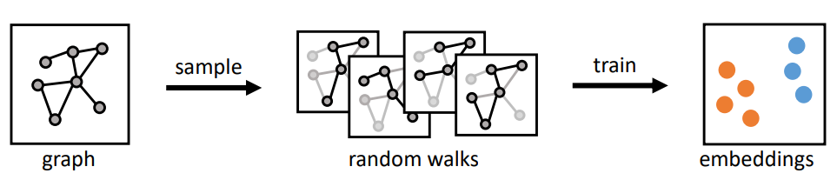
Random Walk Based Embedding
It is close to train a language model, e.g., word2vec
Nodes = words
(Biased) random walks = sentences
Nodes that co-occur in the random-walks have similar embeddings.
Skip-gram with negative sampling: use the current node to predict its context, while node-context pairs are extracted by random walk
For example: DeepWalk, node2vec, etc.
Bryan Perozzi, Rami Al-Rfou, and Steven Skiena. "DeepWalk: Online learning of social representations." In Proceedings of the 20th ACM SIGKDD international conference on Knowledge discovery and data mining, pp. 701-710. ACM, 2014.
Grover, Aditya, and Jure Leskovec. "node2vec: Scalable feature learning for networks." In Proceedings of the 22nd ACM SIGKDD international conference on Knowledge discovery and data mining, pp. 855-864. ACM, 2016.

Slide 6
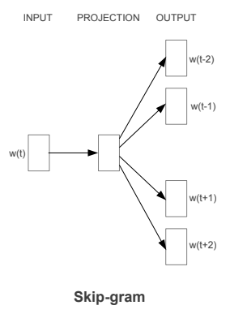
Random Walk Based Embedding
Skip-gram with negative sampling
Key idea: predict the context (local neighbors) using the current word/node
E.g., How is it going today?
E.g.,
1
2
3
4
5
6
7
8
How
3
is
4
it
5
going
6
today
7

Slide 7
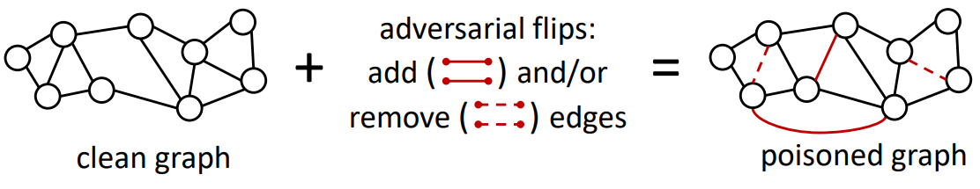
Are node embeddings robust to adversarial attacks?
Plain network (undirected, unweighted network)
Graph structure attack: add/remove edges (limited budget)
Questions:
Q1: How is the overall embedding quality affected by adversarial attack?
Q2: How do these attacks affect the downstream tasks?

Slide 8
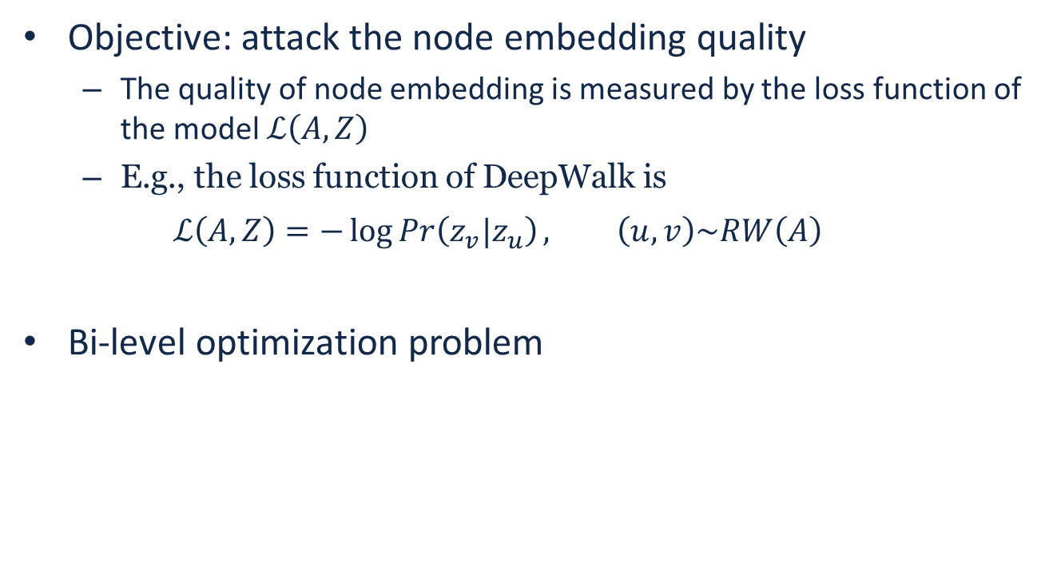


Poisoning attack
Notation:
$G=(V,E)$: input network
$A∈{\left\{0,1\right\}}^{N×N}$: adjacent matrix
$A′∈{\left\{0,1\right\}}^{N×N}$: poisoned adjacent matrix
$Z∈ℝ^{N×K}$: node embedding
$z_{v}∈ℝ^{K}$: node embedding of node $v$
$RW(A)$: random walk sentences from $G$
Objective: attack the node embedding quality
The quality of node embedding is measured by the loss function of the model $ℒ\left(A,Z\right)$
E.g., the loss function of DeepWalk is
$$ℒ\left(A,Z\right)=−\log{Pr\left(z_{v}|z_{u}\right)}, \left(u,v\right)\sim RW\left(A\right)$$
Bi-level optimization problem
The graph after perturbing some edges
$${A^{′}}^{∗}=\arg{\max_{A^{′}∈{\left\{0,1\right\}}^{N×N}}{ℒ\left(A^{′},Z^{∗}\right), Z^{∗}=\arg{\min_{Z}{ℒ\left(A^{′},Z\right)}}}}$$
$$s.t. {\left\|A^{′}−A\right\|}_{0}=2f, A^{′T}=A′$$
Constraint: fixed number of flips (user-defined $f$)
The optimal embedding from the graph $A′$

Slide 9

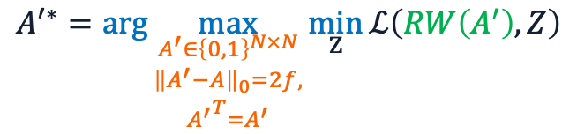
Challenges
Notation:
$G=(V,E)$: input network
$A∈{\left\{0,1\right\}}^{N×N}$: adjacent matrix
$A^{′}∈{\left\{0,1\right\}}^{N×N}$: poisoned adjacent matrix
$Z∈ℝ^{N×K}$: node embedding
$z_{v}∈ℝ^{K}$: node embedding of node $v$
$RW(A)$: random walk sentences from $G$
The loss function of DeepWalk
$${A′}^{∗}=\arg{\max_{\begin{aligned}A^{′}∈{\left\{0,1\right\}}^{N×N} \\ \begin{aligned}{\left\|A^{′}−A\right\|}_{0}=2f, \\ {A^{′}}^{T}=A^{′}\end{aligned}\end{aligned}}{\min_{Z}{ℒ\left(RW\left(A^{′}\right),Z\right)}}}$$
C1: Combinatorial search space.
C2: Bi-level optimization problem.
C3: Inner optimization includes non-differentiable sampling.

Slide 10
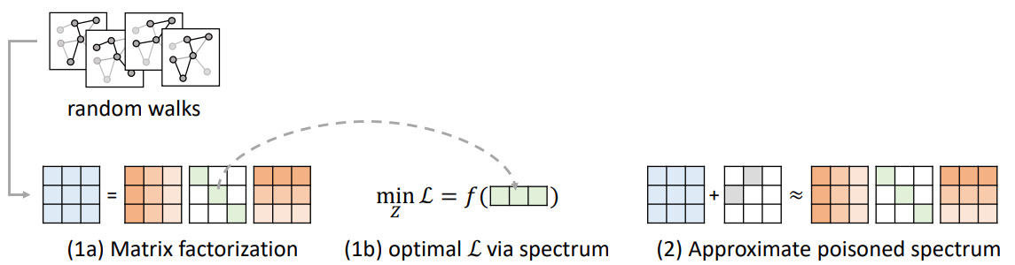
Solutions
Reduce the bi-level problem to a single-level problem (Target C2 & C3)
DeepWalk as matrix factorization
Express the optimal via the graph spectrum
Approximate the poisoned graph’s spectrum (Target C1)

Slide 11
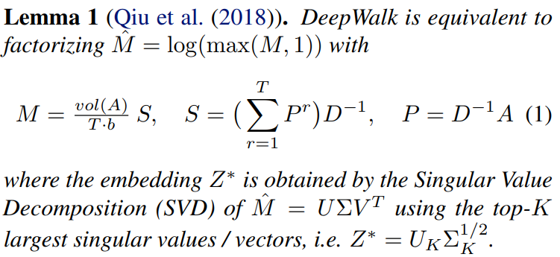
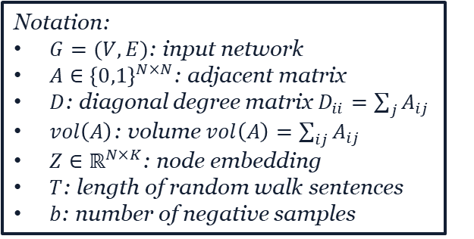
Reduce the bi-level problem to a single-level
DeepWalk corresponds to factorizing the PPMI (Positive Pointwise Mutual Information) matrix.
Embedding dimensionality
Optimal embedding
Notation:
$G=(V,E)$: input network
$A∈{\left\{0,1\right\}}^{N×N}$: adjacent matrix
$D$: diagonal degree matrix $D_{ii}=\sum_{j}{A_{ij}}$
$vol\left(A\right)$: volume $vol\left(A\right)=\sum_{ij}{A_{ij}}$
$Z∈ℝ^{N×K}$: node embedding
$T$: length of random walk sentences
$b$: number of negative samples
Hyperparameters in DeepWalk
Jiezhong Qiu, Yuxiao Dong, Hao Ma, Jian Li, Kuansan Wang, and Jie Tang. "Network embedding as matrix factorization: Unifying DeepWalk, line, PTE, and node2vec." In Proceedings of the Eleventh ACM International Conference on Web Search and Data Mining, pp. 459-467. ACM, 2018.

Slide 12
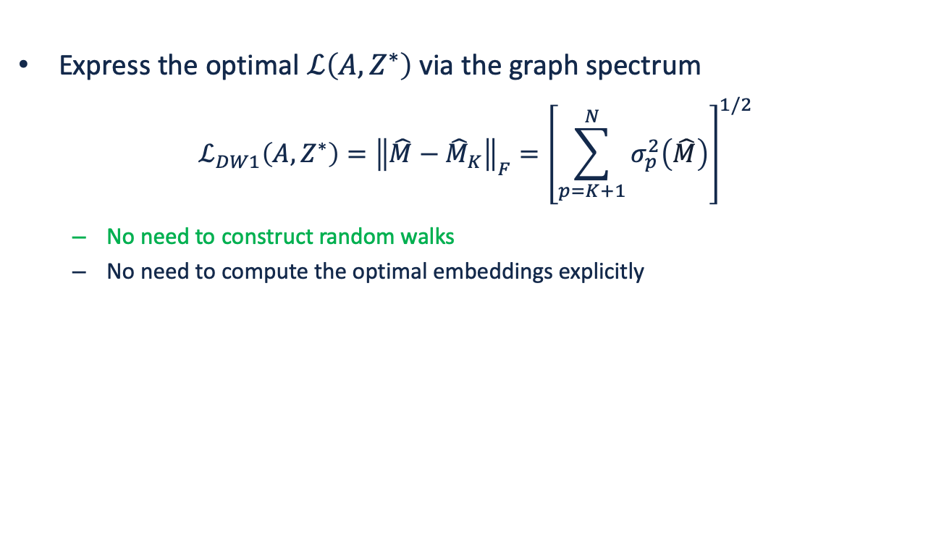
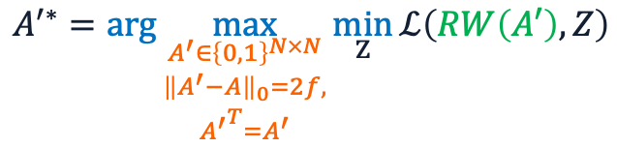
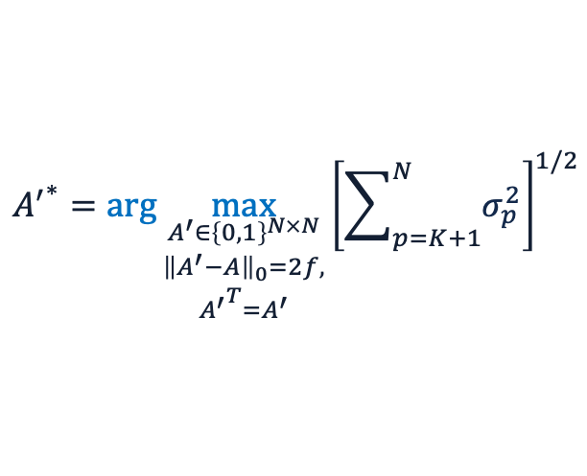
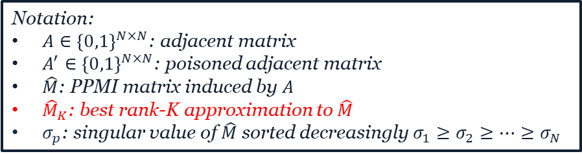
Reduce the bi-level problem to a single-level
Express the optimal $ℒ\left(A,Z^{∗}\right)$ via the graph spectrum
$$ℒ_{DW1}\left(A,Z^{∗}\right)={\left\|\hat{M}−{\hat{M}}_{K}\right\|}_{F}={\left[\sum_{p=K+1}^{N}{σ_{p}^{2}\left(\hat{M}\right)}\right]}^{1/2}$$
No need to construct random walks
No need to compute the optimal embeddings explicitly
$${A^{′}}^{∗}=\arg{\max_{\begin{aligned}A^{′}∈{\left\{0,1\right\}}^{N×N} \\ \begin{aligned}{\left\|A^{′}−A\right\|}_{0}=2f, \\ {A^{′}}^{T}=A^{′}\end{aligned}\end{aligned}}{{\left[\sum_{p=K+1}^{N}{σ_{p}^{2}}\right]}^{1/2}}}$$
$$A^{′∗}=\arg{\max_{\begin{aligned}A^{′}∈{\left\{0,1\right\}}^{N×N} \\ \begin{aligned}{\left\|A^{′}−A\right\|}_{0}=2f, \\ {A^{′}}^{T}=A^{′}\end{aligned}\end{aligned}}{\min_{Z}{ℒ\left(RW\left(A′\right),Z\right)}}}$$
Bi-level optimization problem
Single-level optimization problem
Notation:
$A∈{\left\{0,1\right\}}^{N×N}$: adjacent matrix
$A^{′}∈{\left\{0,1\right\}}^{N×N}$: poisoned adjacent matrix
$\hat{M}$: PPMI matrix induced by $A$
${\hat{M}}_{K}$: best rank-K approximation to $\hat{M}$
$σ_{p}$: singular value of $\hat{M}$ sorted decreasingly $σ_{1}≥σ_{2}≥⋯≥σ_{N}$

Slide 13

Challenges
Notation:
$G=(V,E)$: input network
$A∈{\left\{0,1\right\}}^{N×N}$: adjacent matrix
$A^{′}∈{\left\{0,1\right\}}^{N×N}$: poisoned adjacent matrix
$Z∈ℝ^{N×K}$: node embedding
$z_{v}∈ℝ^{K}$: node embedding of node $v$
$RW(A)$: random walk sentences from $G$
The loss function of DeepWalk
$${A′}^{∗}=\arg{\max_{\begin{aligned}A^{′}∈{\left\{0,1\right\}}^{N×N} \\ \begin{aligned}{\left\|A^{′}−A\right\|}_{0}=2f, \\ {A^{′}}^{T}=A^{′}\end{aligned}\end{aligned}}{\min_{Z}{ℒ\left(RW\left(A^{′}\right),Z\right)}}}$$
C1: Combinatorial search space.
C2: Bi-level optimization problem.
C3: Inner optimization includes non-differentiable sampling.

Slide 14
Single-level optimization
Objective: attack the node embedding quality
The quality of node embedding is measured by the loss function of the model $ℒ_{DW1}\left(A′,Z^{∗}\right)$
Optimization
Gradient-based optimization: discrete solution space
$${A′}_{k+1}←{A′}_{k}−α∇_{A^{′}}ℒ_{DW1}\left(A′,Z^{∗}\right)$$
Brute-force search: extremely time-consuming
$${A′}^{∗}=\arg{\max_{\begin{aligned}A^{′}∈{\left\{0,1\right\}}^{N×N} \\ \begin{aligned}{\left\|A^{′}−A\right\|}_{0}=2f, \\ {A^{′}}^{T}=A^{′}\end{aligned}\end{aligned}}{{\left[\sum_{p=K+1}^{N}{σ_{p}^{2}}\right]}^{1/2}}}$$

Slide 15
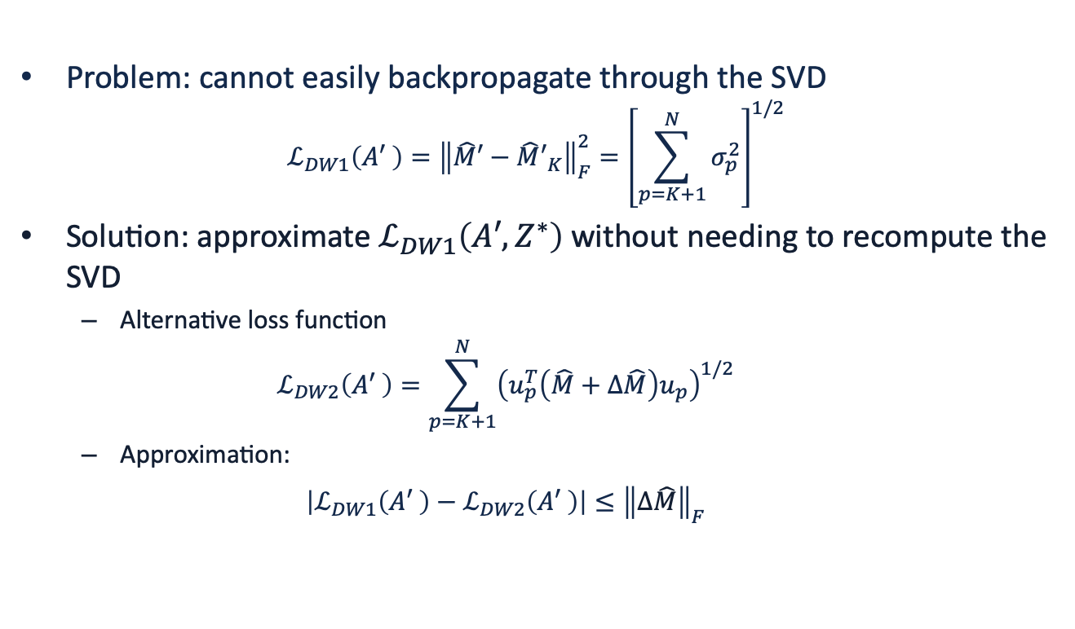
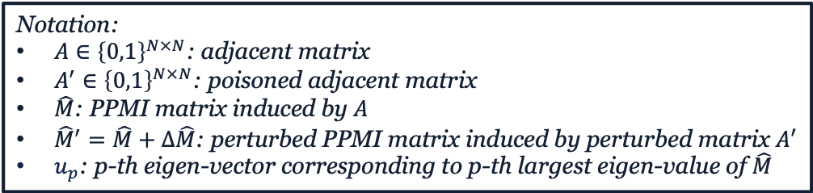

Gradient-based Approach
Problem: cannot easily backpropagate through the SVD
$$ℒ_{DW1}\left(A′ \right)={\left\|\hat{M}′−{\hat{M}′}_{K}\right\|}_{F}^{2}={\left[\sum_{p=K+1}^{N}{σ_{p}^{2}}\right]}^{1/2}$$
Solution: approximate $ℒ_{DW1}\left(A′,Z^{∗}\right)$ without needing to recompute the SVD
Alternative loss function
$$ℒ_{DW2}\left(A′ \right)=\sum_{p=K+1}^{N}{{\left(u_{p}^{T}\left(\hat{M}+Δ\hat{M}\right)u_{p}\right)}^{1/2}}$$
Approximation:
$$\left|ℒ_{DW1}\left(A′ \right)−ℒ_{DW2}\left(A′ \right)\right|≤{\left\|Δ\hat{M}\right\|}_{F}$$
SVD on $\hat{M}′$
Notation:
$A∈{\left\{0,1\right\}}^{N×N}$: adjacent matrix
$A^{′}∈{\left\{0,1\right\}}^{N×N}$: poisoned adjacent matrix
$\hat{M}$: PPMI matrix induced by $A$
${\hat{M}}^{′}=\hat{M}+Δ\hat{M}$: perturbed PPMI matrix induced by perturbed matrix $A′$
$u_{p}$: p-th eigen-vector corresponding to p-th largest eigen-value of $\hat{M}$

Slide 16
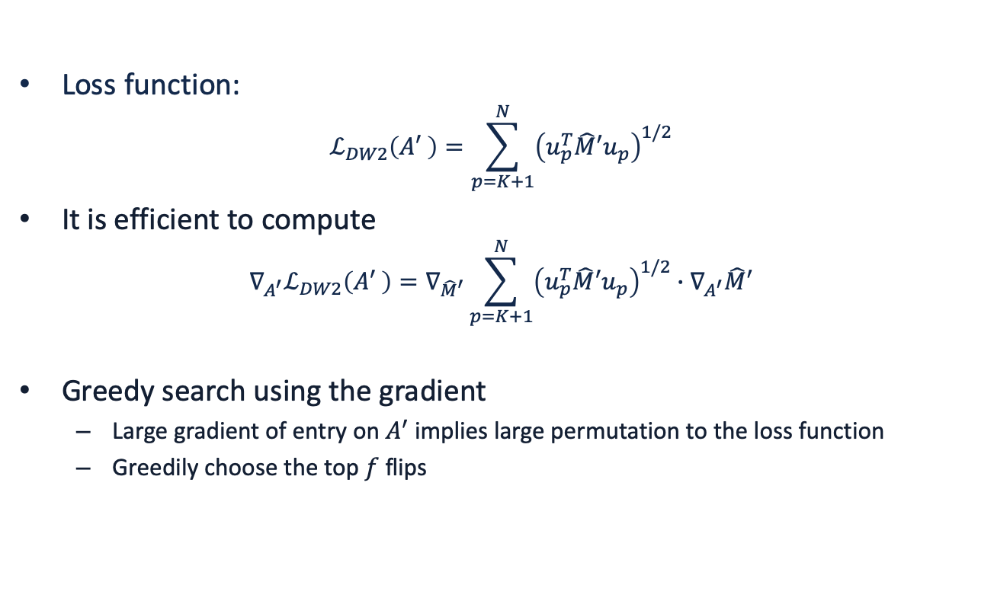

Gradient-based Approach
Loss function:
$$ℒ_{DW2}\left(A′ \right)=\sum_{p=K+1}^{N}{{\left(u_{p}^{T}{\hat{M}′u}_{p}\right)}^{1/2}}$$
It is efficient to compute
$$∇_{A^{′}}ℒ_{DW2}\left(A′ \right)=∇_{{\hat{M}}^{′}}\sum_{p=K+1}^{N}{{\left(u_{p}^{T}{\hat{M}′u}_{p}\right)}^{1/2}}∙∇_{A^{′}}\hat{M}′$$
Greedy search using the gradient
Large gradient of entry on $A^{′}$ implies large permutation to the loss function
Greedily choose the top $f$ flips
solution
$$\begin{aligned}A^{′}∈{\left\{0,1\right\}}^{N×N} \\ \begin{aligned}{\left\|A^{′}−A\right\|}_{0}=2f, \\ {A^{′}}^{T}=A^{′}\end{aligned}\end{aligned}$$
challenge
C1: Combinatorial search space.

Slide 17






Closed-form Approach (Brute-force)
Choose a candidate set
All the real edges
Randomly sampling C candidate pairs (non-edges)
Greedily search the optimal edge flip
Compute the loss value when one flip happened
Choose the edge flip with the largest loss value
Approximate the poisoned graph’s spectrum
approximation
$\frac{N^{2}−N}{2}$ possible flips
approximation
$$ℒ_{DW3}\left(A′\right)=\frac{vol\left(A\right)+2Δw_{ij}}{T∙b}{\left[\sum_{p=K+1}^{N}{\left(\frac{1}{d_{min}^{′}}∙\left|\sum_{r=1}^{T}{{\left(λ_{p}^{′}\right)}^{r}}\right|\right)}\right]}^{1/2}$$
Compute in $O(1)$
$$λ_{p}^{′}=λ_{p}+Δλ_{p}$$
$$Δλ_{p}≈Δw_{ij}\left(2u_{pi}∙u_{pj}−λ_{p}\left(u_{pi}^{2}+u_{pj}^{2}\right)\right)$$
Notation:
$A^{′}∈{\left\{0,1\right\}}^{N×N}$: poisoned adjacent matrix
$vol\left(A\right)$: volume $vol\left(A\right)=\sum_{ij}{A_{ij}}$
$T$: length of random walk sentences
$b$: number of negative samples
$d_{min}^{′}$: smallest degree in $A^{′}$
$λ_{p}^{′}$: generalized eigenvalue of $A^{′}$ by $A^{′}u_{p}^{′}=λ_{p}^{′}D^{′}u_{p}^{′}$
$Δw_{ij}=1−2A_{ij}$: indicate the edge flip, i.e. $±1$
Assume node pair $\left(v_{i},v_{j}\right)$ is flipped

Slide 18
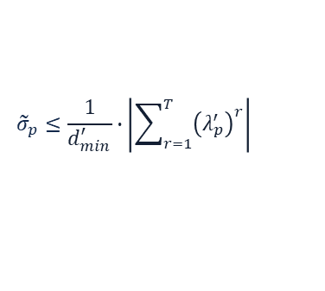
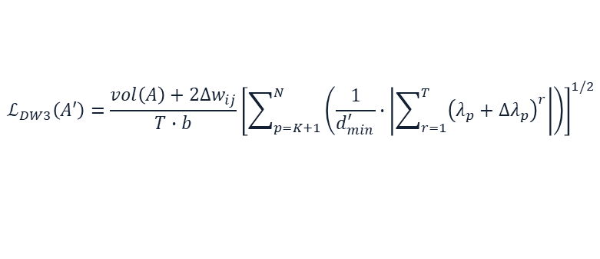
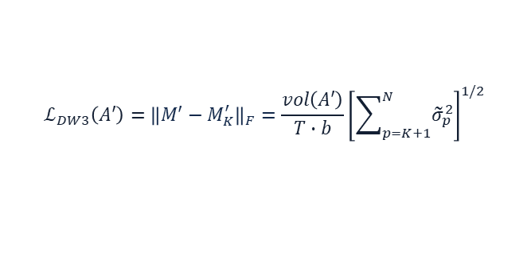

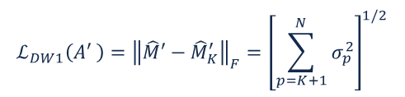
Closed-form Approach (Brute-force)
Approximated loss function
How?
$$ℒ_{DW3}\left(A′\right)=\frac{vol\left(A\right)+2Δw_{ij}}{T∙b}{\left[\sum_{p=K+1}^{N}{\left(\frac{1}{d_{min}^{′}}∙\left|\sum_{r=1}^{T}{{\left(λ_{p}+Δλ_{p}\right)}^{r}}\right|\right)}\right]}^{1/2}$$
$$ℒ_{DW1}\left(A′ \right)={\left\|\hat{M}′−{\hat{M}}_{K}^{′}\right\|}_{F}={\left[\sum_{p=K+1}^{N}{σ_{p}^{2}}\right]}^{1/2}$$
Remove log and max
$$ℒ_{DW3}\left(A′\right)={\left\|M′−M_{K}^{′}\right\|}_{F}=\frac{vol\left(A′\right)}{T∙b}{\left[\sum_{p=K+1}^{N}{{\tilde{σ}}_{p}^{2}}\right]}^{1/2}$$
Upper bound
$${\tilde{σ}}_{p}≤\frac{1}{d_{min}^{′}}∙\left|\sum_{r=1}^{T}{{\left(λ_{p}^{′}\right)}^{r}}\right|$$
Notation:
$A^{′}∈{\left\{0,1\right\}}^{N×N}$: poisoned adjacent matrix
$σ_{p}$: p-th singular value of ${\hat{M}}^{′}=\log\left(\max\left(M^{′},1\right)\right)$
${\tilde{σ}}_{p}$: p-th singular value of $S^{′}$
$d_{min}^{′}$: smallest degree in $A^{′}$
$λ_{p}^{′}$: generalized eigenvalue of $A^{′}$ by $A^{′}u_{p}^{′}=λ_{p}^{′}D^{′}u_{p}^{′}$
$Δw_{ij}=1−2A_{ij}$: indicate the edge flip, i.e. $±1$

Slide 19
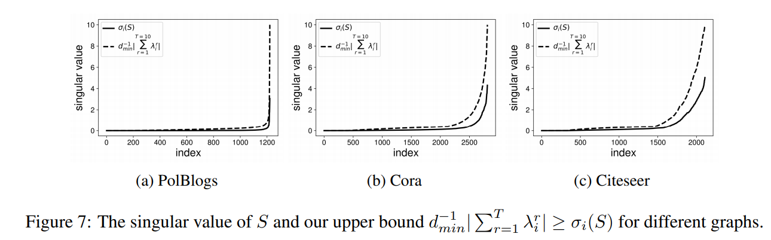
Experiments
Approximation Quality

Slide 20
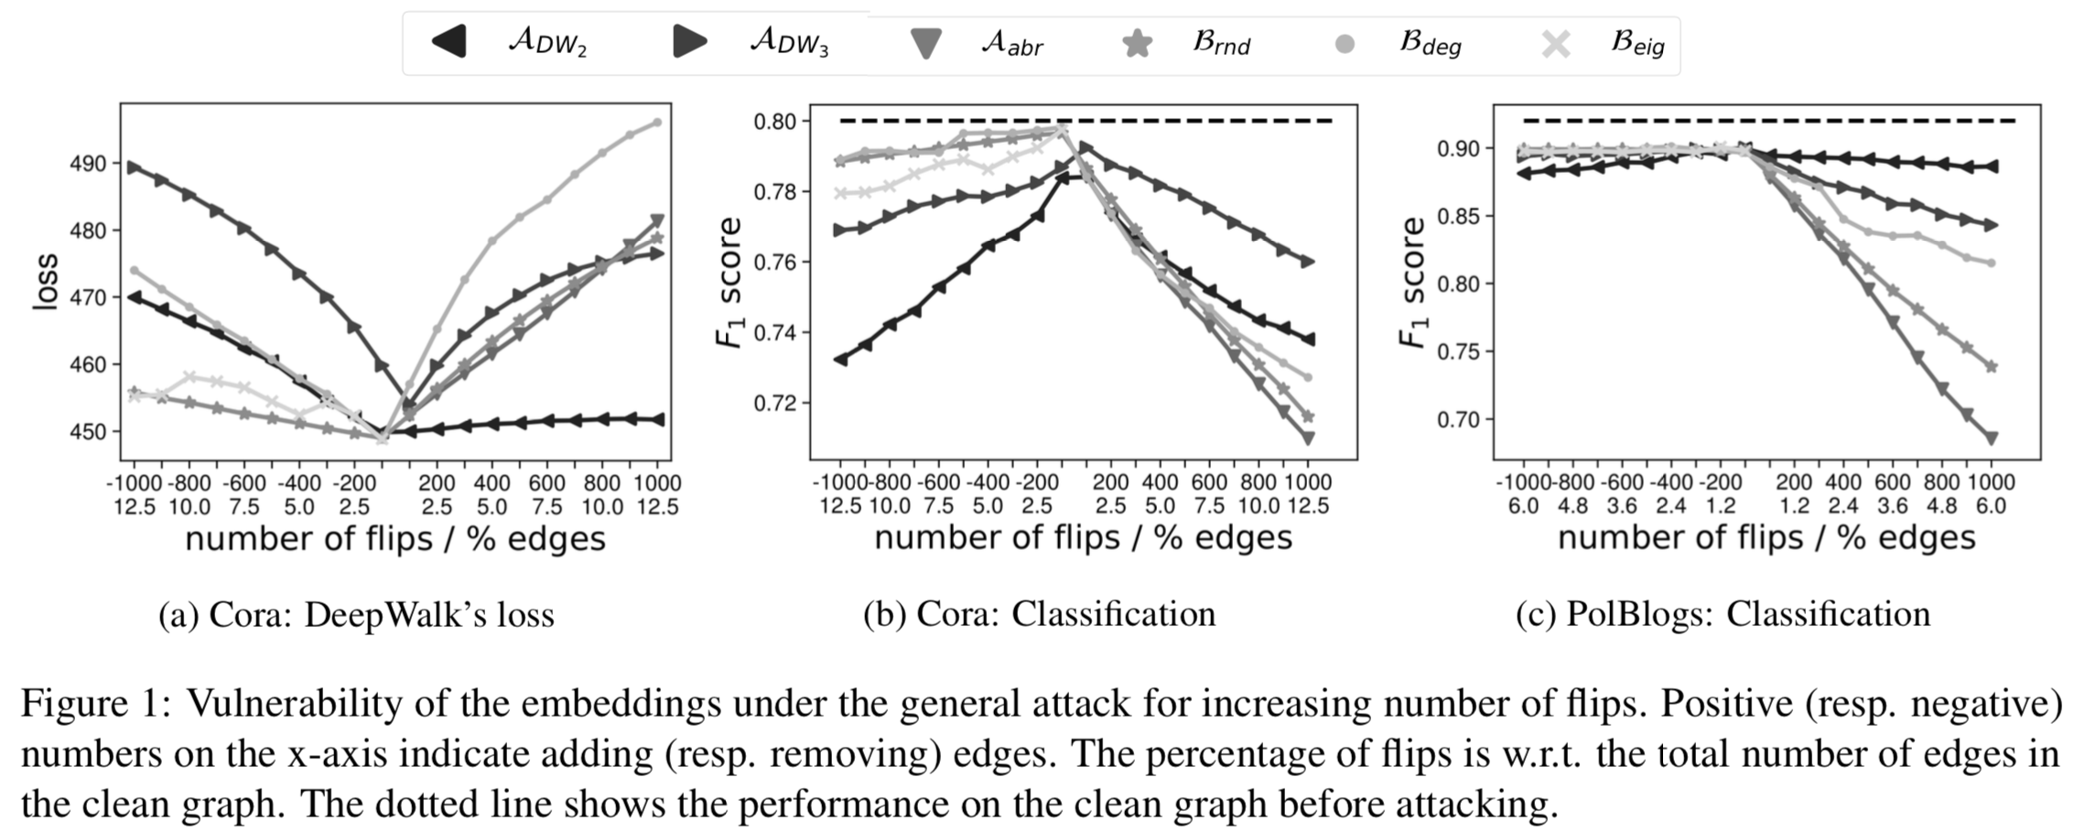
Experiments
Poisoning decreases the overall quality of the embeddings.

Slide 21
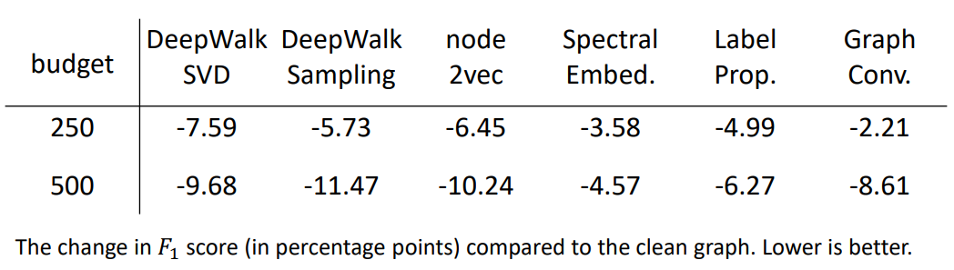
Experiments
Transferability on Citeseer data set
Number of flips
Other graph embedding models
Attack model in this paper

Slide 22
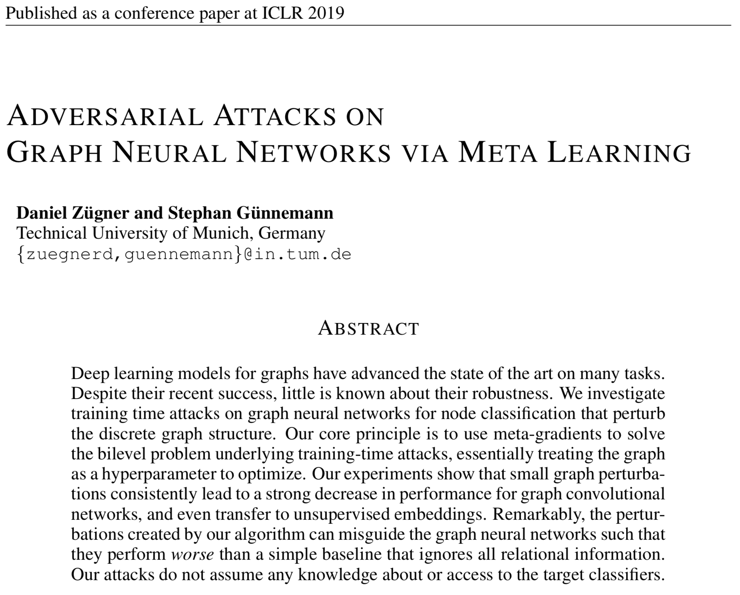
Graph Convolution Based Embedding

Slide 23
Background: Node Embedding
 | Random Walk Based | Graph Convolution Based
Input | Plain network without node features | Attributed network with node features
Output | Node embeddings (unsupervised) | Node embedding Predictive node class-label (semi-supervised)
Assumption | Nearby nodes share the similar embeddings | Nearby nodes share the similar embeddings
Key idea | Maximize the likelihood of positive node-context pairs sampled by (biased) random walk | Recursively aggregate node messages along edges of the graph
Attacks | Aleksandar Bojchevski, and Stephan Günnemann. "Adversarial attacks on node embeddings via graph poisoning." In ICML 2019. | Daniel Zügner, and Stephan Günnemann. "Adversarial attacks on graph neural networks via meta learning." ICLR 2019.

Slide 24
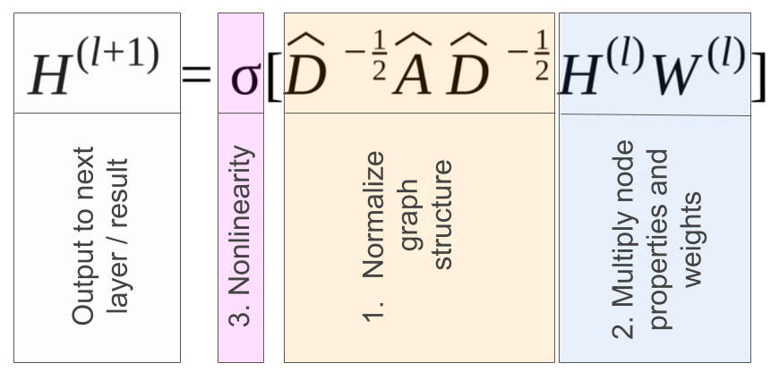
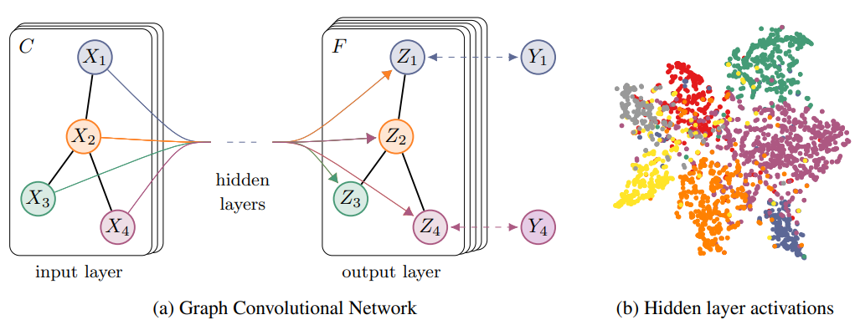
Background: Graph Convolutional Network
Idea: use the graph convolution to learn high-order graph structure for semi-supervised node classification
Kipf, Thomas N., and Max Welling. "Semi-supervised classification with graph convolutional networks." arXiv preprint arXiv:1609.02907 (2016).

Slide 25
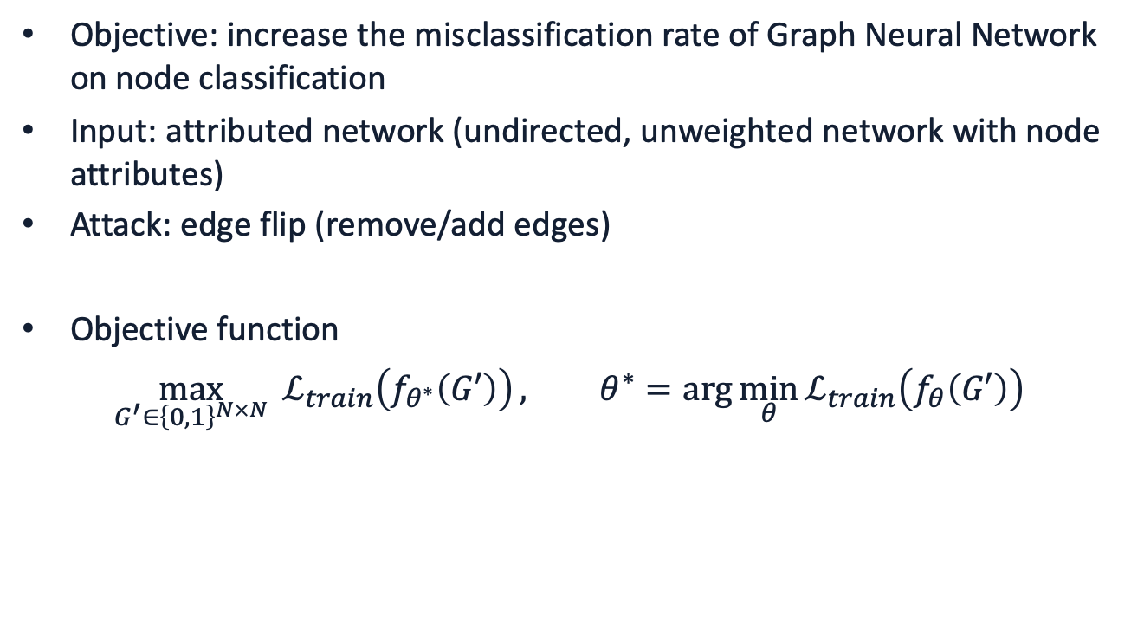
Poison Attack
Objective: increase the misclassification rate of Graph Neural Network on node classification
Input: attributed network (undirected, unweighted network with node attributes)
Attack: edge flip (remove/add edges)
Objective function
$$\max_{G^{′}∈{\left\{0,1\right\}}^{N×N}}{ ℒ_{train}\left(f_{θ^{∗}}\left(G′\right)\right)}, θ^{∗}=\arg{\min_{θ}{ℒ_{train}\left(f_{θ}\left(G′\right)\right)}}$$

Slide 26
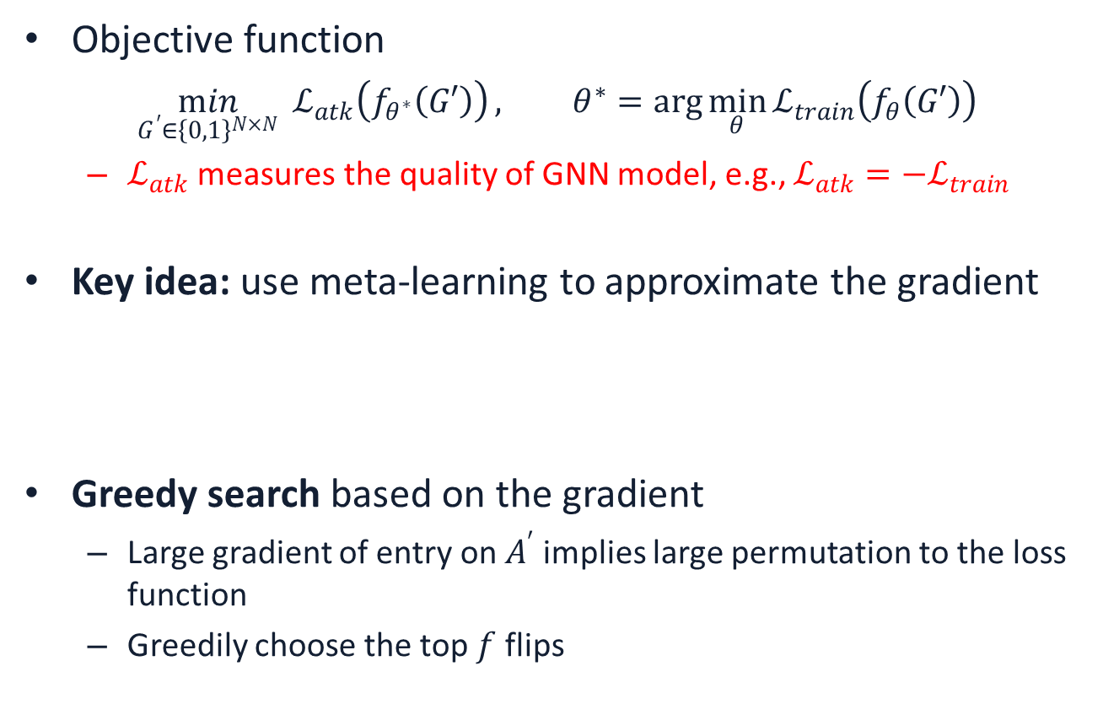

Gradient-based Approach
Simplified GCN: $f_{θ}\left(A,X\right)=softmax\left({\hat{A}}^{2}XW\right)$
Objective function
$$\min_{G^{′}∈{\left\{0,1\right\}}^{N×N}}{ ℒ_{atk}\left(f_{θ^{∗}}\left(G′\right)\right)}, θ^{∗}=\arg{\min_{θ}{ℒ_{train}\left(f_{θ}\left(G′\right)\right)}}$$
$ℒ_{atk}$ measures the quality of GNN model, e.g., $ℒ_{atk}=−ℒ_{train}$
Key idea: use meta-learning to approximate the gradient
Greedy search based on the gradient
Large gradient of entry on $A^{′}$ implies large permutation to the loss function
Greedily choose the top $f$ flips
Felix Wu, Tianyi Zhang, Amauri Holanda de Souza Jr, Christopher Fifty, Tao Yu, and Kilian Q. Weinberger. "Simplifying graph convolutional networks." In ICML 2019.

Slide 27
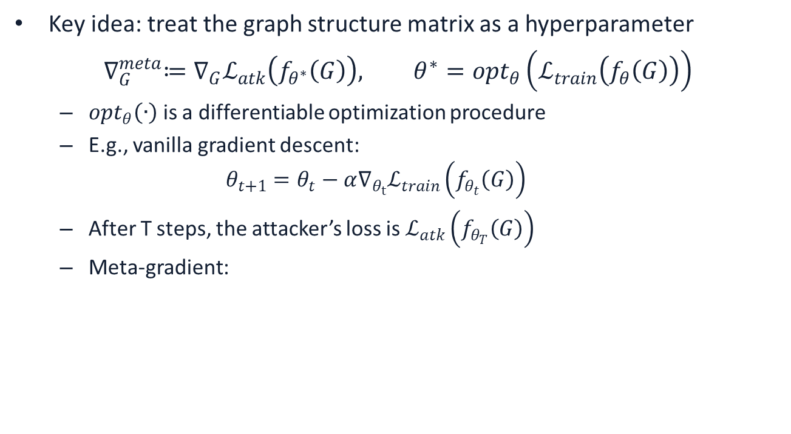

Meta-gradient optimization
Key idea: treat the graph structure matrix as a hyperparameter
$$∇_{G}^{meta}≔∇_{G}ℒ_{atk}\left(f_{θ^{∗}}\left(G\right)\right), θ^{∗}=opt_{θ}\left(ℒ_{train}\left(f_{θ}\left(G\right)\right)\right)$$
$opt_{θ}\left(∙\right)$ is a differentiable optimization procedure
E.g., vanilla gradient descent:
$$θ_{t+1}=θ_{t}−α∇_{θ_{t}}ℒ_{train}\left(f_{θ_{t}}\left(G\right)\right)$$
After T steps, the attacker’s loss is $ℒ_{atk}\left(f_{θ_{T}}\left(G\right)\right)$
Meta-gradient:
$θ_{t}$ is a function w.r.t. $G$
Second derivatives

Slide 28


Meta-gradient optimization
Meta-gradient:
First order approximation (Finn, et al. 2017 )
Assume that ${∇_{A}\tilde{θ}}_{t}=0$
Nichol & Schulman (2018) proposed:
$$∇_{A}^{meta}=\sum_{t=1}^{T}{∇_{A}ℒ_{atk}\left(f_{{\tilde{θ}}_{t}}\left(A\right)\right)}$$
Chelsea Finn, Pieter Abbeel, and Sergey Levine. "Model-agnostic meta-learning for fast adaptation of deep networks." In Proceedings of the 34th International Conference on Machine Learning-Volume 70, pp. 1126-1135. JMLR. org, 2017.
Alex Nichol, Joshua Achiam, and John Schulman. "On first-order meta-learning algorithms." arXiv preprint arXiv:1803.02999 (2018).

Slide 29
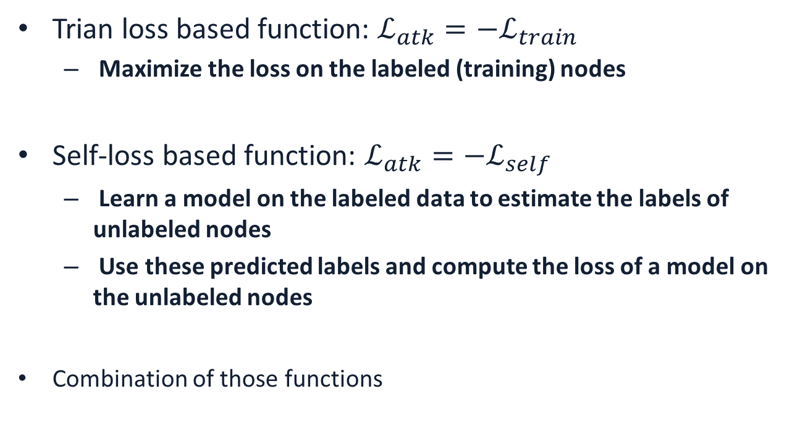
Attack function
Trian loss based function: ${ℒ_{atk}=−ℒ}_{train}$
Maximize the loss on the labeled (training) nodes
Self-loss based function: ${ℒ_{atk}=−ℒ}_{self}$
Learn a model on the labeled data to estimate the labels of unlabeled nodes
Use these predicted labels and compute the loss of a model on the unlabeled nodes
Combination of those functions
$$∇_{A}^{meta}=\sum_{t=1}^{T}{\left({λ∇}_{A}ℒ_{train}\left(f_{{\tilde{θ}}_{t}}\left(A\right)\right)+{\left(1−λ\right)∇}_{A}ℒ_{self}\left(f_{{\tilde{θ}}_{t}}\left(A\right)\right)\right)}$$
Chelsea Finn, Pieter Abbeel, and Sergey Levine. "Model-agnostic meta-learning for fast adaptation of deep networks." In Proceedings of the 34th International Conference on Machine Learning-Volume 70, pp. 1126-1135. JMLR. org, 2017.
Alex Nichol, Joshua Achiam, and John Schulman. "On first-order meta-learning algorithms." arXiv preprint arXiv:1803.02999 (2018).

Slide 30
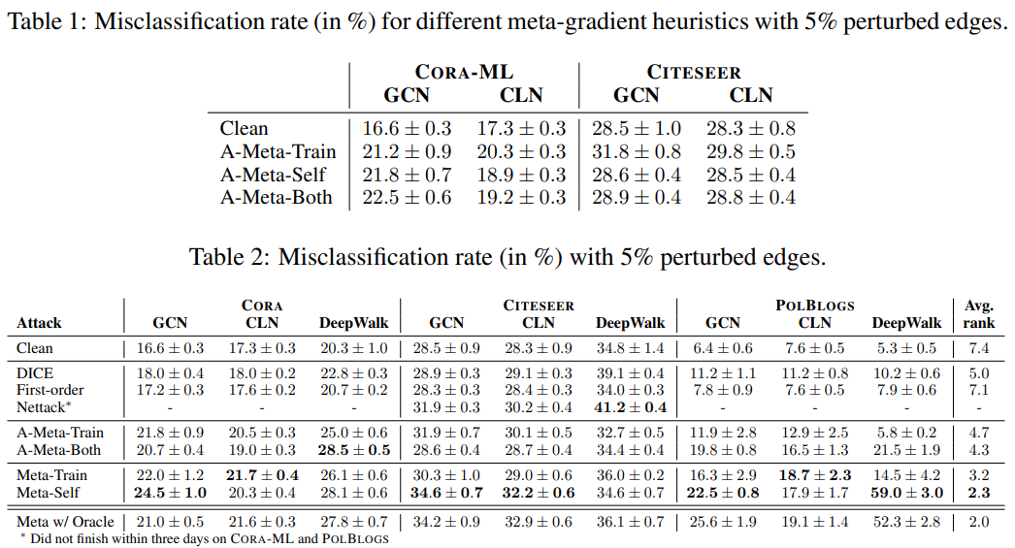
Experiments
Node classification
GCN: graph convolutional network
CLN: column network
With approximation
Without approximation

Slide 31
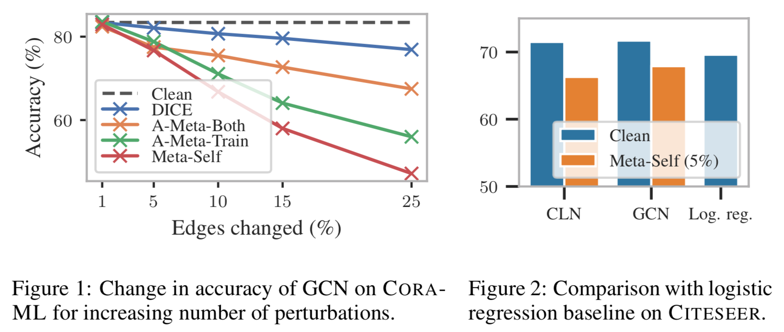
Experiments
Baselines:
Clean
DICE: it randomly chooses whether to insert or remove an edge for each perturbation
Log. Reg.: logistic regression with only node attributes (ignore graph structure)

Slide 32
Thanks
&
Questions?

