Slide 1
Adversarial Attacks for Graphical Data
Presented by: Amish Goel

Slide 2
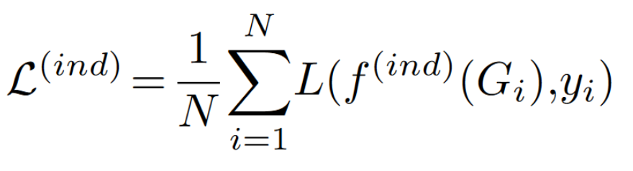
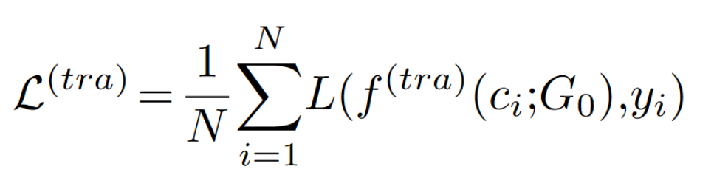
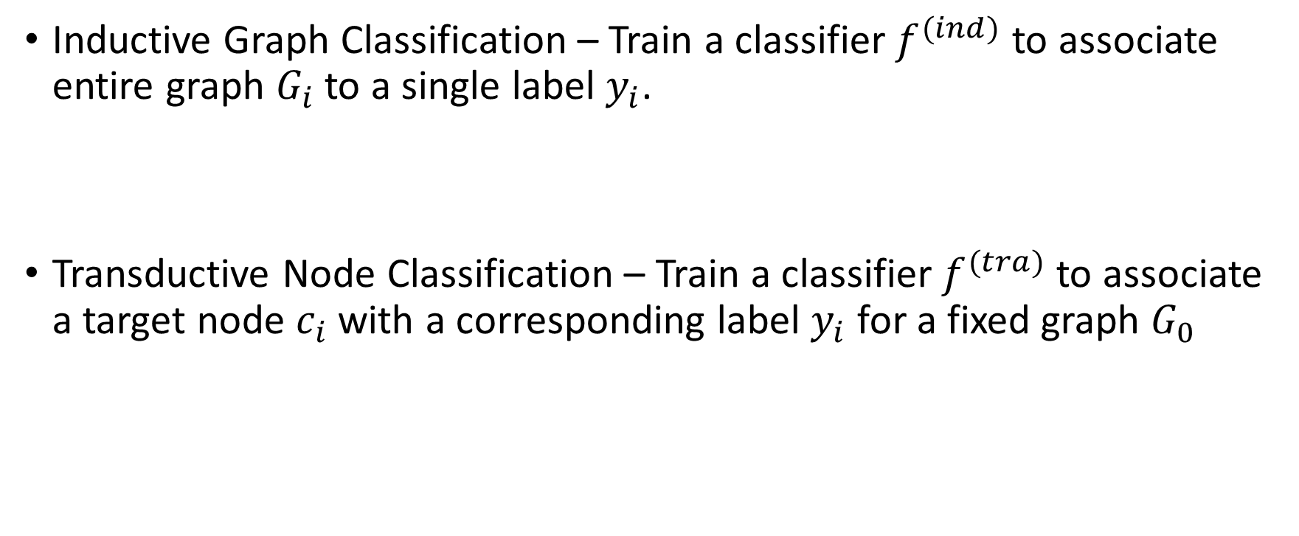
Graph Classification tasks
Inductive Graph Classification – Train a classifier $f^{(ind)}$ to associate entire graph $G_{i}$to a single label $y_{i}$.
Transductive Node Classification – Train a classifier $f^{(tra)}$to associate a target node $c_{i}$ with a corresponding label $y_{i}$ for a fixed graph $G_{0}$

Slide 3
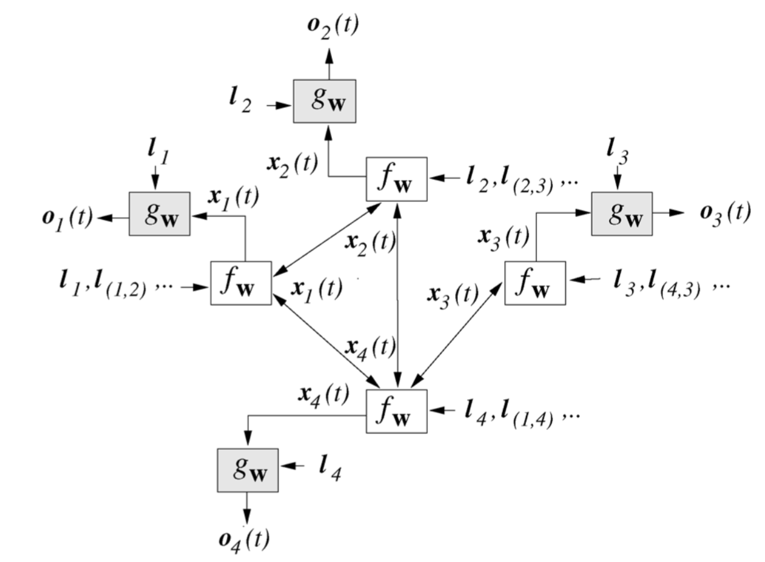
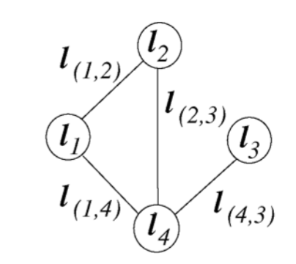
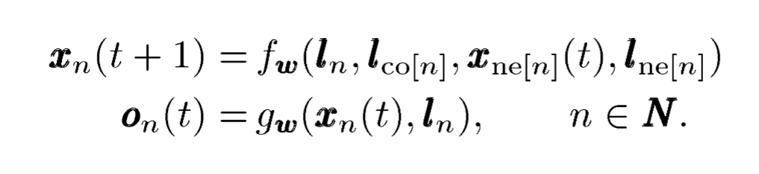
Graph Neural Networks (GNNs)

Slide 4
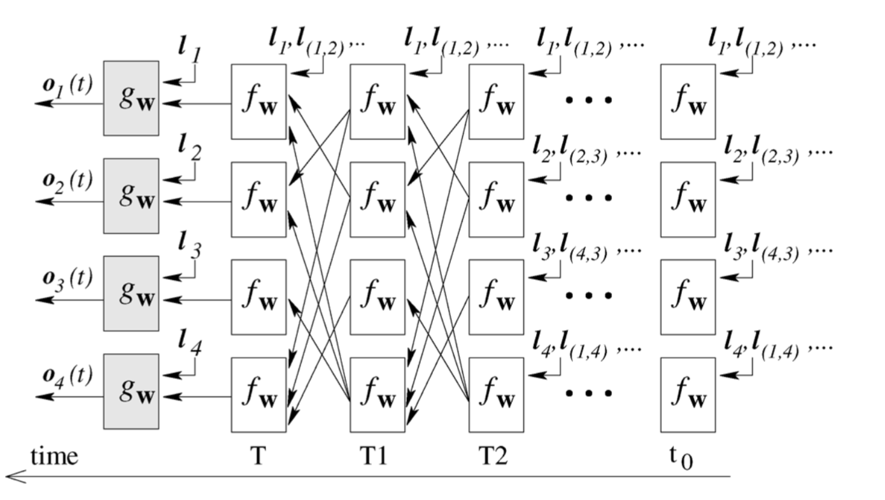
GNN unrolled over time

Slide 5
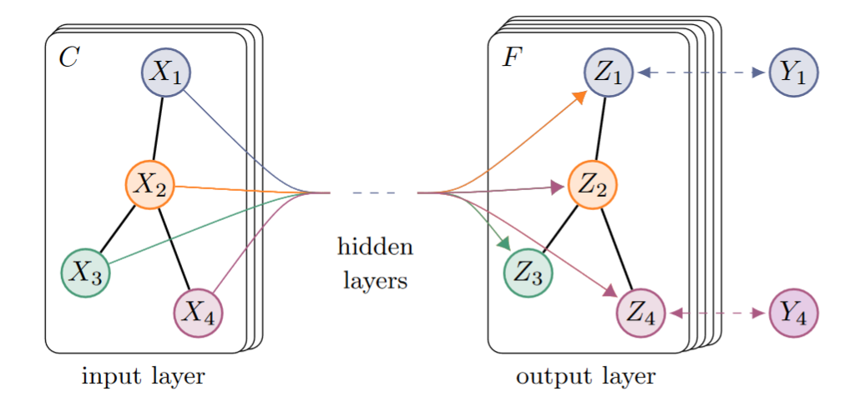
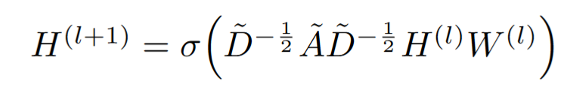
Graph Convolutional Networks (GCN)
Normalized Laplacian Matrix

Slide 6
Overview
Adversarial Attacks on Graph Structured Data
Evasion attacks on GNN and GCN.
Graph level and Node level attacks.
Adversarial Attacks on Neural Networks for Graph Data
Poisoning attacks on GCN.
Node level attacks.

Slide 7
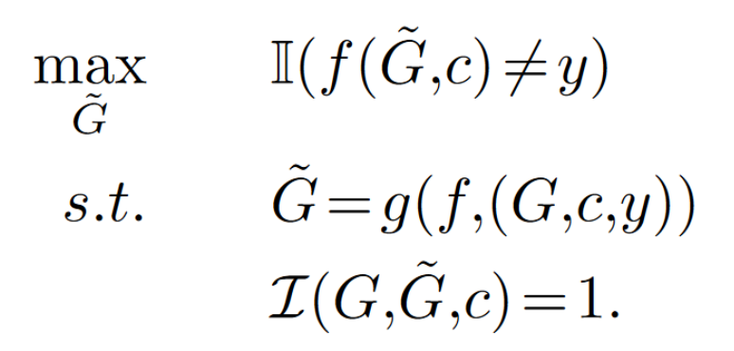
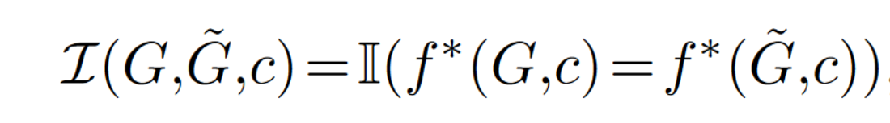
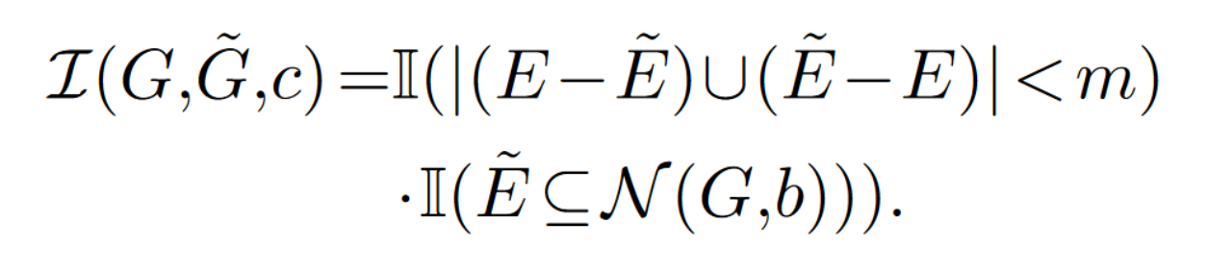

Adversarial attack formulation
Modify the Graph $G=\left(V,E\right)$ into $\tilde{G}=$ $(\tilde{V},\tilde{E})$, so that:
Attack Procedure
Defines Unnoticeable Perturbations for Graphs
Explicit Semantics
Small Modifications

Slide 8
Challenges
Discrete optimization problem – intractable to solve.
Large graphs – huge optimization space.
Definitions of unnoticeable perturbations is not clear.

Slide 9
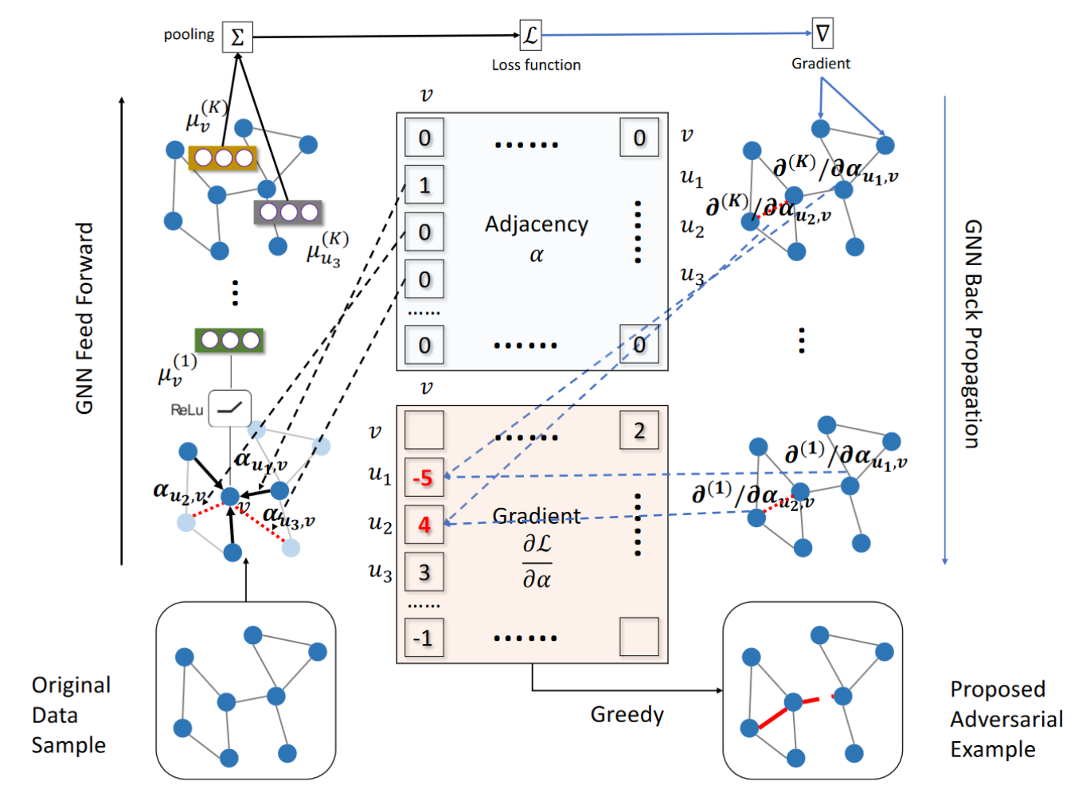
Gradient White-box Attack

Slide 10
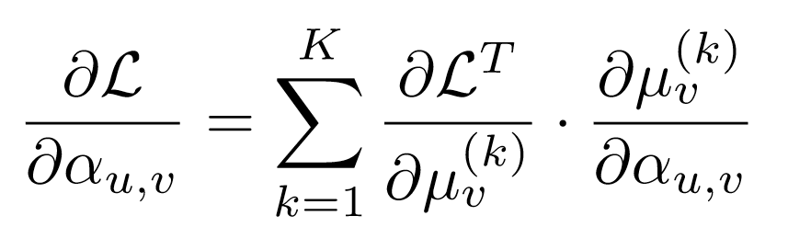
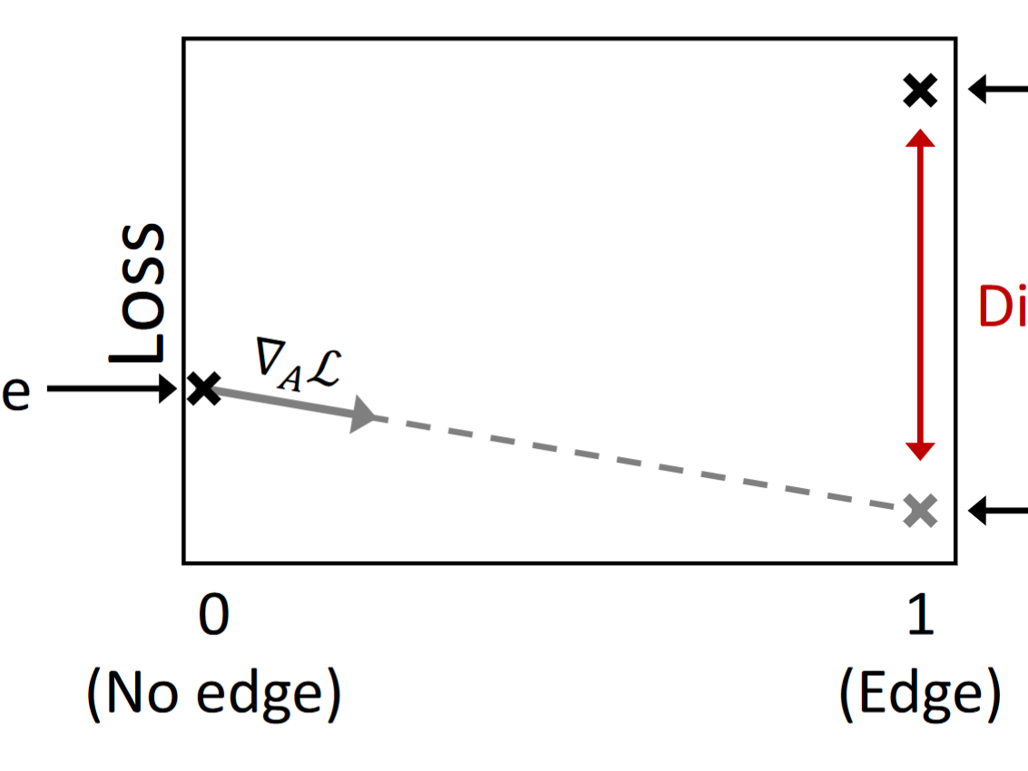
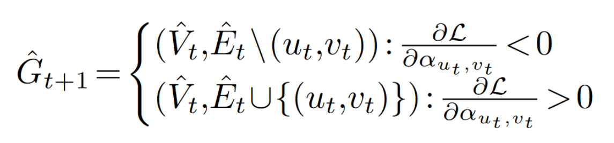
Gradient based White Box attack (WBA)
Compute the gradient of the classification loss with respect to the adjacency matrix A of the graph.
Gradients may not be reliable
Greedy Algorithm - GradArgmax

Slide 11
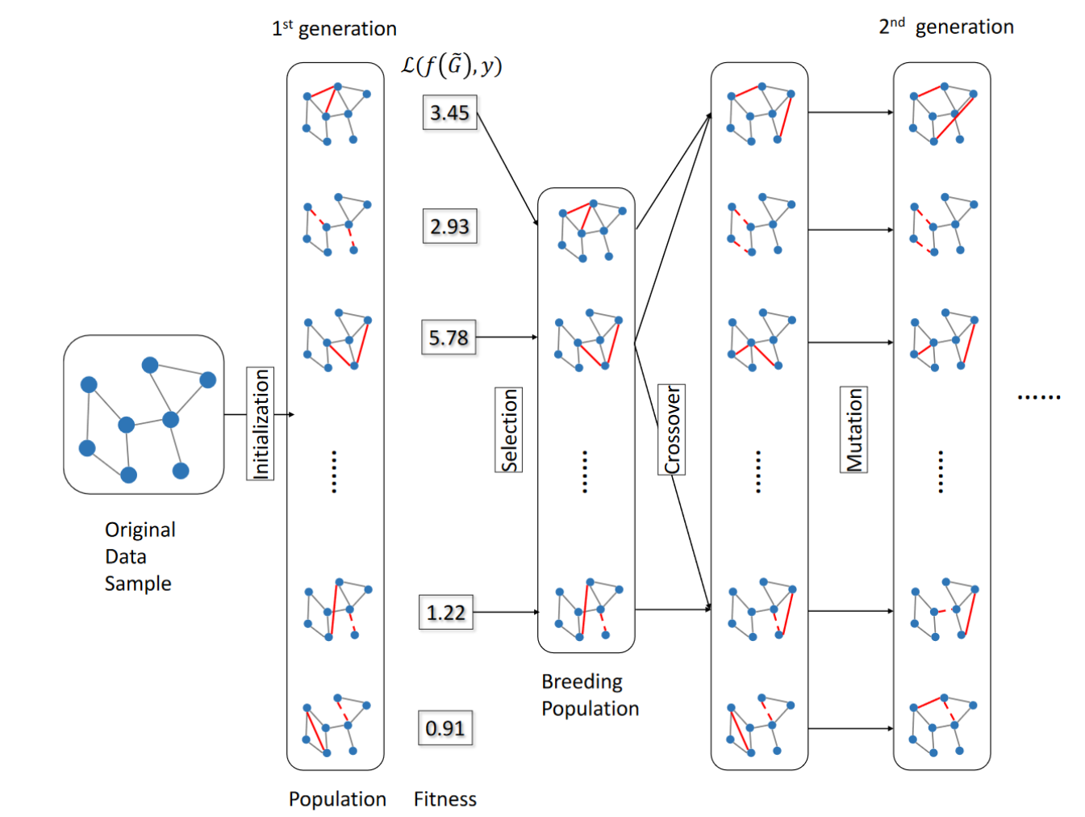
Genetic Algorithms- Black box attack

Slide 12
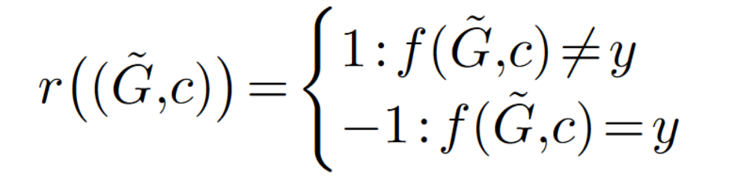
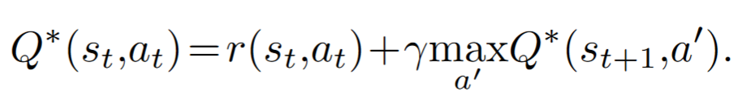
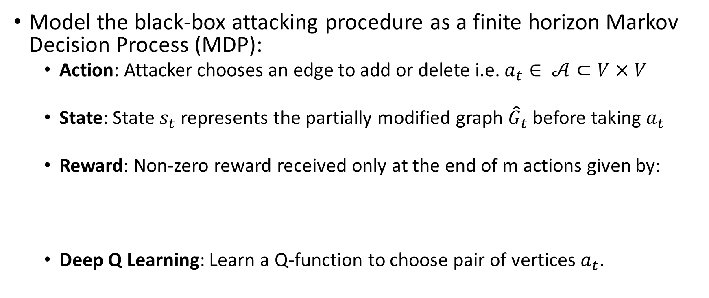
Black-box attack using RL
Model the black-box attacking procedure as a finite horizon Markov Decision Process (MDP):
Action: Attacker chooses an edge to add or delete i.e. $a_{t}∈ 𝒜⊂V×V$
State: State $s_{t}$ represents the partially modified graph ${\hat{G}}_{t}$ before taking $a_{t}$
Reward: Non-zero reward received only at the end of m actions given by:
Deep Q Learning: Learn a Q-function to choose pair of vertices $a_{t}$.

Slide 13
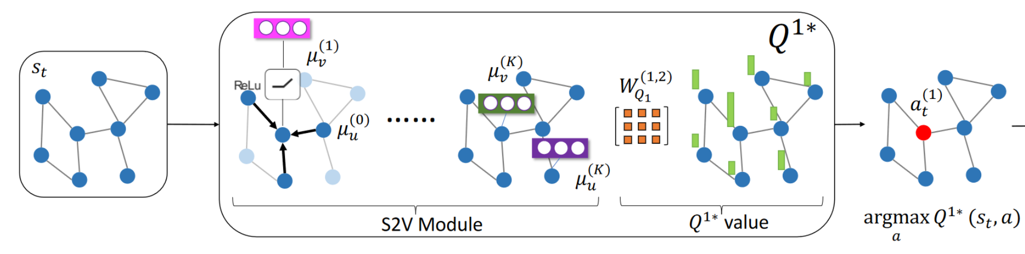
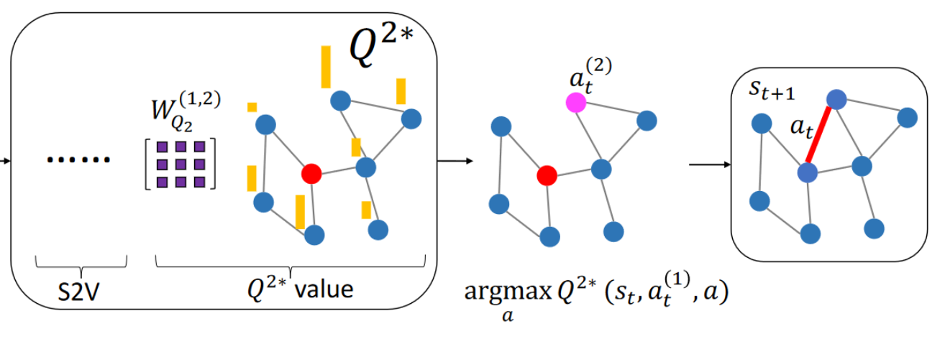
Hierarchical Q-functions

Slide 14
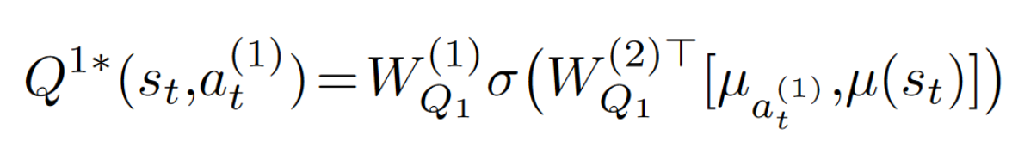
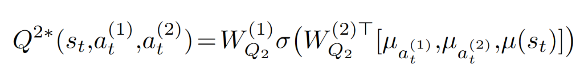
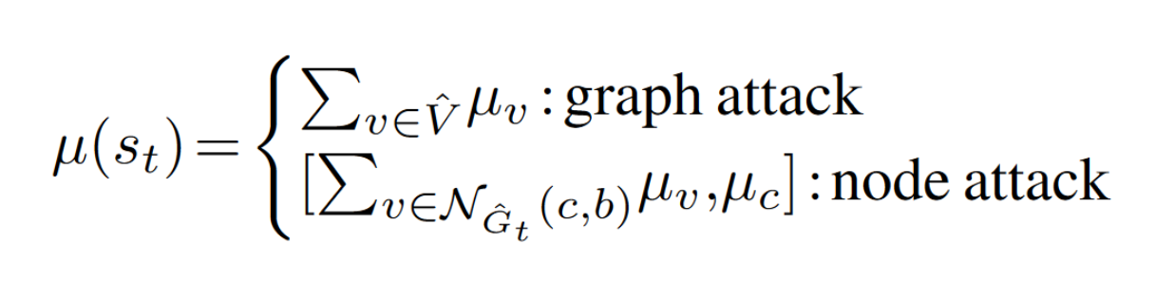
Parametrization of the Q-functions

Slide 15
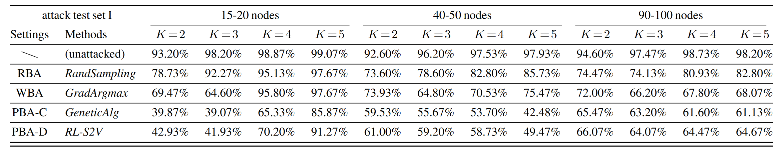
Experiments
Graph-level attack
Determine number of connected components in the graph from {1,2,3}.
Synthetic dataset of 15,000 graphs generated using Erdos-Renyi random graph model. Each of three classes contains 5000 examples.
GNN using structure2vec used as target model to attack with K propagations.

Slide 16
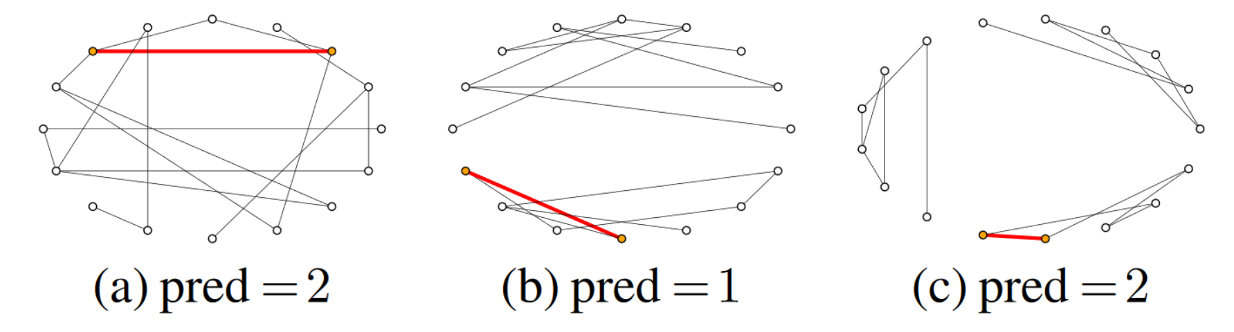
Visualization of Adversarial Graphs

Slide 17
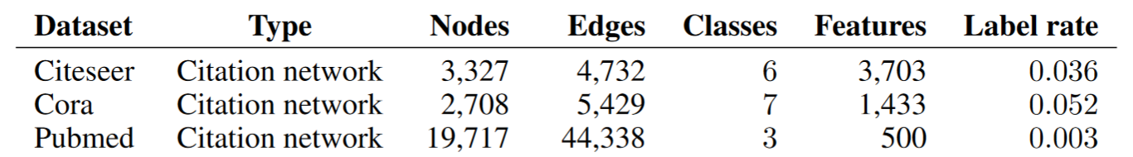
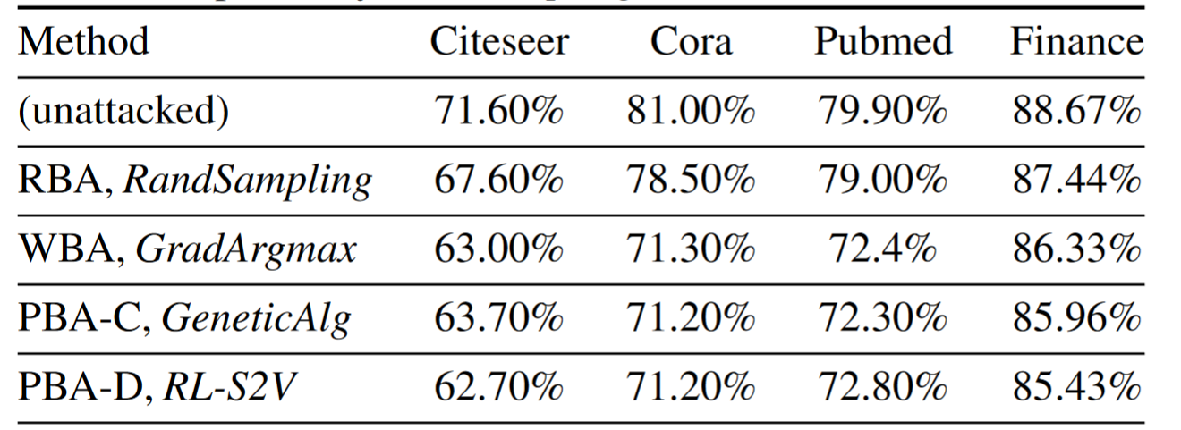
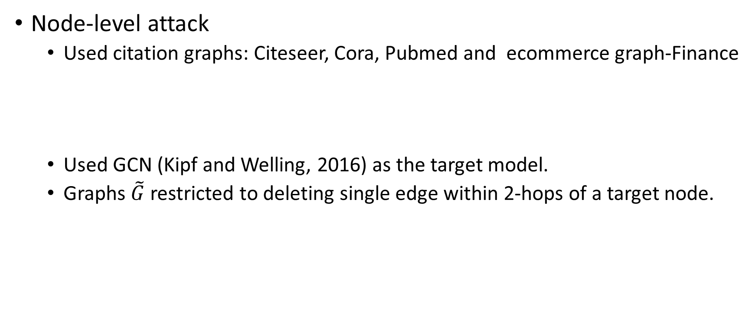
Experiments
Node-level attack
Used citation graphs: Citeseer, Cora, Pubmed and ecommerce graph-Finance
Used GCN (Kipf and Welling, 2016) as the target model.
Graphs $\tilde{G}$ restricted to deleting single edge within 2-hops of a target node.

Slide 18
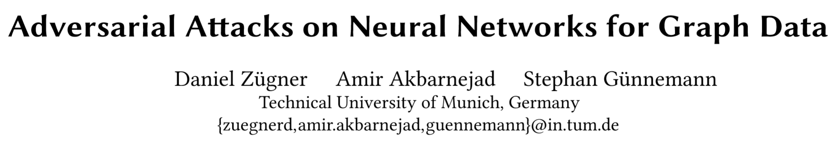

Slide 19
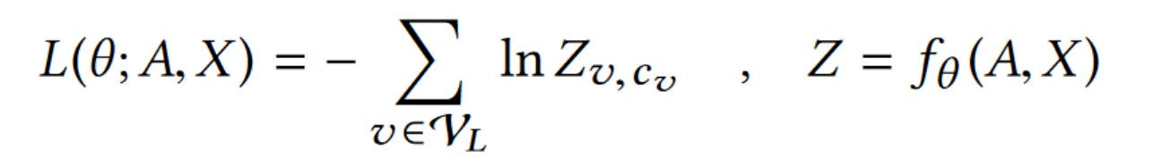
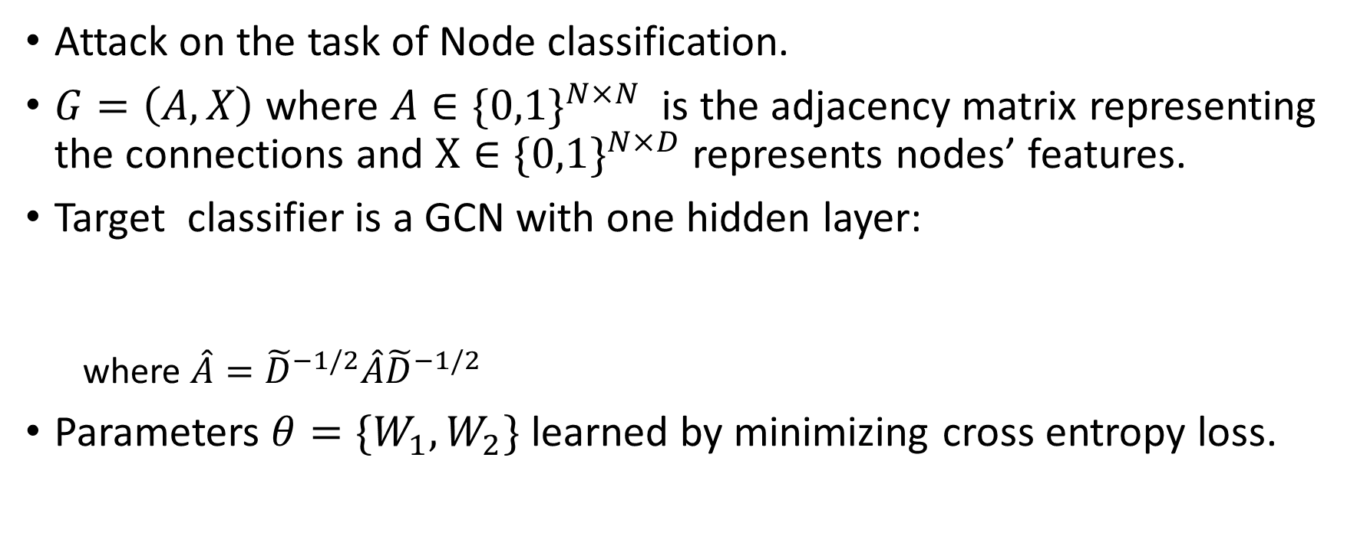
Problem Setting
Attack on the task of Node classification.
$G=\left(A,X\right)$ where $A∈\{0,1\}^{N×N}$is the adjacency matrix representing the connections and $X∈\{0,1\}^{N×D}$ represents nodes’ features.
Target classifier is a GCN with one hidden layer:
where $\hat{A}={\tilde{D}}^{−1/2}\hat{A}{\tilde{D}}^{−1/2}$
Parameters $θ=\{W_{1},W_{2}\}$learned by minimizing cross entropy loss.

Slide 20
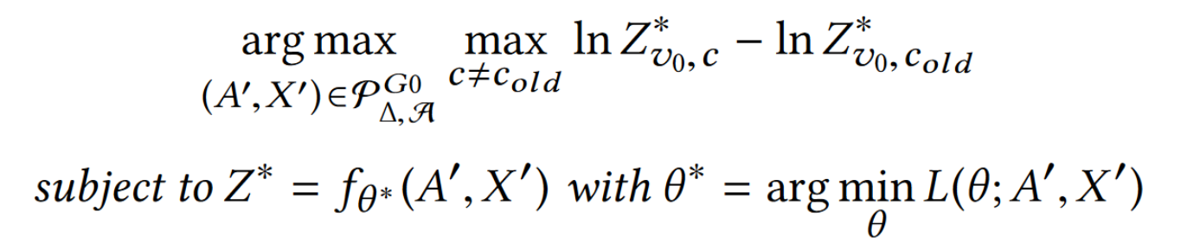
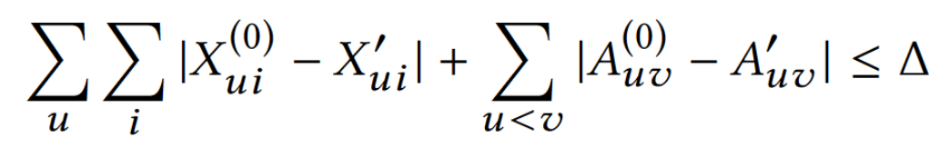
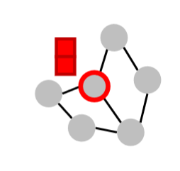
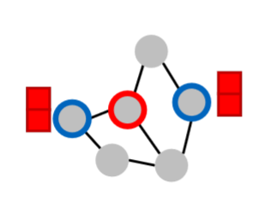
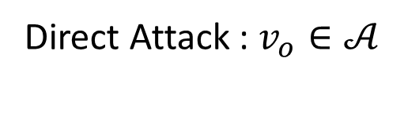

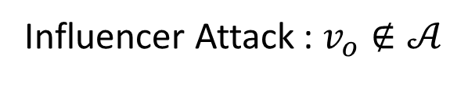
Data poisoning attack
Aim: Misclassify target node $v_{o}$, Attacker has access to nodes in 𝒜.
Bi-level Optimization
Unnoticeable perturbations
Direct Attack : $v_{o}∈𝒜$
Influencer Attack : $v_{o}∉𝒜$

Slide 21
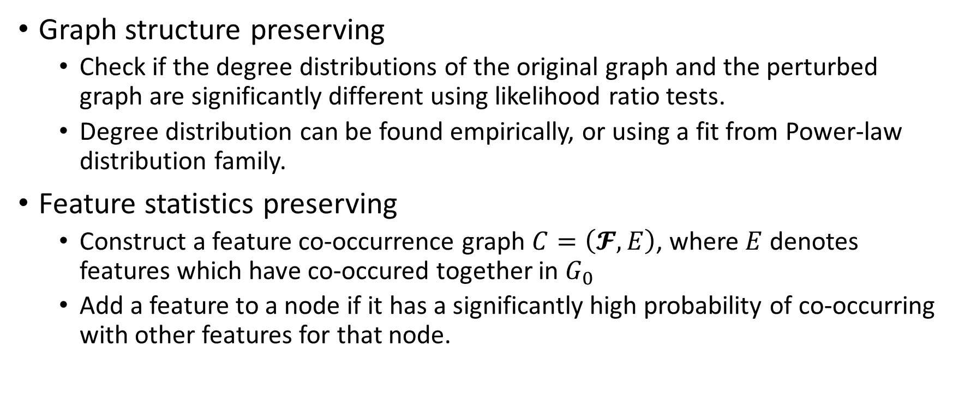
Other Unnoticeability constraints
Graph structure preserving
Check if the degree distributions of the original graph and the perturbed graph are significantly different using likelihood ratio tests.
Degree distribution can be found empirically, or using a fit from Power-law distribution family.
Feature statistics preserving
Construct a feature co-occurrence graph $C=\left(𝓕, E\right)$, where $E$ denotes features which have co-occured together in $G_{0}$
Add a feature to a node if it has a significantly high probability of co-occurring with other features for that node.

Slide 22
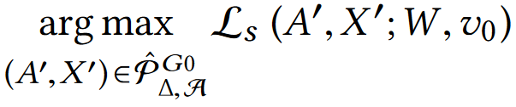
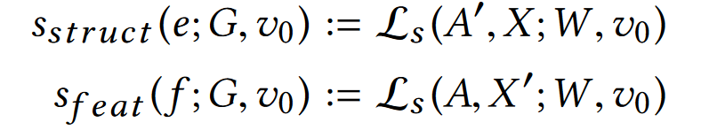
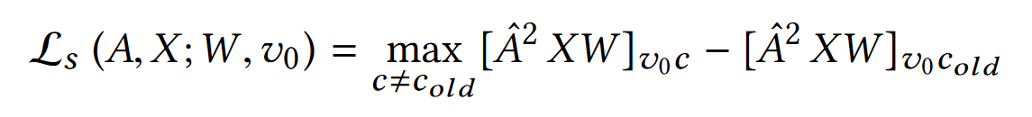


Generating Adversarial Graphs
Solving the Bi-level optimization problem is intractable. Used a tractable surrogate model to generate the adversarial graphs.
Scalable Greedy Approximation
$${(A}^{′},X′)=$$
$$A^{′}=A±e, X^{′}=X±f$$

Slide 23
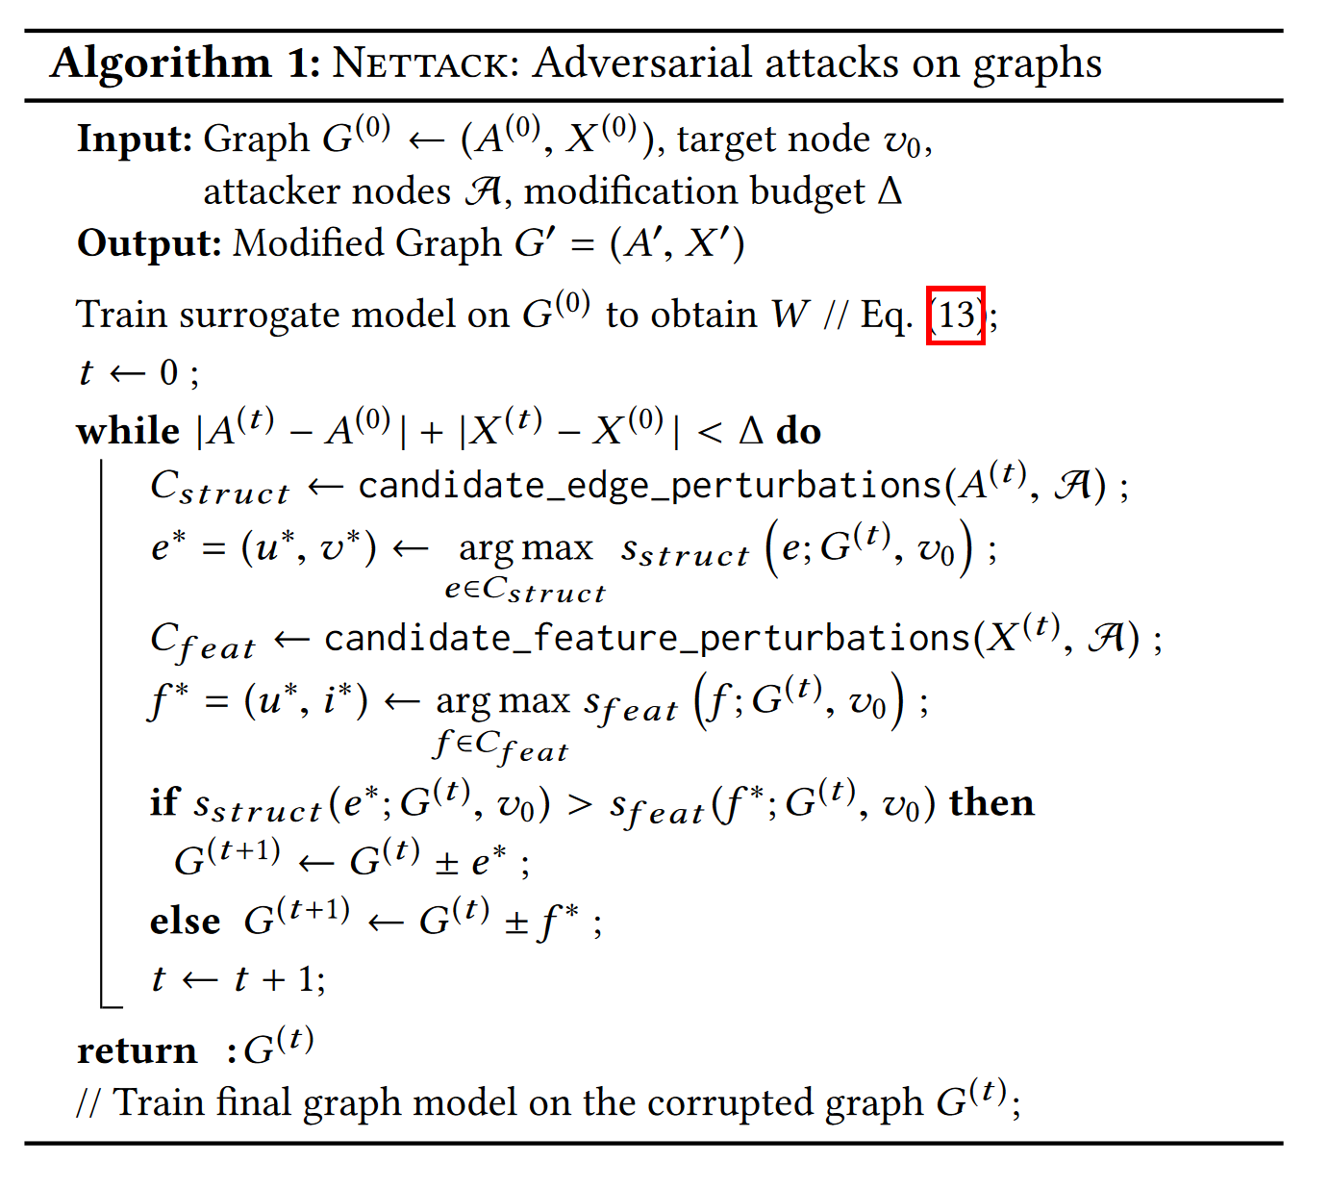
Nettack Algorithm
Sequentially manipulate an entry from the adjacency matrix or a feature entry and pick one which increases the surrogate loss most.
Efficient computation needed for the score functions and candidate edge/feature perturbations (refer to the paper for details).

Slide 24
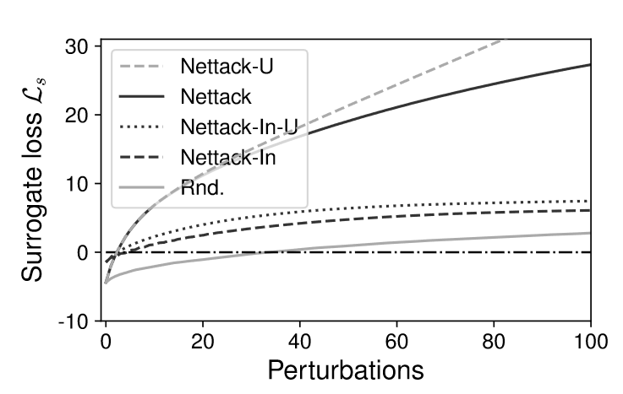
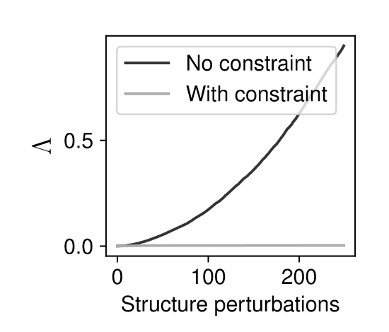
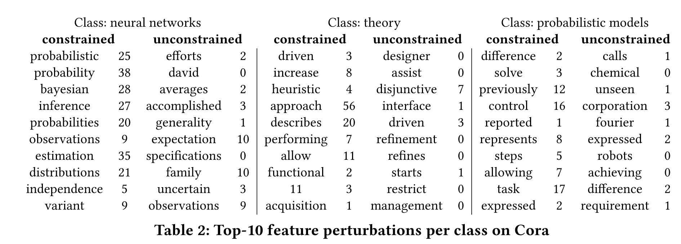
Experimental results : Attack on surrogate
Surrogate model trained on Cora-ML, Citeseer, Polblogs graphs.
Adversarial graphs using Nettack (Direct) successful than Nettack-In(influence).
Unconstrained perturbations are detectable.

Slide 25
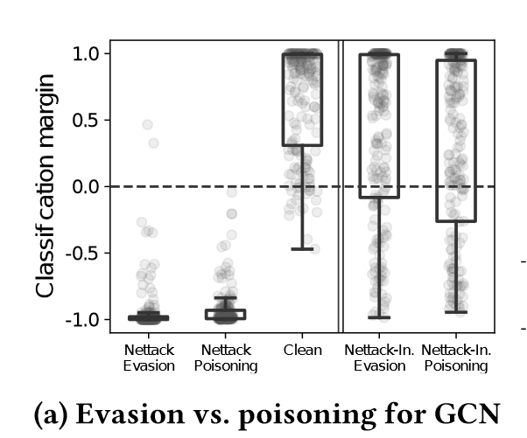

Experimental result: Transfer to actual models
Adversarial Graphs from surrogate model evaluated on GCN for both Evasion attacks and Poisoning attacks ($Δ=d_{v_{0}}+2$).
Surrogate model is a good approximator for true models.
Both Evasion and poisoning attacks are successful.
Direct attacks much successful than gradient attacks

Slide 26

Experimental results: Limited Graph knowledge
Assume that attacker does not know the complete graph but only a subset of the graph.
Used subgraphs of increasing size from the target node (1-hop, 2 hop etc.) to generate the adversarial subgraphs.
Direct attack successful for even 10% of the graph access, with expense of slightly more perturbations.

