Slide 1
Membership Inference Attacks Against Machine Learning Models
Reza Shokri, Marco Stronati, Congzheng Song, Vitaly Shmatikov
Notes:
Hi I’m Zhuolin. Today I’d like to share some brand-new topics about privacy attack. Privacy attack refers to those attack steal user’s information through platform model’s behavior (usually black box). It will become serious under the circumstance that AI will be applied into human’s daily life in the future. Today I’d like to introduce 2 main privacy attack (membership inference and model inverse). These attacks were introduced during 2014 / 2015 – they’re simple enough but interesting. I wish I can make everyone understand their details and everyone could try to figure out how it works by themselves.

Slide 2
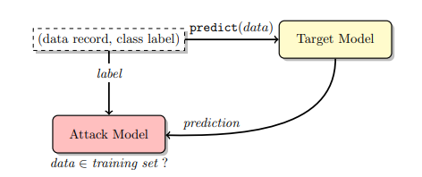
Membership inference
Given a machine learning model and a record, determine whether this record was used as part of the model’s training dataset or not.
Notes:
Like if there’s a platform collect users’ data for group prediction (health problem prediction), and user can only upload their private data / query the model about their personal information. If this platform leaks the information about user’s participation, these user may face the risk of discrimination.

Slide 3
What we have?
Training data’s info:
Another part of training data. (1)
Training data’s distribution / noisy training data. (2)
Statistic infos. (3)
Nothing. (4)
Model’s info:
Model’s structure and training algorithm. (1)
Black-box query access to the target model. (2)

Slide 4
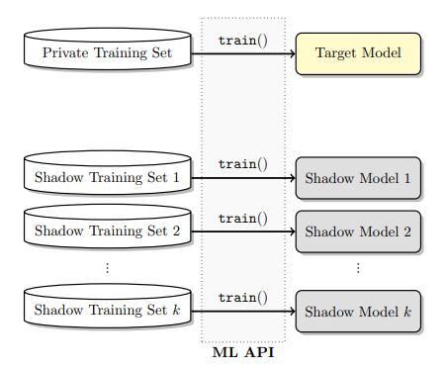
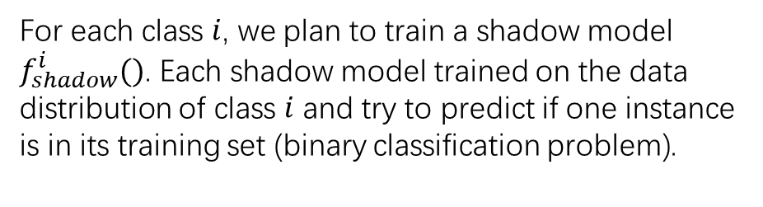
Key point: Mimic
We purposed to mimic target model’s behavior.
Shadow model !!!
For each class $i$, we plan to train a shadow model $f_{shadow}^{i}()$. Each shadow model trained on the data distribution of class $i$ and try to predict if one instance is in its training set (binary classification problem).
Why not just one shadow model ?
Notes:
You can definitely just use one shadow model to predict existence / non-existence of one instance. But multiple shadow model can catch the feature of different class precisely in order to increase attack accuracy.

Slide 5
Shadow models’ food
Everything seems easy now...
but how to obtain the training data of shadow model?
We need to ensure the synthetic data should be from the same distribution of private training data.
Purposed method:
Model-based synthesis
Statistics-based synthesis
Noisy real data

Slide 6
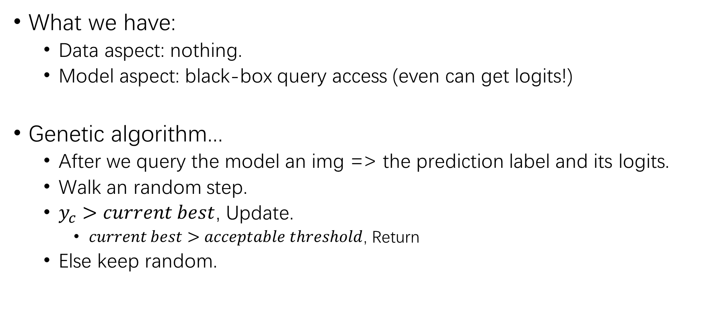
Model-based synthesis
What we have:
Data aspect: nothing.
Model aspect: black-box query access (even can get logits!)
Genetic algorithm...
After we query the model an img => the prediction label and its logits.
Walk an random step.
$y_{c}>current best$, Update.
$current best>acceptable threshold$, Return
Else keep random.

Slide 7
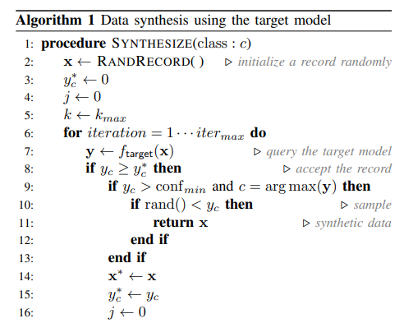
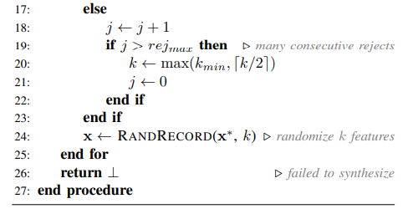
Framework
Why this works ???
Notes:
There author make an assumption => if we sample some point insider model’s decision region => we can obtain the similar geometry distribution from these sampled data. However, we need more proof on that.

Slide 8
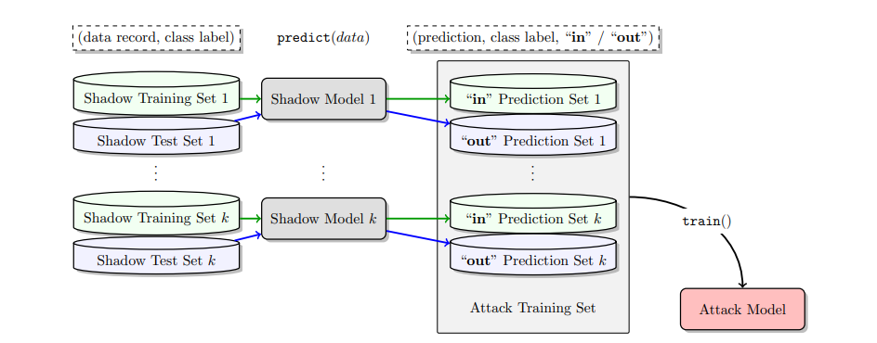
Whole framework

Slide 9
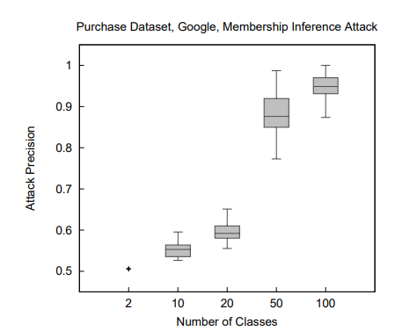
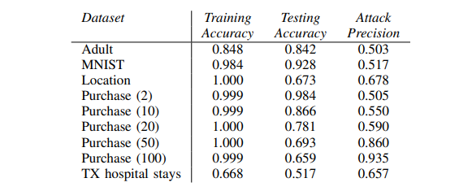
Attack results
Notes:
As the number of classes increases, the model needs to extract more distinctive features from the data to be able to classify inputs with high accuracy. Informally, models with more output classes need to remember more about their training data, thus they leak more information.

Slide 10
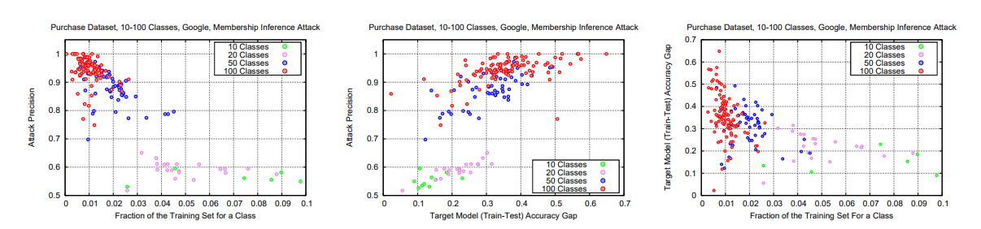
Other thoughts
Overfitting => leaking data ?
“The more overfitted a model, the more it leaks—but only for models of the same type.”
Bad generalization, non-diverse data => leaking data?
Notes:
Here’re some interesting phenomenon found by authors.

Slide 11
Privacy in Pharmacogenetics: An End-to-End Case Study of Personalized Warfarin Dosing
Matthew Fredrikson∗, Eric Lantz∗, Somesh Jha∗, Simon Lin†, David Page∗, Thomas Ristenpart∗

Slide 12
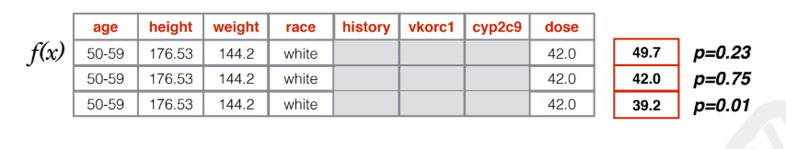
Model inversion
Given a model trained to predict a specific variable, uses it to make predictions of unintended (sensitive) attributes used as input to the model (i.e., an attack on the privacy of attributes).
Notes:
This can be concluded as we use model’s behavior + user’s public data => user’s private data.

Slide 13

What we have?
Training data’s info:
Prior prob of prediction labels.
Target person’s other public info.
Target person’s prediction.
Model’s info:
Black-box query access.
Info about model’s performance

Slide 14


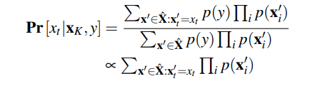
Case #1: Perfect model
Bayes rule:
Maximum Entropy Principle:
MAP estimate:
Notes:
Question: what’s this exactly?

Slide 15

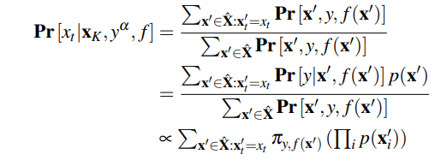
Case #2: Imperfect model
Model’s performance function:
Notes:
Question: what’s this exactly

Slide 16
Model Inversion Attacks that Exploit Confidence Information and Basic Countermeasures
Matt Fredrikson, Somesh Jha,Thomas Ristenpart

Slide 17
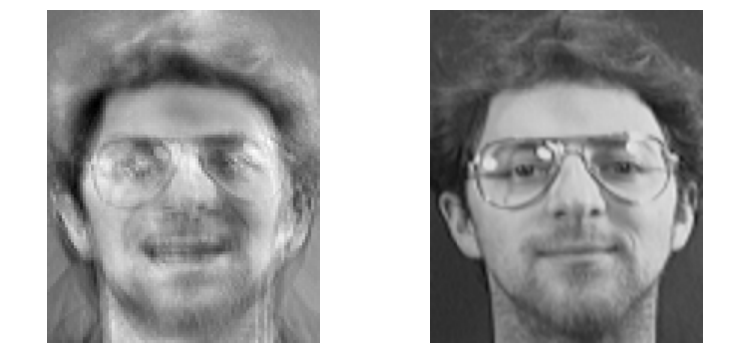

Drawbacks of Model inversion
UNK features / Continuous features
Computational infeasible while $dim$ is large (image level)
Notes:
Like if you would like to know some continuous features, original MI-attack failed. (otherwise you need to build a very large bucket to turn into the discrete categorial)

Slide 18
How to achieve this?
Gradient Descent!
We started our attack image x from scratch.
During every iteration:
We keep following the gradient until meets the confidence threshold.

Slide 19
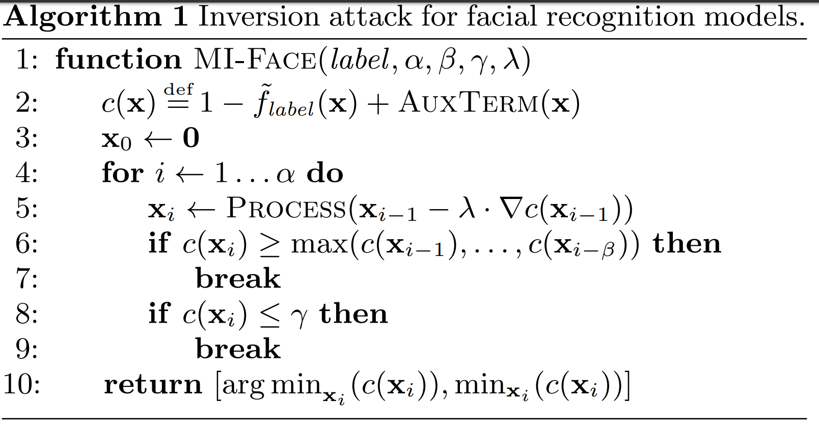
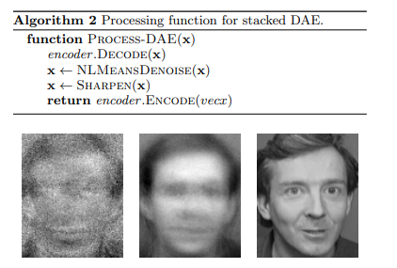
Detailed framework
But... ?
Notes:
Question: anyone doubt this?
It only finds the point sampled on the decision boundary => this is not exactly the training samples but some mix-up of training samples. MI reconstruction attack can only paint the burry impression about model’s decision materials instead of exactly what each training samples like.

Slide 20
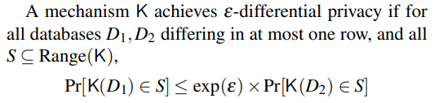
Privacy attack => DP
Differential Privacy can use raw private data as input, either output a new dataset with adding some perturbation or a trained model to achieve the differential privacy rules.

