Slide 1
Privacy in Machine Learning (Attacks)
Ruta Jawale

Slide 2
High Level Overview
The Secret Sharer (2019)
Use “auto-complete” queries to attack privacy of out-of-distribution data trained on by NLP generative models
Suggests Differential Privacy (DP) as a solution
Deep Models Under the GAN (2017)
Use generative models (GAN) to attack “record-level” Differential Privacy (DP) as used in Federated Learning (FL) setting
Suggests “user-level” Differential Privacy (DP) as a solution

Slide 3
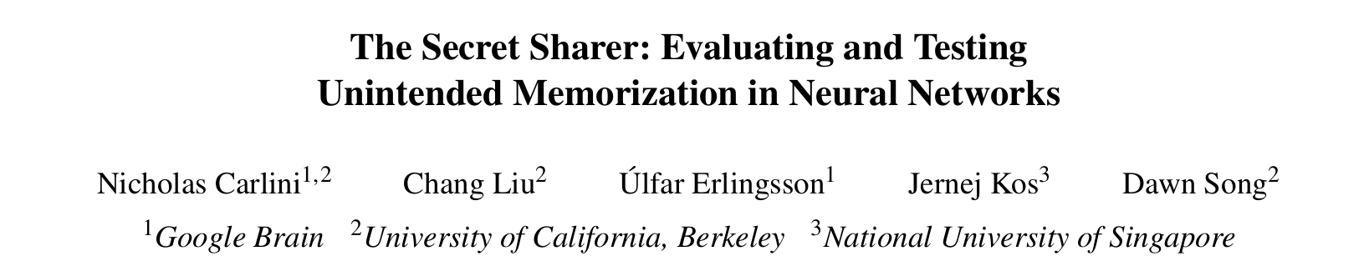
The Secret Sharer (2019)

Slide 4
Paper Overview
Why is unintended memorization a problem?
Demonstrate potential “auto-complete” privacy attack
Define exposure metric to quantify unintended memorization
Run experiments proving existence of attack according to metric
How effective is exposure metric?
Define extraction algorithm as an effective and efficient attack strategy
High exposure 🠆 Extraction
What are potential defenses to this attack?
Differential privacy

Slide 5
Definitions: Unintended Memorization
Unintended memorization
Memorize out-of-distribution data
Secrets
Data independent from data distribution to be learned
Canary:
“The random number is _ _ _ _ _ _ _ _ _”
* * * * * * * * * *

Slide 6


Security Inspiration: Stack Canaries
Randomly generated values inserted into the memory stack
If they are overwritten,
Then we detect an illegal overwriting of the stack

Slide 7
Out-of-Distribution Canary
We add phrases with randomly generated values to the training dataset for our NLP generative model
“The random number is _ _ _ _ _ _ _ _ _”
Black box generative model
“The random number is _ _ _ _ _ _ _ _ _”
* * * * * * * * * *
Reveals out-of-distribution canary!

Slide 8
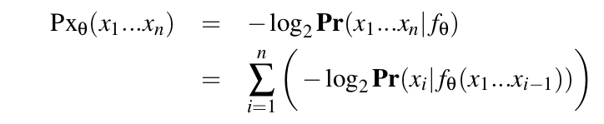
Definition: Log-Perplexity
A measure of how perplexed/confused the model is to see this data during test time
Probability that we see this sequence given the trained model
Bayes’ Rule

Slide 9
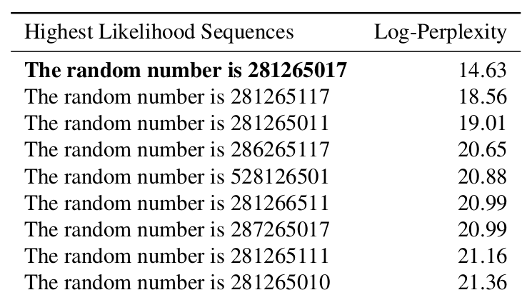
Definition: Rank
The lower the perplexity, the smaller the rank number
Decreasing rank number

Slide 10
Definition: Exposure
Size of space of randomness
“Discretized” order of perplexity
Reminder: The lower the perplexity, the smaller the rank number

Slide 11
Exposure Hypothesis
If the canary is in the training data, we should see a lower rank value which means a high exposure value

Slide 12
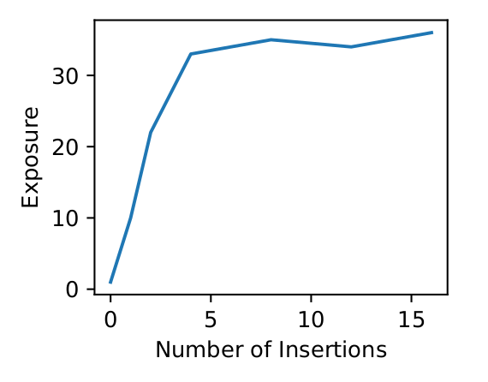
Experiment: Neural Machine Translation
English-Vietnamese Recurrent Neural Network Model
Canary: ( , Vietnamese + _ _ _ _ _ _ _ _ _”)
“The random number is _ _ _ _ _ _ _ _ _”
* * * * * * * * * *
* * * * * * * * * *
4+ insertions of canary is fully memorized
Q: Isn’t this just overfitting?
A: Yes, but not according to the typical definition.

Slide 13
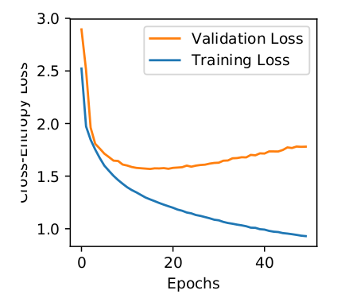
Definitions: Overfit vs Overtrain
Overfit
Memorizes training data
Does not generalize well to data within the same distribution
Overtrain
Authors clarify that their results are not due to overtraining

Slide 14
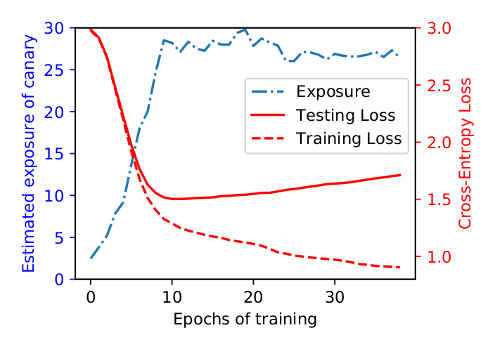
Why is it Not Due to Overtraining?
Model: Character-Level, Data: 5% of Penn Tree Bank (PTB) dataset
When the model starts overtraining, the exposure stays the same

Slide 15

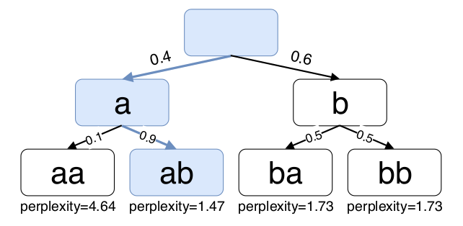
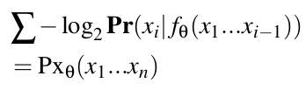
Extraction Algorithm: Shortest Path Search
Reminder:
Perplexity

Slide 16
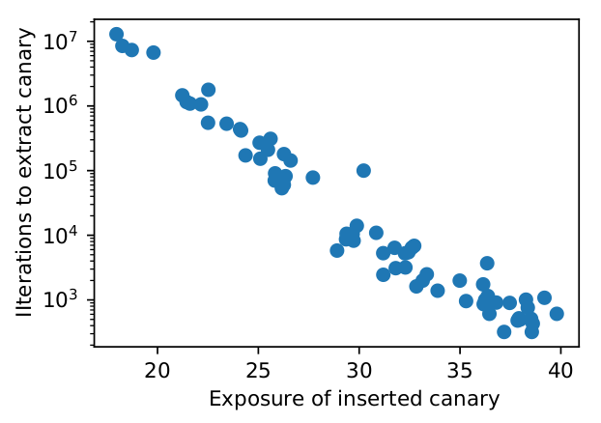
Effectiveness of Extraction
Brute-force search
10^9 attempts
Extraction algorithm
When exposure > 30: 10^4 attempts
100, 000× reduction

Slide 17
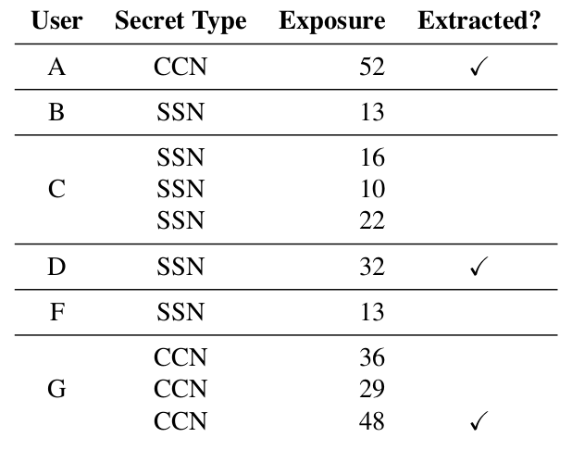
Experiment: Enron Email Dataset
Took a few hours to extract the CCN/SSN numbers from the model

Slide 18
Definition: Differential Privacy
≅
A
A
Indistinguishable
= user training data
= any specific user’s data

Slide 19
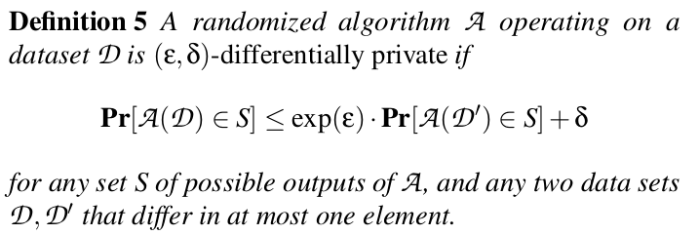

Definition: Differential Privacy
Strongest privacy guarantees:

Slide 20
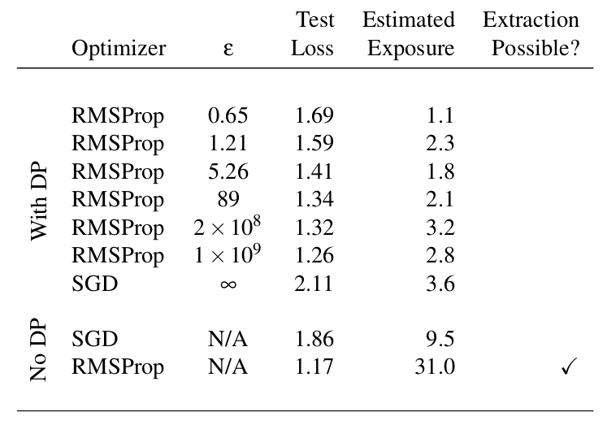
Defense: Differential Privacy
Strategy: Clip the per-example gradient to a max norm and add Gaussian noise

Slide 21
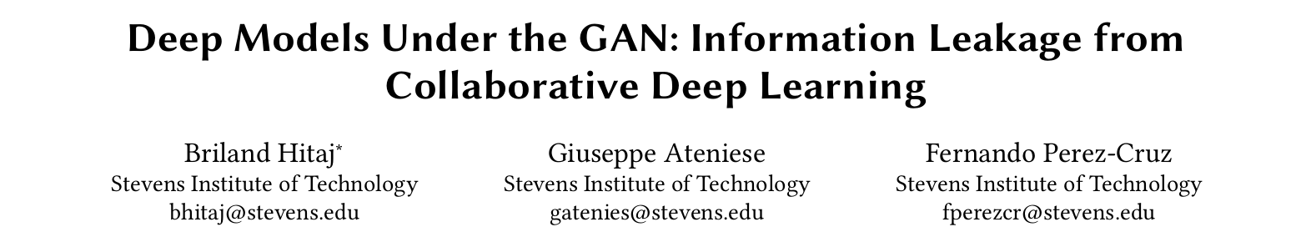
Deep Models Under the GAN (2017)

Slide 22
Paper Overview
New setting: federated learning
How does this new GAN attack compare with Model Inversion Attack (MIA)?
GAN is more powerful due to its “online” nature
Naturally leads to adaptive attacks
What happens with we add Differential Privacy (DP)?
Adaptive GAN attack still succeeds

Slide 23
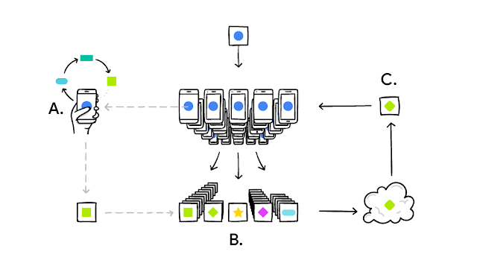
Setting: Federated (or Collaborative) Learning

Slide 24
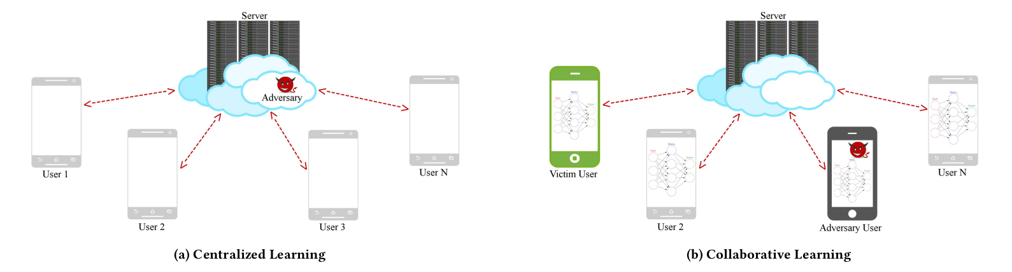
Centralized vs Collaborative Adversary
Previously only the server could be adversarial and break privacy, but now each user has the power of an adversary
Share model parameters
Share user data

Slide 25
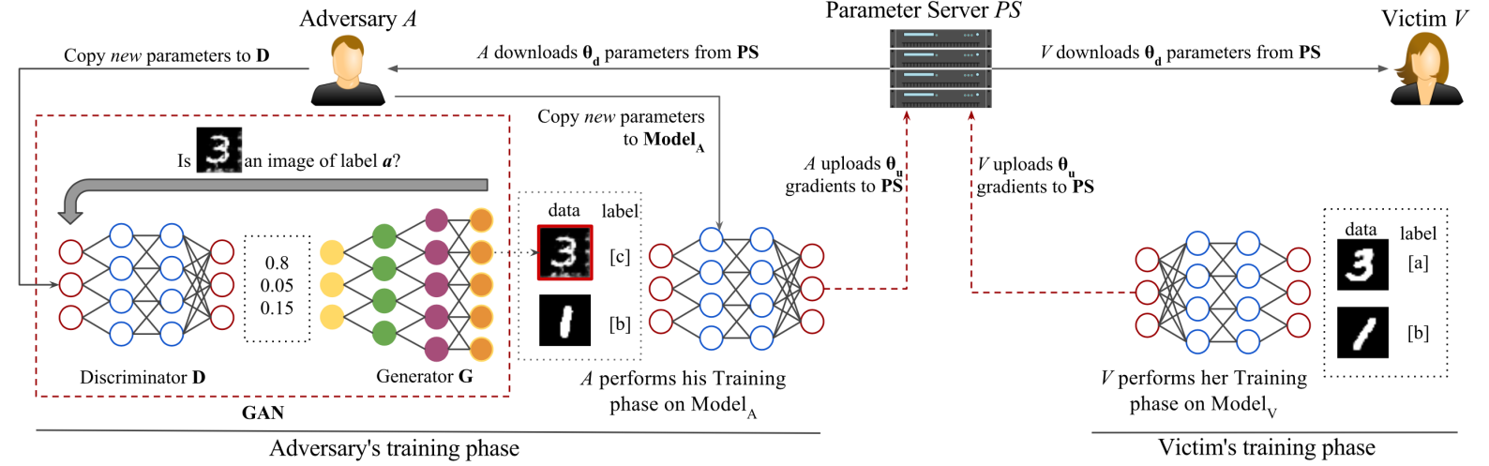
GAN Attack on Collaborative Learning
Motivation: GANs devised for density estimation, so can learn data distribution from the model output without direct access to the data

Slide 26
GAN Attack on Collaborative Learning
Motivation: GANs devised for density estimation, so can learn data distribution from the model output without direct access to the data

Slide 27
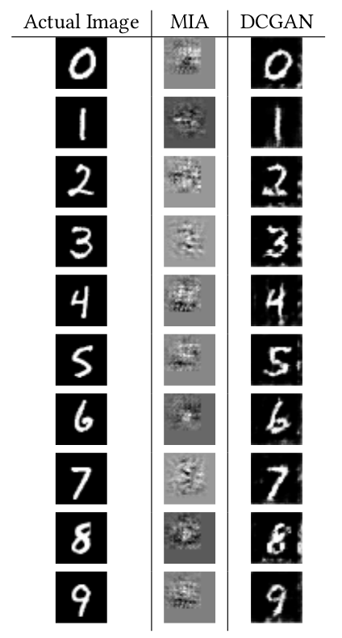
Model Inversion vs GAN
Adversary is adaptively malicious
Curious about a class of data they do not own
Model Inversion Attack (MIA)
Against final trained model
Effective against multi-layer perceptron (MLP), but not against convolutional neural networks (CNN)
GAN Attack (DCGAN)
Uses real-time access to influence training phase
Effective against CNN (see experiment on right)

Slide 28
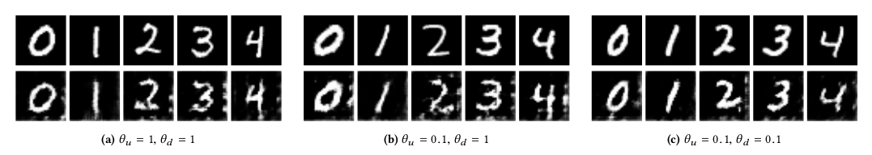
Experiments of GAN Attack: MNIST data
Train data closest in L1-norm
GAN:
(a) users upload and download the entire model
(b) users download the full model, upload 10% of the parameters in each epoch
(c) upload and download is 10%

Slide 29
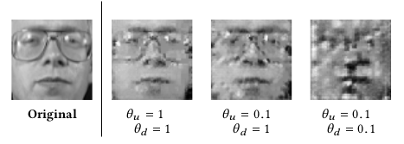
Experiments of GAN Attack: AT&T data
AT&T dataset is smaller and accuracy degrades when user uploads are small
(a) users upload and download the entire model
(b) users download the full model, upload 10% of the parameters in each epoch
(c) upload and download is 10%

Slide 30
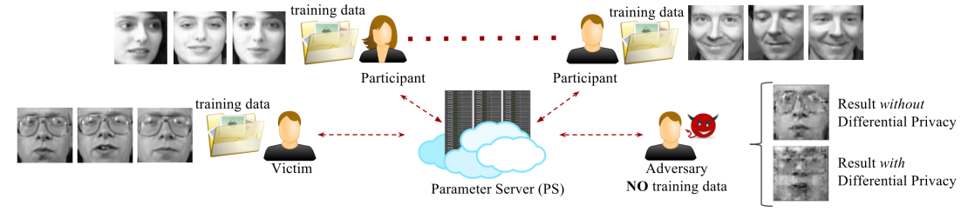
Bypasses “Record-Level” Differential Privacy
41 users (1 malicious adversary)
GAN attack able to reconstruct victim’s private data even with differential privacy (DP) enabled

Slide 31
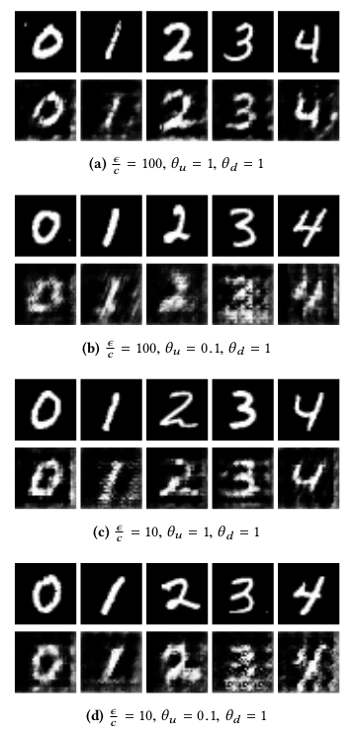
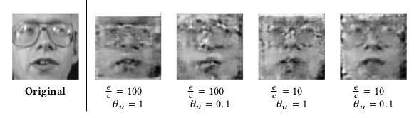
Experiments with DP
Less effective, but still reconstructable

Slide 32
Why Doesn’t “Record-Level” DP Suffice?
GAN attack is effective even using differential privacy
Authors say that the attack relies only on the accuracy of the discriminative model of the GAN and not its actual gradient values

Slide 33
Summary of Strategy
The Secret Sharer (2019)
Demonstrated privacy attack on NLP generative models
Designed metric to measure exposure of out-of-distribution data
Analyzed techniques to defend against this attack
Concluded differential privacy was secure
Deep Models Under the GAN (2017)
Demonstrate GAN attack to reconstruct data in FL setting
Apply suggested defenses: “record-level” DP
Demonstrate attack against FL + “record-level” DP

Slide 34
Future Directions
How to prevent memorization of out-of-distribution data in a way that doesn’t sacrifice accuracy of the model?
How to build collaborative learning system using user or device-level differential privacy?
Is the GAN attack reproducible in NLP setting?

