Slide 1
Introduction of “Plausible Deniability for Privacy-Preserving Data Synthesis”
Paper Title: Plausible Deniability for Privacy-Preserving Data Synthesis
Author: Vincent Bindschaedler, Reza Shokri, Carl A. Gunter
Venue: VLDB’2017
Presenter: Dongqi Fu

Slide 2
Roadmap
Motivation
Illustration of the Idea
Definition of Plausible Deniability
Proposed Algorithm for Realization
Experiments

Slide 3
Motivation
Releasing highly-sensitive data is dangerous
Current de-identification methods depend on background knowledge of adversaries
Current de-identification methods are computationally impractical to use for releasing high dimensional data
Hence, this paper aims to propose a method which does not depend on background knowledge of an adversary; also, it can be efficiently checked by privacy test.

Slide 4







Illustration of the Idea
The first core question: How can we camouflage the real data?
Data item d
Generative model M
Database D
Synthetic data item y
Notes:
We use the synthetic data y to represent d

Slide 5

Illustration of the Idea
The second core question: Once we get a synthetic data,
when can we release privacy-preserving synthetic data item y?
Data item d
Synthetic data item y
Plausible Deniability
Data item d’
Data item d’’
Database D
Notes:
If d’ and d’’ has the considerable probability to generate y, then y is able to be released

Slide 6
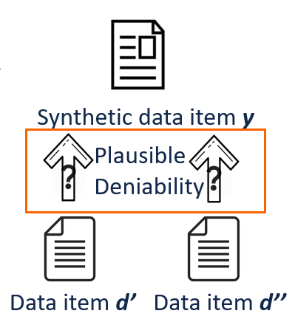

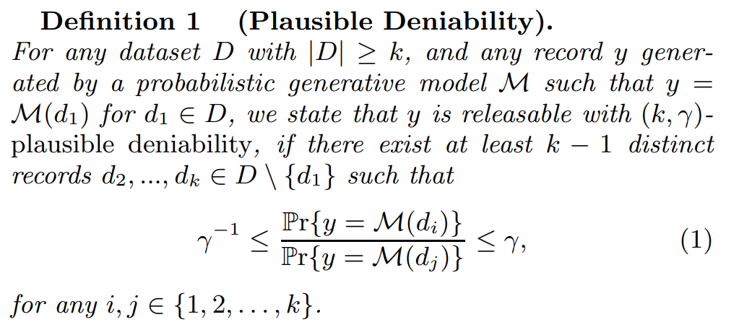
Definition of Plausible Deniability
Let $k≥1$ be an integer and $γ≥1$ be a real number, they are privacy parameters
Synthetic $y$ is releasable if $y$ passes the ($k,γ$)-plausible deniability
Informally, plausible deniability states that an adversary (with any background knowledge) cannot deduce that a particular record in the input (real) dataset was significantly more responsible for an observed output (synthetic record) than was a collection of other input records.

Slide 7

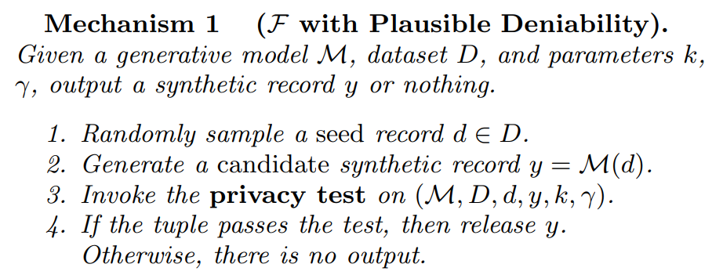
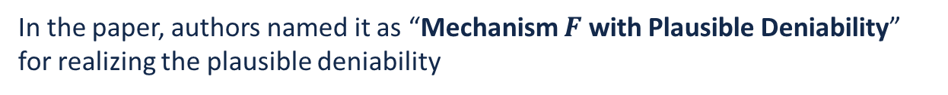
Proposed Algorithm
In the paper, authors named it as “Mechanism $F$ with Plausible Deniability” for realizing the plausible deniability

Slide 8
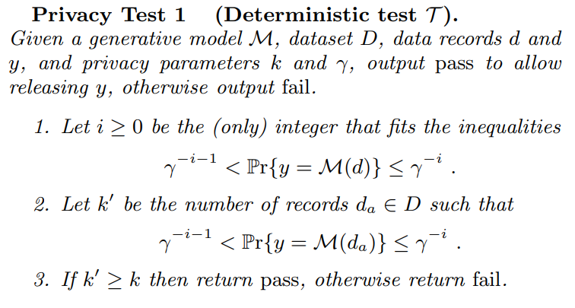
Proposed Algorithm(cont.)
Privacy Test

Slide 9
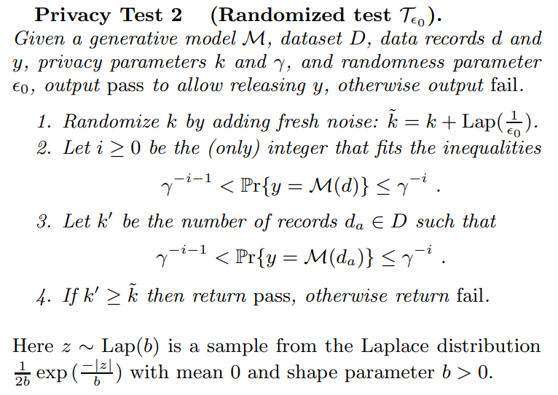
Proposed Algorithm(cont.)
Privacy Test
Privacy test 2 is identical to Privacy test 1 except it randomizes the threshold $k$.

Slide 10
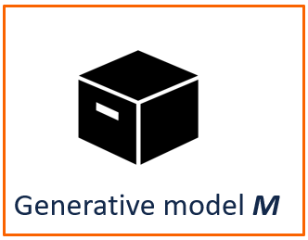
Proposed Algorithm(cont.)
Generative Model
Data item d
Synthetic data item y
At the beginning, the generative model is given.
Next,
What is the generative model?
How can we learn the generative model?

Slide 11
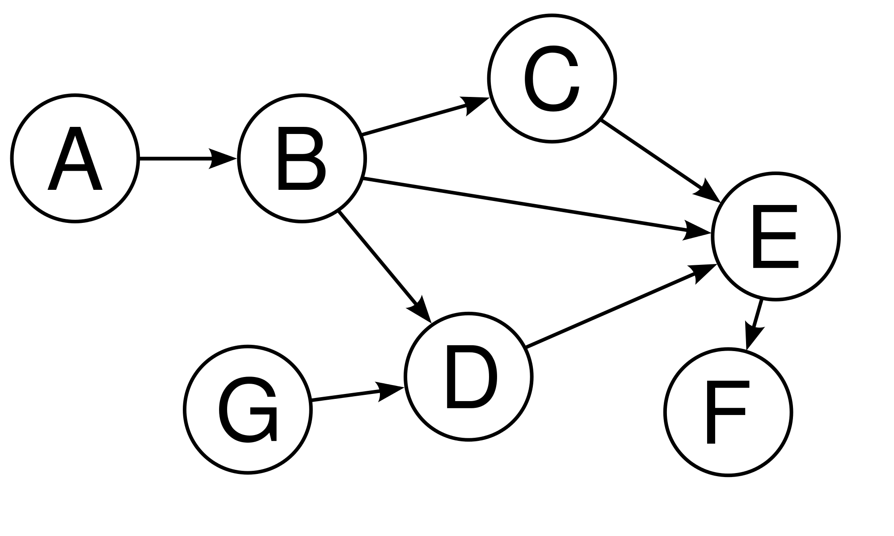

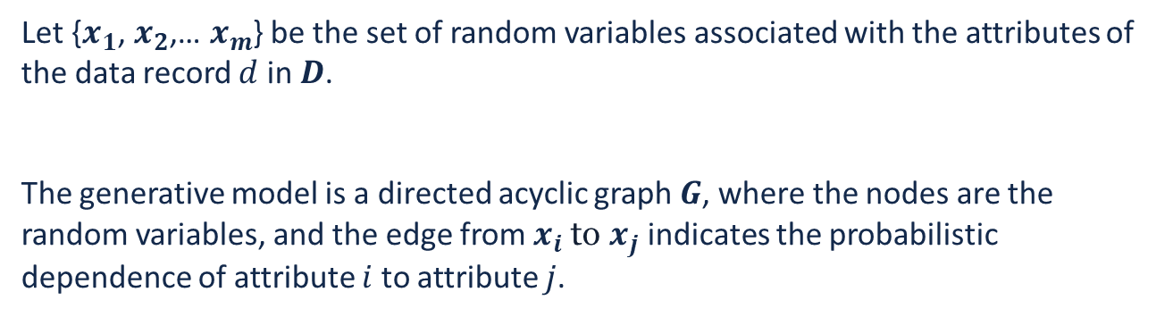


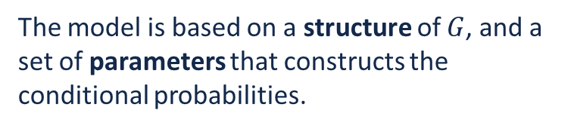
Proposed Algorithm(cont.)
Generative Model
What is the generative model?
How can we learn the generative model?
Let {$x_{1}$, $x_{2}$,… $x_{m}$} be the set of random variables associated with the attributes of the data record $d$ in $D$.
The generative model is a directed acyclic graph $G$, where the nodes are the random variables, and the edge from $x_{i}$ to $x_{j}$ indicates the probabilistic dependence of attribute $i$ to attribute $j$.
$$x_{2}$$
$$x_{1}$$
The model is based on a structure of $G$, and a set of parameters that constructs the conditional probabilities.
attribute
$$x_{m}$$
Graph of attributes

Slide 12
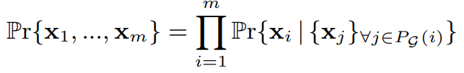
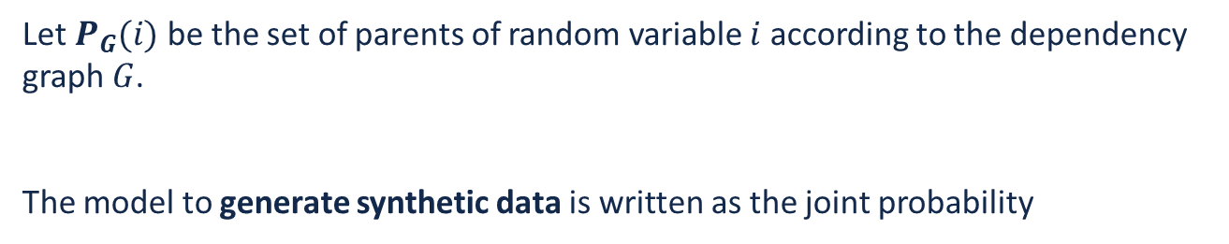
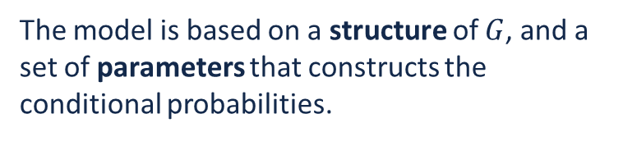
Proposed Algorithm(cont.)
Generative Model
What is the generative model?
How can we learn the generative model?
Let $P_{G}(i)$be the set of parents of random variable $i$ according to the dependency graph $G$.
The model to generate synthetic data is written as the joint probability
$$x_{2}$$
$$x_{1}$$
The model is based on a structure of $G$, and a set of parameters that constructs the conditional probabilities.
attribute
$$x_{m}$$
Graph of attributes

Slide 13



Proposed Algorithm(cont.)
Generative Model
What is the generative model?
How can we learn the generative model?
Database D
$$D_{T}$$
$$D_{P}$$
$$D_{S}$$
for structure learning
for parameter learning
for transforming real data

Slide 14
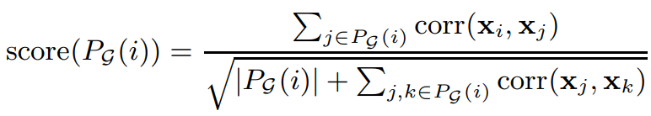

Proposed Algorithm(cont.)
Generative Model
What is the generative model?
How can we learn the generative model?
-- structure learning
$$D_{T}$$
For each attribute, the goal is to find the best set of features (among all attributes) to predict it and add them as the attributes through maximizing a scoring function.
$$x_{2}$$
$$x_{1}$$
attribute
$$x_{m}$$
Graph of attributes

Slide 15





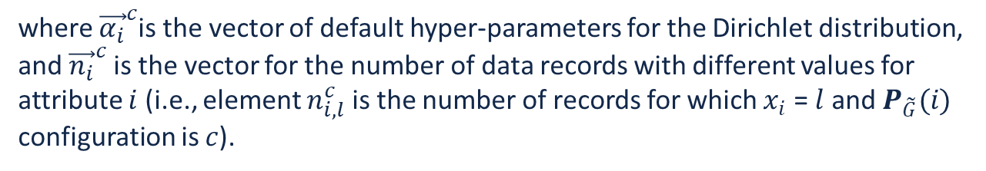
Proposed Algorithm(cont.)
Generative Model
What is the generative model?
How can we learn the generative model?
-- parameter learning
$$D_{P}$$
Having a dependency structure $\tilde{G}$, we need to compute the conditional probabilities for predicting each of the attributes given its parent set.
Let $|x_{i}|$ be the number of distinct values that attribute $i$ can take, our objective is:
To predict attribute $i$, under configuration $c$ for $P_{\tilde{G}}(i)$
where ${\vec{α_{i}}}^{c}$is the vector of default hyper-parameters for the Dirichlet distribution, and ${\vec{n_{i}}}^{c}$is the vector for the number of data records with different values for attribute $i$ (i.e., element $n_{i,l}^{c}$ is the number of records for which $x_{i}$ = $l$ and $P_{\tilde{G}}(i)$ configuration is $c$).

Slide 16
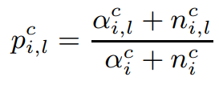
Proposed Algorithm(cont.)
Generative Model
What is the generative model?
How can we learn the generative model?
-- parameter learning
$$D_{P}$$
Derived from the above assumption
Notes:
The probability that the attribute i equals to value l can be computed.

Slide 17




Proposed Algorithm(cont.)
Generative Model
What is the generative model?
How can we learn the generative model?
-- transforming real data
$$D_{S}$$
Using a generative model, we probabilistically transform a real data record (called the seed) into a synthetic data record, by updating its attributes.
Let {$x_{1}$, $x_{2}$, … $x_{m}$} be the values of a randomly selected data record
Length: $m−ω$
Length: $ω$
Fix
Modify according to distribution of $D_{P}$

Slide 18
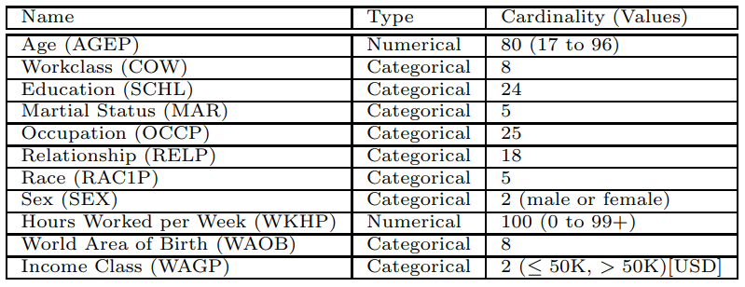
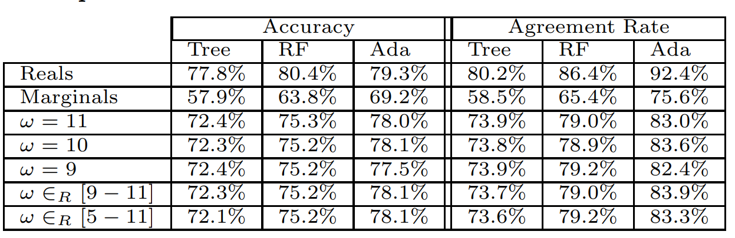
Experiments
Data set (personal data)
Machine learning task metric
Notes:
Machine learning task measures how good when the synthetic data serves different machine learning tasks

Slide 19
Introduction of “Scalable Private Learning with PATE”
Paper Title: Scalable Private Learning with PATE
Author: Nicolas Papernot et al.
Venue: ICLR’2018
Presenter: Dongqi Fu

Slide 20
Roadmap
PATE Framework
PATE Aggregation Mechanism
Improved Aggregation Mechanism for PATE
Experiments

Slide 21
PATE Framework
PATE(Private Aggregation of Teacher Ensembles) enables knowledge transfer from the teacher models to the student models while enforcing privacy.
In the PATE approach, multiple teachers are trained on disjoint sensitive data, and uses the teachers’ aggregate consensus answers in a black-box fashion to supervise the training of a “student” model.
Publish only the student model (keeping the teachers private) and add carefully-calibrated Laplacian noise to the aggregate answers used to train the student.

Slide 22
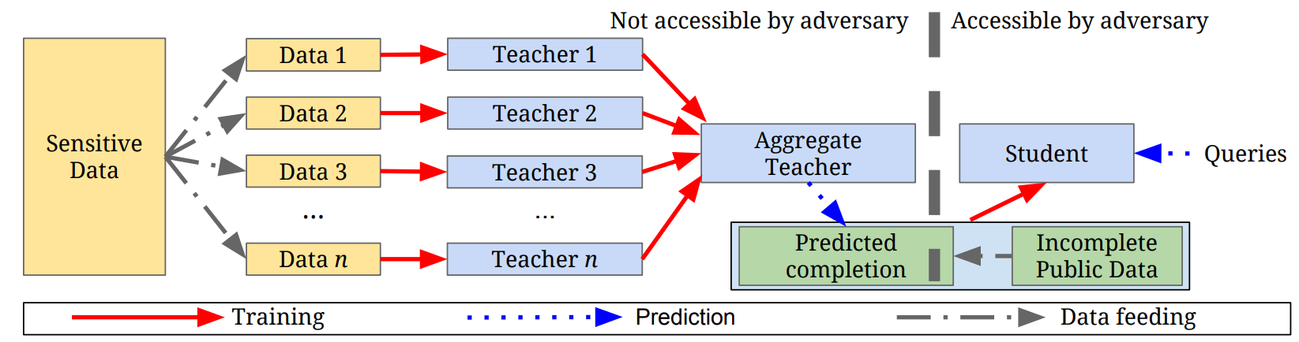
PATE Framework
Teacher model: Each teacher is a model trained independently on a subset of the data whose privacy one wishes to protect
Aggregation mechanism: When there is a strong consensus among teachers, the label they almost all agree on does not depend on the model learned by any given specific teacher. The original PATE framework counts votes assigned to each class and adds noise, outputs the class with the highest votes.
Student model: The student model only sees public data and privacy-preserving labels from teachers’ consensus. And trained itself in a semi-supervised way, because the author notes each ensemble prediction increase the privacy cost.
Notes:
There are three key parts: (1) an ensemble of n teacher models; (2) an aggregation mechanism and (3) a student model
When expose to all un-labeled data, it will reveal the privacy of the aggregation prediction.

Slide 23

PATE Aggregation Mechanism
Aggregation mechanism: When there is a strong consensus among teachers, the label they almost all agree on does not depend on the model learned by any given teacher. The original PATE framework counts votes assigned to each class and adds noise, outputs the class with the highest votes.

Slide 24
Improved Aggregation Mechanism for PATE
Improvements
Reason
First, replace the Laplace noise added to teacher votes with Gaussian noise.
Second, the aggregation mechanism is now selective: teacher votes are analyzed to decide which student queries are worth answering. This considers both the privacy cost of each query and its payout in improving the student’s utility.
Third, they propose and study an interactive mechanism that considers not only teacher votes on a queried example but possible student predictions on that query.
Gaussian distribution is more concentrated than Laplace distribution. Increase the aggregation utility when number of classes is large.
Select student queries which are worthwhile answering.

Slide 25
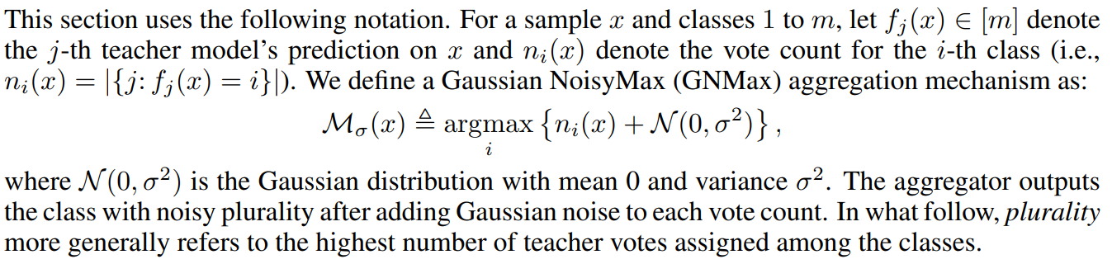
Improved Aggregation Mechanism for PATE
First, replace the Laplace noise added to teacher votes with Gaussian noise.
Notes:
Number of votes on the ith class

Slide 26
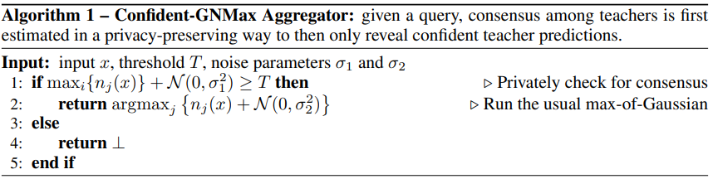
Improved Aggregation Mechanism for PATE
Second, the aggregation mechanism is now selective: teacher votes are analyzed to decide which student queries are worth answering. This considers both the privacy cost of each query and its payout in improving the student’s utility.
Notes:
which means a certain number of teachers agree on this answer, the adversary can not trace back who is the teacher gives the answer.

Slide 27
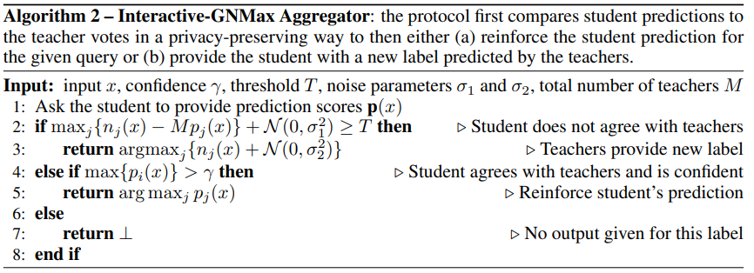
Improved Aggregation Mechanism for PATE
Third, they propose and study an interactive mechanism that considers not only teacher votes on a queried example but possible student predictions on that query.

Slide 28
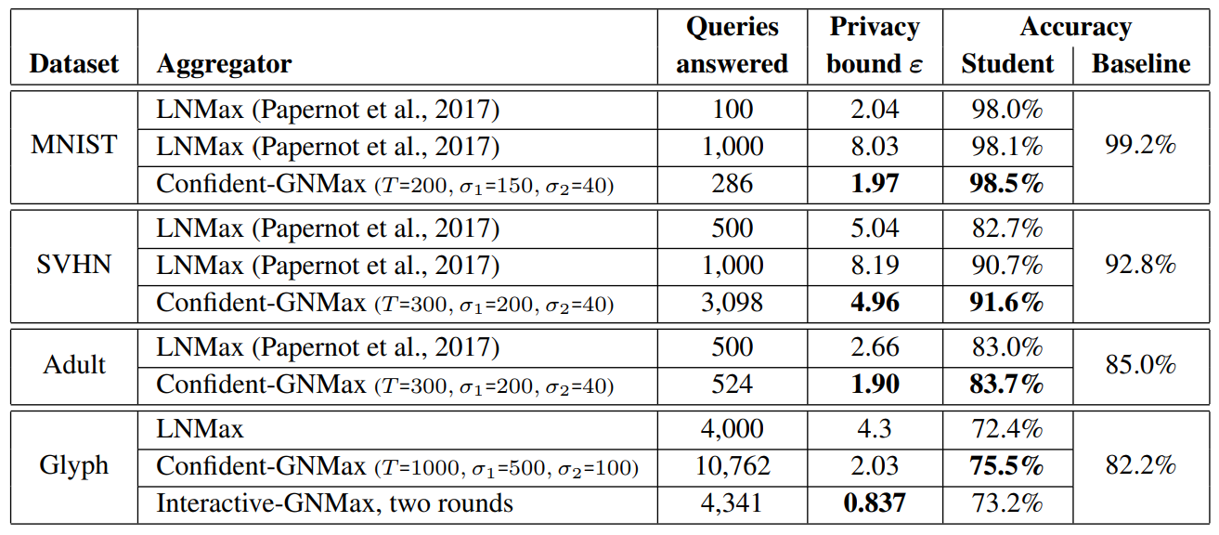
Experiments
Notes:
Achieve comparable accuracy but save the privacy cost

