Slide 1
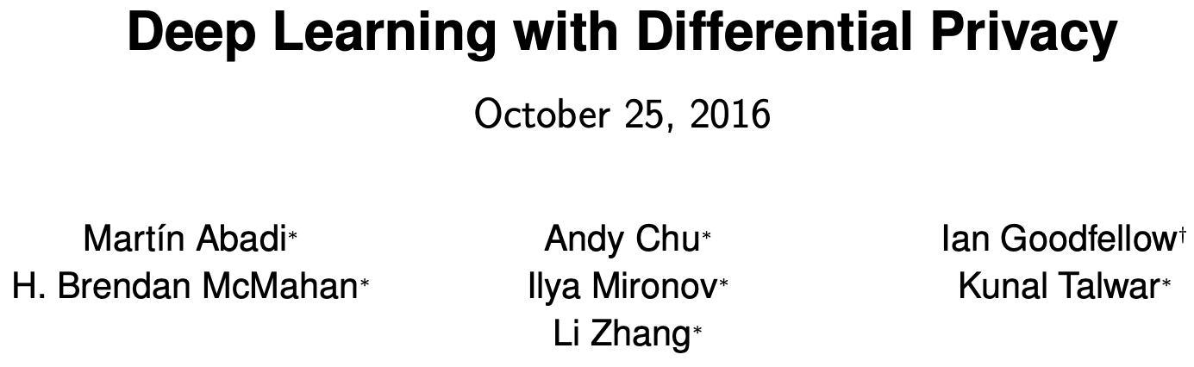
Presented By: Hari Cheruvu

Slide 2
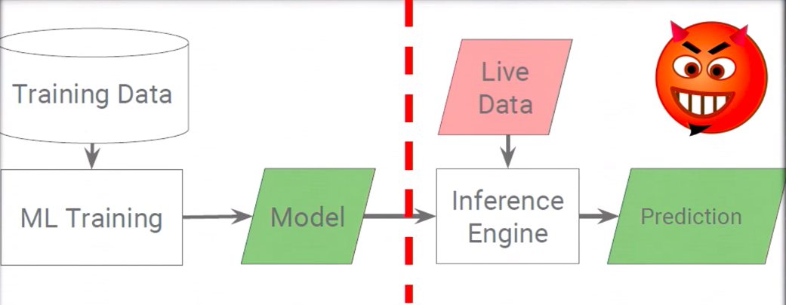
Motivation
Want to protect sensitive training data
Model should not change much with a single training point
CCS 2016 Presentation

Slide 3
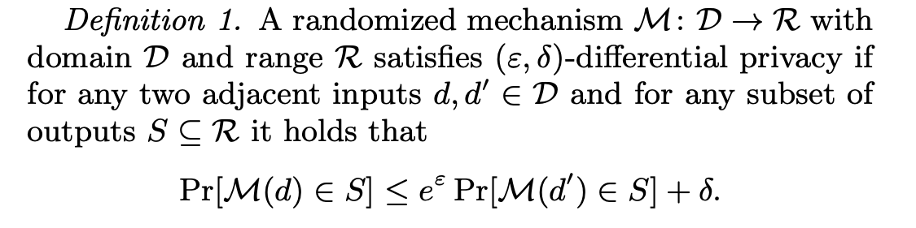
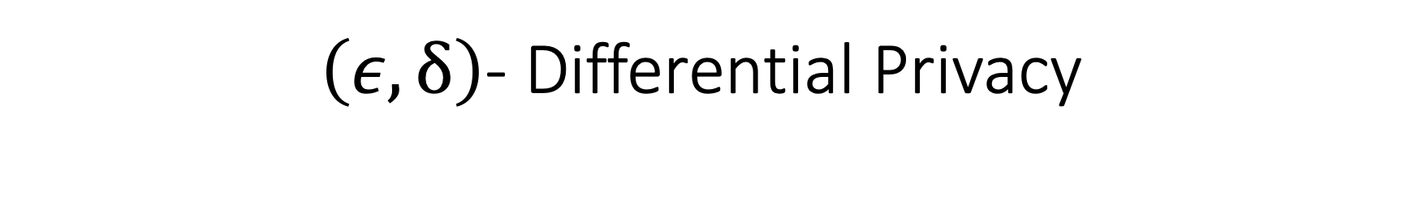
$\left(ε,δ\right)$- Differential Privacy
Privacy Loss
Allows for small probability of failure

Slide 4
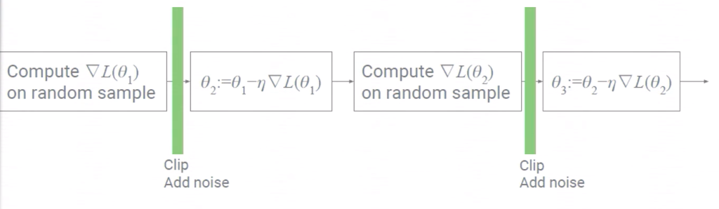
Differentially Private SGD

Slide 5
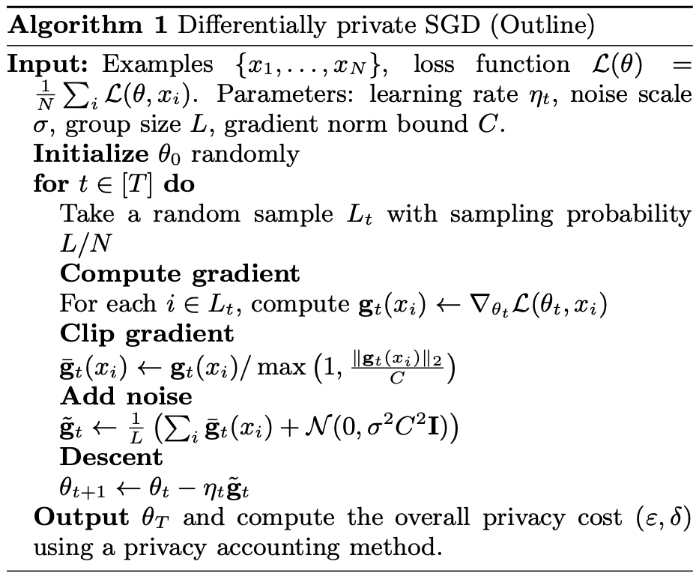
Differentially Private SGD

Slide 6
Key Ideas
Norm clipping, adding noise
Lots (separate from batch)
Moments Accountant

Slide 7
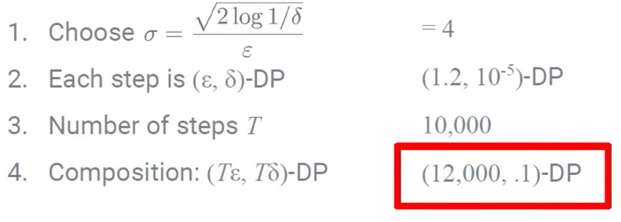

Basic Composition Theorem
If $f$ is ${(ε}_{1},δ_{1})$-DP and $g$ is ${(ε}_{2},δ_{2})$-DP,
then $f\left(D\right),g\left(D\right)$ is $\left(ε_{1}+ε_{2},δ_{1}+δ_{2}\right)$-DP

Slide 8
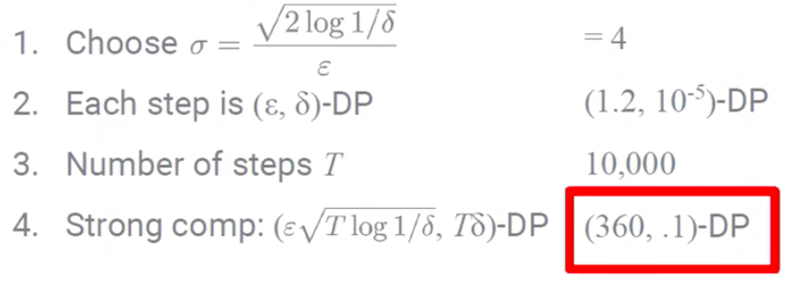
Strong Composition Theorem

Slide 9
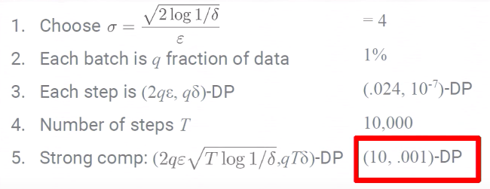
Notice Sampling

Slide 10
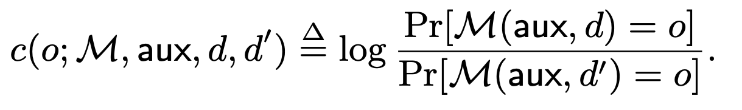
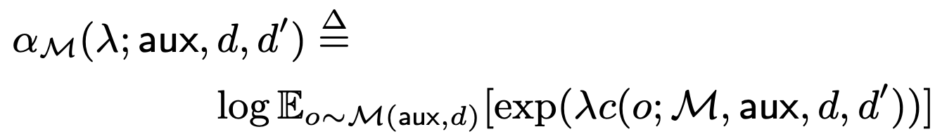
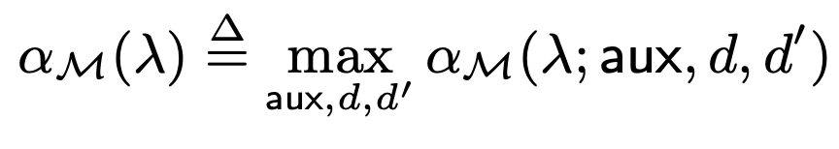

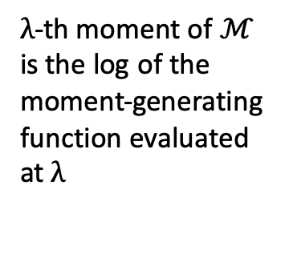
Preliminary Definitions
Privacy Loss at $o:$
$λ$-th moment of $ℳ$
is the log of the moment-generating function evaluated at $λ$

Slide 11
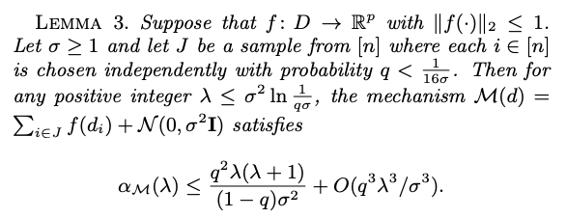
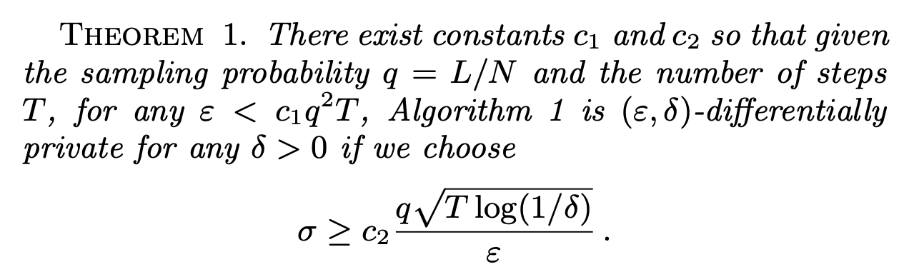
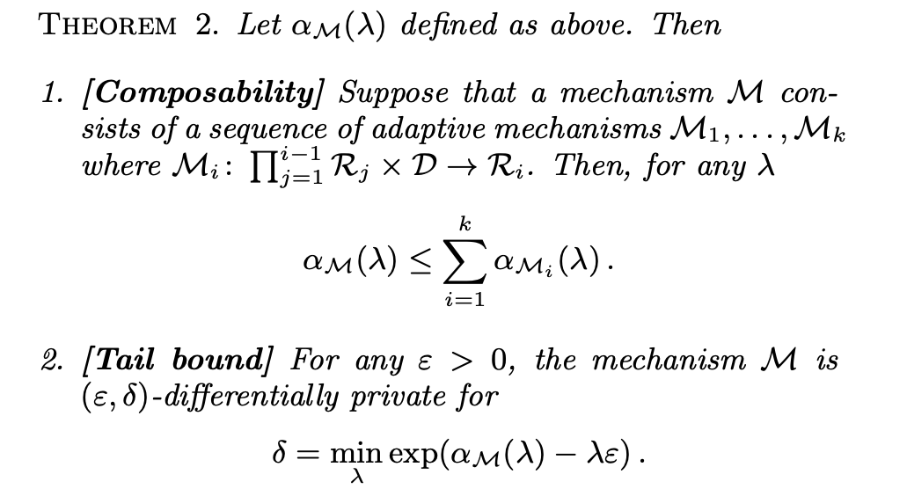

Slide 12
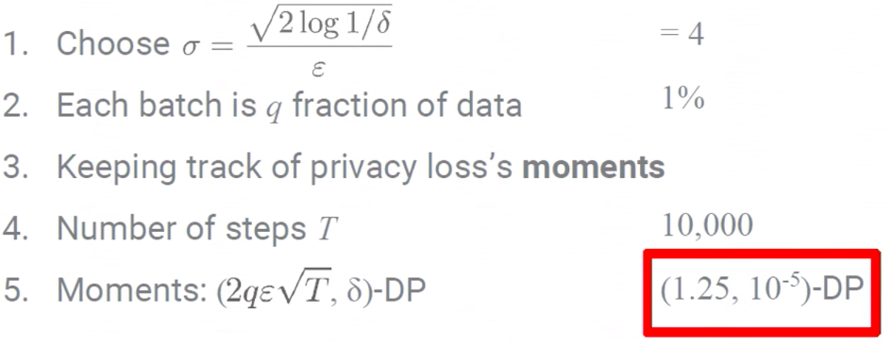
Key Contribution is Obtaining a Tighter Bound
Solution: Use Moments Accountant to obtain this tighter bound

Slide 13
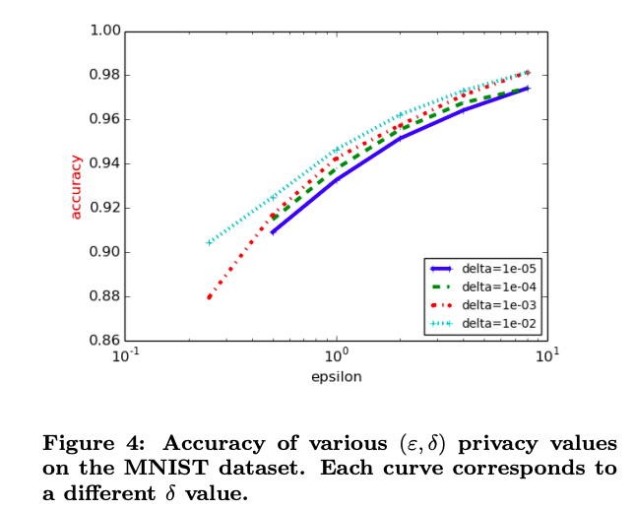
Accuracy vs Epsilon for MNIST Classification

Slide 14
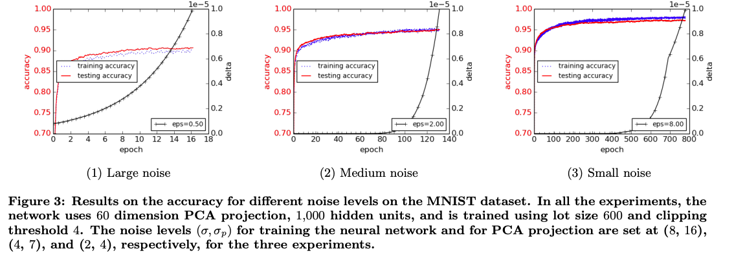
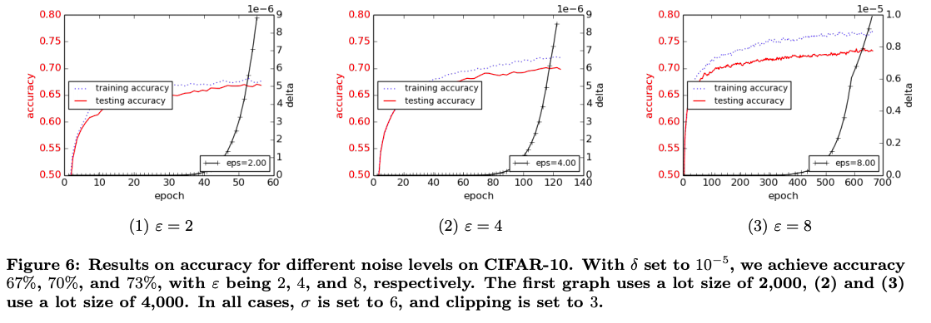
Results

Slide 15
Advantages + Drawbacks
Advantage:
Greatly Improved Bounds Through Moments Accountant
Introduced differentially private SGD which bounds sensitivity of updates
Applies to Large Complex Models
Drawback:
Not generalizable to all models
Lower accuracy

Slide 16
Future Directions
Improve Accuracy
Apply to other models and tasks such as LSTM and language modeling

Slide 17
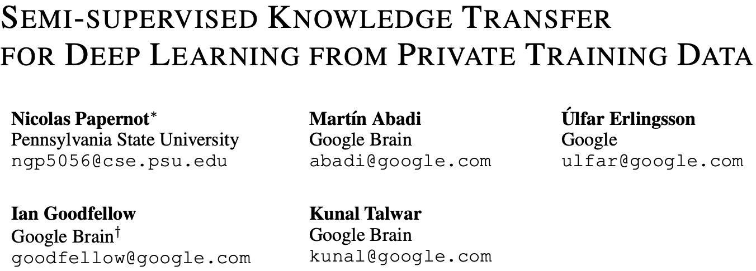

Slide 18
Idea
General framework for any model
Previous strategy (Dietterich, 2000) uses teacher ensembles trained on disjoint sets of training data for privacy
PATE strengthens this by restricting student training to limited number of teacher votes and only revealing topmost vote after adding random noise
Defend against black-box and white-box adversaries

Slide 19
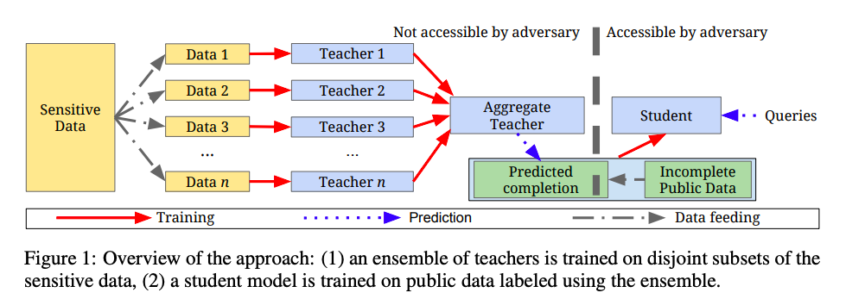
Framework for PATE

Slide 20
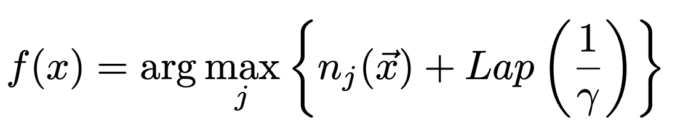
Drawbacks of Naïve Aggregation
Single training example could have large effect if teachers disagree
Solution: Introduce noise
Key Idea: Classification can no longer depend on a single teacher/training example

Slide 21
Details
Student is trained using fixed number of queries to the teacher. After that when an adversary queries the student model the total privacy loss is not increased

Slide 22
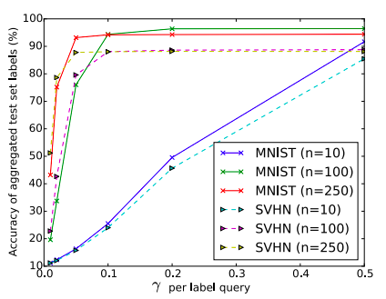
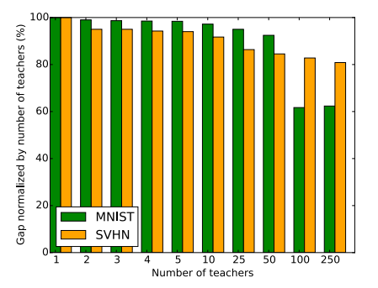
PATE Results
Gap increases as number of teachers increases -> Less Privacy Loss, but there will be acc. tradeoffs

Slide 23
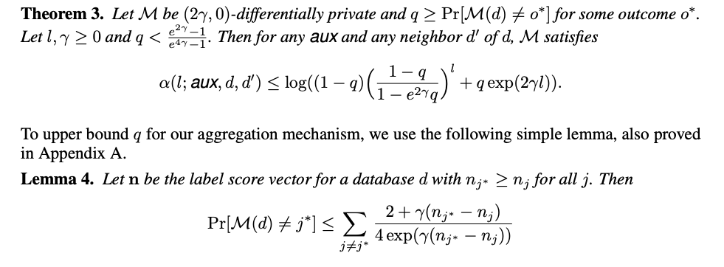
Privacy Analysis- Using Moments Accountant
Intuition: When quorum among teachers is large, then the majority outcome has high likelihood, which implies that the privacy cost is small

Slide 24
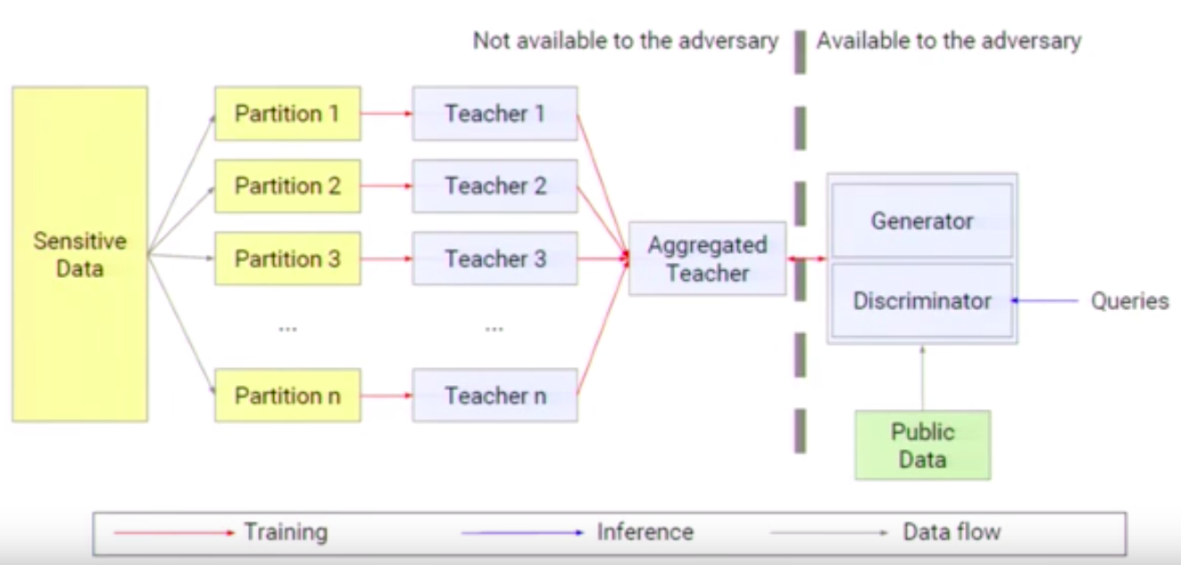
Semi-Supervised Variant (PATE-G)

Slide 25
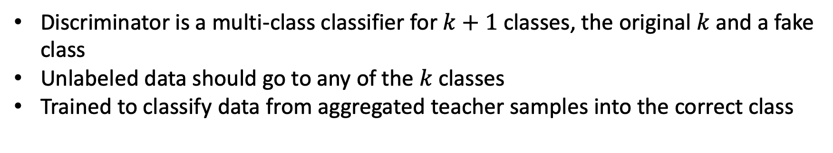
Details
Discriminator is a multi-class classifier for $k+1$ classes, the original $k$ and a fake class
Unlabeled data should go to any of the $k$ classes
Trained to classify data from aggregated teacher samples into the correct class

Slide 26
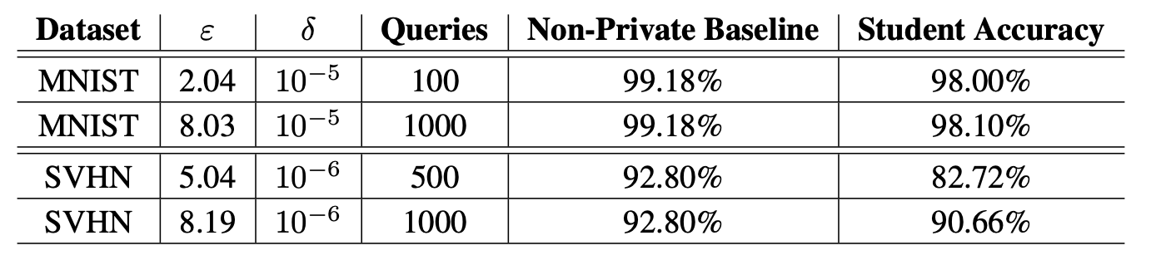
PATE-G Results
Previous paper achieved $(8, {10}^{−5})$privacy bound and 97% accuracy on MNIST

Slide 27
Conclusion
Advantages:
Works well whether partitioning is random or not
Easily extendable to any model
SOTA Tradeoffs between accuracy and privacy
Disadvantages:
Currently assume that teacher classifier arbitrarily changes with just one training example change -> Bound could potentially be made tighter

Slide 28
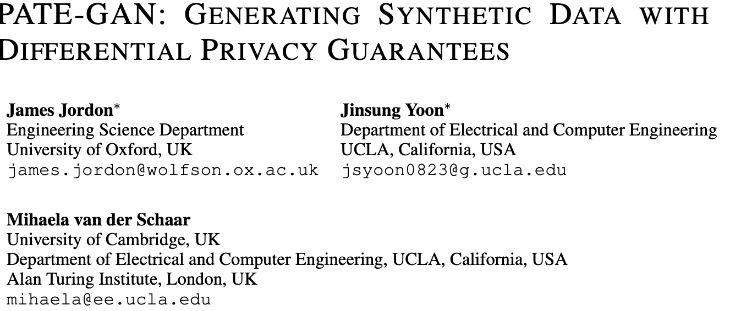

Slide 29
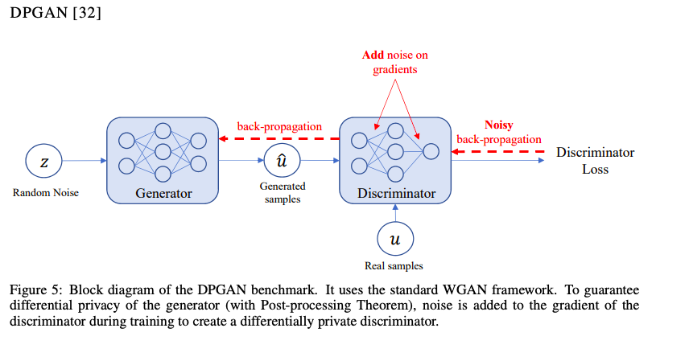
DPGAN

Slide 30
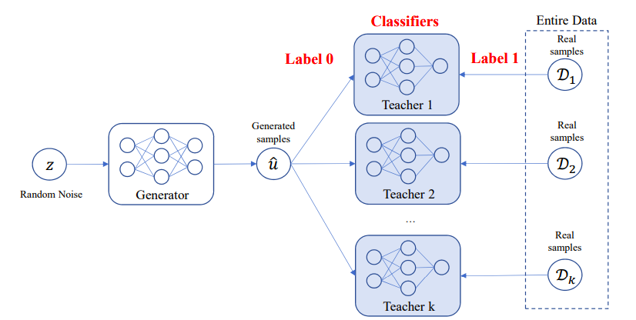
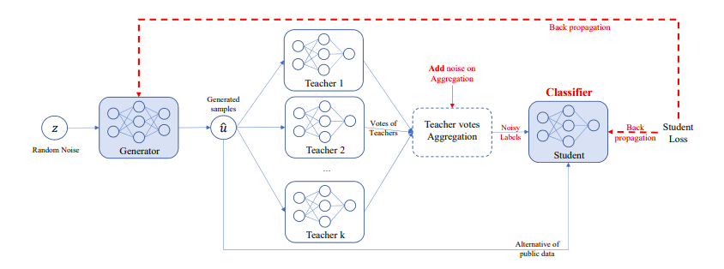
PATE-GAN
Training Procedure for Teacher Discriminators
Training Procedure for Generator and Student

Slide 31
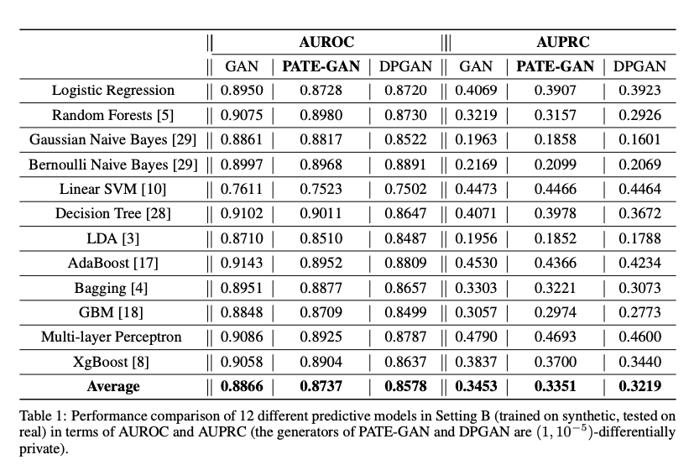
Results

Slide 32
Sources
Deep Learning with Differential Privacy, Abadi et al. 2016.
Deep Learning with Differential Privacy, CCS 2016 Presentation.
Semi-Supervised Knowledge Transfer for Deep Learning from Private Training Data, Papernot et al. 2017.
Semi-Supervised Knowledge Transfer for Deep Learning from Private Training Data, ICLR 2017 Presentation.
PATE-GAN: Generating Synthetic Data with Differential Privacy Guarantees, Jordan et al. 2019.

