Slide 1
Detecting Communities under Differential Privacy
Hiep H. Nguyen
Abdessamad Imine
Michaël Rusinowitch

Slide 2
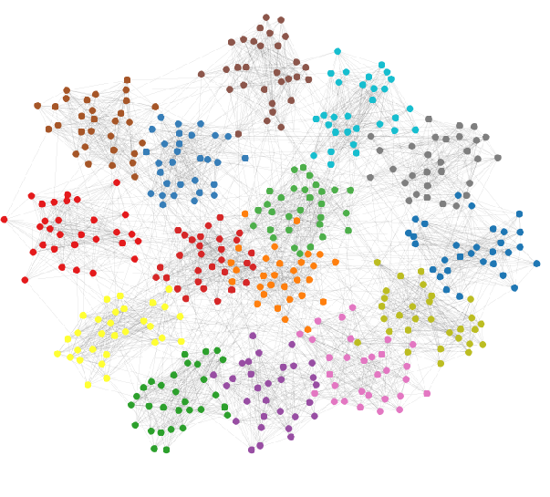
Community Detection
https://paperswithcode.com/task/community-detection

Slide 3

Definitions

Slide 4
Motivation
Community Detection (CD) is an important tool for analyzing graph networks
Research rarely tries to conduct CD with privacy guarantees

Slide 5
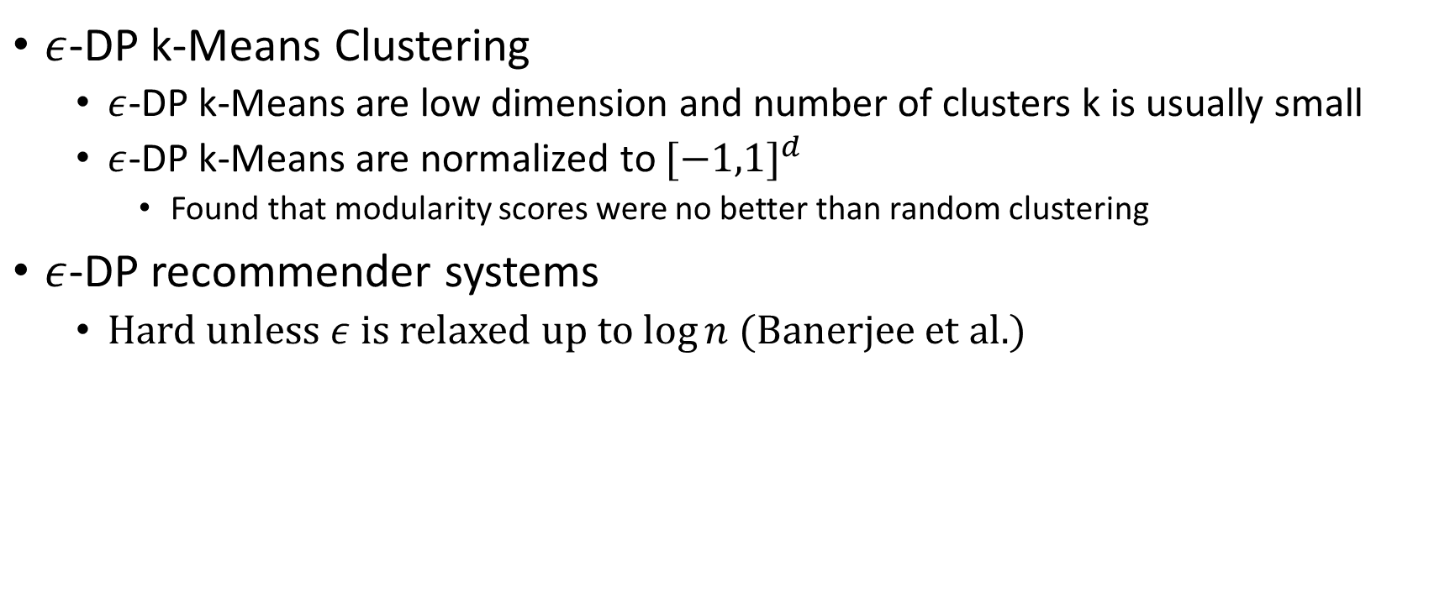
Previous Work
$ε$-DP k-Means Clustering
$ε$-DP k-Means are low dimension and number of clusters k is usually small
$ε$-DP k-Means are normalized to ${[−1,1]}^{d}$
Found that modularity scores were no better than random clustering
$ε$-DP recommender systems
Hard unless $ε$ is relaxed up to $\log{n}$ (Banerjee et al.)

Slide 6
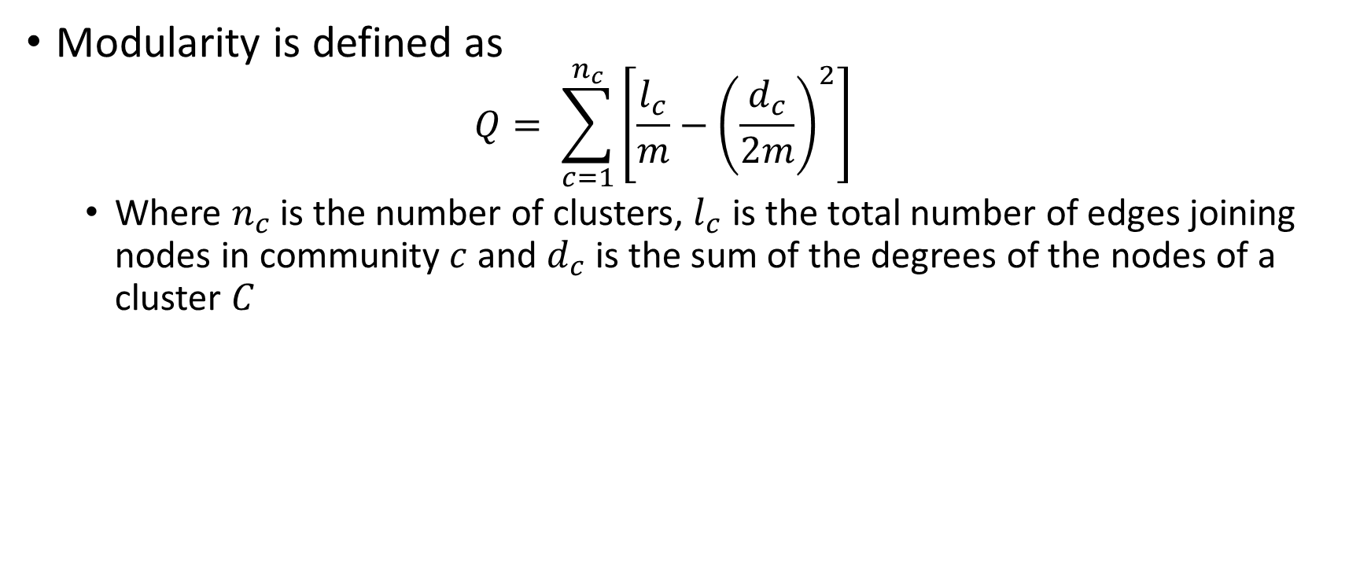
Modularity
Modularity is defined as
$$Q= \sum_{c=1}^{n_{c}}{\left[\frac{l_{c}}{m}−{\left(\frac{d_{c}}{2m}\right)}^{2}\right]}$$
Where $n_{c}$ is the number of clusters, $l_{c}$ is the total number of edges joining nodes in community $c$ and $d_{c}$ is the sum of the degrees of the nodes of a cluster $C$

Slide 7
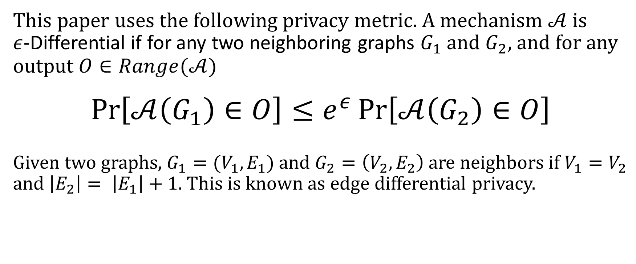
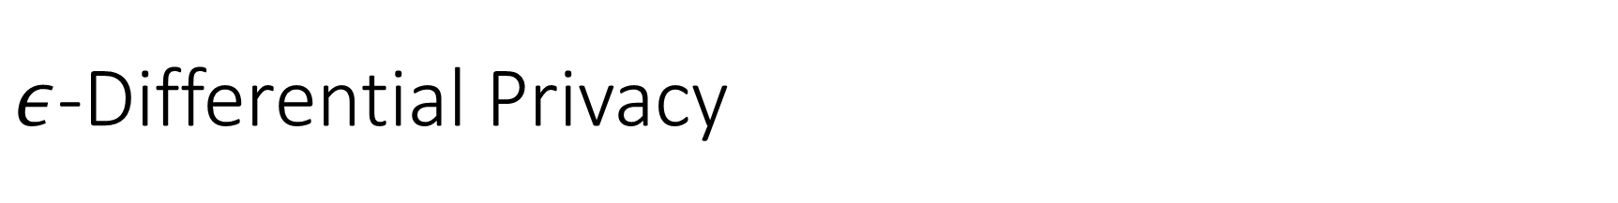
$ε$-Differential Privacy
This paper uses the following privacy metric. A mechanism $𝒜$ is $ε$-Differential if for any two neighboring graphs $G_{1}$ and $G_{2}$, and for any output $O∈Range(𝒜)$
$$\operatorname{Pr}\left[𝒜\left(G_{1}\right)∈O\right]≤e^{ε}\operatorname{Pr}\left[𝒜\left(G_{2}\right)∈O\right]$$
Given two graphs, $G_{1}=(V_{1},E_{1})$ and $G_{2}=\left(V_{2},E_{2}\right)$ are neighbors if $V_{1}=V_{2}$ and $\left|E_{2}\right|= \left|E_{1}\right|+1$. This is known as edge differential privacy.

Slide 8
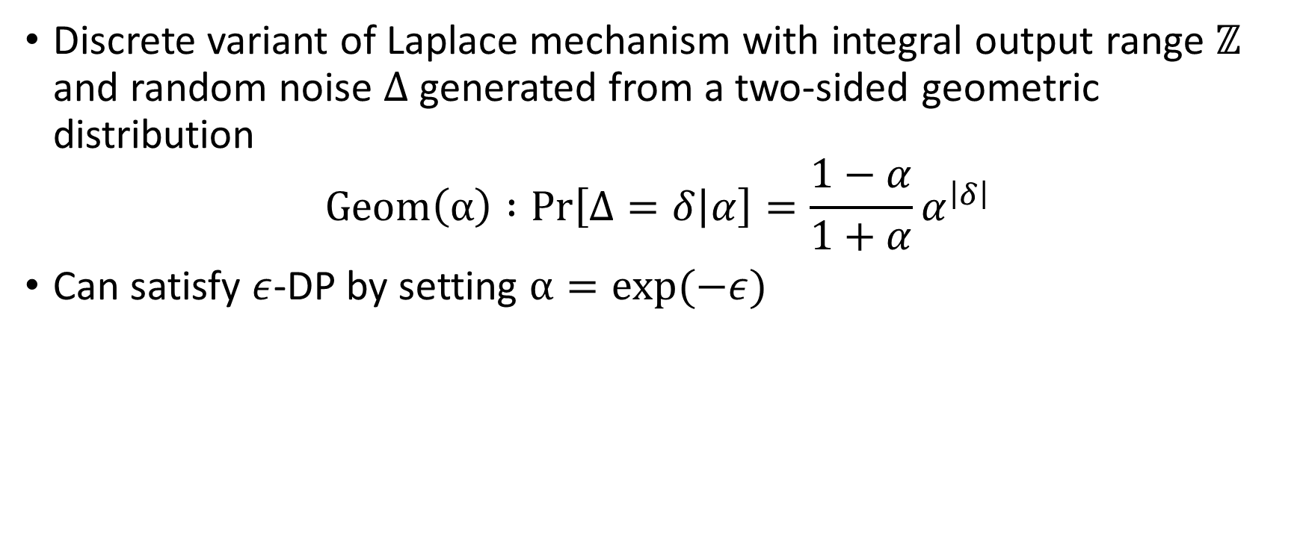
Geometric Mechanism
Discrete variant of Laplace mechanism with integral output range $ℤ$ and random noise $Δ$ generated from a two-sided geometric distribution
$$Geom\left(α\right) :Pr\left[Δ=δ | α\right]=\frac{1−α}{1+α}α^{\left|δ\right|}$$
Can satisfy $ε$-DP by setting $α=exp(−ε)$

Slide 9

Important elements of Differential Privacy
Privacy Budget : Inverse to sensitivity. A budget associated for each for each query and effectively limits how many operations can be done on the query before it is no longer considered anonymous
Noise Distribution : some mechanism like Laplacian or Geometrical is typically used
Global Sensitivity : A measure of differential privacy
$Δf=\max_{G_{1},G_{2}}{\left\|f\left(G_{1}\right)−f(G_{2})\right\|}_{1}$

Slide 10
Two Main Algorithms
Louvain Method
Input Perturbation
ModDivisive
Algorithm Perturbation

Slide 11
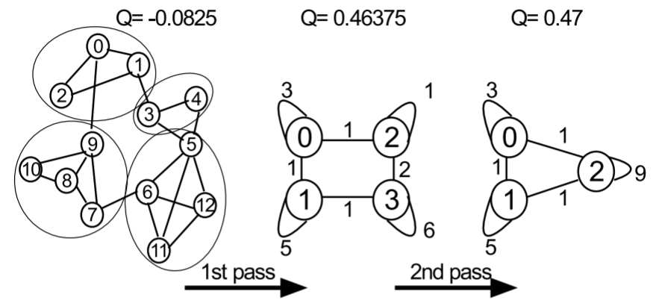
Louvain Method

Slide 12
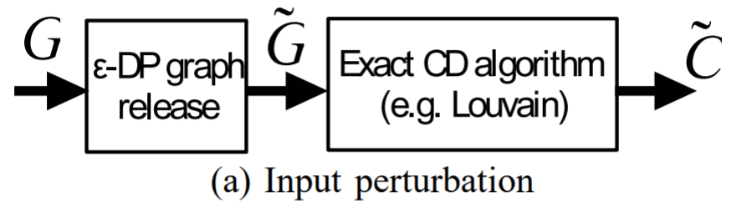
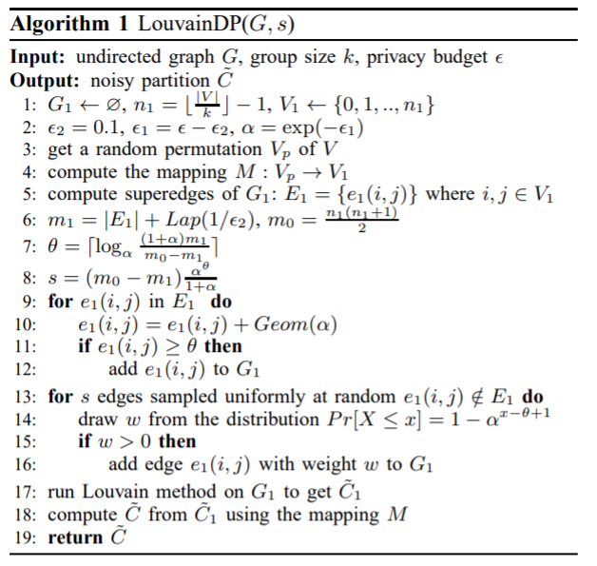
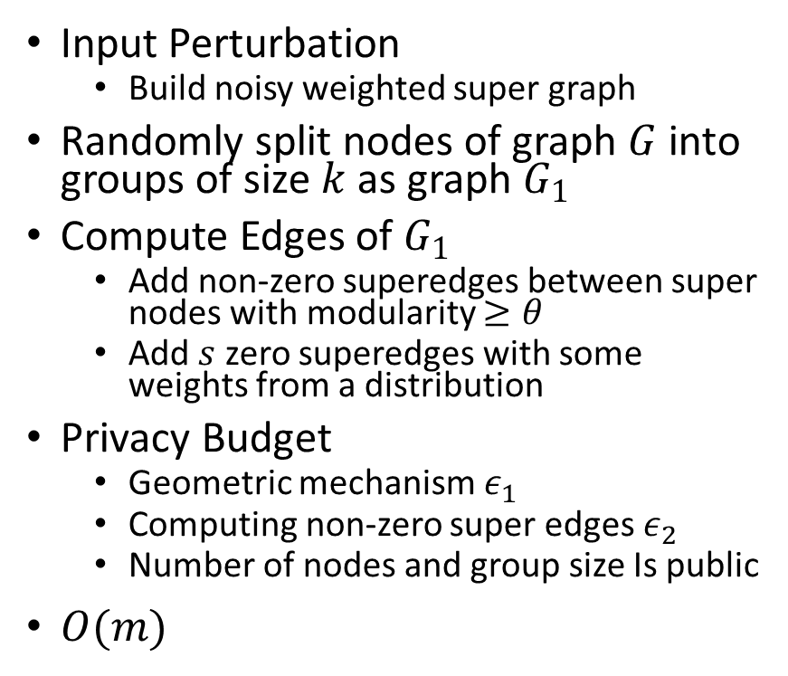
LouvainDP
Input Perturbation
Build noisy weighted super graph
Randomly split nodes of graph $G$ into groups of size $k$ as graph $G_{1}$
Compute Edges of $G_{1}$
Add non-zero superedges between super nodes with modularity $≥θ$
Add $s$ zero superedges with some weights from a distribution
Privacy Budget
Geometric mechanism $ε_{1}$
Computing non-zero super edges $ε_{2}$
Number of nodes and group size Is public
$O(m)$

Slide 13
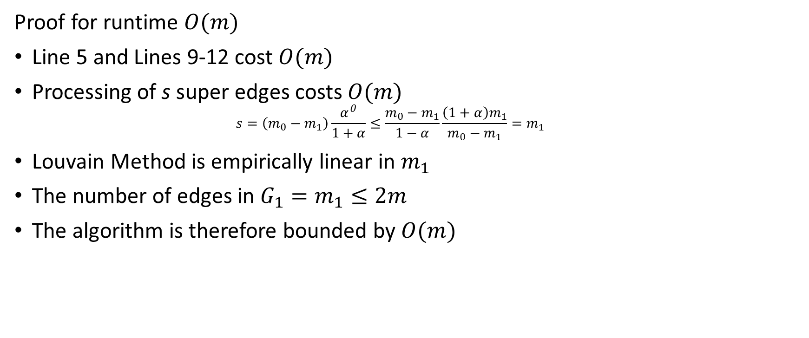
LouvainDP Runtime
Proof for runtime $O(m)$
Line 5 and Lines 9-12 cost $O(m)$
Processing of s super edges costs $O(m)$
$$s=\left(m_{0}−m_{1}\right)\frac{α^{θ}}{1+α}≤\frac{m_{0}−m_{1}}{1−α}\frac{\left(1+α\right)m_{1}}{m_{0}−m_{1}}=m_{1}$$
Louvain Method is empirically linear in $m_{1}$
The number of edges in $G_{1}=m_{1}≤2m$
The algorithm is therefore bounded by $O(m)$

Slide 14
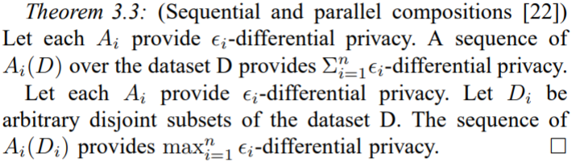
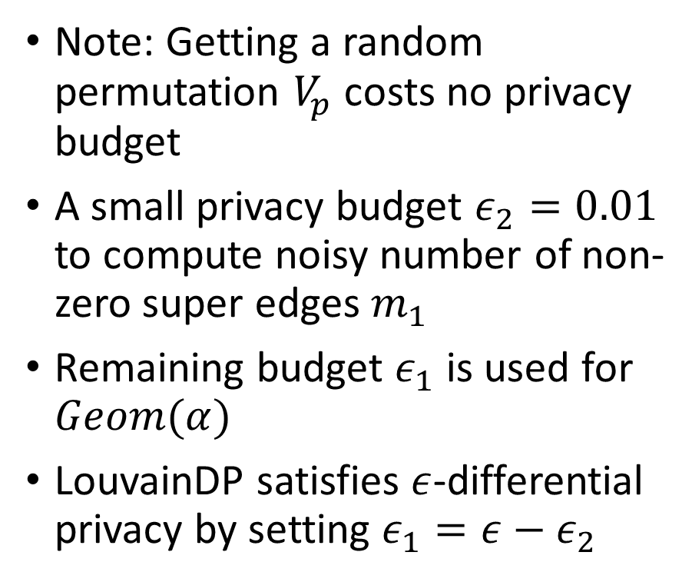
Proof of Privacy
Note: Getting a random permutation $V_{p}$ costs no privacy budget
A small privacy budget $ε_{2}=0.01$ to compute noisy number of non-zero super edges $m_{1}$
Remaining budget $ε_{1}$ is used for $Geom(α)$
LouvainDP satisfies $ε$-differential privacy by setting ${ε_{1}=ε−ε}_{2}$

Slide 15
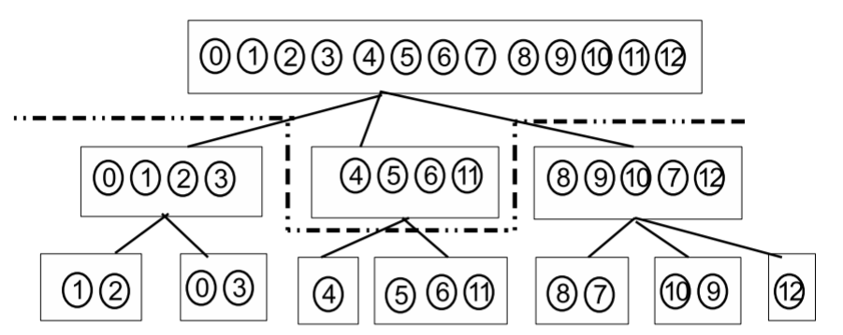
ModDivisive

Slide 16
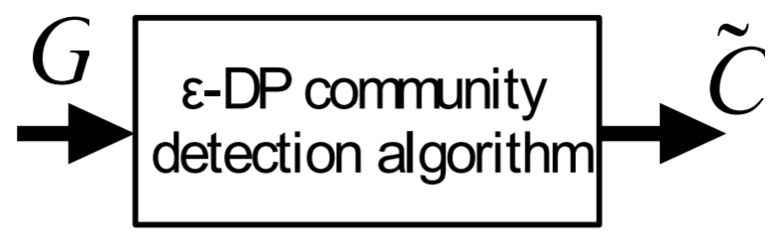
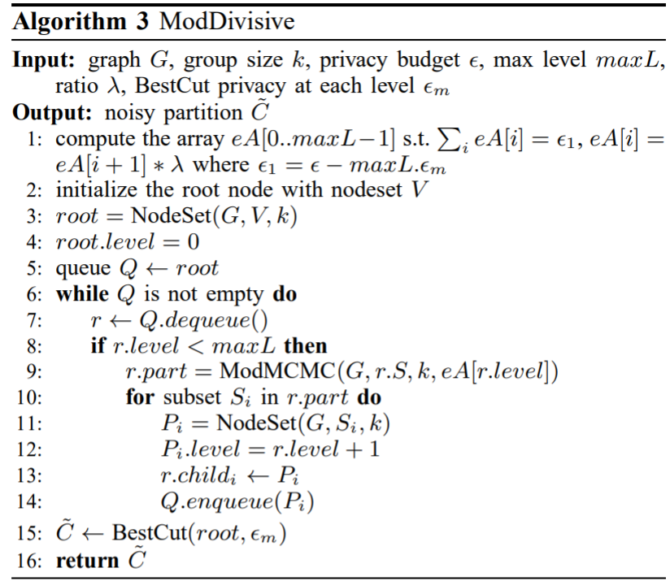
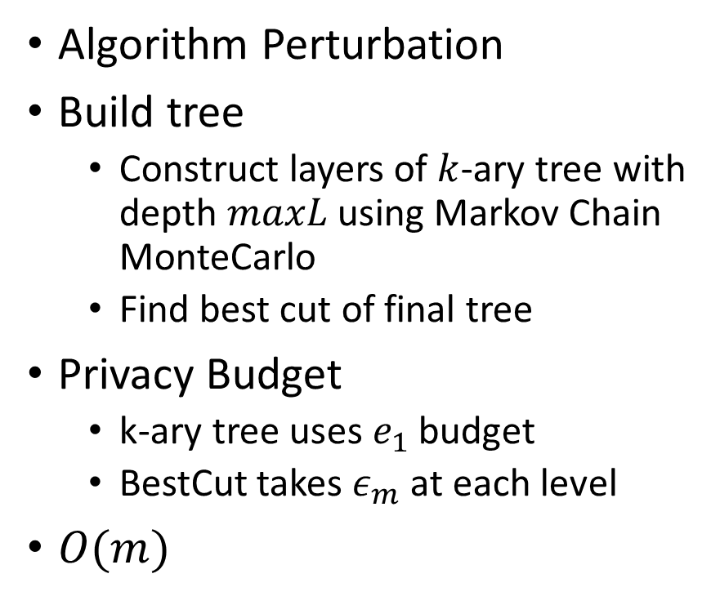
ModDivisive
Algorithm Perturbation
Build tree
Construct layers of $k$-ary tree with depth $maxL$ using Markov Chain MonteCarlo
Find best cut of final tree
Privacy Budget
k-ary tree uses $e_{1}$ budget
BestCut takes $ε_{m}$ at each level
$O(m)$

Slide 17

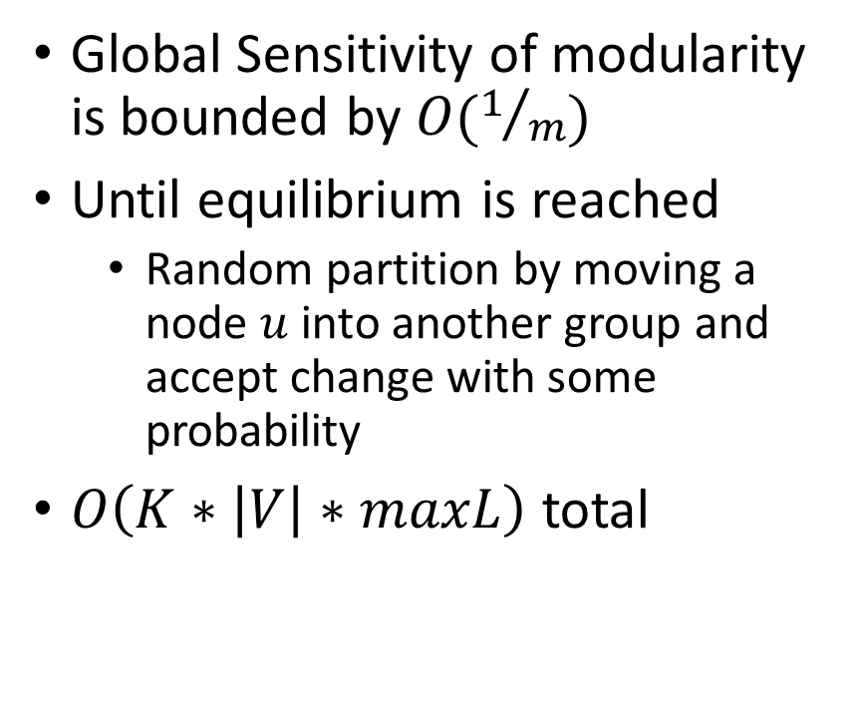
ModMCMC
Global Sensitivity of modularity is bounded by $O(1/m)$
Until equilibrium is reached
Random partition by moving a node $u$ into another group and accept change with some probability
$O\left(K∗\left|V\right|∗maxL\right)$ total

Slide 18
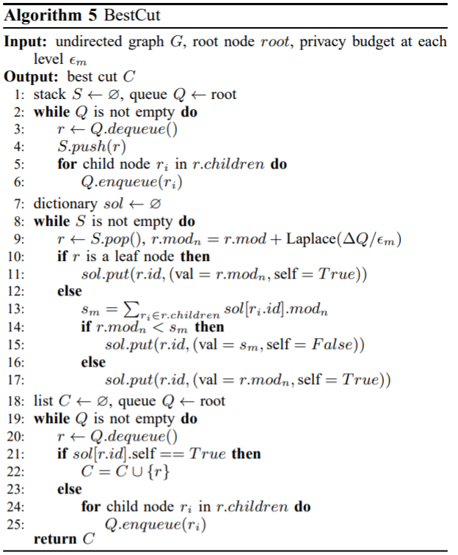
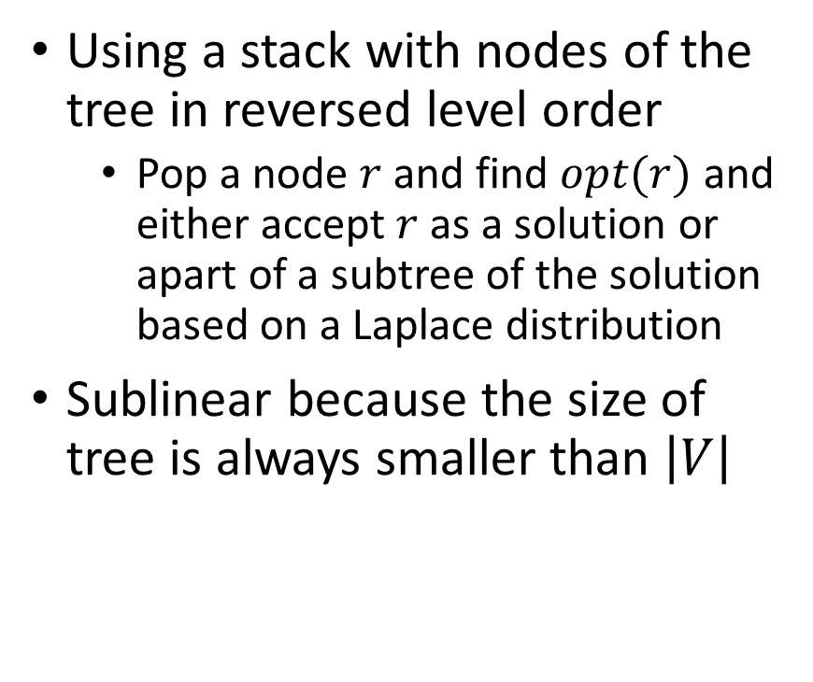
BestCut
Using a stack with nodes of the tree in reversed level order
Pop a node $r$ and find $opt(r)$ and either accept $r$ as a solution or apart of a subtree of the solution based on a Laplace distribution
Sublinear because the size of tree is always smaller than $\left|V\right|$

Slide 19
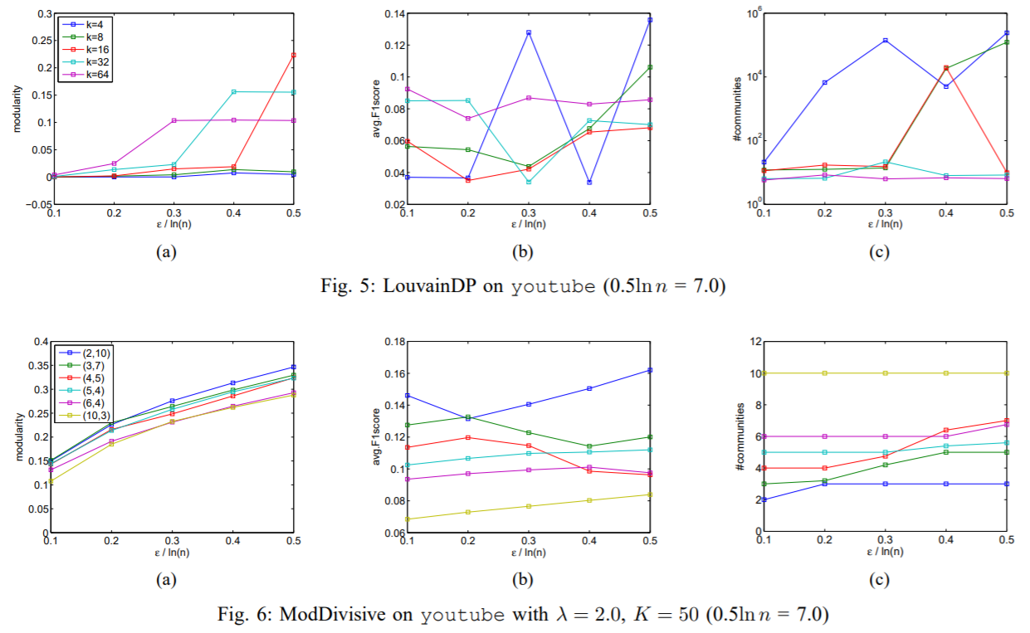
Results

Slide 20
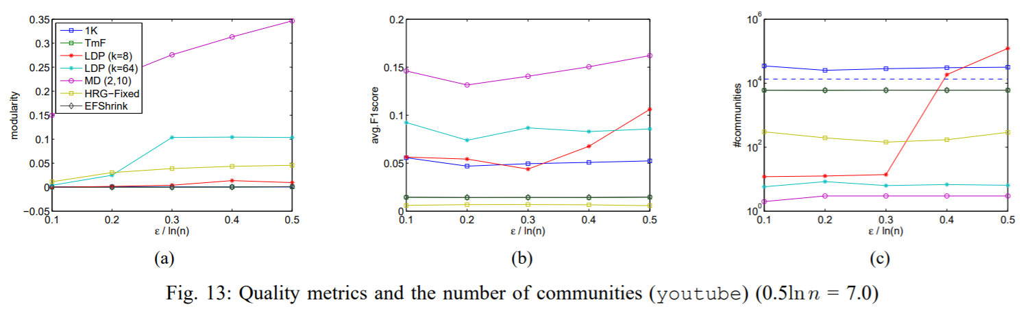
Results

Slide 21
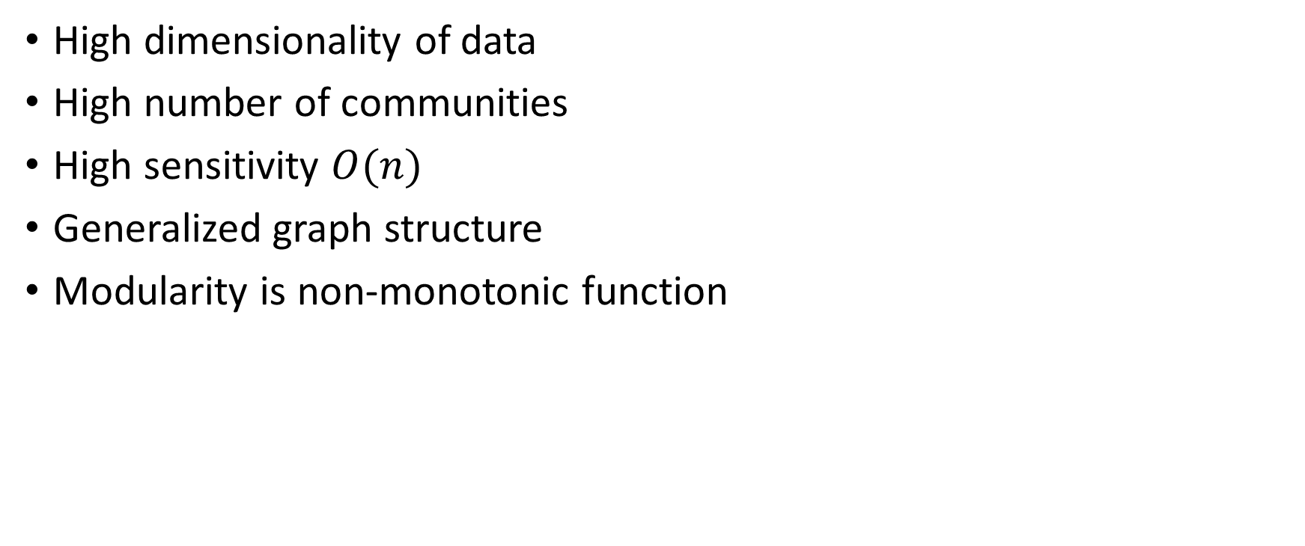
Important Challenges
High dimensionality of data
High number of communities
High sensitivity $O(n)$
Generalized graph structure
Modularity is non-monotonic function

Slide 22
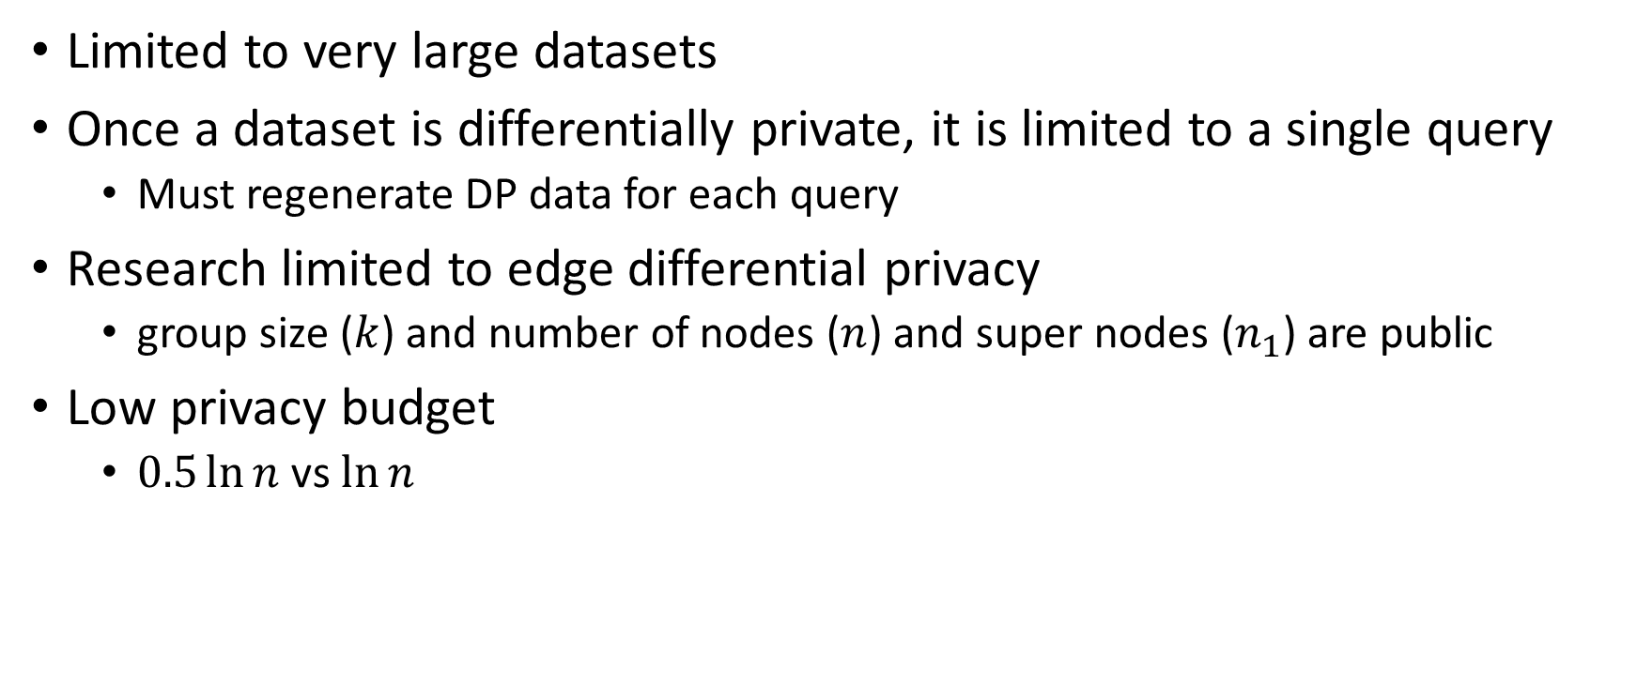
Limitations
Limited to very large datasets
Once a dataset is differentially private, it is limited to a single query
Must regenerate DP data for each query
Research limited to edge differential privacy
group size ($k$) and number of nodes ($n$) and super nodes ($n_{1}$) are public
Low privacy budget
$0.5\ln{n}$ vs $\ln{n}$

