Slide 1
Fairness in Machine Learning
On Formalizing Fairness in Prediction with Machine Learning - Gajane et al.
Avoiding Discrimination through Causal Reasoning - Kilbertus et al.
Presented by
Ankit Raj

Slide 2
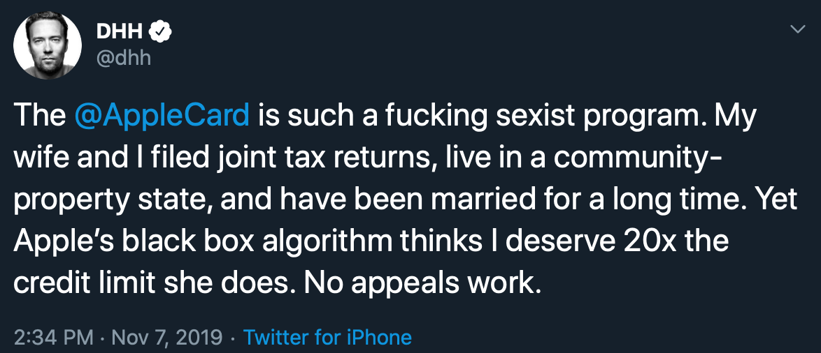
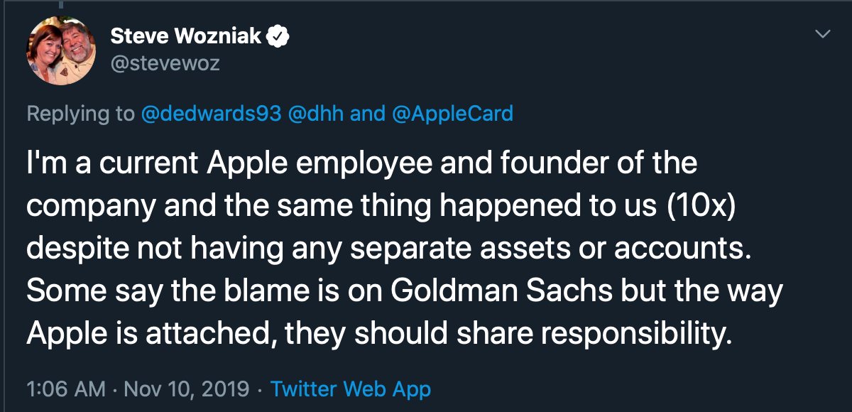
Why do we care?
Source: Tweet by DAVID HEINEMEIER HANSSON
Source: Tweet by Steve Woznaik

Slide 3
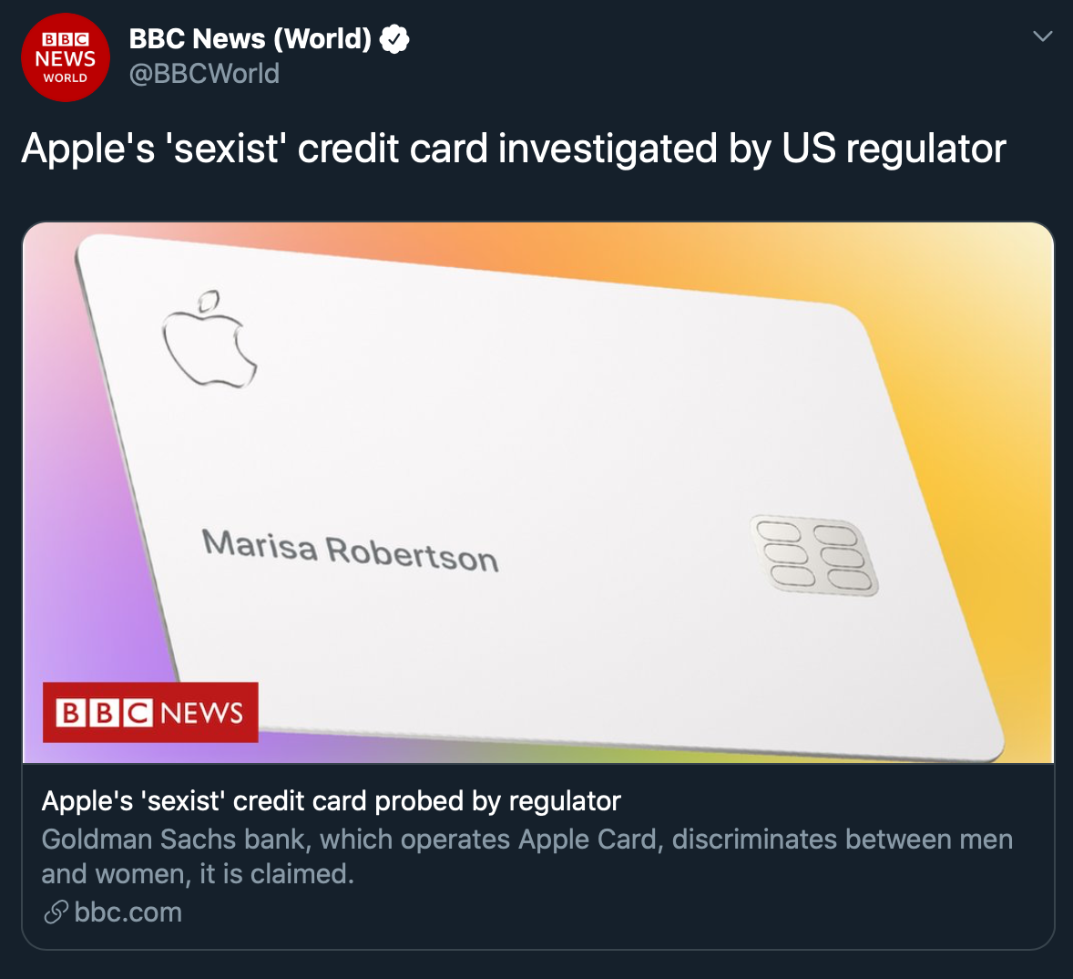
And it became viral

Slide 4
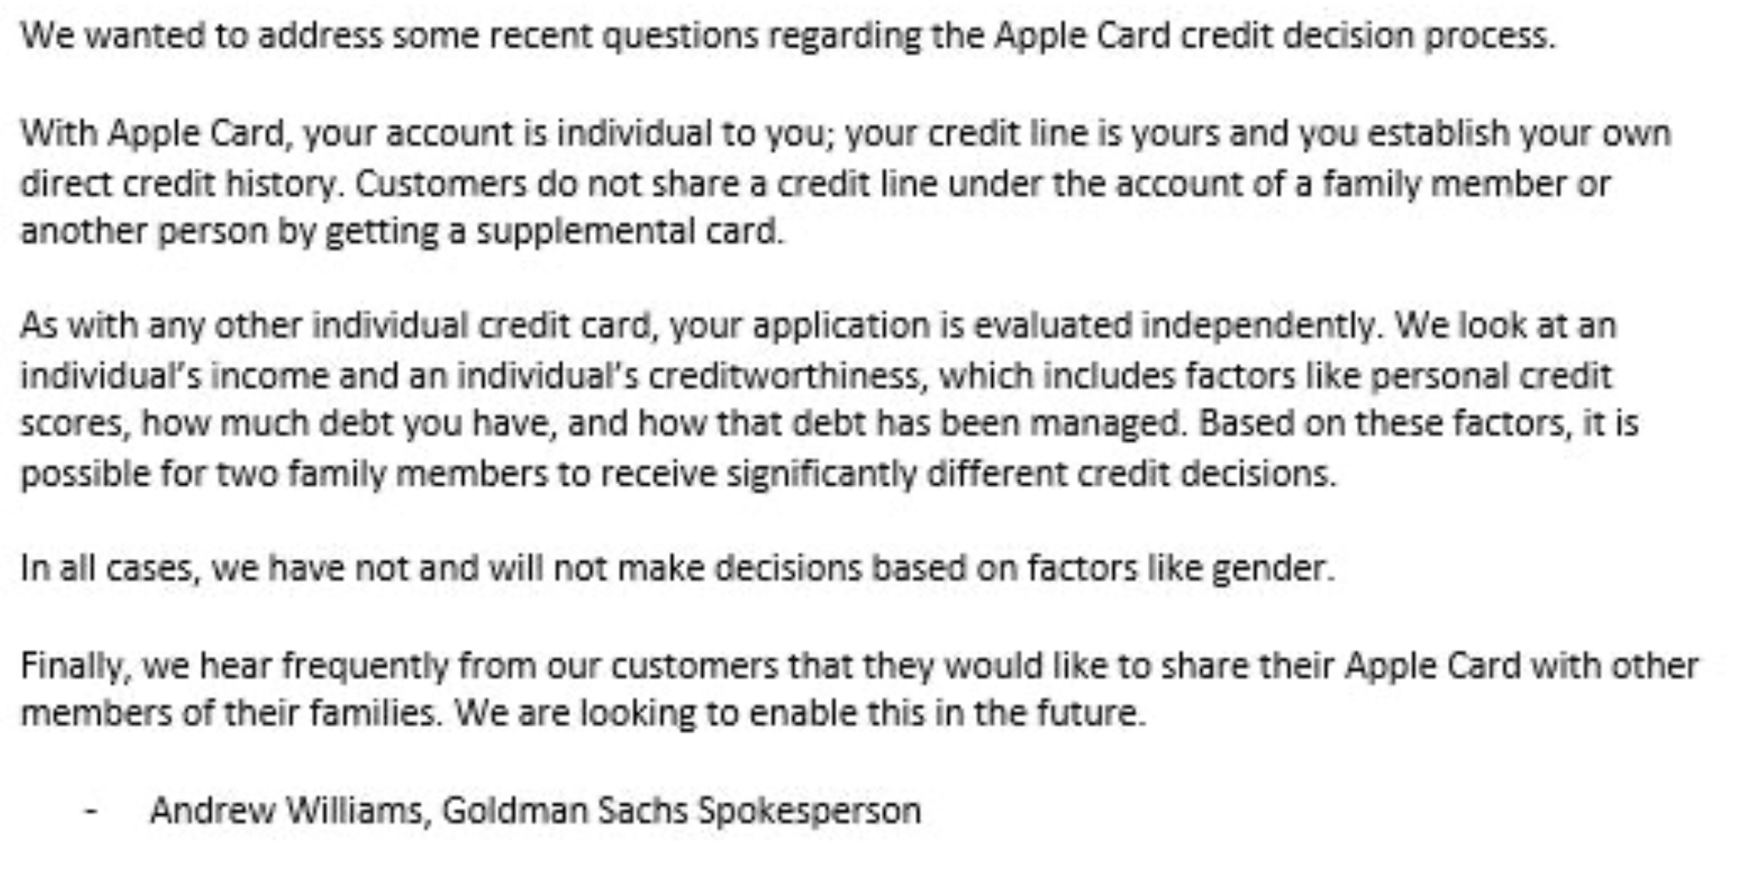
Clarification from the company

Slide 5
Definition of Fairness
Discrimination refers to unfavourable treatment of people due to the membership to certain demographic groups
Illegal to distinguish based on attributes protected by law
Legally protected domains/classes: Race, Color, Sex, Religion etc.
Fairness in a decision making implies the designing algorithms that make fair predictions devoid of discrimination

Slide 6
Why important in Machine Learning
ML increasingly being used in high-impact domains such as credit, employment, education and criminal justice
These are prone to discrimination
Can’t consider the ML algorithms be mystical
Sources of errors: sample size disparity, biases in data
ML models reflect underlying data?
Need to take steps to make these models/algorithms fair

Slide 7
But software is not free of human influence. Algorithms are written and maintained by people, and machine learning algorithms adjust what they do based on people’s behavior. As a result […] algorithms can reinforce human prejudices.
When Algorithms Discriminate by Miller [2015]

Slide 8
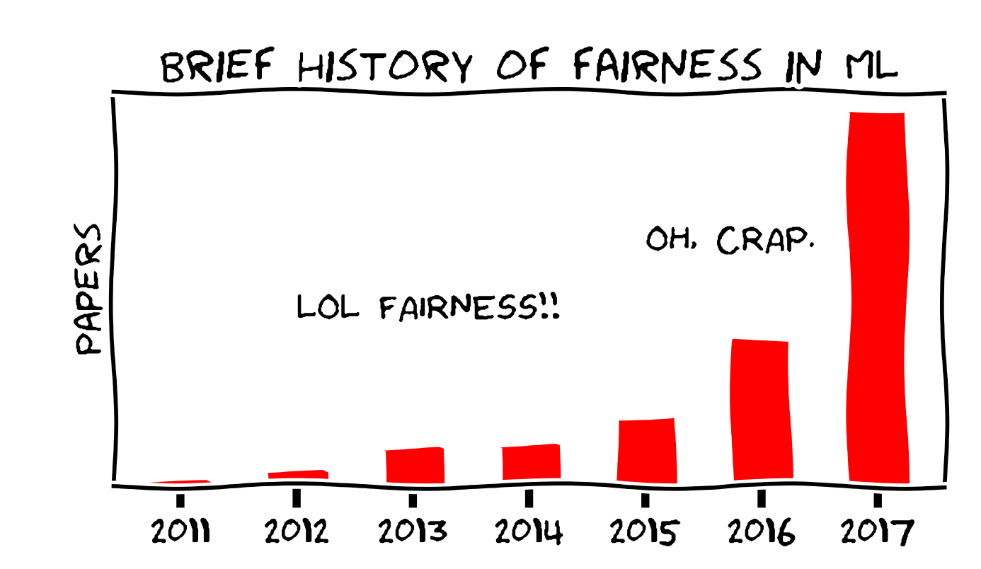
Papers on fairness - trending?
Source: https://fairmlclass.github.io/1.html#/4

Slide 9
Formalizing Fairness in Prediction with ML

Slide 10
Overview
Survey how fairness is formalized in ML
Present those formalizations with the notion of distributive justice from the social sciences literature
Critiques of those
Suggests two notions of distributive justice which address those critiques

Slide 11
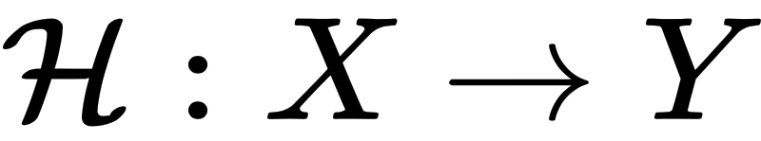
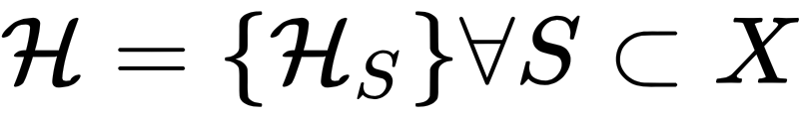
Mathematical Formulation
X: set of individuals
A: set of protected attributes (those protected by law)
Z: set of remaining attributes
Y: set of the outcomes
Individual Predictor
Group-conditional predictor consists of a set of mappings, one for each group of population

Slide 12
What is fair? Different formalizations

Slide 13
Unawareness
Protected Attributes are not explicitly used in the prediction process
ISSUE: Other non-protected attributes might have information about the protected attributes which will impact the algorithm
Distributive Justice Viewpoint: This corresponds to being “blind” to counter discrimination. It has been shown in previous study, the race-blind approach is less efficient than race-conscious approach

Slide 14

Counterfactual Measures
Predictor is counterfactually fair, if
This measure deems a predictor to be fair if its output remains the same when the protected attribute is flipped to its counterfactual value.
Compares individual with different versions of themselves
Social Sciences Viewpoint: relates with the theory of counterfactual reasoning by Lewis
ISSUES: susceptible to hindsight bias and outcome bias (i.e. evaluating the quality of a decision when its outcome is already known)

Slide 15
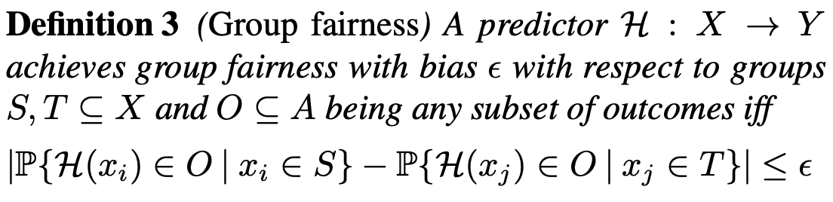
Group Fairness (Statistical/Demographic parity)
Imposes the condition that the predictor should predict a particular outcome for individuals across groups with almost equal probability.
Useful when ground truth labels not available e.g. in domains like employment, housing, credit etc.
ISSUES: When disproportionality can be justified based on non-protected attributes, it may to incorrect outcomes and may amount to discrimination against qualified candidates. Distributive Justice Viewpoint: Notion of collectivist egalitarianism -- Not meritocratic and reduces efficiency

Slide 16
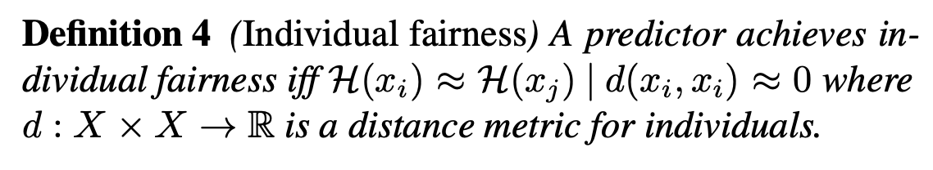

Individual Fairness
A predictor is fair in terms of individual fairness if it produces similar outputs for similar individuals
Captured by (D, d)-Lipschitz property:
ISSUES: This notion delegates the responsibility of ensuring fairness from the predictor to its distance metric. If the distance metric uses the protected attributes directly (or indirectly), the predictor (satisfying above)could still be discriminatory
Notion of individualism egalitarianism in the social sciences literature

Slide 17
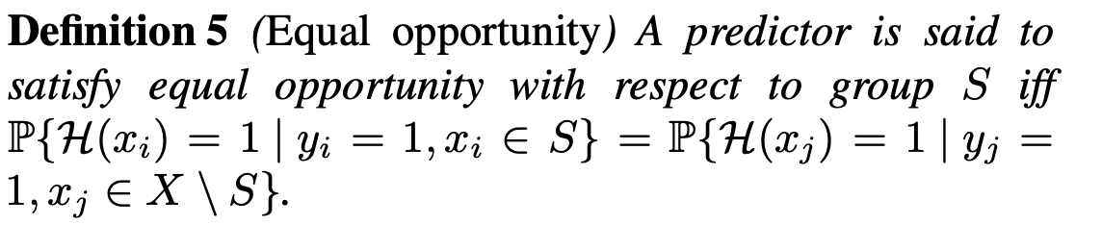
Equality of opportunity
True positive rate is same for all the groups
ISSUES: It doesn’t consider the effect of discrimination due to protected attributes like gender, race etc. which have been shown to affect individual’s life prospects

Slide 18
Preference-based fairness
So far discussed fairness imposing parity!!
Preferred treatment: A group-conditional predictor is said to satisfy preferred treatment if each group of the population receives more benefit from their respective predictor then they would have received from any other predictor
Preferred impact: A predictor is said to have preferred impact if it offers at-least as much benefit as another predictor for all the groups.
It corresponds to the notion of envy-freeness in the social sciences literature, which is neither necessary nor sufficient for fairness

Slide 19
Prospective Notion - 1
Equality of resources
Unequal distribution of social benefits is only considered fair when it results from the intentional decisions and actions of the concerned individuals
Each individual’s unchosen circumstances including the natural endowments which should be offset to achieve fairness

Slide 20
Prospective Notion - 2
Equality of capability of functioning
People should not be held responsible for attributes they had no say in to include personal attributes which cause difficulty in developing functionings
Functionings are states of “being and doing”, that is, various states of existence and activities that an individual can undertake.
Variations related to the protected attributes like age, sex, gender, race, caste give individuals unequal powers to achieve goals even when they have the same opportunities.
In order to equalize capabilities, people should be compensated for their unequal powers to convert opportunities into functionings.

Slide 21
Avoiding Discrimination through Causal Reasoning

Slide 22
Overview
Recent works on fairness depend on observational criteria
Inherent limitations that prevent them from resolving matters of fairness conclusively
This paper frames the problem of discrimination based on protected attributes in the language of causal reasoning
“What do we want to assume about our model of the causal data generating process?”
Proposes algorithms for natural causal non-discrimination criteria

Slide 23
Mathematical terminologies
R: predictor
A: protected attributes
X: features
Y: outcome
Observational fairness criteria depends on the joint distribution of R, A, X and Y. Possible to generate identical joint distribution for two scenarios with intuitively different social interpretations. Thus no observational criteria can distinguish them.
This work uses the data generating process using causality to remove discrimination

Slide 24
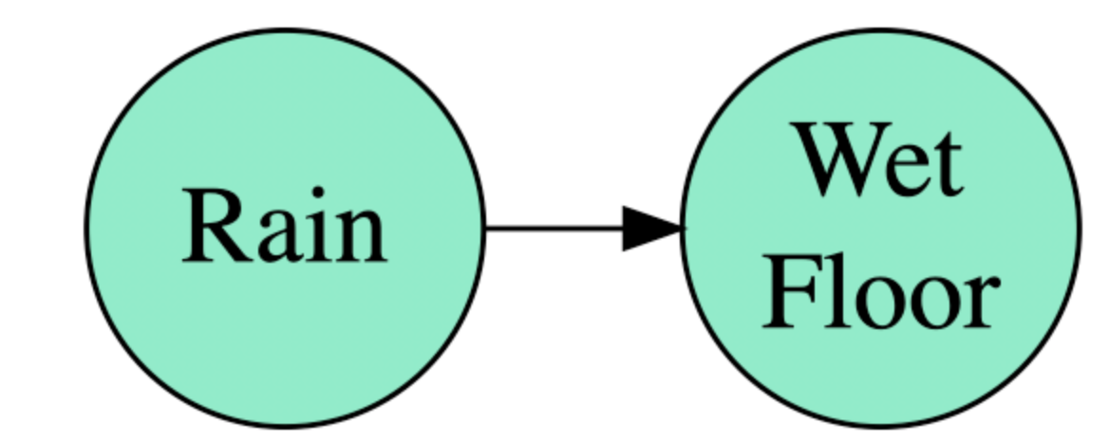
Causal graphs and notation
Cause and Effect
In this paper, causal graph is a DAG whose nodes represent random variables
A directed path is a sequence of distinct nodes V1,..., Vk
The directed path is blocked by a set of intermediate blocked nodes
Structural equation model represents the dependencies between connected nodes
These equations are interpreted as assignments
The equation model and the corresponding graph can be viewed as data generating model
The predictor R maps the inputs e.g., the features X to a predicted output

Slide 25
Unresolved Discrimination
A lower college-wide admission rate for women than for men was explained by the fact that women applied in more competitive departments
When adjusted for department choice, women experienced a slightly higher acceptance rate compared with men
What matters is the direct effect of the protected attribute (here, gender A) on the decision (here, college admission R) that cannot be ascribed to a resolving variable such as department choice X

Slide 26
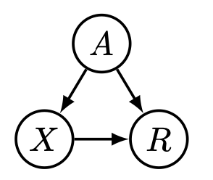
Unresolved Discrimination
Skeptic viewpoint: All paths from the protected path A to R are problematic unless they are justified by a resolving variable. The presence of unresolved discrimination in the predictor R is worrisome and should be corrected.
Naive way to solve this to consider features that do not exhibit unresolved discrimination

Slide 27
Proxy discrimination and interventions
Protected attributes, A have proxies P, such as name, visual features, languages spoken etc. in the features
In ML, one would want to separate A from its proxies
Intervention based on proxy variables poses a more manageable problem
We envision the proxy to be a clearly defined observable quantity, which is highly correlated with A, yet in our view shouldn’t affect prediction

Slide 28
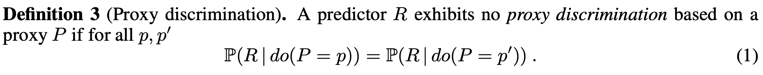
Potential proxy discrimination
Benevolent viewpoint: we allow any path from A to R unless it passes through a proxy variable P, which we consider worrisome.
Naive way to solve this to constrain the predictor to use only those features which don’t have proxy.
In the proposed approach, they aim for canceling the effect of proxies on the features that exhibit potential proxy discrimination by explicit dependencies on proxies

Slide 29
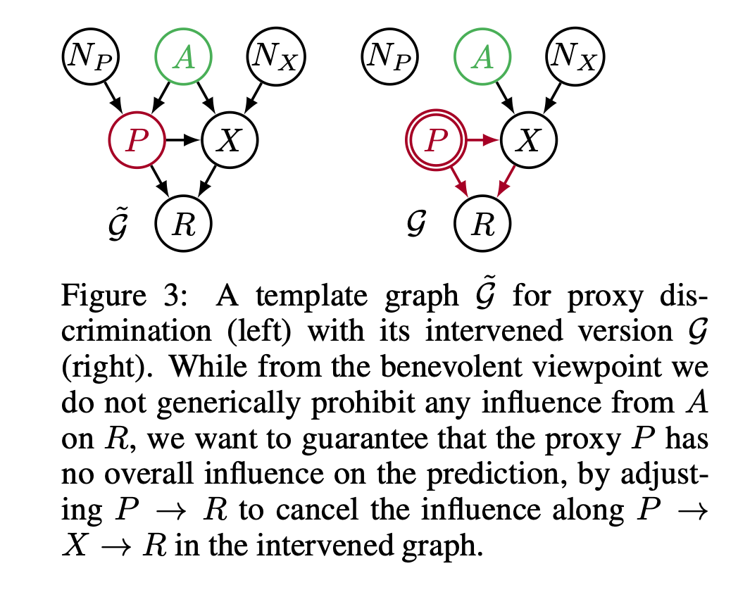
Avoiding proxy discrimination

Slide 30
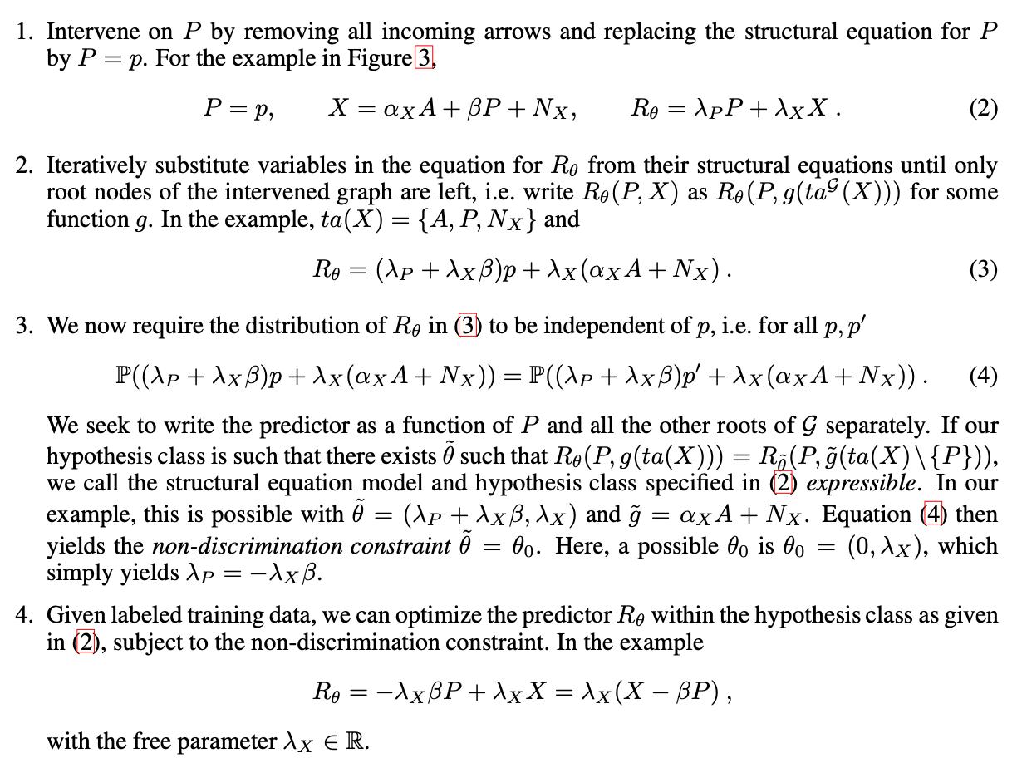
Avoiding proxy discrimination

Slide 31
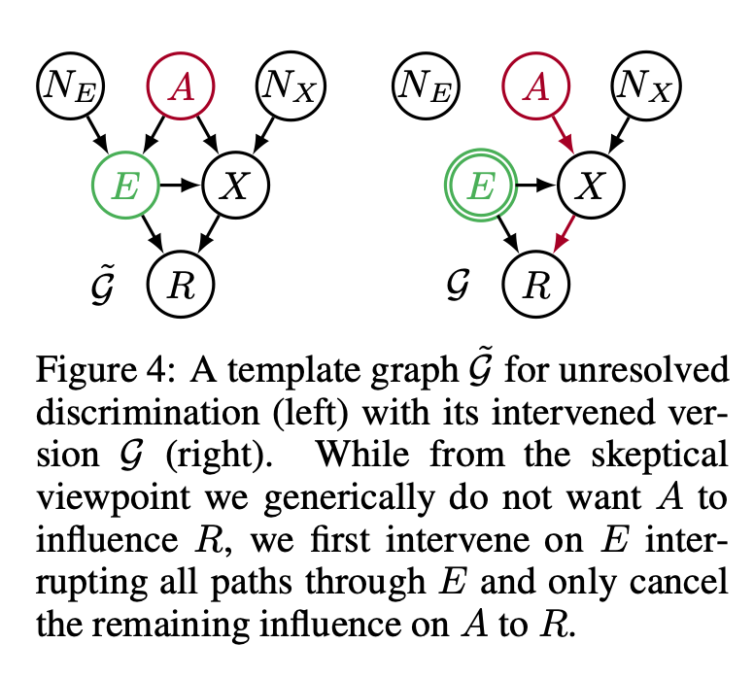
Avoiding unresolved discrimination

Slide 32
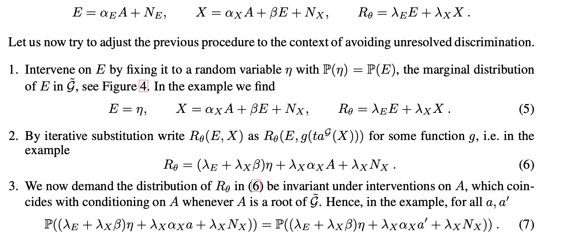
Avoiding unresolved discrimination

Slide 33
Conclusions
Key concepts of their conceptual framework are resolving variables and proxy variables
Develop a practical procedure to remove proxy discrimination given the structural equation model and analyze a similar approach for unresolved discrimination.
Framework is limited by the assumption that we can construct a valid causal graph
The causal perspective suggests a number of interesting new directions at the technical, empirical, and conceptual level

Slide 34
Thank You!

