Slide 1
Adversarial Classification
Nilesh Dalvi, Pedro Domingos, Mausam, Sumit Sanghai, Deepak Verma
Presented by, Osmar Coronel

Slide 2





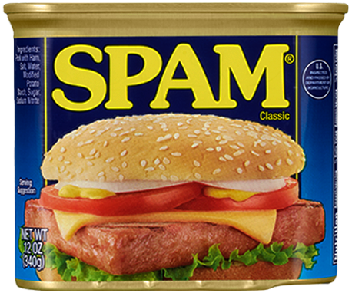

Problem Setup
Model

Slide 3
Problem Setup
Model
From:attacker@spam.xyz
Cheap Burritos!!

Slide 4
Problem Setup
Model
Cheap = 1.0
Burritos = 2.0
Threshold: 3.0 > 1.0
From:attacker@spam.xyz
Cheap Burritos!!

Slide 5

Problem Setup
Model
Cheap = 1.0
Burritos = 2.0
Threshold: 3.0 > 1.0
From:attacker@spam.xyz
Cheap Burritos!!

Slide 6
Problem Setup
Model
Cheap = 1.0
Burritos = 2.0
Eugene = -1.5
Krabs = -1.0
Threshold: 0.5 > 1.0
From:attacker@spam.xyz
Cheap Burritos!!
Eugene Krabs

Slide 7

Problem Setup
Model
Cheap = 1.0
Burritos = 2.0
Eugene = -1.5
Krabs = -1.0
Threshold: 0.5 > 1.0
From:attacker@spam.xyz
Cheap Burritos!!
Eugene Krabs

Slide 8
Some Definitions
Instance Space
The Classifier
Adversarial Cost
+
X2
x
-
X1
X1, X2 are features (words).
x is an instance composed of features (email).
The classifier c(x) -> {+, -}. Outputs if an instance is spam or not spam.
The adversarial cost a(x) -> R. Outputs a score on the current instance.

Slide 9
Classifier vs Adversary
Goal: Defeat adaptive Classifier
Assumptions: All parameters of both players are known to each other
Problem: Classifier adapts to Adversary.
+
-

Slide 10
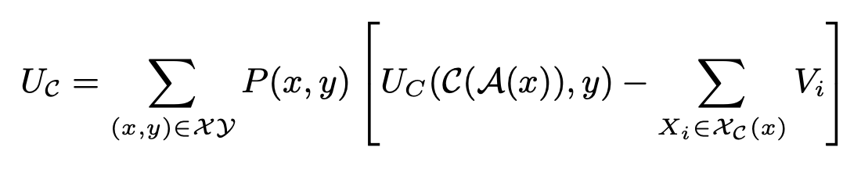
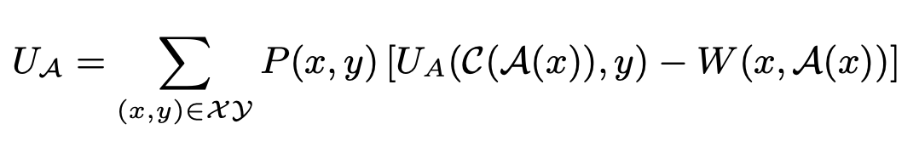
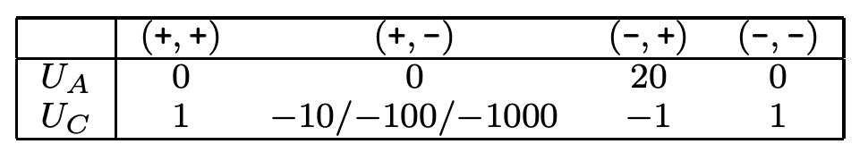
Classifier vs Adversary
Uc(yc, y) - Utility that classifier classifies yc as y.
Uc(+, +), Uc(-, -) > 0 ; Correct
Uc(-, +), Uc(+, -) < 0 ; Incorrect
Ua(yc, y) - Utility that Adversary gets classifier to classify yc as y
Uc(+, -) > 0 ; Correct
Uc(+, +) < 0 ; Classifier was correct
Uc(-, +), Uc(-, -) = 0 ; Dont Care
Notes:
A is optimal Adversary
C is optimal classifier
Vi is cost of viewing feature
W is cost of changing x

Slide 11
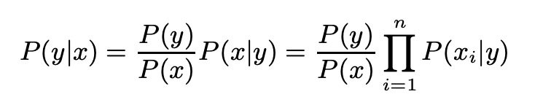
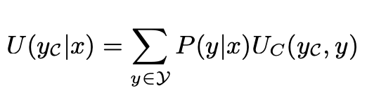
Normal Classifier
Normal classifier does not assume that the adversary will change.
We use a Naive Bayes classifier where U(yc|x) is like the Uc function shown before, but ignoring the feature lookup cost.

Slide 12
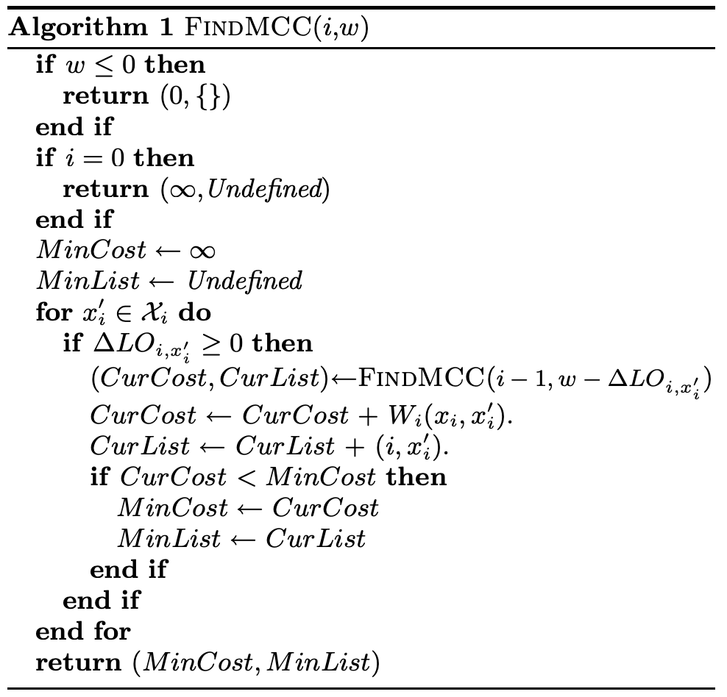

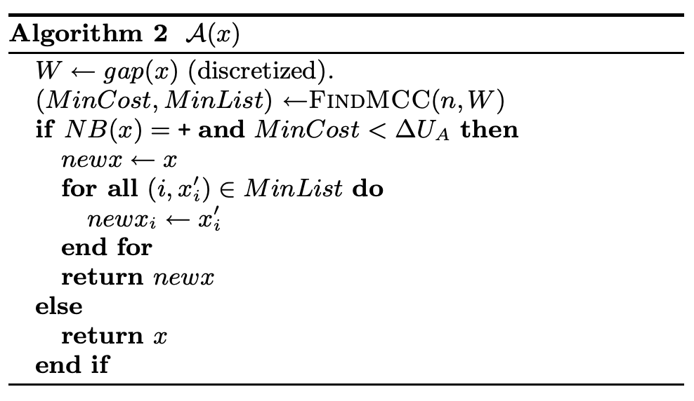
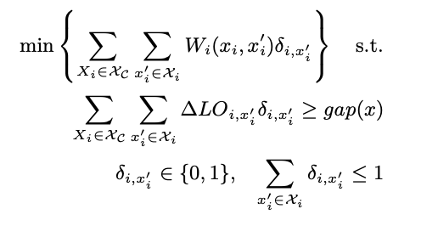

Adversary Strategy
Classifier marks spam if
LO=

Slide 13

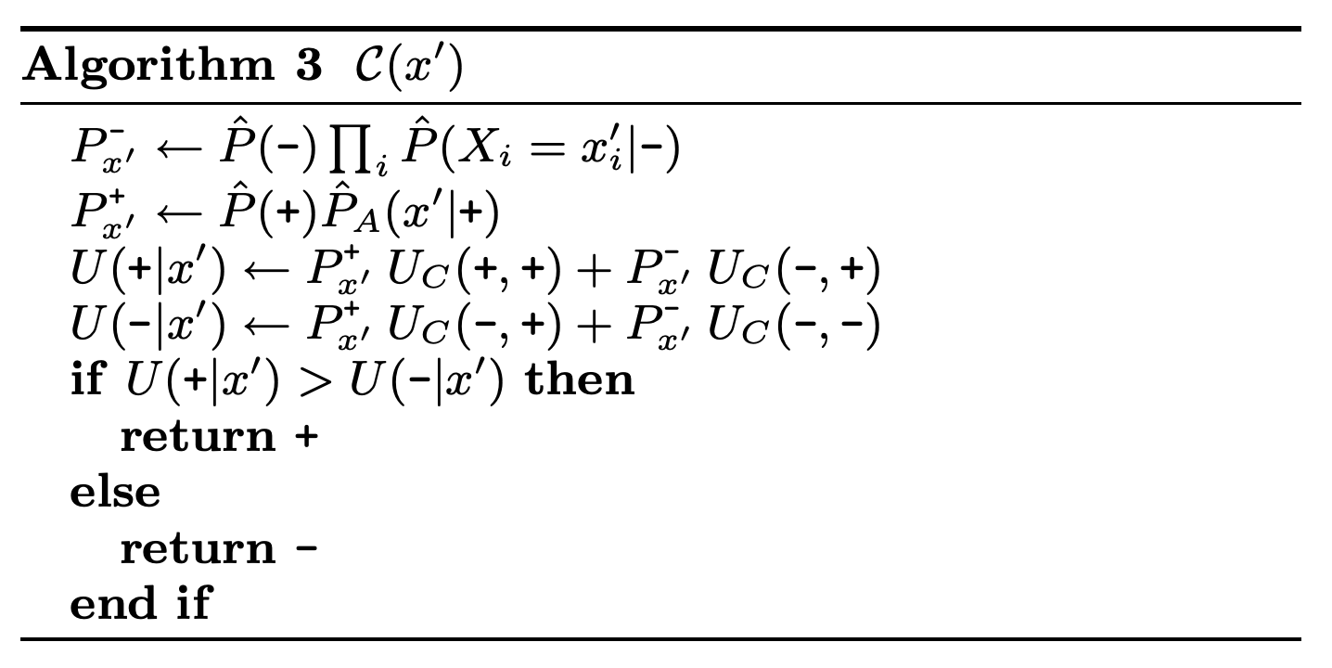
Adversarial Classifier
Has all the information that the adversary has.
Knows the adversary is constantly changing.

Slide 14
Adversary Scenarios
Datasets:
Ling-Spam - 2412 non-spam emails and 481 spam emails.
Email-Data - 642 non-spam emails and 789 spam emails.
Adversary Costs:
Add word - Every word added increases the cost of the email. The message the spammer haas does not change.
Add Length - Similar to Add word but now the cost increases with the length added (Each character).
Synonym - Words in the spammer's email get changed by their synonyms at a unit cost.

Slide 15
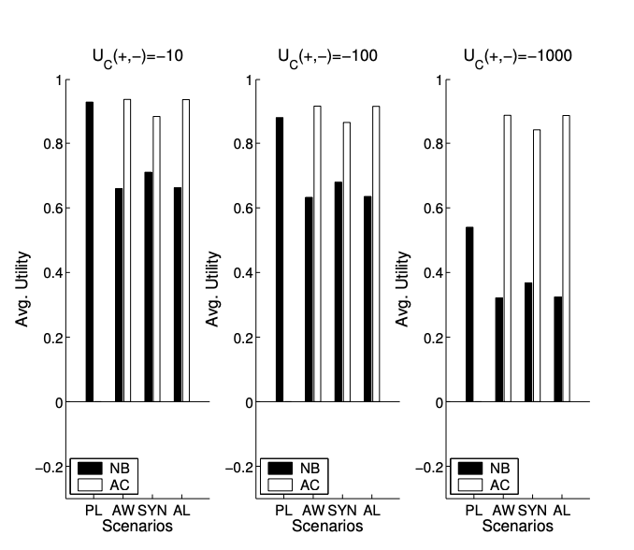
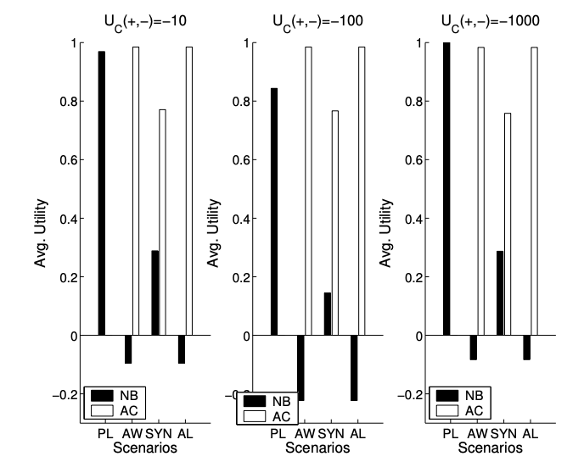
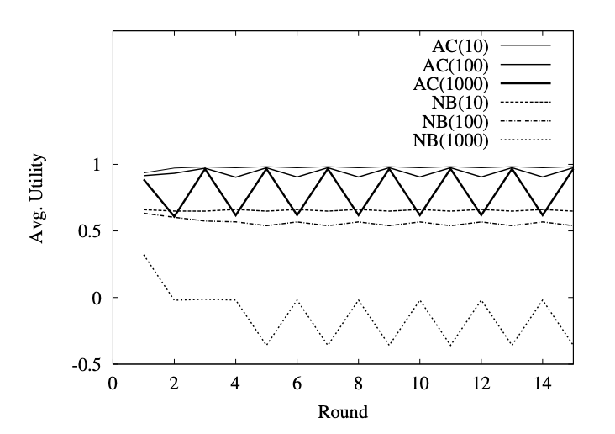
Results
Ling-Spam AW
Ling-Spam
Email-Data

Slide 16
Adversarial Machine Learning
Daniel Lowd, Christopher Meek
Presented by, Osmar Coronel

Slide 17
Reverse Engineer the Classifier
Goal: Assess Classifier Vulnerability
Adversary's Task: Minimize a(x) subject to c(x) = -
Problem: c(x) is unknown.
+
-

Slide 18
Adversarial Classification Reverse Engineering (ACRE)
Task: Minimize a(x) subject to c(x) = -
Given:
* a(x) known.
* Two instances, - and +.
* A polynomial number of queries.
+
-

Slide 19

Adversarial Classification Reverse Engineering (ACRE)
The minimal adversarial cost
The instances of minimal adversarial cost
The instances who's cost are a factor of k.

Slide 20
ACRE on Boolean Formulae
Task: modify x so that c(x) = -, where c(x) = (¬x2 ∧ ¬x4) but we do not know that
Given:
* x = (F, F, T, F) = <x1, x2, x3, x4>
Solution:
* x' = (T, F, T, F)
* c(x') = +
* guess = ¬x1 ∧ ¬x2 ∧ x3 ∧ ¬x4

Slide 21
ACRE on Boolean Formulae
Task: modify x so that c(x) = -, where c(x) = (¬x2 ∧ ¬x4) but we do not know that
Given:
* x = (F, F, T, F) = <x1, x2, x3, x4>
Solution:
* x' = (F, T, T, F)
* c(x') = -
* guess = ¬x2 ∧ x3 ∧ ¬x4

Slide 22
ACRE on Boolean Formulae
Task: modify x so that c(x) = -, where c(x) = (¬x2 ∧ ¬x4) but we do not know that
Given:
* x = (F, F, T, F) = <x1, x2, x3, x4>
Solution:
* x' = (F, F, F, F)
* c(x') = +
* guess = ¬x2 ∧ x3 ∧ ¬x4

Slide 23
ACRE on Boolean Formulae
Task: modify x so that c(x) = -, where c(x) = (¬x2 ∧ ¬x4) but we do not know that
Given:
* x = (F, F, T, F) = <x1, x2, x3, x4>
Solution:
* x' = (F, F, T, T)
* c(x') = -
* guess = ¬x2 ∧ ¬x4

Slide 24
ACRE on Boolean Formulae
Conclusion:
* Too simple or can become too complex O(n^k) to go from x to x.
* Therefore classifier is not ACRE learnable under most interesting adversarial cost functions.

Slide 25
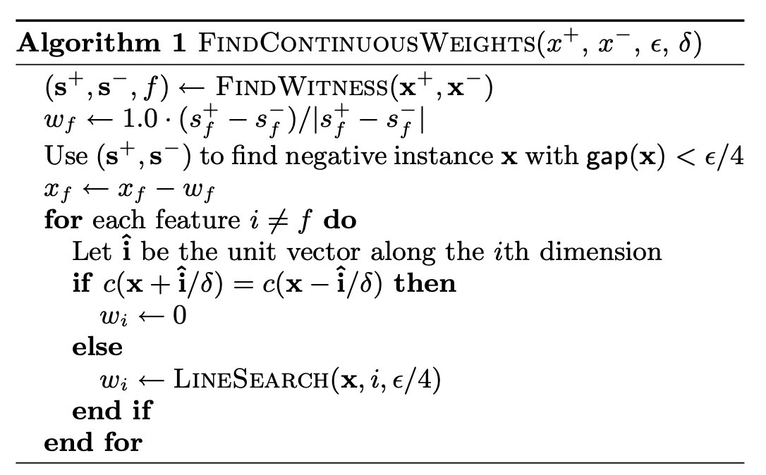
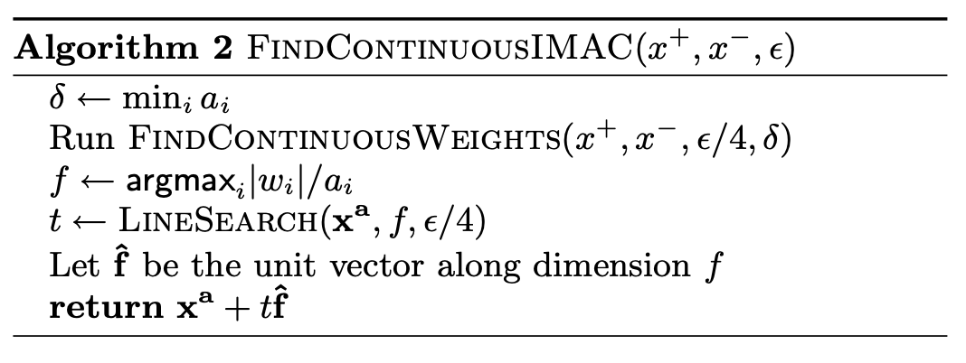
ACRE on Linear Classifier (Continuous)
Solution:
Using line searches of the features with the highest cost, we can find a solution.
+
-

Slide 26
ACRE on Linear Classifier (Boolean Features)
Problem:
Line searches is NP-hard
However:
It is still 2-ACRE learnable if changes are of unit cost.
x
w1
w2
w3
w4
x

Slide 27
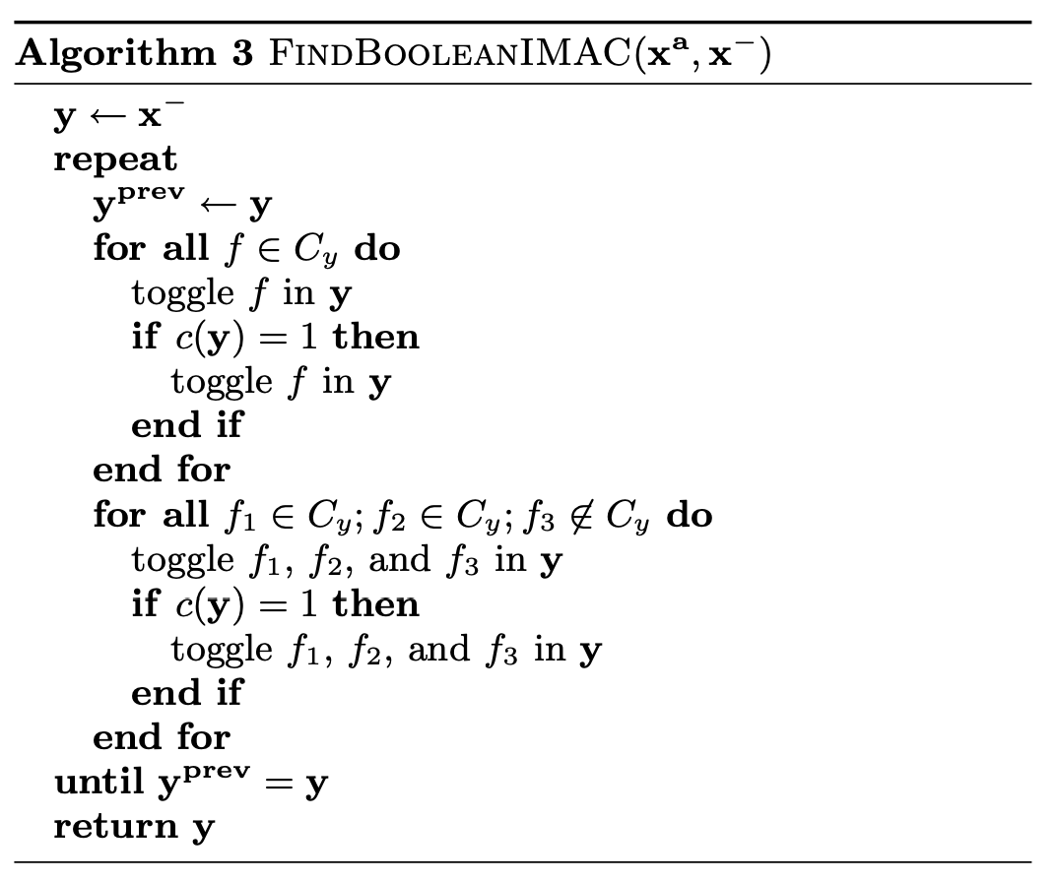
ACRE on Linear Classifier (Boolean Features)
Problem:
Line searches is NP-hard
Solution:
Using line searches of the features with the highest cost, we can find a solution.

Slide 28
Thanks!
Post feedback about set attacks in #general on Slack!

