Slide 1
Adversarial Reinforcement Learning
A Presentation by Thomas Warther
Notes:
Alright, let’s get started. Today’s lecture is about adversarial reinforcement learning.

Slide 2

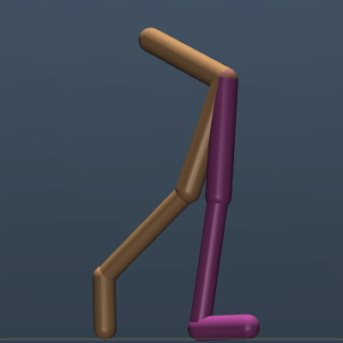

Problems Addressed by Today’s Papers
Most current RL-based approaches fail to generalize.
Data is scarce, even when policy learning is done in the real world.
The gap between simulation and the real world is large.
Robots are vulnerable to malicious intervention.
Contributions: Adversarial training approaches to improve the robustness of reinforcement learning.
Training Scenario
Test Scenario
Notes:
This means today’s papers will address the main robustness problems of reinforcement learning.
The primary robustness problem they address is that most current RL-based approaches fail to generalize.
One reason this happens is because training data is scarce, even when agents are trained in the real world. Training in the real-world is expensive, time-consuming, and potentially dangerous, so agents are usually trained in simulated environments.
But simulations introduce new problems that also make RL-based approaches fail to generalize. More precisely, the environment and physics of the simulator are not the same as the real world, so policies learned in simulations tend to fail to transfer to the real world. For example, when a robot is trained to walk, it may be trained inside a simulated environment in which the frictional coefficient with the ground matches that of a carpet. However, once the robot is deployed in the real world, it may end up in a scenario where it has to walk on ice. We would like agents to learn policies that are robust to these errors in models of the real world and generalize well to scenarios beyond training.
Another problem today’s papers, particularly the second one, address is that robots are vulnerable to malicious intervention. When a robot is deployed, a malicious adversary can try to hinder its ability to successfully complete its designated task.
Today’s papers address these problems by proposing adversarial training approaches for reinforcement learning.

Slide 3
Robust Adversarial Reinforcement Learning
Lerrel Pinto
Rahul Sukthankar
Carnegie Mellon University
Google Research
James Davidson
Abhinav Gupta
Google Brain
Carnegie Mellon University
Google Research
Notes:
Today’s first paper is “Robust Adversarial Reinforcement Learning”.

Slide 4
Approach

Slide 5
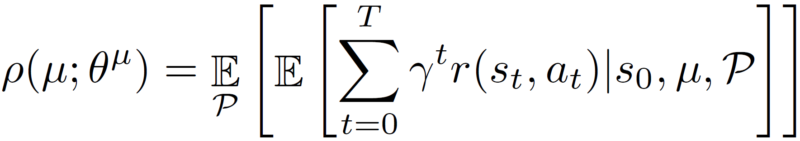
The Generalization Problem
Reinforcement learning objective
Many policies learned by optimizing the expected reward over all transition functions fail to generalize.
Optimizes mean performance
Risk neutral formulation
Assumes known distribution over model parameters
Notes:
To address the problem of generalizing training to test scenarios, this paper first assumes the transition function underlying the system will have modeling errors and that there will be differences between training and test conditions. The goal then is to learn a policy \mu parameterized by \theta^{\mu} that maximizes the expected cumulative reward over different possible transition functions. However, optimizing for the expected reward over all transition functions optimizes mean performance. This is a risk neutral formulation that assumes a known distribution over the model parameters. Optimizing over this formulation is problematic because it does not optimize for worst-case scenarios, so many policies learned in this way will likely fail in different environments and worst-case scenarios.

Slide 6
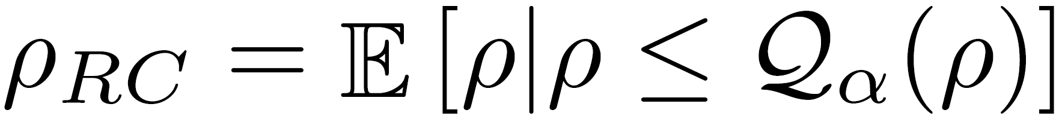
Solution: Optimize Conditional Value at Risk (CVaR)
Idea: Sample the worst possible (alpha-quantile) trajectories
Notes:
So what this paper does is optimize for the conditional value at risk (CVaR). Intuitively, the idea is to sample the trajectories during training that produce the worst possible rewards, namely the rewards in the worst alpha-quantile. This is challenging because the number of possible trajectories is large.

Slide 7
Solution: Optimize Conditional Value at Risk (CVaR)
Idea: Sample the worst possible (alpha-quantile) trajectories
How can these trajectories by tractably sampled?
Notes:
So how can these trajectories be efficiently sampled?

Slide 8

Solution: Optimize Conditional Value at Risk (CVaR)
Idea: Sample the worst possible (alpha-quantile) trajectories
How can these trajectories by tractably sampled?
Answer: Introduce an adversarial agent (i.e. adversarial training)
Notes:
The paper’s answer is to introduce an adversarial agent into the training process.
So let’s take a look at what this proposed training approach looks like.

Slide 9
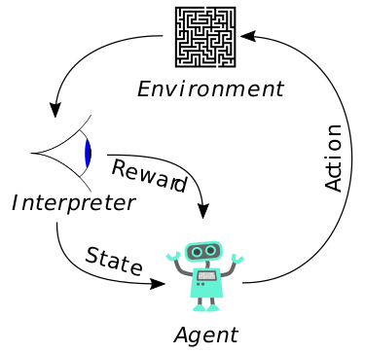
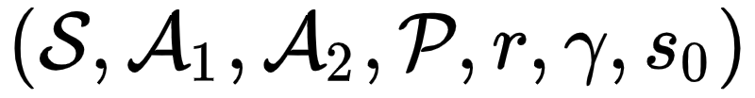
Robust Adversarial Reinforcement Learning (RARL)
Adversary’s Action Space
Protagonist’s Action Space
Two Agents
Notes:
In this adversarial training setting, there are two agents: the protagonist, which is the agent designed for the desired task, with action space A_1, and the adversary, with action space A_2. This new training setting is the main contribution of this paper, and it is called, “Robust Adversarial Reinforcement Learning,” or RARL for short.
The goal of the adversarial agent in this setting is to make the protagonist fail its task by applying...

Slide 10
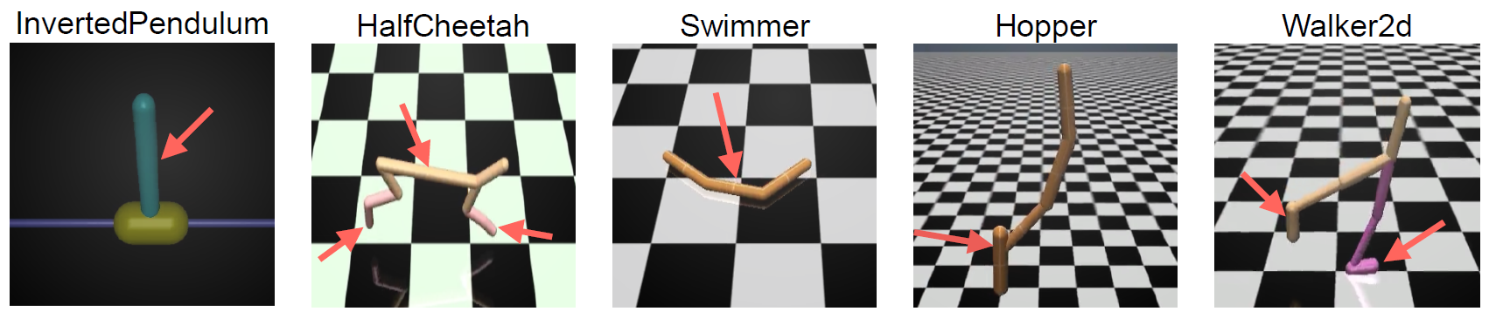
Adversarial Agents for Modeling Disturbances
The adversary applies destabilizing forces to the original agent (the “protagonist”)
Rewarded for protagonist’s failure
Learns to sample hard examples
The protagonist learns policy robust to any of the adversary’s disturbances
Notes:
...destabilizing forces to it. Through the training process, the adversary will learn to sample hard examples to make the protagonist fail at its task, and the adversary will be rewarded for succeeding. As a result, the protagonist will be exposed to the worst possible destabilizing forces and consequently learn a policy robust to the adversary’s distrubances.
For example, in the InvertedPendulum simulation, the adversary can challenge the protagonist’s attempts to keep the pendulum balanced on this cart by learning to apply the forces that most effectively cause the pendulum to fall over. Similarly, in Walker2d, the adversary can challenge the walker by learning to apply the forces most likely to make the walker fall over.
But the most powerful characteristic of this adversarial agent is...

Slide 11
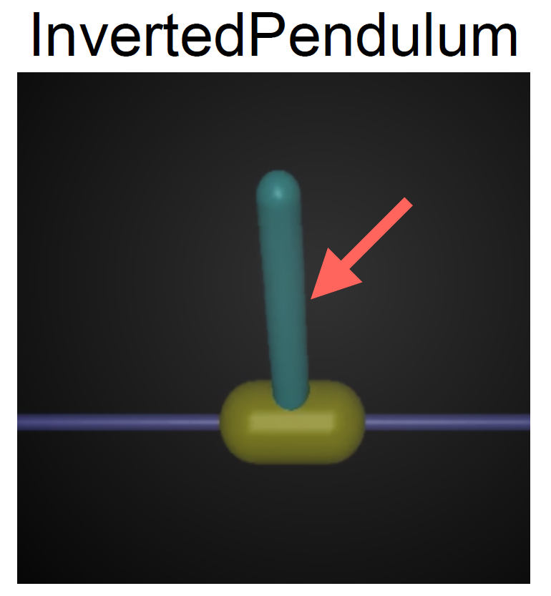
Adversaries with Domain Knowledge
Exploit domain knowledge to focus on protagonist’s weaknesses
Example: Exert 2D forces in InvertedPendulum
Can exploit simulations to have “super-powers” and affect the protagonist and environment in ways the protagonist can’t
Example: Can change physical parameters, such as frictional coefficient or mass
Notes:
...that it is not restricted to the same action space as the protagonist. The adversarial agent can be designed to exploit domain knowledge to more effectively attack the protagonist’s weaknesses. An example of this is the ability to exert 2D forces, such as this one, on the pendulum in InvertedPendulum, while the protagonist can only exert 1D forces.
In training simulations, the adversary can also exploit the fact that the environment is simulated to have “super-powers” and affect the protagonist and environment in ways that the protagonist can’t. This means the adversary can have actions in its action space to change environment parameters such as frictional coefficient and mass in the middle of a training simulation.

Slide 12
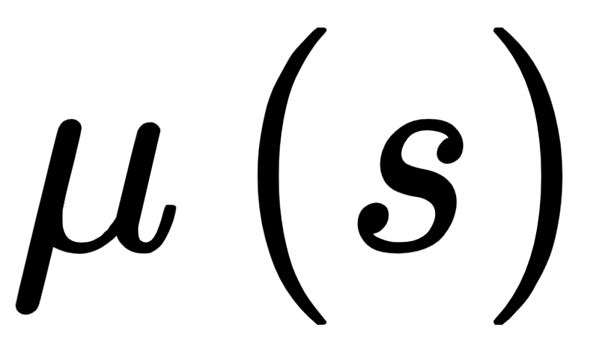
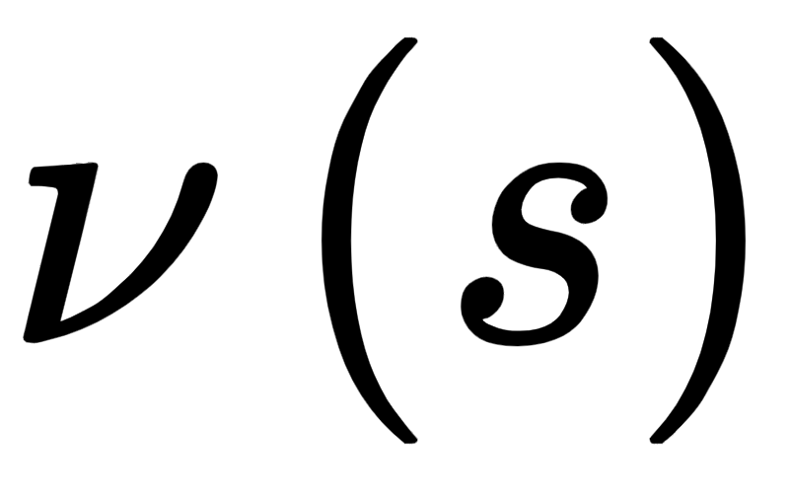
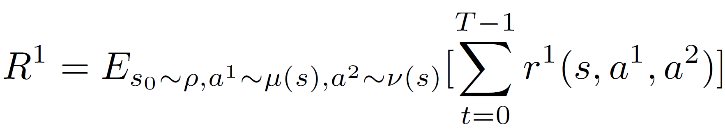
Training by Playing a Zero-Sum Markov Game
Protagonist’s Policy :
Adversary’s Policy :
Protagonist maximizes rewards against adversary.
Two Agents
Nash equilibrium is the optimal equilibrium reward.
Notes:
The training process can be modeled as a two-player, zero-sum Markov game. The protagonist’s goal is to learn a policy \mu(s) to maximize its cumulative rewards R^1 given the adversary’s policy \nu(s) [gesture to minimax equation]. The adversary’s goal is to learn a \nu(s) that minimizes the protagonist’s cumulative rewards given \mu(s) [gesture to minimax equation]. This means the protagonist and antagonist have these minimax objective functions. Training converges when the protagonist and adversary have learned the Nash equilibria policies. In this game, Nash equilibrium is equivalent to the optimal equilibrium reward, so the agents will have learned their optimal policies when Nash equilibrium is reached.

Slide 13
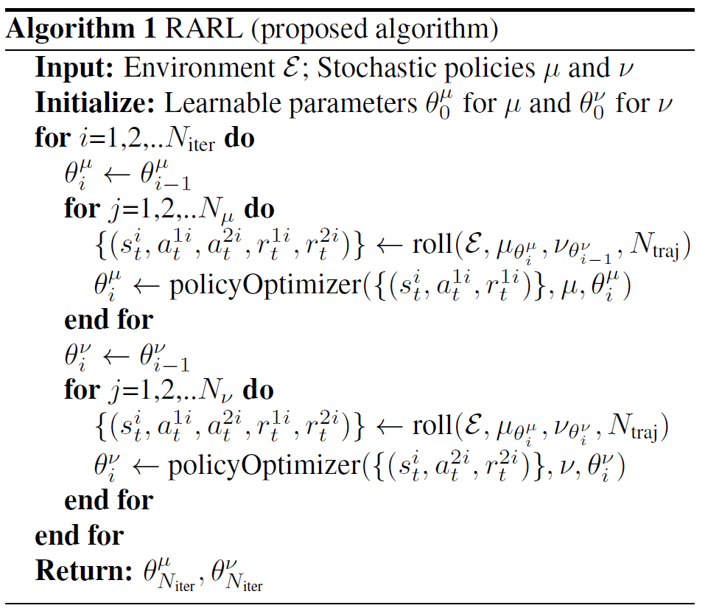
RARL Algorithm
Notes:
Here is the Robust Adversarial Reinforcement Learning algorithm.

Slide 14
RARL Algorithm
Protagonist
Adversary
Notes:
When reading this algorithm and the paper in general, note that any symbol containing \mu or a superscript of 1 corresponds to the protagonist and any symbol containing \nu or a superscript of 2 corresponds to the adversary.

Slide 15

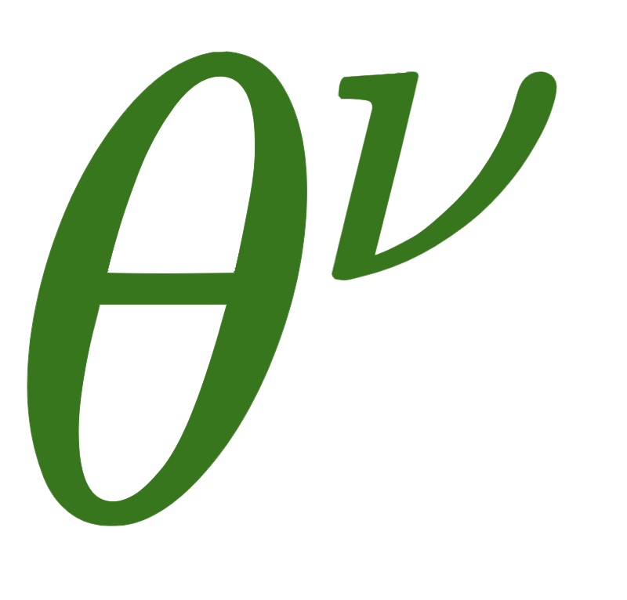
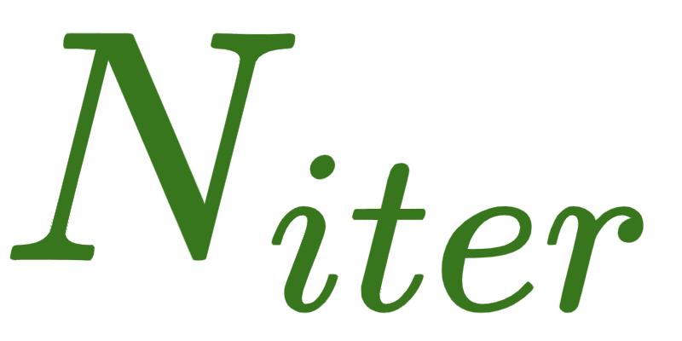
RARL Algorithm
Alternate optimization of and
iterations
Notes:
This algorithm trains both the protagonist and the adversary over multiple iterations, alternating updates to each agent’s policy.

Slide 16
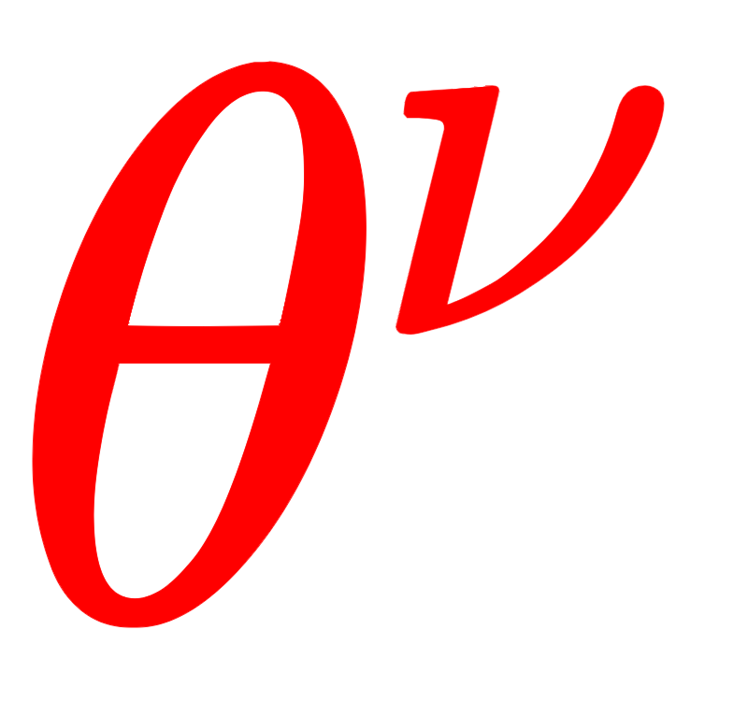
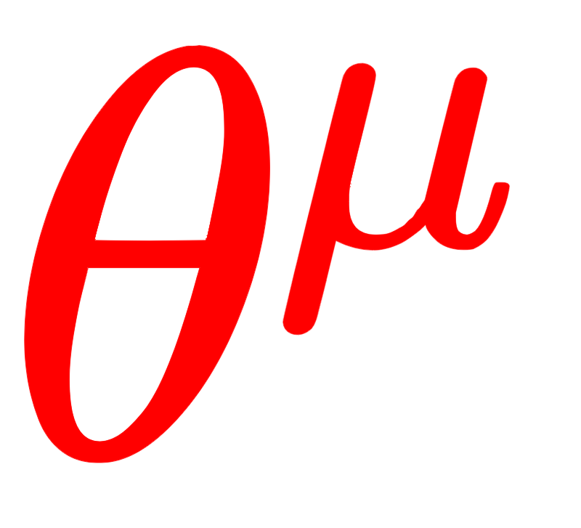
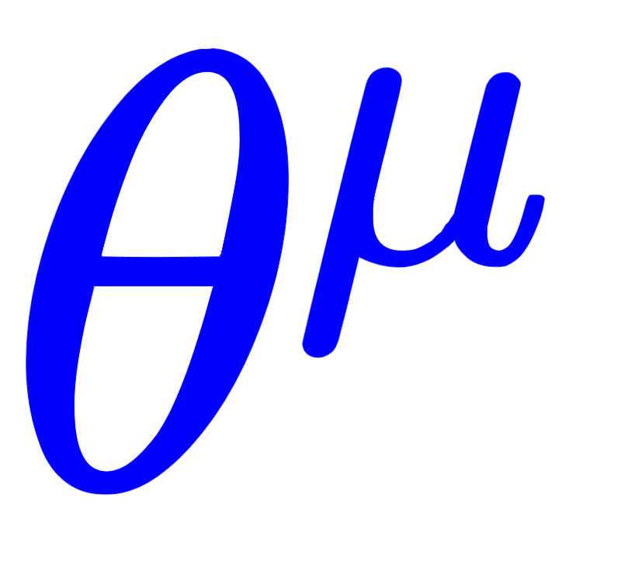
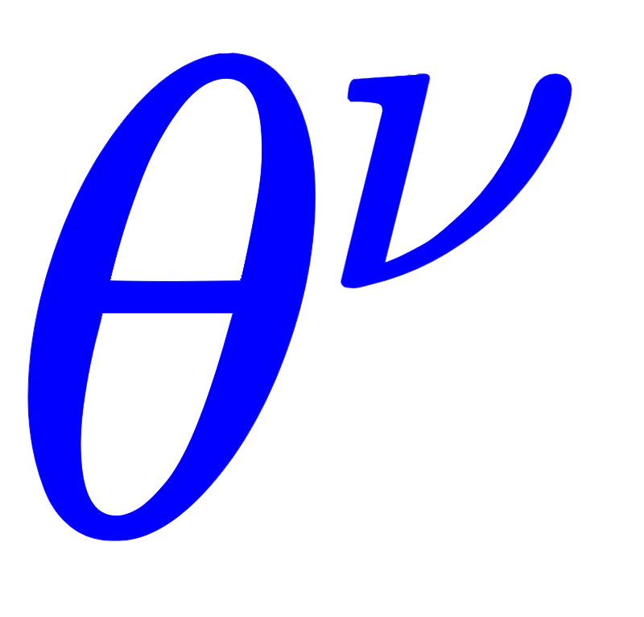
RARL Algorithm
Fix
Optimize
Fix
Optimize
Notes:
Within each iteration, the protagonist’s policy is first optimized while the adversary’s policy is held constant, then the adversary’s policy is optimized while the protagonist’s policy is held constant.

Slide 17
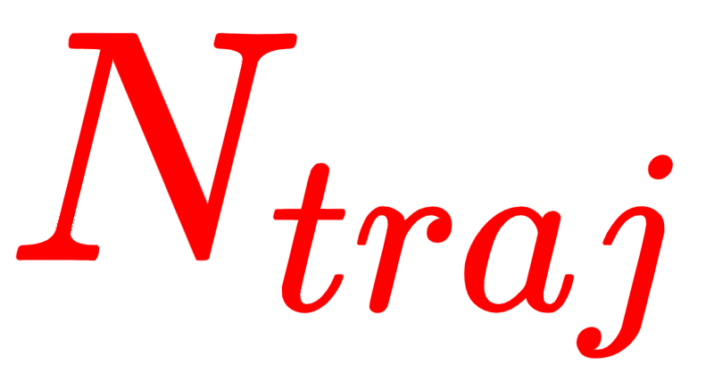
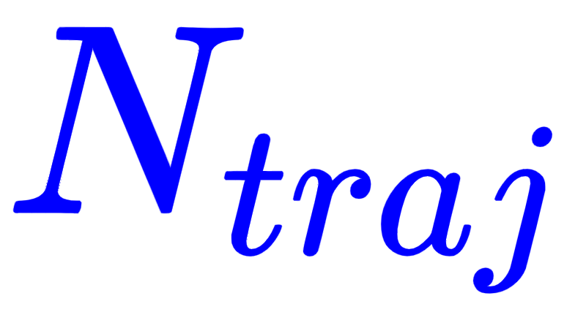
RARL Algorithm
Sample
trajectories with current policies
Sample
trajectories with current policies
Notes:
Within each iteration of policy optimization, N_traj trajectories are sampled with the current policies...

Slide 18
RARL Algorithm
Optimize
with
trajectories
Optimize
with
trajectories
Notes:
...then the appropriate policy is optimized with those trajectories. Notice that all trajectories contain the actions and rewards for both the protagonist and the adversary, but we only use the actions and rewards corresponding the agent whose policy is currently being optimized.

Slide 19
Results
Notes:
So that is the adversarial training approach of this paper. Now let’s look at the results.

Slide 20
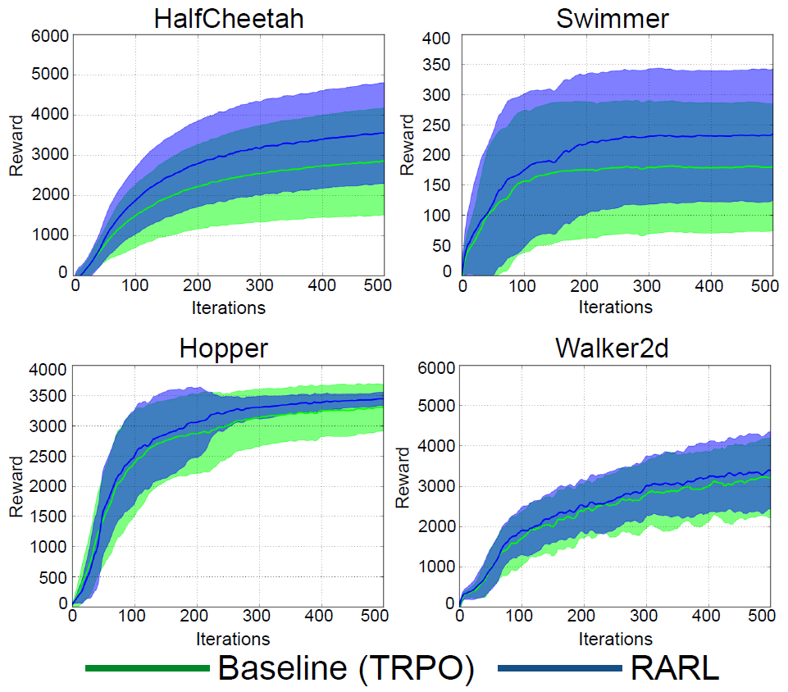
Rewards Sometimes Better than TRPO
With no adversary...
HalfCheetah & Swimmer
RARL gets better mean rewards.
Hopper & Walker2d
RARL does not get significantly better mean rewards.
With adversary, results are similar
Notes:
This paper conducted experiments in five different OpenAI environments. As a baseline, some agents were trained with Trust Region Policy Optimization, or TRPO, which is a state-of-the-art on-policy batch learning algorithm for continuous control that uses a constrained policy gradient update to improve policies. Other agents were trained with RARL.
On this slide, you can see plots of the mean rewards for the TRPO and RARL agents during training as a function of the number of iterations of the corresponding algorithms. In the HalfCheetah and Swimmer simulations, RARL gets better mean rewards than TRPO over time. However, in the Hopper and Walker2d simulations, RARL and TRPO get approximately the same mean rewards over time.
When testing the trained agents, the paper conducts experiments on both TRPO and RARL agents without any disturbances applied and with learned adversarial disturbances applied. In both test scenarios, the results reflect the same conclusion as in these plots, with agents trained with RARL outperforming the agents trained with TRPO in HalfCheetah and Swimmer, but both types of trained agents performing the same in Hopper and Walker2d.

Slide 21
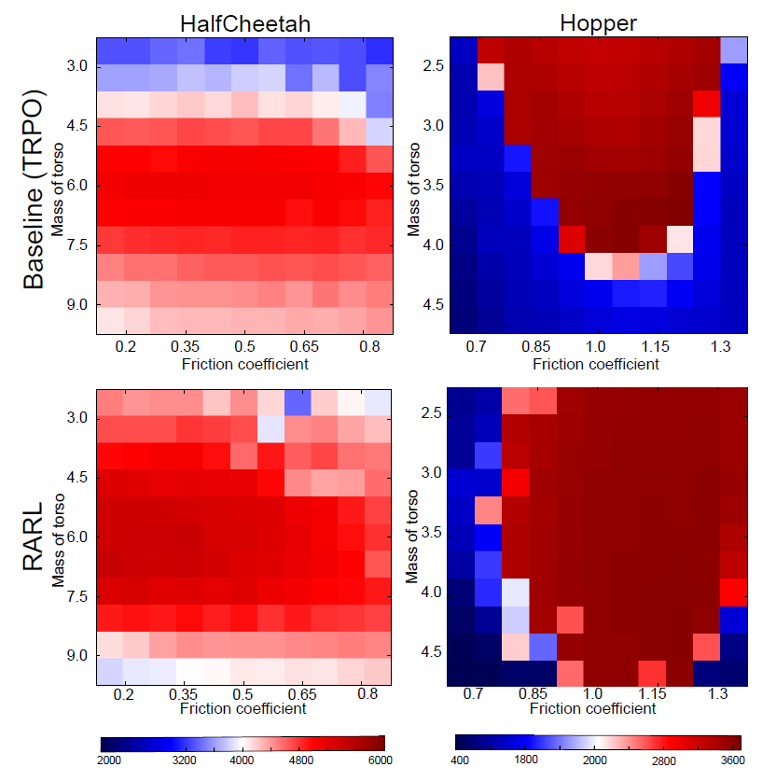
More Robust to Changes in Mass and Friction than TRPO
HalfCheetah & Hopper
RARL gets better reward values, especially across different masses.

Slide 22
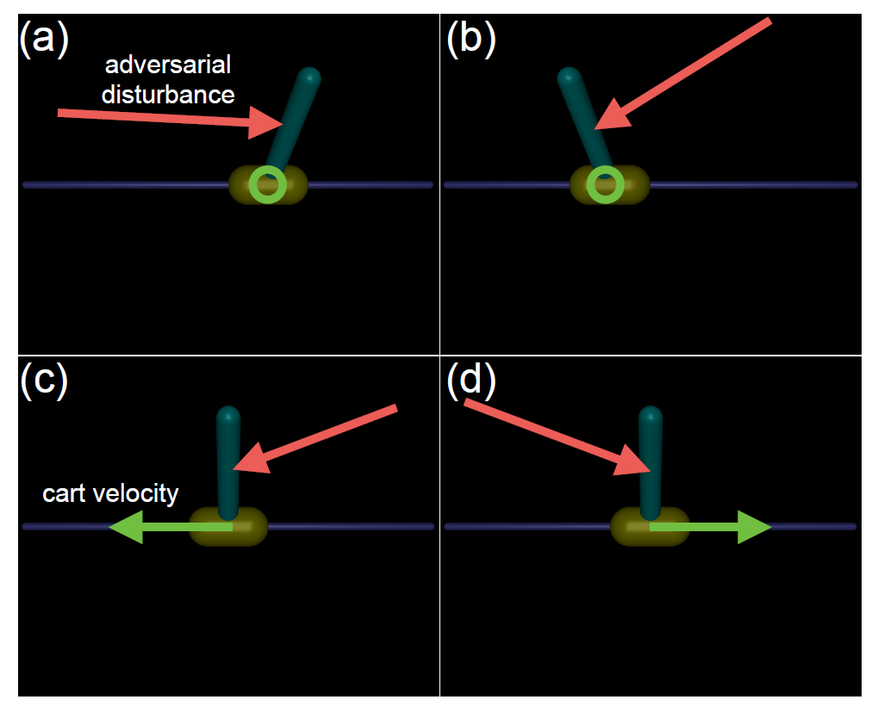
Adversary Learns Intuitive Policy
Stationary Pendulum (a and b)
Adversary accentuates the pendulum’s tilt.
Moving Pendulum (c and d)
Adversary pushes in the direction of motion.
Pushing in the opposite direction is less effective because the protagonist can slow the cart down.

Slide 23
Critiques

Slide 24
Disadvantages
Adversarial approaches show improvements for simple simulations, but hardly any difference for more complex simulations.
TRPO is the only baseline.

Slide 25
Adversarially Robust Policy Learning: Active Construction of Physically-Plausible Perturbations
Ajay Mandlekar
Animesh Garg
amandlek@stanford.edu
Silvio Savarese
animesh.garg@stanford.edu
Yuke Zhu
ssilvio@stanford.edu
Li Fei-Fei
yukez@stanford.edu
feifeili@stanford.edu
All authors are affiliated to AI Lab, Stanford University, CA US

Slide 26
Approach
Notes:
First off,...

Slide 27
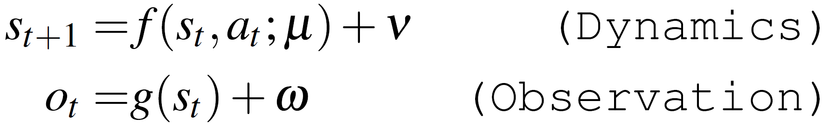
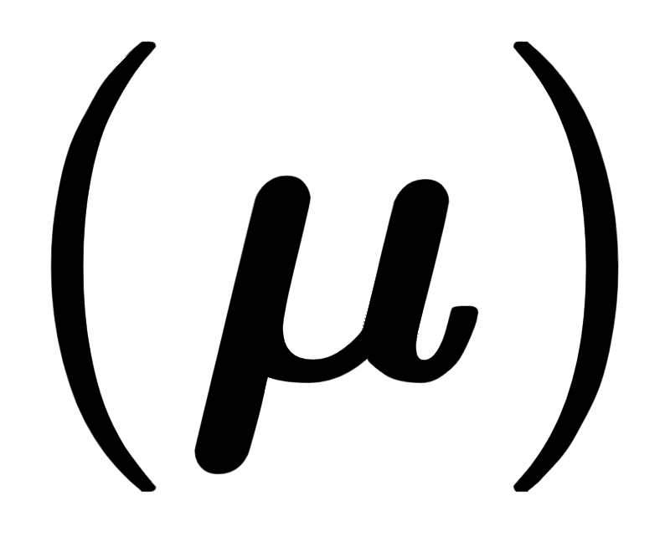
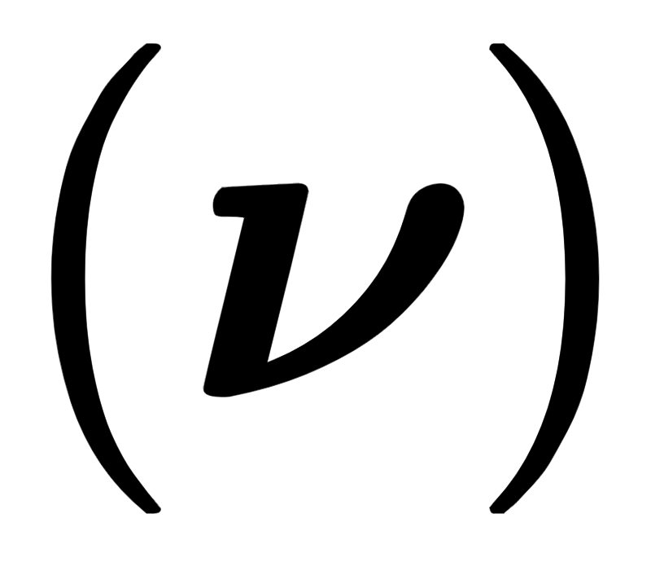
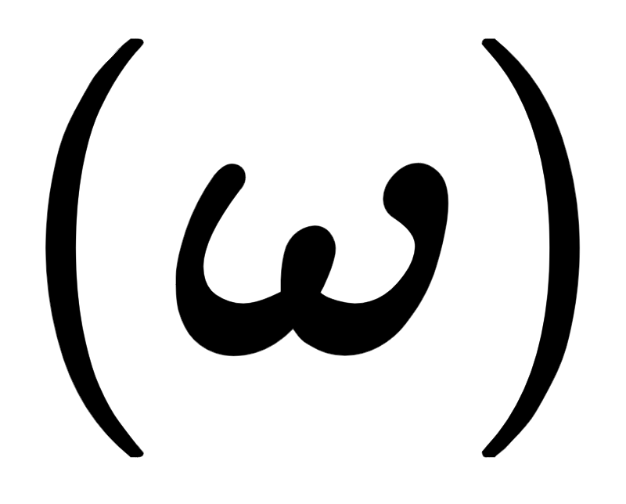
Physical Dynamical Systems
Dynamics Noise : Uncertainty in physical parameters (mass, friction, inertia, etc.)
Process Noise : Direct perturbations of state
Observation Noise : Direct perturbations of observation
Notes:
...this paper focuses on physical dynamical systems. A physical dynamical system models state transition dynamics in an environment in terms of a state transition function f with dynamics noise \mu and process noise \nu and observed state in terms of an observation function g with observation noise \omega. Dynamics noise represents uncertainty and variations in underlying physical parameters of the environment, such as mass, friction, and inertia. Process noise represents direct perturbations of the state that can result from noise in the execution of actions. Observation noise represents direct perturbations of the observation of the state that can result from noise in sensor measurements.
To improve an agent’s robustness in physical dynamical systems, this paper proposes an adversarial training approach in which...

Slide 28
Adversarially Robust Policy-Learning (ARPL)
Add noise adversarially to the system
Notes:
...noise is added adversarially to the system. In this training approach, noise can be added adversarially to any of the three noise types in the system to expose the agent to the worst possible noise values in the corresponding noise type. This adversarial training approach is the main contribution of this paper, and it is called, “Adversarially Robust Policy-Learning,” or ARPL for short.

Slide 29
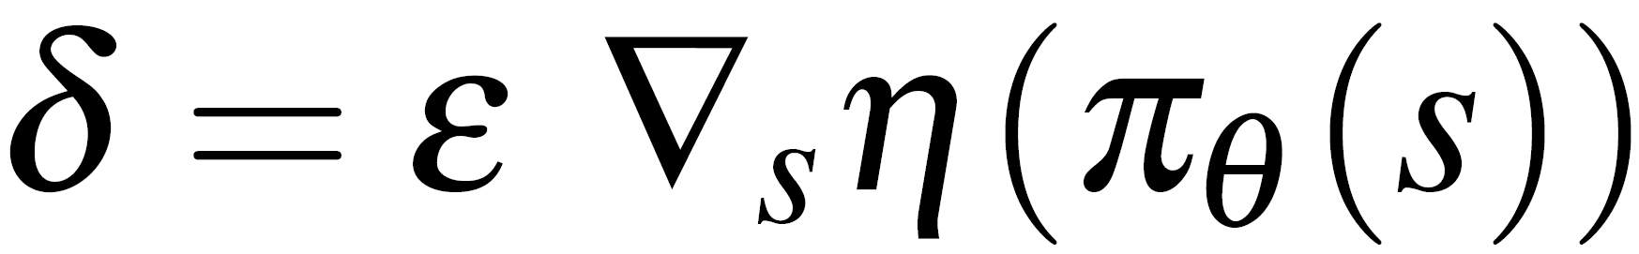
Computing the Optimal Adversarial Noise
Similar to Fast Gradient Sign Method
Main Difference: Scales with gradient
Images are high dimensional with IID dimensions.
But, physical systems have components with different scales and units.
Therefore, the noise needs to be scaled.
Notes:
ARPL computes the optimal adversarial noise using a modified version of the fast gradient sign method. The main difference here is that the gradient of the loss function is not passed into the sign function, so it is multiplied directly with the perturbation strength \epsilon. A consequence of this is that the computed adversarial noise \delta scales with the magnitude of the gradient and can take on values other than +-\epsilon.
The paper argues this modification is reasonable because fast gradient sign method was primarily designed for images, which are high dimensional with IID dimensions. However, dynamical models have dimensions in the state space that correspond to different physical quantities, such as mass and frictional coefficient. Since different physical quantities have different scales and units, scaling issues can occur when a fixed unit step size is added to every dimension. This is the justification for scaling the noise with the gradient.

Slide 30
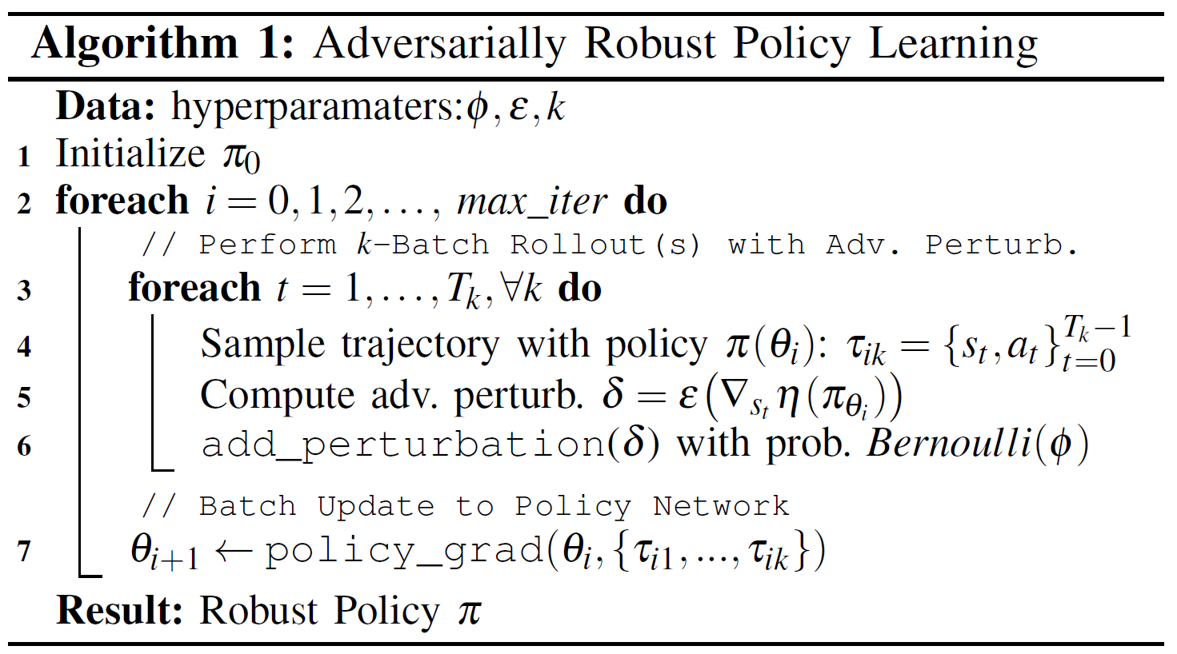
ARPL Algorithm
Notes:
Here is the Adversarially Robust Policy-Learning algorithm.

Slide 31
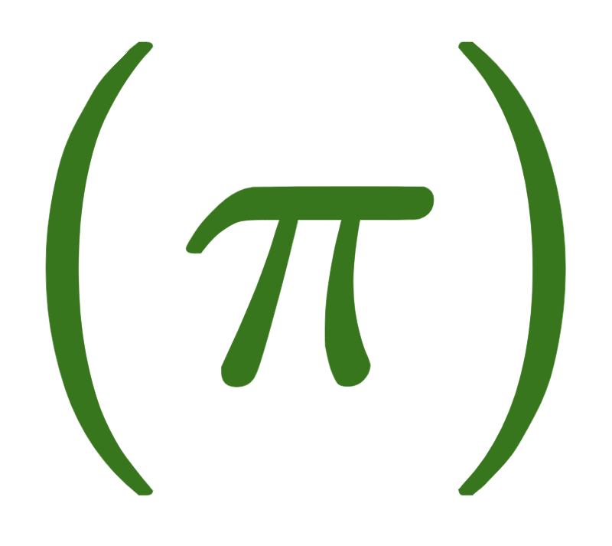

ARPL Algorithm
Optimize policy
iterations
Notes:
In this algorithm, the agent’s policy \pi is optimized over multiple iterations.

Slide 32
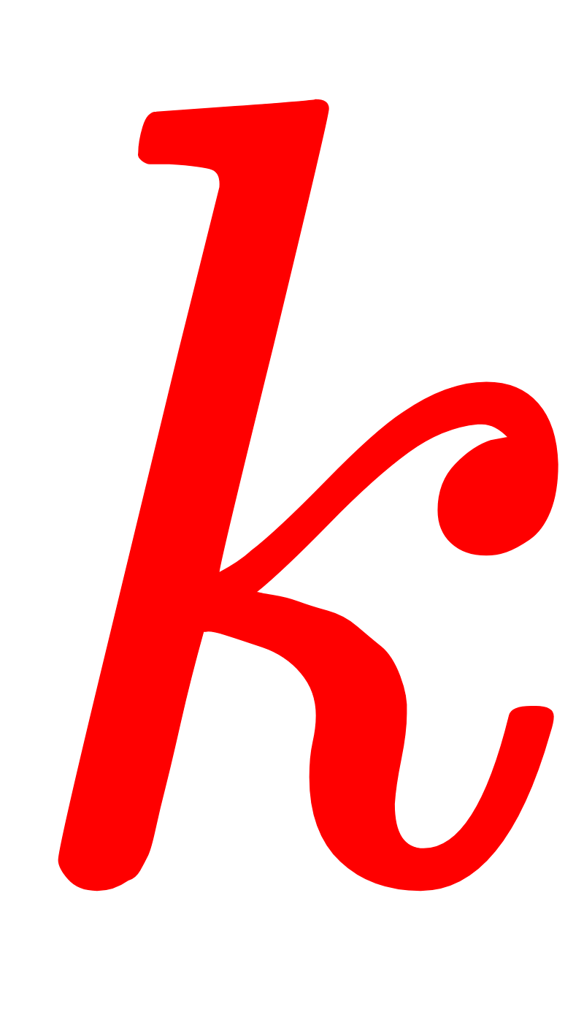
ARPL Algorithm
Sample
trajectories with current policy
Notes:
Within each iteration, \k trajectories are sampled using the agent’s current policy.

Slide 33
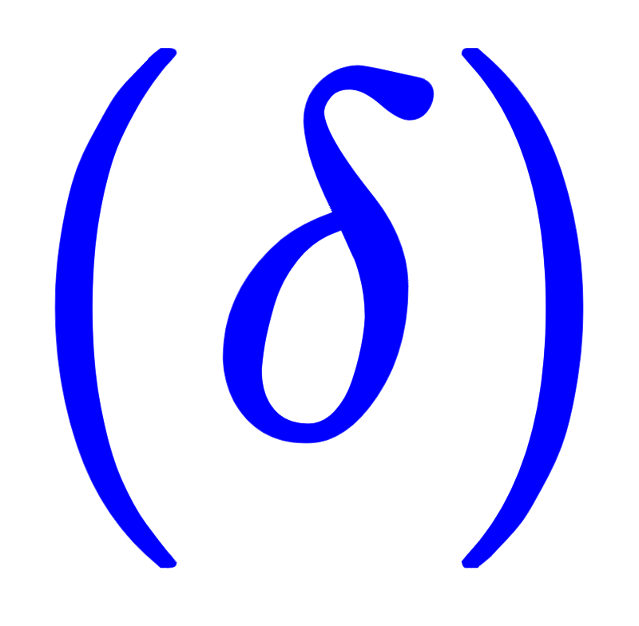
ARPL Algorithm
Compute
noise
Notes:
For each trajectory, the noise perturbation is computed...

Slide 34


ARPL Algorithm
Add
with
probability
Notes:
...and then added to the trajectory with probability \phi. \phi is a hyperparameter that dictates the frequency at which noise is added to trajectories during training.

Slide 35
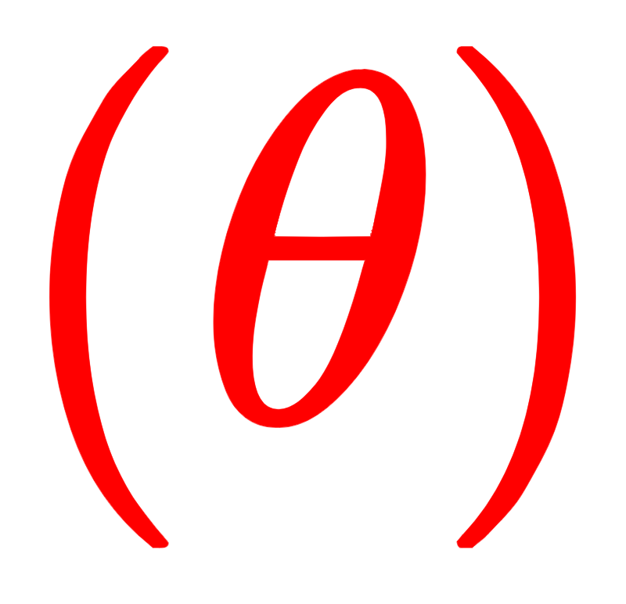
ARPL Algorithm
Update policy parameters
Notes:
After all k trajectories are sampled with or without noise added, they are used to update the policy parameters \theta.

Slide 36
Controllability

Slide 37
A dynamical system is said to be controllable if for every state x (previously called state s), there exists a sequence of control inputs that can transfer the system to state x.

Slide 38
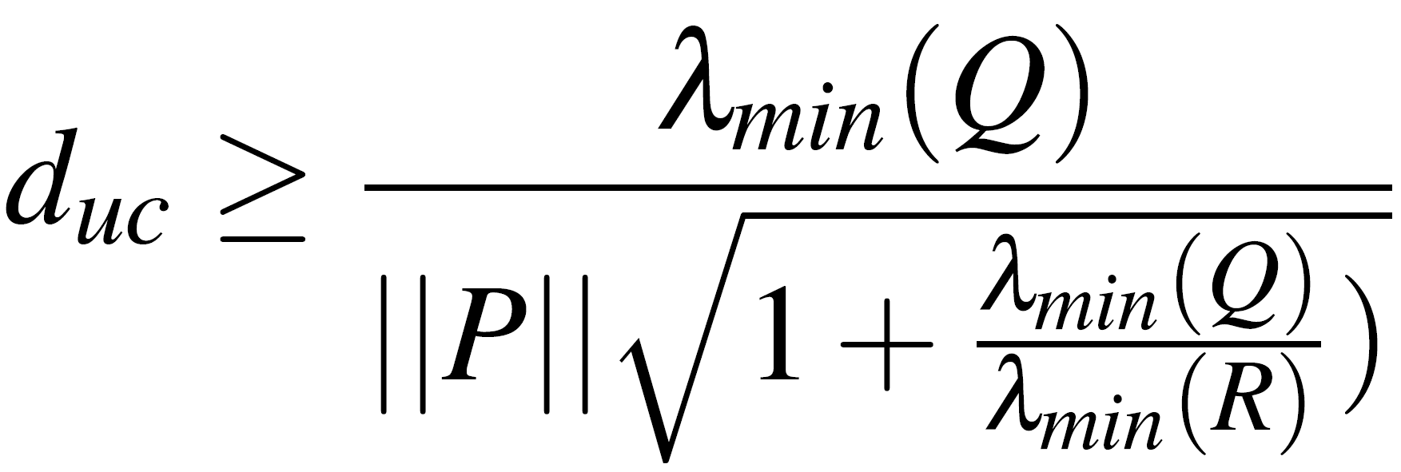
Distance to Uncontrollability
Model perturbations can turn a controllable dynamical system into an uncontrollable system.
Paper derives lower bound on distance to uncontrollability, and shows it is inversely proportional to total control effort.
Larger distance to uncontrollability means the system is more robust.

Slide 39
Results

Slide 40
Experimental Setup
Three agent types compared
Nominal: No random or adversarial perturbations
Random: ARPL with random perturbations
Adversarial: ARPL with adversarial perturbations
All agents trained with TRPO
15 agents of each type trained. Selected agent with best learning curve
Necessary due to high variance of performance across trainings

Slide 41
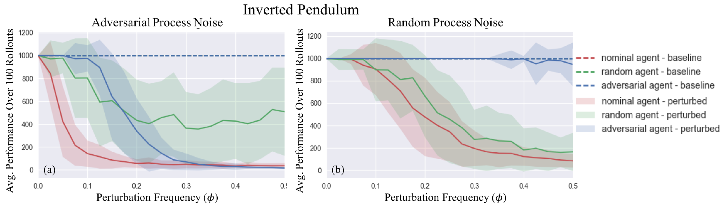
Adversarial Agent is Robust to Random Process Noise,
but not Adversarial Process Noise
Adversarial Process Noise: Robust only in region of training
Random Process Noise: Robust against all frequencies of random process noise perturbations, much more so than the random agent

Slide 42
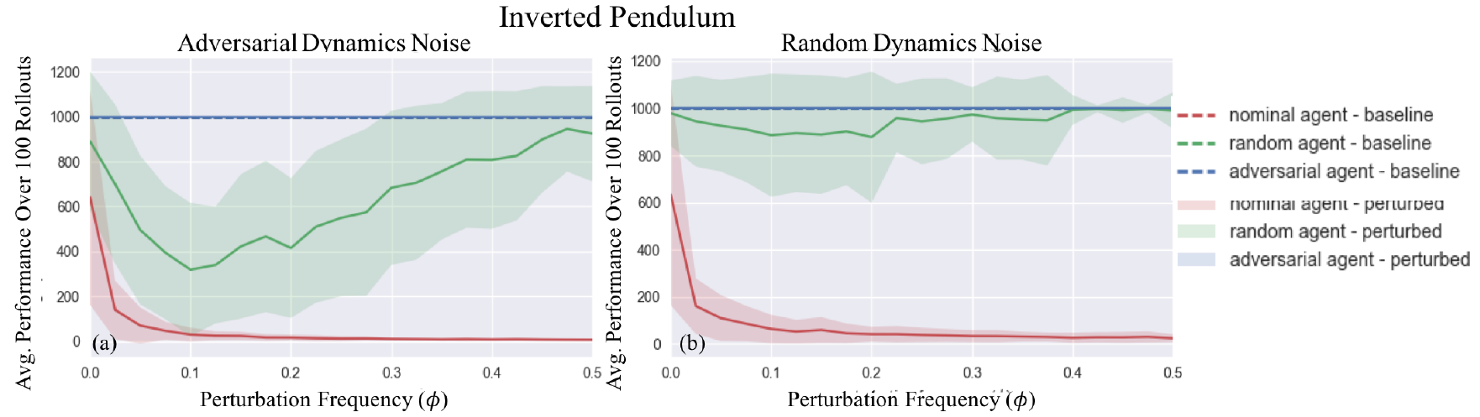
Adversarial Agent is Very Robust to Random and Adversarial Dynamics Noise
Both adversarial and random agents are significantly more robust than nominal agents.
Random agent is especially robust to random dynamics noise.

Slide 43
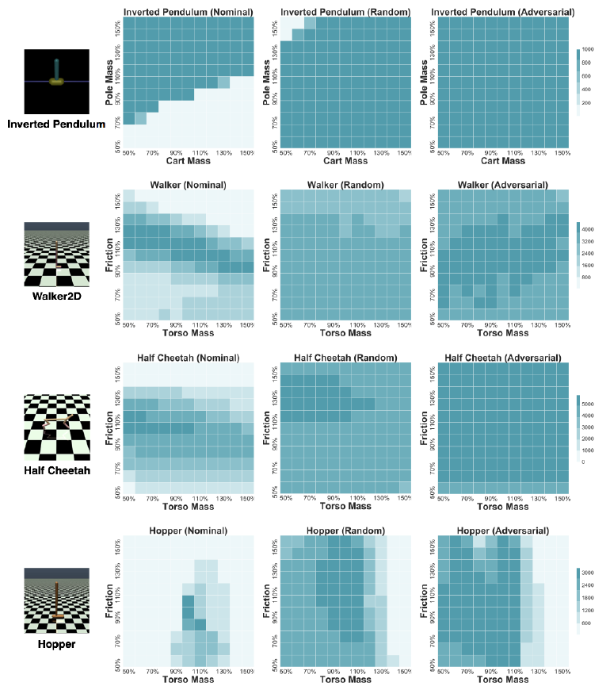
Adversarial and Random Dynamics Noise Agents are Robust to Changes in Environment Dynamics
Both adversarial and random agents are much more robust than nominal agents.
Adversarial agents not much better than random agents

Slide 44
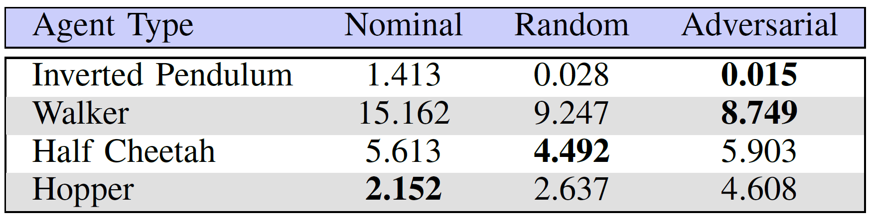
Adversarial Agent Sometimes Exerts less Control Effort
Adversarial agent does not always exert less control effort. Indeed, more complex agents exert more control effort.

Slide 45
Critiques

Slide 46
No Experimental Evaluation of Attacking Observation Noise
Paper’s Justification: Space Constraints
Observation noise is very important in the context of real world robot experiments, so evaluation is still desirable.

Slide 47
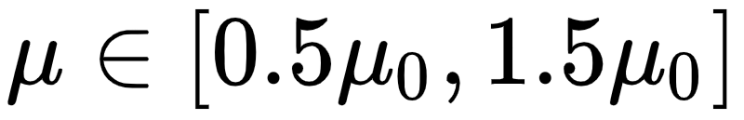

Unjustified Definition of “Physically-Plausible” Perturbations
= Nominal (source) dynamics
Why was this bounded variation range selected? How does this range maintain the “physical plausibility” of perturbations?
Justification and a more precise definition of “physical plausibility” is desirable.

Slide 48
Other Disadvantages
Conclusions of process noise only come from Inverted Pendulum.
Distance to uncontrollability lower bound only applies to linear systems
May still serve as a guideline for comparing robustness
Control effort of more complex adversarially-trained agents is worse than nominal agents and agents trained against random noise.
Very high variance in performance of agents trained by ARPL (hence why results were compared across the best agents)
Adversarial noise perturbations may not perform much better than random noise perturbations.

Slide 49
Conclusion

Slide 50
Conclusion
Adversarial training approaches show some improvements for simple simulations, but hardly any difference for more complex simulations
Agents adversarially trained for dynamics noise tend to perform about the same as random agents, but with slightly higher rewards

