Slide 1
Adversarial Reinforcement Learning
A Presentation by Thomas Warther

Slide 2
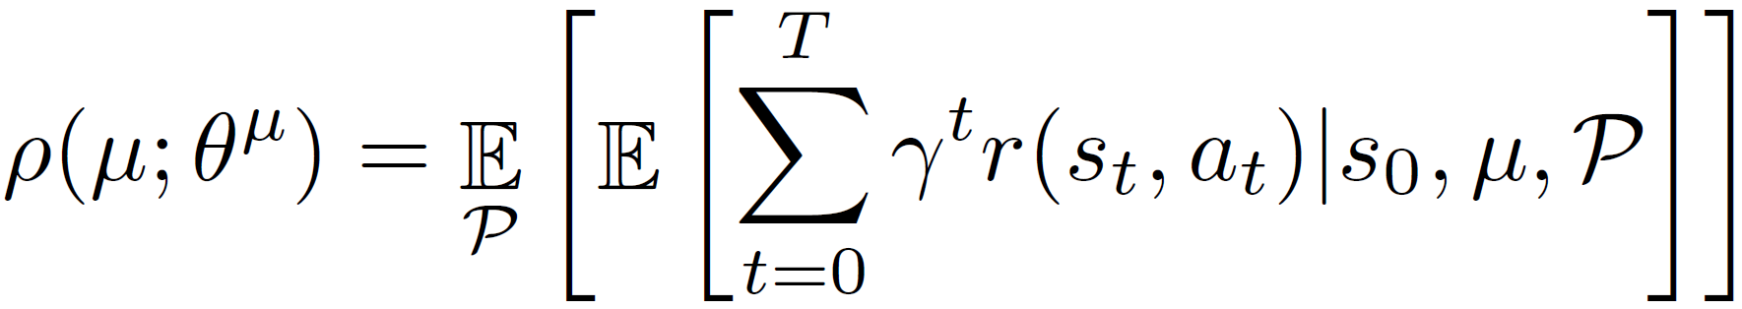
The Generalization Problem
Reinforcement learning objective
Many policies learned by optimizing the expected reward over all transition functions fail to generalize.
Optimizes mean performance
Risk neutral formulation
Assumes known distribution over model parameters

Slide 3
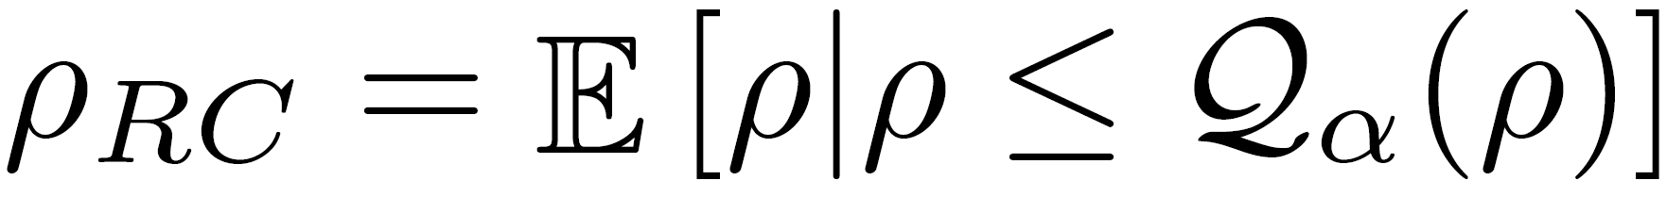
Solution: Adversarial Training
In unconstrained scenarios, the space of possible disturbances could be larger than the space of possible actions.
Solution: Sample the worst possible (alpha-quantile) disturbances with adversarial training

Slide 4

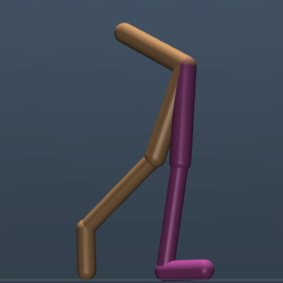

Problems Addressed by Today’s Papers
Most current RL-based approaches fail to generalize.
The gap between simulation and the real world is large.
Data is scarce, even when policy learning is done in the real world.
Robots are vulnerable to malicious intervention.
Contributions: Adversarial training approaches to improve the robustness of reinforcement learning.
Training Scenario
Test Scenario

Slide 5
Robust Adversarial Reinforcement Learning
Lerrel Pinto
Rahul Sukthankar
Carnegie Mellon University
Google Research
James Davidson
Abhinav Gupta
Google Brain
Carnegie Mellon University
Google Research

Slide 6
Approach

Slide 7
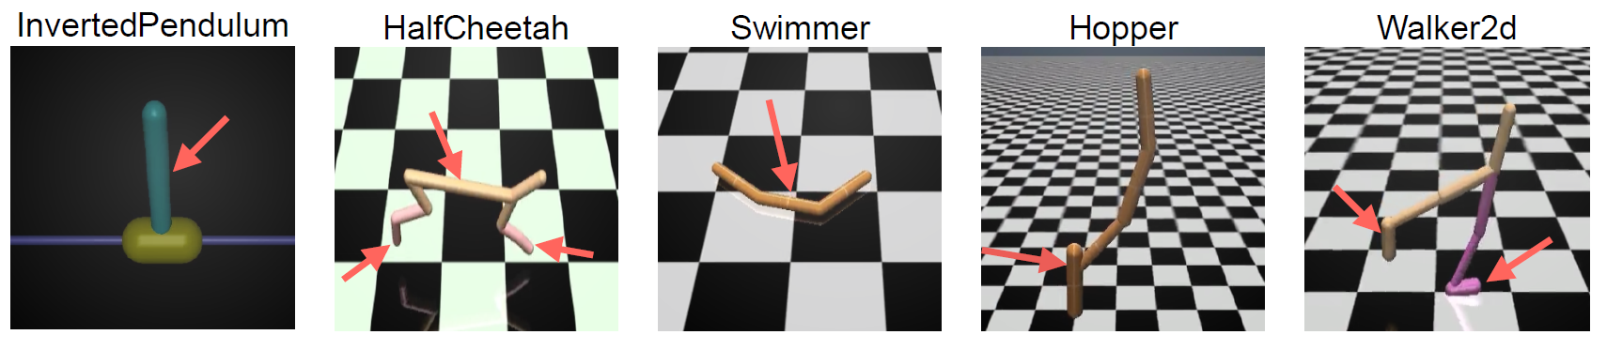
Adversarial Agents for Modeling Disturbances
Train a second agent (the “adversary”) to impede the original agent (the “protagonist”)
Adversary applies destabilizing forces to protagonist
Reward adversary for protagonist’s failure
Adversary learns to sample hard examples
Protagonist learns policy robust to any of the adversary’s disturbances

Slide 8
Adversaries with Domain Knowledge
Exploit domain knowledge to focus on protagonist’s weaknesses
Can affect the protagonist and environment in ways the protagonist can’t (i.e. “super-powers”)
Examples
Can exert 2D forces while protagonist can only exert 1D forces
Can change physical parameters, such as frictional coefficient or mass

Slide 9
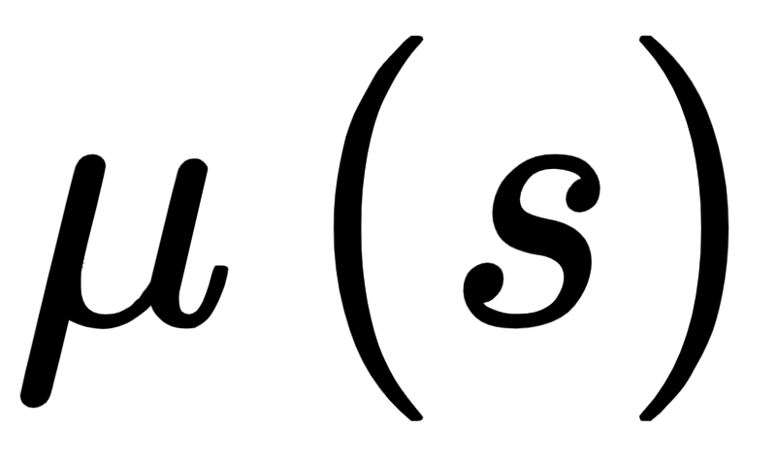
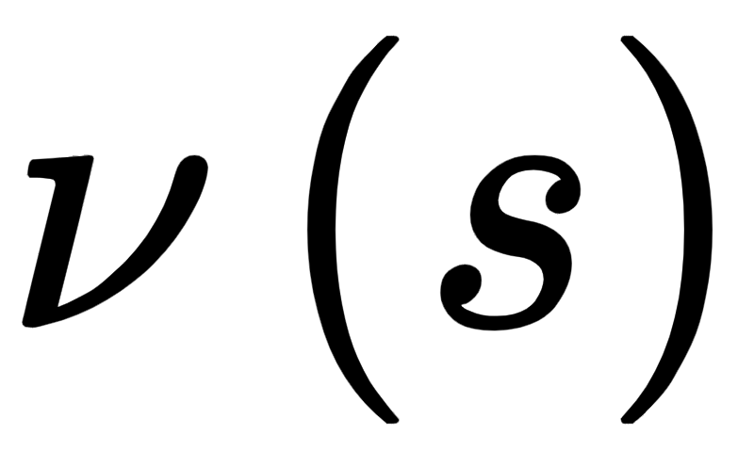
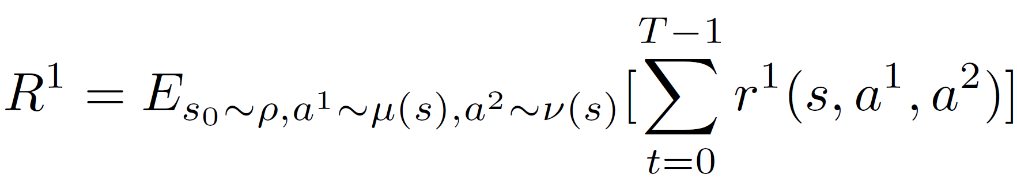
Training by Playing a Zero-Sum Markov Game
Protagonist’s Policy :
Adversary’s Policy :
Protagonist maximizes rewards against adversary.
Nash equilibrium is the optimal equilibrium reward.

Slide 10
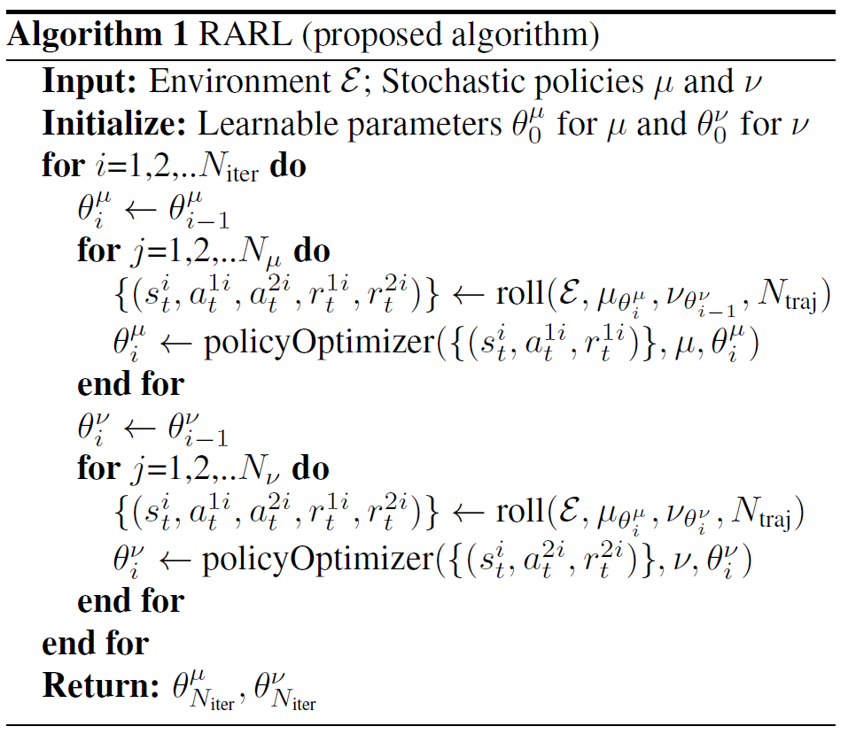
RARL Algorithm

Slide 11
RARL Algorithm
Protagonist
Adversary

Slide 12

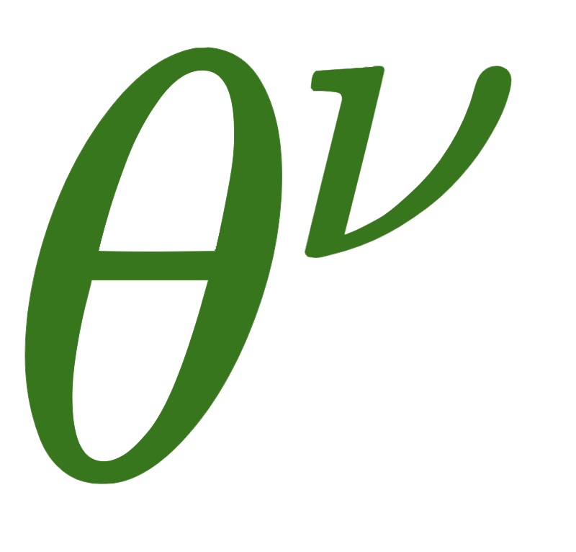
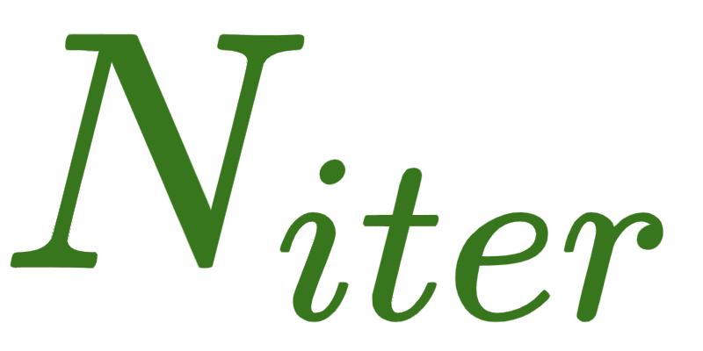
RARL Algorithm
Alternate optimization of and
iterations

Slide 13
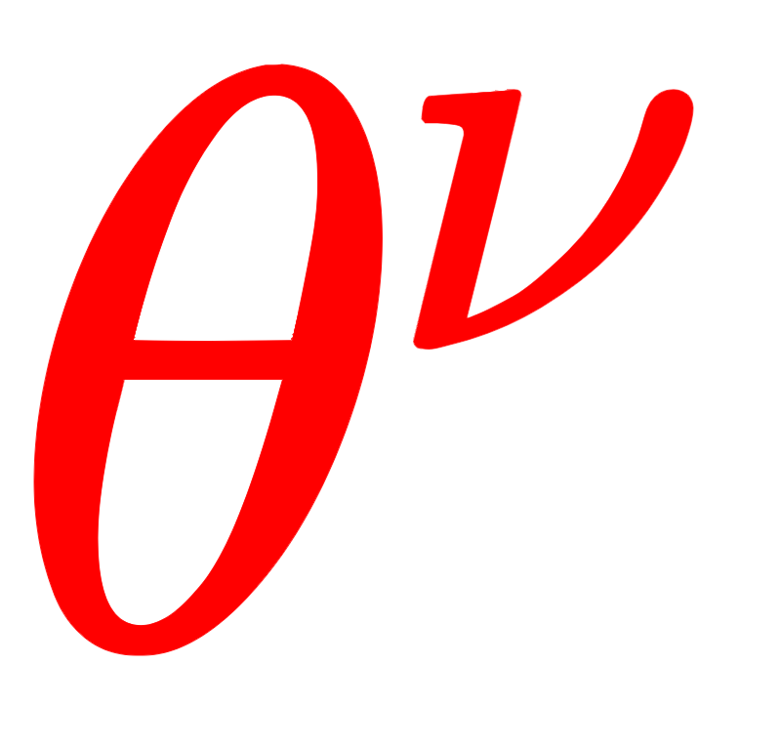

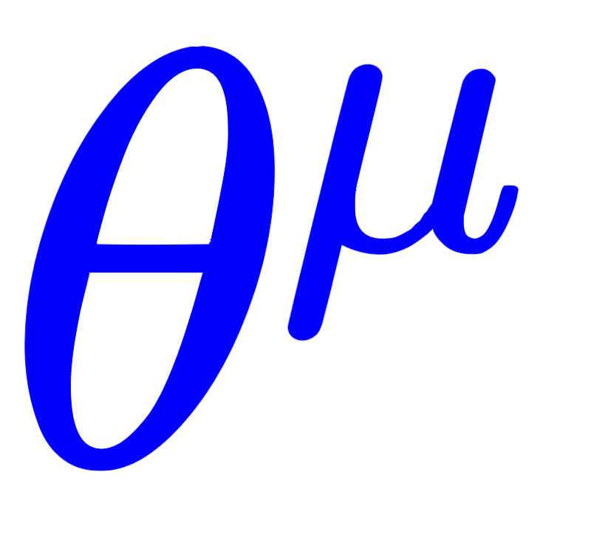
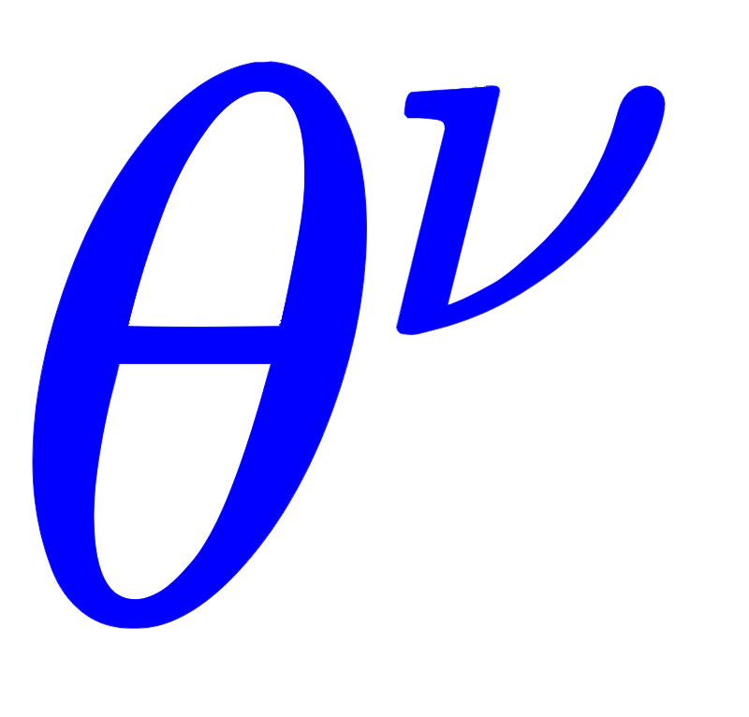
RARL Algorithm
Fix
Optimize
Fix
Optimize

Slide 14
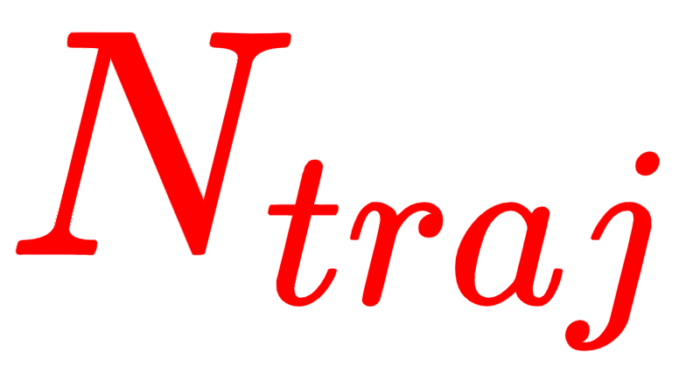
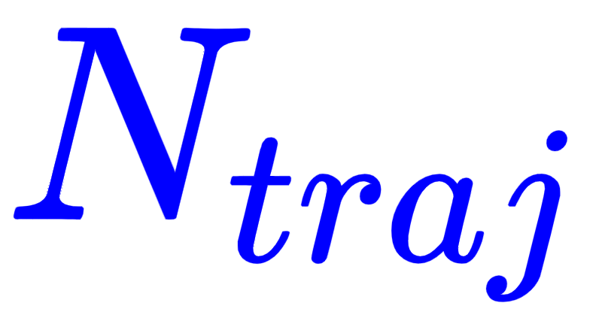
RARL Algorithm
Sample
trajectories with current policies
Sample
trajectories with current policies

Slide 15
RARL Algorithm
Optimize
with
trajectories
Optimize
with
trajectories

Slide 16
Results

Slide 17
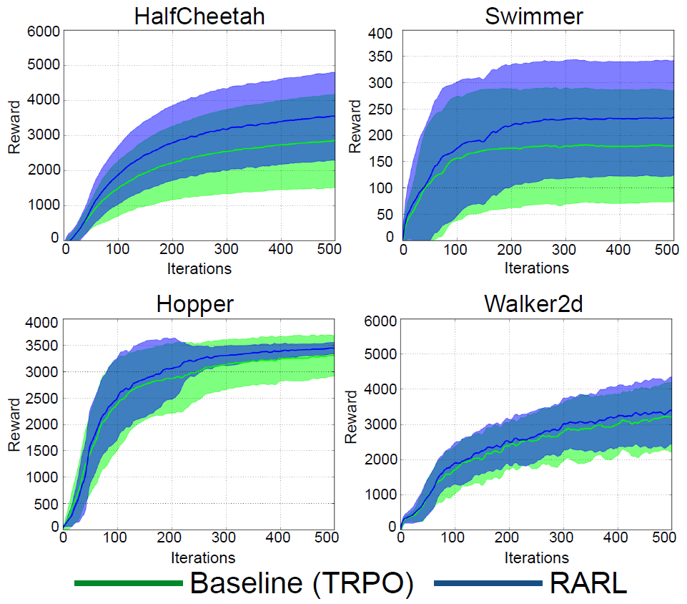
Rewards Sometimes Better than TRPO
With no adversary...
HalfCheetah & Swimmer
RARL gets better mean rewards.
Hopper & Walker2d
RARL does not get significantly better mean rewards.
With adversary, results are similar

Slide 18
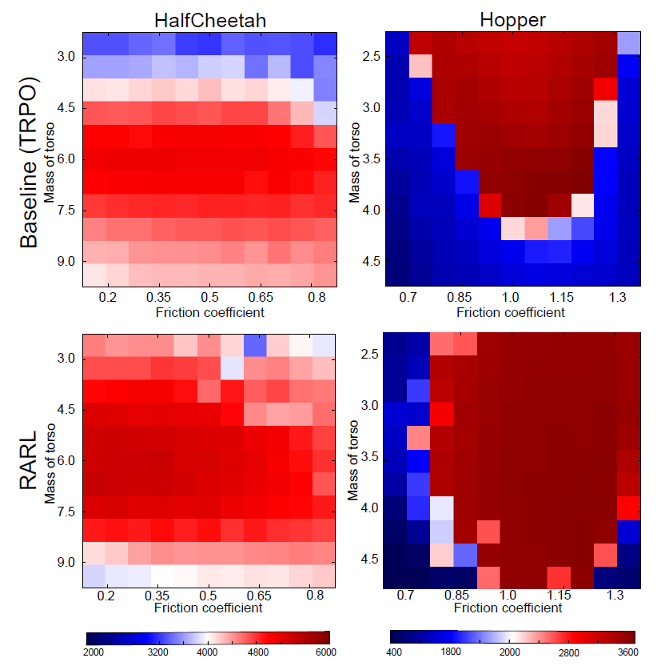
More Robust to Changes in Mass and Friction than TRPO
HalfCheetah & Hopper
RARL gets better reward values, especially across different masses.

Slide 19
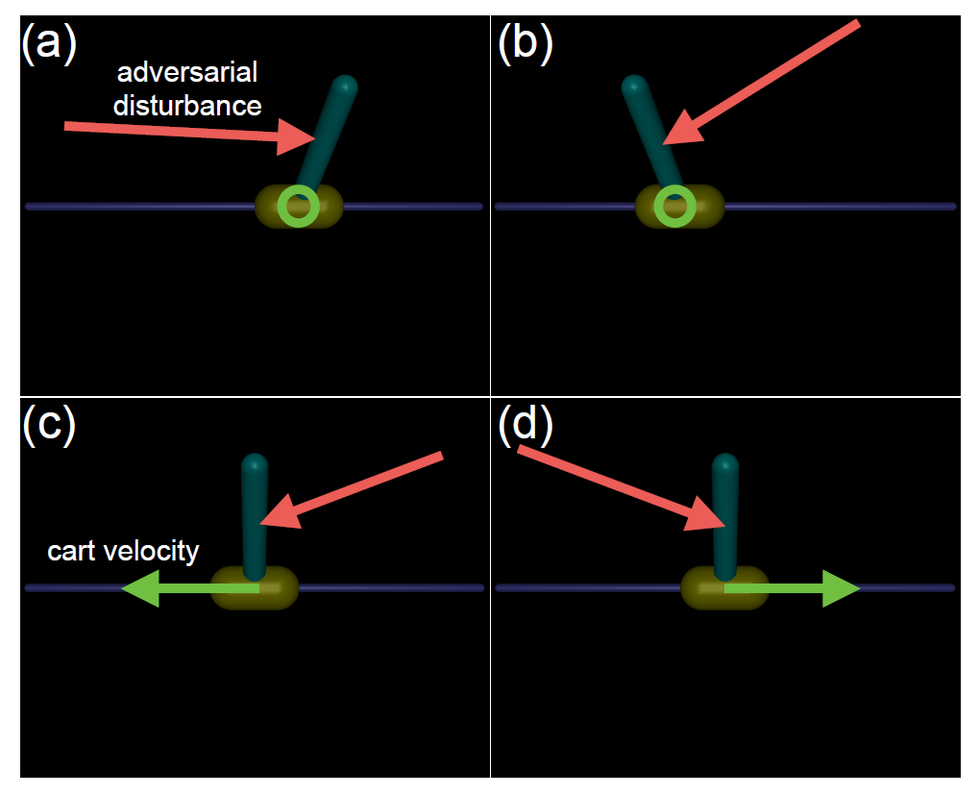
Adversary Learns Intuitive Policy
Stationary Pendulum (a and b)
Adversary accentuates the pendulum’s tilt.
Moving Pendulum (c and d)
Adversary pushes in the direction of motion.
Pushing in the opposite direction is less effective because the protagonist can slow the cart down.

Slide 20
Critiques

Slide 21
Disadvantages
Adversarial approaches show improvements for simple simulations, but hardly any difference for more complex simulations.
TRPO is the only baseline.

Slide 22
Adversarially Robust Policy Learning: Active Construction of Physically-Plausible Perturbations
Ajay Mandlekar
Animesh Garg
amandlek@stanford.edu
Silvio Savarese
animesh.garg@stanford.edu
Yuke Zhu
ssilvio@stanford.edu
Li Fei-Fei
yukez@stanford.edu
feifeili@stanford.edu
All authors are affiliated to AI Lab, Stanford University, CA US

Slide 23
Approach

Slide 24
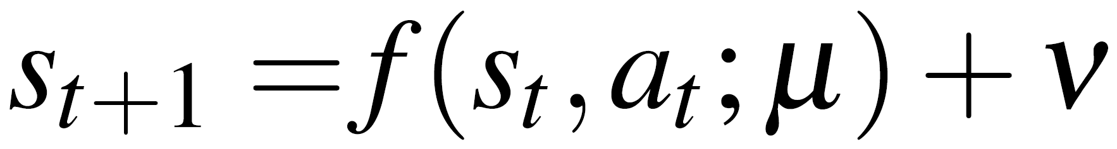

Add Noise to Physical Dynamical System
Dynamics Noise: Uncertainty in physical parameters (mass, friction, inertia, etc.)
Process Noise: Direct perturbations of state
Dynamics
Noise
Process
Noise

Slide 25
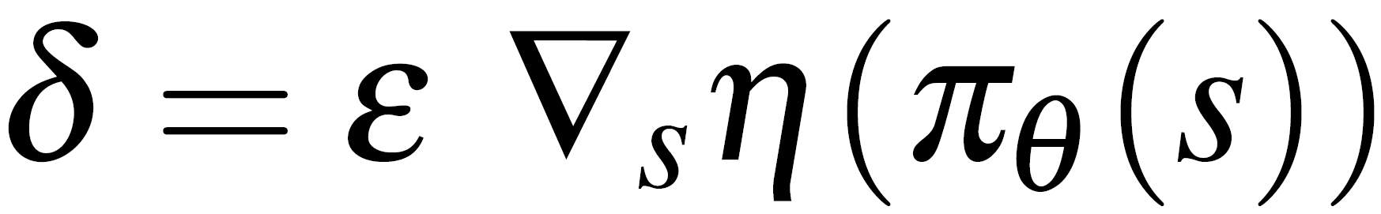
Computing the Optimal Noise
Similar to Fast Gradient Sign Method
Main Difference: Scales with gradient
Images are high dimensional with IID dimensions.
But, physical systems have components with different scales and units.
Therefore, the noise needs to be scaled.

Slide 26
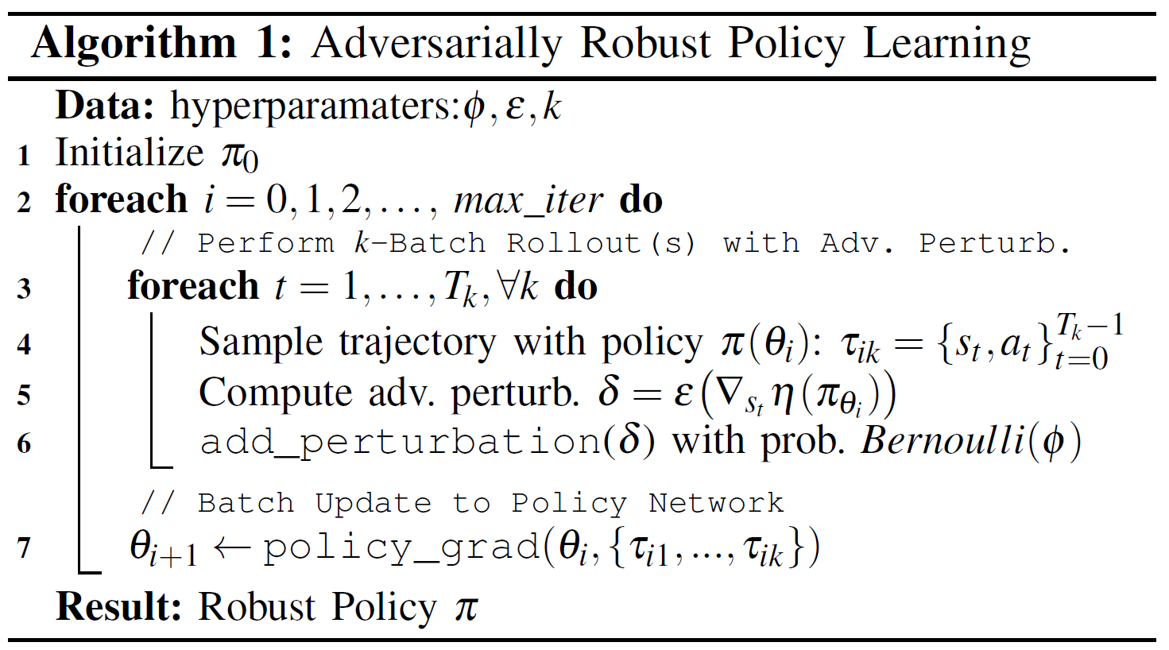
ARPL Algorithm

Slide 27
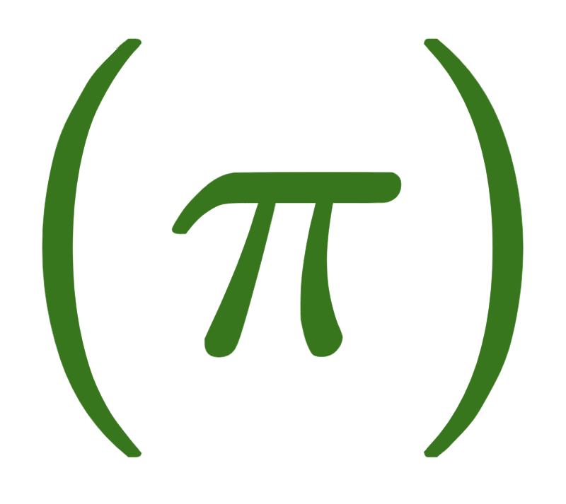

ARPL Algorithm
Optimize policy
iterations

Slide 28

ARPL Algorithm
Sample
trajectories with current policy

Slide 29
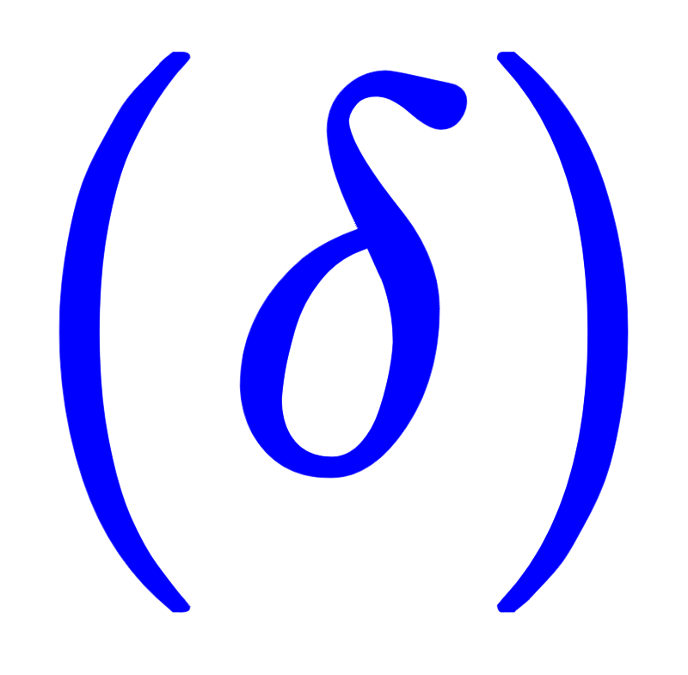
ARPL Algorithm
Compute
noise

Slide 30


ARPL Algorithm
Add
with
probability

Slide 31
Controllability

Slide 32
A dynamical system is said to be controllable if for every state x (previously called state s), there exists a sequence of control inputs that can transfer the system to state x.

Slide 33
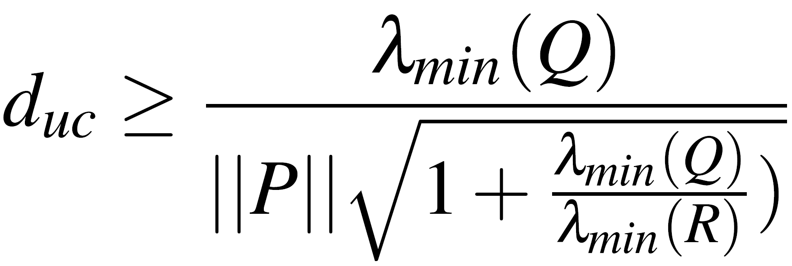
Distance to Uncontrollability
Model perturbations can turn a controllable dynamical system into an uncontrollable system.
Paper derives lower bound on distance to uncontrollability, and shows it is inversely proportional to total control effort.
Larger distance to uncontrollability means the system is more robust.

Slide 34
Results

Slide 35
Experimental Setup
Three agent types compared
Nominal: No random or adversarial perturbations
Random: ARPL with random perturbations
Adversarial: ARPL with adversarial perturbations
All agents trained with TRPO
15 agents of each type trained. Selected agent with best learning curve
Necessary due to high variance of performance across trainings

Slide 36
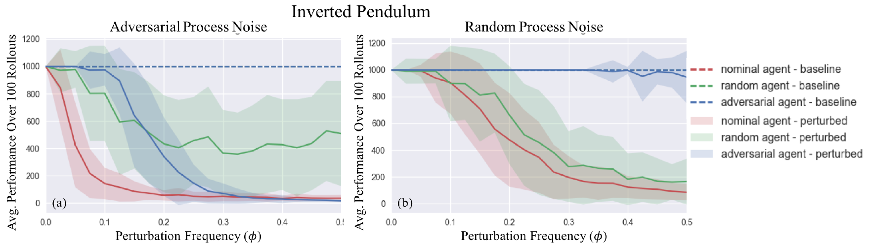
Adversarial Agent is Robust to Random Process Noise,
but not Adversarial Process Noise
Adversarial Process Noise: Robust only in region of training
Random Process Noise: Robust against all frequencies of random process noise perturbations, much more so than the random agent

Slide 37
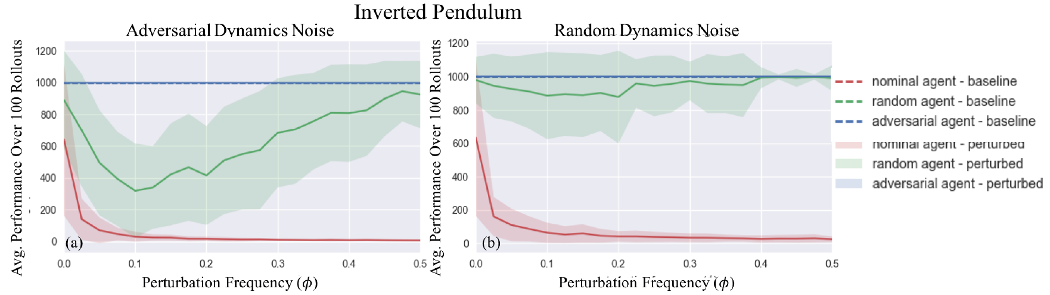
Adversarial Agent is Very Robust to Random and Adversarial Dynamics Noise
Both adversarial and random agents are significantly more robust than nominal agents.
Random agent is especially robust to random dynamics noise.

Slide 38
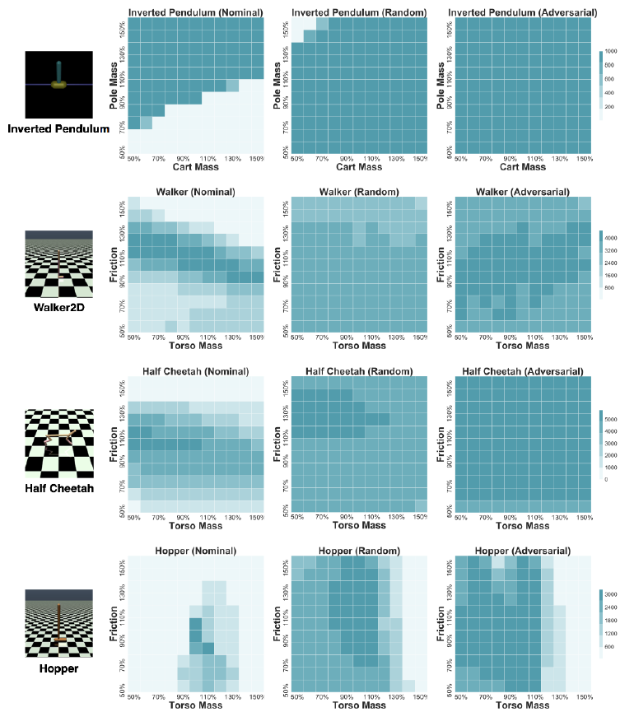
Adversarial and Random Dynamics Noise Agents are Robust to Changes in Environment Dynamics
Both adversarial and random agents are much more robust than nominal agents.
Adversarial agents not much better than random agents

Slide 39
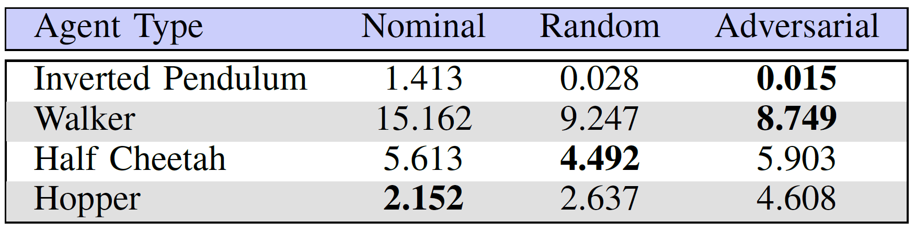
Adversarial Agent Sometimes Exerts less Control Effort
Adversarial agent does not always exert less control effort. Indeed, more complex agents exert more control effort.

Slide 40
Critiques

Slide 41
Disadvantages
Conclusions of process noise only come from Inverted Pendulum.
Vague definition of “physically-plausible” perturbations
No experimental evaluation of attacking observation noise
Distance to uncontrollability lower bound only applies to linear systems
May still serve as a guideline for comparing robustness
Control effort of more complex adversarially-trained agents is worse than nominal agents and agents trained against random noise.
Adversarial noise perturbations may not perform much better than random noise perturbations.

Slide 42
Conclusion

Slide 43
Conclusion
Adversarial training approaches show some improvements for simple simulations, but hardly any difference for more complex simulations
Agents adversarially trained for dynamics noise tend to perform about the same as random agents, but with slightly higher rewards

