Slide 1

Company Acquisitions of top 7 Companies
NAME | SRN
Aishwarya Shanbhag | PES 2201800006
Kokila | PES 2201800625
Prema Hanchinal | PES 2201800702
November 10, 2019
Introduction to Data Science Section: D sec

Slide 2

Company Acquisitions Data
Description
The data is about the acquisitions made by the companies Apple, Facebook, IBM, Twitter, Yahoo ,Microsoft, Google till 2015.
In this presentation we will be showing how are
We going to clean the data normalise visualise
Make some hypothesis tests and correlation
Acquisition Date
Month
Year
Parent Company
Value
Company
Business
Derived products
ID
Rows | Column | Numerical Columns | Categorical Columns | NAN%
917 | 10 | 3 | 10 | 12-15%
November 10, 2019
Introduction to Data Science Section: A/D sec

Slide 3
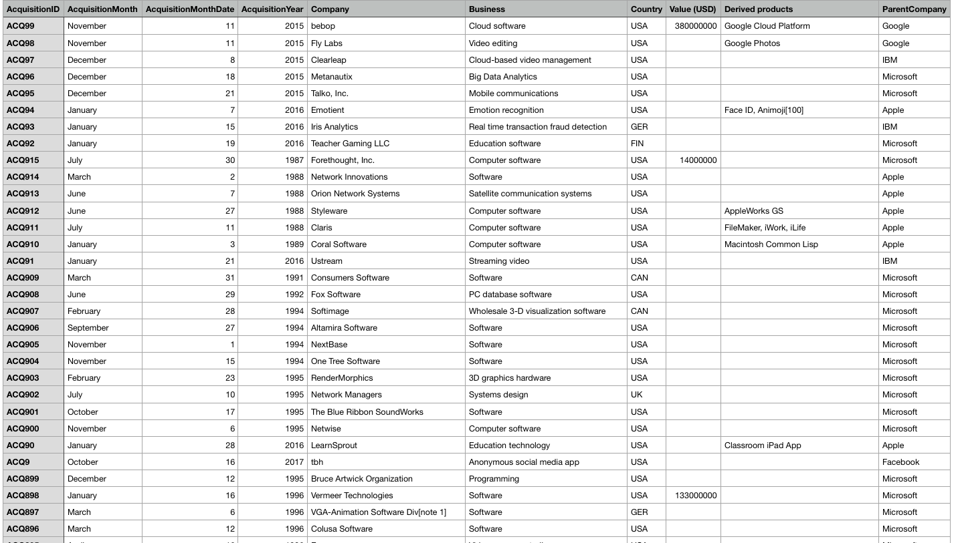
Company Acquisitions Data

Slide 4
Company Acquisitions Data
2. Data Cleaning
November 10, 2019
Introduction to Data Science Section: A/D sec

Slide 5
Company Acquisitions Data
November 10, 2019
Introduction to Data Science Section: A/D sec

Slide 6
Company Acquisitions Data
November 10, 2019
Introduction to Data Science Section: A/D sec

Slide 7
Company Acquisitions Data
November 10, 2019
Introduction to Data Science Section: A/D sec

Slide 8
Importance Of Normalization and Standardization
Company Acquisitions Data
3. Normalization and Standardization:
The goal of normalization is to change the values of numeric columns in the dataset to a common scale, without distorting differences in the ranges of values.
Data standardization is about making sure that data is internally consistent; that is, each data type has the same content and format. Standardized values are useful
for tracking data that isn't easy to compare otherwise.
Standardizing the features around the center and 0 with a standard deviation of 1 is important when we compare measurements that have different units. Variables that are measured at different scales do not contribute equally to the analysis and might end up creating a bias.
November 10, 2019
Introduction to Data Science Section: A/D sec

Slide 9
Company Acquisitions Data
Conversion of categorical data to numerical data
November 10, 2019
Introduction to Data Science Section: A/D sec

Slide 10
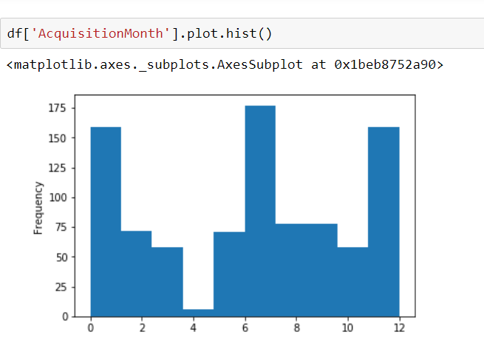
Company Acquisitions Data
Changes before and after normalisation
November 10, 2019
Introduction to Data Science Section: A/D sec

Slide 11
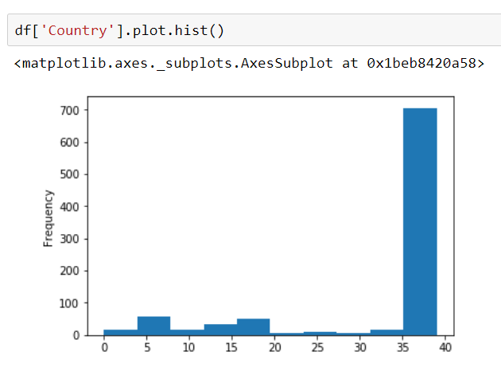
Company Acquisitions Data
November 10, 2019
Introduction to Data Science Section: A/D sec

Slide 12
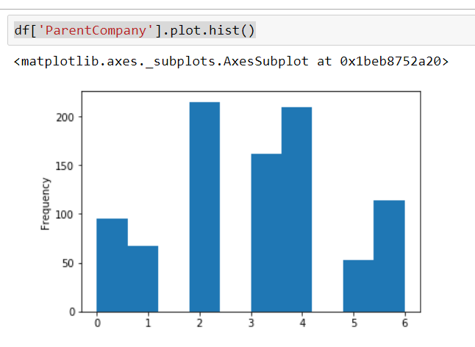
Company Acquisitions Data
November 10, 2019
Introduction to Data Science Section: A/D sec

Slide 13
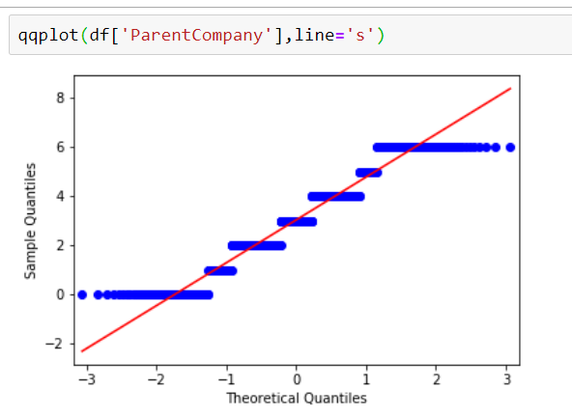
Company Acquisitions Data
November 10, 2019
Introduction to Data Science Section: A/D sec

Slide 14
Company Acquisitions Data
What’s the use of normalising data?
The goal of data normalisation is to reduce and even eliminate data redundancy, an important consideration for application developers because it is incredibly difficult to stores objects in a relational database that maintains the same information in several places.
November 10, 2019
Introduction to Data Science Section: A/D sec

Slide 15
Company Acquisitions Data
4. Graph visualization:
November 25, 2019
Introduction to Data Science Section: D sec

Slide 16
Company Acquisitions Data
November 10, 2019
Introduction to Data Science Section: A/D sec

Slide 17
Company Acquisitions Data
November 10, 2019
Introduction to Data Science Section: A/D sec

Slide 18
Company Acquisitions Data
November 10, 2019
Introduction to Data Science Section: A/D sec

Slide 19
Company Acquisitions Data
November 10, 2019
Introduction to Data Science Section: A/D sec

Slide 20
Company Acquisitions Data
November 10, 2019
Introduction to Data Science Section: A/D sec

Slide 21
Company Acquisitions Data
November 10, 2019
Introduction to Data Science Section: A/D sec

Slide 22
Company Acquisitions Data
November 10, 2019
Introduction to Data Science Section: A/D sec

Slide 23
Company Acquisitions Data
November 10, 2019
Introduction to Data Science Section: A/D sec

Slide 24
Company Acquisitions Data
November 10, 2019
Introduction to Data Science Section: A/D sec

Slide 25
Company Acquisitions Data
5. Hypothesis Testing:
Acquisition Year:
Here the Assumption is all the acquisitions have taken place before 1998
And Alternative hypothesis for that is that most of the transactions have taken place after 2009.35
Null hypothesis: Ho: µ<=1999.98
Alternative hypothesis H1: µ>2009.35
November 10, 2019
Introduction to Data Science Section: A/D sec

Slide 26
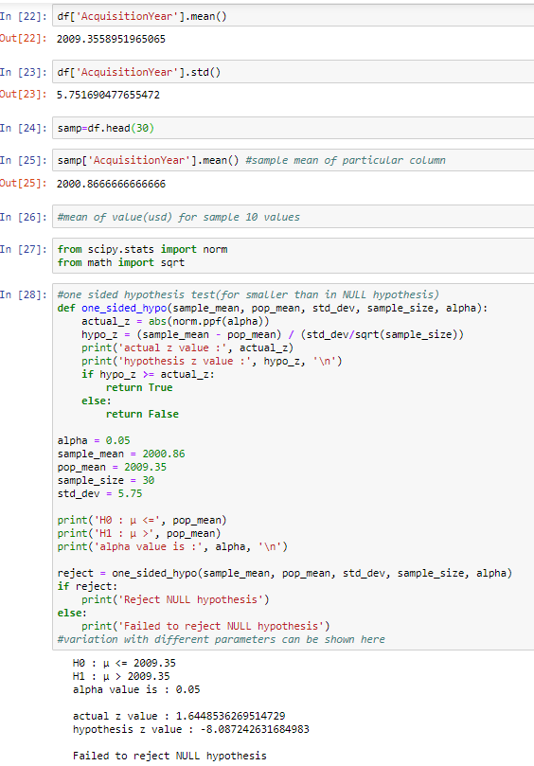
Company Acquisitions Data
November 10, 2019
Introduction to Data Science Section: A/D sec

Slide 27
Company Acquisitions Data
Acquisition Year:
Alpha=0.05
Sample mean=2000.866
Pop_mean=2009.35
Sample size =30
Std dev=5.75
November 10, 2019
Introduction to Data Science Section: A/D sec

Slide 28
Company Acquisitions Data
November 10, 2019
Introduction to Data Science Section: A/D sec

Slide 29
Company Acquisitions Data
Hypothesis z value : 0.247
Hypothesis alpha value = 0.69
Actual Z value:-8.08
-8.08<1.644
Hence it failed to reject NULL hypothesis.
November 10, 2019
Introduction to Data Science Section: A/D sec

Slide 30
Company Acquisitions Data
Parent Company:
Here the Assumption is all the parent company IBM had
made many Acquisitions
And Alternative hypothesis for that is
other companies made more acquisitions than IBM
Null hypothesis: Ho: µ=3.026
Alternative hypothesis H1: µ!=3.026
November 10, 2019
Introduction to Data Science Section: A/D sec

Slide 31
Company Acquisitions Data
November 10, 2019
Introduction to Data Science Section: A/D sec

Slide 32
Company Acquisitions Data
Alpha=0.05
Sample mean=3.57
Pop_mean=3.026
Sample size =100
Std dev=1.744
November 10, 2019
Introduction to Data Science Section: A/D sec

Slide 33
Company Acquisitions Data
November 10, 2019
Introduction to Data Science Section: A/D sec

Slide 34
Company Acquisitions Data
Hypothesis z value : 3.119
Hypothesis alpha value =0.0009
Actual Z value=1.9599
3.119>1.9599
Hence it reject NULL hypothesis.
November 10, 2019

Slide 35
Company Acquisitions Data
6. Correlation:
Correlation is the way to find relation between two different parameters of the data. The value ranges from -1 to 1.
Where 1 representing the values are completely dependent on each other whereas -1 indicates inversely related to each other and means that they are independent on each other.
November 10, 2019
Introduction to Data Science Section: A/D sec

Slide 36
Company Acquisitions Data
November 10, 2019
Introduction to Data Science Section: A/D sec

Slide 37
Company Acquisitions Data
Hence in the taken example between Acquisition Year and Value the correlation value is 0.070 ,which are 7% dependent on each other.
November 10, 2019
Introduction to Data Science Section: A/D sec

Slide 38
Company Acquisitions Data
November 10, 2019
Introduction to Data Science Section: A/D sec

Slide 39
Company Acquisitions Data
Similarly comparing Acquisition year
with ParentCompany the correlation value
Is -0.179 which states that the values
Are 18% percent inversely dependent
On each other
November 10, 2019
Introduction to Data Science Section: A/D sec

Slide 40
Company Acquisitions Data
Thank you
November 10, 2019
Introduction to Data Science Section: A/D sec

