Slide 1





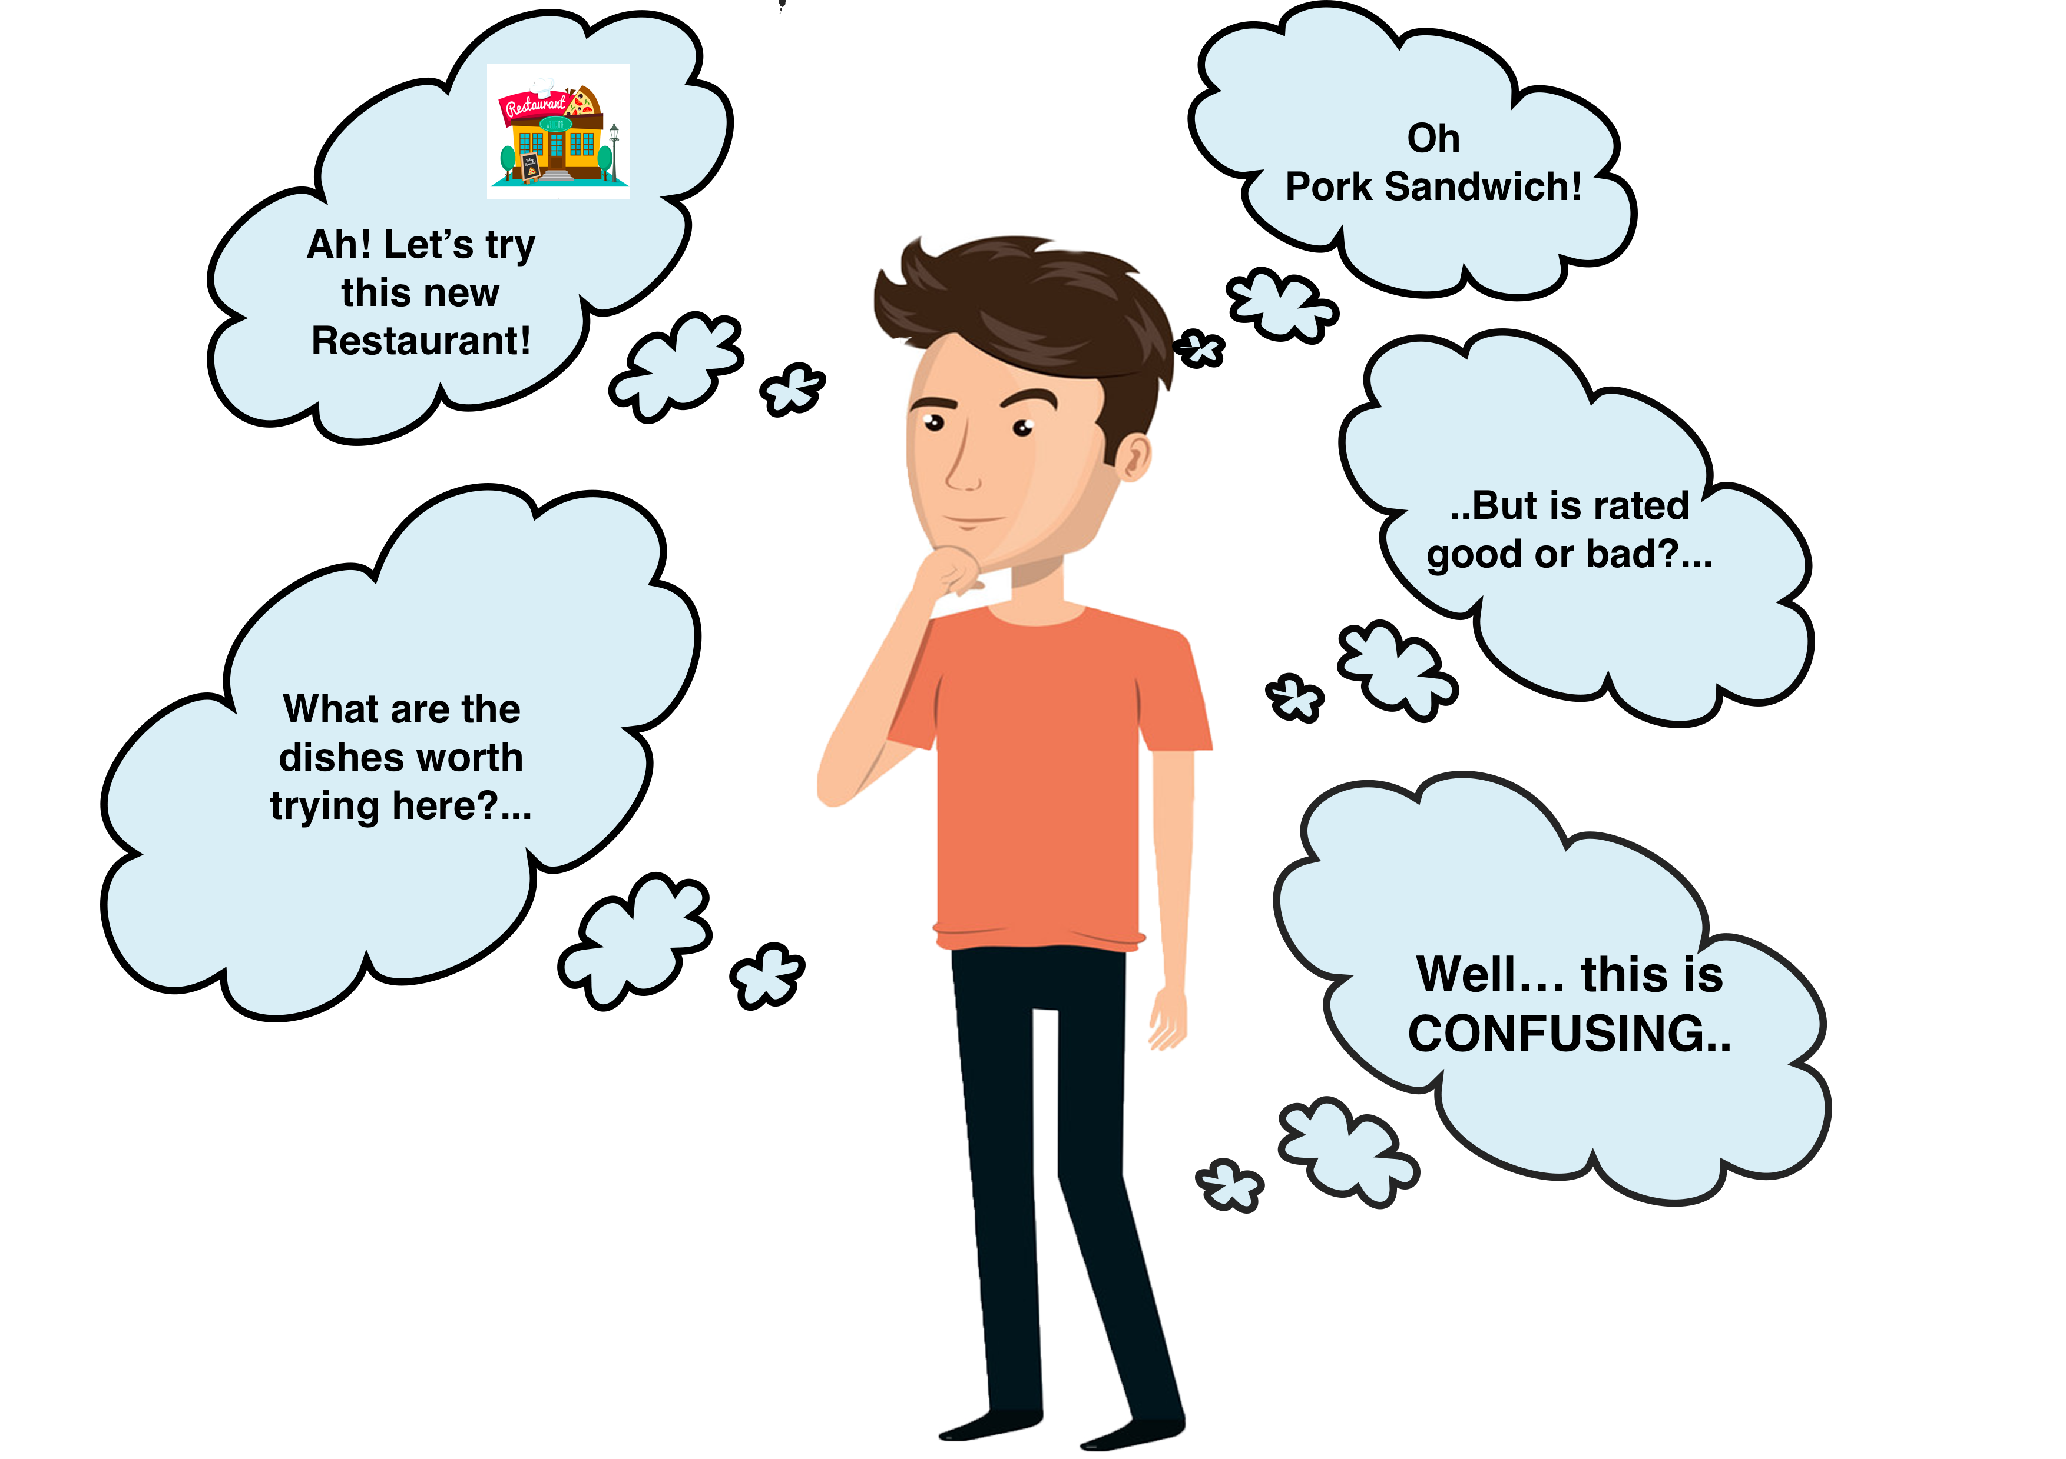




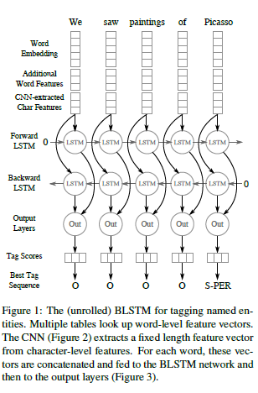
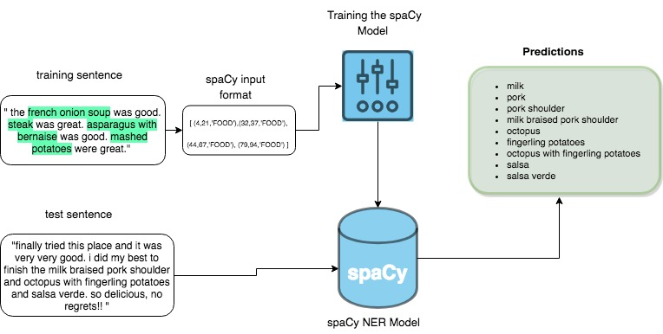

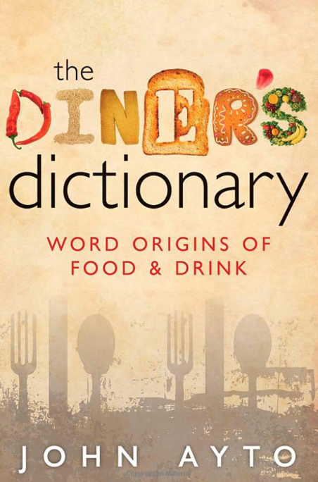
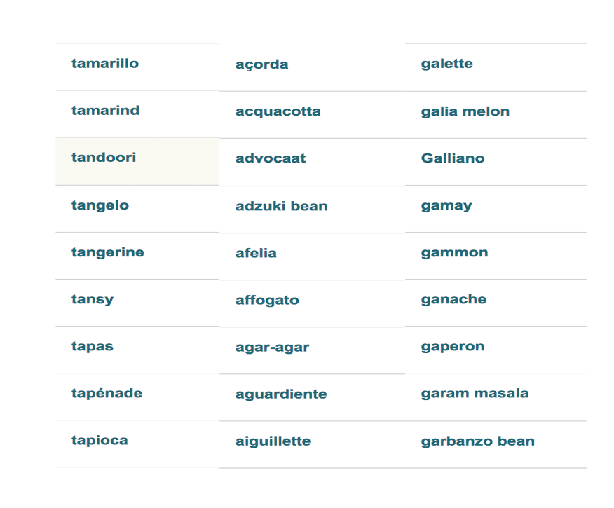




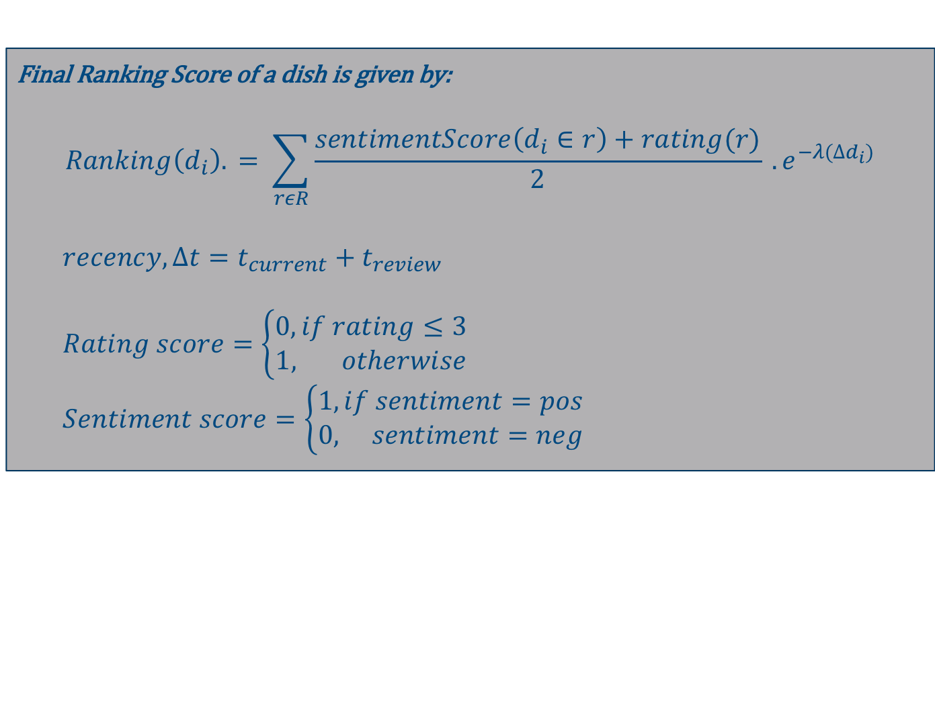
Word2Mouth: A Top Dish Recommender System
Abhirup Mukherjee, Mithra Muthukrishnan, Aditya Narula, Aishwarya Turuvekere
University of Massachusetts Amherst
The problem
Reviews
List of Menu Items
Eliminate duplicates using similarity measure
Annotate
Split into Train and Test
Named Entity Recognition
SpaCy
BiLSTM
Final list of Dishes
Validate against scraped menus
Analysis
Customers visiting a new restaurant are often faced with the dilemma of which dishes to try out. The most convenient way is to go to Yelp and to browse through customer reviews and find dishes rated best by others.
But the amount of data available is both overwhelming and confusing for one to find the restaurant’s most popular dishes quickly.
Comparison between top 10 dishes found on Yelp and reviewed by our model:
Reviews
Aggregate
+
Identify positive dishes
Final Top Dishes
Validate against scraped top dishes
Tag all reviews with sentiment
Sentiment Analysis
Stanford Core NLP
Logistic Regression
Top items on Yelp | Top items retrieved by model
dungeness crab roll | chowder
market chowder | crab
new england clam chowder | seafood bisque
seafood bisque | bread
seared scallop chowder | clam chowder
smoked salmon chowder | new england clam chowder
southwestern chicken & corn chowder | dungeness crab roll
vegan chowder | smoked salmon chowder
 | Lobster
 | England clam chowder
NER using BiLSTM
NER using spaCy
The BiLSTM approach involves training a CNN + RNN model pipeline using manually annotated training data.
The CNN extracts fixed length feature vectors from character level features.
For each word, these vectors are concatenated and fed to BiLSTM network and then to output layers.
The spaCy approach involves training the NER model using the annotated training data.
Once trained, we use it to extract food entities from unannotated reviews. The output is a list of food/menu items.
A similarity metric is applied to the predictions list to eliminate redundant menu items.
Overall Precision and Recall score comparison between the two similarity metrics used:
 | Precision | Recall
Absolute Match | 40% | 50%
Substring Match | 80% | 100%
Baseline
Used the food dictionary as the baseline for the Named Entity Recognition Task.
Stemmed and Unstemmed versions of our dataset were tested with the baseline. The Unstemmed version performed better.
Model Strengths:
The model does not require a dictionary for label classification.
The model will be able to pick up on names that are restaurant specific which is good for menu generation.
Model Weaknesses:
Requires careful annotations which can be time consuming.
People usually fail to mention exact dish names in their reviews and the mentions often contain spelling errors
The sentiment analysis is done sentence by sentence whereas NER models are trained on the full review.
Evaluation
NER Performance Analysis
The following ranking formula helps find the top K dishes from the set of menu items provided by the model.
The formula takes into account sentiment, rating and number of times the model outputs, as well as how recent the review has been posted.
Data
Data scraped from yelp.com for 22 most popular restaurants located in Seattle, San Francisco, New York, and Chicago.
Final Ranking Score of a dish is given by:
$$Ranking\left(d_{i}\right). = \sum_{rεR}{\frac{sentimentScore\left(d_{i}∈r\right)+rating(r)}{2}} . e^{−λ(∆d_{i})}$$
$recency, ∆t=t_{current}+t_{review}$
$Rating score=\left\{\begin{aligned}0, if rating≤3 \\ 1, otherwise\end{aligned}\right.$
$Sentiment score=\left\{\begin{aligned}1, if sentiment=pos \\ 0, sentiment=neg\end{aligned}\right.$
The Future Direction
Raw data scraped for each restaurant
menu list
reviews to annotate
Use opinion mining to assign opinions directly to the entities in the sentence, instead of Vanilla sentiment analysis.
Build a more robust data collection pipeline to improve the performance of the NER module.
Expand the scope to understand and incorporate the dishes mentioned in negative reviews.
Employ a cutting edge BiLSTM + CRF architecture for the NER task.

